Slide 1
Lecture 3
Branches
Sign in on the attendance sheet!

Slide 2
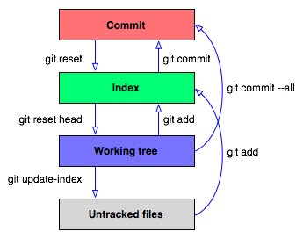
Last Time

Slide 3
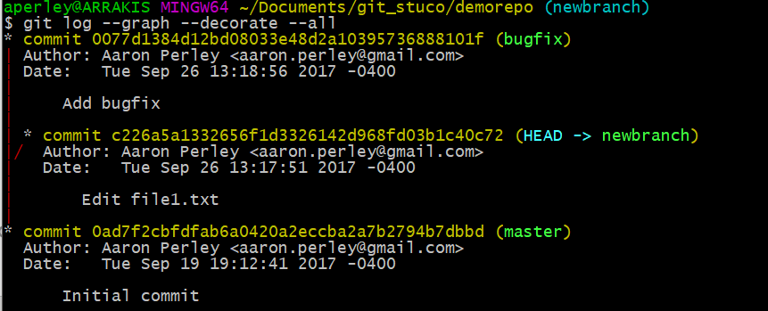
Empowering git log
git log --graph --decorate --all

Slide 4
Scenario: You work on two features at once in a project
e167179: more work on feature B
b5f3729: even more work on feature A
8277e09: even more work on feature B
6f96cf3: more work on feature A
master, HEAD
8b7d883: begin work on feature B
8fc42c6: begin work on feature A
b4e2c29: initial commit

Slide 5
Scenario: You work on two features at once in a project
e167179: more work on feature B
b5f3729: even more work on feature A
8277e09: even more work on feature B
6f96cf3: more work on feature A
master, HEAD
8b7d883: begin work on feature B
Hard to distinguish the two different features that are being worked on based on the git history
If the features are related, the commits might interfere with each other
8fc42c6: begin work on feature A
b4e2c29: initial commit

Slide 6
Solution: Non-linear development via branches
featureB, HEAD
featureA
b5f3729: even more work on feature A
8277e09: even more work on feature B
6f96cf3: more work on feature A
e167179: more work on feature B
8fc42c6: begin work on feature A
8b7d883: begin work on feature B
master
b4e2c29: initial commit

Slide 7
Activity!

Slide 8
git branch
Example use:
git branch
Lists all the local branches in the current repository and marks which branch you’re currently on
Where are “you”? Well, you’re always at HEAD. Usually, you’re also at a branch as well.
The default branch in a repository is called “master”

Slide 9
git branch <newbranchname>
Example use:
git branch develop
Creates a new branch called “develop” that points to wherever you are right now (i.e. wherever HEAD is right now)

Slide 10
git checkout <branchname>
Example use:
git checkout develop
Switches to the branch named “develop”
Instead of a branch name, you can also put a commit hash
More on this next lecture

Slide 11
Commits are made on whatever branch you’re on
git commit –m “A”
git commit –m “B”
A
master
HEAD

Slide 12
Commits are made on whatever branch you’re on
git commit –m “A”
git commit –m “B”
git branch experiment
B
master
HEAD
A

Slide 13
Commits are made on whatever branch you’re on
git commit –m “A”
git commit –m “B”
git branch experiment
git checkout experiment
B
master
HEAD
experiment
A

Slide 14
Commits are made on whatever branch you’re on
git commit –m “A”
git commit –m “B”
git branch experiment
git checkout experiment
git commit –m “C”
B
master
experiment
HEAD
A

Slide 15
Commits are made on whatever branch you’re on
git commit –m “A”
git commit –m “B”
git branch experiment
git checkout experiment
git commit –m “C”
git commit –m “D”
C
experiment
HEAD
B
master
A

Slide 16
Commits are made on whatever branch you’re on
git commit –m “A”
git commit –m “B”
git branch experiment
git checkout experiment
git commit –m “C”
git commit –m “D”
git branch wildidea
D
experiment
HEAD
C
B
master
A

Slide 17
Commits are made on whatever branch you’re on
git commit –m “A”
git commit –m “B”
git branch experiment
git checkout experiment
git commit –m “C”
git commit –m “D”
git branch wildidea
git checkout wildidea
D
experiment
HEAD
wildidea
C
B
master
A

Slide 18
Commits are made on whatever branch you’re on
git commit –m “A”
git commit –m “B”
git branch experiment
git checkout experiment
git commit –m “C”
git commit –m “D”
git branch wildidea
git checkout wildidea
git commit –m “E”
D
experiment
wildidea
HEAD
C
B
master
A

Slide 19
Commits are made on whatever branch you’re on
git commit –m “A”
git commit –m “B”
git branch experiment
git checkout experiment
git commit –m “C”
git commit –m “D”
git branch wildidea
git checkout wildidea
git commit –m “E”
git checkout master
E
wildidea
HEAD
D
experiment
C
B
master
A

Slide 20
Commits are made on whatever branch you’re on
git commit –m “A”
git commit –m “B”
git branch experiment
git checkout experiment
git commit –m “C”
git commit –m “D”
git branch wildidea
git checkout wildidea
git commit –m “E”
git checkout master
git commit –m “F”
E
wildidea
D
experiment
C
B
master
HEAD
A

Slide 21
Commits are made on whatever branch you’re on
git commit –m “A”
git commit –m “B”
git branch experiment
git checkout experiment
git commit –m “C”
git commit –m “D”
git branch wildidea
git checkout wildidea
git commit –m “E”
git checkout master
git commit –m “F”
E
wildidea
D
experiment
F
master
HEAD
C
B
A

Slide 22
How do we bring branches back together?
featureB
featureA,
head
b5f3729: Alice: even more work on feature A
8277e09: Bob: even more work on feature B
6f96cf3: Alice: more work on feature A
e167179: Bob: more work on feature B
8fc42c6: Alice: begin work on feature A
8b7d883: Bob: begin work on feature B
master
b4e2c29: initial commit

Slide 23
How do we bring branches back together?
git checkout master
featureA
HEAD
db82ca7: Merge branch ‘featureA’ into master
git merge featureA
b5f3729: Alice: even more work on feature A
8277e09: Bob: even more work on feature B
featureB
6f96cf3: Alice: more work on feature A
e167179: Bob: more work on feature B
master
8fc42c6: Alice: begin work on feature A
8b7d883: Bob: begin work on feature B
b4e2c29: initial commit

Slide 24
How do we bring branches back together?
master, HEAD
29ca3b3: Merge branch ‘featureB’ into master
featureA
db82ca7: Merge branch ‘featureA’ into master
b5f3729: Alice: even more work on feature A
8277e09: Bob: even more work on feature B
featureB
6f96cf3: Alice: more work on feature A
e167179: Bob: more work on feature B
8fc42c6: Alice: begin work on feature A
8b7d883: Bob: begin work on feature B
b4e2c29: initial commit

Slide 25
git merge <branch_to_merge_in>
Example use:
git merge featureA
Makes a new merge commit on the CURRENT branch that brings in changes from featureA

Slide 26
How does git know how to merge changes from another branch into yours?
Any guesses?

Slide 27
How does git know how to merge changes from another branch into yours?
It doesn’t.

Slide 28
Most cases: Merging with possible conflicts
Let’s say I’m on master (as denoted by HEAD) and I want to merge goodidea into master.
git merge goodidea
master, HEAD
F
goodidea
D
E
C
B
A

Slide 29
Most cases: Merging with possible conflicts
master, HEAD
G
Let’s say I’m on master (as denoted by HEAD) and I want to merge goodidea into master.
git merge goodidea
At this point, if bringing in all the changes from goodidea do not conflict with the files in master, then a new commit is created (you’ll have to specify a commit message) and we’re done.
Otherwise…git just goes halfway and stops.
master, HEAD
F
goodidea
D
E
C
B
A

Slide 30
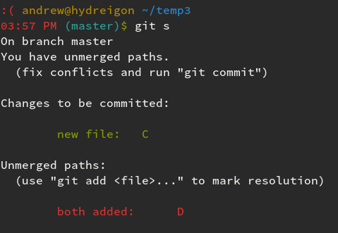
MERGE CONFLICT
master, HEAD
G
master, HEAD
F
goodidea
D
E
C
B
A

Slide 31
MERGE CONFLICT
This file is demo.txt
<<<<<<< HEAD
Here is another line. modified in master
=======
Here is another line. modified in goodidea
>>>>>>> goodidea

Slide 32
“How to fix a merge conflict”
Run `git status` to find the files that are in conflict.
For each of these files, look for lines like “<<<<<< HEAD” or “>>>>>> 3de67ca” that indicate a conflict.
Edit the lines to match what you want them to be.
After you finish doing this for each conflict in each file, `git add` these conflicted files and run `git commit` to complete the merge.

Slide 33
Special Case: Fast-forward merges
F
badidea
git merge experiment
E
wildidea
experiment
D
C
B
master, HEAD
A

Slide 34
Special Case: Fast-forward merges
F
badidea
git merge experiment
HEAD, master, experiment
E
wildidea
Git doesn’t bother creating another commit to combine the changes because this kind of merge is guaranteed to not have conflicts.
D
C
B
master, HEAD
A

Slide 35
Special Case: Fast-forward merges
F
badidea
master, HEAD
G
E
wildidea
Some people like creating a new commit anyway to document the fact that the merge occurred. To do so, do
git merge --no-ff
experiment
D
C
B
A

Slide 36
Summary
git branch – list all branches
git branch <branchname> - make a new branch
git checkout <branchname> - switch to another branch or commit
git merge <branchname> - make a commit merging in a branch

Slide 37
Activity!
In pairs:
Create a git repository
Make a new file called file1.txt, add some lines to it, and commit it
Create two branches called branch1 and branch2
Edit the same line in the text file and make a commit in each branch
Merge both branches back to master (merging the second branch back will require resolving the conflicts).
What do we call the merge that occurred when merging the first branch back to master?

Slide 38
Backups

Slide 39
Exercise: What [directed, acyclic] graph do the following git commands produce?
git commit –m “A”
git commit –m “B”
git branch stable
git branch experiment
git checkout experiment
git commit –m “C”
git checkout master
git commit –m “D”
git branch goodidea
git checkout experiment
git branch whereami
git commit –m “E”
git checkout goodidea
git checkout master
git commit –m “F”
git checkout whereami
git commit –m “G”
git checkout master
master, HEAD
F
experiment
E
goodidea
D
whereami
C
G
B
stable
A

Slide 40
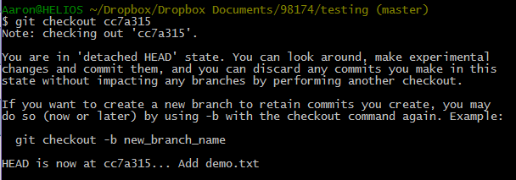
What branch am I on if I checkout some commit’s hash?
master
HEAD
experiment
F
E
D
C
stable
B
A

Slide 41
How to start a new branch from this commit?
git branch new-feature
git checkout new-feature
How to get back to experiment?
git checkout experiment

