Slide 1
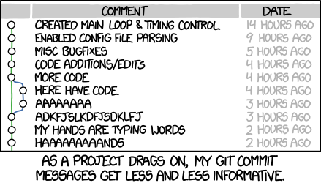
Lecture 2
Making Simple Commits
Sign in on the attendance sheet!
credit: https://xkcd.com/1296/

Slide 2
Course Website
https://www.andrew.cmu.edu/course/98-174/

Slide 3
Homework Reminders
Great job gitting the homework done this week!
Remember not to do this:
Andrewid.zip/
question-2/
left-pad/
question-4.txt

Slide 4
Review of Last Lecture
git init – creates a git repo in the current directory
git clone <git url> – copies the remote git repo into the current directory
git log [ --oneline ] – lists all commits in the git repo, starting with the most recent one
git help <command>, git <command> --help, man git <command> – brings up the man help page for the git command

Slide 5
The .git folder
Every git repository has a .git directory in the toplevel project directory
This is where all git commit objects and metadata are stored
Don’t delete it! Doing so deletes the repository
Folders starting with a dot are hidden on UNIX

Slide 6
Today: The Git Commit Workflow
Review: git log
git diff
git status
git add
git commit
git show

Slide 7
Once when a lion, the king of the jungle, was asleep, a
little mouse began running up and down on him. This soon
awakened the the lion, who placed his huge paw on the mouse,
and opened his big jaws to swallow him.
"Pardon, O King!" cried the little mouse. "Forgive me this
time. I shall never repeat it and I shall never forget your
kindness. And who knows, I may be able to do you a good turn
one of these days!"
The ion was so tickled by the idea of the mouse being able
to help him that he lifted his paw and let him go.

Slide 8
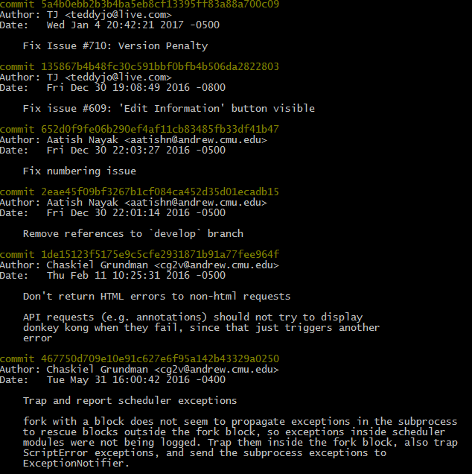
From Last Time: git log
Also try git log --oneline:

Slide 9
What is 2eae45f?
Commits are uniquely represented by SHA-1 hashes
The first 6-7 characters of a hash are usually enough to identify it uniquely from all the other commits in the repository
This is called the short hash

Slide 10
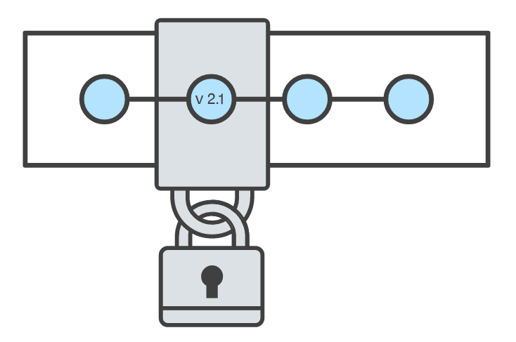
What is a commit?
A snapshot of all the files in a project at a particular time
A checkpoint in your project you can come back to or refer to
The changes a commit makes over the previous commit
Commits are identified by their SHA-1 hash

Slide 11
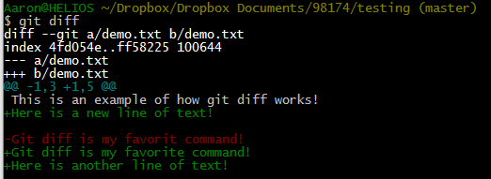
Git Diff

Slide 12
Commits: Revisited
List of commits
Editing a file takes its state from 1 particular snapshot to the next
When we edit a file, we can see it as a set of changes (a “diff”) from the snapshotted state of that file
Commits bundle up sets of changes to a list of files
file1.txt (v2)
file2.txt (v1)
file3.txt (v1)
bb2df1a (HEAD)
file1.txt (v1)
file2.txt (v1)
file3.txt (v1)
782cb4f
file1.txt (v1)
file2.txt (v1)
ab628cc

Slide 13
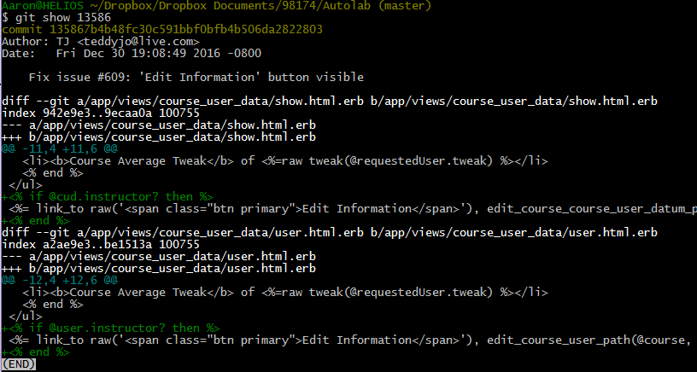
git show <commit hash>

Slide 14
The Git Commit Workflow: Edit
Working Directory
List of Changes
file1.txt (v2)
file2.txt (v1)
file3.txt (v2)
file1.txt (v1)
file2.txt (v1)
file3.txt (v1)
In file1.txt: add the line “here is a new line!” between lines 3 and 4
In file3.txt: delete line 27
Make changes to files
vim file1.txt file3.txt

Slide 15
The Git Commit Workflow: Add
Working Directory
List of Changes
file1.txt (v2)
file2.txt (v1)
file3.txt (v2)
In file1.txt: add the line “here is a new line!” between lines 3 and 4
In file3.txt: delete line 27
Staging Area
Add the current differences
git add file1.txt file3.txt

Slide 16
The Git Commit Workflow: Commit
List of Changes
List of commits
HEAD
file1.txt (v2)
file2.txt (v1)
file3.txt (v2)
bb2df1a
file1.txt (v1)
file2.txt (v1)
file3.txt (v1)
782cb4f
Staging Area
In file1.txt: add the line “here is a new line!” between lines 3 and 4
file1.txt (v1)
file2.txt (v1)
ab628cc
In file3.txt: delete line 27
Commit the currently staged differences
git commit –m "fixed bug in file1 and file3"

Slide 17
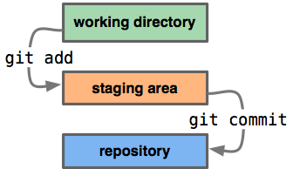
git add
Example use:
git add file1.txt file2.txt
(or)
git add . (adds changes to all files in directory)
Creates a commit out of a snapshot of the staging area, and updates HEAD.

Slide 18
git commit
Example use:
git commit
(or)
git commit –m “commit message goes here”
Creates a commit out of a snapshot of the staging area, and updates HEAD.

Slide 19
Aside: commit HEAD
The “most recent commit” has a special name: HEAD

Slide 20
Good commit messages
Good:
Build: Don't install jsdom3 on Node.js 0.10 & 0.12 by default
Bad:
bugfix lol get rekt
http://whatthecommit.com

Slide 21
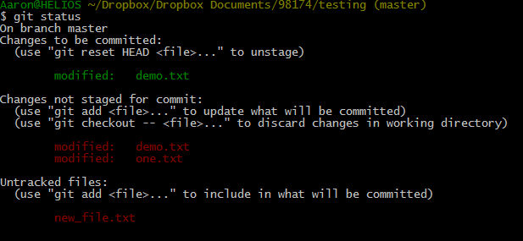
git status
Shows files differing between the staging area and the working directory (i.e. unstaged changes), the staging area and HEAD (i.e. changes ready to commit), and untracked files

Slide 22
git diff
Example use:
(show unstaged changes)
git diff
(show staged changes)
git diff --cached
Shows unstaged changes or staged changes

Slide 23
git show
Example use:
git show [commit hash (default is HEAD)]
Shows the changes in the specified commit

