Slide 1
Lecture 11: Plumbing and Porcelain

Slide 2
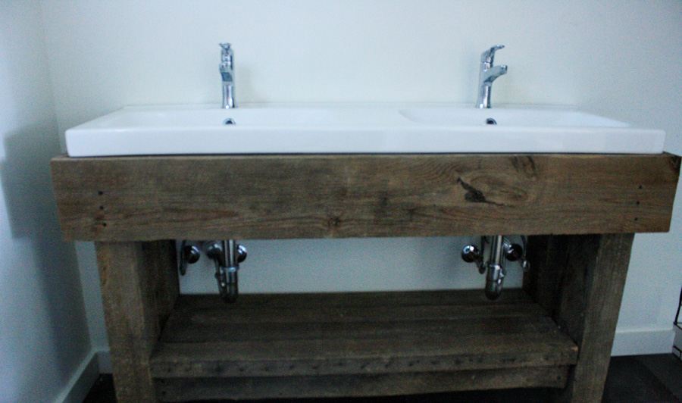
Schedule
Today (4/26)
Plumbing and Porcelain
Last Class (5/3)
Final Exam

Slide 3
The .git Folder
$ ls .git
config local configuration (not --global)
description
HEAD the head
hooks/ scripts that run on various events
info/ staging area metadata
objects/ content database
refs/ branches, tags, remotes

Slide 4
Object Database
Key-value data store addressable by SHA-1 hash
This is my file
Database
(.git/objects)
hash

Slide 5
Adding Files to Object Database
$ git hash-object -w <filename>
Adds object to database and returns SHA-1 hash of file + header
$ git cat-file -p <hash>
Pretty-prints an object in the database
Objects live in .git/objects:
$ find .git/objects -type f
.git/objects/7d/b4ad2eaea38d5714120aa20bac869ed69de756
.git/objects/c6/1a4dbe8af3b1a3c3338367fce1be14596fe80e

Slide 6
Update Index
$ git update-index --add --cacheinfo 100644 \
<hash> <filename>
Add object from database to index
$ git write-tree
Creates tree object and returns hash

Slide 7
Committing
$ git commit-tree <tree hash> -p <parent commit hash> \
-m "message"
Creates a commit with the given tree and parent
Returns commit hash
Does not move any refs!
Now we can do:
$ git log <commit hash>

Slide 8
Refs and Moving Branches
$ git update-ref refs/heads/<branch name> <commit hash>
Moves branch to point to different commit
$ git symbolic-ref HEAD refs/heads/<branch name>
Moves the HEAD
Remote refs live in refs/remotes/<remote name>/<branch name>

Slide 9
Packfiles
List size of object directory
$ du -sh .git/objects
List sizes of each object
$ find .git/objects -type f | xargs du -h
Run garbage collection and packing
$ git gc
List contents of packfile
$ git verify-pack -v <path to pack>

Slide 10
Data Recovery
$ git reflog
Lists any changes to refs in reverse-chronological order

