Slide 1
Lecture 10
Stash, Blame, Undoing, and Visual Git Tools

Slide 2
Schedule
Only a few classes left ☹
Today (4/12): Stash, Blame, Undoing Things, SourceTree
4/19: Carnival! – no class
Last Lecture (4/26): Reflog, Plumbing and Porcelain
Last Class (5/3): Final Exam

Slide 3
Scenario: you want to switch branches, but you have uncommitted changes
What if you don’t want to commit?

Slide 4
git stash
Example use:
git stash
Makes a “pseudo-commit” and puts it on a stack of stashed pseudo-commit.
Message for stash is “WIP on <branchname>…​”
Use git stash save <message> to store stashes with better messages

Slide 5
git stash list
Example use:
git stash list
Lists all stashed changes on the stash stack

Slide 6
git stash apply (stash@{<depth>})
Example use:
git stash apply stash@{2}
Reapplies the stashed change at the specified depth, if given.
Depth is just another way of choosing from a list of saved stashes

Slide 7
git stash pop
Example use:
git stash pop
Reapplies the top stashed change and removes it from the stash stack.

Slide 8
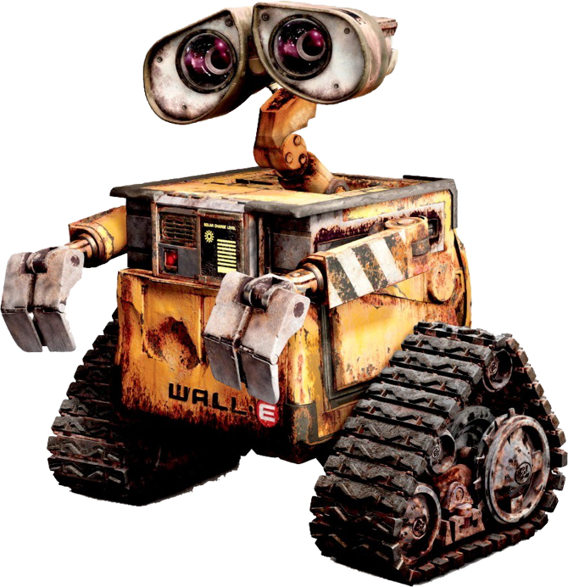
git stash drop (stash@{<depth>})
Example use:
git stash drop stash@{2}
Removes the stashed change at the specified depth, if given.

Slide 9
git stash show (-p) (stash@{<depth>})
Example use:
git stash show stash@{2}
Show details about the stashed change at the specified depth, if given.

Slide 10
File History on Github
Same as git log <filename>

Slide 11
git blame <filename>
Shows which commit last modified a specific line

Slide 12
Undoing Things: Commit
Just the message: $ git commit --amend
Files too:
$ git reset --soft HEAD~ (moves changes back to index)
<make fixes>
$ git commit ...

Slide 13
Undoing Things: Merge
The feature branch hasn’t moved, just need to move master back
$ git reset --hard HEAD^
Why "^" and not "~"?
^ = first parent
^2 = second parent
^n = nth parent (waaaay to complicated, google Octopus merge)

Slide 14
Undoing Things: Rebase
Be Safe: Drop a backup branch before you rebase
<On branch feature>
$ git branch feature-before-rebase
$ git rebase master
<crap I don’t want this>
$ git reset --hard feature-before-rebase

Slide 15
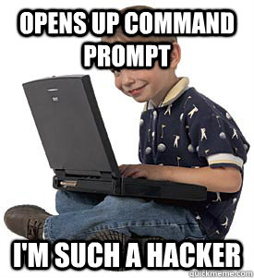
What we’ve done so far
Used git in the terminal
Best for learning (in my opinion!)
Hopefully no magic!
Used Github’s UI
Great for collaborating with others
Also check out GitLab and Bitbucket
Can’t do everything

Slide 16
Why not just use the command line?
Using vim for commit messages and interactive rebase
<<<<<<<<<<<<<< ============== >>>>>>>>>>>>>>
git log --graph is impossible to read
Interactive add (git add -i) UI is horrible
Having to remember and type commands (aliases help with this)

Slide 17
Atlassian SourceTree
GUI for Git
https://www.sourcetreeapp.com/
Produced by Atlassian
You need an Atlassian account to install SourceTree for some reason

Slide 18
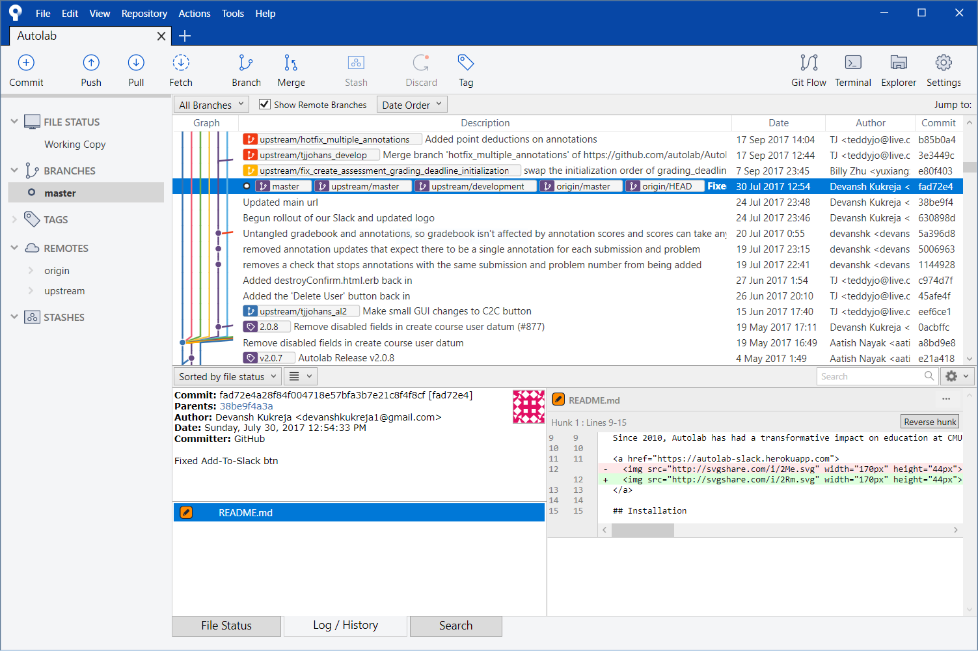
SourceTree’s powers
Almost everything in the terminal can be done just as easily as in SourceTree
The UI is often more intuitive
SourceTree shows you things like graphs and diffs along the way without you having to ask

