Slide 1

98-174 S18
Modern Version Control with Git
Aaron Perley (aperley@andrew.cmu.edu)
Ilan Biala (ibiala@andrew.cmu.edu)
https://www.andrew.cmu.edu/course/98-174/

Slide 2

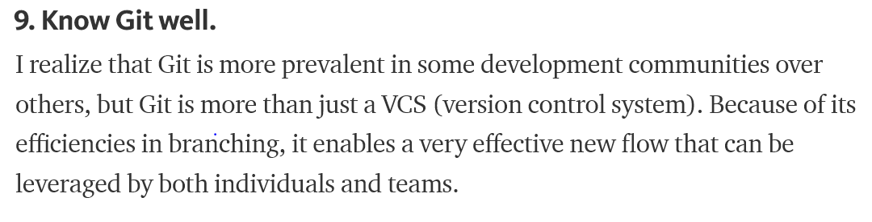
Why should you take this course?
“Version control software is an essential part of the every-day of the modern software team's professional practices.”
-- Atlassian Git Tutorial

Slide 3
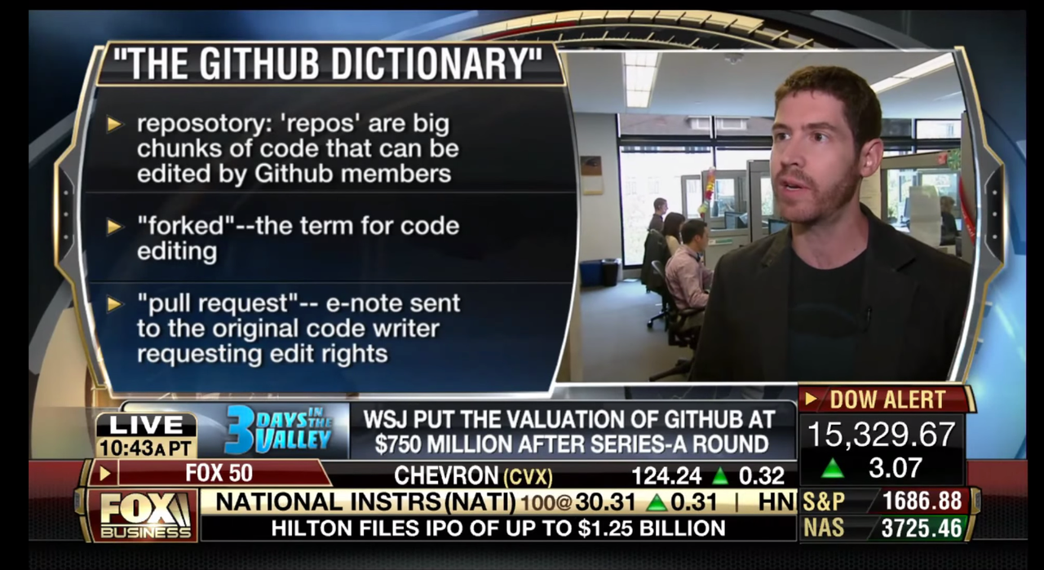
Why should you take this course?
From a 2013 Fox News report:

Slide 4

Git ≠ Github
≠

Slide 5
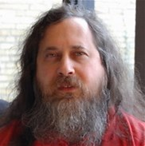
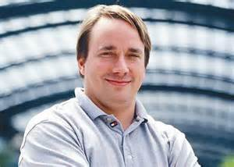

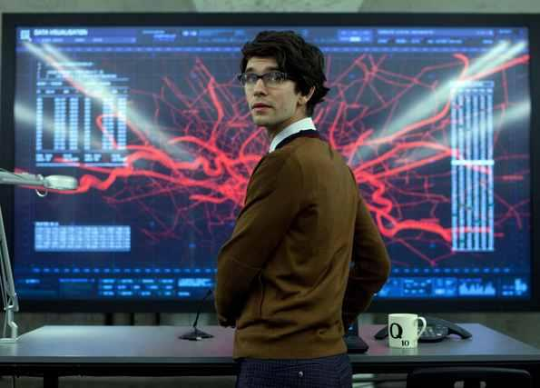

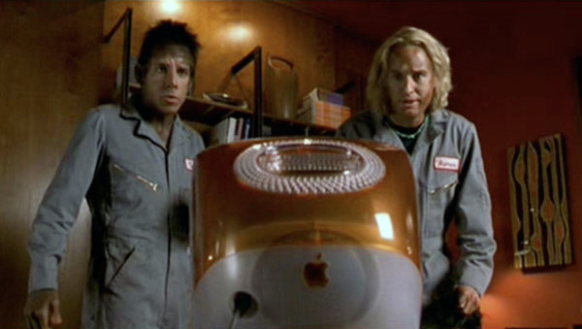
What this course isn’t
For seasoned Linuxbeards

Slide 6
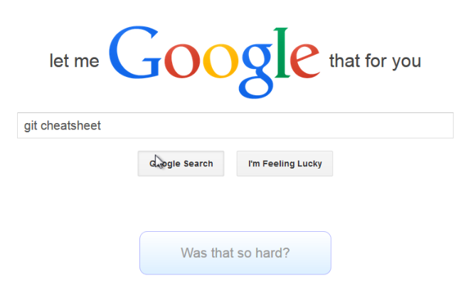
What this course isn’t
A crashcourse on git commands

Slide 7
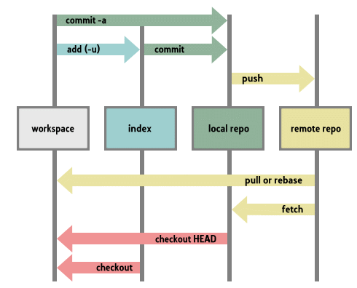
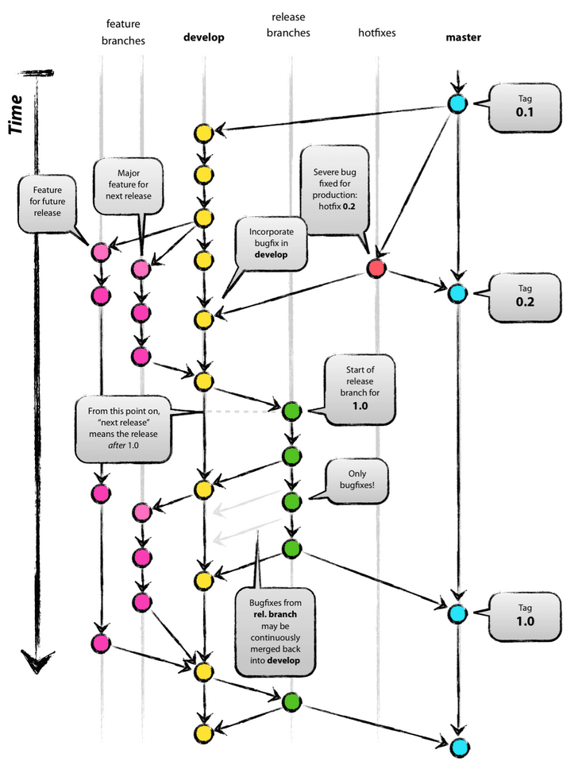
What this course is about
Forming a mental model for how git interacts with versions of files
Understanding how to use git (and a bit of Github) in a collaborative setting

Slide 8

Course Website
https://www.andrew.cmu.edu/course/98-174/

Slide 9
Syllabus
No prerequisites
3 Free Elective credits
No official textbook, but we recommend Pro Git by Scott Chacon (free, online)
No office hours unless specifically requested
  Email Aaron and Ilan if you have questions
Slides and lecture notes posted online

Slide 10
More Syllabus
2 unexcused absences allowed
  3+ unexcused absences and we have to give you a No Pass
  Email us if you’re going to miss for a legitimate reason
  More than 15 minutes late = unexcused
Discussion of in-class and homework assignments is encouraged, but write up your own answers
No late work
  Email us if you think you need an extension

Slide 11
Grade Breakdown
Pass/No Credit. Need to get 70% out of:
20% Weekly Lecture Attendance
30% Submitted work (often in-class)
20% Midterm (Date TBA)
30% Final (Date TBA)

Slide 12

Waitlist
If you are on the waitlist, please keep coming to class.
There is a 99.99999% chance you will be able to get in off the waitlist

Slide 13
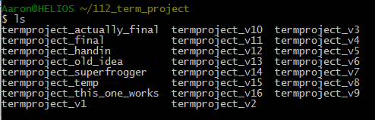
What is Version Control?

Slide 14
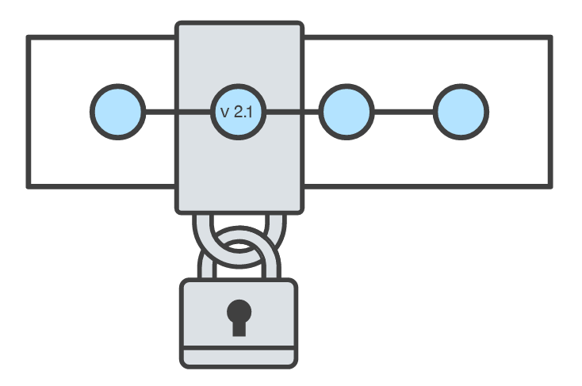
Goals of Version Control
Be able to search through revision history and retrieve previous versions of any file in a project
Be able to share changes with collaborators on a project
Be able to confidently make large changes to existing files
https://www.atlassian.com/git/tutorials/what-is-version-control

Slide 15
Named Folders Approach
Easy
Familiar
…
Can be hard to track
Memory-intensive
Can be slow
Hard to share
No record of authorship

Slide 16
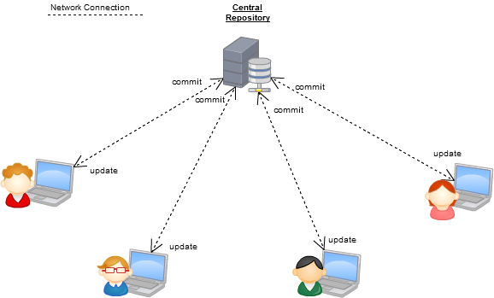
Centralized Version Control Systems
A central repository determines the order of versions of the project
Collaborators “push” changes to the files to the repository
Any new changes must be compatible with the most recent version of the repository. If it isn’t, somebody must “merge” it in.
Examples: SVN, CVS, Perforce

Slide 17
Distributed Version Control Systems (DVCS)
No central repository, each developer has their own copy
Developers work on their own copy of the repository locally and sync changes with others
Examples: Git, Mercurial
Commit
Dev C’s Repo
Commit
Push/Fetch
Dev A’s Repo
Push/Fetch
Push/Fetch
Push/Fetch
Commit
Dev D’s Repo
Push/Fetch
Dev B’s Repo
Push/Fetch
Distributed Version Control System
Commit

Slide 18
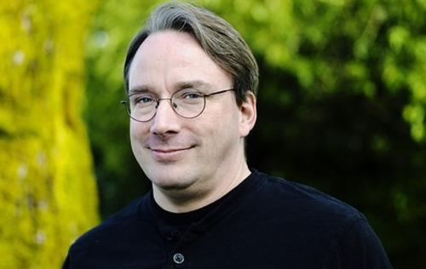
Git
Created in 2005 by Linus Torvalds to maintain the Linux kernel. Oh, and he created that too.
Distributed VCS
https://www.git-scm.com/

Slide 19
Installing Git
https://www.andrew.cmu.edu/course/98-174/lecturenotes/installing_git.html

Slide 20
Git Init
Initializes a new git repository in an existing folder
The folder is now called a git repository
Changes to any files in the folder (and its subfolders) can be tracked by git
Git stores its metadata in a hidden .git folder in the repository root
$ mkdir myrepo
$ cd myrepo
$ git init

Slide 21
Git Clone
Download an existing repository (and all of its history!)
$ git clone https://github.com/autolab/Autolab.git
$ cd Autolab

Slide 22
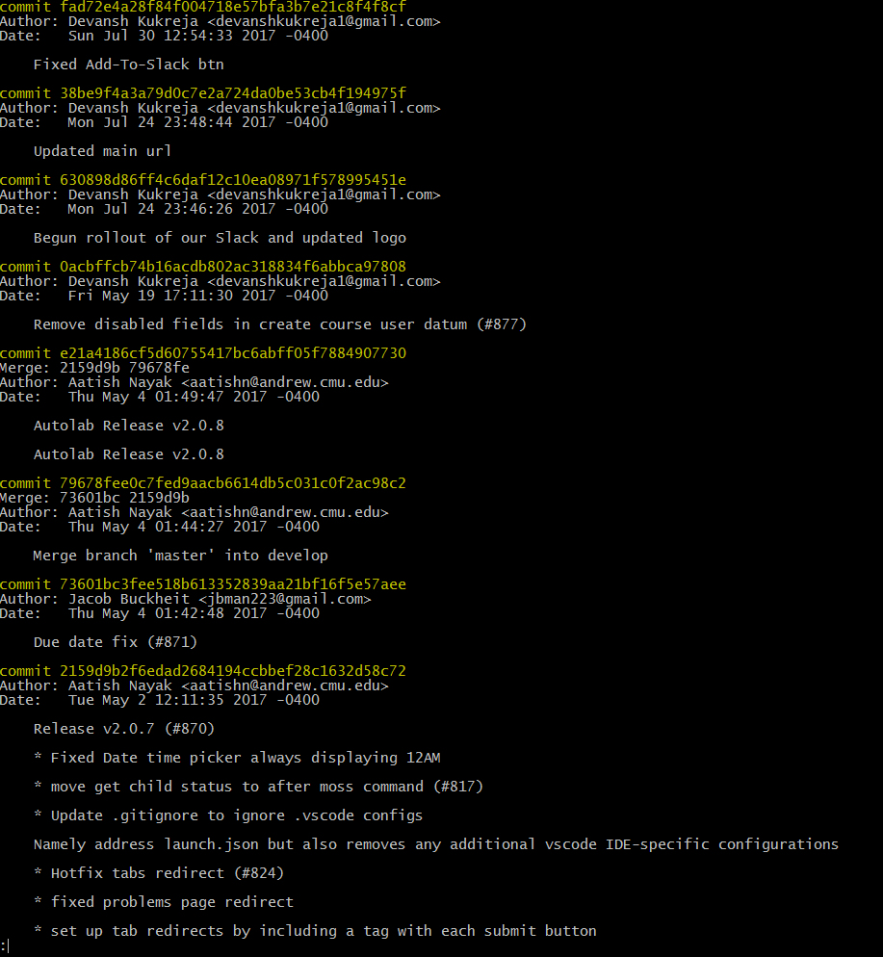
Git Log
List the history of a repository
$ git log
Press ‘q’ to exit, use arrow keys (or j,k) to scroll

Slide 23
What is fad72e4?
Commits are uniquely represented by SHA-1 hashes
The first 6-7 characters of a hash are usually enough to identify it uniquely from all the other commits in the repository
This is called the short hash

Slide 24

Okay, so what is a commit?
A snapshot of all the files in a project at a particular time.
A checkpoint in your project you can come back to or refer to.
Anything else?
The changes a commit makes over the previous commit

Slide 25
Homework
One hour or less a week
Released on Thursdays after class, due next Thursday at beginning of class
Posted on the course website
Email us if you have questions, I’ll be happy to help you out!
Submit on Autolab:
https://autolab.andrew.cmu.edu/courses/98174-s18/

