Slide 1
Hydronic Heating/Cooling System of Intelligent Workplace at Carnegie Mellon University, Pittsburgh

Slide 2
Components of the Hydronic of the heating/cooling system
Water Mullions System
Radiant Panels
Cool Waves

Slide 3
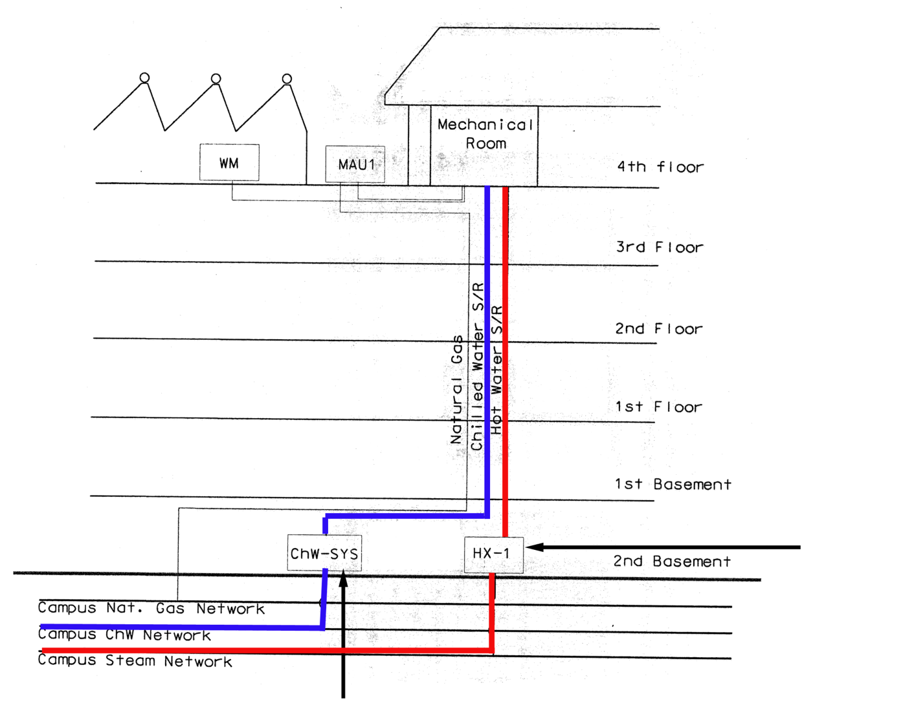
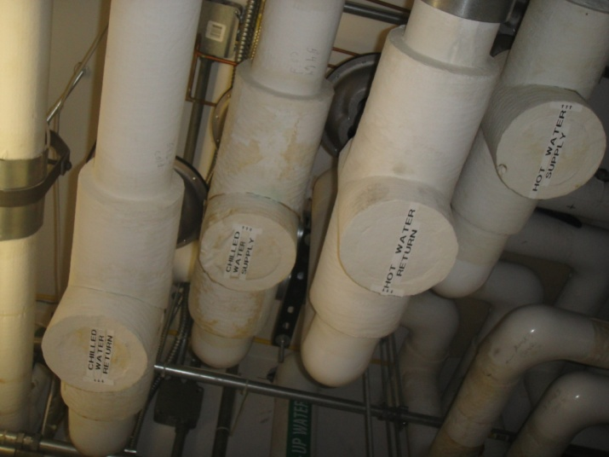
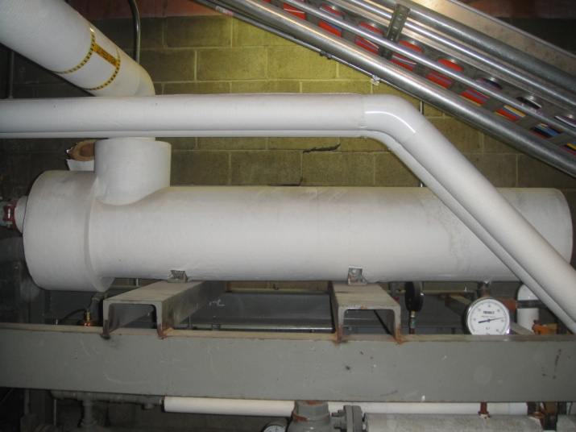
IW Overall HVAC System
View of the supply/return pipes
View of the basement heat exchanger

Slide 4
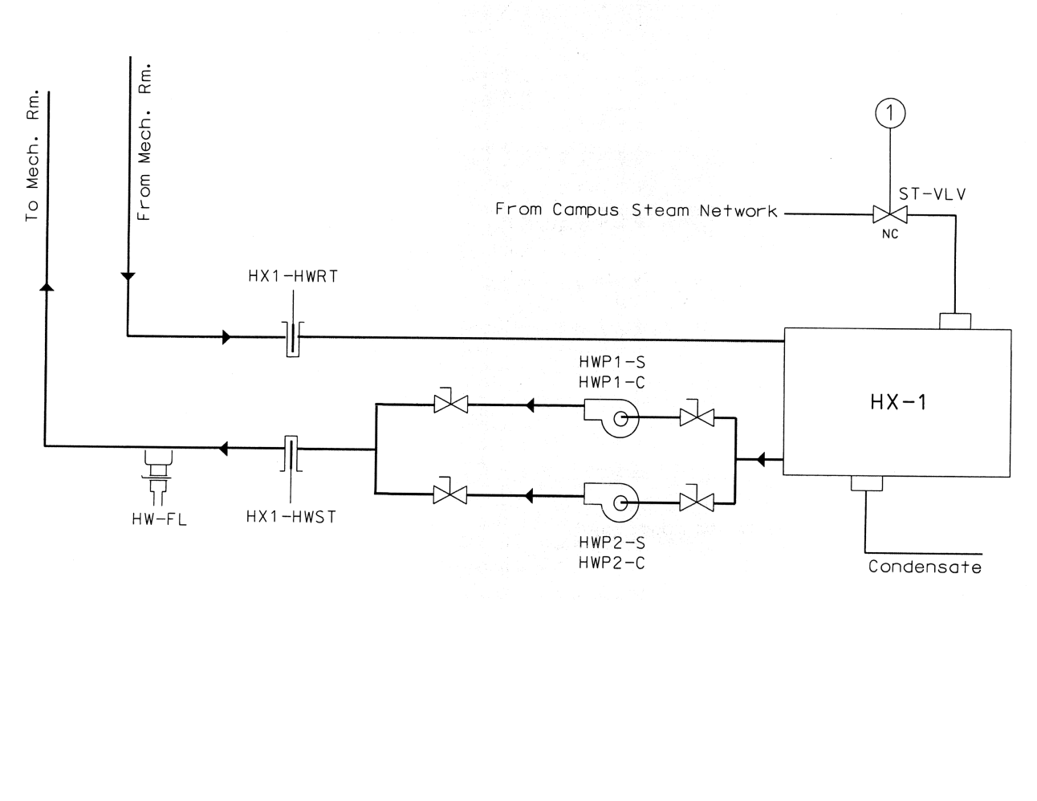
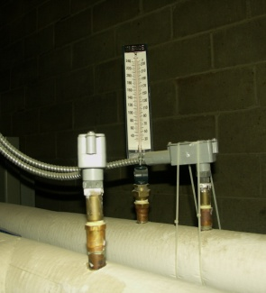
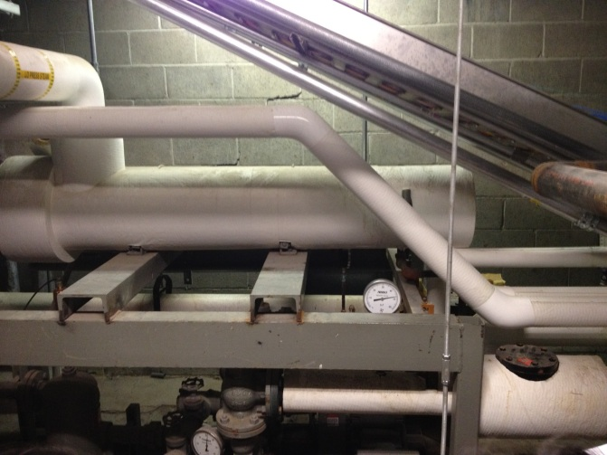
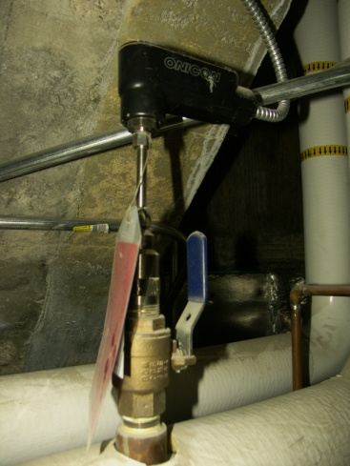
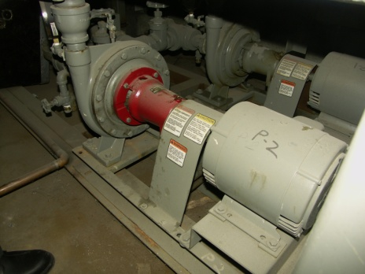
IW Schematic Hot Water System
Hot water supply/return temperature sensor
Heat exchanger
* Only one pump is functional at any given time
Water flow rate sensor
Hot water pump to the fourth floor

Slide 5
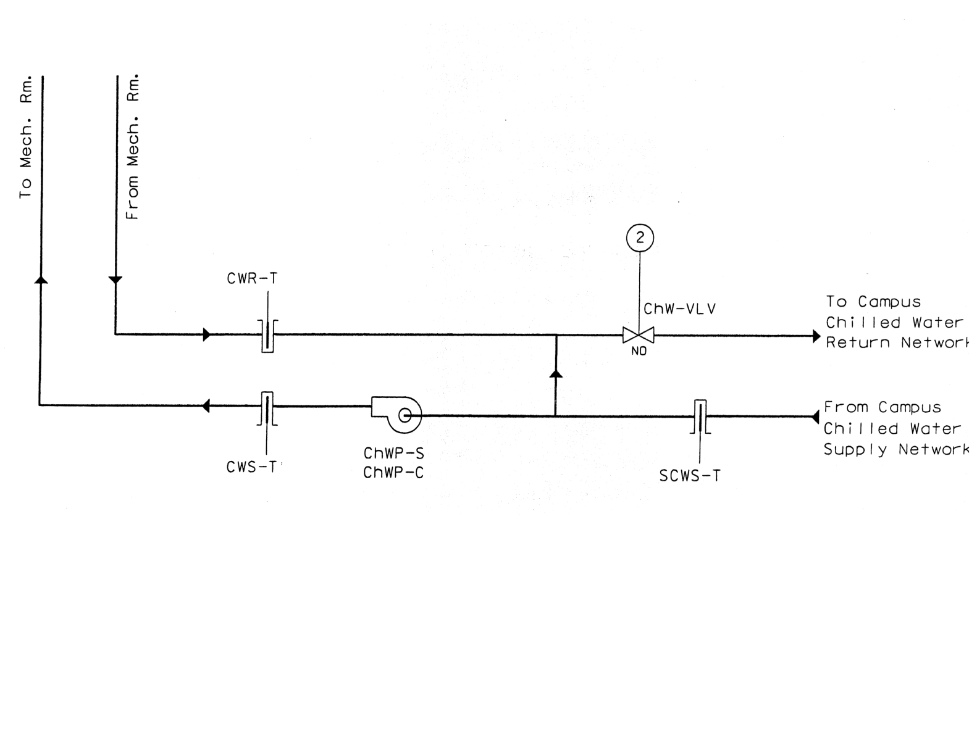
IW Schematic Chilled Water System
Chilled water system flow rate valve
Chilled water system temperature sensor

Slide 6
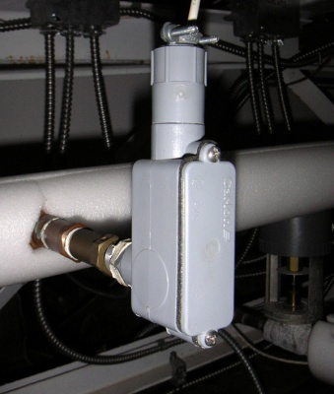
Secondary Water Loop in the 4th floor Mechanical room
Water mullion flow rate sensor
Water mullion mixing valve
Water Mullion flow rate valve

Slide 7
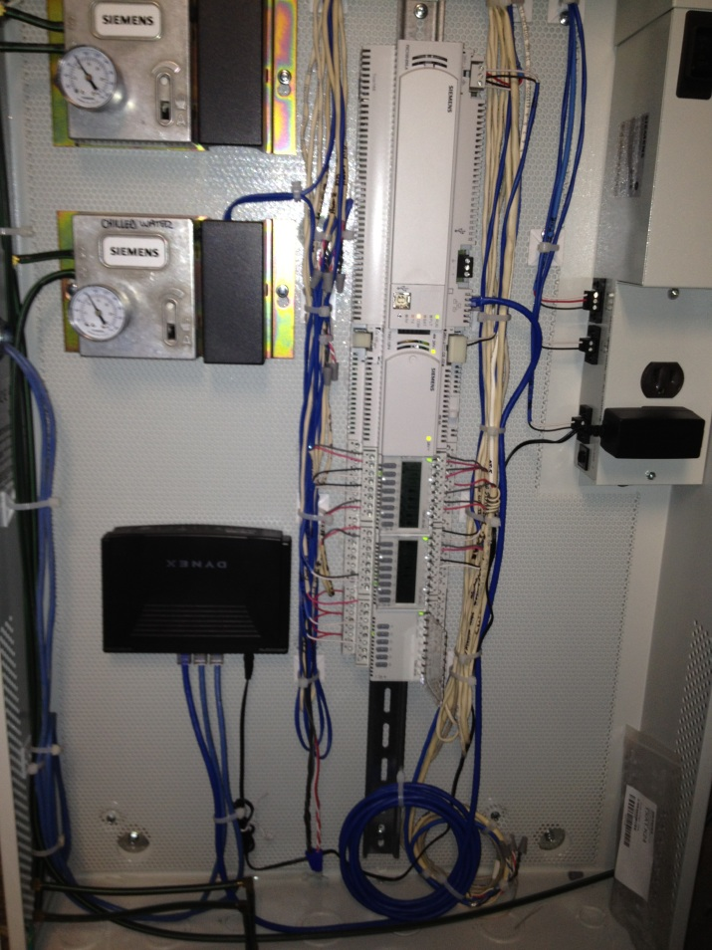
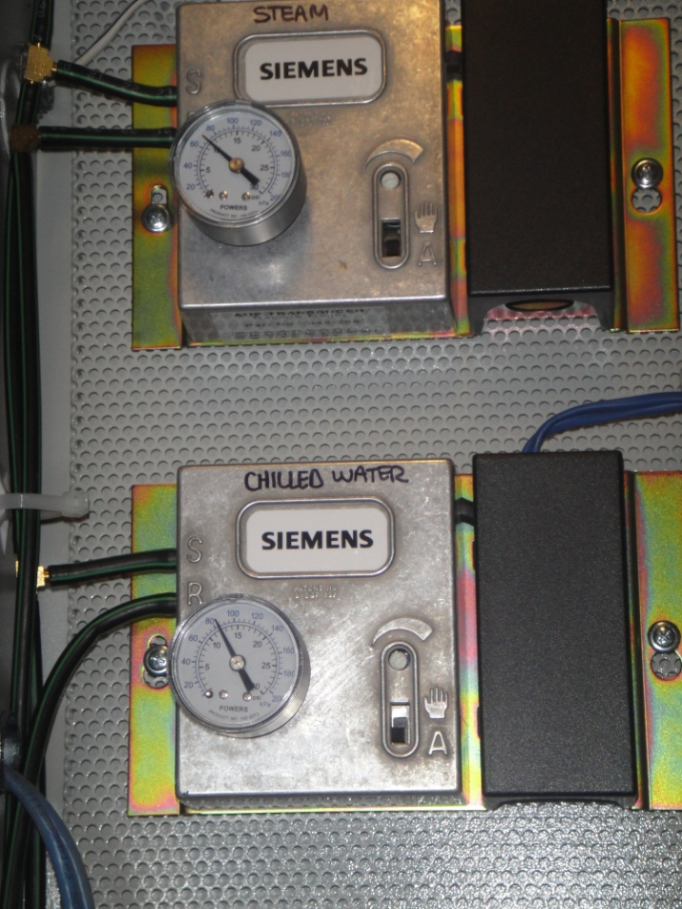
HVAC Control System
Temperature of the hot water in the basement – 180 F
Temperature of the chilled water in the basement – 40-42 F
Temperature of the hot water on the 4th floor– 120 F
Mullion Surface Temperature – 80-90 F
Siemens control panel in the basement

Slide 8
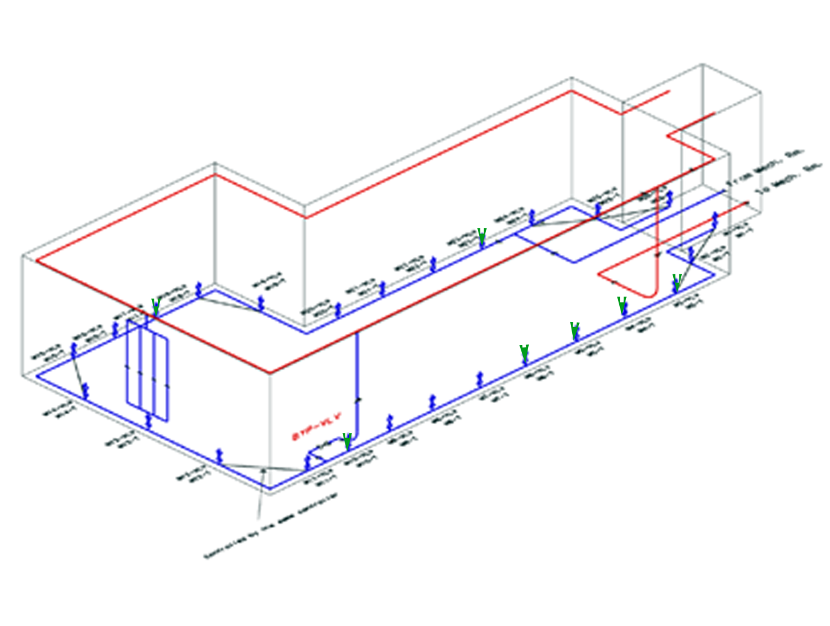
HVAC Control System
Johnson Controls – Metasys server (former)
Siemens Controls – Apogee server (March/April 2011)
The control system turns on the basement pump if the average south and north zone indoor temperature is below pump set-point (60 F) or if the schedule call for it which also turns on the fourth floor mullion water pump

Slide 9
HVAC Control System
EN 1
Flow rate control
EN 2
EN 3
EN 4
EN 5
Temperature control
Actuator control
Flow rate control
Flow rate control
Temperature control
Actuator control
Actuator control
Temperature control
Siemens Apogee Server
Flow rate control
Temperature control
Actuator control
Flow rate control
Temperature control
Actuator control

Slide 10
Mathematical model for the control system
Hot water set point equation:
T_{hws} = (38-T_{o})*f_{oA} + (72 – (T_{south} + T_{north})/2) * f_{IA} +120
T_{hws} - Hot water supply temperature set point
T_{north & south} – indoor temperature of south/north zones
f_{oA &} f_{IA} – outside/inside air temperature weighing factors (1)
Mullion surface temperature set point:
T _{mullion-s} =((T_{south} +T_{north})/2 + T_{hws})/2
T _{mullion-s}- Mullion Surface temperature set-point

Slide 11
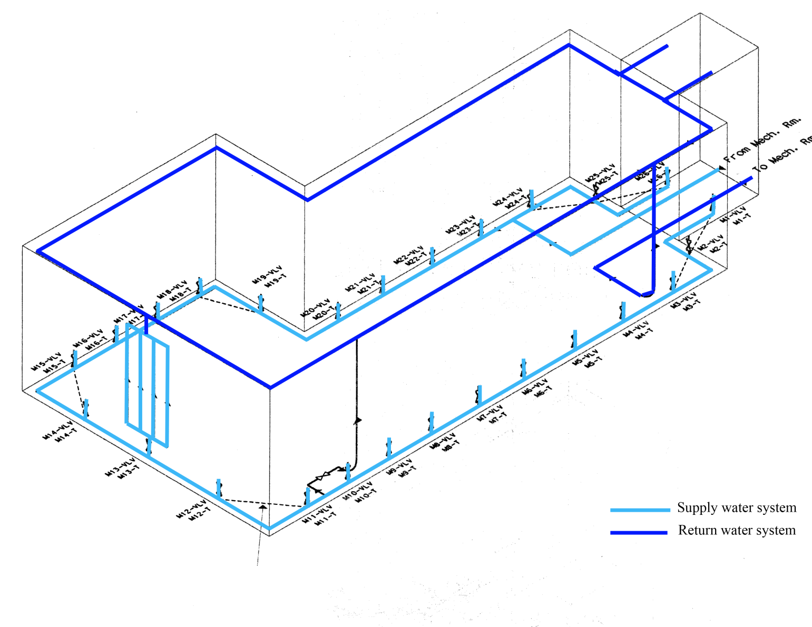
Mullions - Heating/Cooling

Slide 12
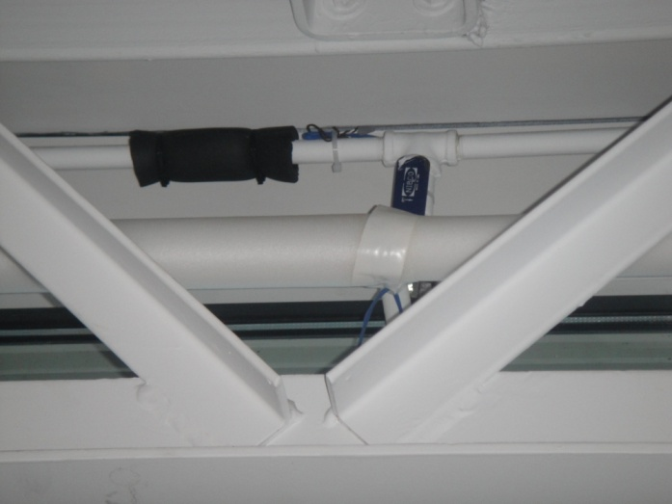
Mullions - Heating/Cooling
Return water temperature sensor
Supply water temperature sensor

Slide 13
Mullions – Heating/Cooling
26 groups of mullions in the IW
Each group has four mullions controlled by one control valve/ flow rate meter
The mullion pump runs at 24 gpm during daytime schedule

Slide 14
Performance Analysis of South Mullions for two days

Slide 15
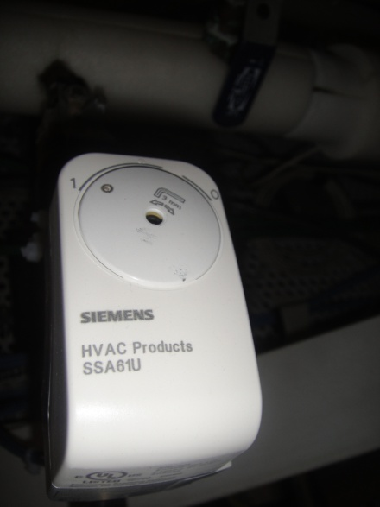
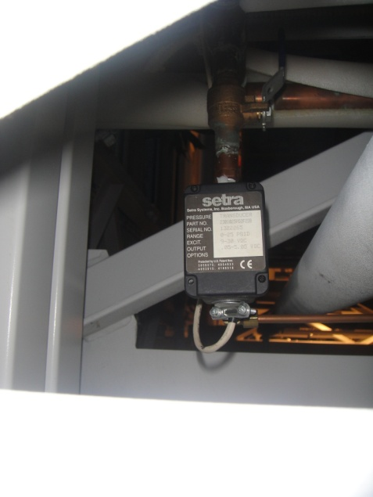
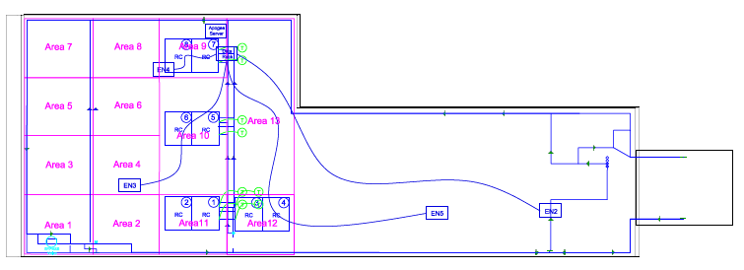
Radiant Panels
Radiant panel temperature sensor
Sentra Flow rate valve

Slide 16
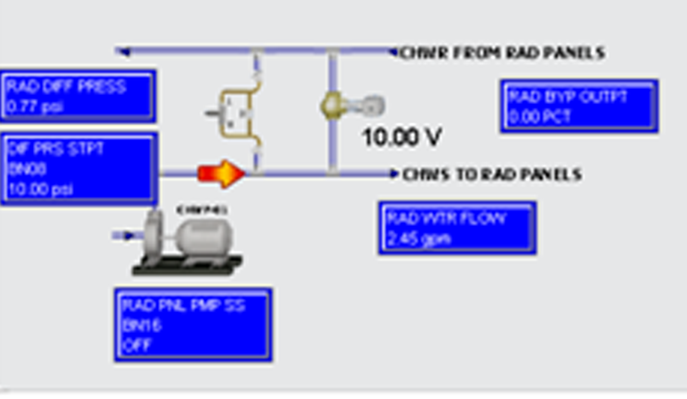
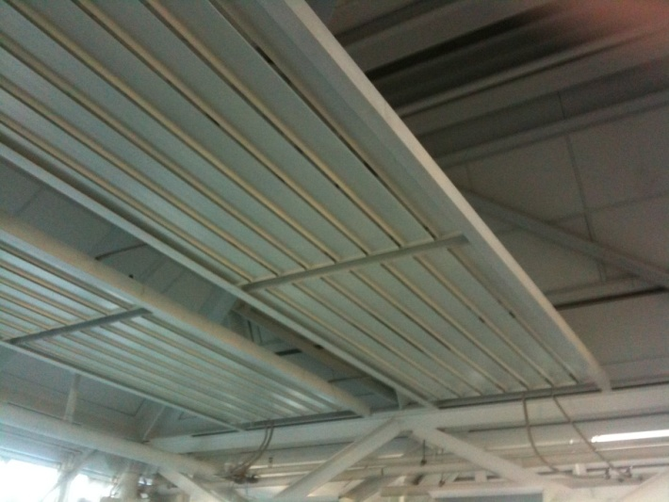
Radiant Panels
Water Supply to the radiant panels
Water Supply to the radiant panels
Radiant Panels

Slide 17
Performance Analysis
Temperatures in the basement, IW mechanical room, mullion surface, radiant panel, cool wave
Flow rates at the basement, IW mechanical room, before/after supply/return
Temperature, humidity, CO2 measures
Entire system on/off controls
Night set back temperatures
Outdoor air temperature every 10 mins

Slide 18
Performance Analysis of Radiant Panel 1 on two days

Slide 19
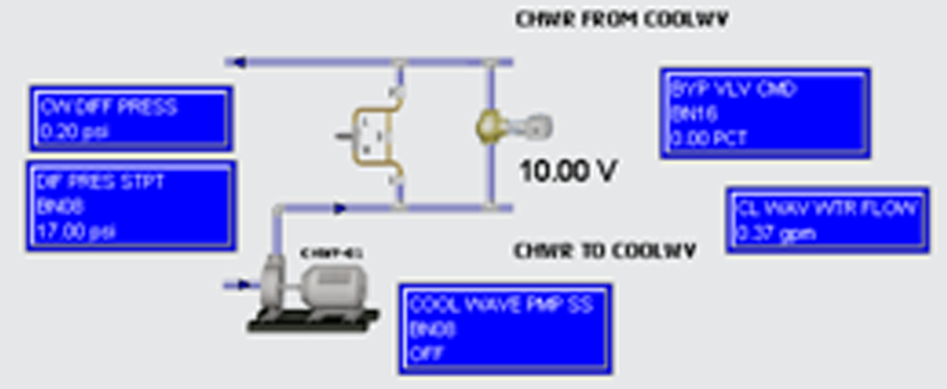
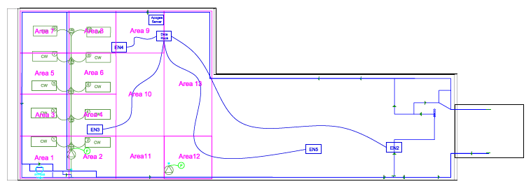
Cool Waves – Cooling System

Slide 20
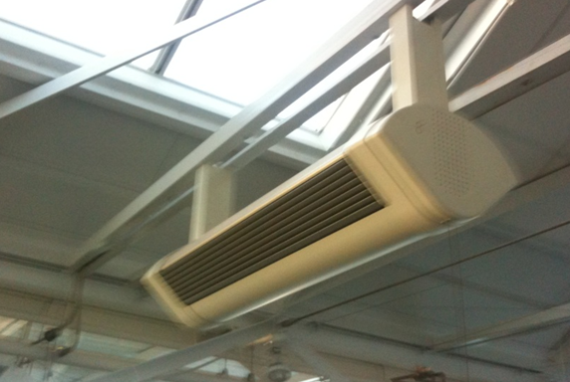
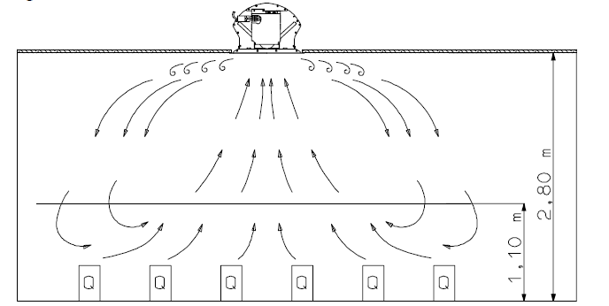
Cool Waves – Cooling System
View of the LTG Cool Wave
Oscillating fans for air circulation
Air circulation by convection

Slide 21
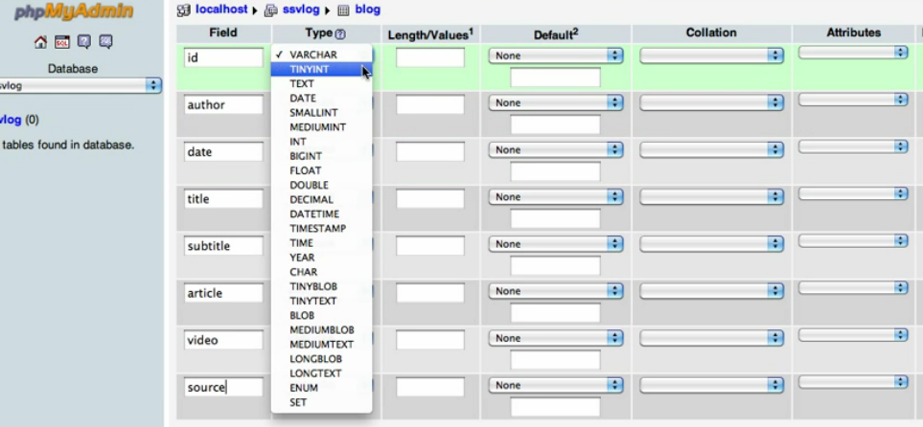
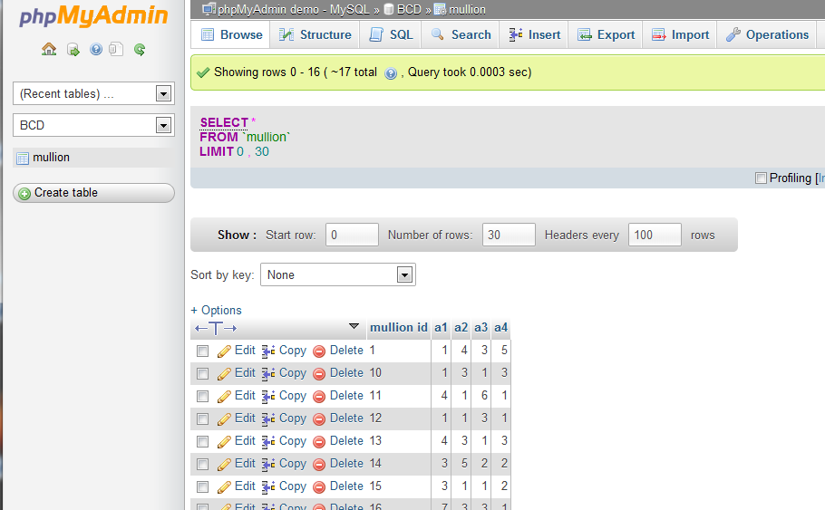
Implementation of web-based database
Create the table of the database
Import data from Csv file
Creating online database

Slide 22
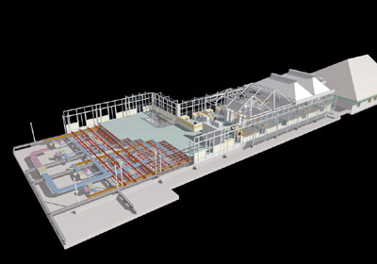
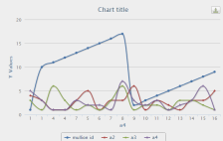
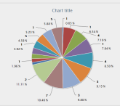
Implementation of web-based database
Web Browser
Mullion ID | 1 | 2
04:00~05:00 | data1 | data2
05:00~06:00 | data3 | data4
12:00~13:00 | data N | Data N+1
…
PHP
online database
JavaScript CSS
Web browser with GUI and analytic algorithm

Slide 23
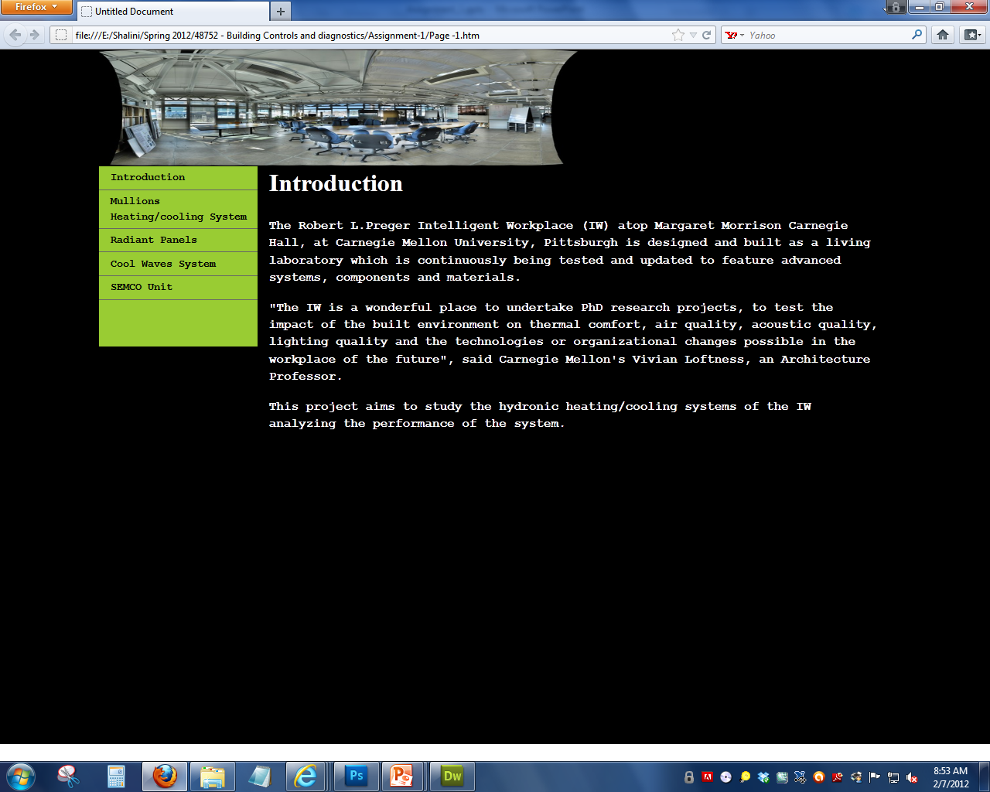
Mockup website

