Slide 1
The Building Skin: SPAIGR
  Stephen R. Lee, AIA, LEED AP
  Professor | Carnegie Mellon School of Architecture
  Consulting Principal, TAI+LEE, Architects PC

Slide 2
References
Ron Brand: Architectural Details For Insulated Buildings
Joseph Lstiburek: BSD-106 Understanding Vapor Barriers
Ed Allen: Fundamentals of Building Construction & Architectural Detailing

Slide 3
Requirements for
Building Enclosures¹
Control heat flow
Control airflow
Control rain penetration
Control water vapor flow
Control solar radiation
Control noise
Control fire
Provide strength & rigidity
Be durable
Be aesthetically pleasing
Be economical
1) Ron Brand: Architectural Details For Insulated Buildings

Slide 4
Control heat flow
Insulation, insulation, insulation......
actually outsulation is a
much better way to think of it

Slide 5
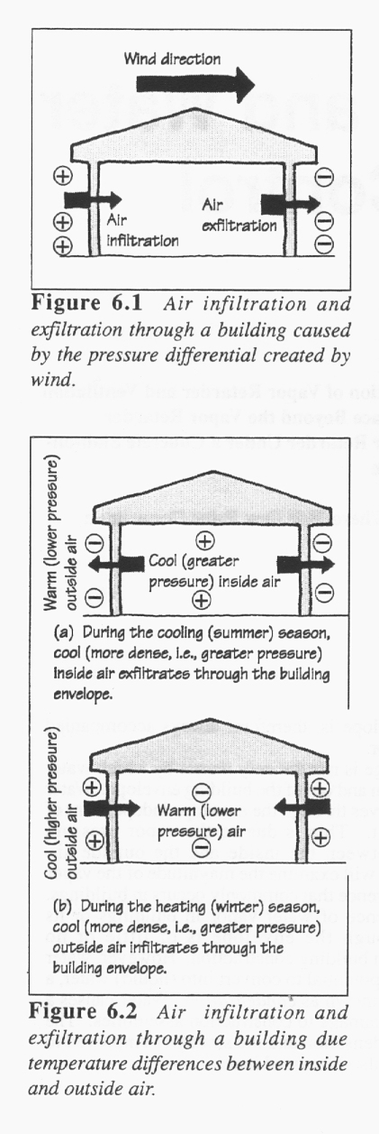
Control airflow

Slide 6
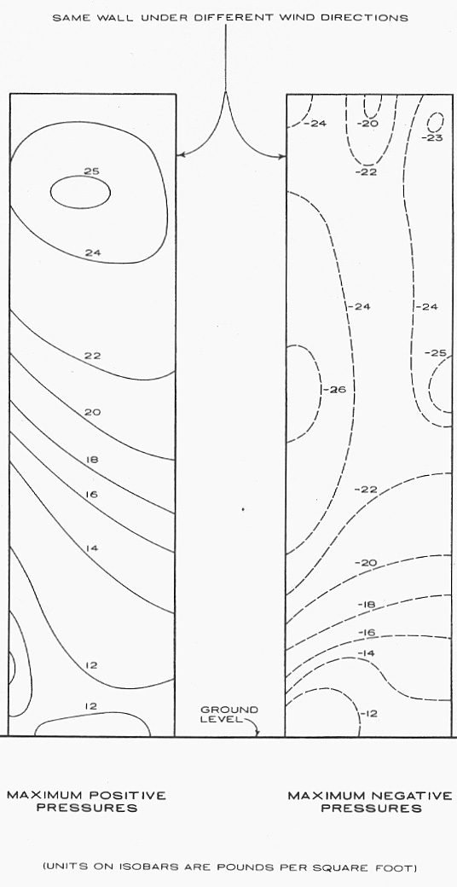
Control airflow³
3) Ed Allen: Fundamentals of Building Construction

Slide 7
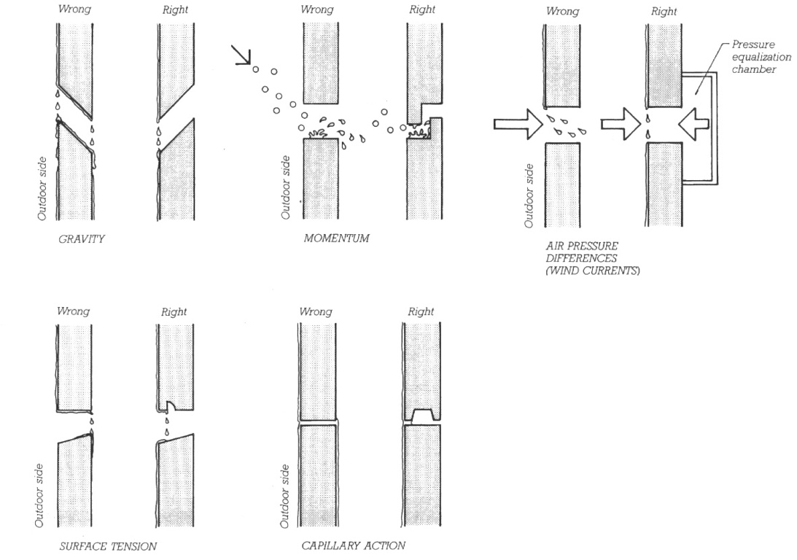
Control rain penetration
2) Ed Allen: Fundamentals of Building Construction
Notes:
Water, Hole, Force

Slide 8
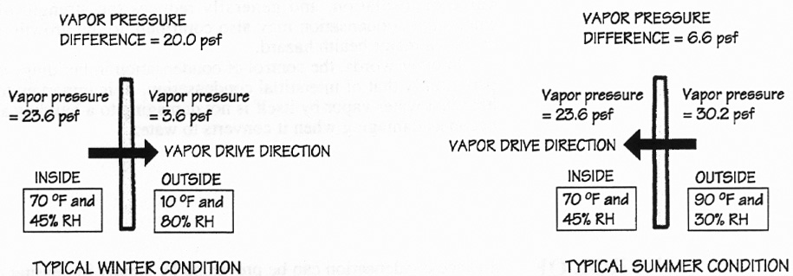
Control water vapor flow

Slide 9
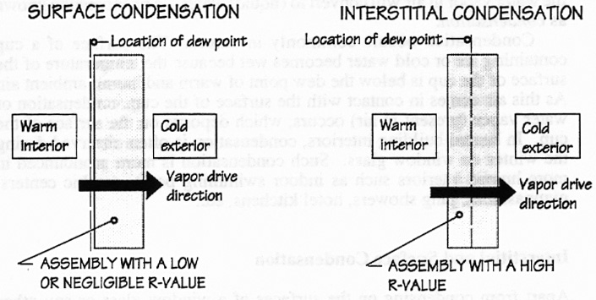
Control water vapor flow

Slide 10
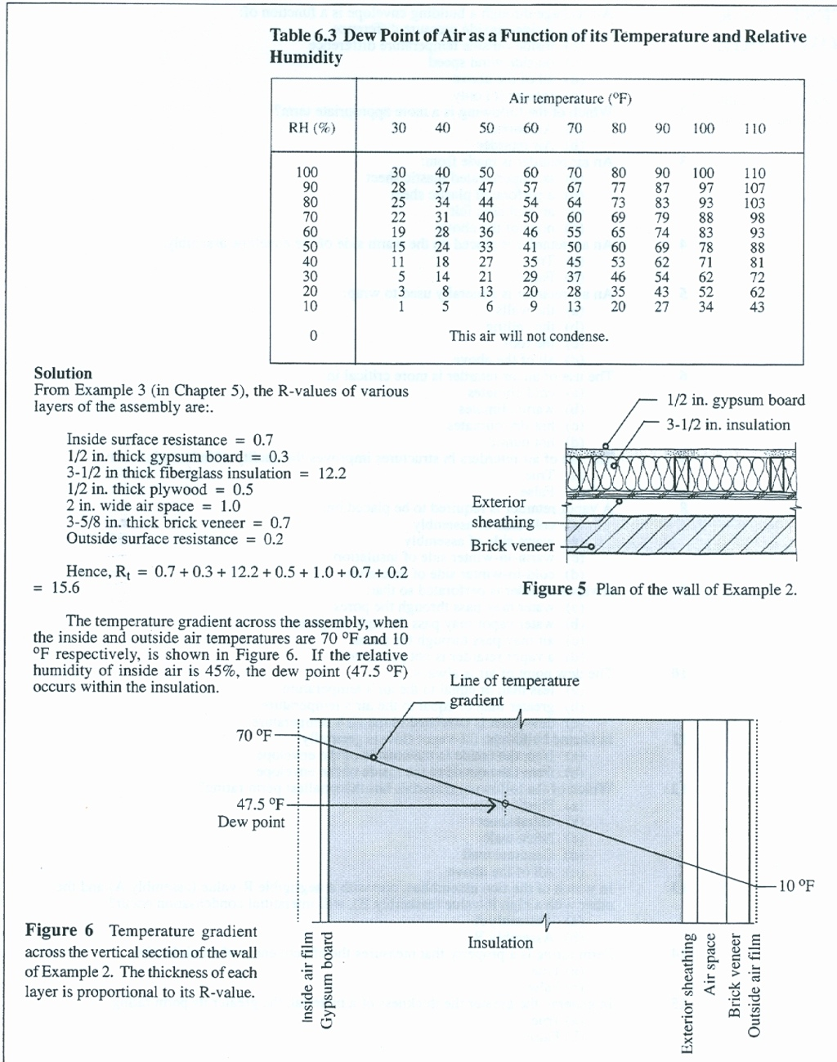
Control water vapor flow

Slide 11
Joe Lstiburek's Rules²
The fundamental principle of control of water in the vapor form is to keep it out and to let it out if it gets in.
2) Joseph Lstiburek: BSD-106 Understanding Vapor Barriers
Notes:
It gets complicated because sometimes the best strategies to keep water vapor out also trap water vapor in. This can be a real problem if the assemblies start out wet because of rain or the use of wet materials.It gets even more complicated because of climate. In general water vapor moves from the warm side of building assemblies to the cold side of building assemblies. This is simple to understand, except we have trouble deciding what side of a wall is the cold or warm side. Logically, this means we need different strategies for different climates. We also have to take into account differences between summer and winter. Finally, complications arise when materials can store water. This can be both good and bad. A cladding system such as a brick veneer can act as a reservoir after a rainstorm and significantly complicate wall design. Alternatively, wood framing or masonry can act as a hygric buffer absorbing water lessening moisture shocks.

Slide 12
Vapor Retarder²
Vapor Retarder*: The element that is designed and installed in an assembly to retard the movement of water by vapor diffusion.
    Class I Vapor Retarder:
        0.1 perm or less
    Class II Vapor Retarder:
      1.0 perm or less and greater than 0.1 perm
    Class III Vapor Retarder
      10 perm or less and greater than 1.0 perm
        * taken somewhat from ASHRAE Fundamentals 2001, Chapter 23.
2) Joseph Lstiburek: BSD-106 Understanding Vapor Barriers
Notes:
The unit of measurement typically used in characterizing the water vapor permeance of materials is the “perm”.

Slide 13
Vapor Barrier²
So, what is a Vapor Barrier?
  It is a Class I vapor retarder (0.1 perm or less).
2) Joseph Lstiburek: BSD-106 Understanding Vapor Barriers

Slide 14
Categories of Permeability²
Vapor impermeable
  0.1 perm or less
Vapor semi-impermeable
  1.0 perm or less and greater than 0.1 perm
Vapor semi-permeable:
  10 perms or less and greater than 1.0 perm
Vapor permeable:
  10 perms or greater
2) Joseph Lstiburek: BSD-106 Understanding Vapor Barriers

Slide 15
Joe Lstiburek's Principles²
Avoidance of using vapor barriers where vapor retarders will provide satisfactory performance.
Avoidance of using vapor retarders where vapor permeable materials will provide satisfactory performance. Thereby encouraging drying mechanisms over wetting prevention mechanisms.
Avoidance of the installation of vapor barriers on both sides of assemblies – i.e. “double vapor barriers” in order to facilitate assembly drying in at least one direction.
Avoidance of the installation of vapor barriers such as polyethylene vapor barriers, foil faced batt insulation & reflective radiant barrier foil insulation on the interior of air-conditioned assemblies.
Avoidance of the installation of vinyl wall coverings on the inside of air-conditioned assemblies.
Enclosures are ventilated meeting ASHRAE Standard 62.2 or 62.1
2) Joseph Lstiburek: BSD-106 Understanding Vapor Barriers

Slide 16
Ron Brand's Rules
1) Enclose the building in a continuous air barrier
2) Provide continuous support (panel) for the air barrier against when loads begin
3) Ensure that the air barrier is flexible joints where movement may occur begin
1) Ron Brand: Architectural Details For Insulated Buildings
Notes:
1) Ron Brand: Architectural Details For Insulated Buildings

Slide 17
Ron Brand's Rules
4) Provide continuous insulation to keep the air barrier warm and to conserve energy in the building
5) Keep the insulation tight to the air barrier
6) Protect the insulation with the rain screen/sunscreen supported out from the structure in a way that does not penetrate the insulation with excessive bridges
1) Ron Brand: Architectural Details For Insulated Buildings
Notes:
1) Ron Brand: Architectural Details For Insulated Buildings

Slide 18
Ron Brand's Rules
7) Provide enough open space (gap) for drainage and construction clearances between the rain screen and the insulation
8) Drain the wall cavity to the outside
1) Ron Brand: Architectural Details For Insulated Buildings

Slide 19
Steve Lee's Mnemonic: SPAIGR
S – structure
P – panel
A – air barrier (vapor barrier, drainage plane)
I – insulation
G – gap
R – rainscreen

Slide 20
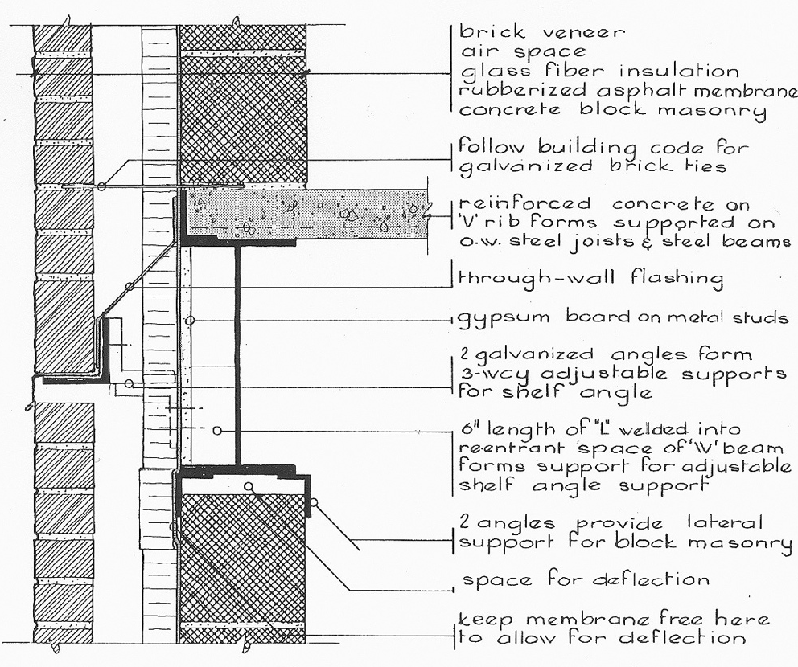
Brick/ CMU/ Steel Spandrel Section:
Complete
1) Ron Brand: Architectural Details For Insulated Buildings

Slide 21
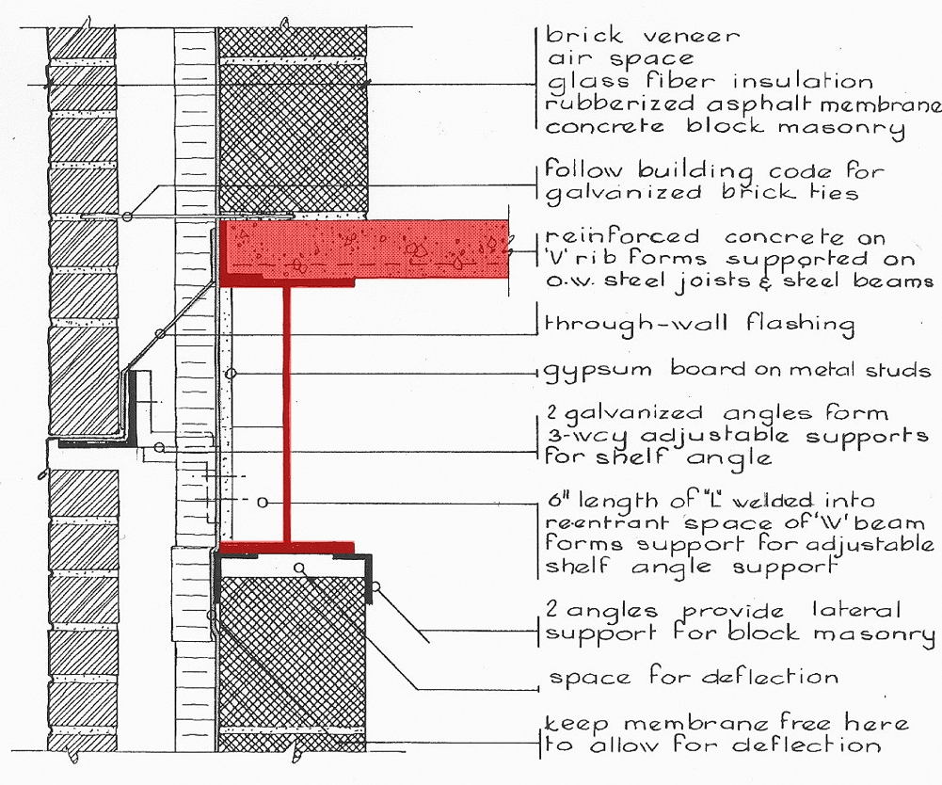
Brick/ CMU/ Steel Spandrel Section:
S – Structure

Slide 22
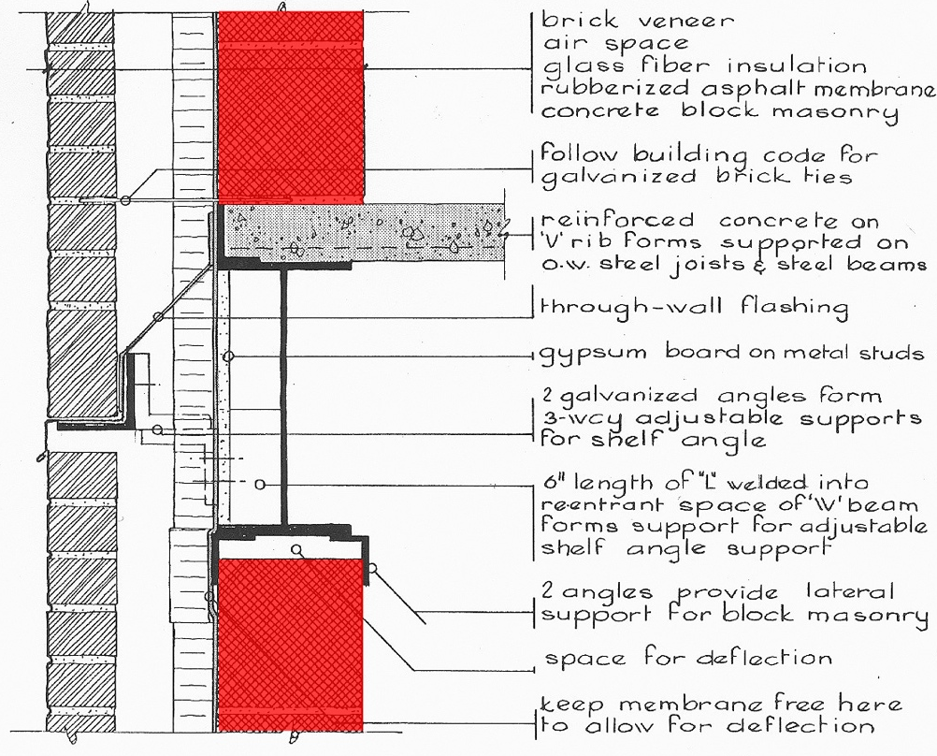
Brick/ CMU/ Steel Spandrel Section:
P – Panel

Slide 23
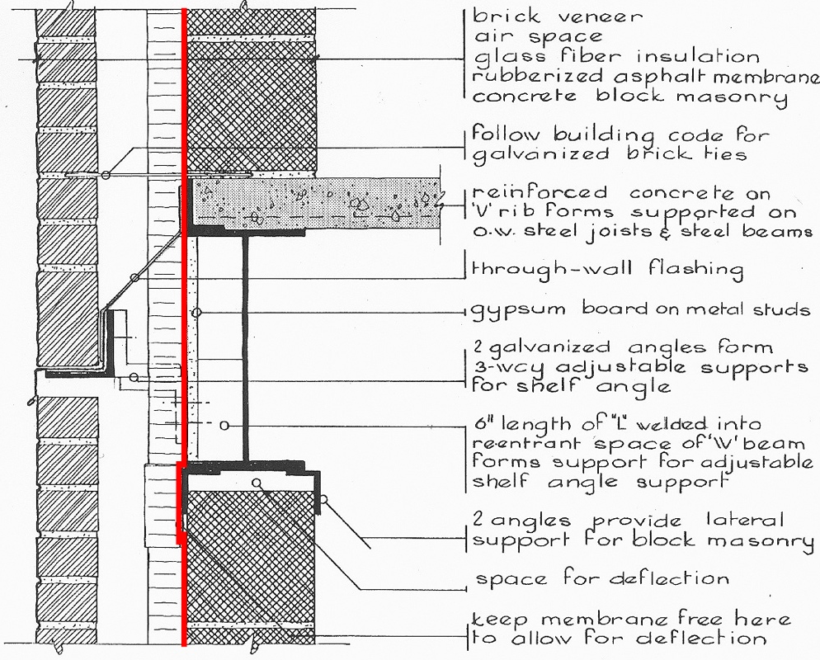
Brick/ CMU/ Steel Spandrel Section:
A – Air Barrier

Slide 24
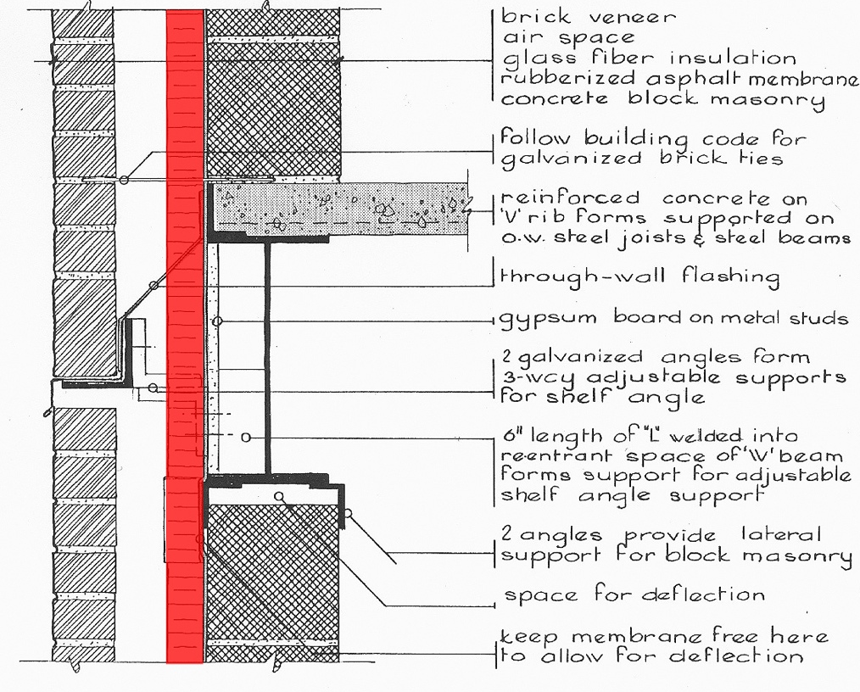
Brick/ CMU/ Steel Spandrel Section:
I – Insulation

Slide 25
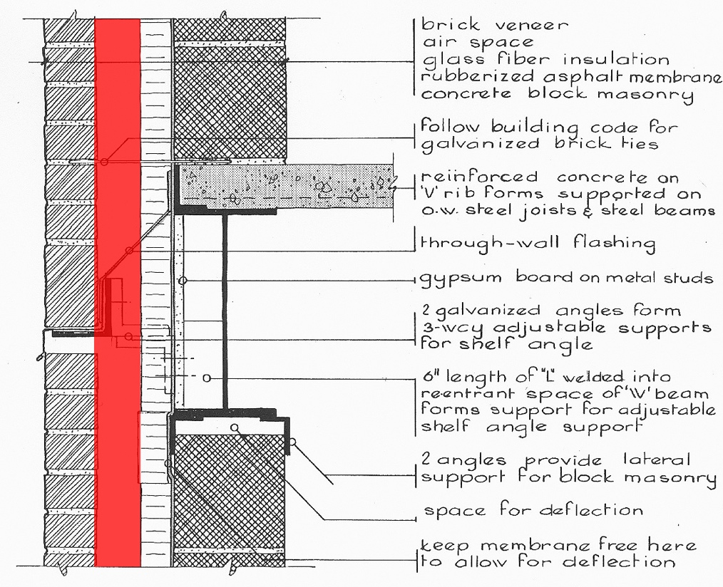
Brick/ CMU/ Steel Spandrel Section:
G -– Gap

Slide 26
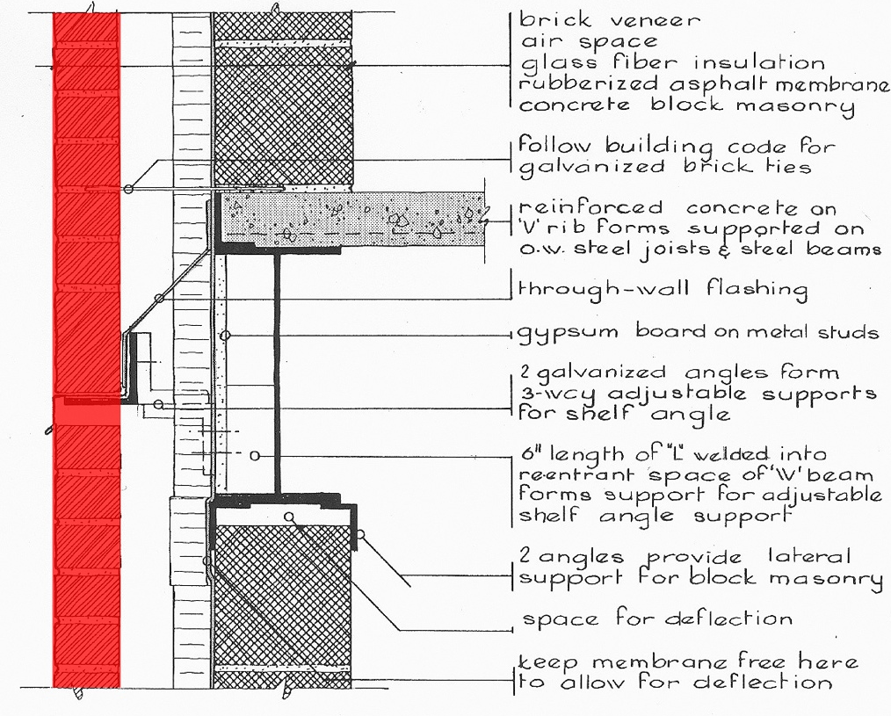
Brick/ CMU/ Steel Spandrel Section:
R – Rainscreen

Slide 27
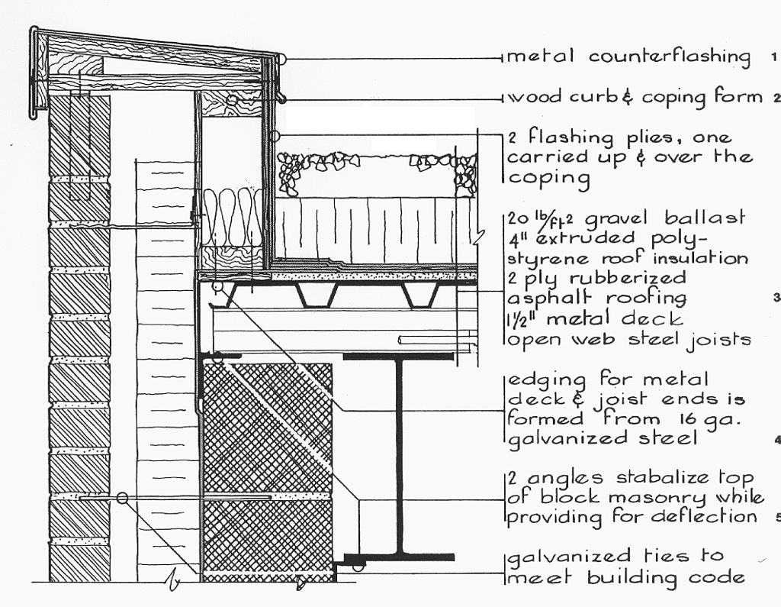
Brick/ CMU/ Steel Parapet Section:
Complete

Slide 28
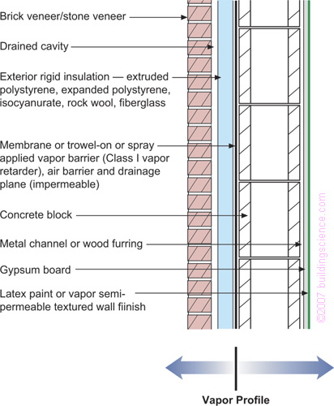
Brick/ CMU Wall Section:
Vapor Profile
2) Joseph Lstiburek: BSD-106 Understanding Vapor Barriers
Notes:
Applicability – all hygro-thermal regionsThis is arguably the most durable wall assembly available to architects and engineers. It is constructed from non-water sensitive materials and due to the block construction has a large moisture storage (or hygric buffer) capacity. It can be constructed virtually anywhere. In cold climates condensation is limited on the interior side of the vapor barrier as a result of installing all of the thermal insulation on the exterior side of the vapor barrier (which is also the drainage plane and air barrier in this assembly). In hot climates any moisture that condenses on the exterior side of the vapor barrier will be drained to the exterior since the vapor barrier is also a drainage plane. This wall assembly will dry from the vapor barrier inwards and will dry from the vapor barrier outwards.

Slide 29
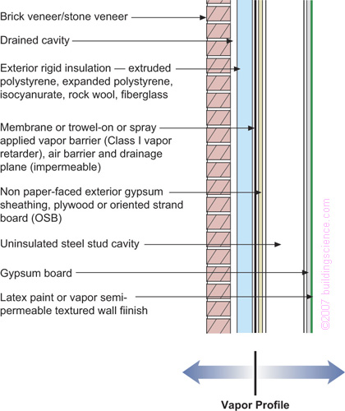
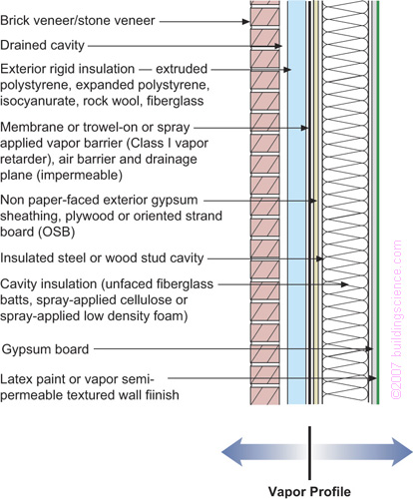
Brick/ Steel Stud Wall Section:
Vapor Profile
2) Joseph Lstiburek: BSD-106 Understanding Vapor Barriers
Notes:
Figure 5: Frame Wall With Exterior Insulation and Brick or Stone VeneerApplicability – all hygro-thermal regionsThis wall is a variation of Figure 1 – but without the moisture storage (or hygric buffer) capacity. This wall is also a durable wall assembly. It is constructed from non-water sensitive materials and has a high drying potential inwards due to the frame wall cavity not being insulated. It can also be constructed virtually anywhere. In cold climates condensation is limited on the interior side of the vapor barrier as a result of installing all of the thermal insulation on the exterior side of the vapor barrier (which is also the drainage plane and air barrier in this assembly). In hot climates any moisture that condenses on the exterior side of the vapor barrier will be drained to the exterior since the vapor barrier is also a drainage plane. This wall assembly will dry from the vapor barrier inwards and will dry from the vapor barrier outwards.
Figure 8: Frame Wall With Exterior Rigid Insulation With Cavity Insulation and Brick or Stone VeneerApplicability – all hygro-thermal regions except subarctic/arctic – in cold and very cold regions the thickness of the foam sheathing should be determined by hygro-thermal analysis so that the interior surface of the foam sheathing remains above the dew point temperature of the interior air (see Side Bar 2)This wall is a variation of Figure 5. In cold climates condensation is limited on the interior side of the vapor barrier as a result of installing some of the thermal insulation on the exterior side of the vapor barrier (which is also the drainage plane and air barrier in this assembly). In hot climates any moisture that condenses on the exterior side of the vapor barrier will be drained to the exterior since the vapor barrier is also a drainage plane. This wall assembly will dry from the vapor barrier inwards and will dry from the vapor barrier outwards. Moisture driven inwards out of the brick veneer will condense on the vapor barrier/drainage plane and be drained outwards.

Slide 30
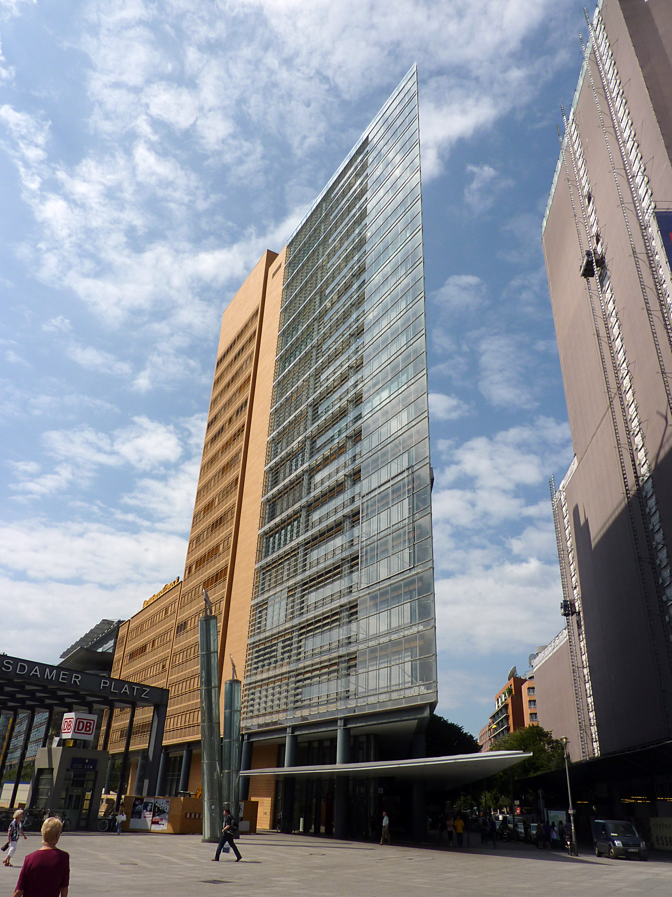

Slide 31


Slide 32
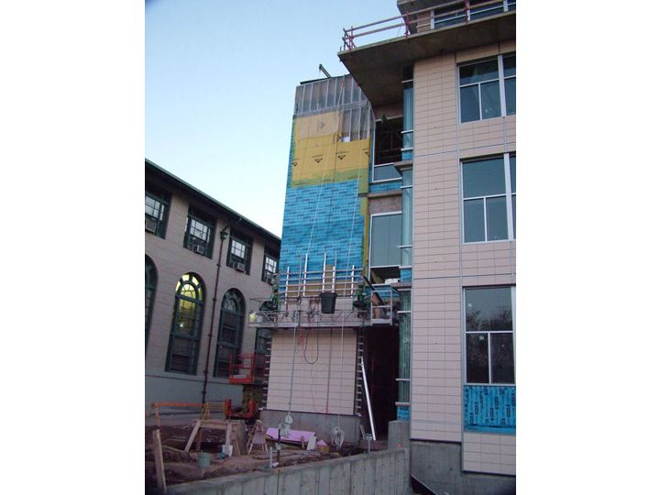

Slide 33
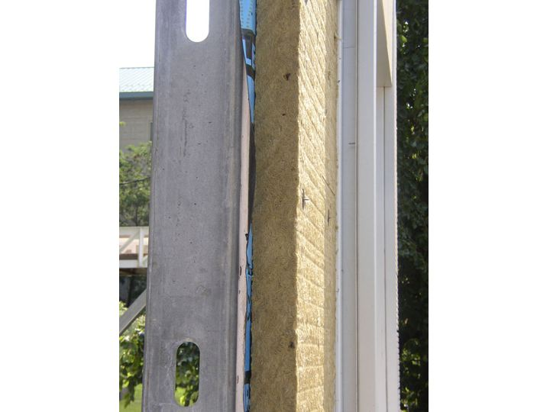

Slide 34
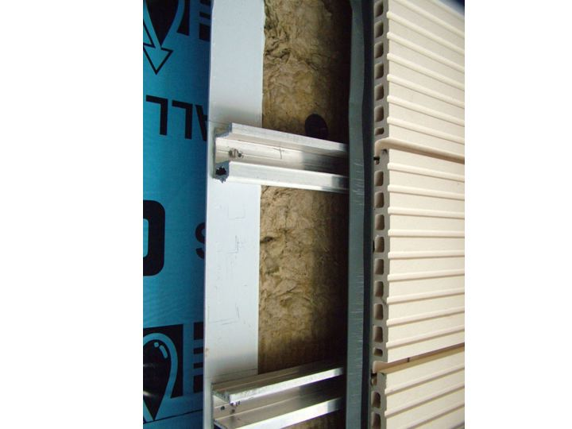

Slide 35
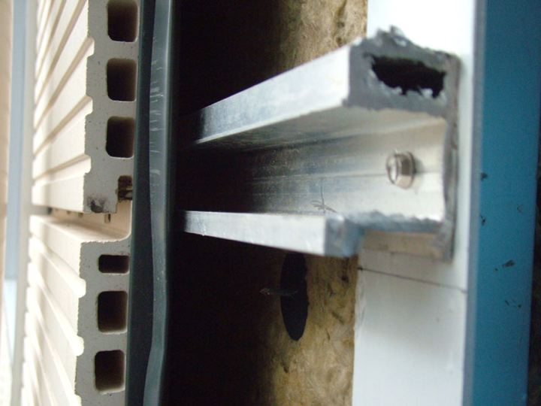

Slide 36
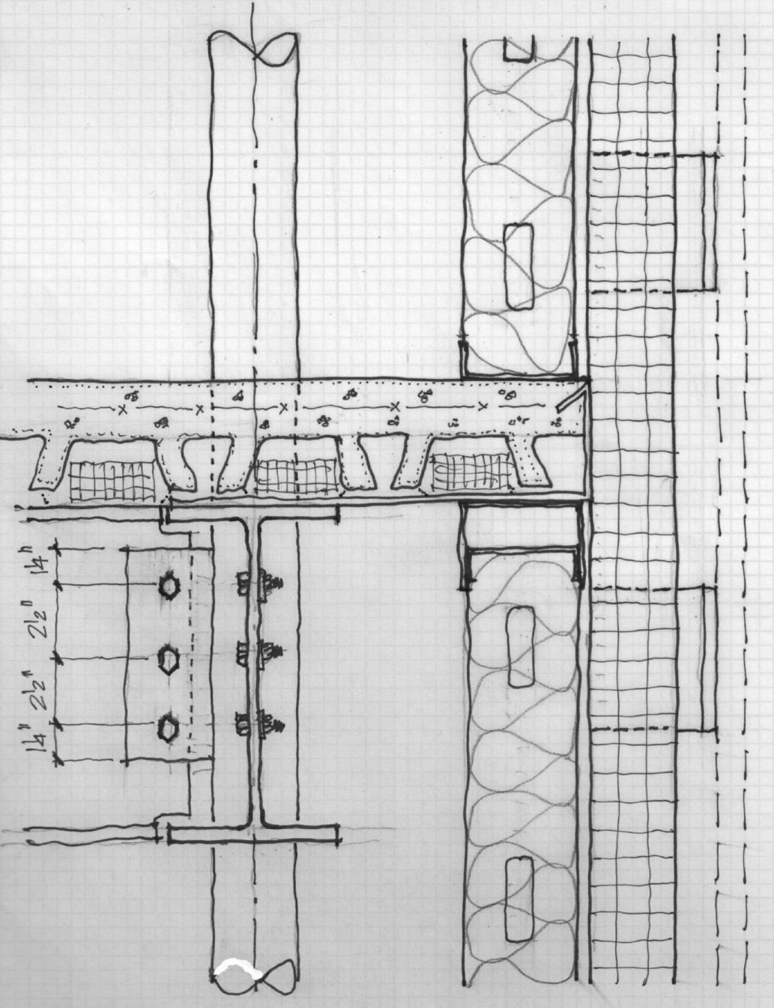
Slee’s SPAIGR

Slide 37
Switch Over to ArchiCAD

Slide 38
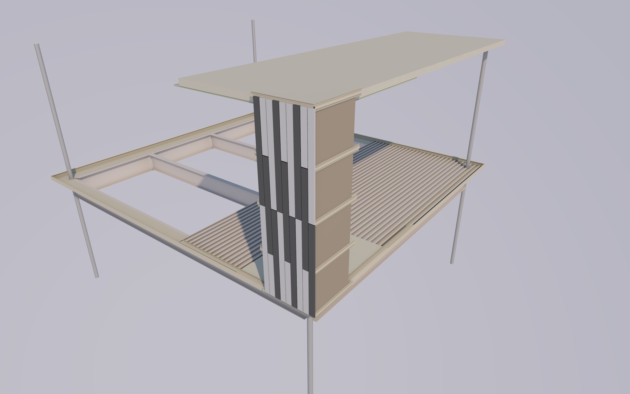
Workshop Render

Slide 39
URL’s for Rendered Products
Deck:
  https://www.epicmetals.com/
Metal Studs:
  https://www.clarkdietrich.com/
GP Densglass Sheathing:
  https://tinyurl.com/y6ssbcsz
Rockwool Exterior Insulation:
  https://tinyurl.com/4cjd8jma
Knight Wall Systems Rainscreen Attachment:
  https://tinyurl.com/hszwk8mv
TAKTL Rainscreen Cladding:
  https://www.taktl-llc.com/taktlnow/

Slide 41
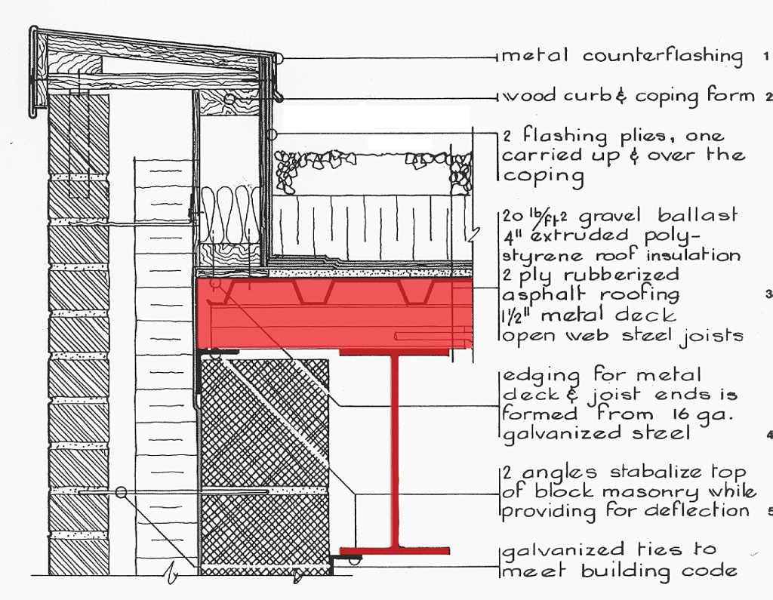
Brick/ CMU/ Steel Parapet Section:
S – Structure

Slide 42
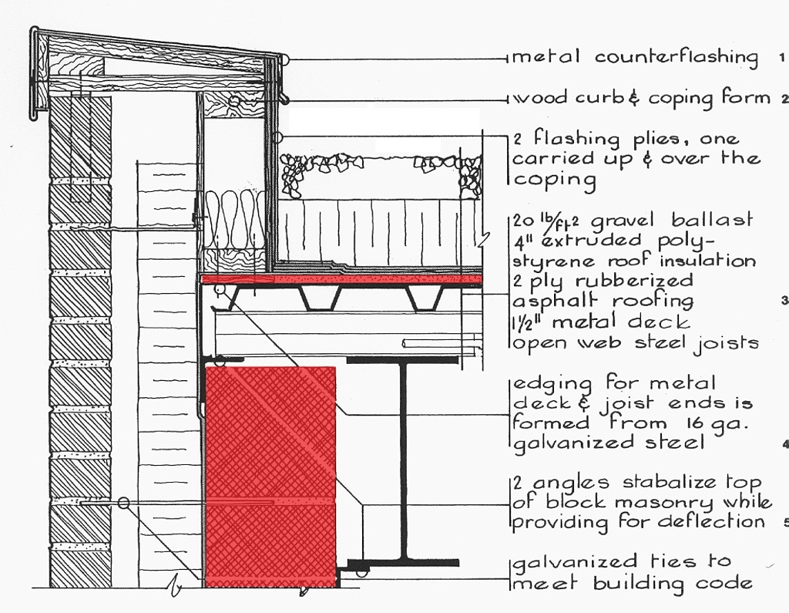
Brick/ CMU/ Steel Parapet Section:
P – Panel

Slide 43
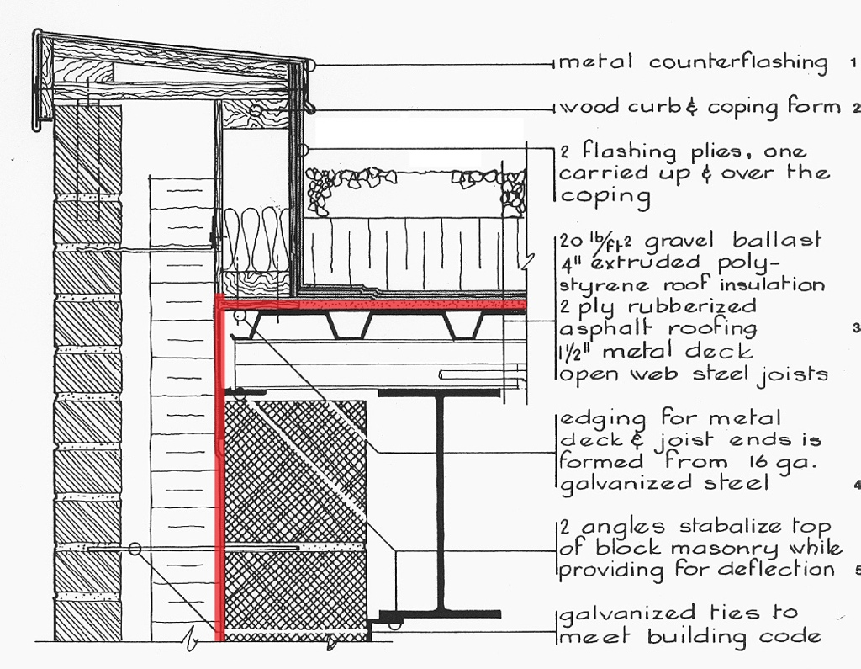
Brick/ CMU/ Steel Parapet Section:
A – Air Barrier

Slide 44
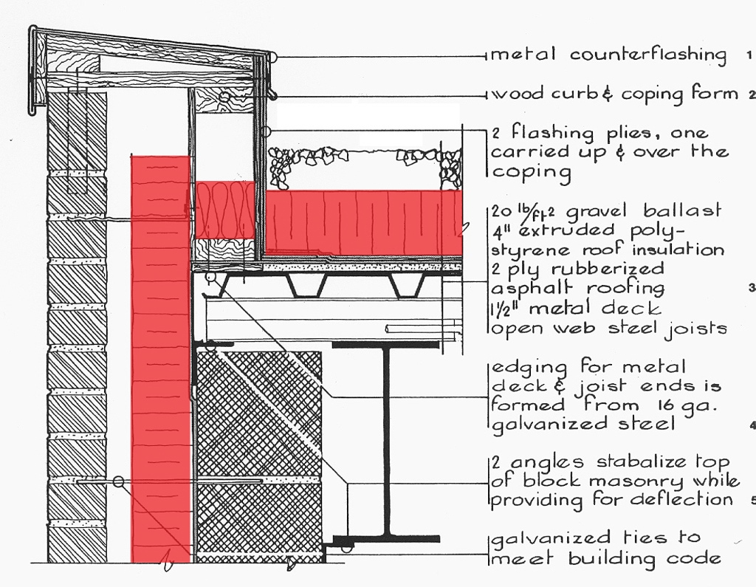
Brick/ CMU/ Steel Parapet Section:
I – Insulation

Slide 45
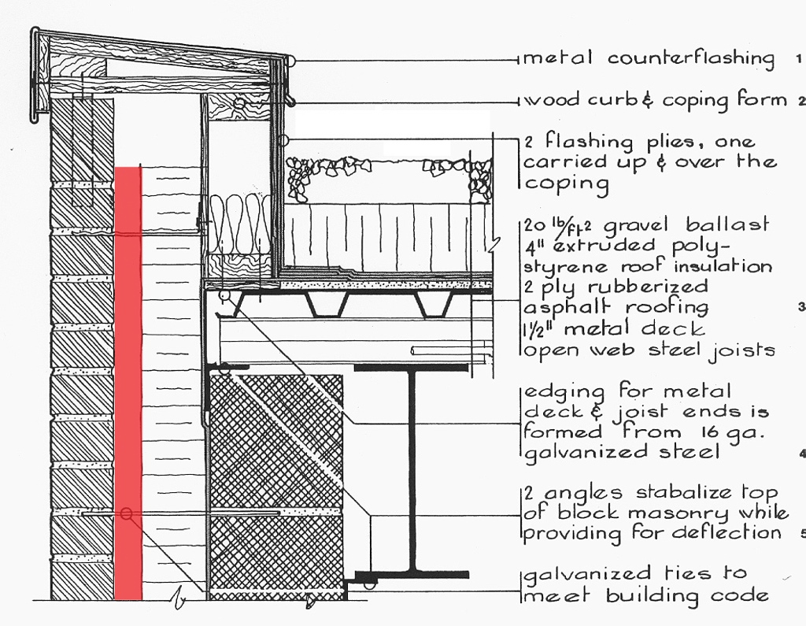
Brick/ CMU/ Steel Parapet Section:
G – Gap

Slide 46
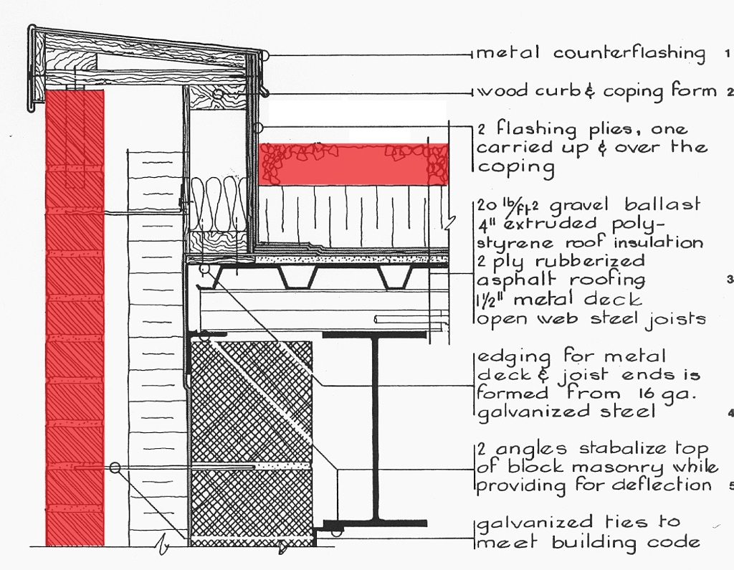
Brick/ CMU/ Steel Parapet Section:
R – Rainscreen

