Slide 1
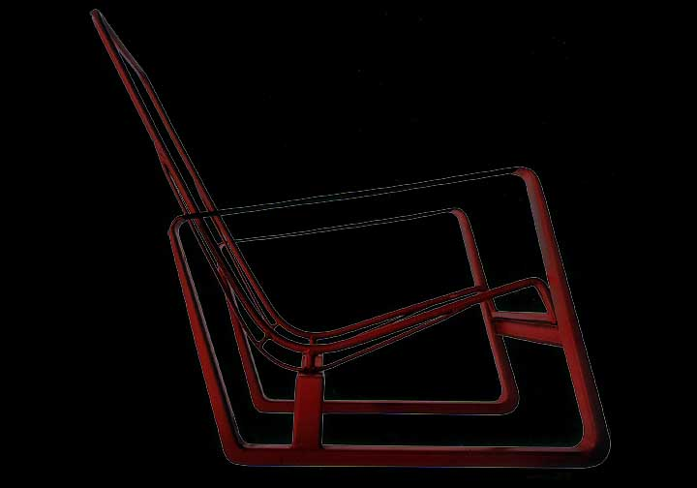
Jean Prouvé
References:
Jean Prouvé, Complete Works, Vol. I & II by P.Sulzer

Slide 2
Thoughts from Sir Norman Foster
  “…. It is very difficult to categorize him
    technocrat/ visionary
    pioneer/ teamworker
    innovator/ constructor…..
  I am particularly interested in the relationship between his creative process, what I perceive as the quest for quality… and the resulting potential for a new aesthetic of the age. Perhaps the ingredient of ‘loving care’ is the true bond with the past.

Slide 3
Thoughts from Renzo Piano
“For many architects, JP has been, and will remain, an exemplary figure, an inescapable point of reference……I have always kept in mind the fundamental truth that one must not separate
  the head and the hand,
  the idea and the means of realizing it,
  that architecture is a matter of building, not drawing and
  that it must be a deep understanding of materials that gives rise to its forms…”

Slide 4
Themes Seen by Piano
  Thinking on the borderline between building construction and automobile manufacturing
  Thinking in terms of form, elegance and the strong relationships between the parts
    “anybody can build using too much material”
  Thinking about joining one form to another by following the one
  Integrating thought and action
  Experimenting with new materials

Slide 5
In his career,
JP narrowed the gap between the builder’s and the architect’s craft, but was not accepted by the “profession”
Taught students to think in 3 dimensions
  thru exercises such as bridges from one sheet of paper
  weight of one m3 of auto v. one m3 of bldg
Was on the jury for Centre Beauborg and frequently stopped by to talk to RP and RR during construction

Slide 6
JP received 32 patents,
truly representing design straying into invention
  Double hung and sliding windows, doors and frames
  Interior metal panel systems
  Metal building skeletons
  Exterior metal panel systems
  Prefabricated roof panels
  Structural ribbed metal panels

Slide 7
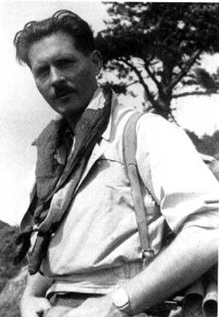
Jean Prouvé (1901-1984)
Trained as a metalworker, Prouvé owned and operated the Atelier Jean Prouvé from 1922 to 1954, a workshop for the manufacture of metal objects.
He emphasized advanced metalworking techniques and was particularly concerned with the design and production of architectural components and furniture.
Prouvé taught at the School of Arts and Crafts (Conservatoire National des Arts et Matières) from 1958 to 1971.
He was elected a member of the Academy of Architecture in Paris in 1972.

Slide 8
Jean Prouvé (1901-1984)
Important commissions include:
  Roland Garros Club at Buc Airport (1937-39)
  Maison du Peuple at Clichy, France (1938-39).
  Headquarters of the Federation of Building Industries, Paris (1947-51
  Meridian Room of the Paris Observatory (1951),
  Exhibition Hall at Nanterre, France (1956-58),
  Church of the Sacré-Coeur de Bonnecousse (1959-60), at Mazamet, France.

Slide 9
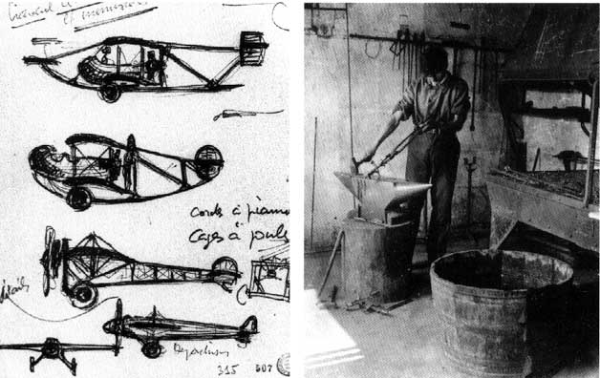
Early Life

Slide 10
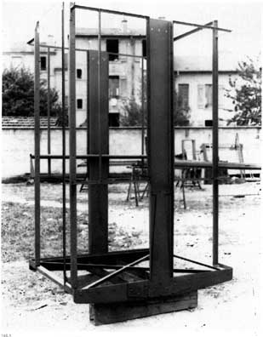
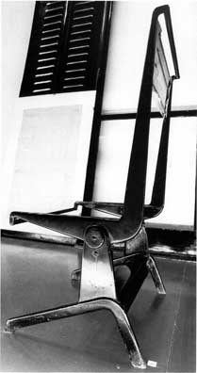
Elevator Lift and Reclining Chair (1928-30)

Slide 11
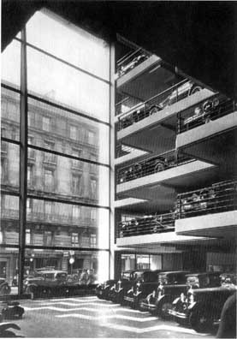
Citroen Garage, Paris, 1930
Notable for the 19m x 21 m glazed wall
Two uniform strength (tapered) columns

Slide 12
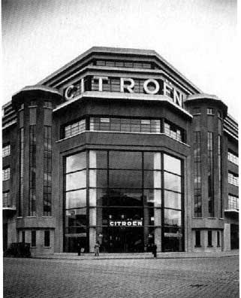
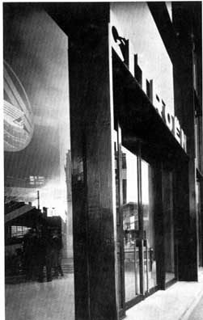
Citroen, Lyons, 1930-31

Slide 13
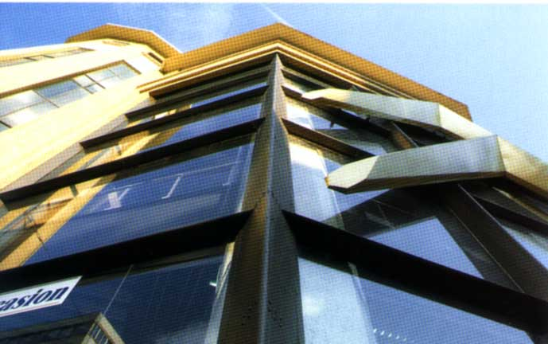
Citroen, Lyons, 1930-31

Slide 14
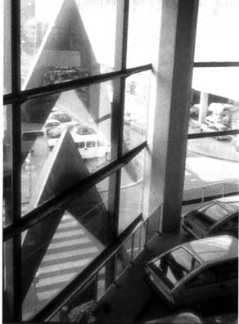
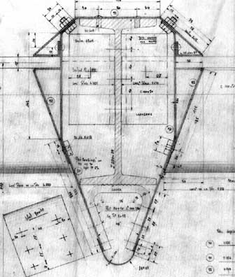
Citroen, Lyons, 1930-31

Slide 15
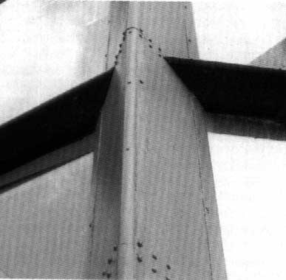
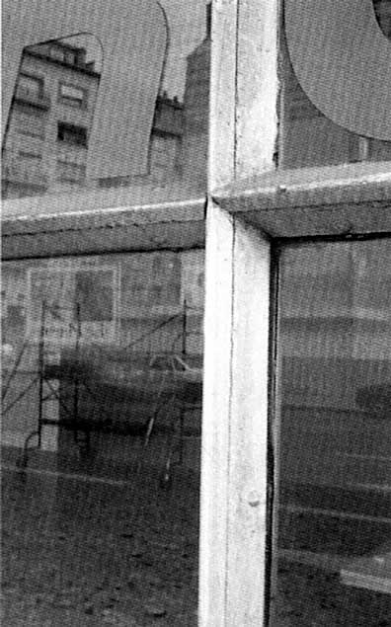
Citroen, Lyons, 1930-31

Slide 16
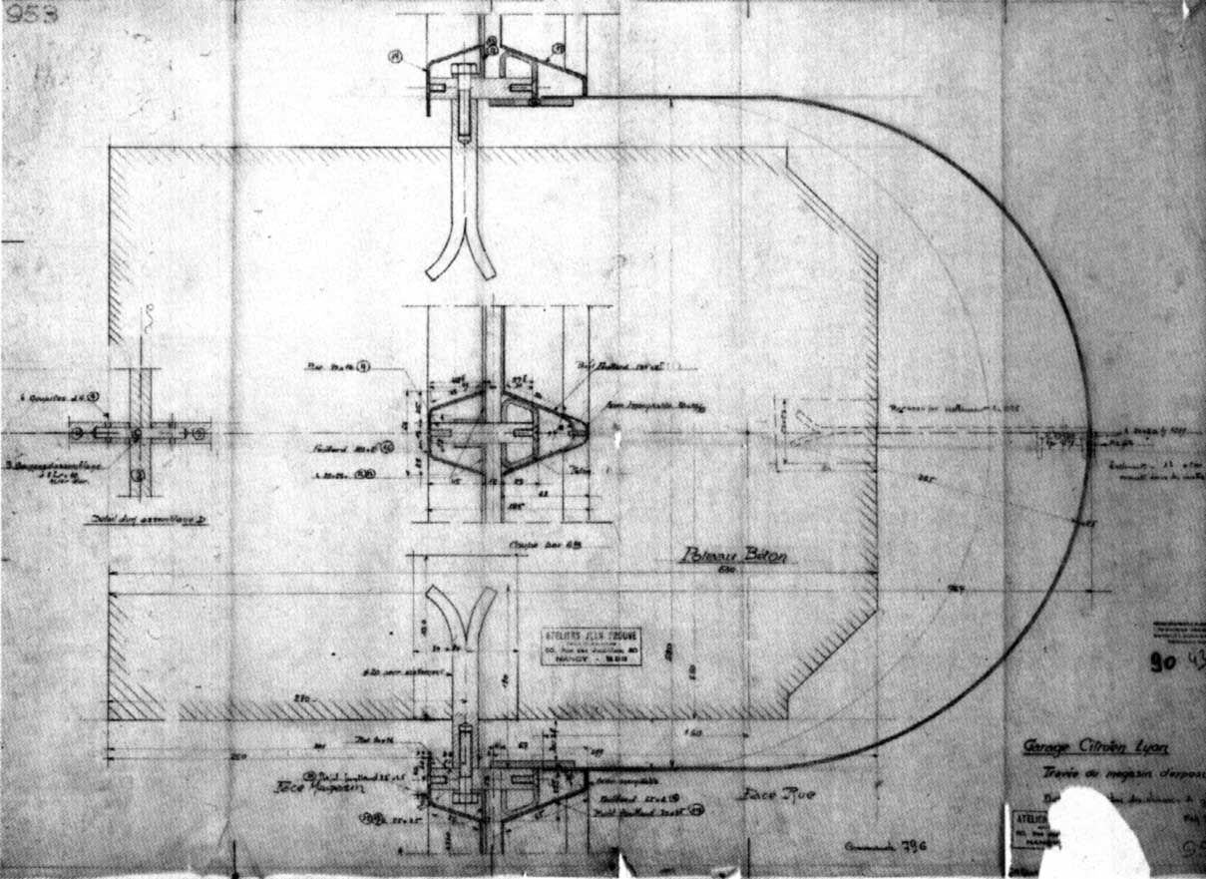
Citroen, Lyons, 1930-31

Slide 17
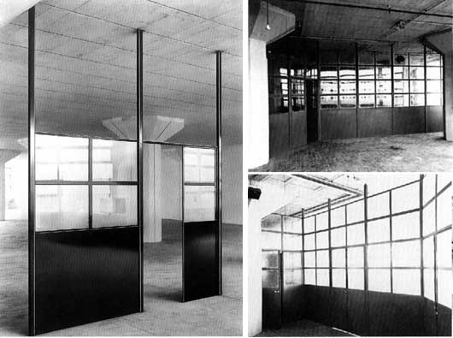
Moveable Partitions, Messageries Hachette, Paris, 1931-35

Slide 18
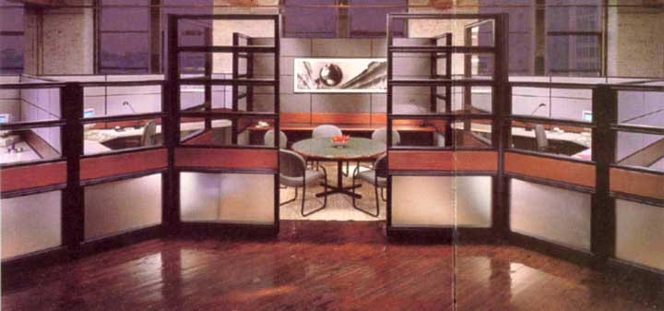
Kimball Transwall, Intelligent Workplace, 2001

Slide 19
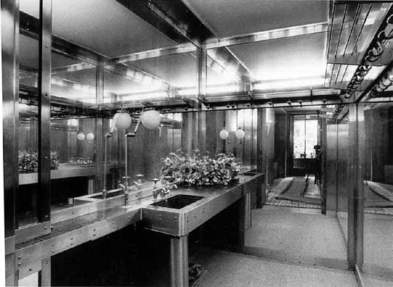
Stainless Steel Cloakroom, Paris, 1930

Slide 20
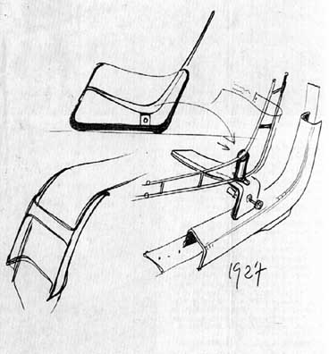
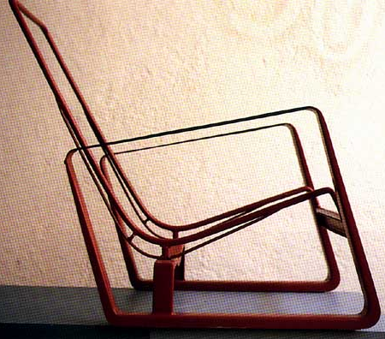
Armchairs, 1927

Slide 21
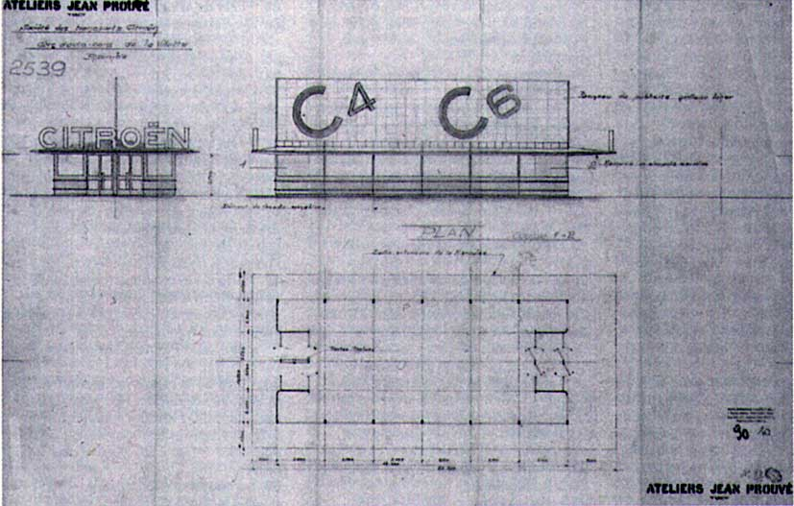
Coach Station, La Villette, Paris, 1933

Slide 22
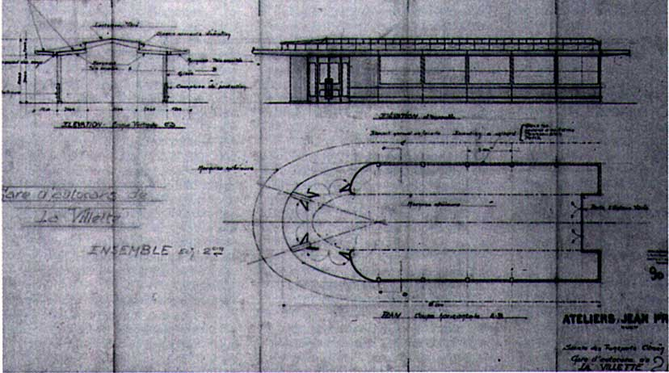
Coach Station, La Villette, Paris, 1933

Slide 23
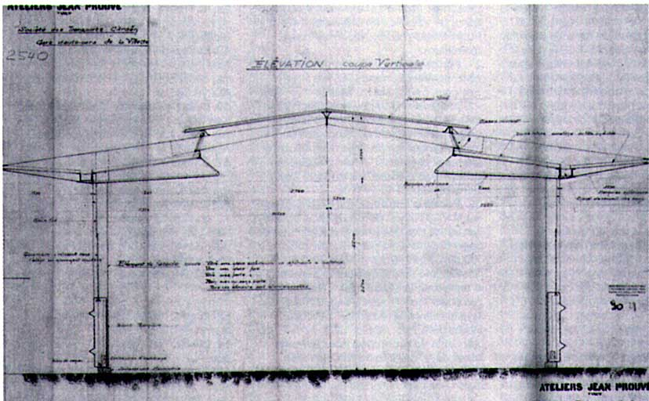
Coach Station, La Villette, Paris, 1933

Slide 24
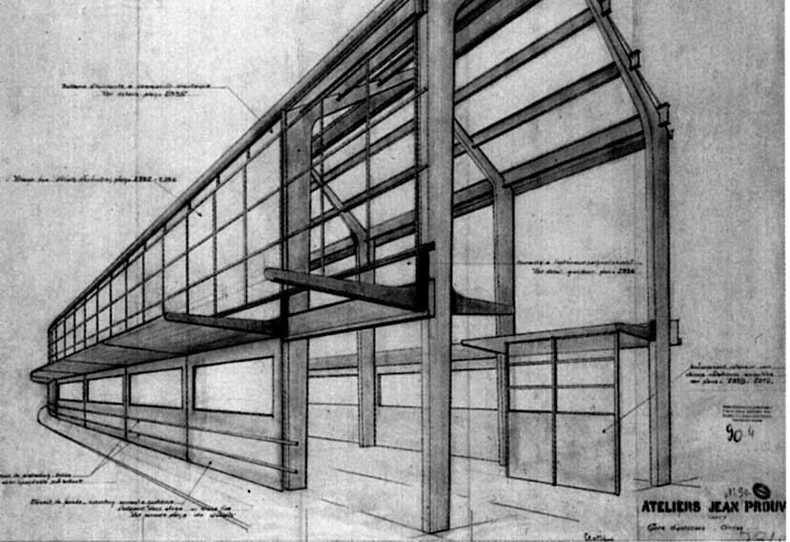
Coach Station, La Villette, Paris, 1933

Slide 25
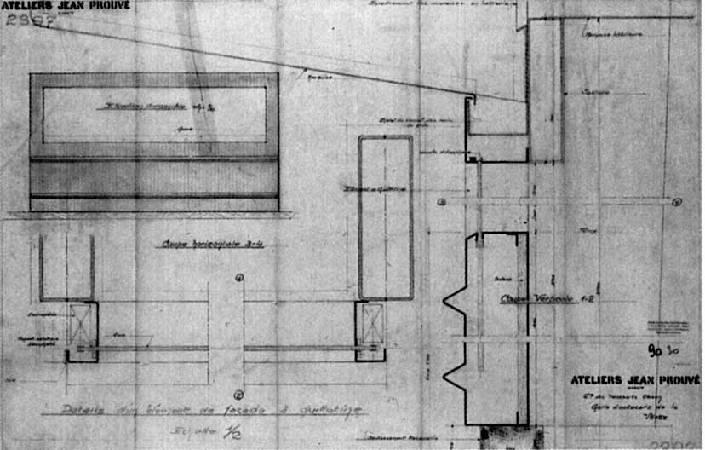
Coach Station, La Villette, Paris, 1933, Sash Facade

Slide 26
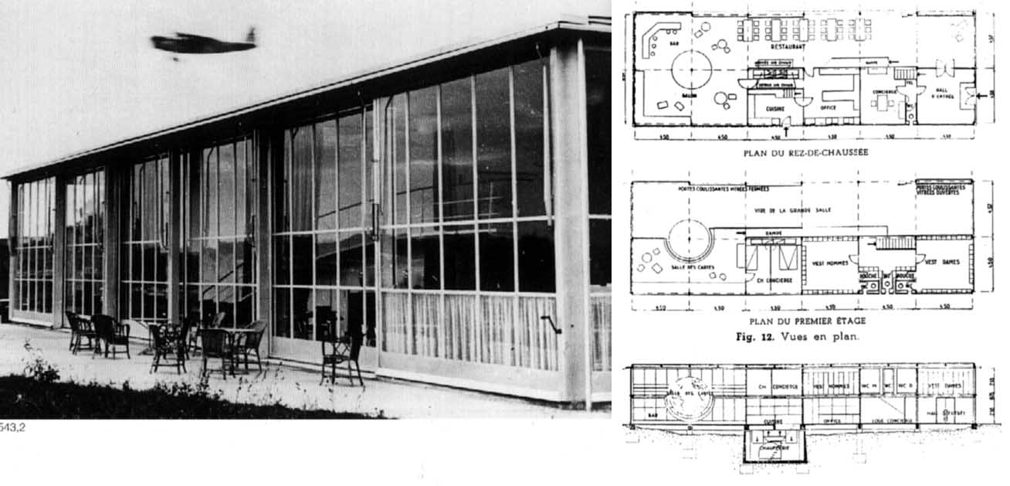
Roland Garros Flying Club, Buc, 1935-36

Slide 27
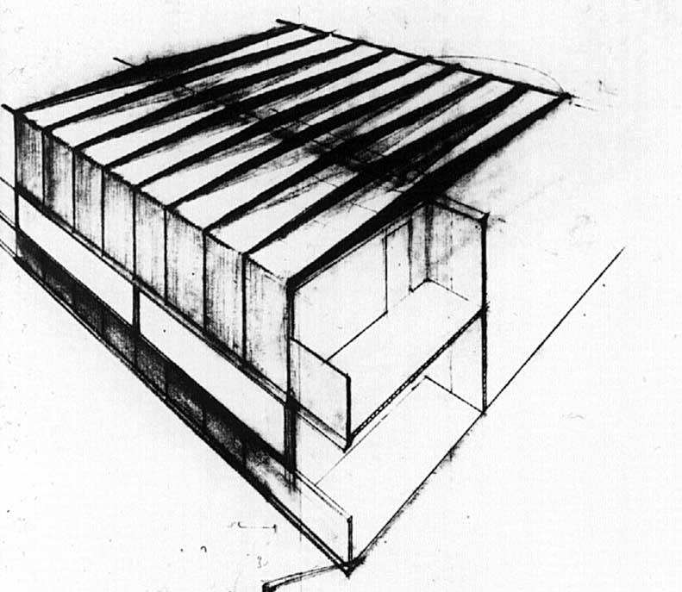
Roland Garros Flying Club, Buc, 1935-36

Slide 28
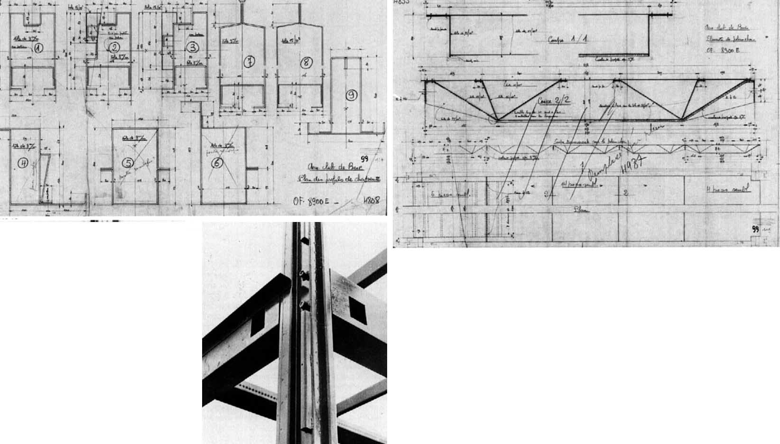
Roland Garros Flying Club, Buc, 1935-36, Folded Metal Structure

Slide 29
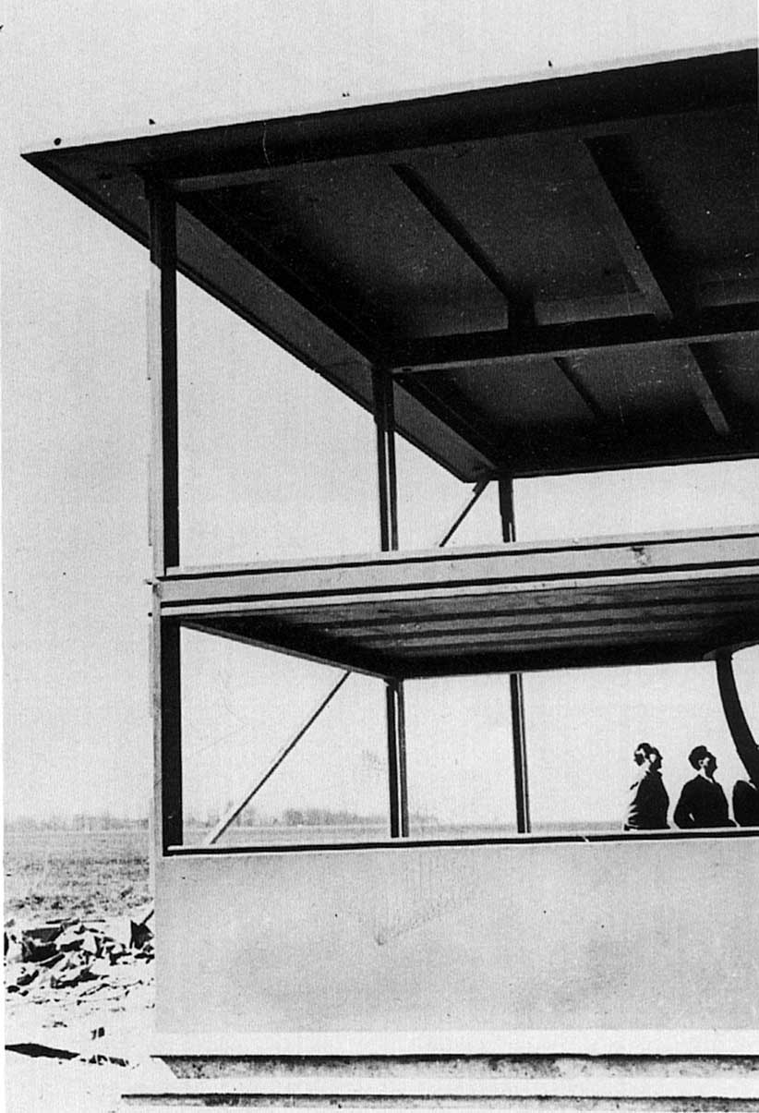
Roland Garros Flying Club, Buc, 1935-36

Slide 30
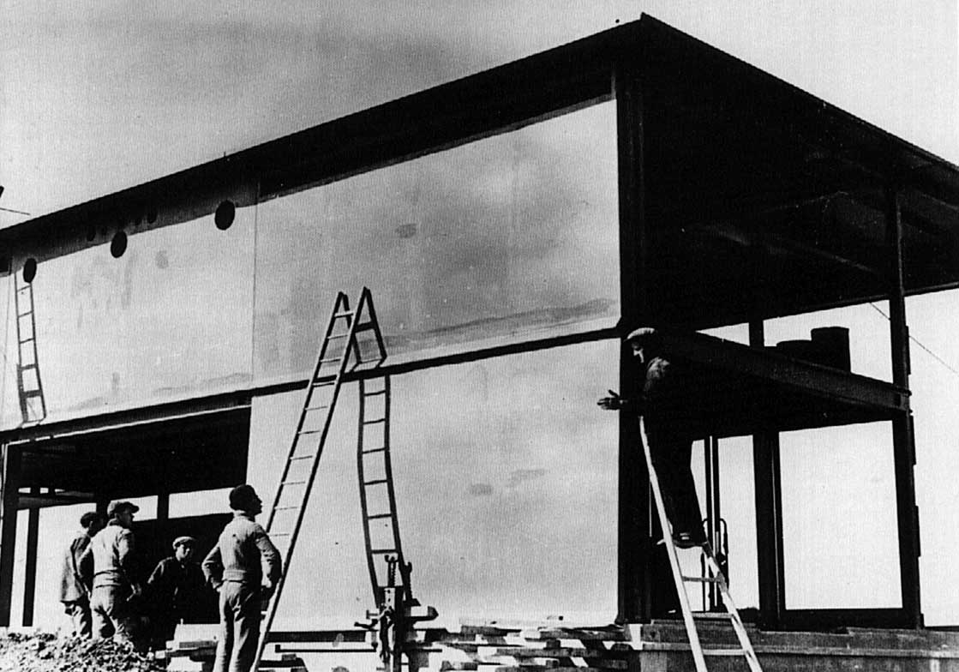
Roland Garros Flying Club, Buc, 1935-36

Slide 31
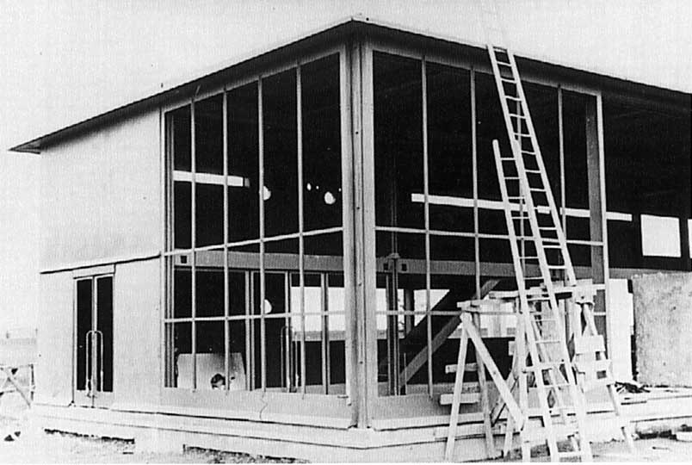
Roland Garros Flying Club, Buc, 1935-36

Slide 32
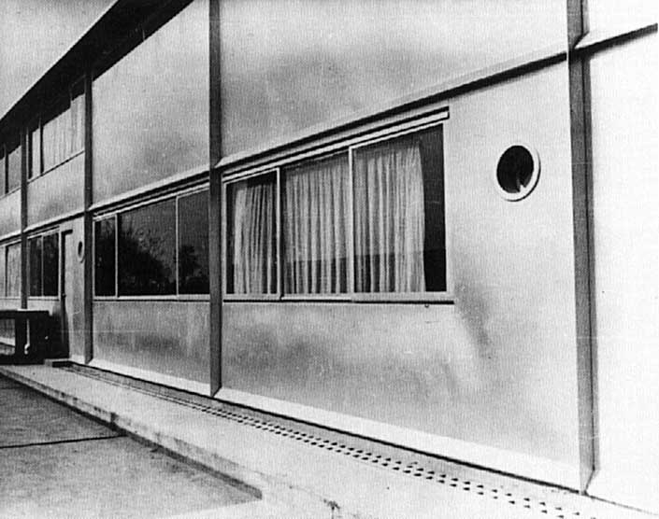
Roland Garros Flying Club, Buc, 1935-36

Slide 33
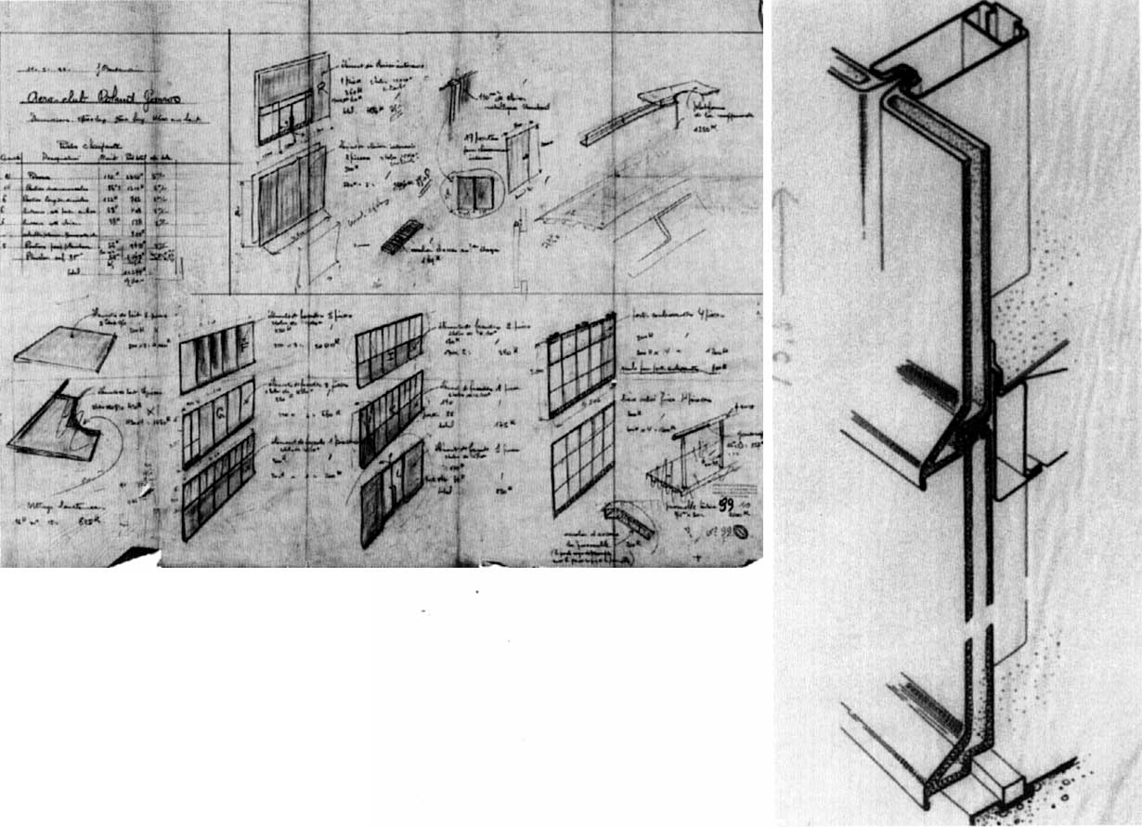
Roland Garros Flying Club, Buc, 1935-36

Slide 34
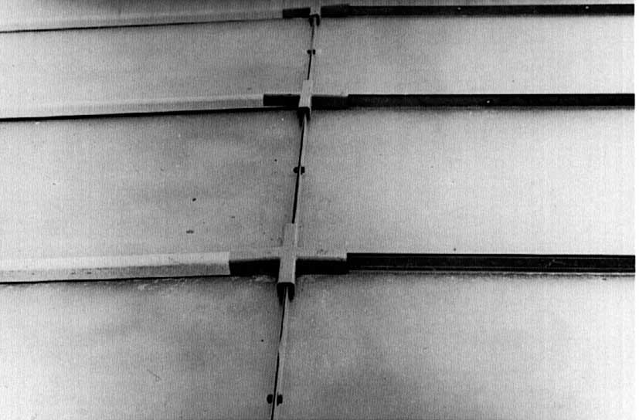
Wall, Roland Garros Flying Club, Buc, 1935-36

Slide 35
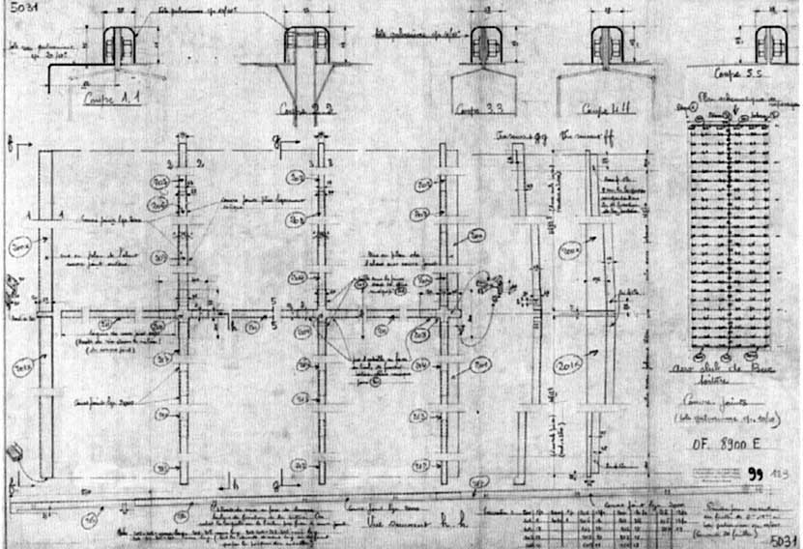
Roof, Roland Garros Flying Club, Buc, 1935-36

Slide 36
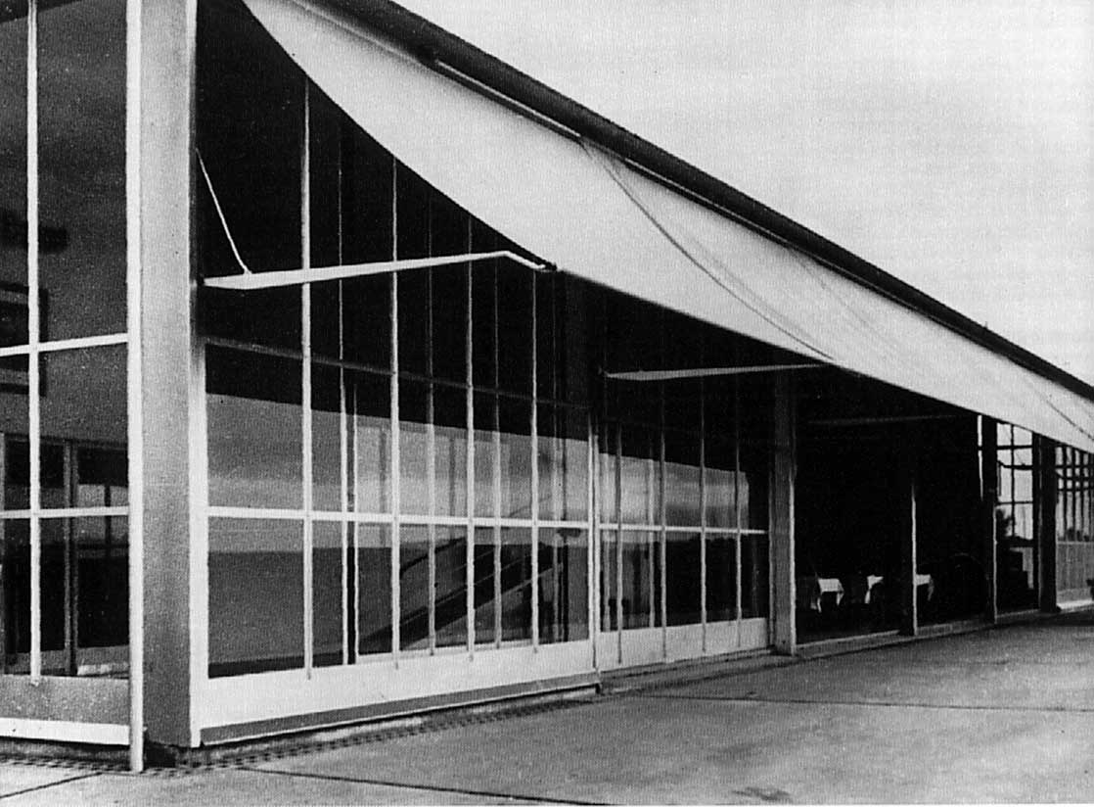
Roland Garros Flying Club, Buc, 1935-36

Slide 37
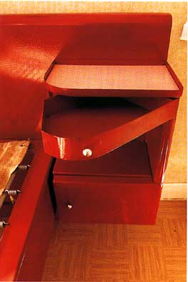
Sanitorium Bed, 1936

Slide 38
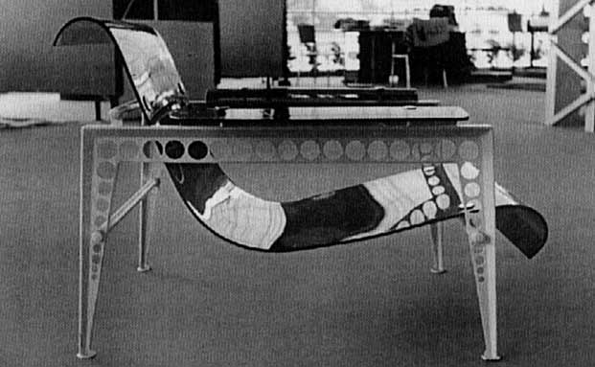
Metal & Rhodoid Chair, International Exhibition, Paris, 1937

Slide 39
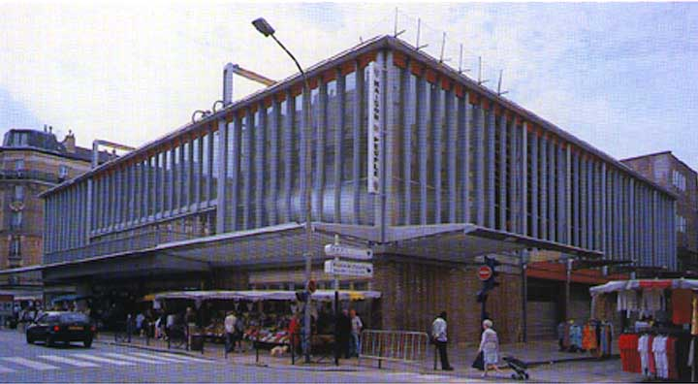
Maison du Peuple, Clichy, 1935-39 (Restoration, 1988)

Slide 40
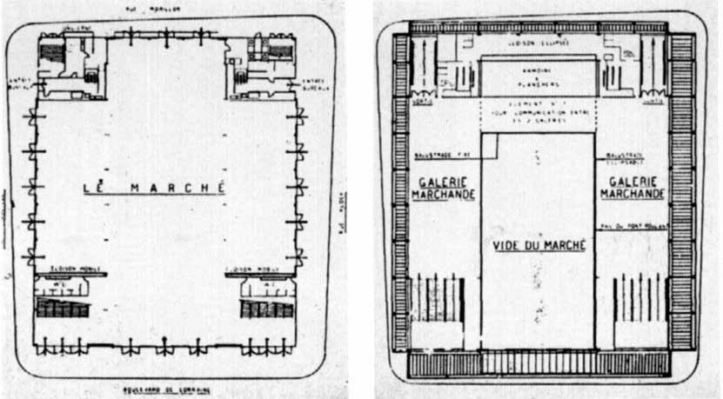
Maison du Peuple, Clichy, 1935-39

Slide 41
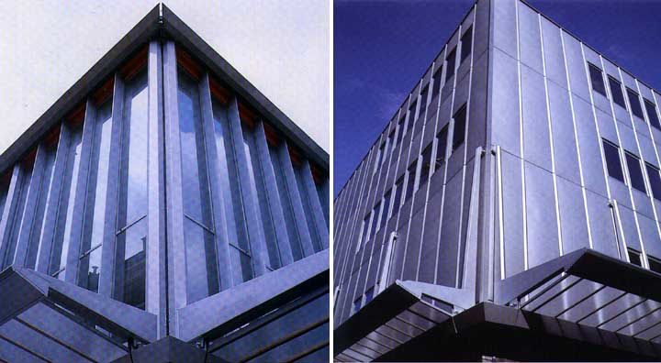
Maison du Peuple, Clichy, 1935-39 (Restoration, 1988)

Slide 42
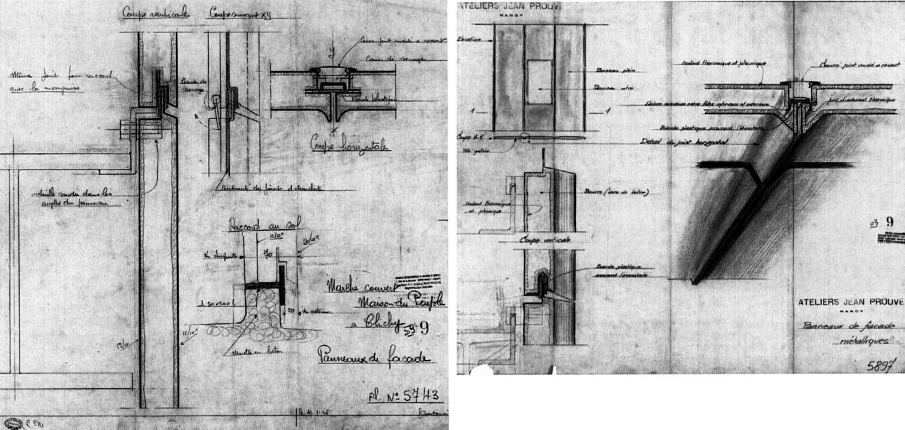
Maison du Peuple, Clichy, 1935-39

Slide 43
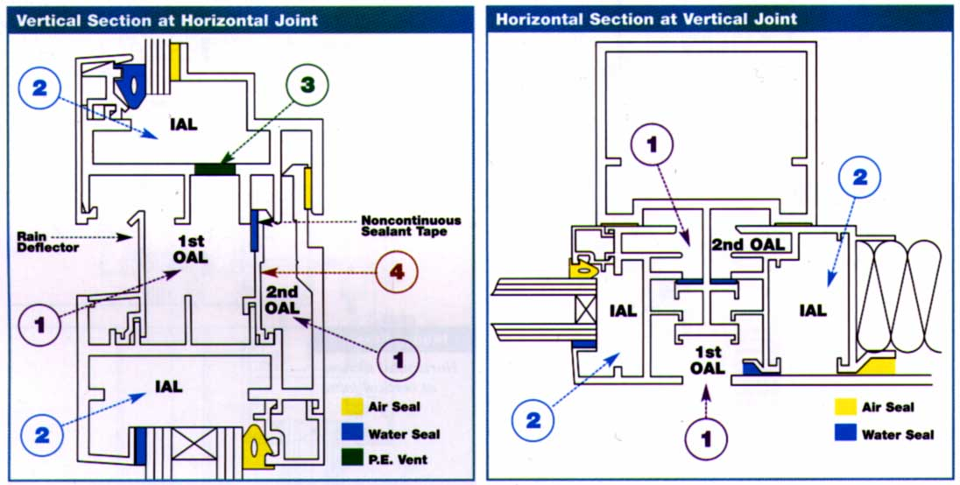
Ting Wall, Pittsburgh, 2001

Slide 44
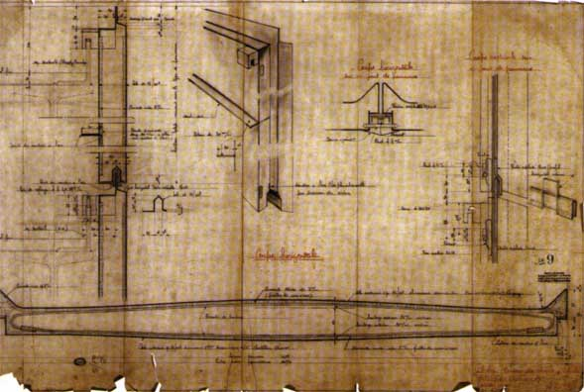
Maison du Peuple, Clichy, 1935-39

Slide 45
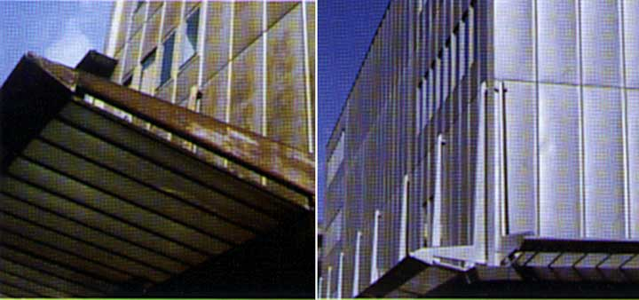
Maison du Peuple, Clichy, 1935-39 (Restoration, 1988)

Slide 46
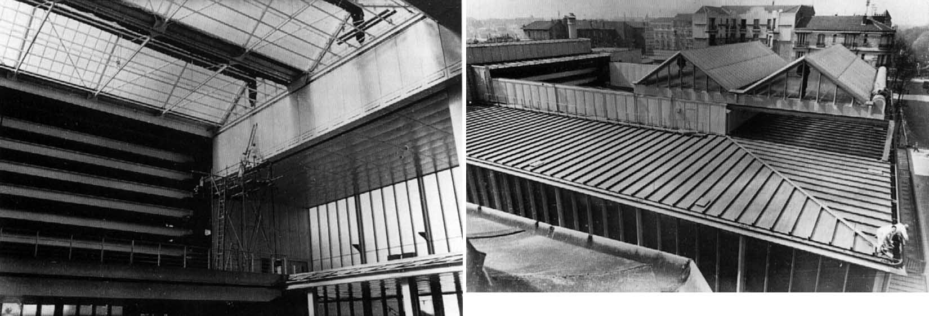
Moveable Skylight, Maison du Peuple, Clichy, 1935-39

Slide 47
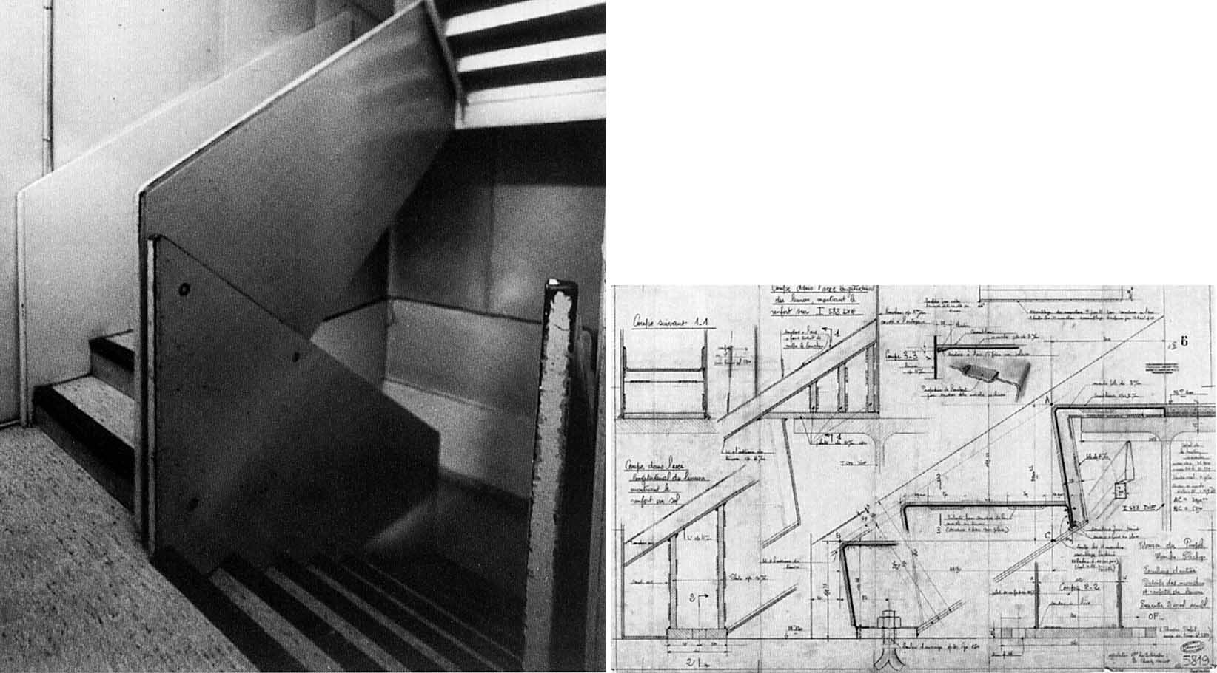
Maison du Peuple, Clichy, 1935-39

Slide 48
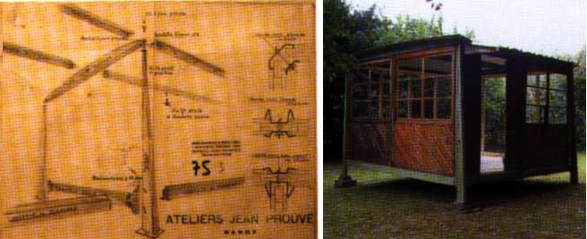
De-mountable Barracks, 1939
Factory Entrance, 1943-44

Slide 49
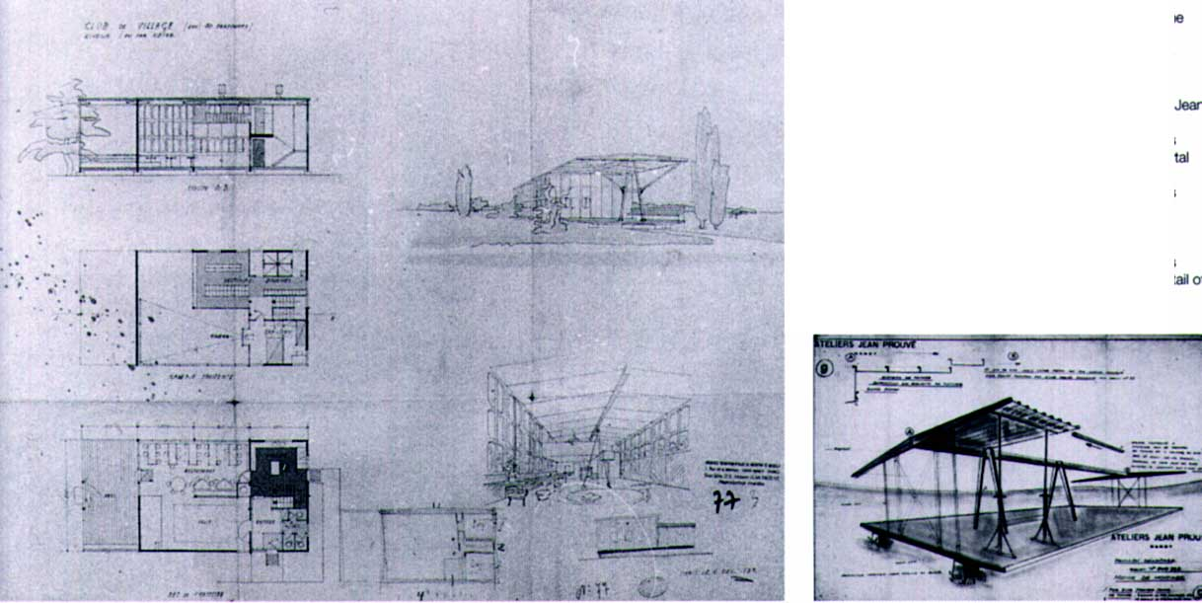
Pavilions for S.C.A.L., 1939-40

Slide 50
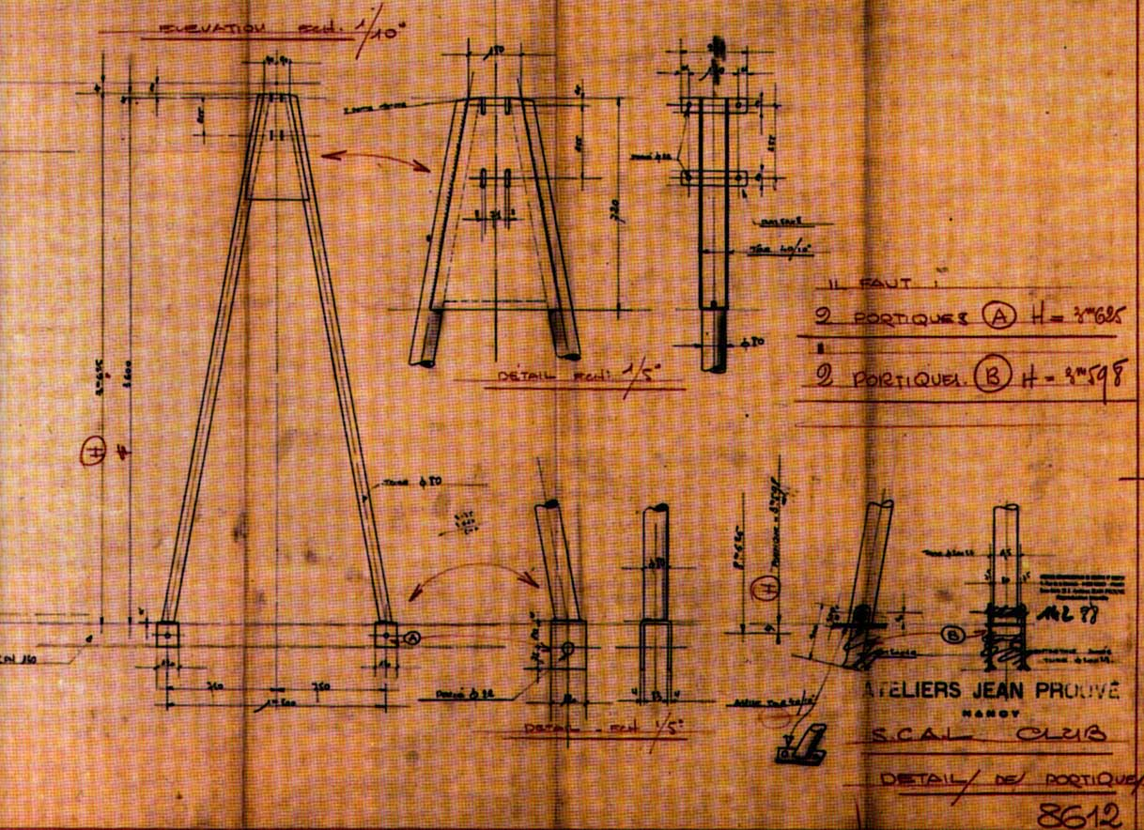
Pavilions for S.C.A.L., 1939-40

Slide 51
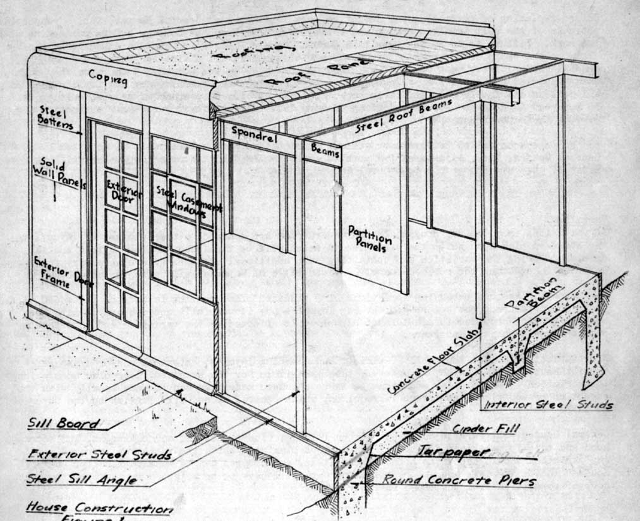
General House, Inc, 1937, Greenbelt, MD

Slide 52

General House, Inc, 1937, Greenbelt, MD

Slide 53

General House, Inc, 1937, Greenbelt, MD

Slide 54

General House, Inc, 1937, Greenbelt, MD

Slide 55

General House, Inc, 1937, Greenbelt, MD

Slide 56

Haller USM Mini, 1960’s and 1970’s

Slide 57
Conclusion
Prouvé pioneered new materials and techniques that would permit the efficient and inexpensive construction of objects and buildings with prefabricated components while retaining architectural quality and individuality.
His atelier process was collaborative and encouraged the individual to contribute to both the form making and the technology.

