Slide 1
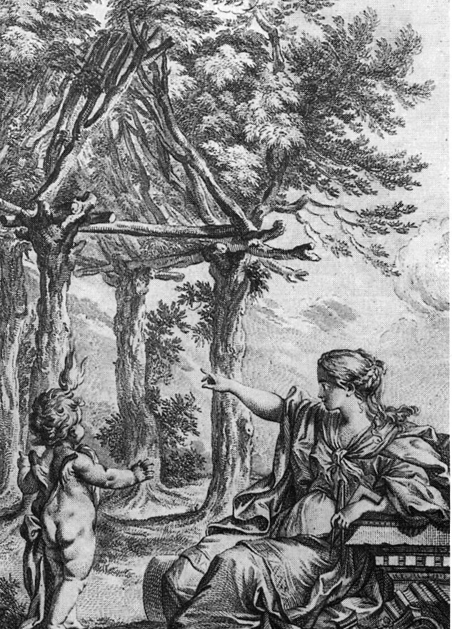
References:
The Tower and the Bridge
by David Billington
Bridging the Gap, Proceedings of
the Building Arts Forum
Zen & the Art of Motorcycle Maintenance by Robert Pirsig
Finding Form: Towards an Architecture of the Minimal by Frei Otto & Bodo Rasch

Slide 2
“But if you consider the present to be merely an instant between the past and the future, just a passing moment, then to neglect the past and future for the present is bad quality indeed.”
Pirsig, Robert; Zen and the Art of Motorcycle Maintenance; p.248

Slide 3
"The way to solve the conflict between human values and technological needs is not to run away from technology. That's impossible. The way to resolve the conflict is to break down the barriers of dualistic thought that prevent a real understanding of what technology is--not an exploitation of nature, but a fusion of nature and the human spirit into a new kind of creation that transcends both."
Pirsig, Robert; Zen and the Art of Motorcycle Maintenance

Slide 4
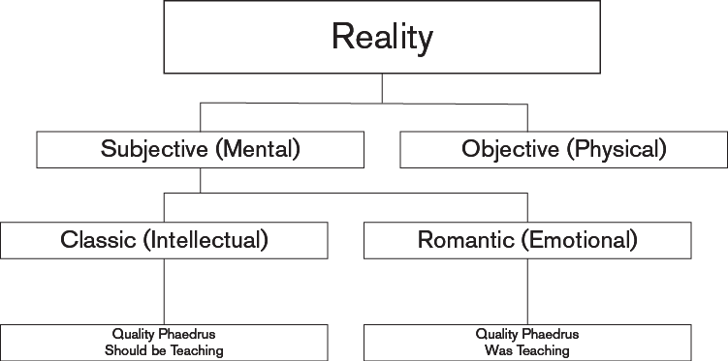
Pirsig, Robert; Zen and the Art of Motorcycle Maintenance; p.249
Notes:
Duality = mind + matter
Trinity = quality + mind + matter
Classic = past, present & future
Romantic = present only

Slide 5
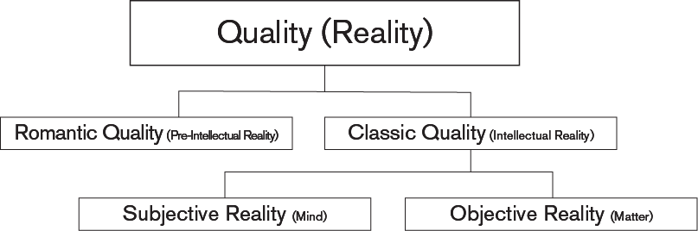
Pirsig, Robert; Zen and the Art of Motorcycle Maintenance; p.249

Slide 6
Eduard Sekler defined the tectonic as,
“…a certain expressivity

Slide 7
Expression (ik-SPRESH'uhn) n.
Definition --n.
1. The act of expressing, conveying, or representing in
words, art, music, or movement.
Express (ik-SPRES') tr.v.
Definition --tr.v. -pressed, -pressing, -presses.
4. To make a representation of; depict.
5. To represent by a sign or symbol; symbolize.
[American Heritage Dictionary Online]

Slide 8
Eduard Sekler defined the tectonic as,
“…a certain expressivity arising from the statical resistance of constructional form in such a way that the resultant form could not be accounted for in terms of structure and construction alone.”

Slide 9
Three Measures of Design Performance
Efficiency
  Scientific Dimension
  Use of Minimal Natural Resouces
Economy
  Social Dimension
  Use of Minimal Public Resources
  Must Consider Material Costs & Constructability
Elegance
  Symbolic Dimension
  Aesthetic Motivation of the Designer

Slide 10
Why Is This Important?
Environmental Impact of
Commercial & Residential Buildings:
  65.2% of total U.S. electricity consumption ¹
  30% of total U.S. greenhouse gas emissions ³
  136 million tons of construction and demolition waste in the U.S. (approx. 2.8 lbs/ person/ day) ⁴
  12% of potable water in the U.S. ⁵
  40% (3 billion tons/ yr) of raw materials use globally ⁶
Notes:
Footnotes:
1. U.S. Department of Energy, Energy Information Administration, March 2001, Monthly Energy Review.
2. Ibid.
3. U.S. Department of Energy, Energy Information Administration, “Emissions of Greenhouse Gases in the United States 1999.”
4. U.S. EPA, 1998, “Characterization of Building-Related Construction and Demolition Debris in the United States.”
5. U.S. Geological Service, 1995 data.
6. Lenssen and Roodman, 1995, “Worldwatch Paper 124: A Building Revolution: How Ecology and Health Concerns are Transforming Construction,” Worldwatch Institute.

Slide 11
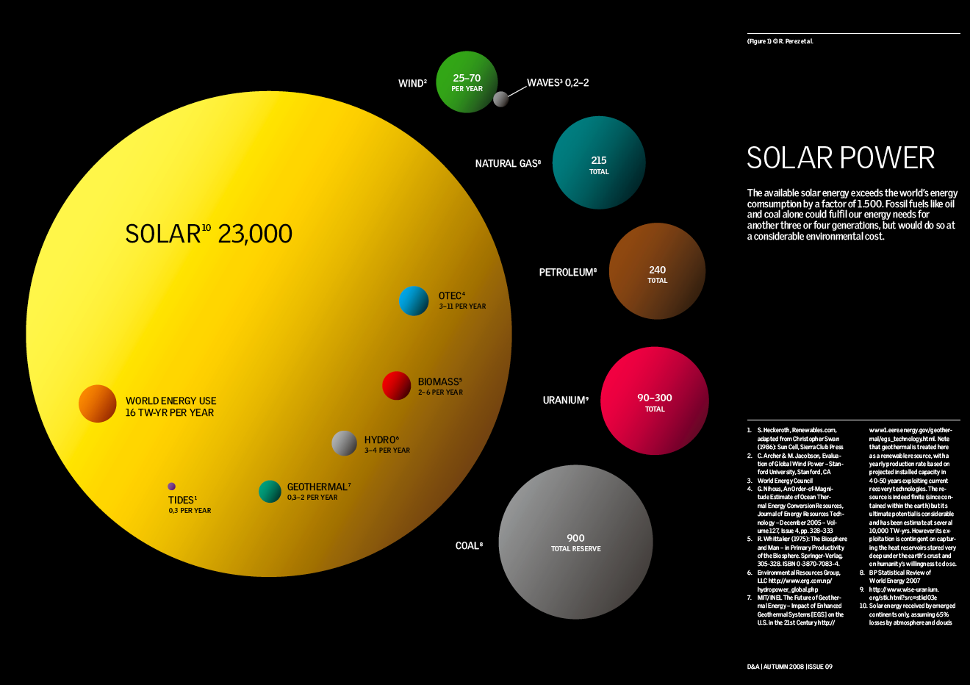
Notes:
Ocean Thermal Energy Conversion (OTEC)
Figure 1: Comparing finite and renewable planetary energy reserves (Terawatt- years). Total recoverable reserves are shown for the finite resources. Yearly potential is shown for the renewables.
REFERENCE
1.S. Heckeroth, Renewables.com, adapted from Christopher Swan (1986): Sun Cell, Sierra Club Press
2.C. Archer & M. Jacobson , Evaluation of Global Wind Power -- Stanford University, Stanford, CA
3.World Energy Council
4.G. Nihous, An Order-of-Magnitude Estimate of Ocean Thermal Energy Conversion (OTEC) Resources, Journal of Energy Resources Technology -- December 2005 -- Volume 127, Issue 4, pp. 328-3335.R. Whittaker (1975): The Biosphere and Man -- in Primary Productivity of the Biosphere. Springer-Verlag, 305-328. ISBN 0-3870-7083-4.
5.Environmental Resources Group, LLC http://www.erg.com.np/hydropower_global.php
7. MIT/INEL The Future of Geothermal Energy-- Impact of Enhanced Geothermal Systems [EGS] on the U.S. in the 21st Century http://www1.eere.energy.gov/geothermal/egs_technology.html -- based on estimated energy recoverable economically in the next 50 years. Ultimate high depth potential would be much higher.
8.BP Statistical Review of World Energy 2007
9. http://www.wise-uranium.org/stk.html?src=stkd03e R. Price, J.R. Blaise (2002): Nuclear fuel resources: Enough to last? NEA updates, NEA News 2002 – No. 20.2
10. Solar energy received by emerged continents only, assuming 65% losses by atmosphere and clouds

Slide 12
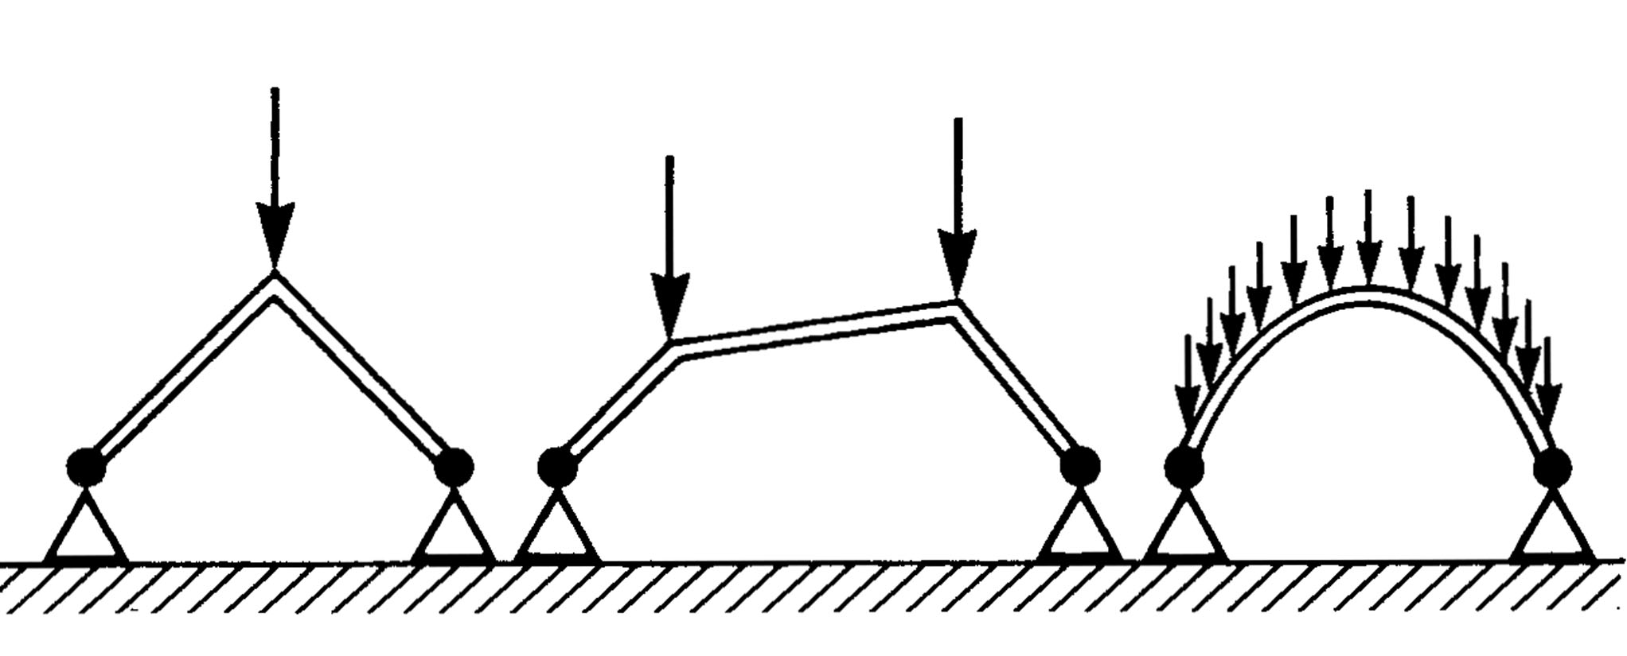
Efficiency
Form Controls the Forces
Form Changes the Actions & Reactions

Slide 13
Shaping Forces: Otto
Forms originate in all natural spheres
  in inanimate nature
  in animate nature
  in animal and human technology
  in art

Slide 14
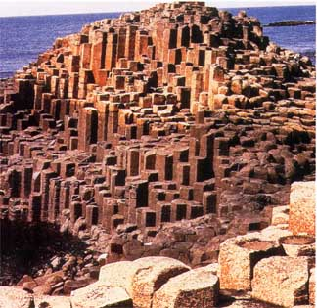
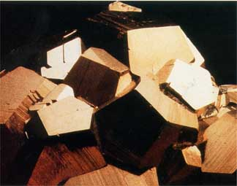
Shaping Forces: Inanimate Nature
Notes:
Basalt crystals & crystallization

Slide 15
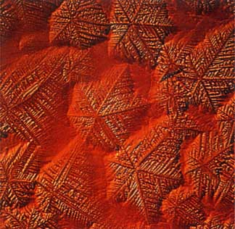
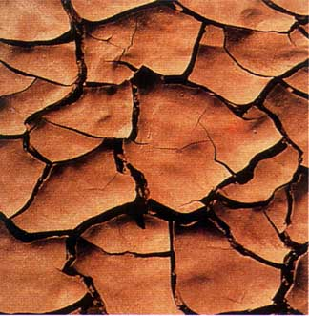
Shaping Forces: Inanimate Nature
Notes:
Crystal formation on surfaces (lead sulfide) & shrinkage cracks

Slide 16
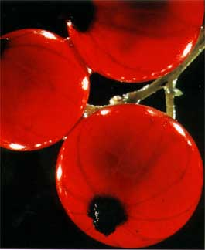
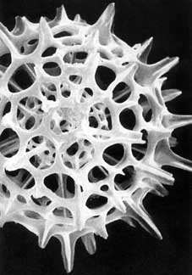
Shaping Forces: Animate Nature
Notes:
Berries & radiolaria

Slide 17
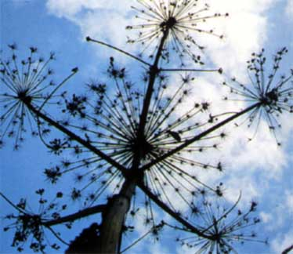
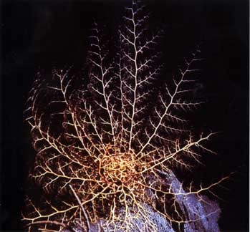
Shaping Forces: Animate Nature
Notes:
Ramification of non-woody plants & coral

Slide 18
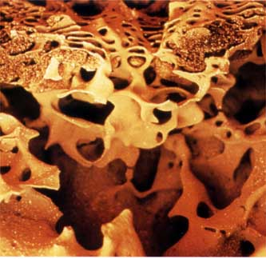
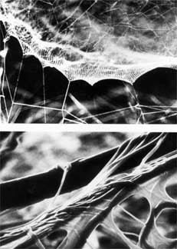
Shaping Forces: Animal Technologies
Notes:
Termites & spiders

Slide 19
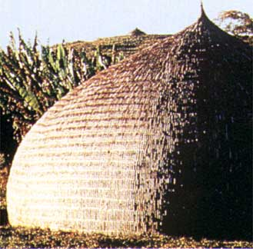
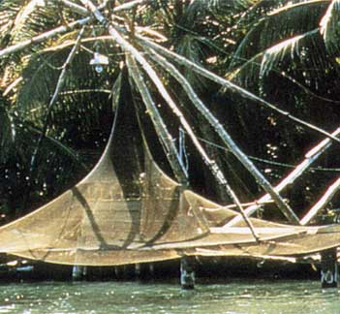
Shaping Forces: Human Technologies
Notes:
Woven reed huts & fishing nets

Slide 20
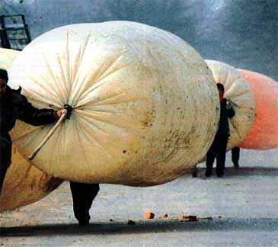
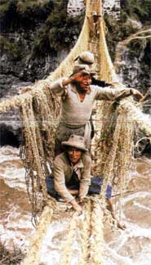
Shaping Forces: Human Technologies
Notes:
Methane gas bags & suspension bridge

Slide 21
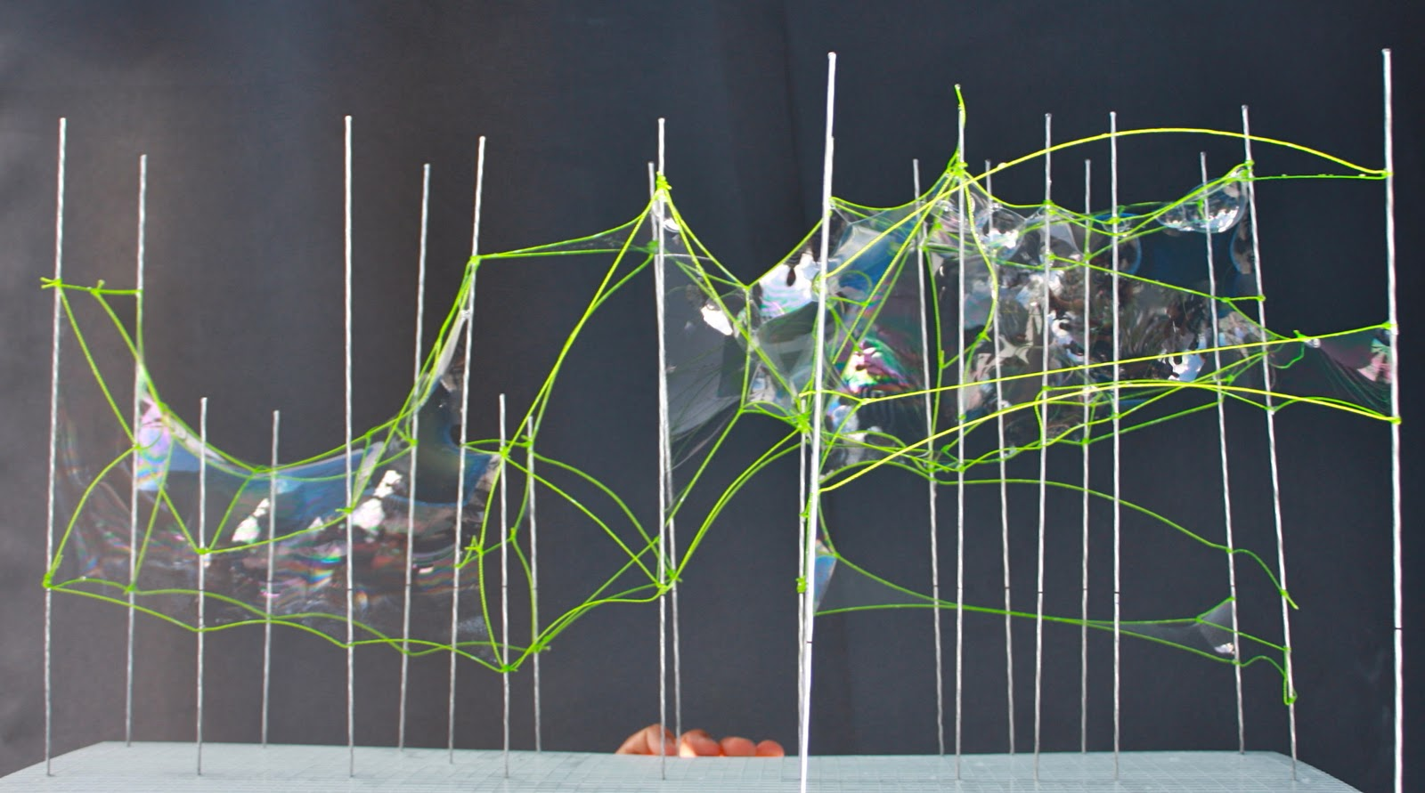
Self-formation Processes: Soap Films
Notes:
Methane gas bags & suspension bridge

Slide 22
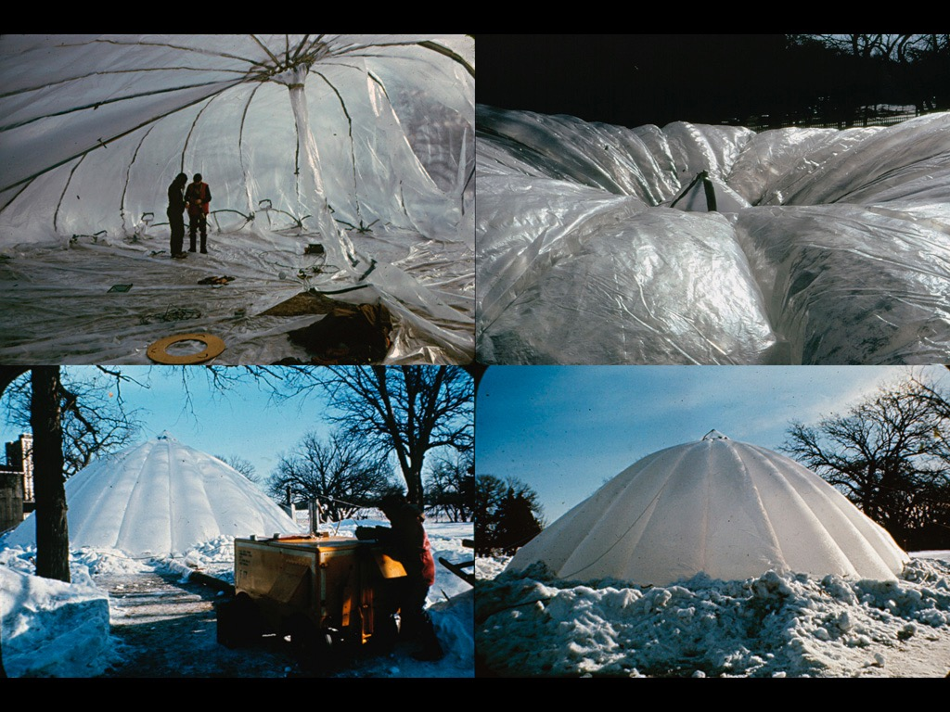

Slide 23
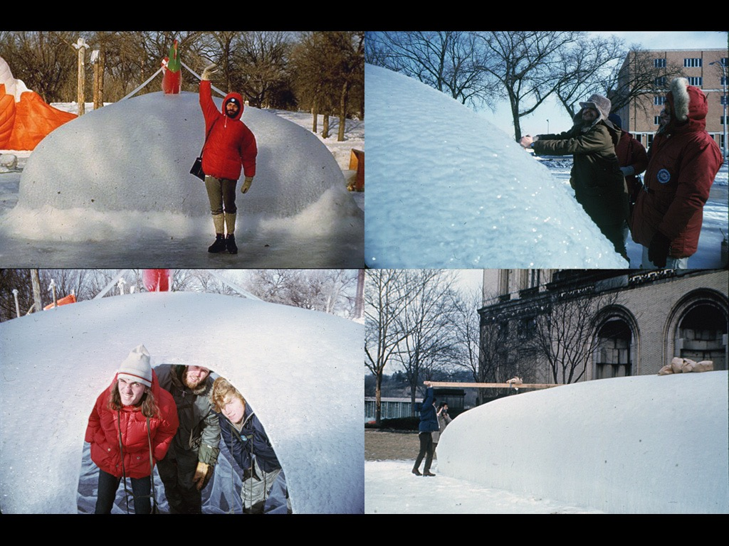

Slide 24
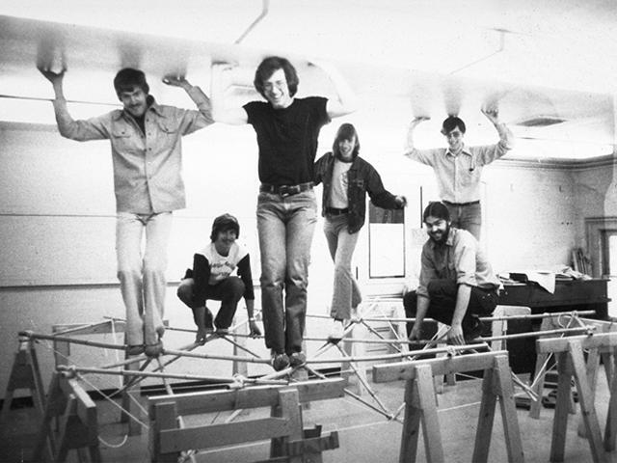

Slide 25
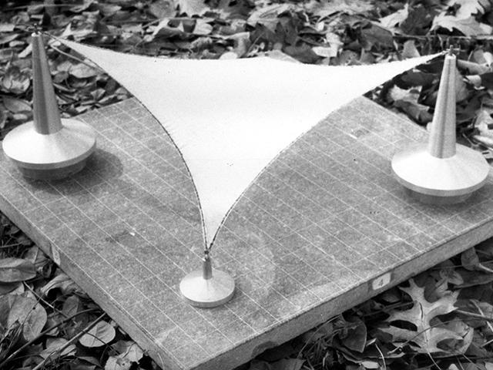

Slide 26
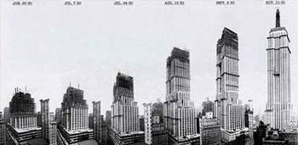
Economy
Dependent upon time & place
Quantities are measurable but…
labor & bidding process are not

Slide 27
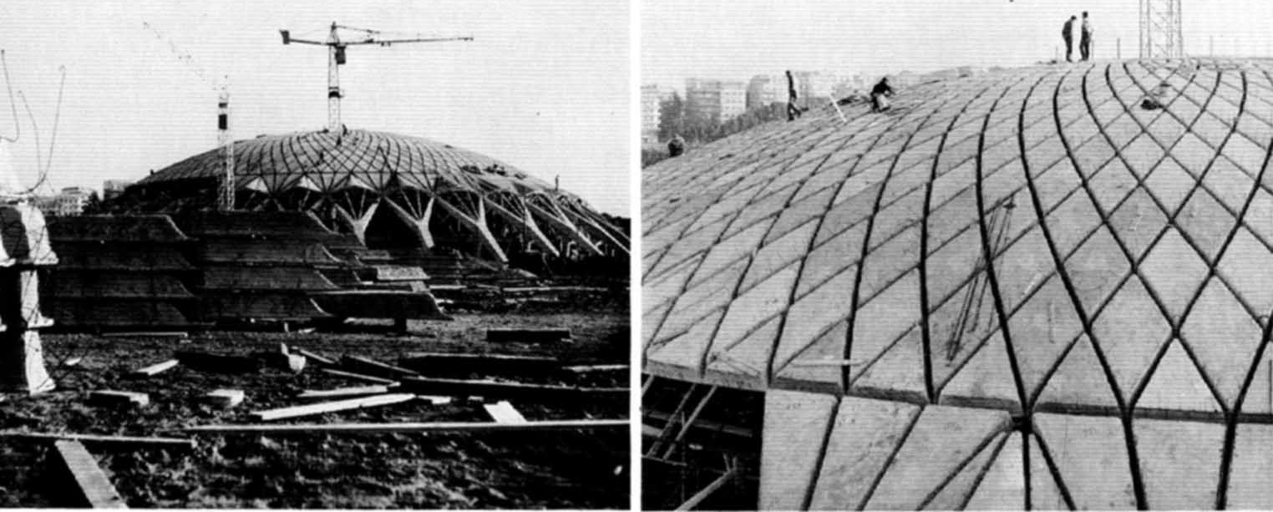
Nervi
A builder and designer of new forms
  “..searching for solutions that were intrinsically and constructionally the most economic..”

Slide 28
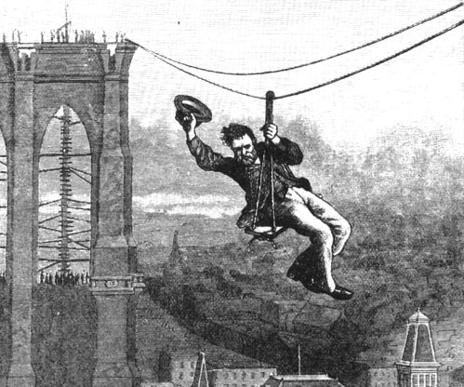
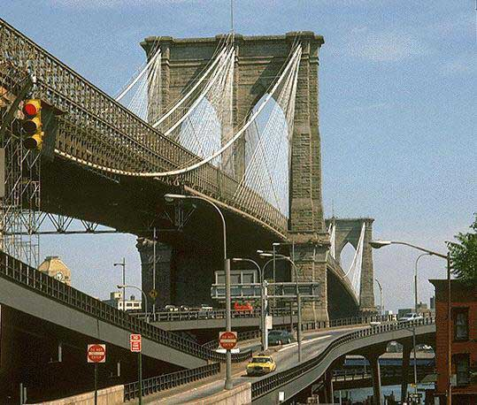
Constructability
Roebling
numerous dwgs & studies of construction methods

Slide 29
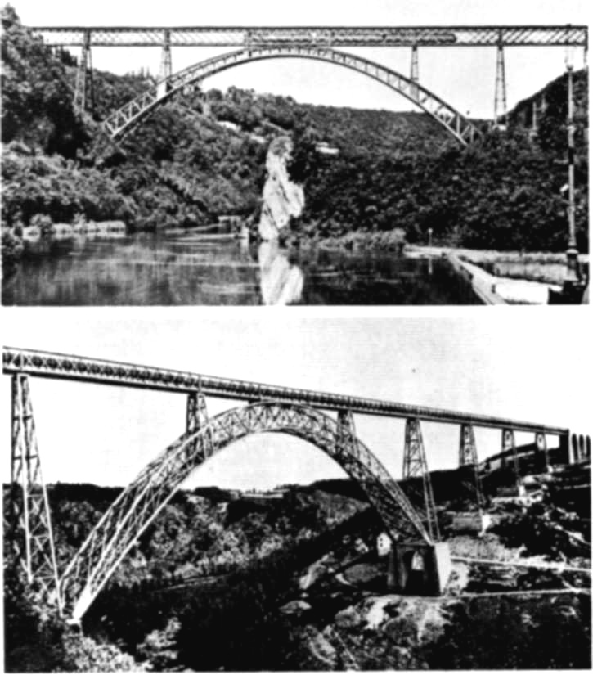
Constructability
Eiffel
  5000 dwgs of parts & assembly techniques
  close relationship w/ contractor to refine design
    Pia Maria bridge -> Garabit Viaduct
  Span: 165m, Material: wrought iron

Slide 30
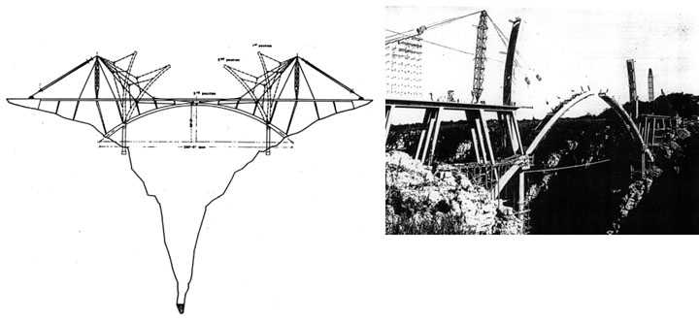
Constructability
Morandi
  detailed investigations of construction process
  Span: 100m, Rise: 20m, Ravine Depth: 110m

Slide 31
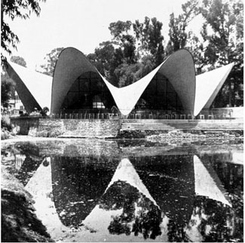
Candela
Hyperbolic paraboloid concrete shells
  “ ..the only way to be an artist in this difficult specialty of building is to be your own contractor.”

Slide 32
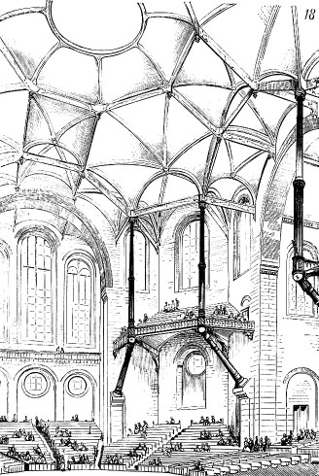
Elegance (Aesthetics)
Some aesthetic ideas can be traced back to Viollet le Duc, Entretiens, (1863, 1872)
Theories on the importance of structural expression and construction techniques

Slide 33
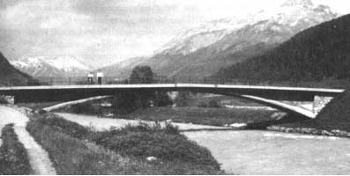
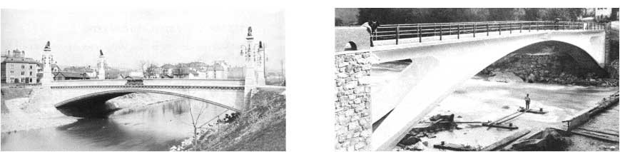
Robert Maillart
evolution of three-hinged concrete arch bridges
visual & empirical methods
Zuoz Bridge, 38.3m
Stauffacher Bridge, 39.6m
Tavanasa Bridge, 51m

Slide 34
Another thought…..
In theory, there is no difference between theory and practice, but in practice there is.
  Jan L. A. van de Snepscheut, 1953–1994

Slide 35
Three Aspects of the Relationship between Engineering & Architecture
Schism
Collaboration
Synthesis

Slide 36
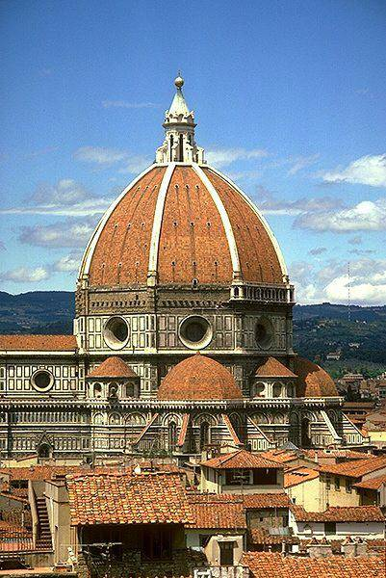
Schism
separation between architect, engineer and constructor
pre-schism architect was the “Master Builder” ie Brunelleschi

Slide 37
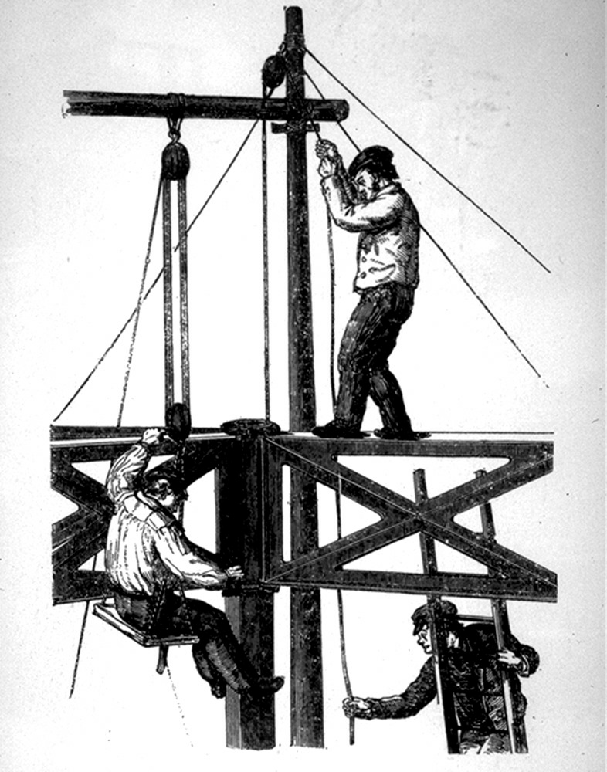
What Lead to the Schism:
  Industrial Revolution introduced new materials, methods & aspirations
  specialized schools were established
    Ecole des Beaux Arts
    ETH, Zurich
  architectural curricula focused on:
    visual methods & product
  engineering curricula focused on:
    numeric methods & process

Slide 38
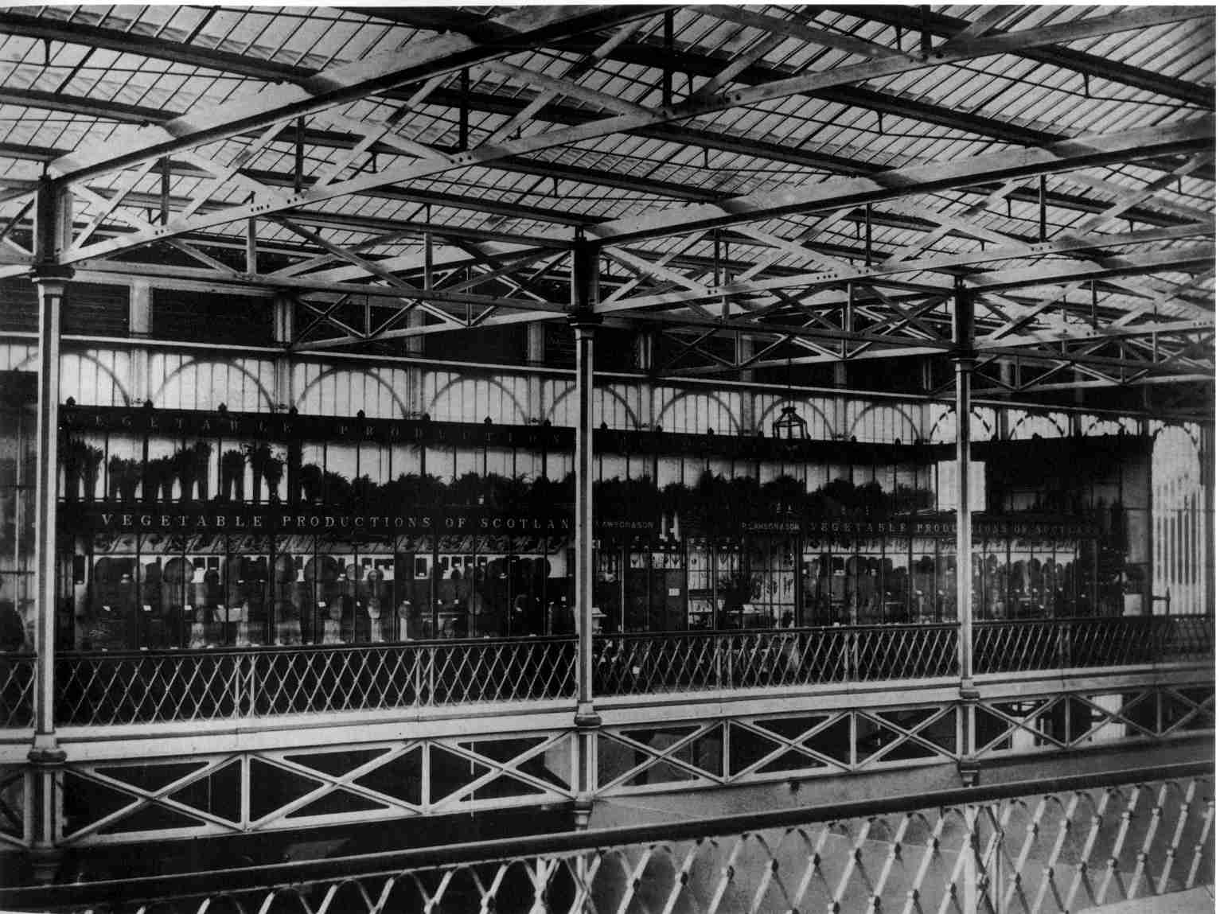
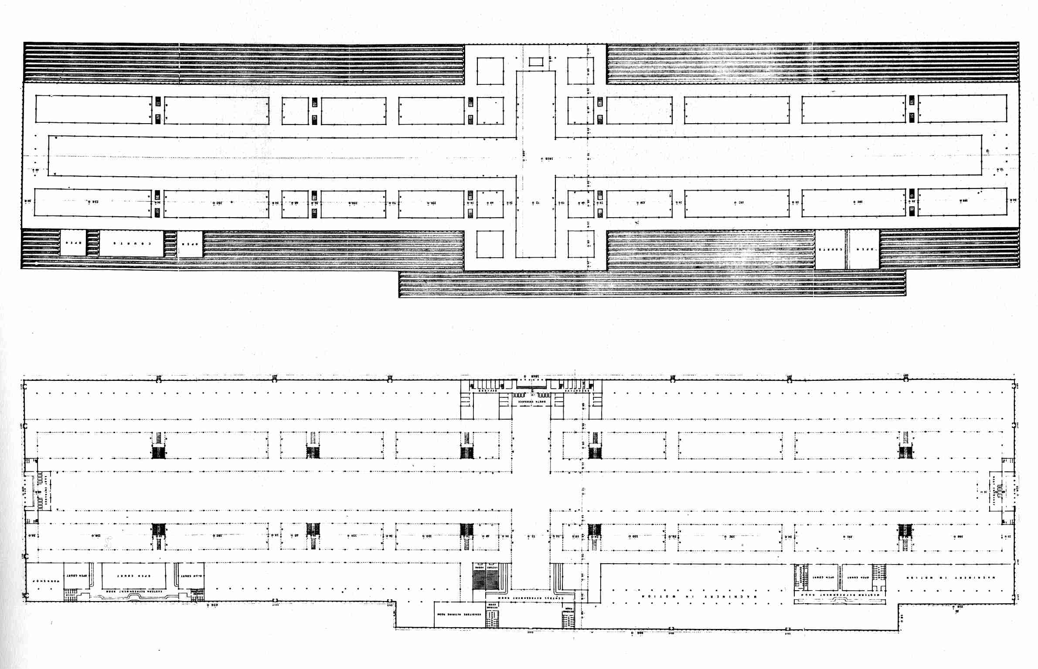

Slide 39
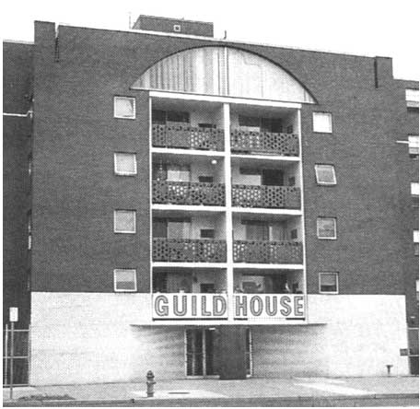
Role of the Architect Today
Venturi: “The Decorated Shed”

Slide 40
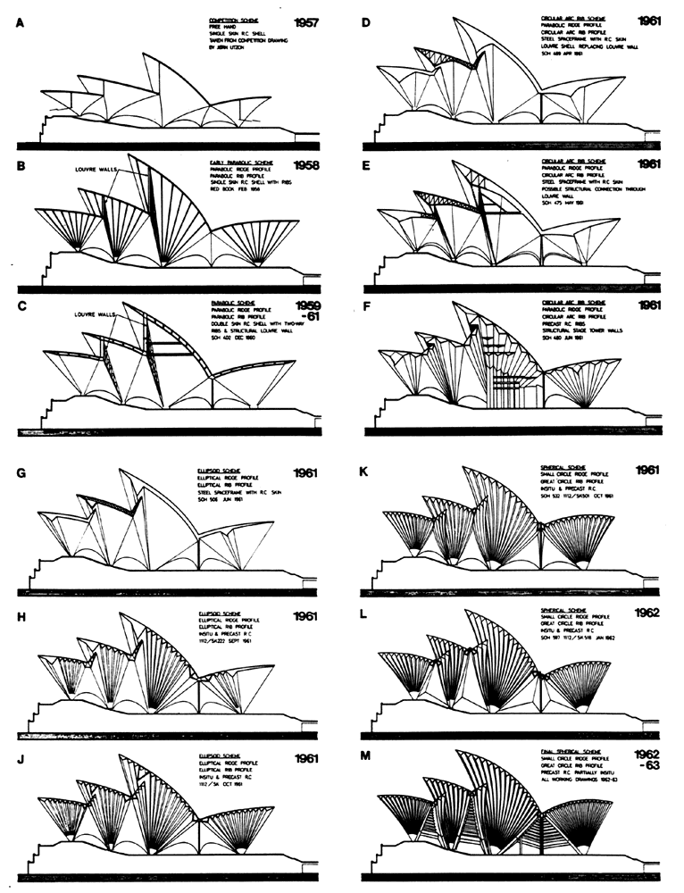
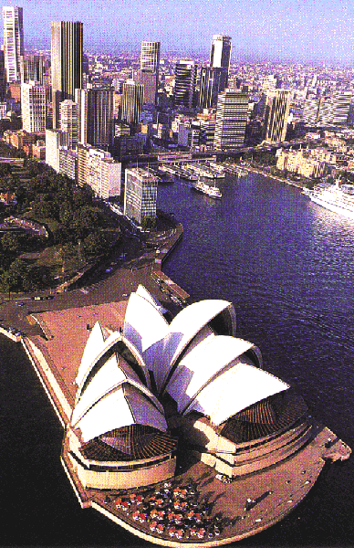
Role of the Architect Today
Jorn Utzon, Sydney Opera House

Slide 41
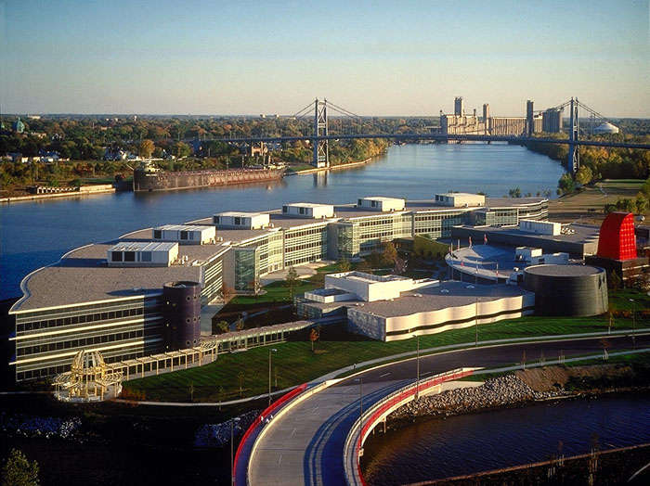
Role of the Architect Today
Owens Corning HQ:
Toledo, OH
  CMU CBPD team
  exterior architect
  interior architect
  production drawing architect
  curtainwall architect
  engineering disciplines
  construction manager

Slide 42
Role of the Engineer Today
technician vs innovator
synthesis of scientific & empirical knowledge
debate is raging over appropriate curriculum

Slide 43
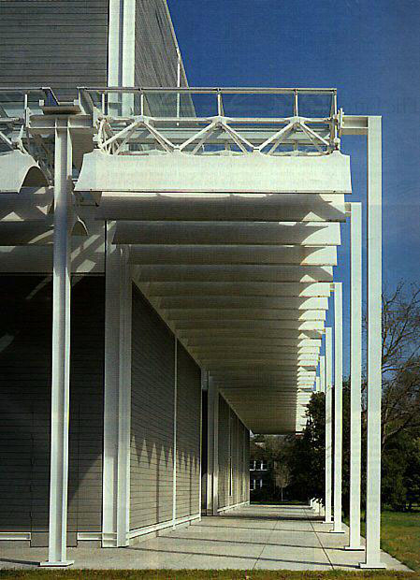
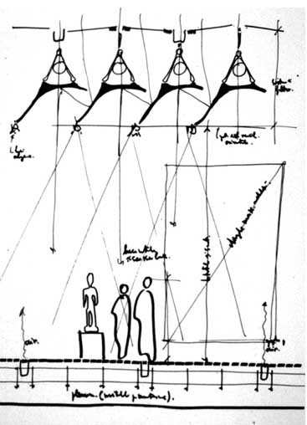
De Menil Gallery: Piano & Rice

Slide 44
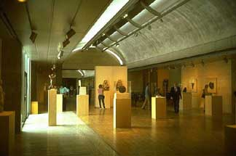
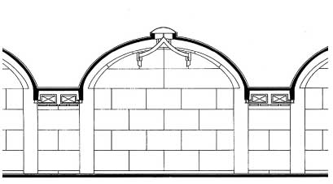
Kimball Art Museum:
Kahn & Kommendant
Is it a Barrel Vault
or
is it an Inverted “T”?

Slide 45
Collaboration
a close working relationship between individuals from different backgrounds
mutual respect
common vocabulary

Slide 46
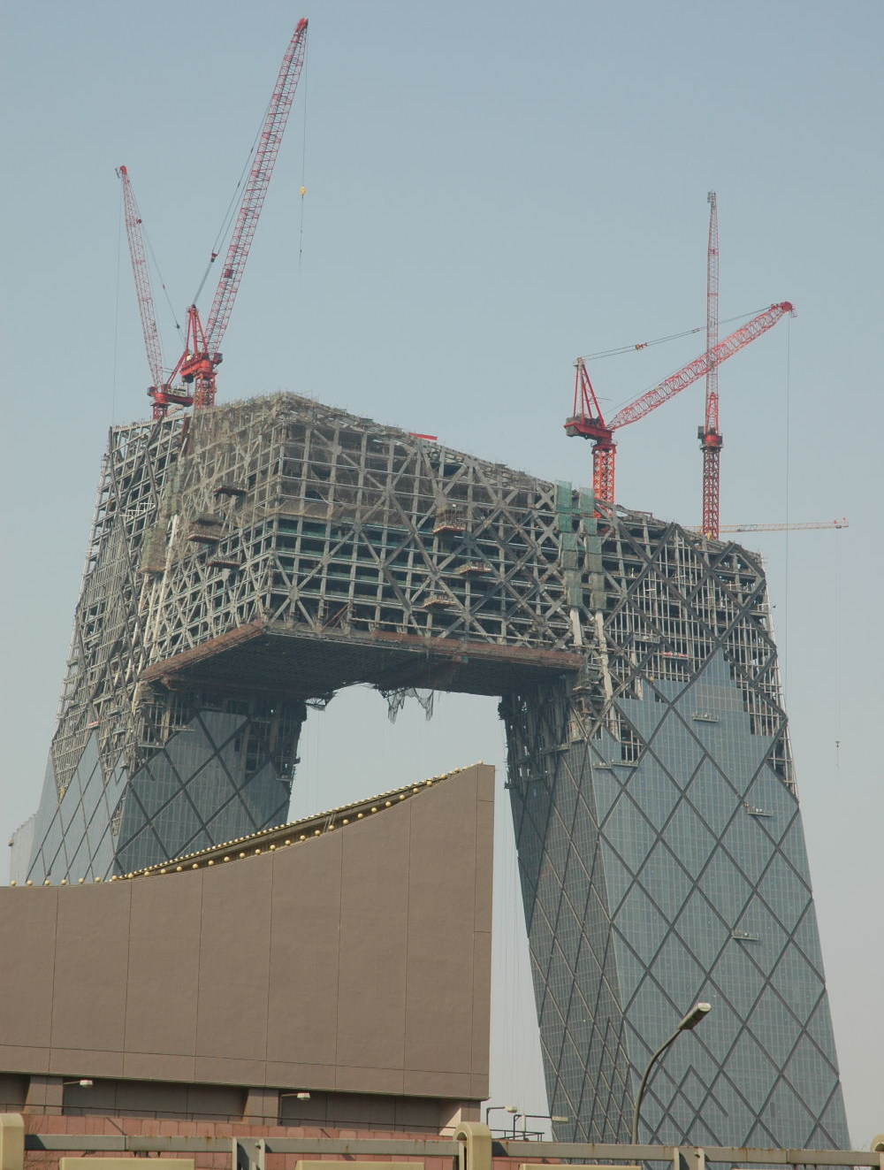
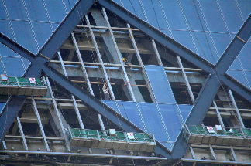
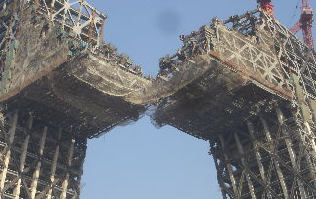
CCTV:
Koolhaus + Arup

Slide 47
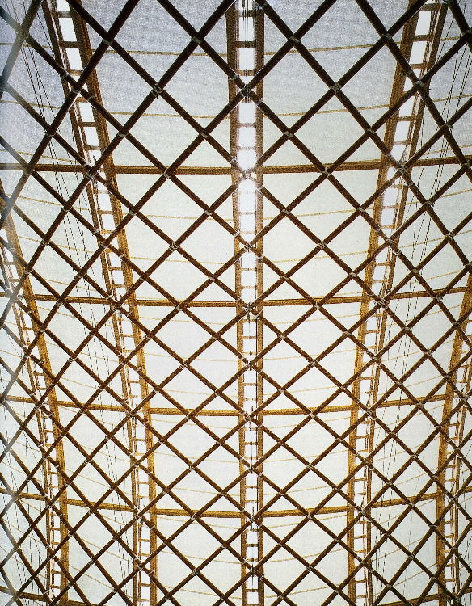

Japan Pavilion Expo 2000:
Buro Happold + Ban + Otto

Slide 48


BMW Welt:
Coop Himmelb(l)au + B&G

Slide 49

Mercedes Museum:
UN Studio + Werner Sobek

Slide 50

Soumaya Museum:
LAR + Fineout + Gehry Technologies

Slide 51

Soumaya Museum:
LAR + Fineout + Gehry Technologies

Slide 52

Soumaya Museum:
LAR + Fineout + Gehry Technologies

Slide 53

Soumaya Museum:
LAR + Fineout + Gehry Technologies

Slide 54

Synthesis: Can there be a modern day “master builder”?
Notes:
Nervi, Candela, Wright, Rogers, Calatrava

Slide 55

Can the synthetic process be one of skillful coordination?
  Specialists and manufacturers are taking a bigger role in the process
  Maki, Fujisawa, Gymnasium Roof
  Ando, Mt Rokko Chapel, Ground Glass
  Foster, Hong Kong Shanghai Bank

Slide 56

Synthesis
Can we transfer technologies and solutions from other disciplines?
  NASA, composites, ceramics, polymers

Slide 57
Synthesis
Can the synthetic process be a redefinition of the problem?
  Traditional process
    client, architect, builder
    design - bid - build
  Owens Corning Process
    CM hires specialized disciplines

Slide 58
Conclusion
No definitive answers
CMU curriculum helps to expose you to these issues so that you are better prepared for the future but,
  while you have architects & engineers for teachers you do not collaborate with engineering students in the studio
Push yourselves to understand the relationship between engineering & architecture through the vehicle of this studio

