Slide 1
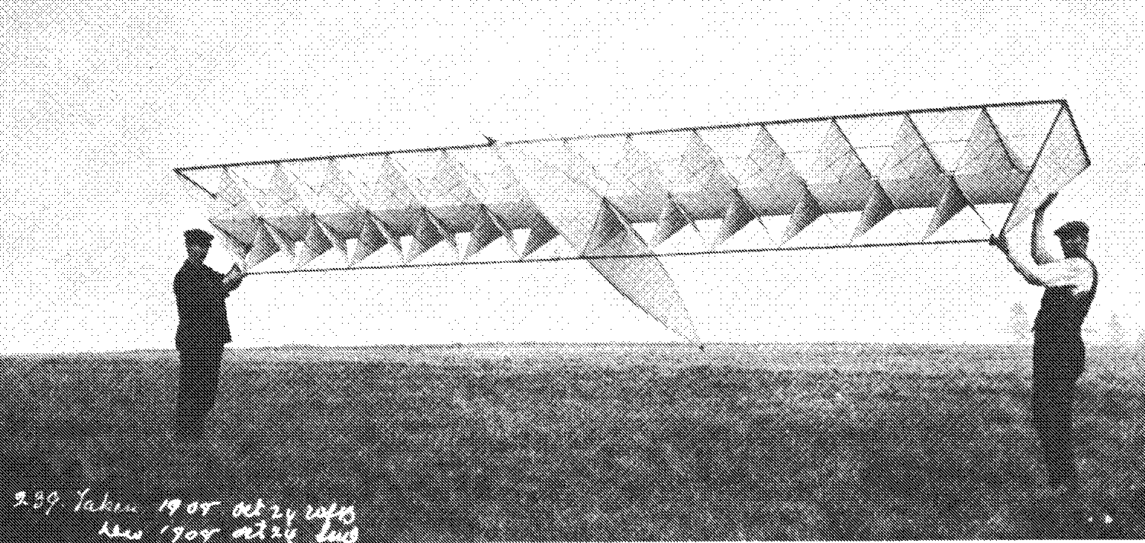
R. Buckminster (Bucky) Fuller
References:
Your Private Sky, R. Buckminster Fuller, The Art of Design Science ed. by J.Krausse & C.Lichtenstein
Far From Equilibrium, Essays on Technology & Design Culture by Sanford Kwinter
Buckminster Fuller: Poet Of Geometry by Cole Gerst

Slide 2
Philosophy
KW & RBF shared a lot from a technical & methodological the point of view, yet…
were very different ideologically
  Fulller repudiated history in favor of nature…..
  Wachsmann revered history, the ultimate source of tectonic inspiration
  Fulller sought the universally applicable invention…
  Wachsmann saw in the Crystal Palace and the Gothic cathdrals a paradigm to which all subsequent bldgs should aspire

Slide 3
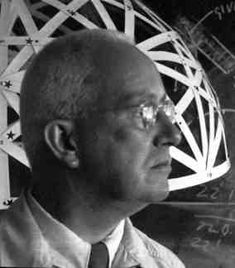

Slide 4
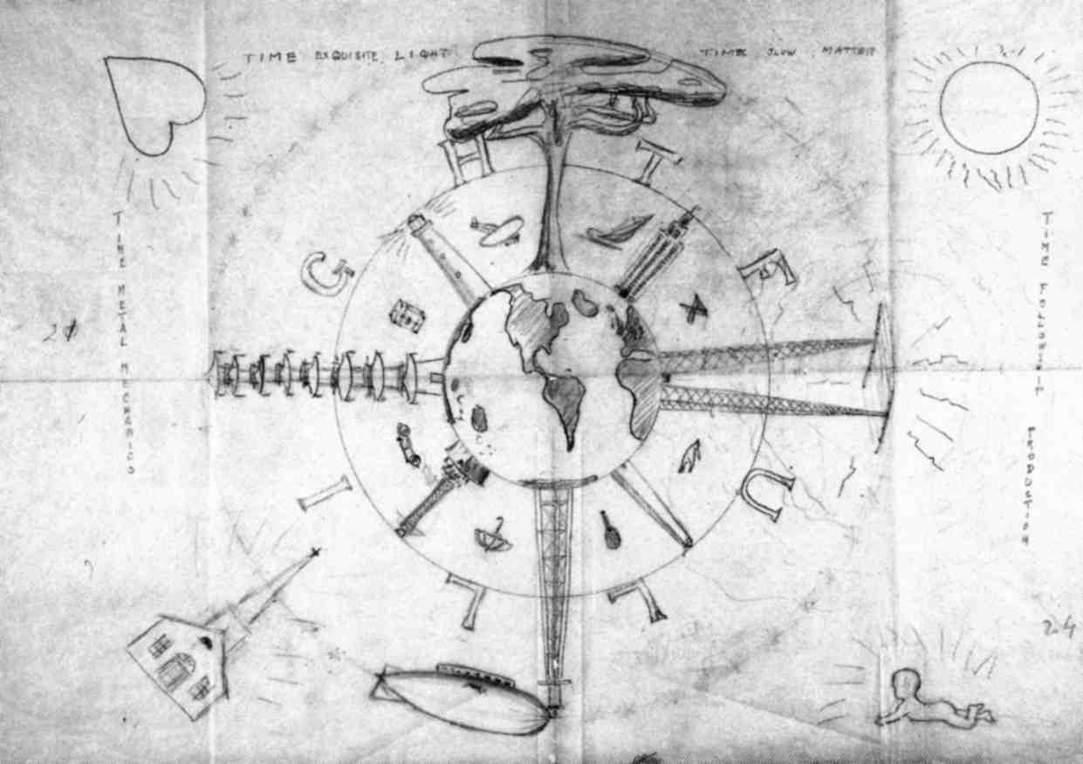
Lightful Houses

Slide 5
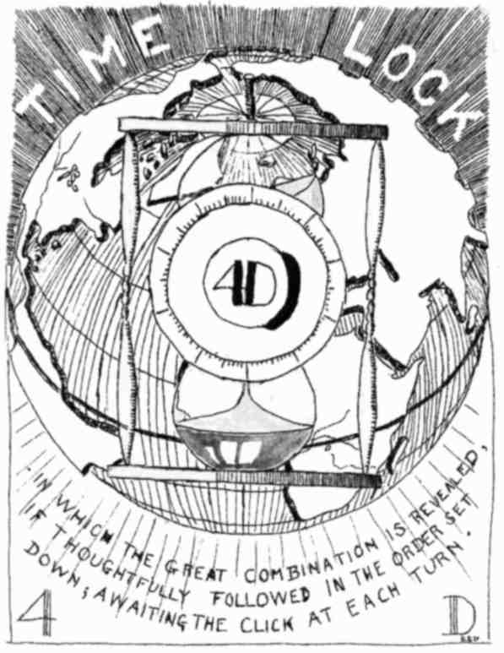
Book Cover

Slide 6
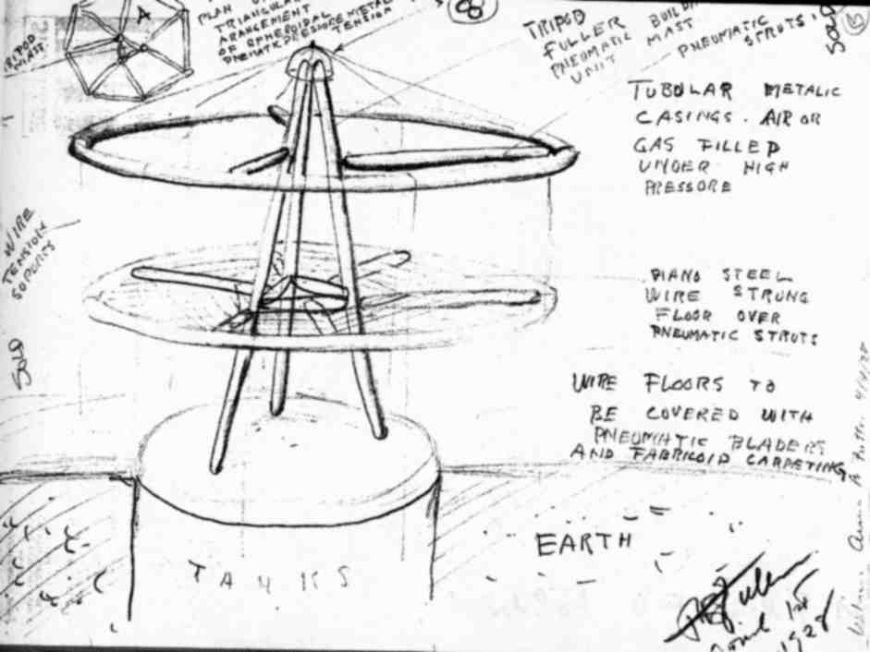
Benefits of Chassis Construction

Slide 7
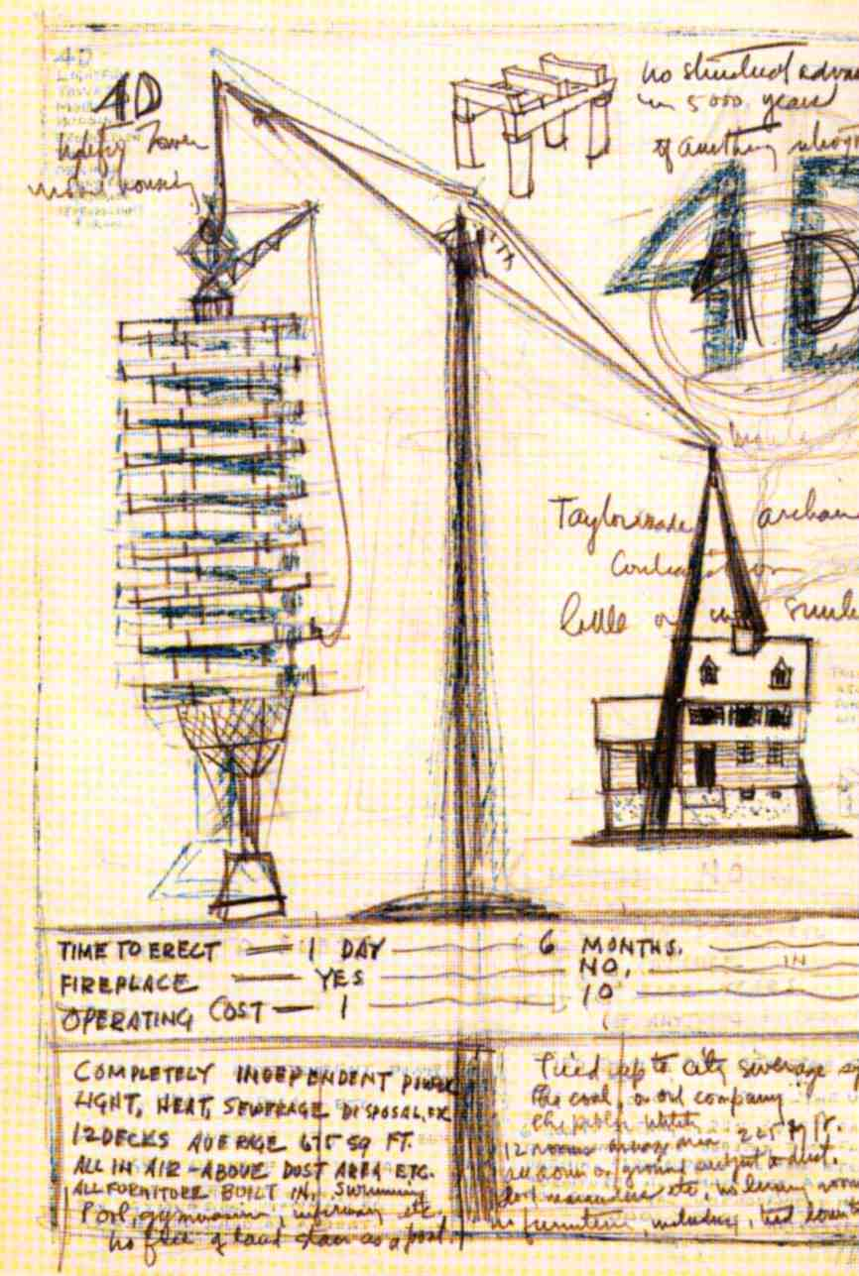
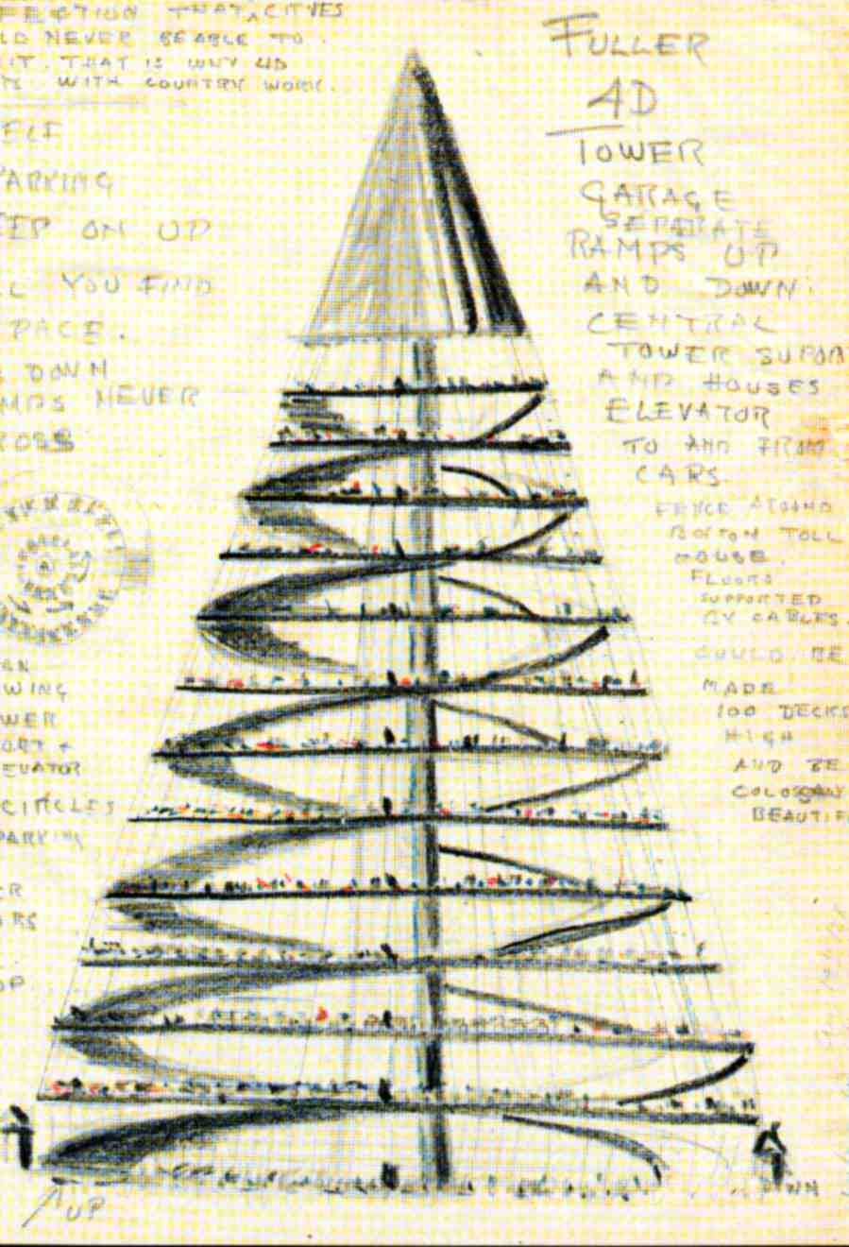
4D Construction

Slide 8

Zeppelin Excavation

Slide 9
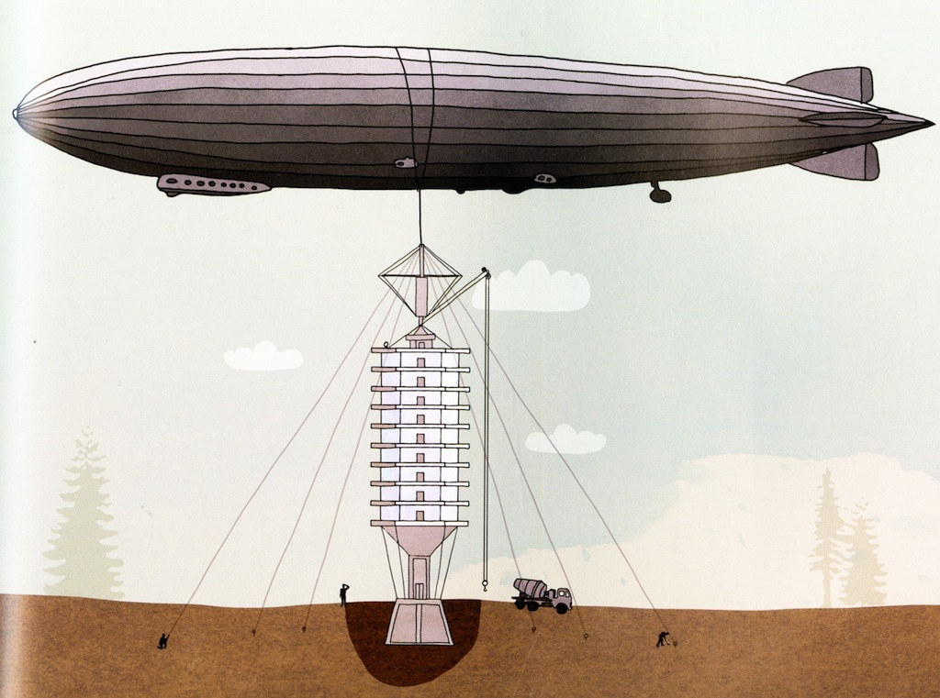
Zeppelin Erection

Slide 10
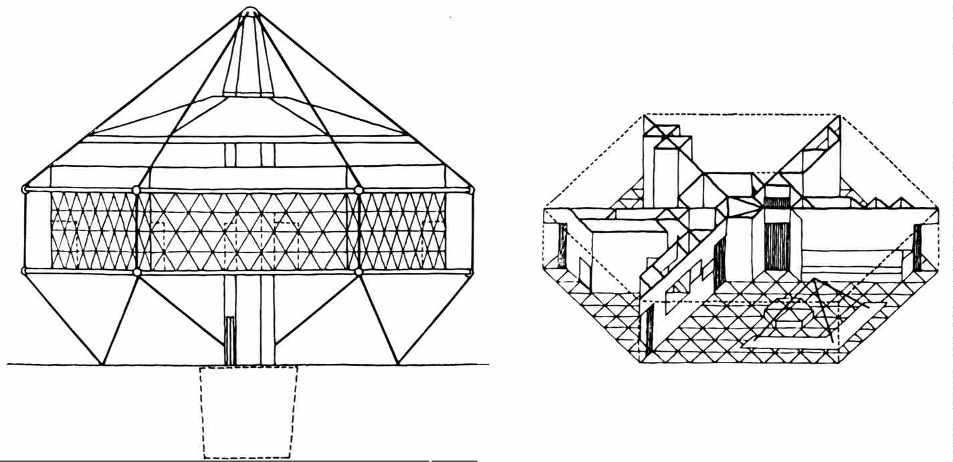
Dymaxion House; 1927-29
Dymaxion = “Dynamic Maximum Tension”

Slide 11
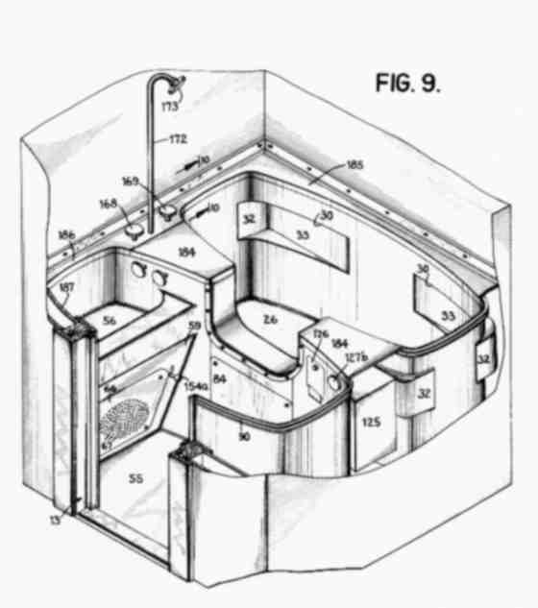
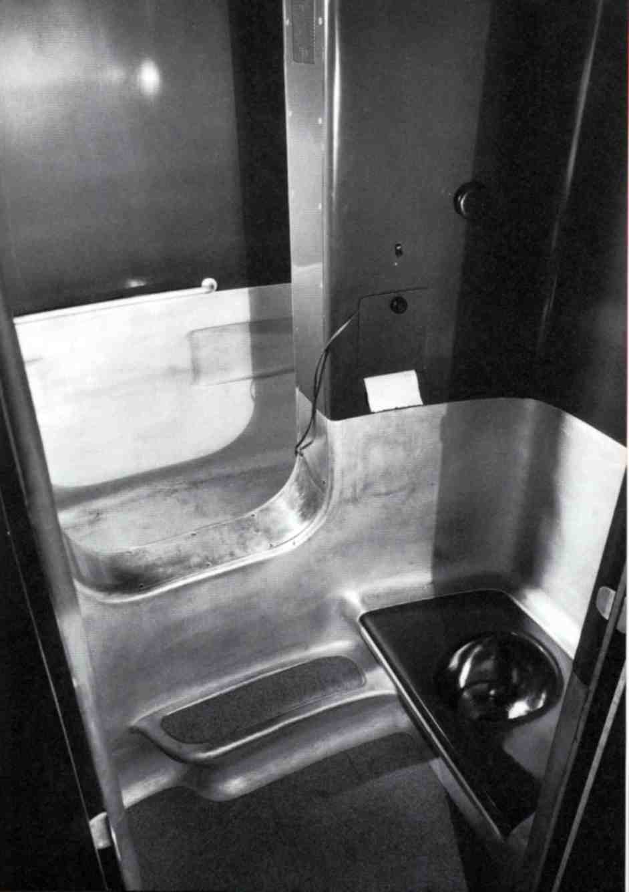
Dymaxion Bathroom

Slide 12
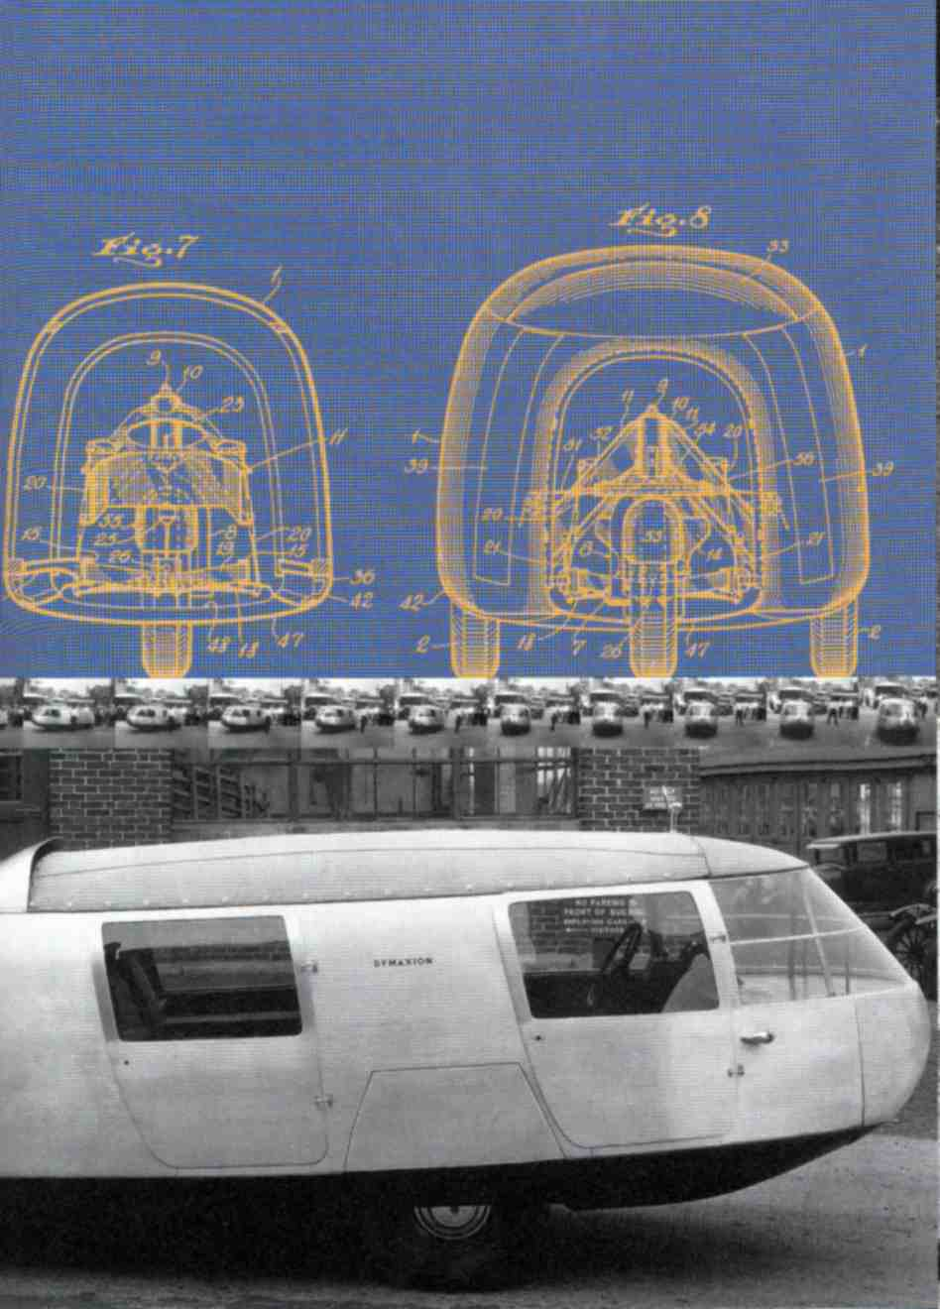
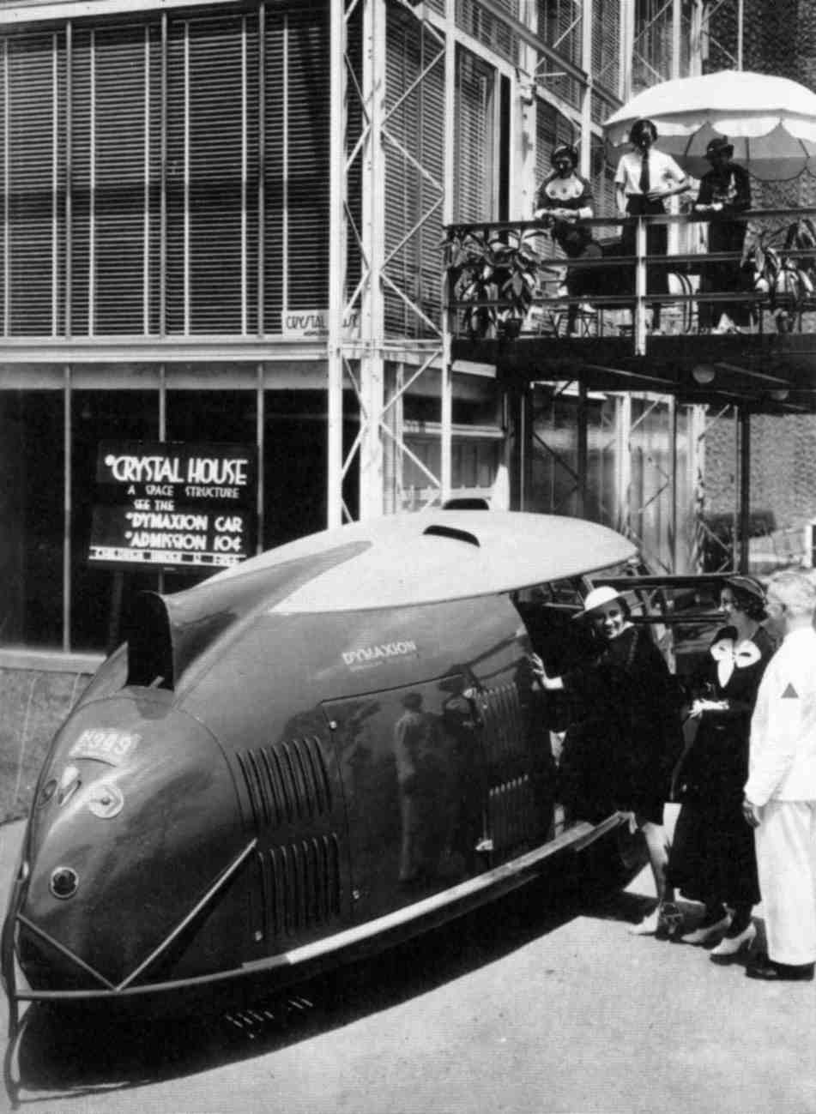
Dymaxion Car

Slide 13
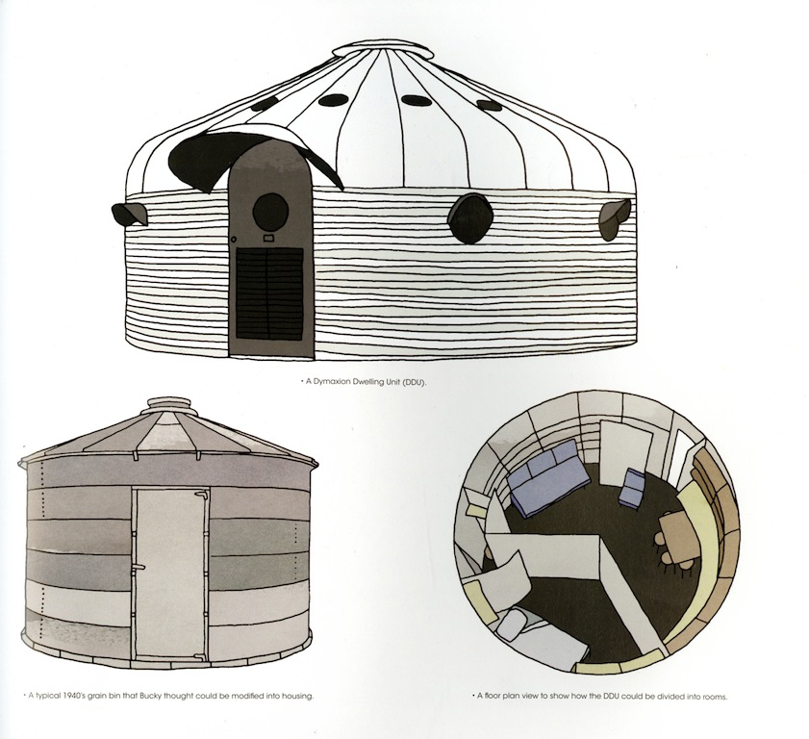
Grain bins as a precedent for housing

Slide 14
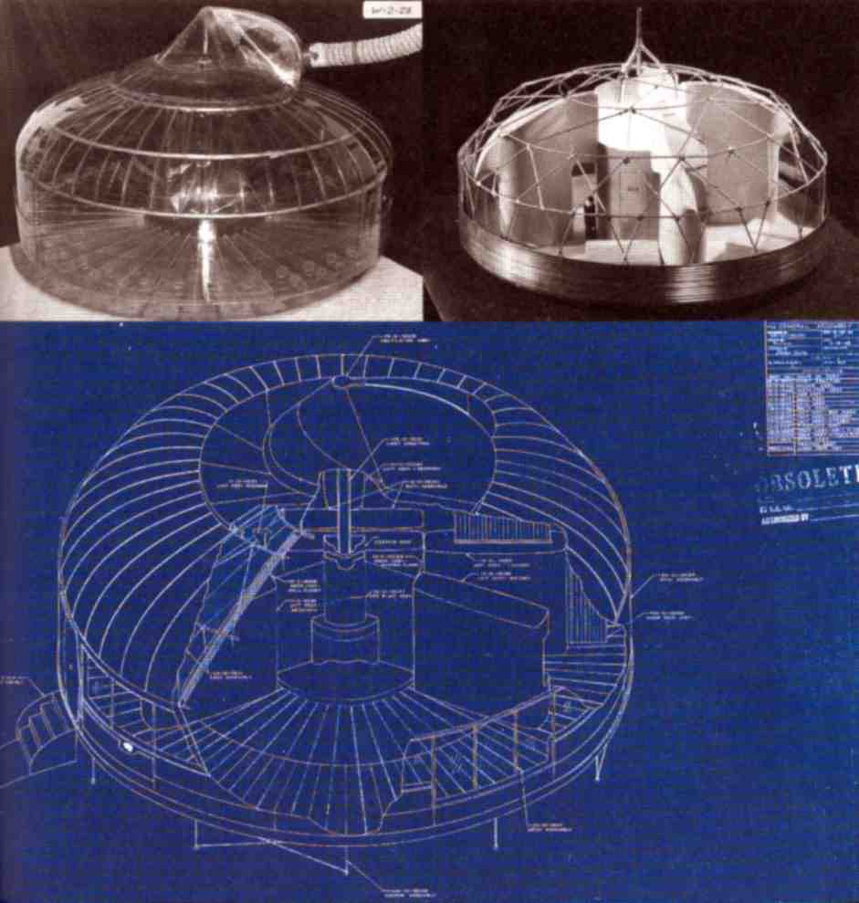
Wichita House

Slide 15
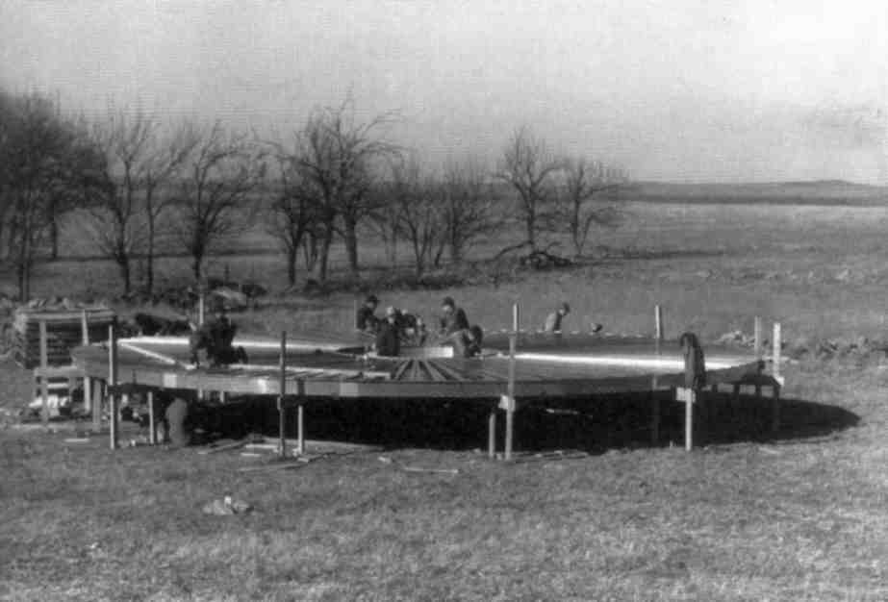
Wichita House Erection

Slide 16
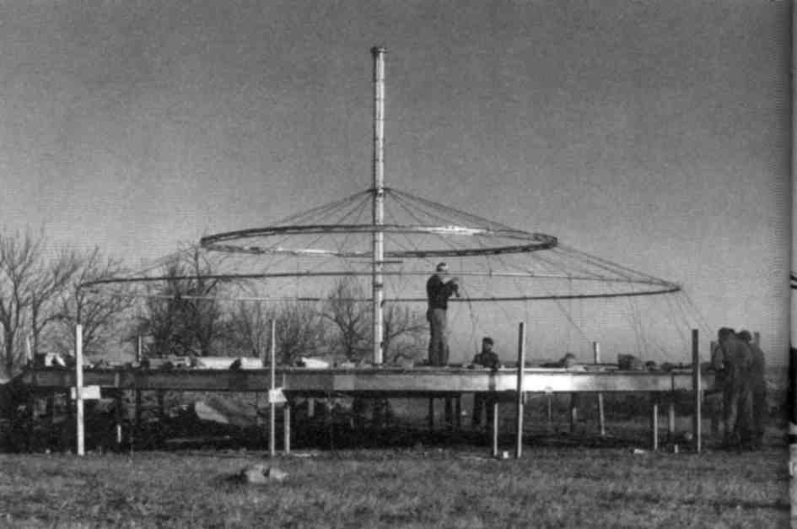
Wichita House Erection

Slide 17
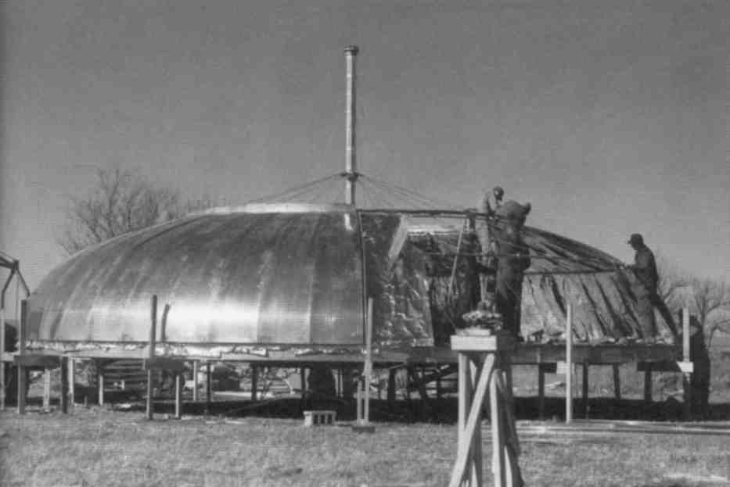
Wichita House Erection

Slide 18
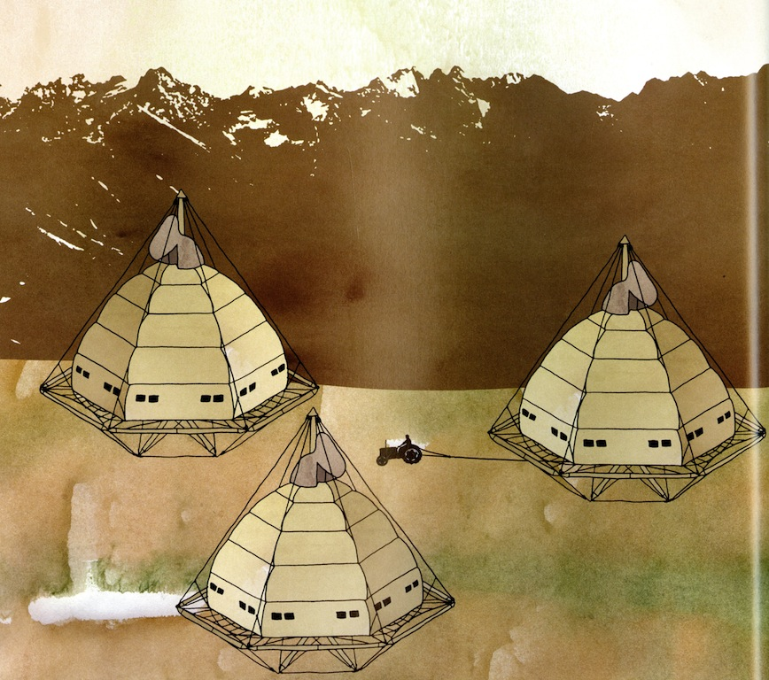
Wichita House Tractors

Slide 19
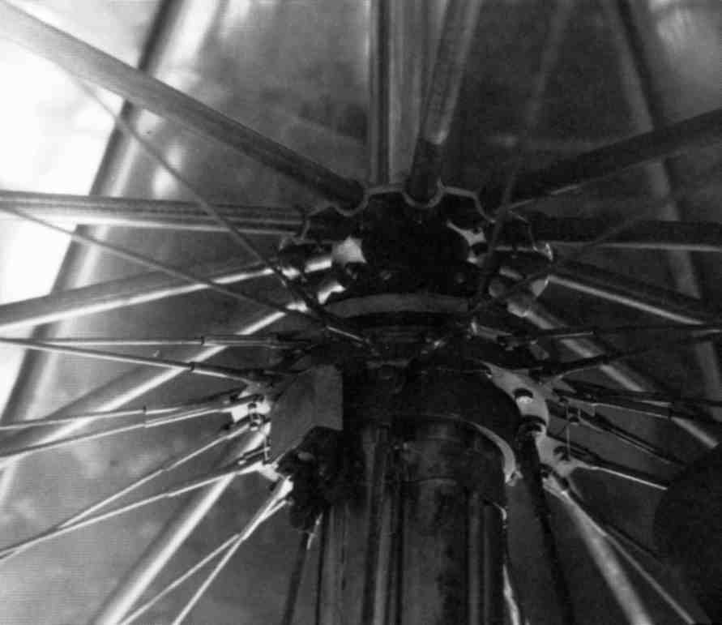
Wichita Hub Detail

Slide 20
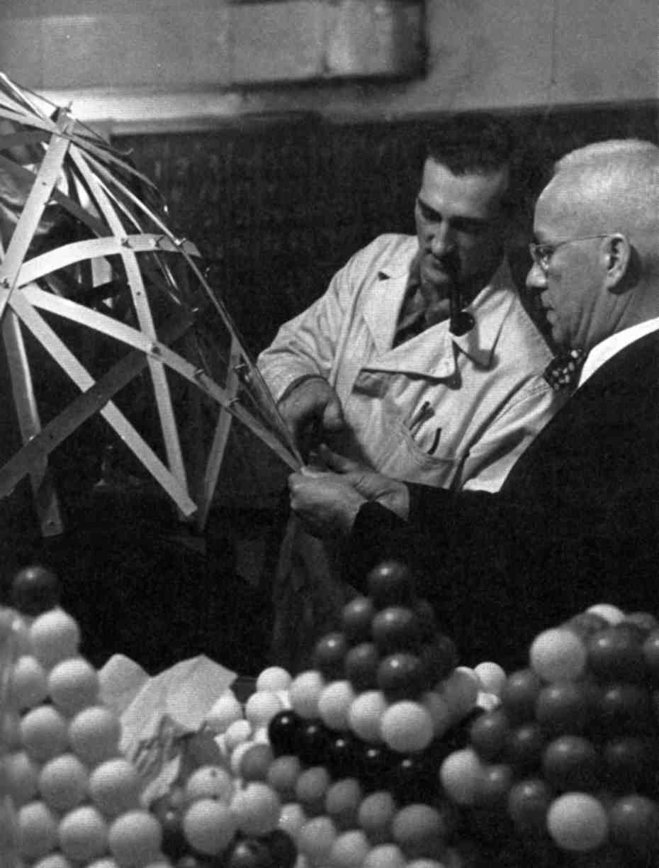
Bucky’s Research

Slide 21
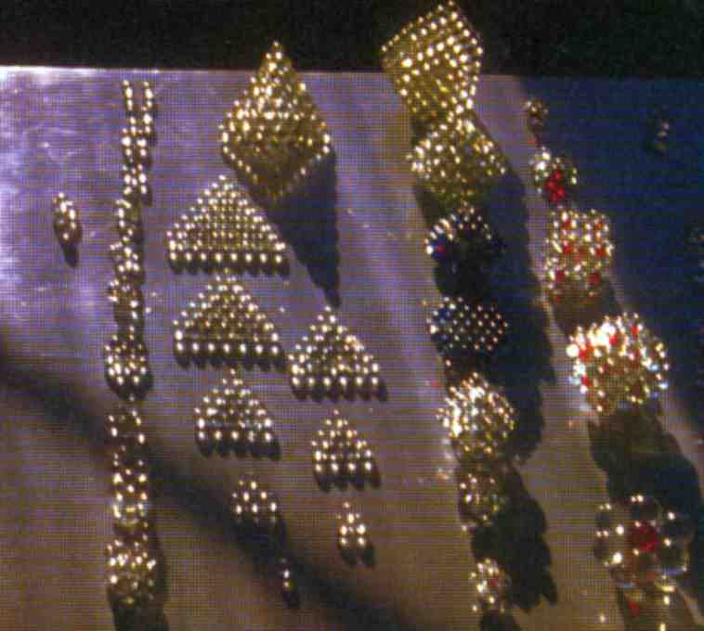
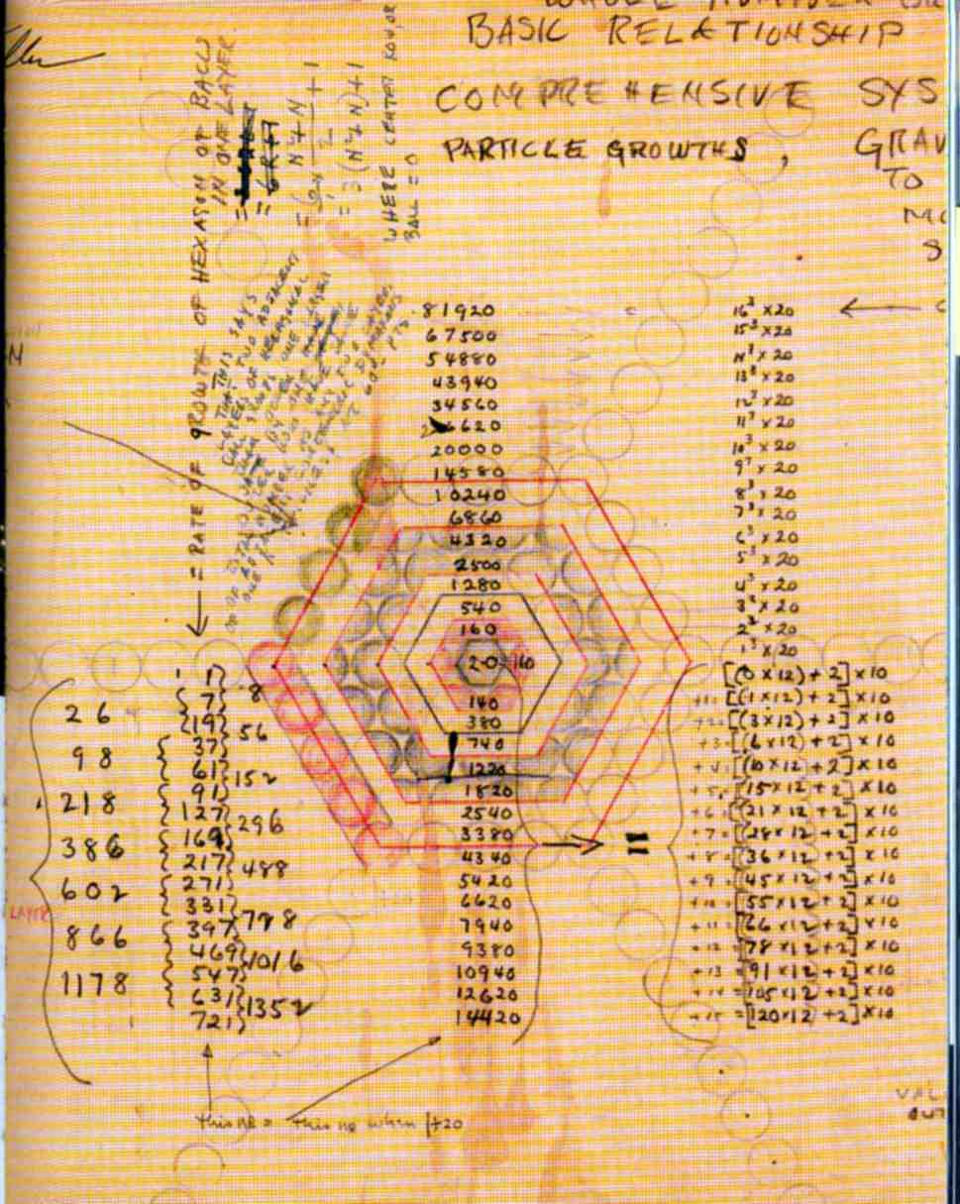
Close Packing Spheres

Slide 22
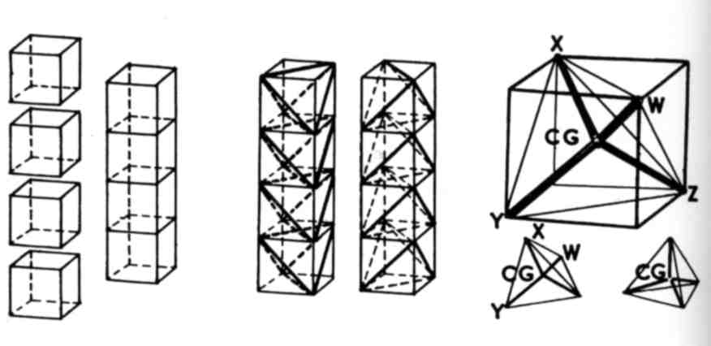
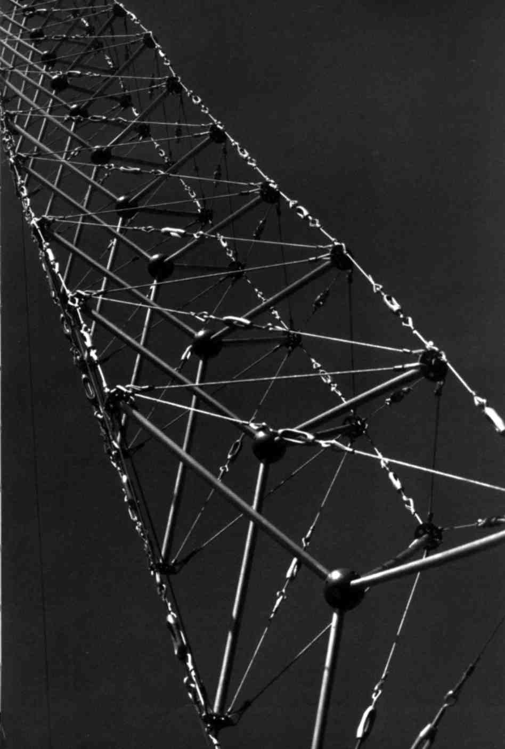
Tensegrity

Slide 23
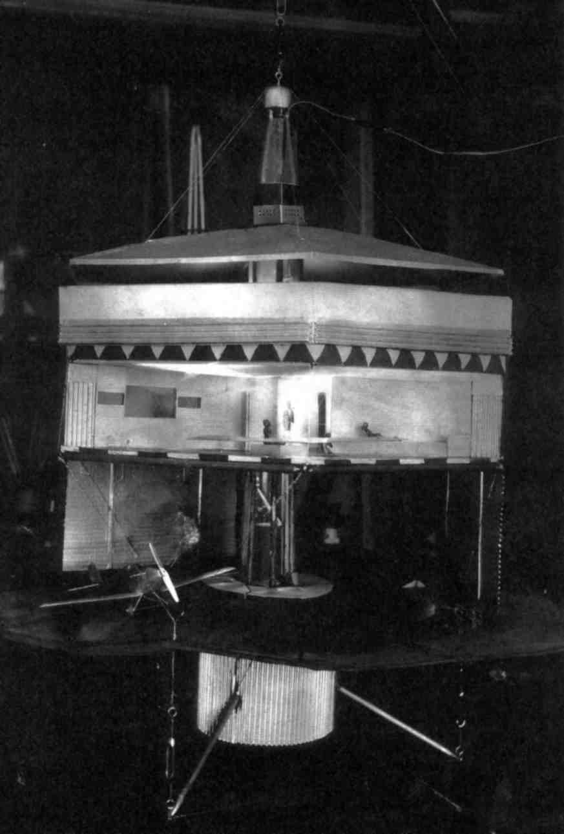
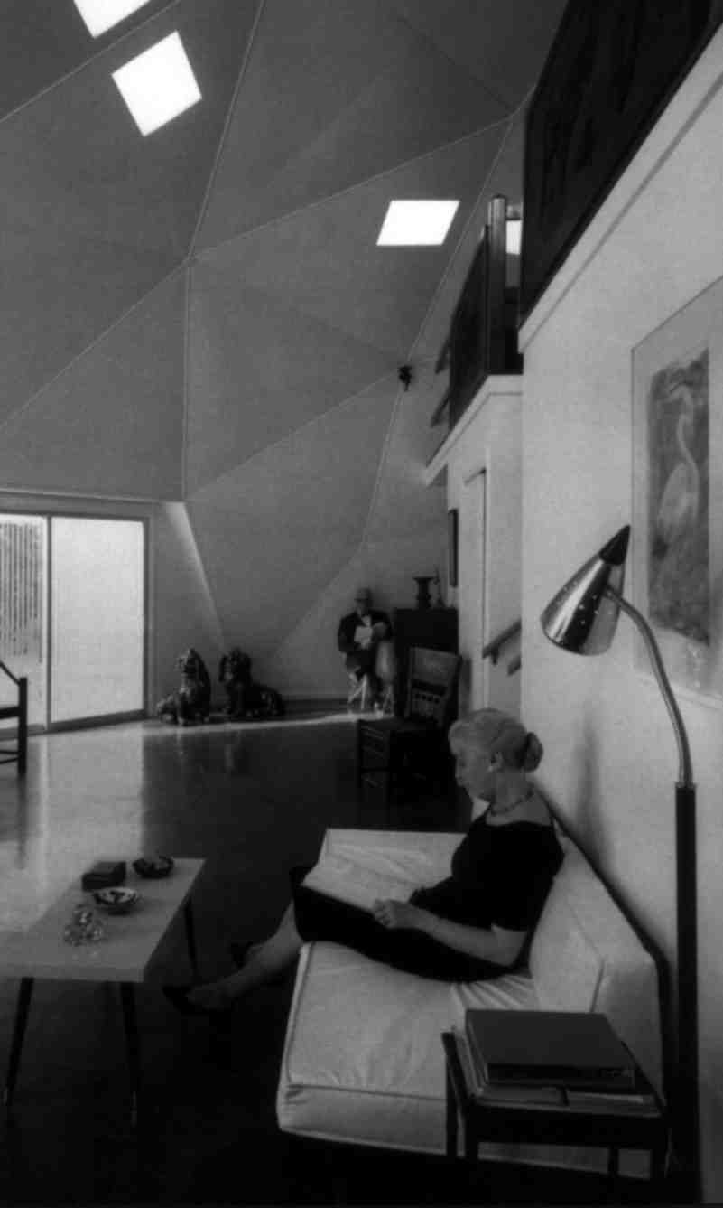
Dymaxion House Model/ Bucky at Home

Slide 24
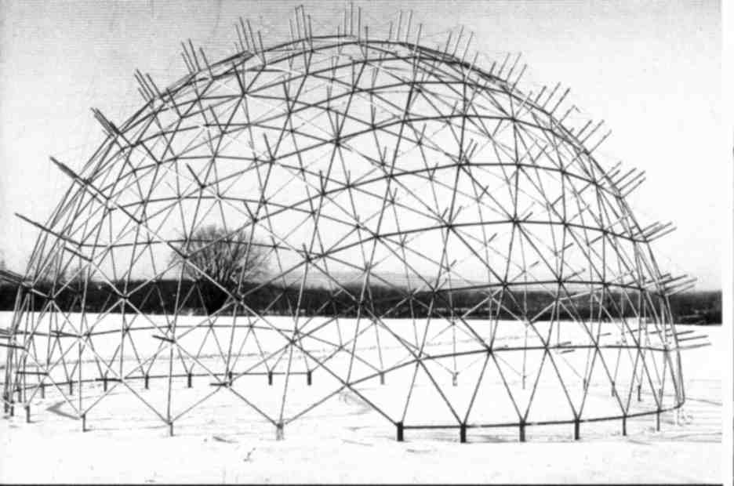
Geodesic Structure

Slide 25
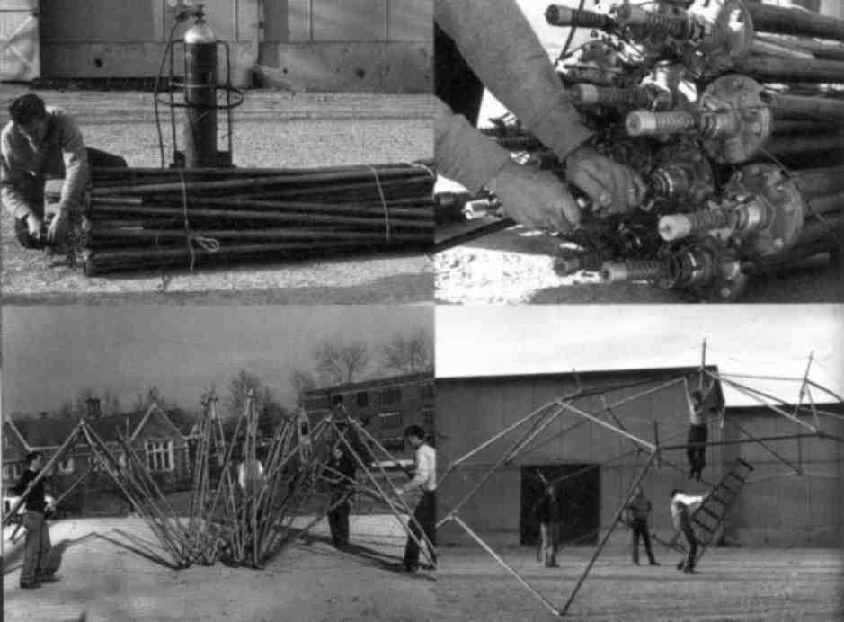
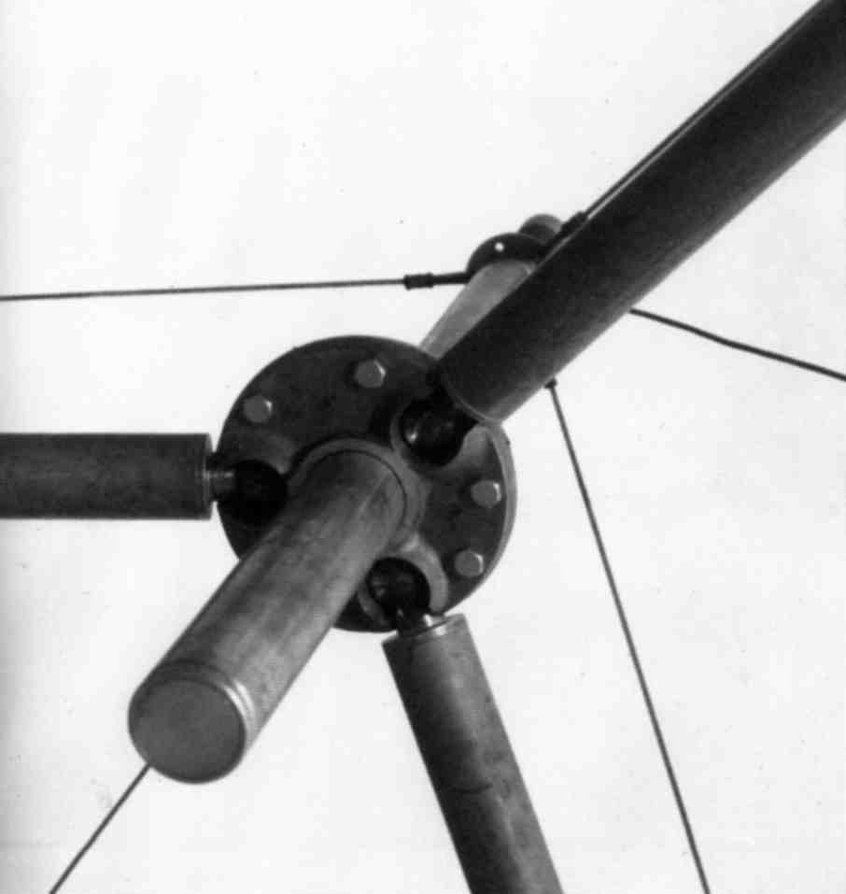
Seed Pod Project, Washington University

Slide 26
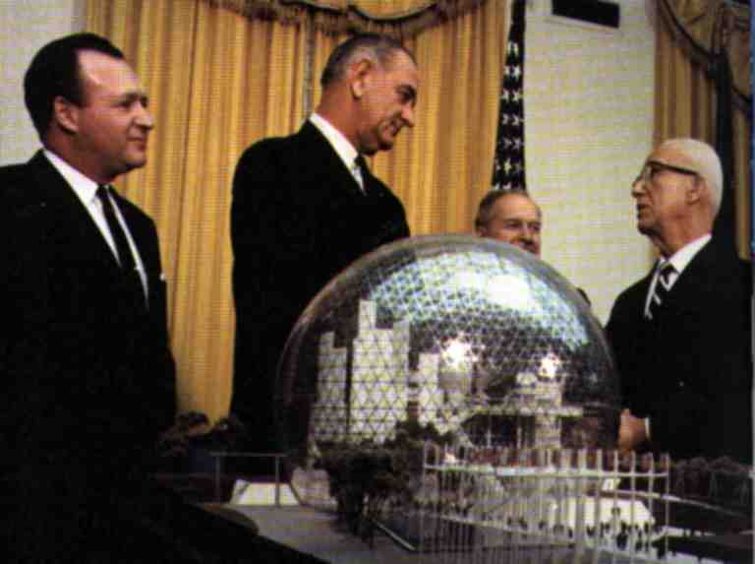
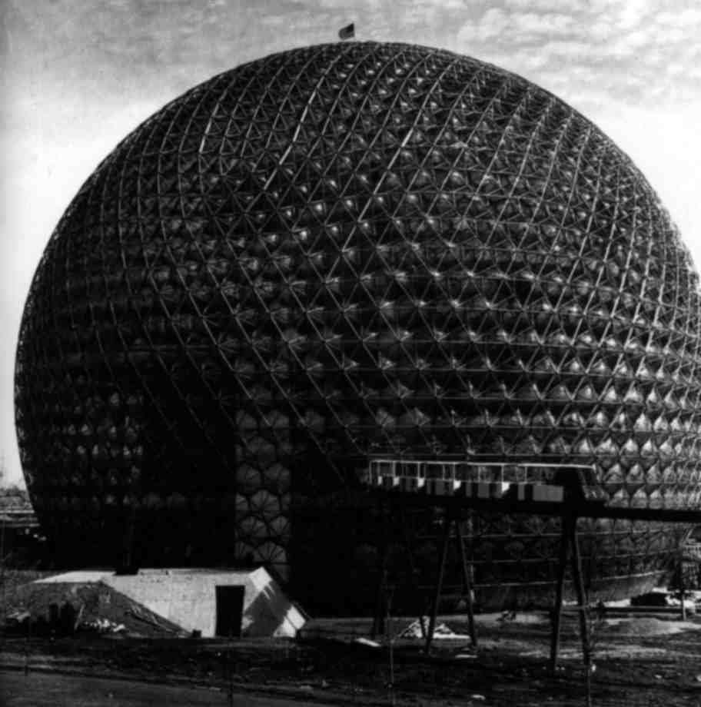
US Pavilion, Expo ‘67, Montreal, Canada

Slide 27
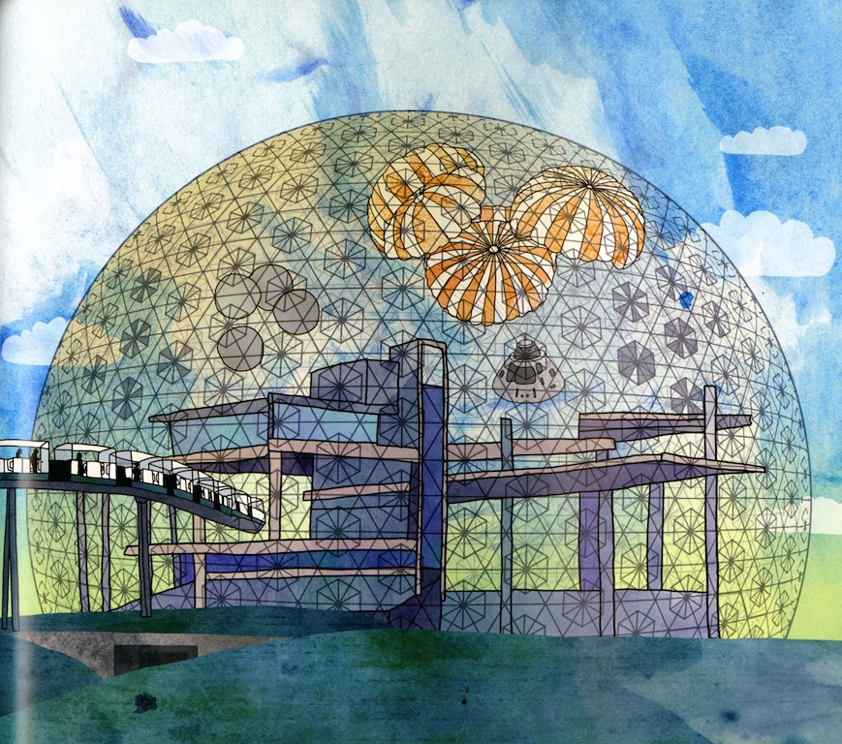
US Pavilion, Expo ‘67, Montreal, Canada

Slide 28
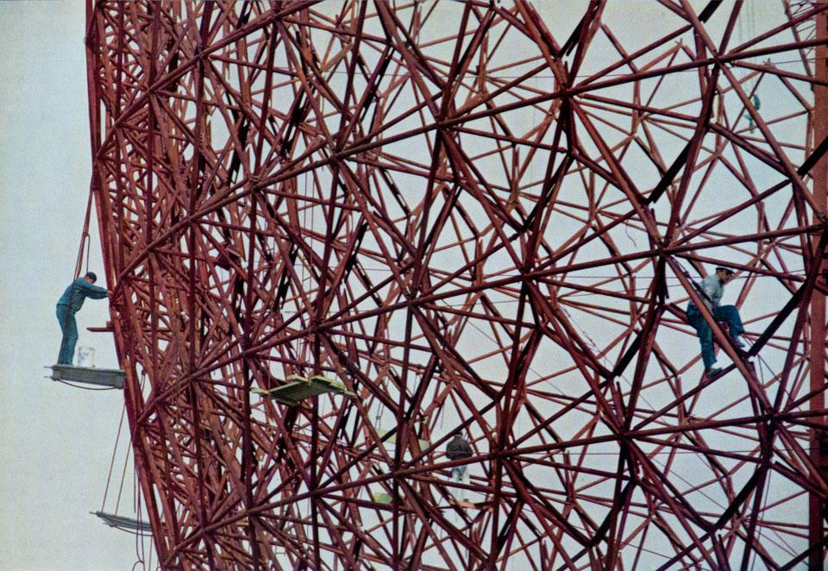

Slide 29


Slide 30
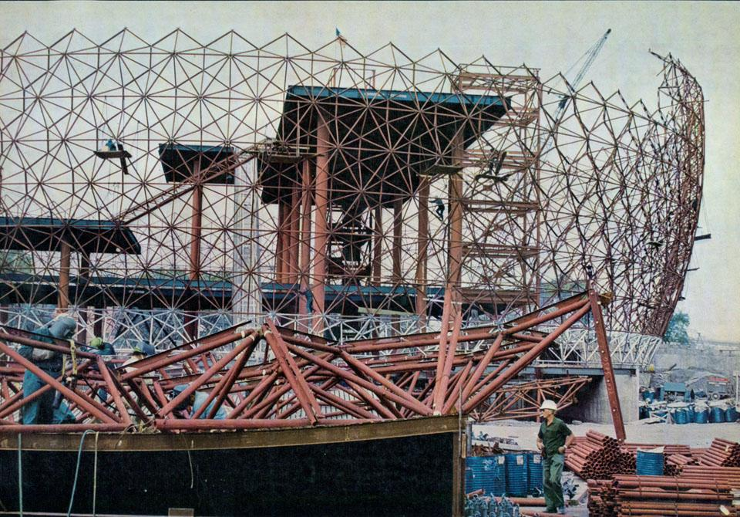

Slide 31
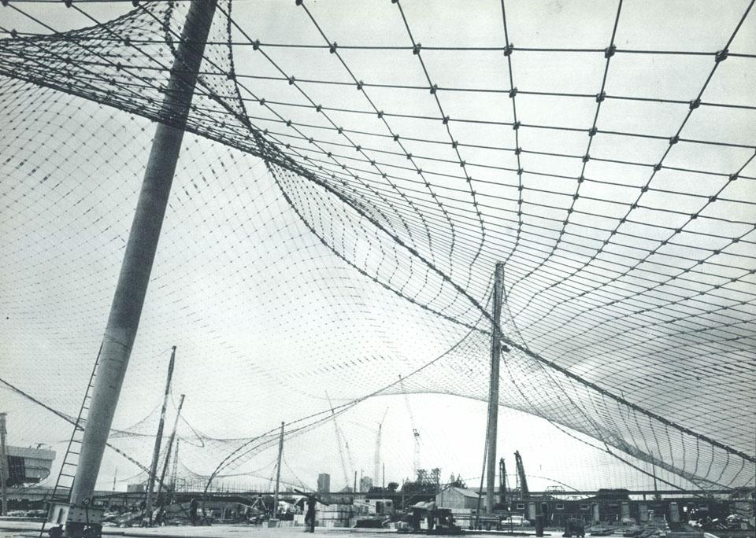

Slide 32
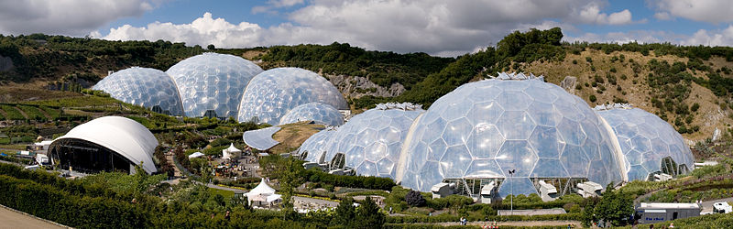

Slide 33
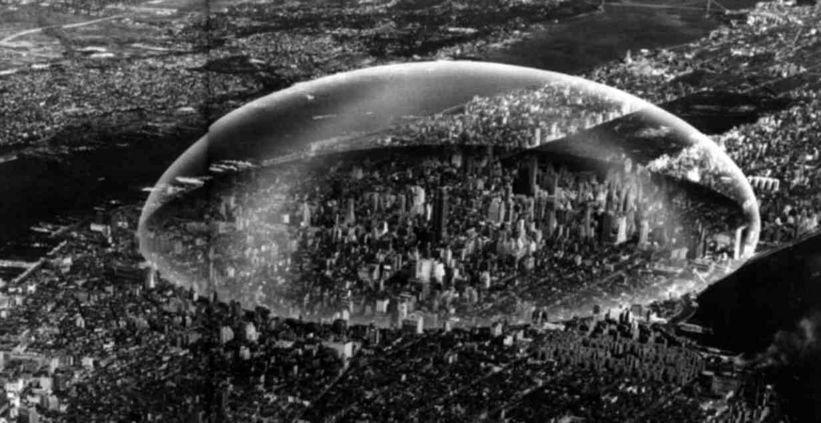
Dome over Manhattan

Slide 34
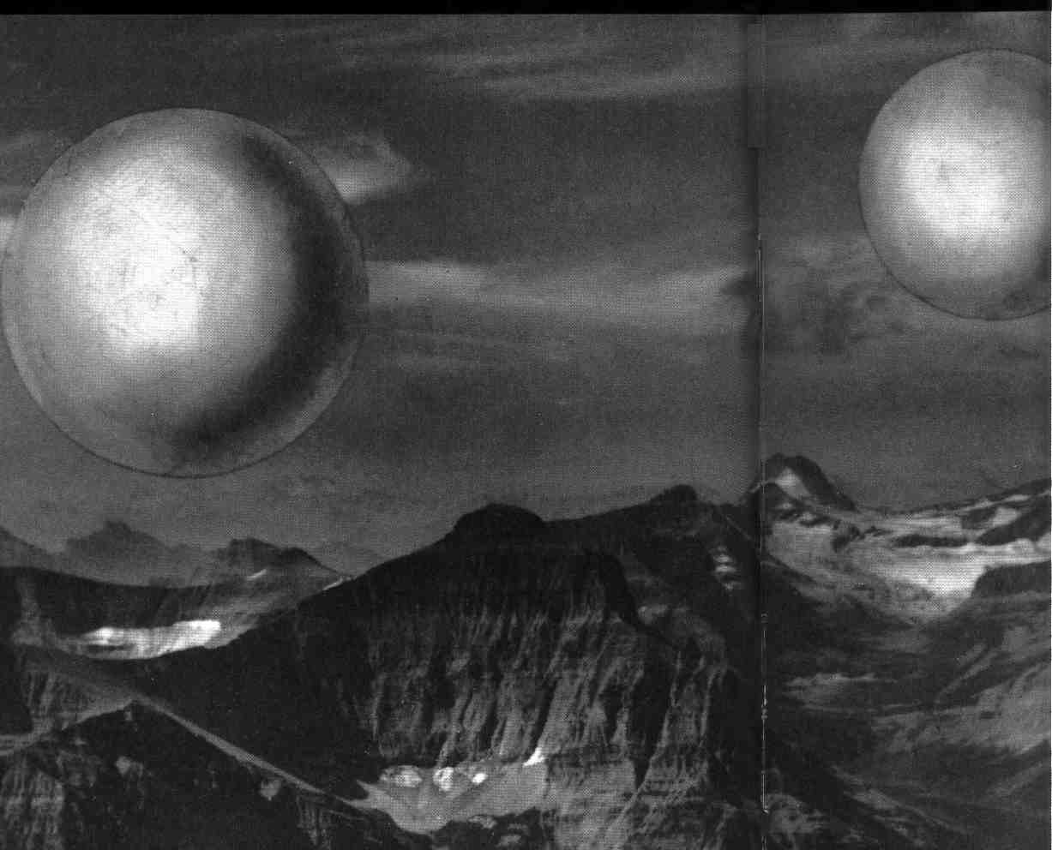
Cloud Structures

Slide 35
from Sanford Kwinter, “Fuller Themselves”
“No other discipline makes small-mindedness a virtue quite the way architecture does, and nowhere as dogmatically as in it’s knowing denunciation of overextended ambition, unbridled invention, systematic theorization, obsessive technical rigor, sweeping universalism and anti-classicism – in a word, of Fuller. One might say, in the tradition of the Italian Futurists, that Fuller was the first truly secular architect, the first to embrace synthetic ideas and the brute realities of modernization to the total eschewal of tradition, it's glories and superstitions. Fuller was the veritable Einstein, the Schoenberg of architecture, but architecture was never interested in real revolutions. ….. Fuller revealed modern architecture to be an imposter, and in a treacherous, effective summoning of its own army of clerks, the architecture establishment succeeded in exiling him to its lunatic fringe.”

Slide 36
from Sanford Kwinter, “Fuller Themselves”
“But Fuller was indomitable because he was the first to truly marry design to science and philosophy, and no one could then, nor now, dispute the following point: he alone was responsible for more fundamental innovations and transformations of thought than the entire profession could muster or make claim to in several hundred years.”

