Slide 1
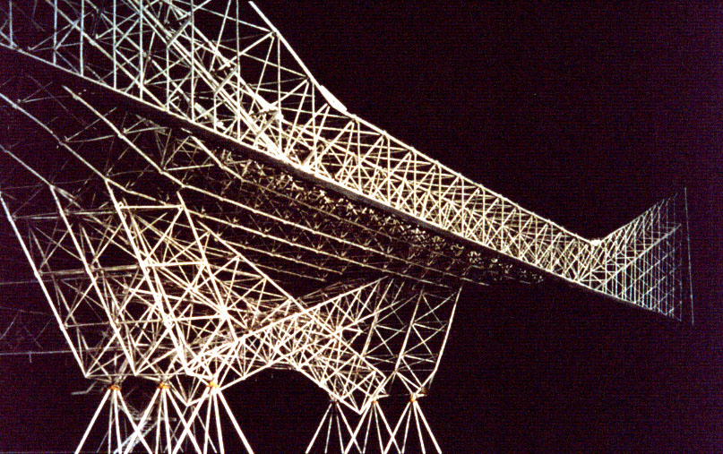
Konrad Wachsmann Reference: The Turning Point of Building by K.Wachsmann

Slide 2
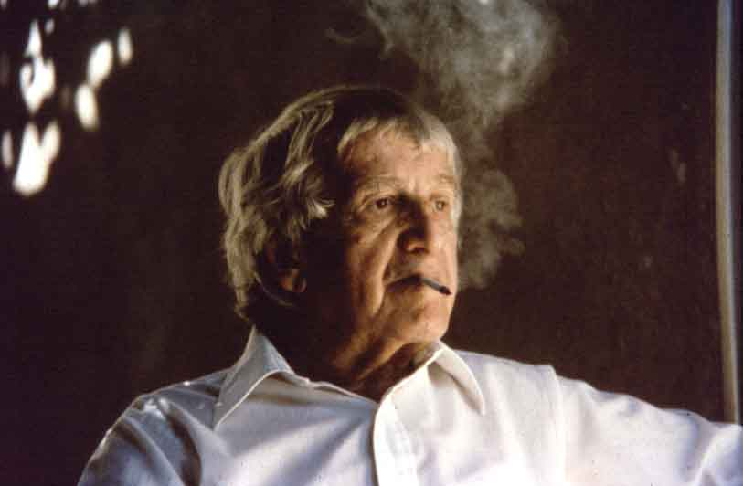

Slide 3
Philosophy
Wachsmann revered history, the ultimate source of tectonic inspiration
Wachsmann saw in the Crystal Palace and the Gothic cathedrals a paradigm to which all subsequent buildings should aspire

Slide 4
Philosophy
KW admired the techno-scientific genius of Alexander Graham Bell
KW’s thought was grounded in tectonic culture - detailing & rational fabrication and assembly methods
accepted the orthogonal as the normative matrix of manmade objects

Slide 5
Wachsmann Projects
French Panel House
Packaged House
American Panel Corporation
Mobilar
Tetra Node

Slide 6
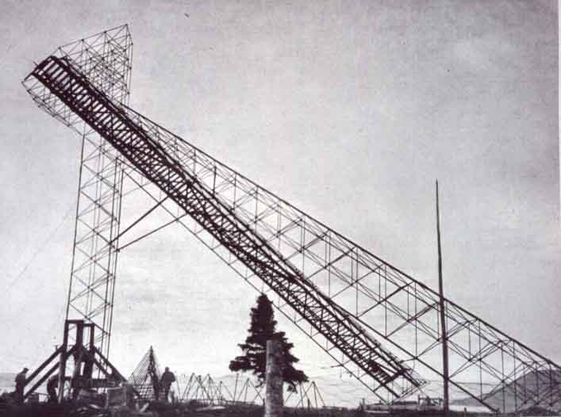
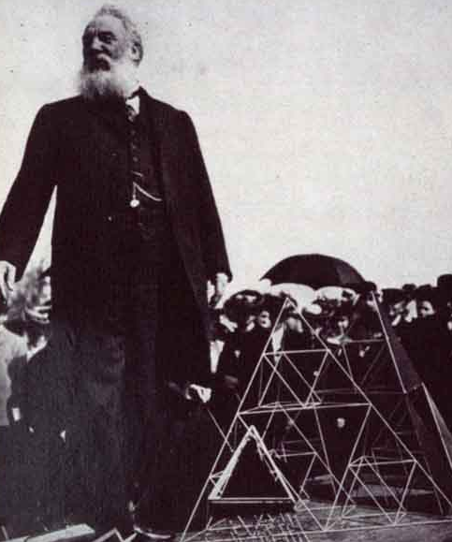

Slide 7
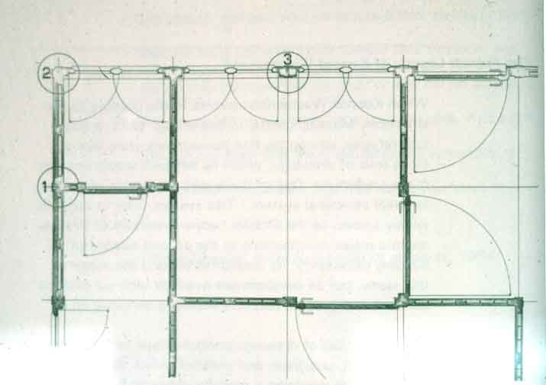

Slide 8
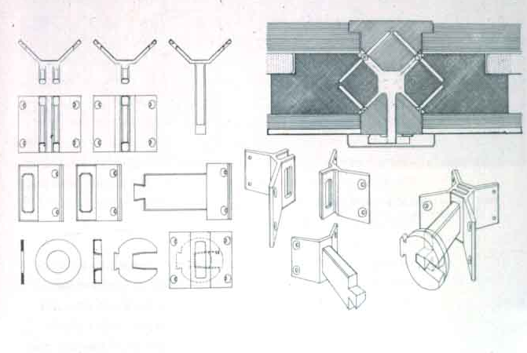

Slide 9
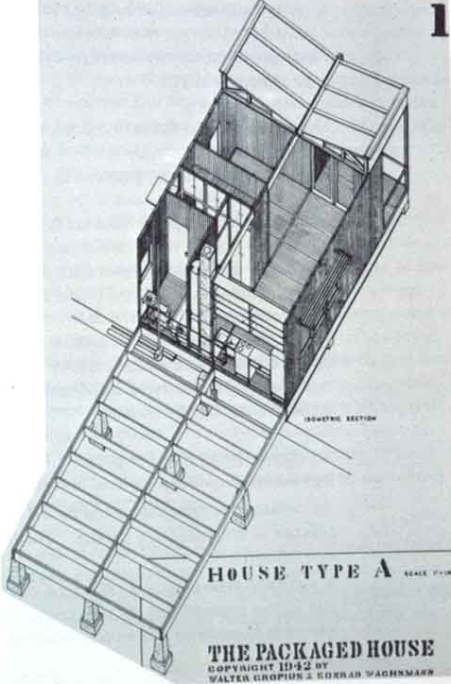
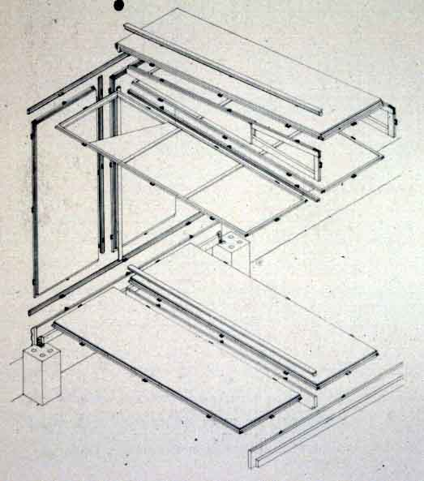

Slide 10
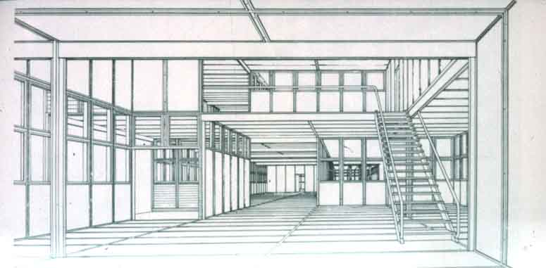

Slide 11
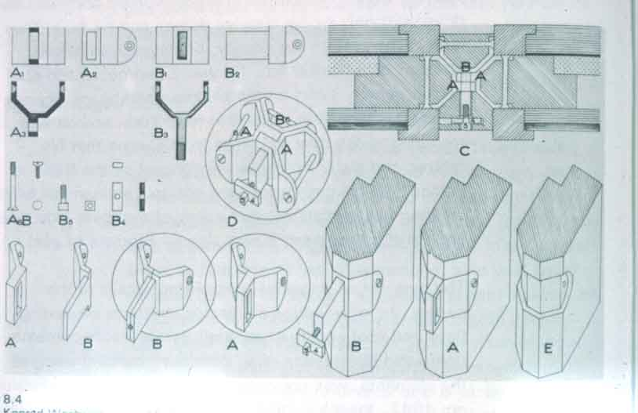

Slide 12
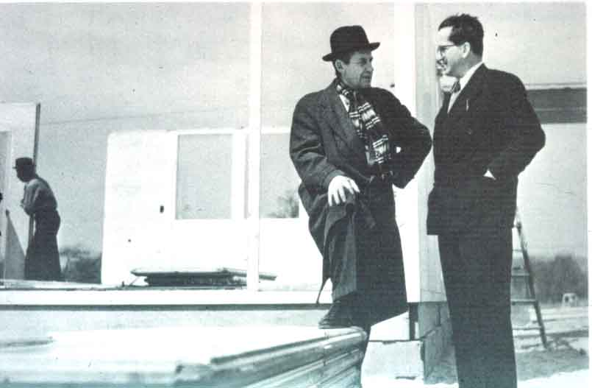

Slide 13
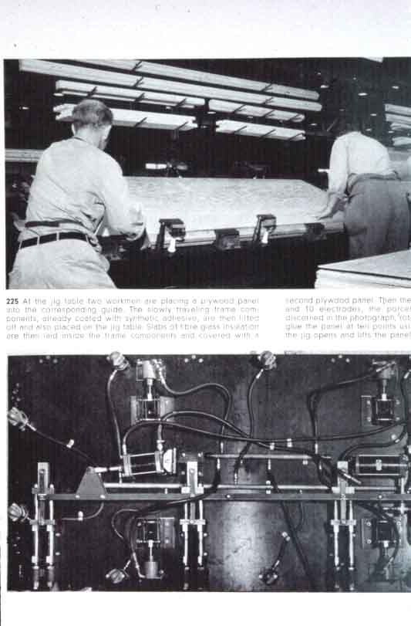
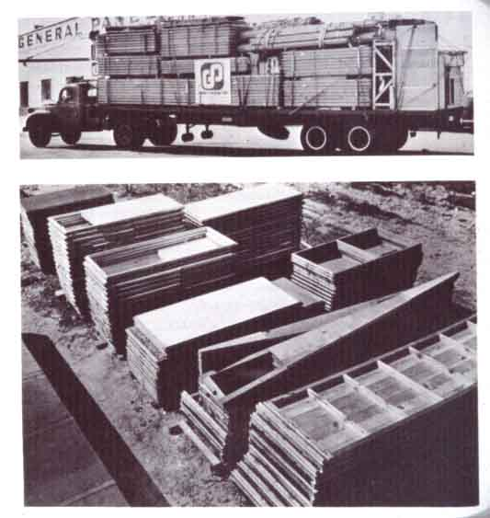

Slide 14
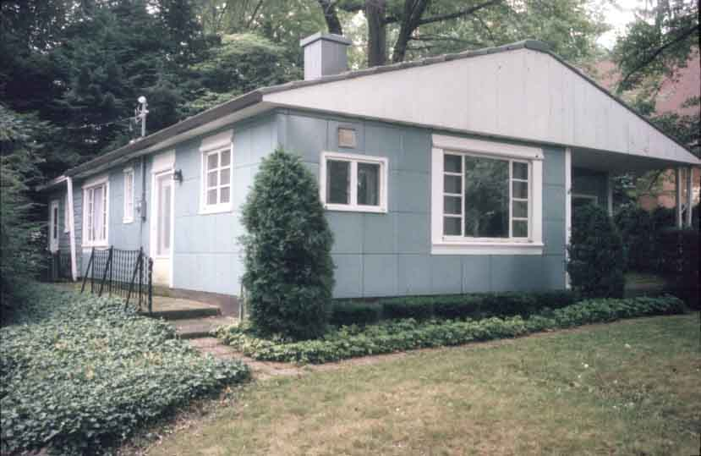

Slide 15
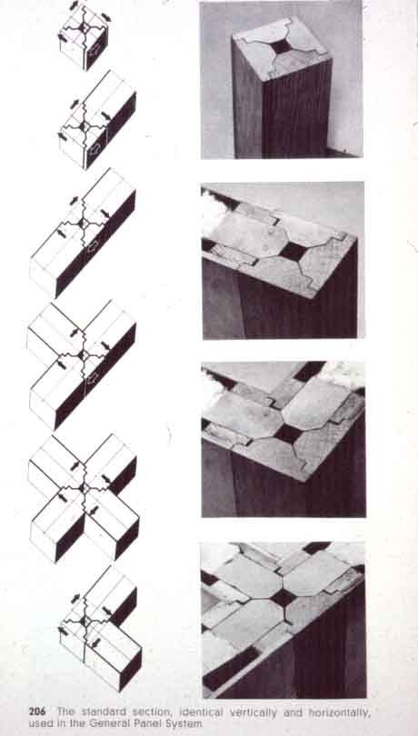
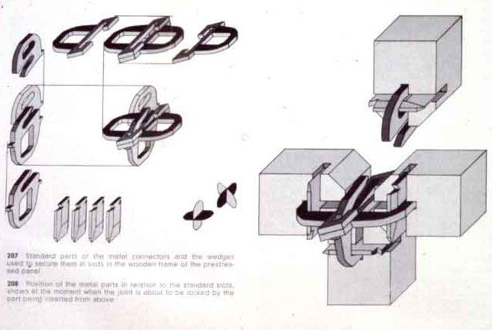
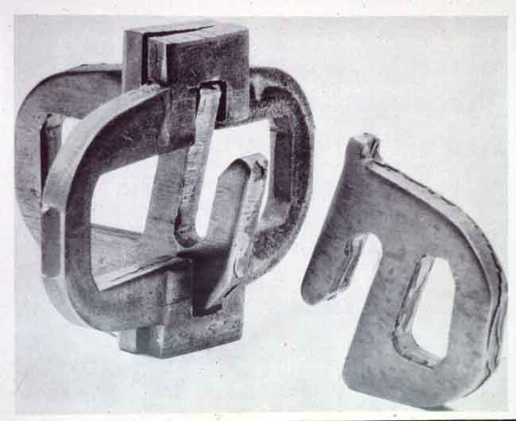

Slide 16
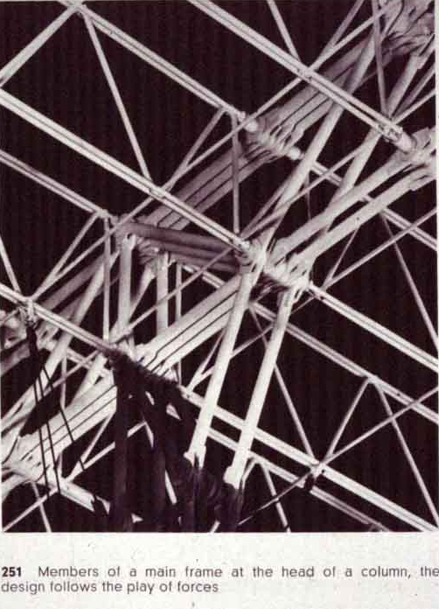
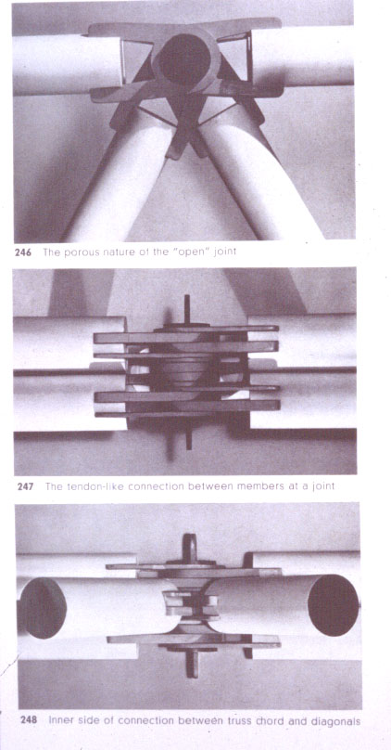

Slide 17
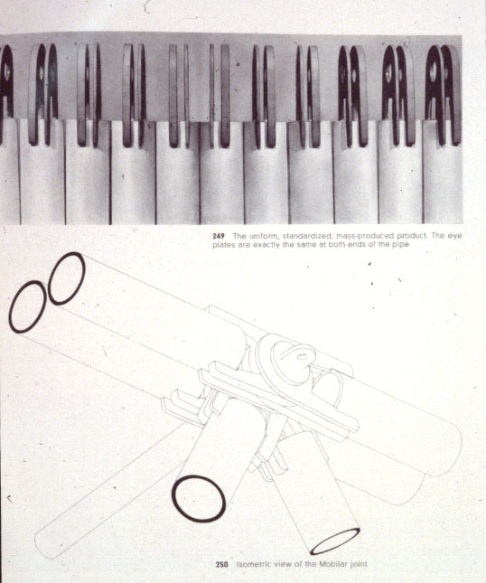

Slide 18
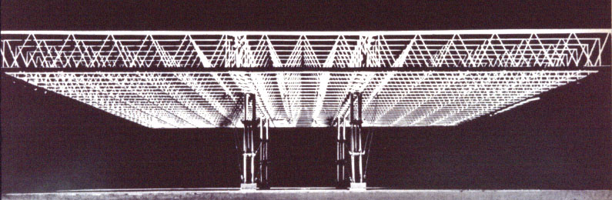

Slide 19
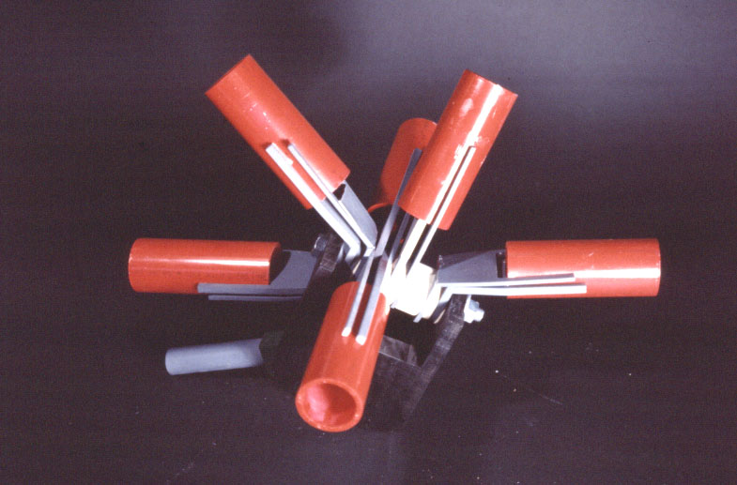

Slide 20
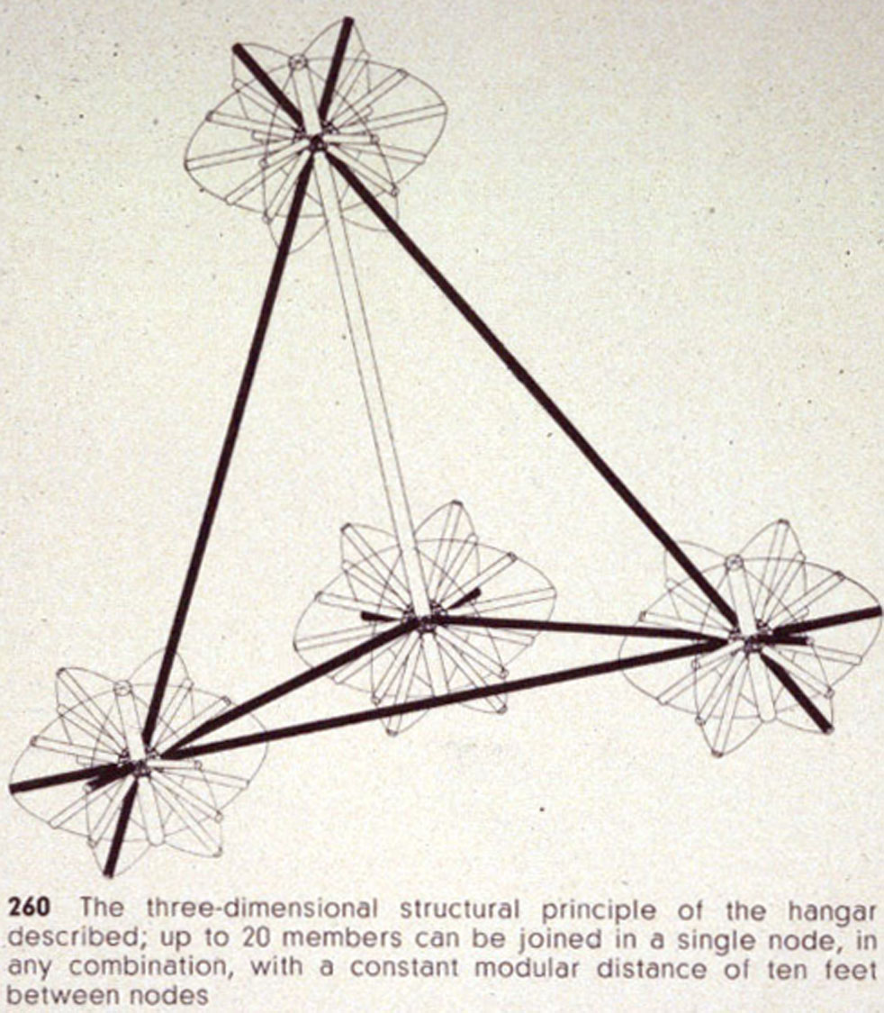

Slide 21
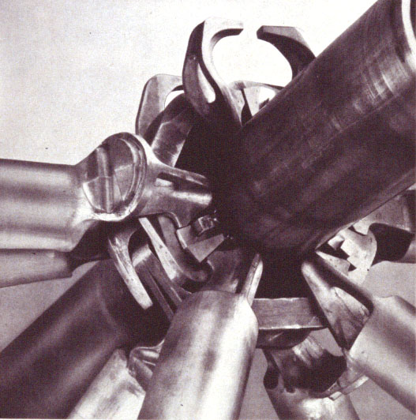
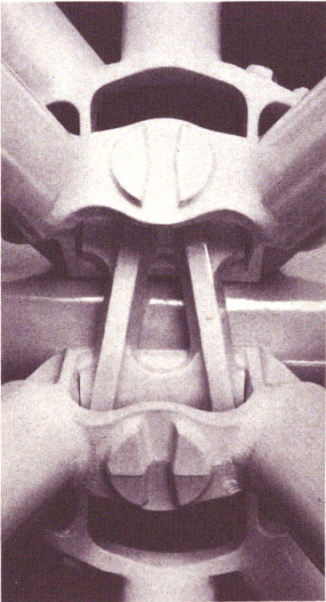
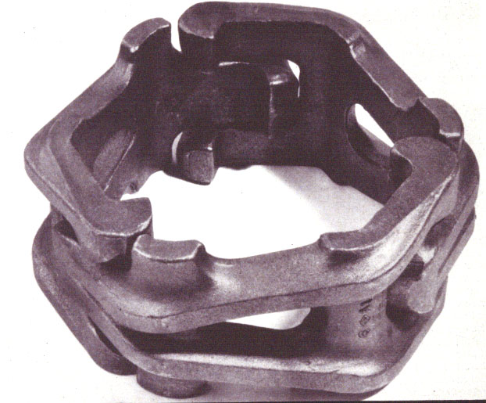

Slide 22
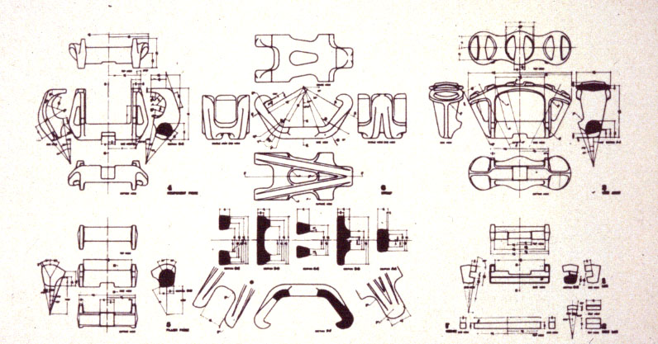

Slide 23
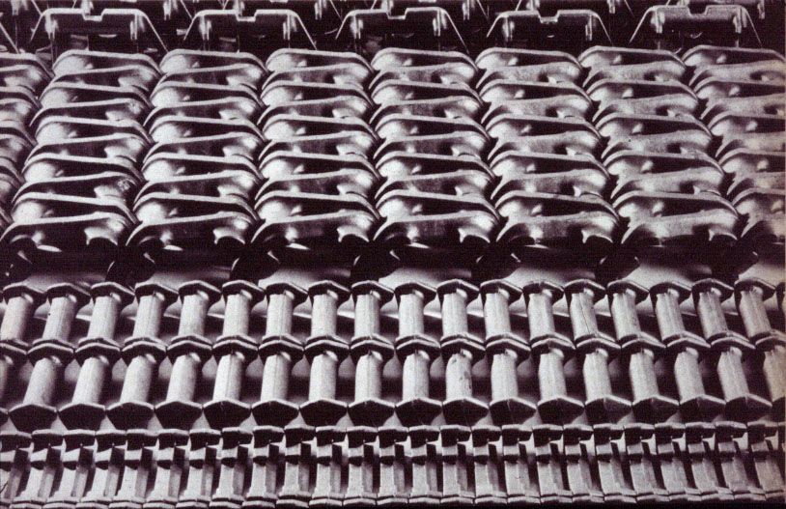

Slide 24
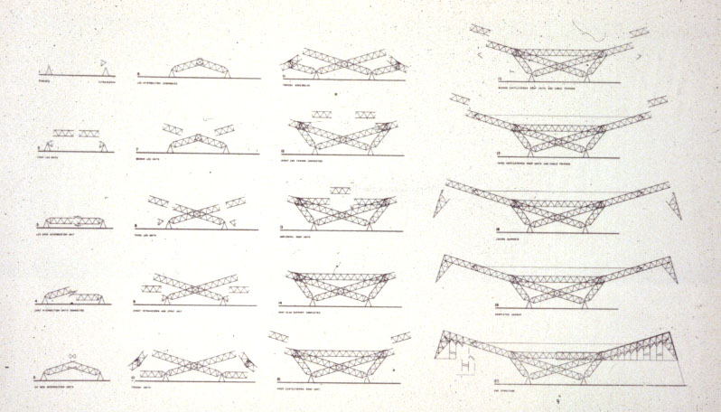

Slide 26
Conclusion
KW was destined to stay on the periphery of practice
He had faith in the imminence of a de-materialized world in which art, science and technology were united
Often proved the optimum range of a concept, rather than the pragmatics
Important for the stance adopted towards material world, rather than specificity of their designs.

