Slide 1
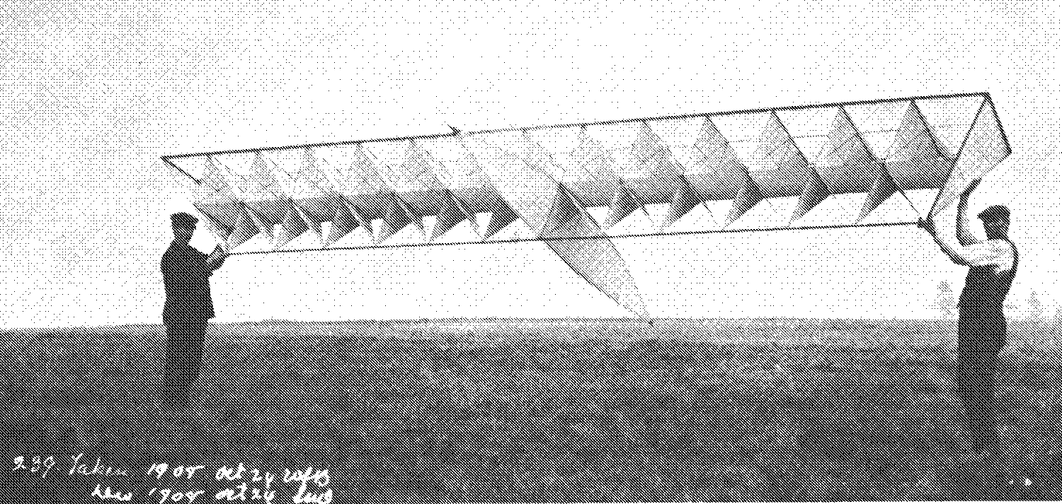
An Introduction to Space Frames
References:
Space Grid Structures by John Borrego
The Design of Building Structures by Wolfgang Schueller (pp521 – 563)
Pearce Structures Literature

Slide 2
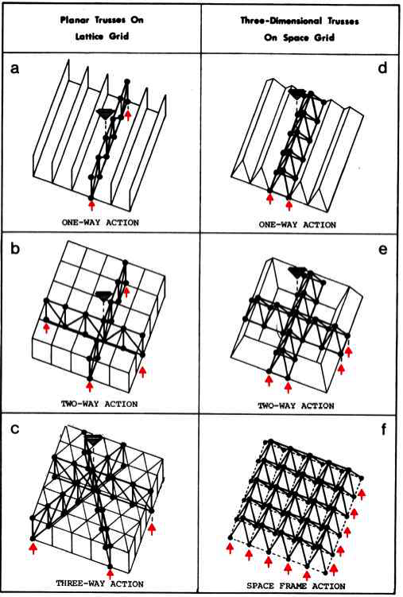
Structural Behavior

Slide 3
Support Locations
Systems w/ Symmetry about Two or Three Axes are Structurally Efficient
Column Supported Space Frame Behaves Like a Concrete Flat Plate
Parallel Wall Supported Space Frame Behaves Like a Concrete One Way Slab
Peripheral Wall Supported Space Frame Behaves Like a Concrete Two Way Slab

Slide 4
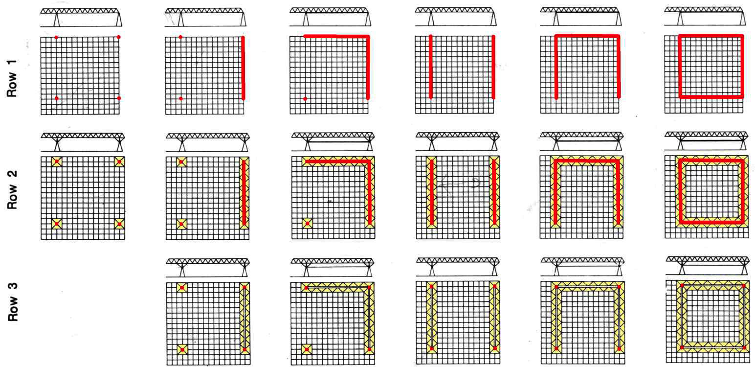
Support Matrix
Row 1 – Simple Column – Wall
Row 2 – Column – Wall w/ Beams
Row 3 – Columns w/ Beams

Slide 5
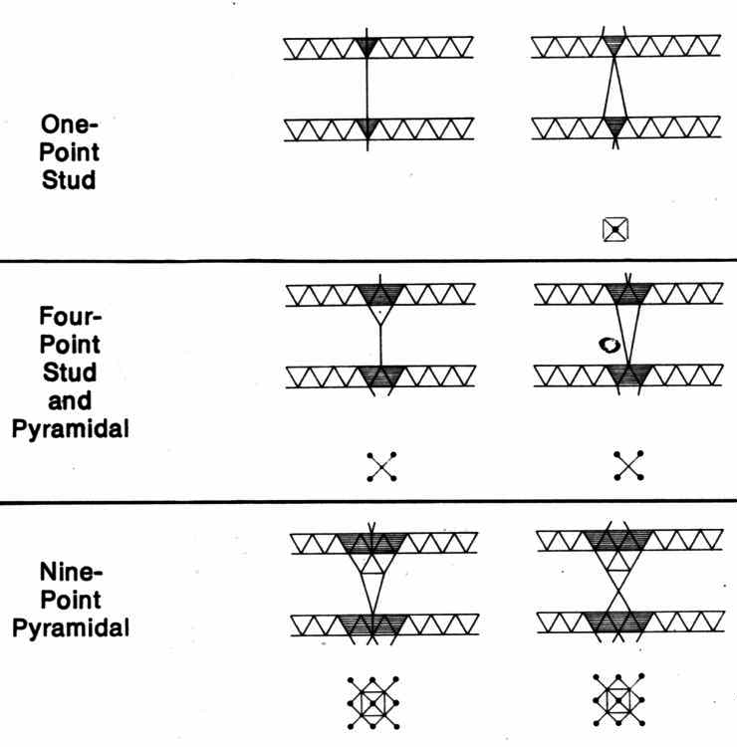
Support Points

Slide 6
Span to Depth Ratio
Horizontal Double Layer, Edge Supported
One Way, 12:1
Two Way, 15:1
Three Way, 20:1
Cantilever Spans, 9:1
Horizontal Double Layer, Corner Supported
15:1

Slide 7
Dimensions
Typical Bay Size
4 ft ≤ a ≤ 12 ft
Frame Depth
0.5 ≤ d/a ≤1.0
Ex: 0.5 = d/a or 2 ft deep and 4 ft bay size 1.0 = d/a or 4 ft deep and 4 ft bay size
Chord Angle
30° ≤ α ≤ 60°
Aspect Ratio (Member Length / Diameter)
25:1

Slide 8
Erection Methods
Scaffold Methods
Individual Elements are Assembled in Place at Actual Elevations
Block Assembly Methods
Components are Pre – Assembled on the Ground and Crane or Hoist Erected
Lift – Up Methods
Large Sections are Pre – Assembled on the Ground and Erected w/ Heavy Equipment e.g. Hydraulic Jacks

Slide 9
Joint Types
Connector Plates
Hollow Balls
Solid Balls
Extruded Hubs
Welded Multi–Planar Gusset Plates
Mulithinge

Slide 10
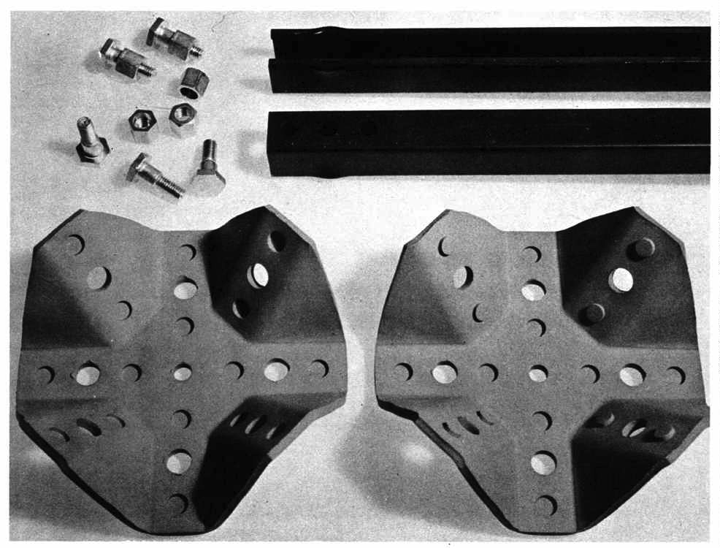
Connector Plates
Unistrut

Slide 11
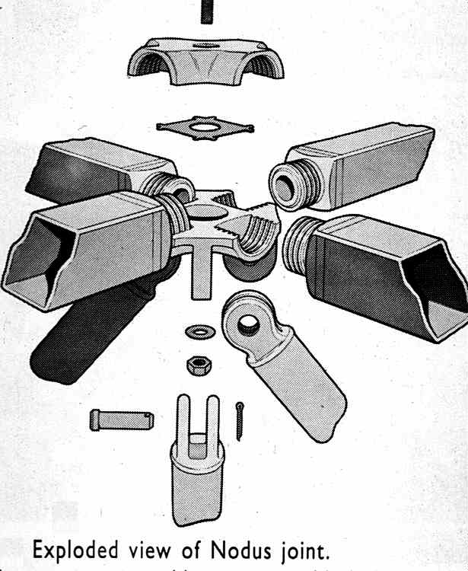
Hollow Balls
Nodus

Slide 12
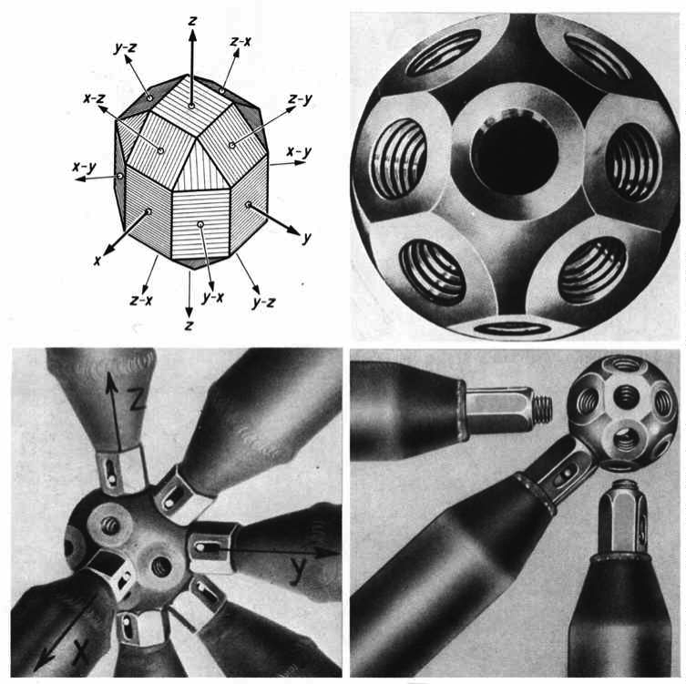
Solid Balls
Mero

Slide 13
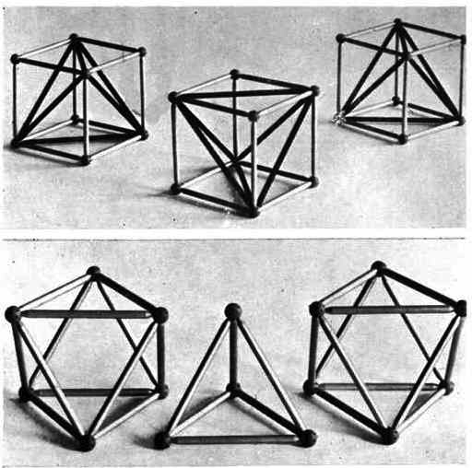
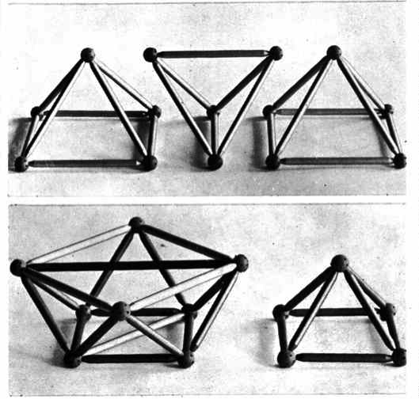
Mero Geometry

Slide 14
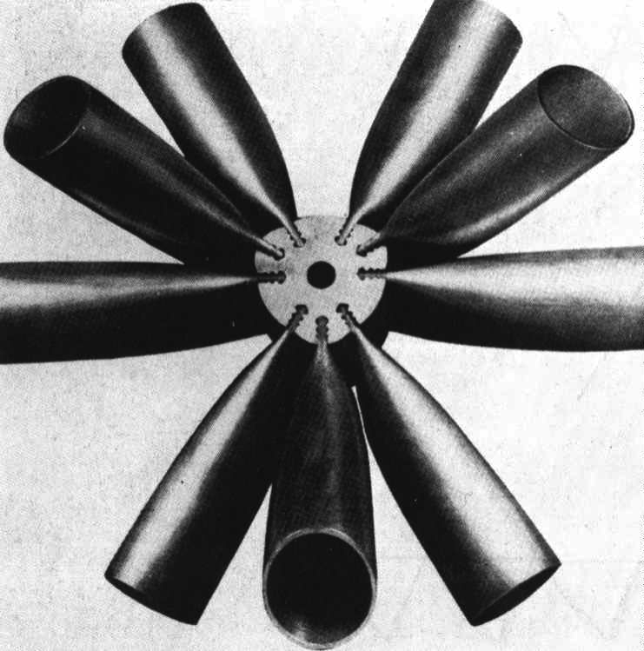
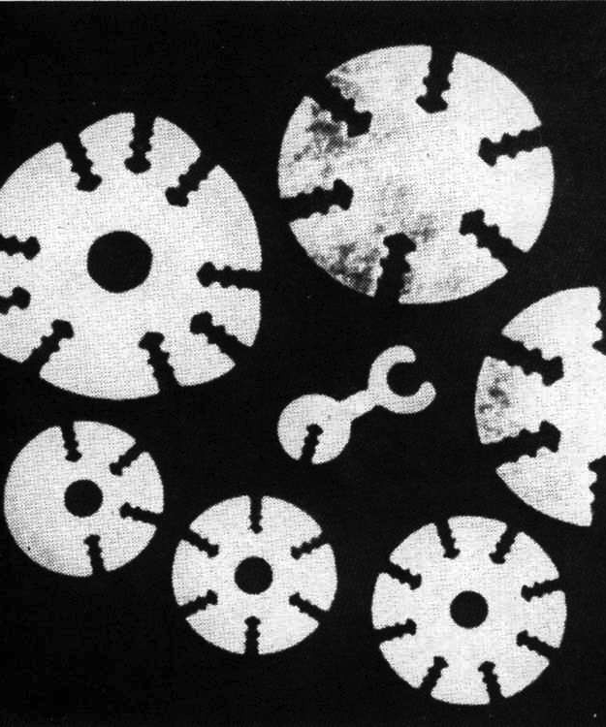
Extruded Hubs
Triodetic

Slide 15
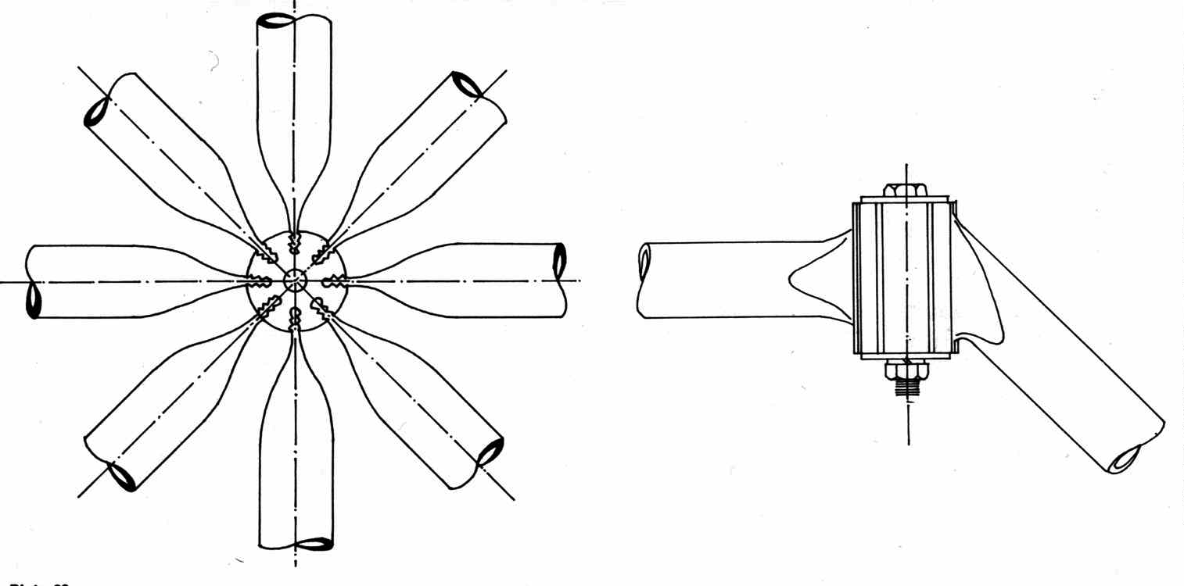
Triodetic Geometry

Slide 16
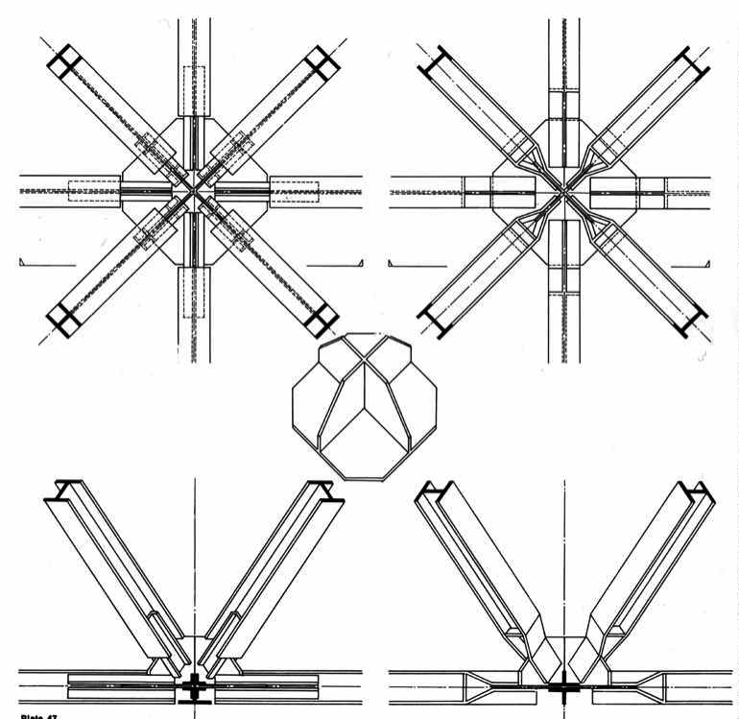
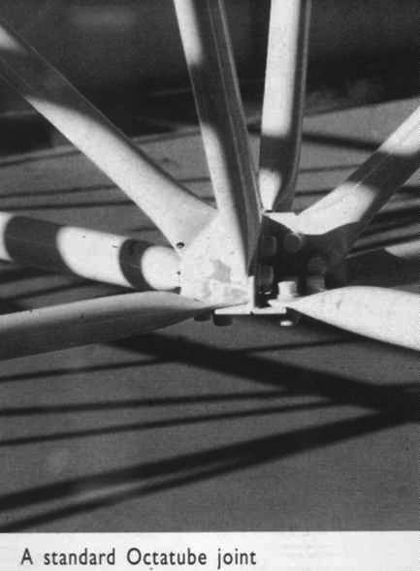
Welded Multi–Planar Gusset Plates
Custom Fabricated
Octatube

Slide 17
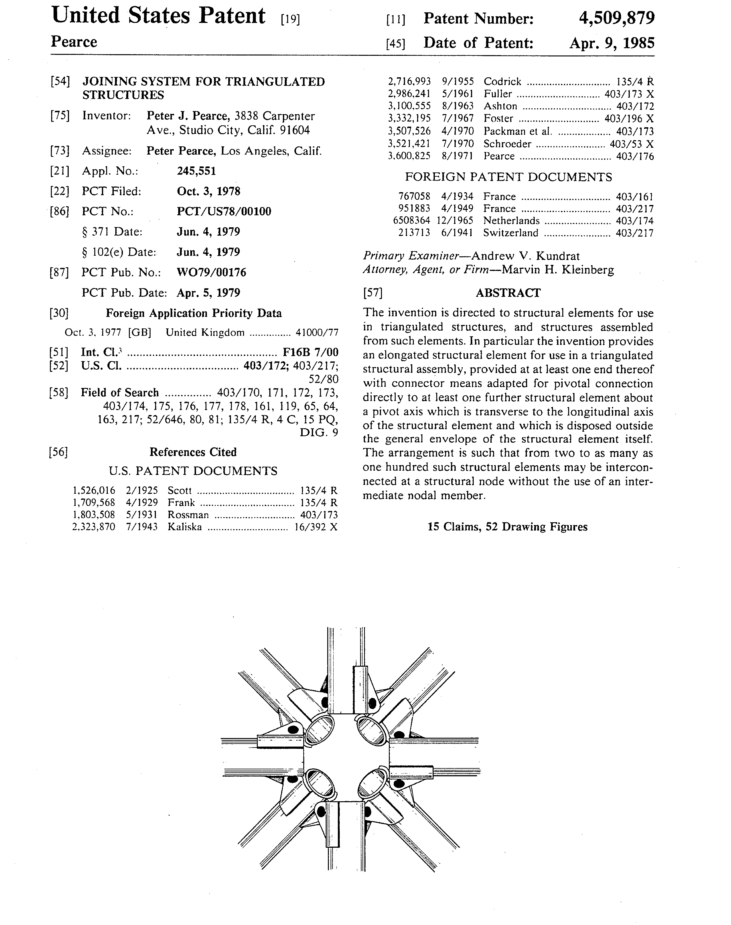
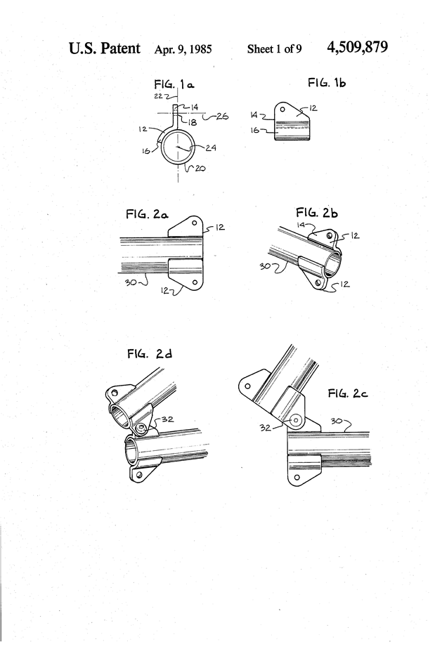
Pearce Multi-hinge Structures

Slide 18
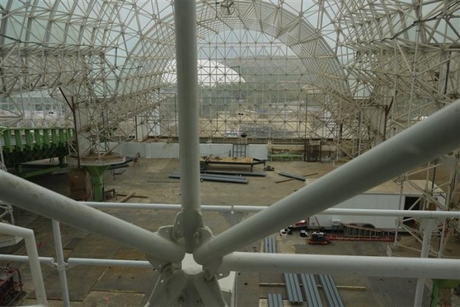
Pearce Multi-hinge Structures: Biosphere, Arizona

Slide 19
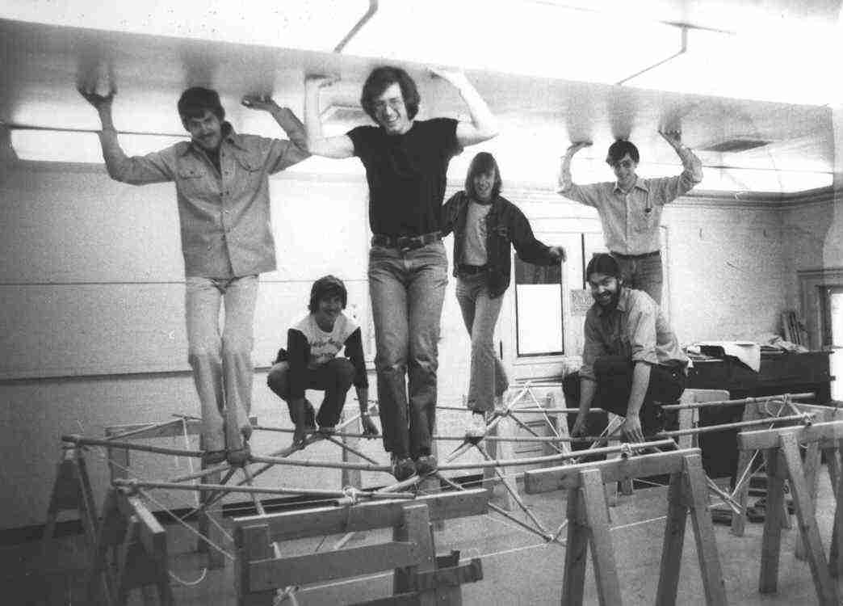
Slee CEISS Project: Pittsburgh, 1975

Slide 21
Lattice Grids

Slide 22
Direct Grids

Slide 23
Offset Grids

Slide 24
Differential Grids

