Slide 3
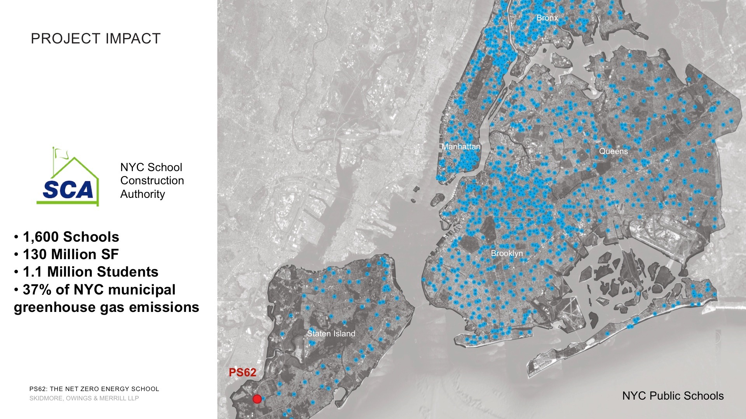

Slide 4
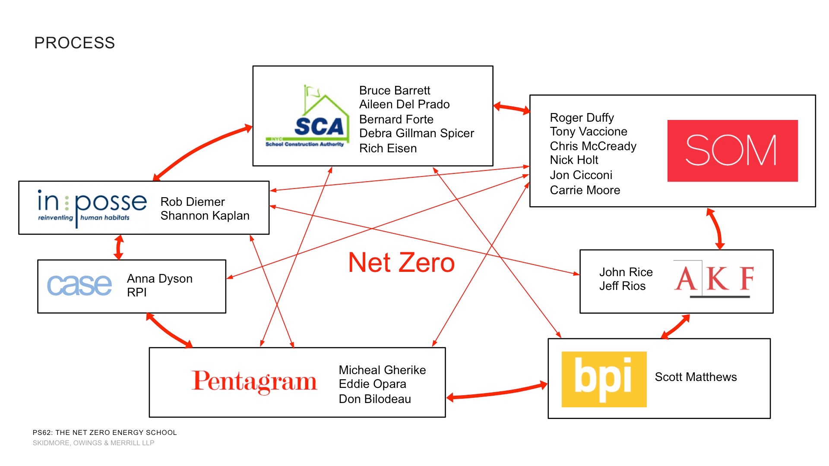

Slide 7
Passive
Orientation/Configuration (Space Zoning)
Daylight
Natural ventilation

Slide 8
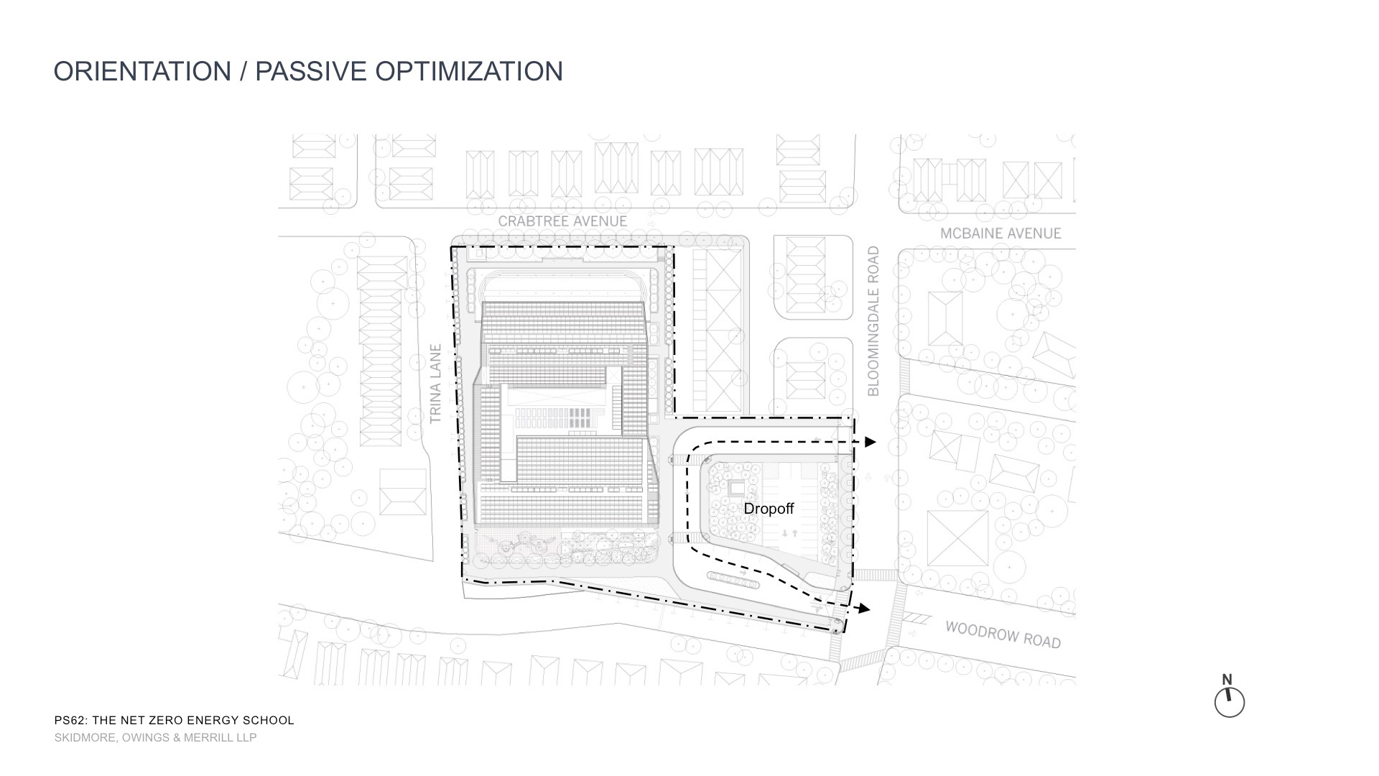

Slide 9
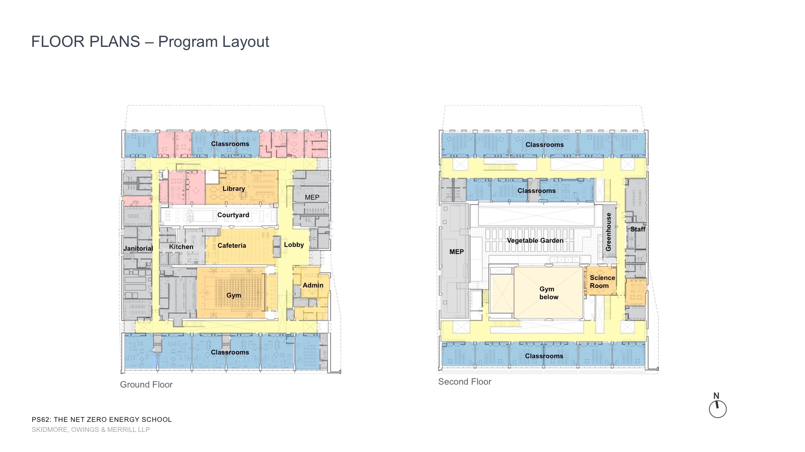

Slide 10
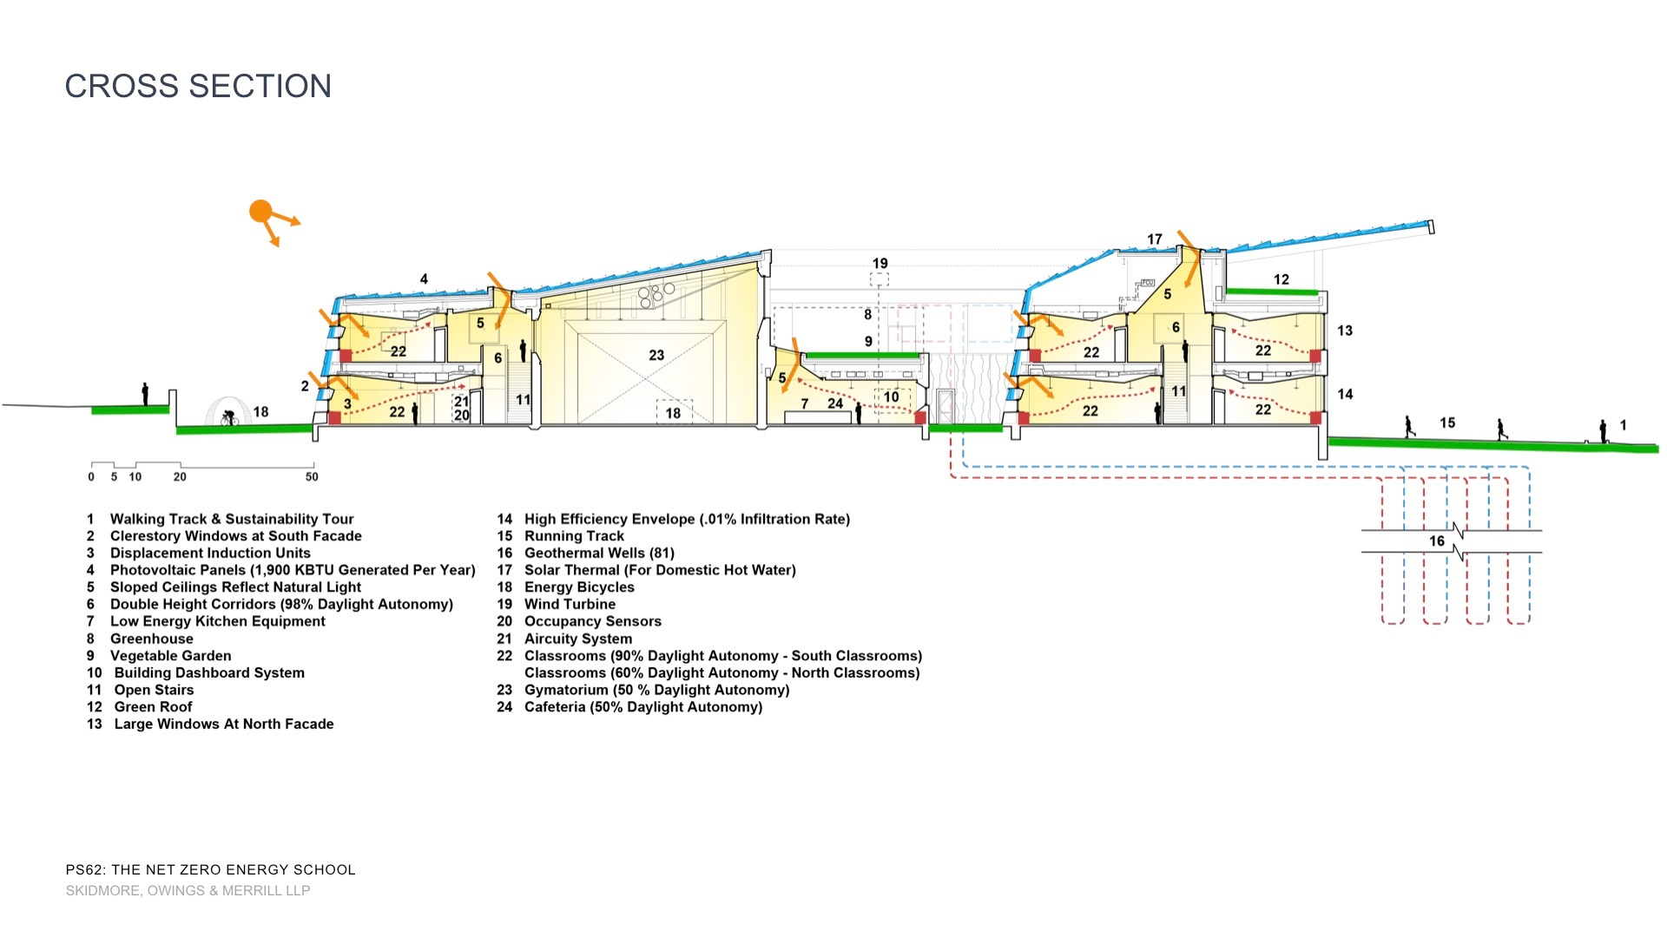

Slide 11
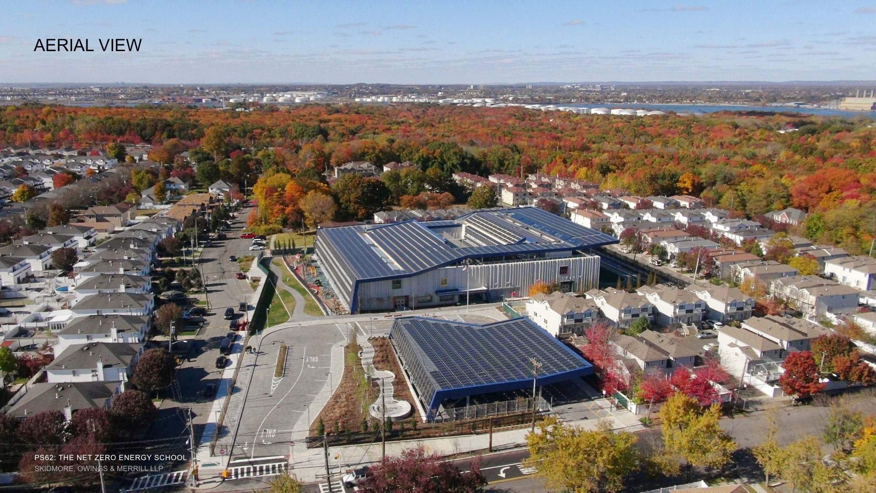

Slide 14
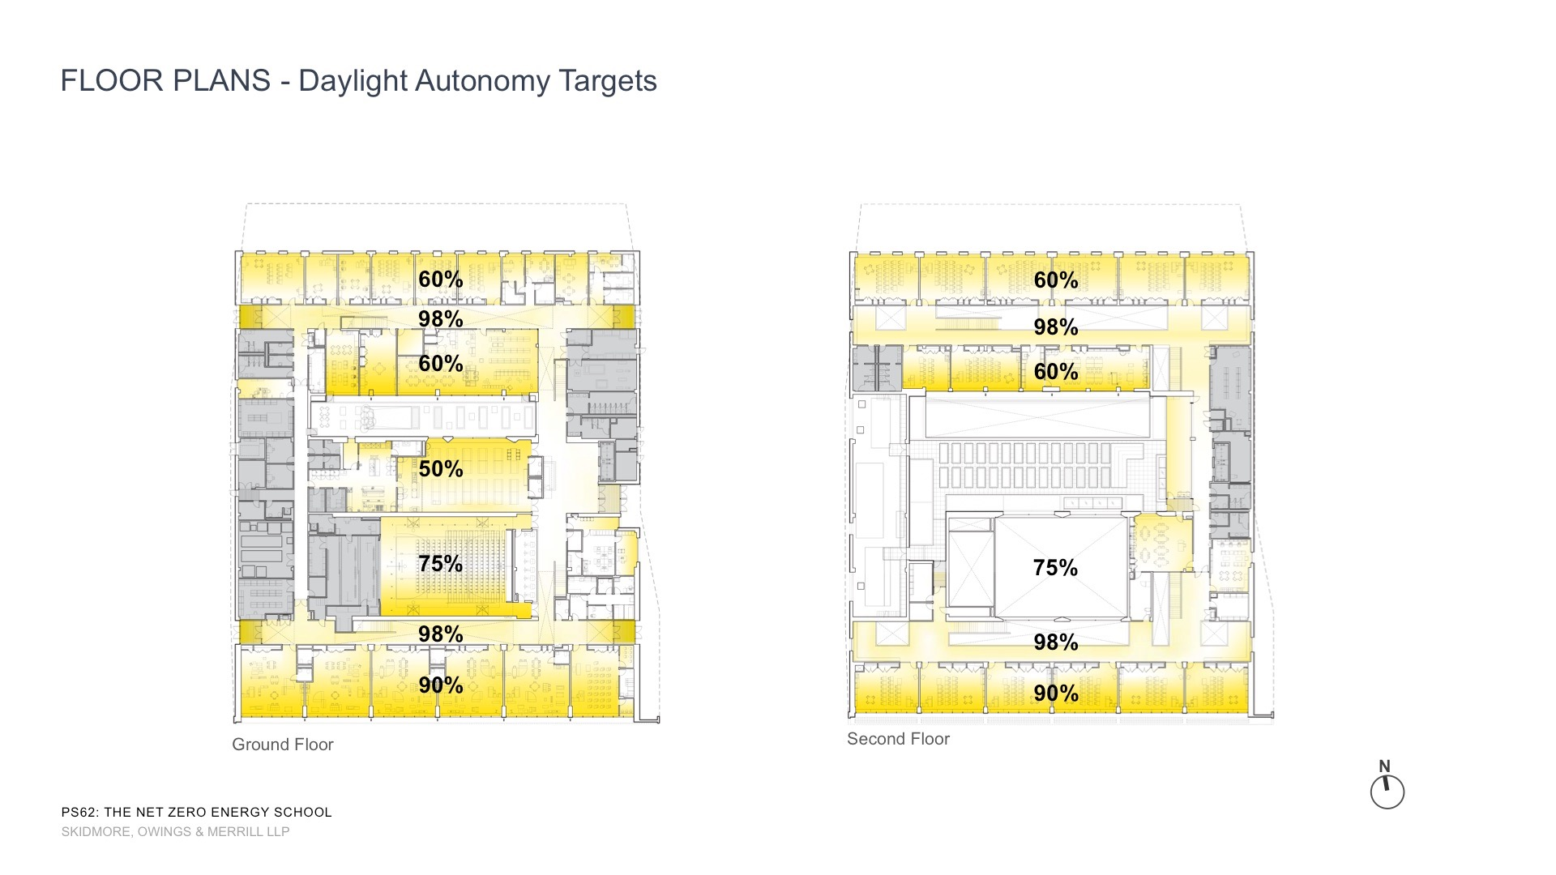

Slide 16
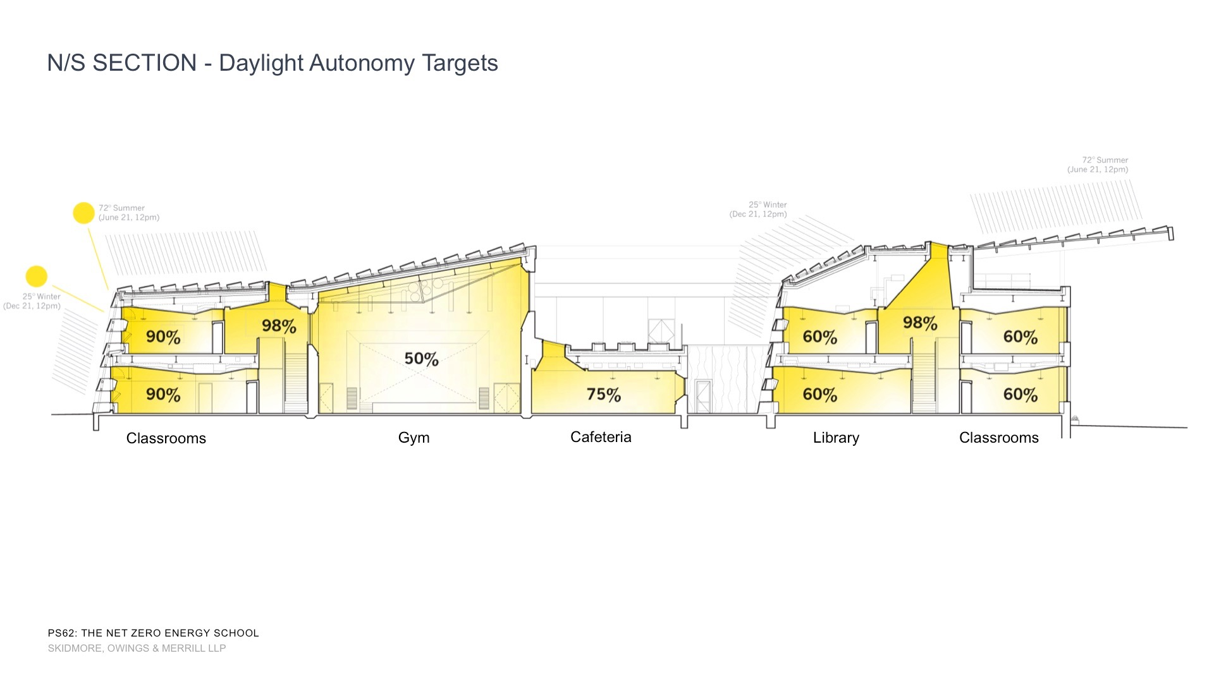

Slide 20
South Facade Daylighting

Slide 21
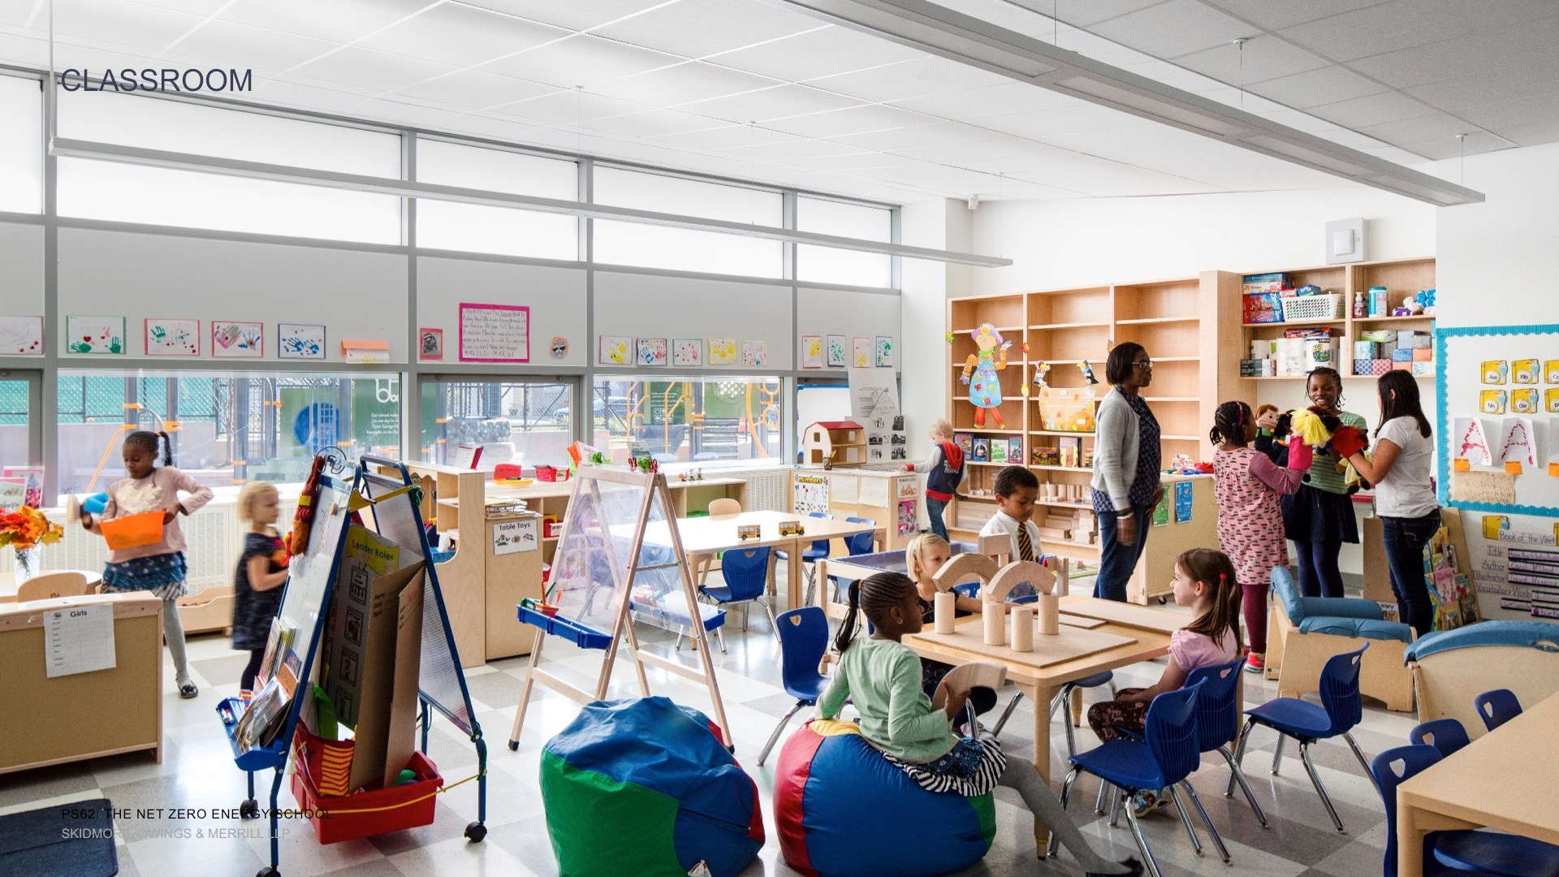

Slide 22
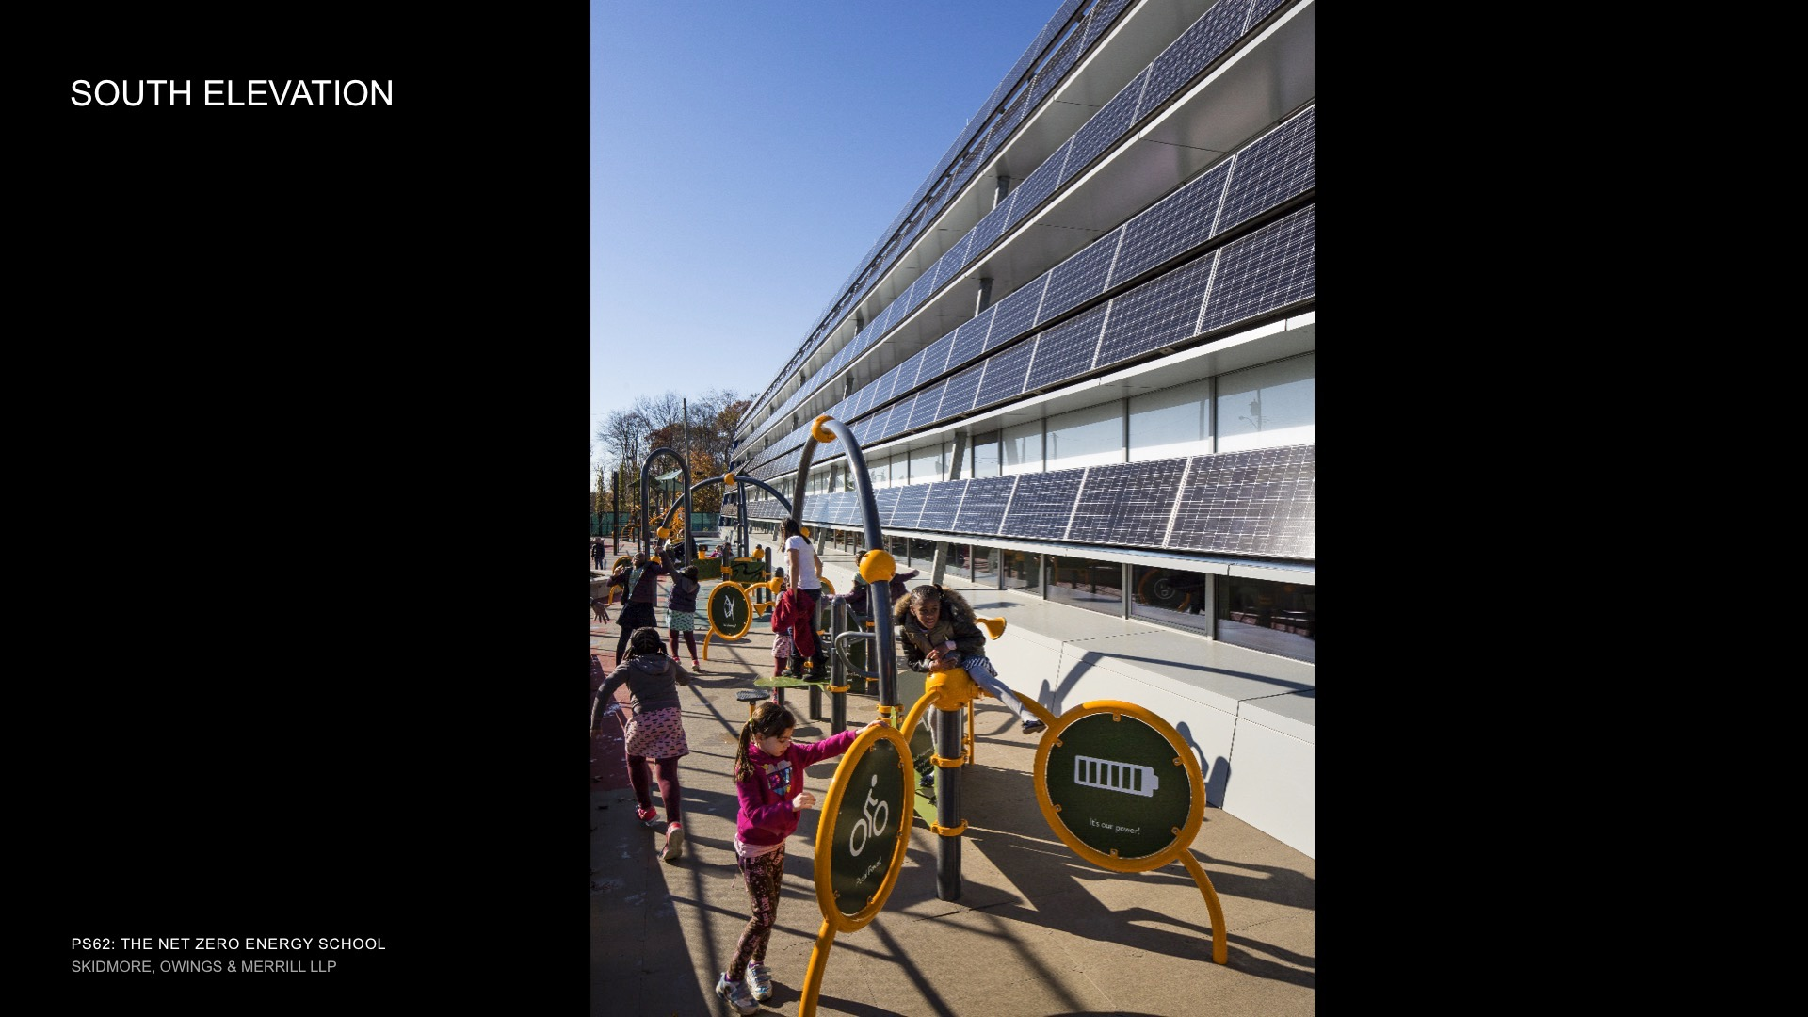

Slide 25
Active Systems

Slide 28
Renewable Energy
√ Optimize passive performance
√ Optimize active systems
√ Engage occupants
Now, add renewable systems

Slide 29
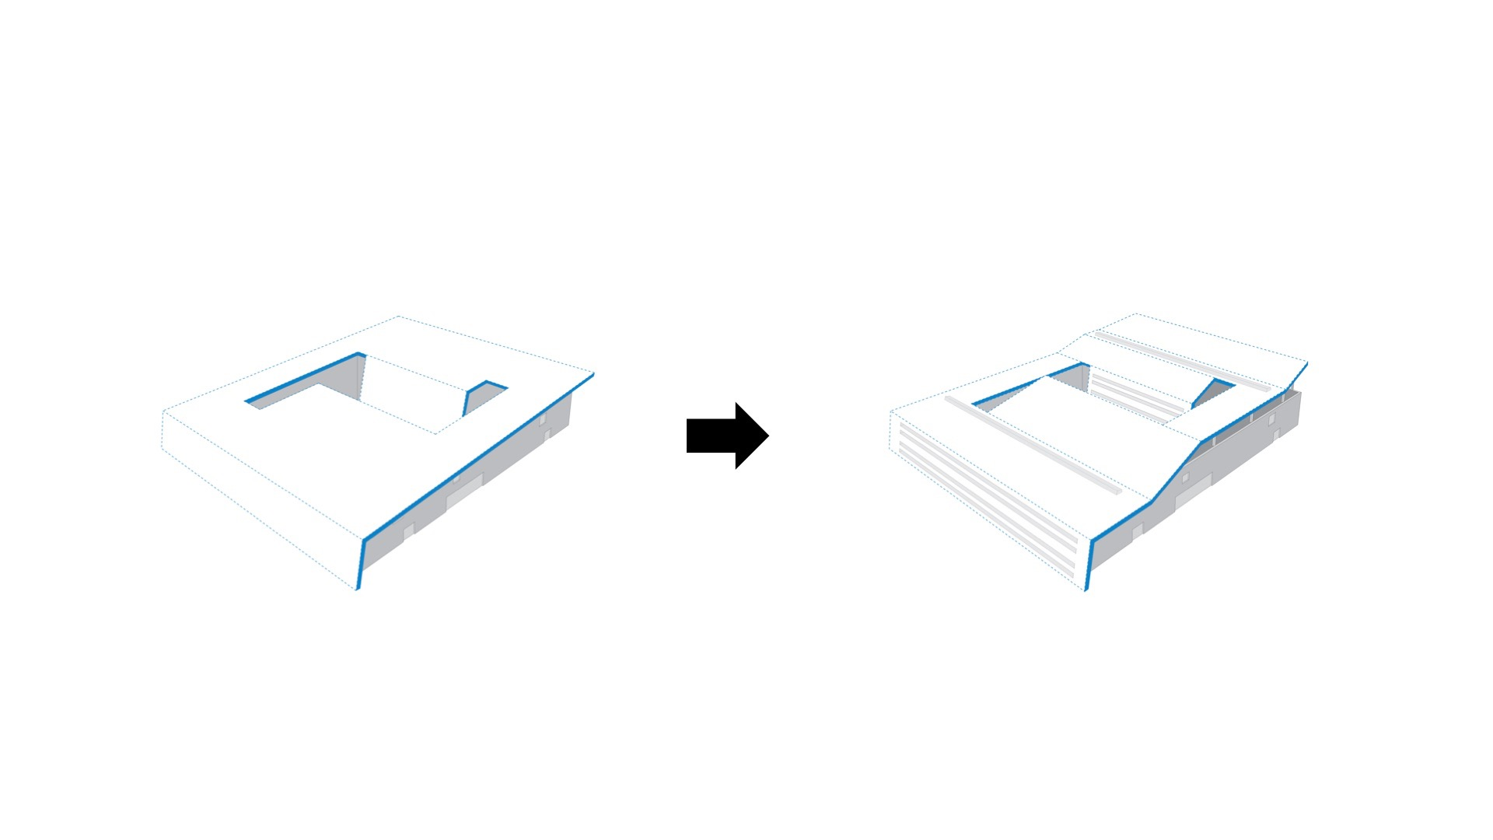

Slide 30
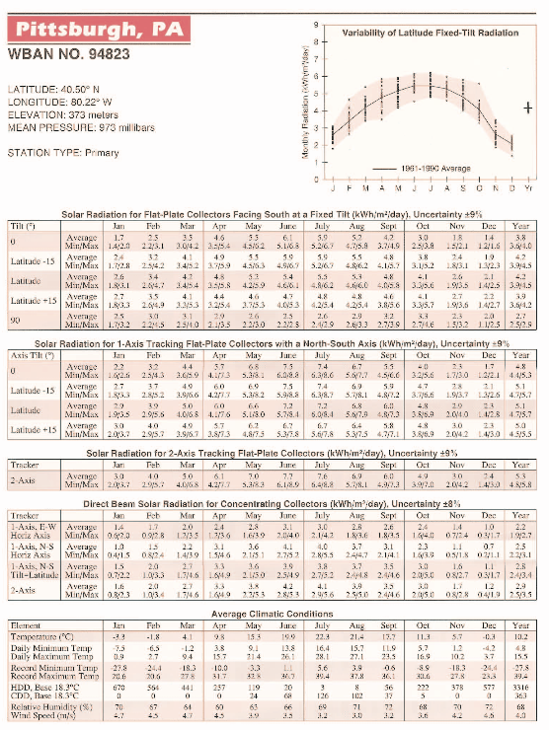
ECS Roof Area:
20,000 ft²
x
0.092903 m²/ft²
=
1800 m²
Pgh Solar Data:
4.2 kWh/m²-day
x
365 days/year
=
1533 kWh/m²-a
ECS Energy Use:
200 kWh/m²-a
x
3500 m²
=
700 MWh-a
ECS PV Potential:
1533 kWh/m²-a
x
1800 m²
=
2759 MWh-a
x
0.12 panel eff
=
331 MWh-a max

Slide 32
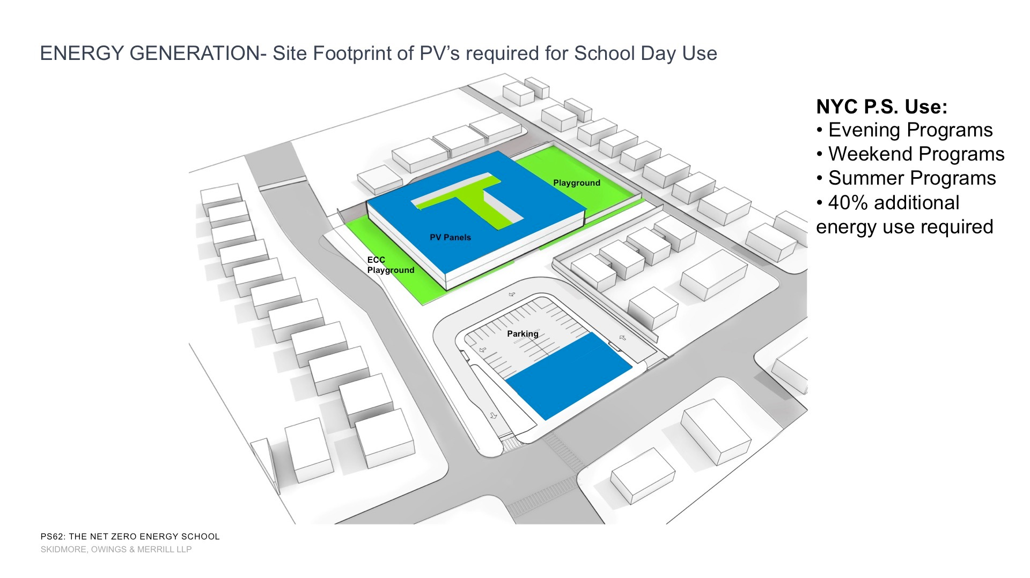

Slide 33
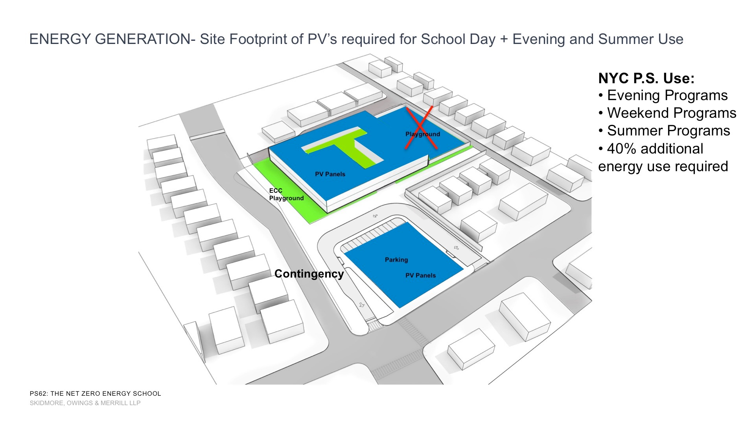

Slide 34
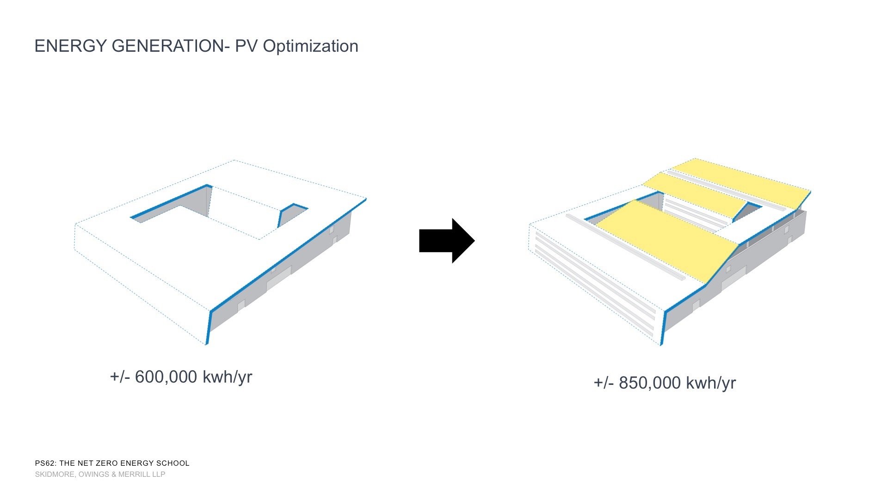

Slide 38
Occupant Behavior

Slide 39
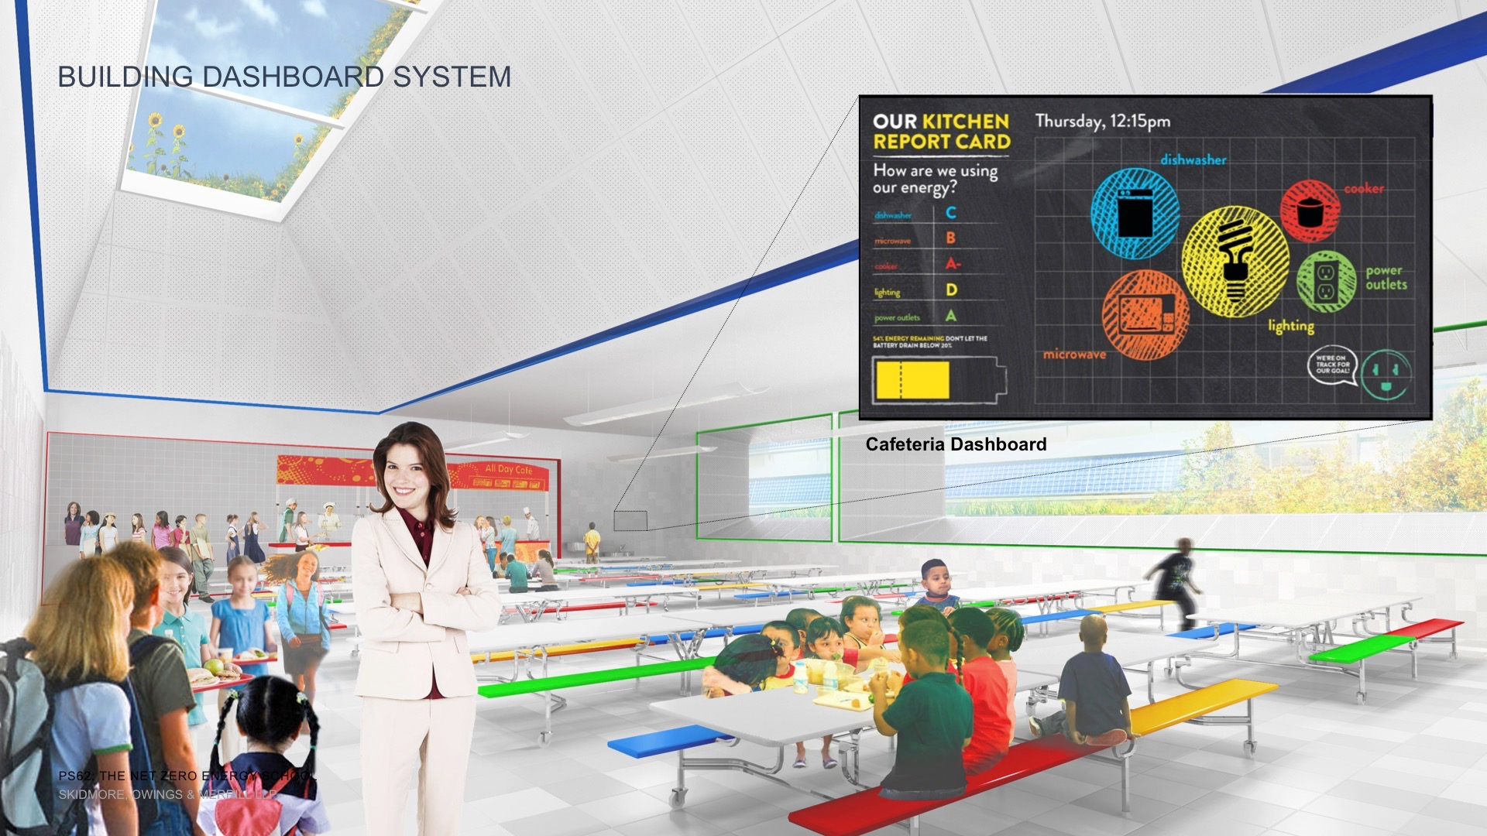

Slide 48
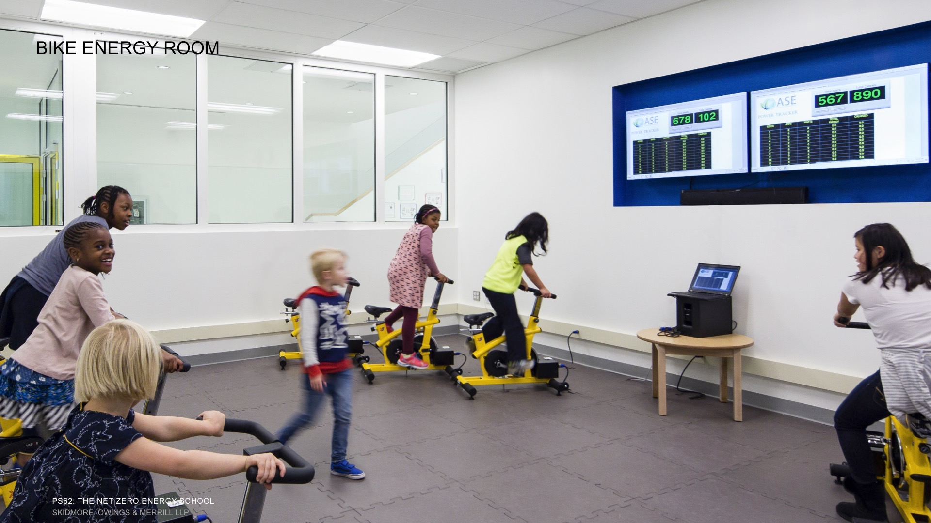

Slide 50
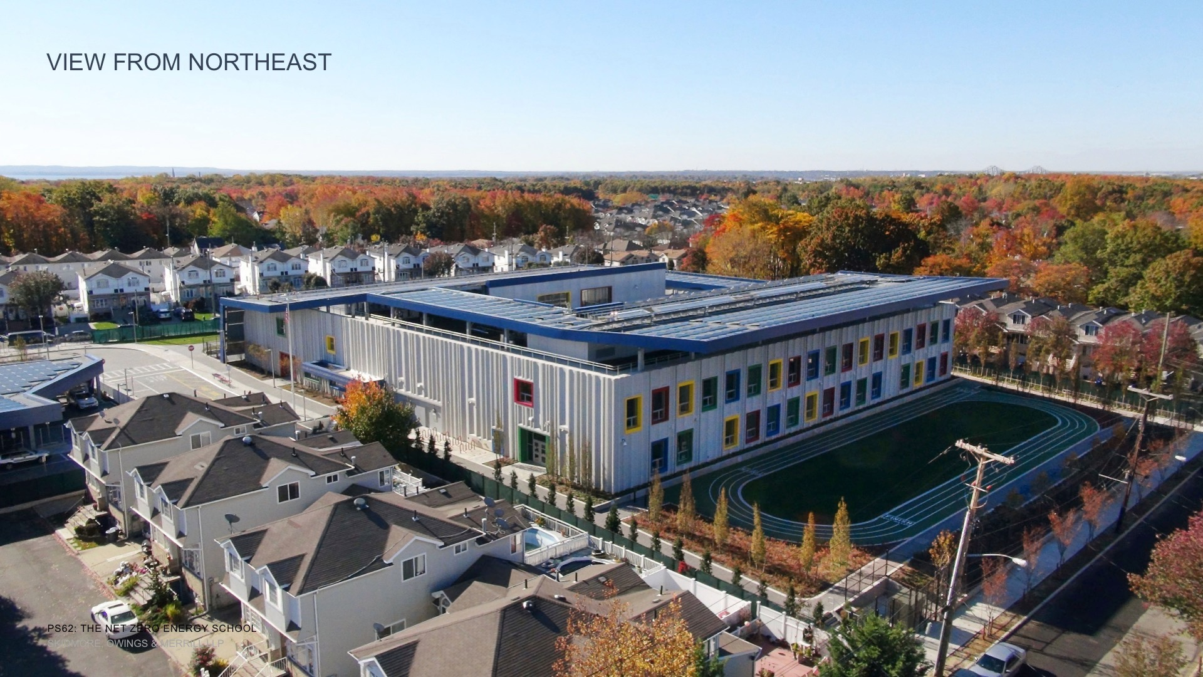

Slide 51
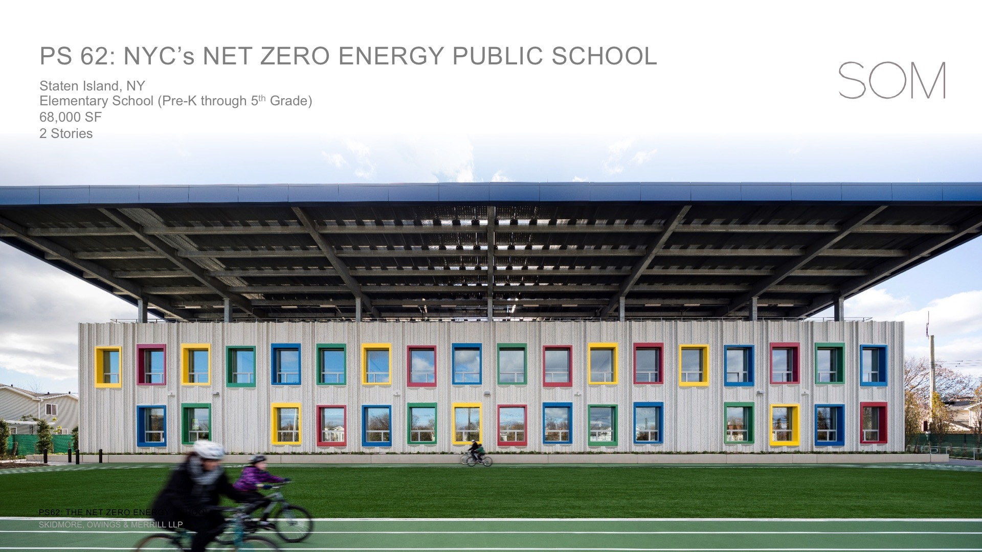

Slide 52
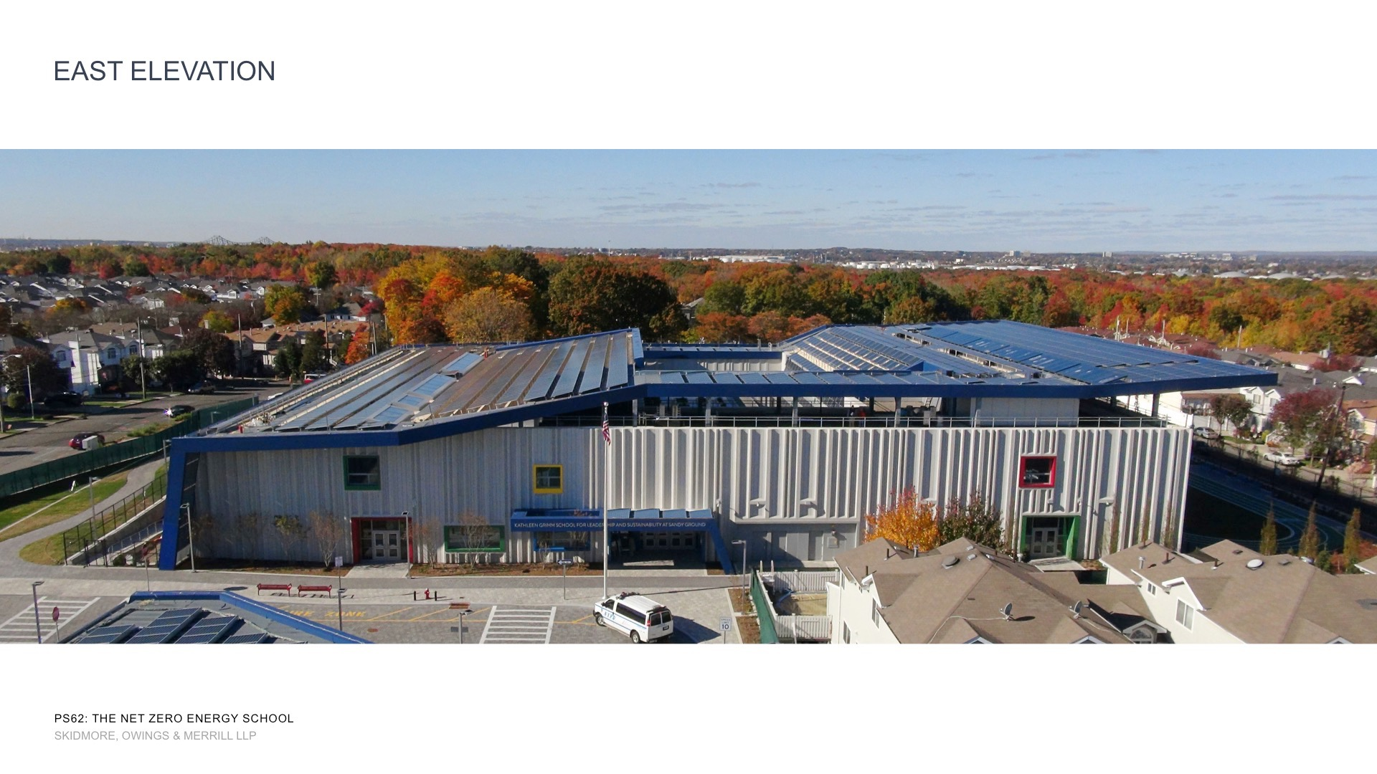

Slide 53
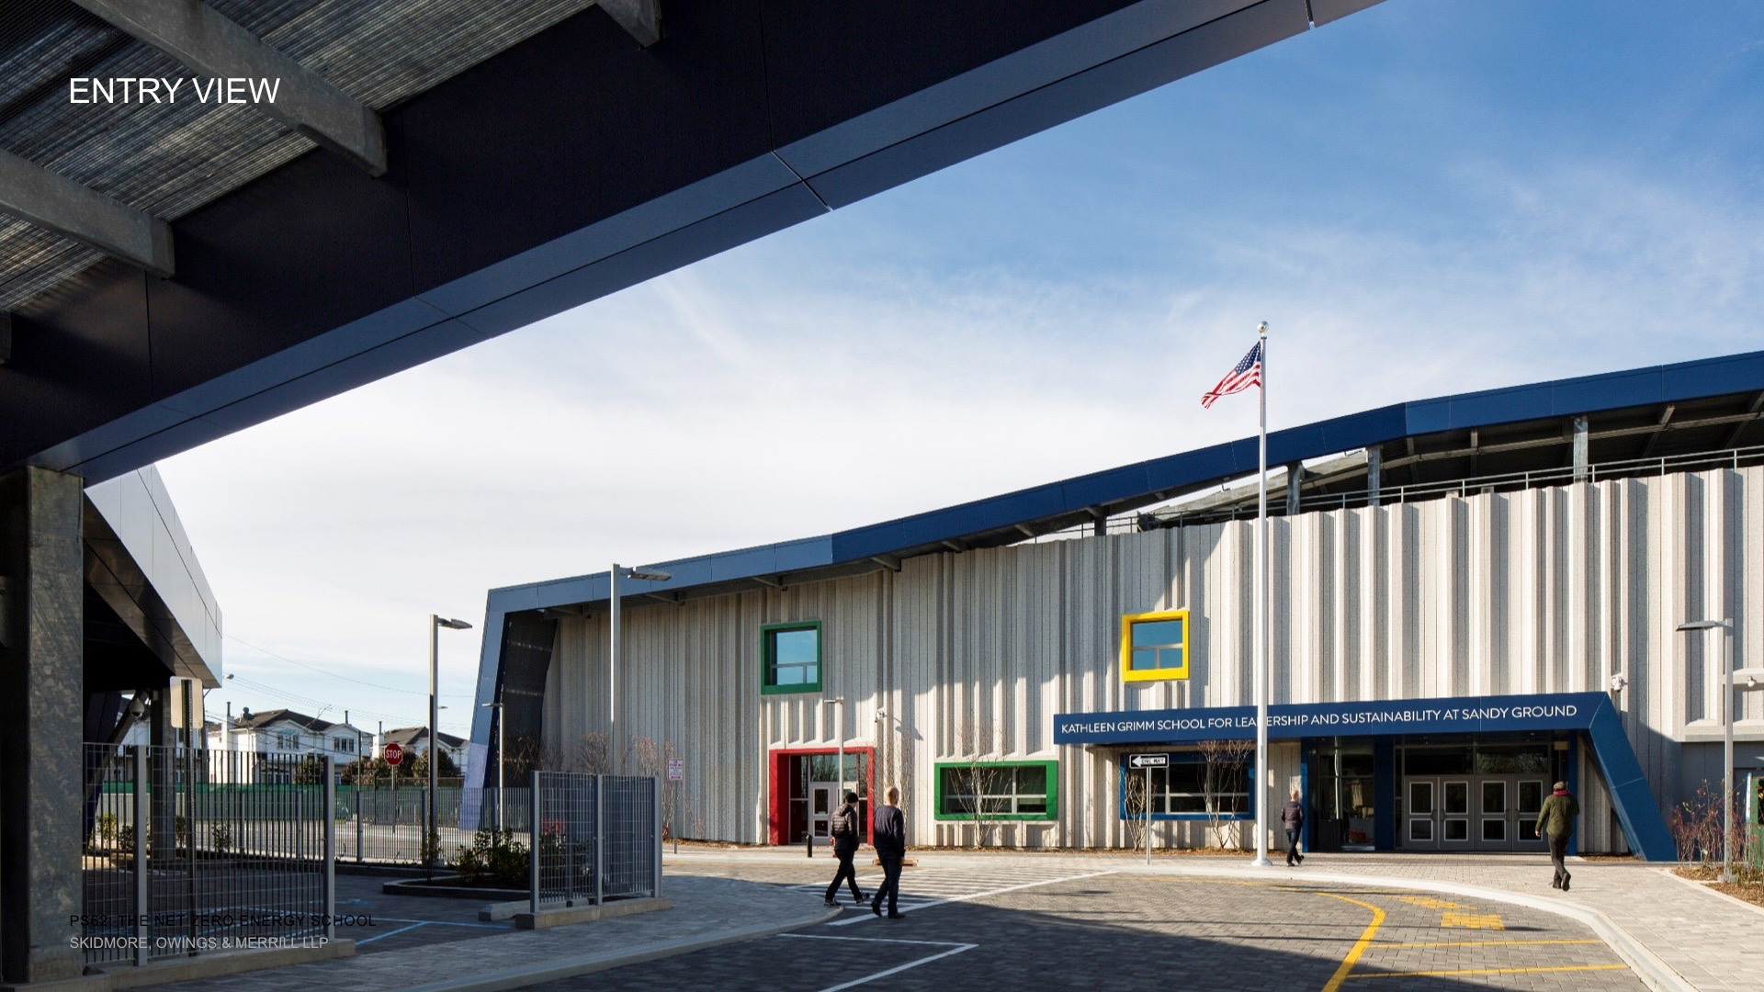

Slide 55
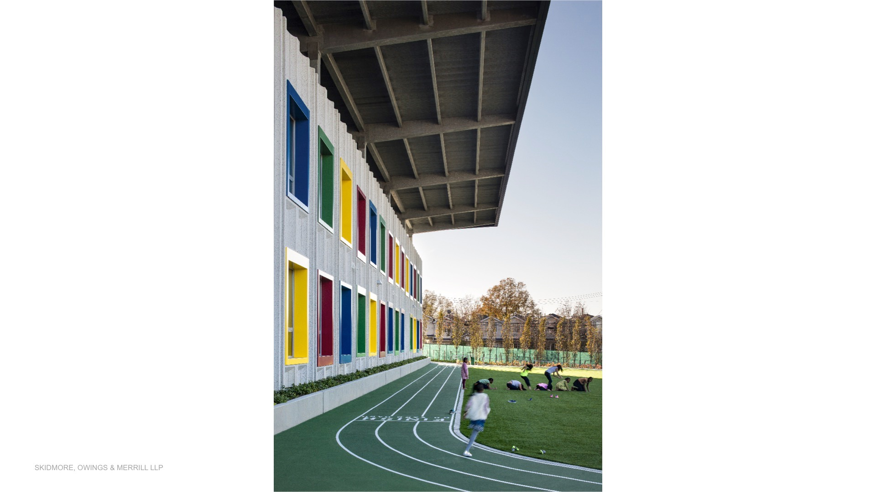

Slide 56
