Slide 1
Week 6 - Lecture Product Documentation

Slide 2
Team Project – Task 1
Submit conceptual sketch of side handle release design.
Submit Project Task List

Slide 3
Lecture Topics
Design Documentation Overview
Design for Manufacturing Overview
Design Documentation Future

Slide 4
Product Lifecycle – Week 6
Requirements
Management
Portfolio Management
Conceptual Design
Product Engineering
Manufacturing Engineering
Simulation & Validation
Build & Produce
Disposal & Recycling
Maintenance & Repair
Sales & Distribution
Test & Quality

Slide 5
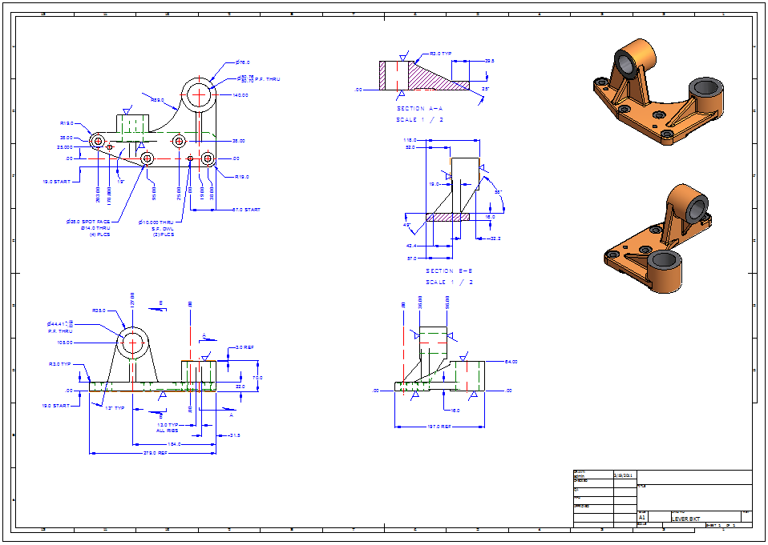
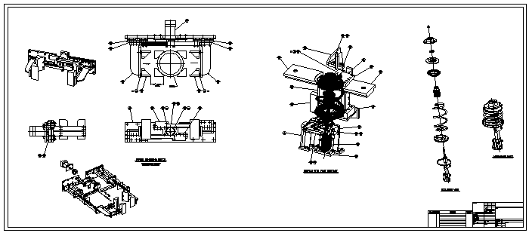
Design Documentation
Creation of digital and paper printed documents for communicating product manufacturing and assembly information.

Slide 6
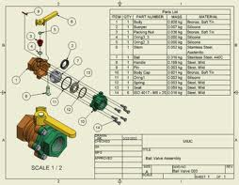
Documentation Types Examples
Component Detail Drawings
Assembly Drawings
Schematic Drawings
Layout Drawings
Process Drawings
Bill of Material Documents
Notes:
In detail drawings, components used to build the mechanical system are described in some detail to show that the designer's specifications are met: relevant codes, standards, geometry, weight, mass, material, heat treatment requirements, surface texture, size tolerances, and geometric tolerances.[
The assembly drawing typically includes three orthographic views of the system: overall dimensions, weight and mass, identification of all the components, quantities of material, supply details, list of reference drawings, and notes. Assembly drawings detail how certain component parts are assembled.
The schematic is a line diagram, not necessarily to scale, that describes interconnection of components in a system.

Slide 7
Design Documentation Purpose
Contract for Manufacturing Agreement
Provides formal documentation of the requirements of the form and fit of components from engineering to manufacturing.
Quality Control
Provides the component tolerance, relationship, specification requirements of components to manufacturing.
Communication
Used to communicate design elements outside of engineering and instructions for manufacturing and service related tasks.
Notes:
Quality control is a process by which entities review the quality of all factors involved in production. This approach places an emphasis on three aspects:
1. Elements such as controls, job management, defined and well managed processes, performance and integrity criteria, and identification of records
2. Competence, such as knowledge, skills, experience, and qualifications
3. Soft elements, such as personnel integrity, confidence, organizational culture, motivation, team spirit, and quality relationships.

Slide 8
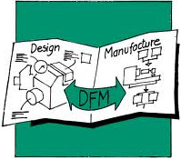
Design for Manufacturing (DFM)
Design for Manufacturing is the process of proactively developing products to:
Optimize all the manufacturing functions
Assure the best cost, quality, reliability, time, and etc.
Ensure the lack of manufacturability doesn’t compromise functionality, styling, product delivery, and etc.
Notes:
DFM is the general engineering art of designing products in such a way that they are easy to manufacture. The basic idea exists in almost all engineering disciplines, but of course the details differ widely depending on the manufacturing technology. This design practice not only focuses on the design aspect of a part but also on the producibility. In simple language it means relative ease to manufacture a product, part or assembly.

Slide 9
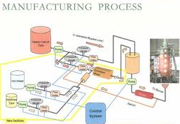
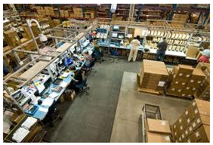
Items to Consider and Communicate
Material Type
Manufacturing Process
Tolerance Requirements
Finish & Treatment Requirements
Setup Required for
Manufacturing

Slide 10
Manufacturing Process Cost
10X
10
8
6X
6
Relative Cost
4
3.5X
2X
2
1.0
0
Rough Machining +/- 0.030”
Standard Machining +/- 0.005”
Fine Machining +/- 0.001”
Grinding +/- 0.0005”
Honing +/- 0.0002”

Slide 11
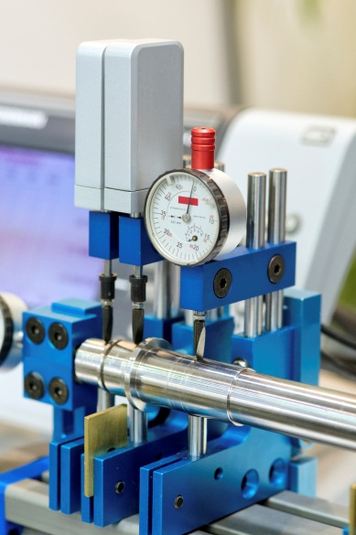
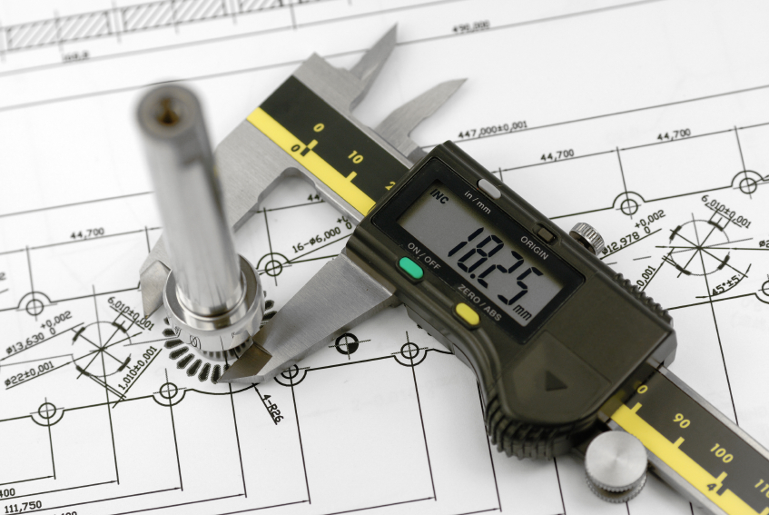
Quality Assurance
Design documentation is also used for checking and inspecting the final manufactured components to validate design requirements.
Notes:
Quality assurance refers to the planned and systematic activities implemented in a quality system so that quality requirements for a product or service will be fulfilled. It is the systematic measurement, comparison with a standard, monitoring of processes and an associated feedback loop that confers error prevention. This can be contrasted with quality control, which is focused on process outputs.
Two principles included in QA are: "Fit for purpose", the product should be suitable for the intended purpose; and "Right first time", mistakes should be eliminated. QA includes management of the quality of raw materials, assemblies, products and components, services related to production, and management, production and inspection processes.
Suitable quality is determined by product users, clients or customers, not by society in general. It is not related to cost and adjectives or descriptors such "high" and "poor" are not applicable. For example, a low priced product may be viewed as having high quality because it is disposable where another may be viewed as having poor quality because it is not disposable.

Slide 12
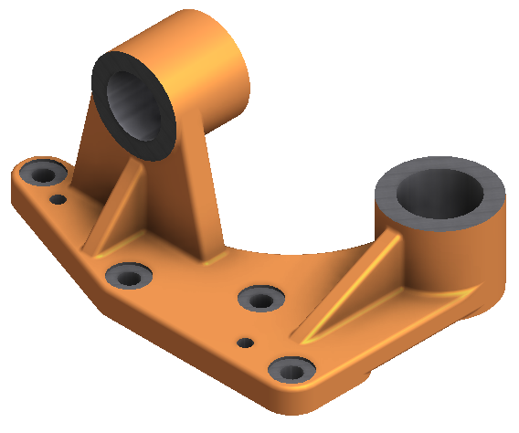
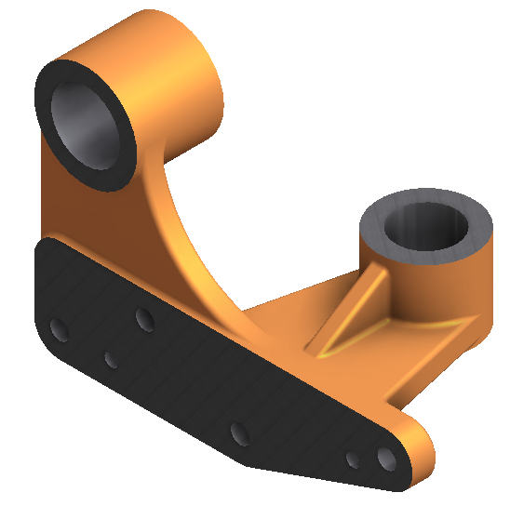
Component Example

Slide 13
Component Example

Slide 14
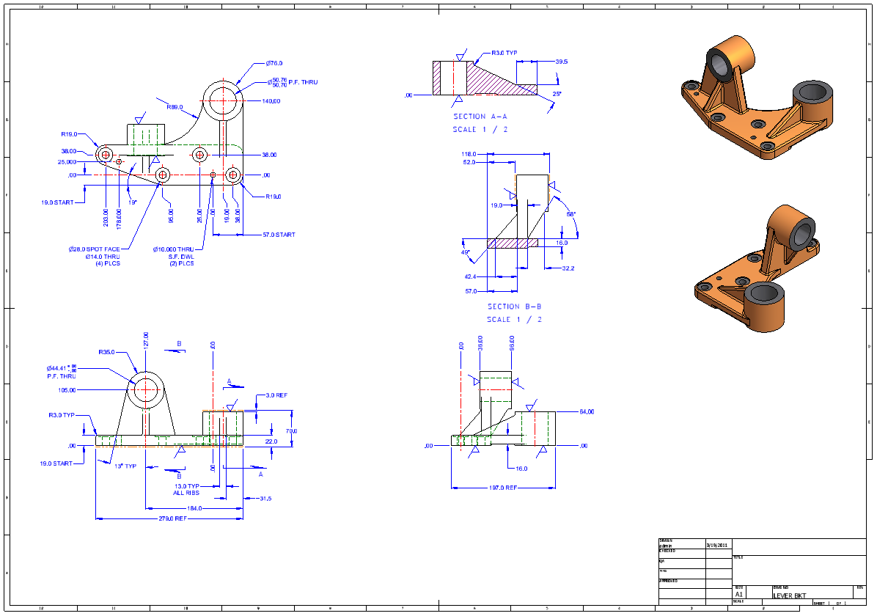
Detailed Drawing

Slide 15
Dimensional Tolerance Chart
Decimal Precision | Tolerance
X | +/- 0.8 mm
X.X | +/- 0.25 mm
X.XX | +/- 0.10 mm
X.XXX | +/- 0.015 mm
Examples
10.0 = Min. 9.75 and Max. 10.25
10.00 = Min. 9.90 and Max. 10.10

Slide 16
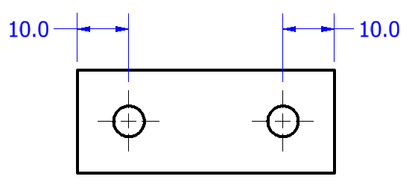
Dimension Tolerance Example

Slide 17
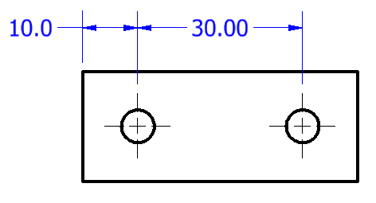
Dimension Tolerance Example

Slide 18
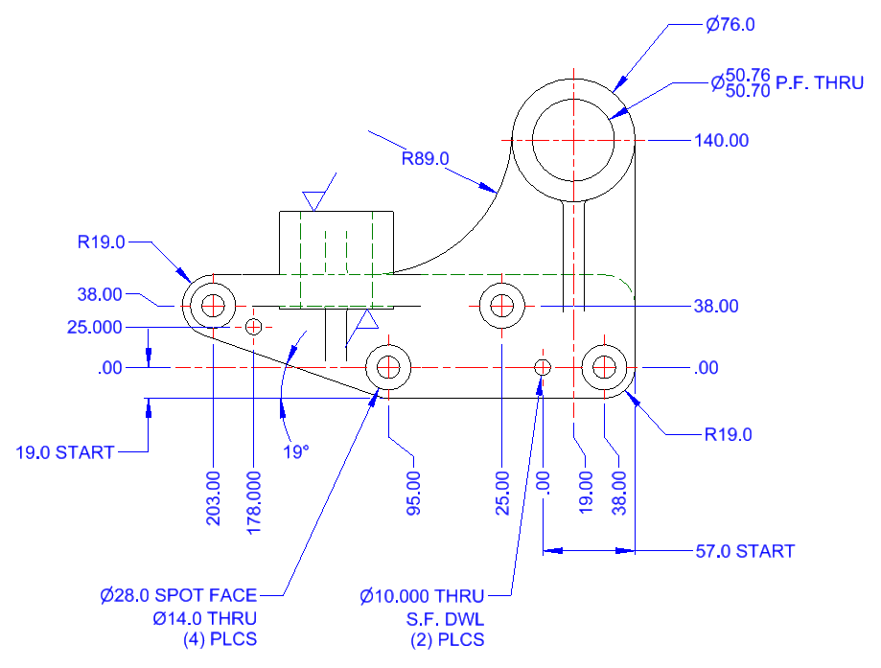
Datum's and Relationships
Notes:
A datum is a theoretical ideal plane, line, point, or cylinder. A datum feature is a physical feature of the part identified by a datum feature symbol and corresponding datum feature triangle.
These are then referred to by one or more datum feature reference which indicate measurements should be made with respect to the corresponding datum feature and may be found in a datum reference frame.

Slide 19
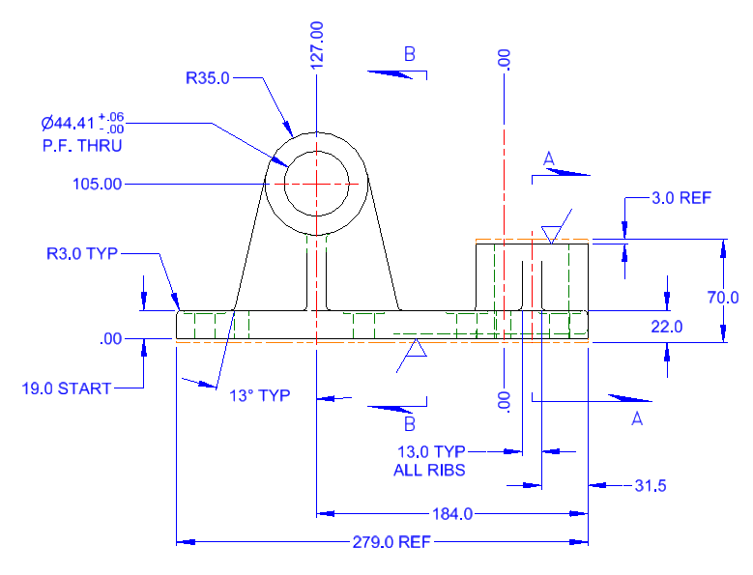
Datum’s and Relationships

Slide 20
Tolerances
Notes:
Engineering tolerance is the permissible limit or limits of variation in
1. A physical dimension,
2. A measured value or physical property of a material, manufactured object, system, or service,
3. Other measured values (such as temperature, humidity, etc.).
4. In engineering and safety, a physical distance or space (tolerance), as in a truck (lorry), train or boat under a bridge as well as a train in a tunnel (see structure gauge and loading gauge).
5. In mechanical engineering the space between a bolt and a nut or a hole, etc..
Dimensions, properties, or conditions may vary within certain practical limits without significantly affecting functioning of equipment or a process. Tolerances are specified to allow reasonable leeway for imperfections and inherent variability without compromising performance.
A variation beyond the tolerance (for example, a temperature that's too hot or too cold) is said to be non-compliant, rejected, or exceeding the tolerance (regardless of if this breach was of the lower or the upper bound). If the tolerance is set too restrictive, resulting in most objects run by it being rejected, it is said to be intolerant.

Slide 21
GD&T
Introduction to GD&T
Feature Control Frame Symbols
ASME Y14.5M-1994 Geometric Dimension and Tolerancing (GD&T)
Notes:
Geometric dimensioning and tolerancing (GD&T) is a system for defining and communicating engineering tolerances. It uses a symbolic language on engineering drawings and computer-generated three-dimensional solid models for explicitly describing nominal geometry and its allowable variation. It tells the manufacturing staff and machines what degree of accuracy and precision is needed on each facet of the part.
Geometric dimensioning and tolerancing (GD&T) is used to define the nominal (theoretically perfect) geometry of parts and assemblies, to define the allowable variation in form and possible size of individual features, and to define the allowable variation between features. Geometric dimensioning and tolerancing specifications are used as follows:
Dimensioning specifications define the nominal, as-modeled or as-intended geometry. One example is a basic dimension.
Tolerancing specifications define the allowable variation for the form and possibly the size of individual features, and the allowable variation in orientation and location between features. Two examples are linear dimensions and feature control frames using a datum reference (both shown above).
There are several standards available worldwide that describe the symbols and define the rules used in GD&T. One such standard is American Society of Mechanical Engineers (ASME) Y14.5-2009. The Y14.5 standard has the advantage of providing a fairly complete set of standards for GD&T in one document. The ISO standards, in comparison, typically only address a single topic at a time.

Slide 22
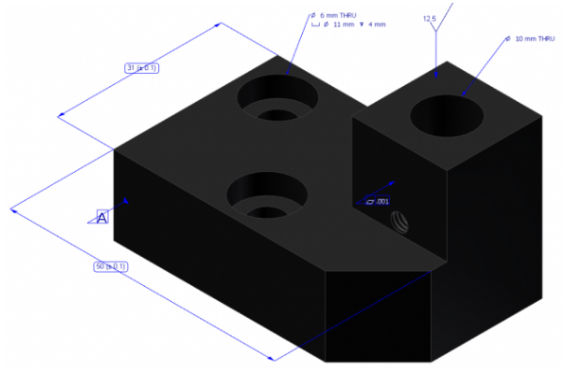
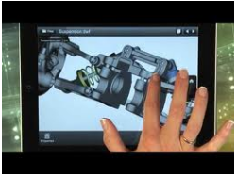
Modern Design Documentation
Several new technologies like the items listed below are being adopted today.
3D Annotation (3DA)
3D Assembly Instructions
Viewing and Markup (Mobile Access)

Slide 23
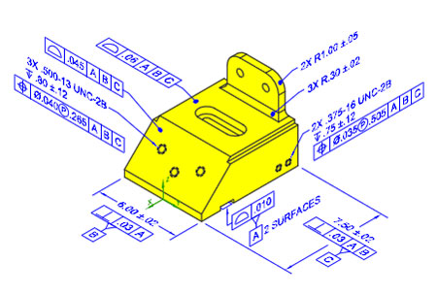
3D Annotation (3DA)
3D Annotation is the method of adding all required manufacturing annotations directly to the 3D model.
Notes:
Used today in the automotive and aerospace industries but is not the most common method.
This could be the next step to paperless manufacturing, but at a minimum will allow engineers and designers properly define a model prior to any 2D detail drawings being created. When it comes to design intent, this will allow a more collaborative design and detailing process.

Slide 24
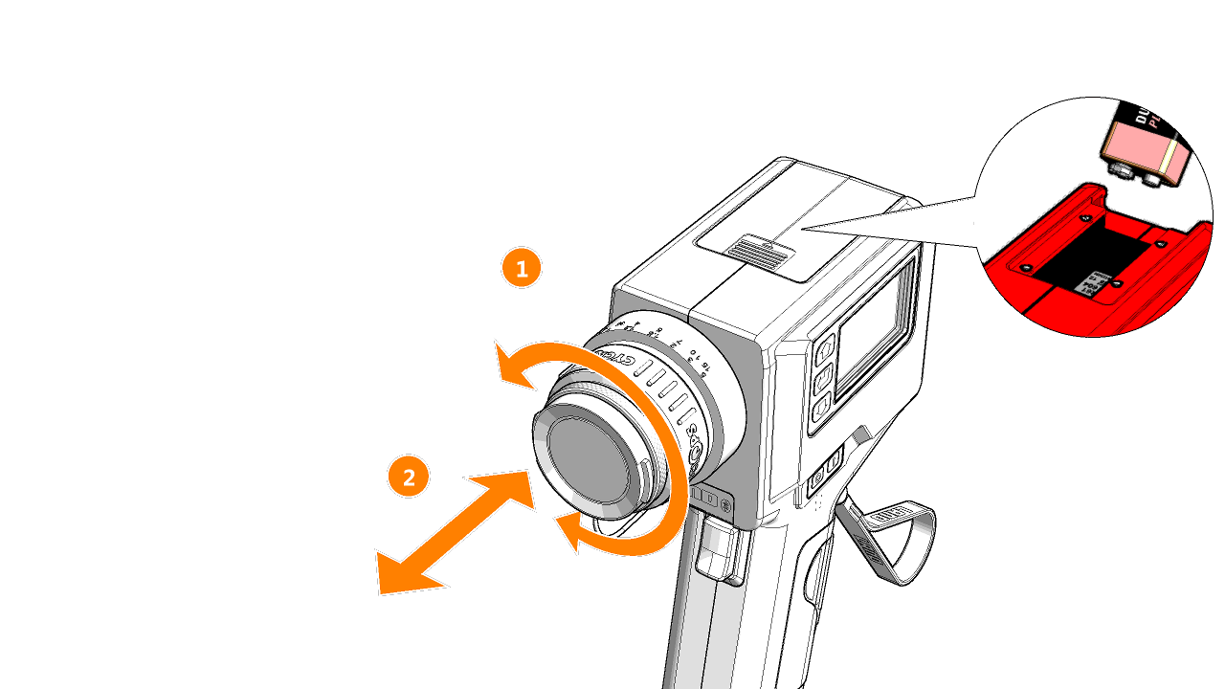
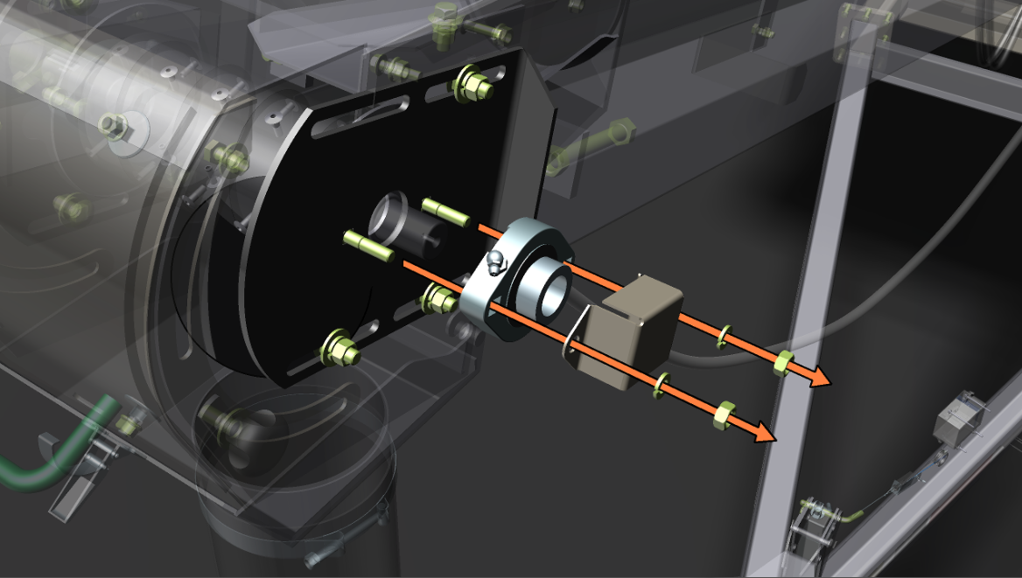
3D Assembly Instructions
Creating visual and interactive 3D technical documentation directly from 3D models.
Notes:
Can eliminate the frustration of trying to figure out how to assemble a piece of furniture, a fixture, or a product: showing exactly which part to use, where it goes, and how the result should look. This can save time and expense and can be cost-effective marketing tool for products.
Check out the video by 123D: http://www.123dview.com/otherservices_animated_assembly_instructions.html

Slide 25
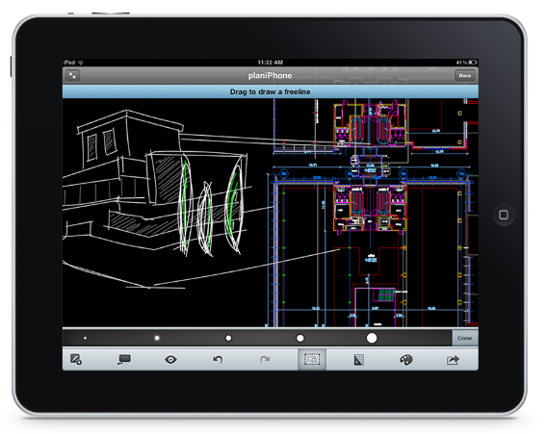
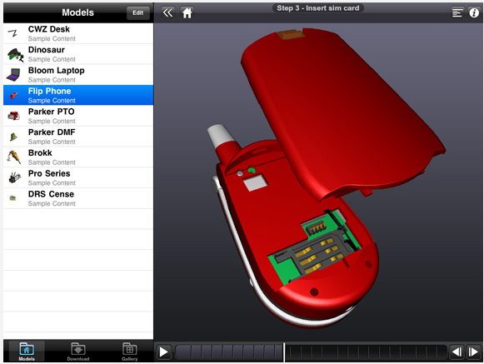
Mobile Viewing and Markup
Access, view, and markup your product documentation on common mobile devices.
Notes:
View and edit files on your mobile device or on the web without any software. Share drawings with others and plot to PDF or DWF. Expedite the design review process by viewing and red-lining design files in the field. Files can even be saved in the cloud so that you’re not using up precious storage space on your mobile devices.

Slide 26
Computer-Cluster Projects (CP6)

Slide 27
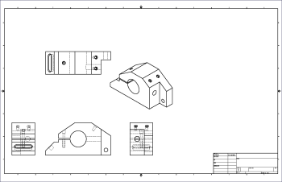
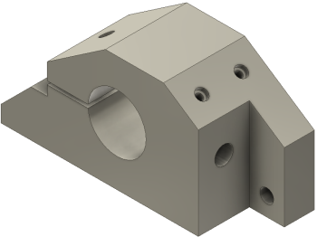
Guided Lab Project 1
Guides instructions for creating drawing views.

Slide 28
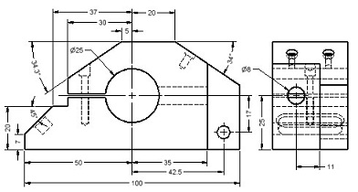
Guided Lab Project 2
Guided instructions for creating drawing dimensions and annotations.

Slide 29
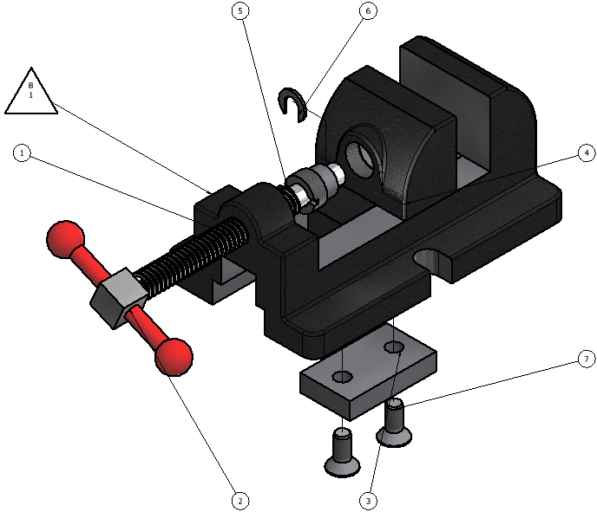
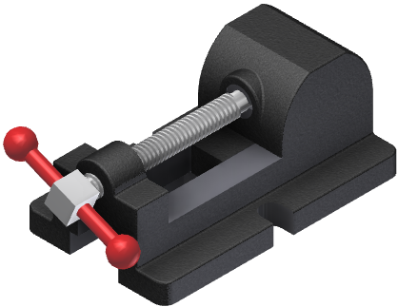
Guided Lab Project 3
Guided instructions for creating assembly drawing with BOM and balloons.

Slide 30
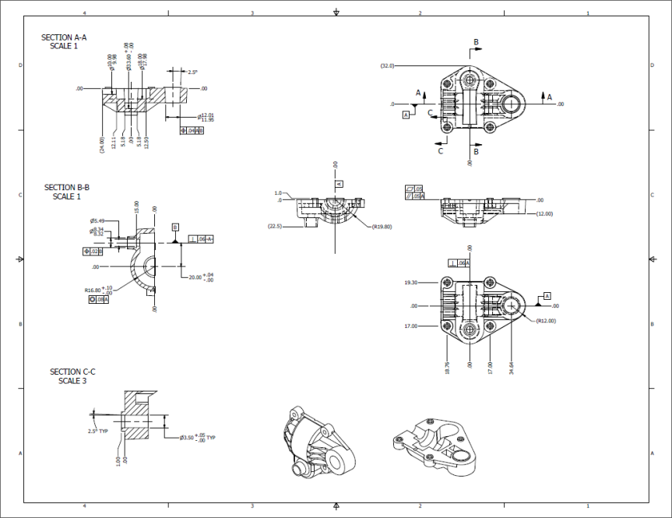
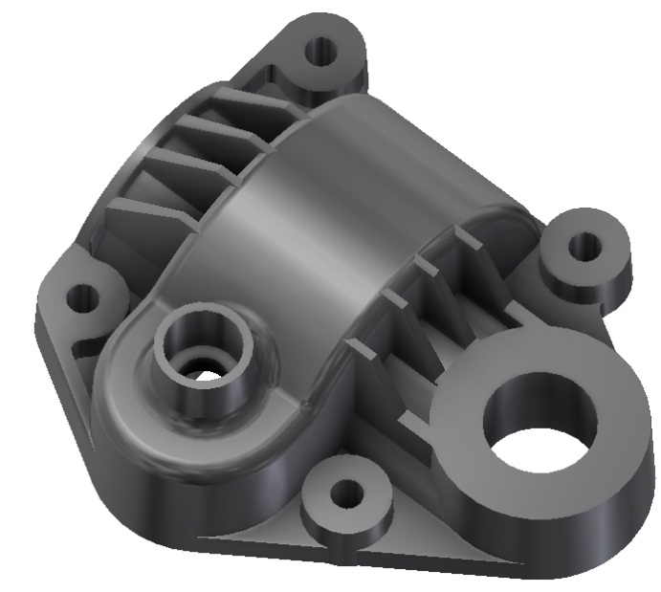
Project Set Assignment
Create part drawing for manufacturing molded plastic gear case.

Slide 31
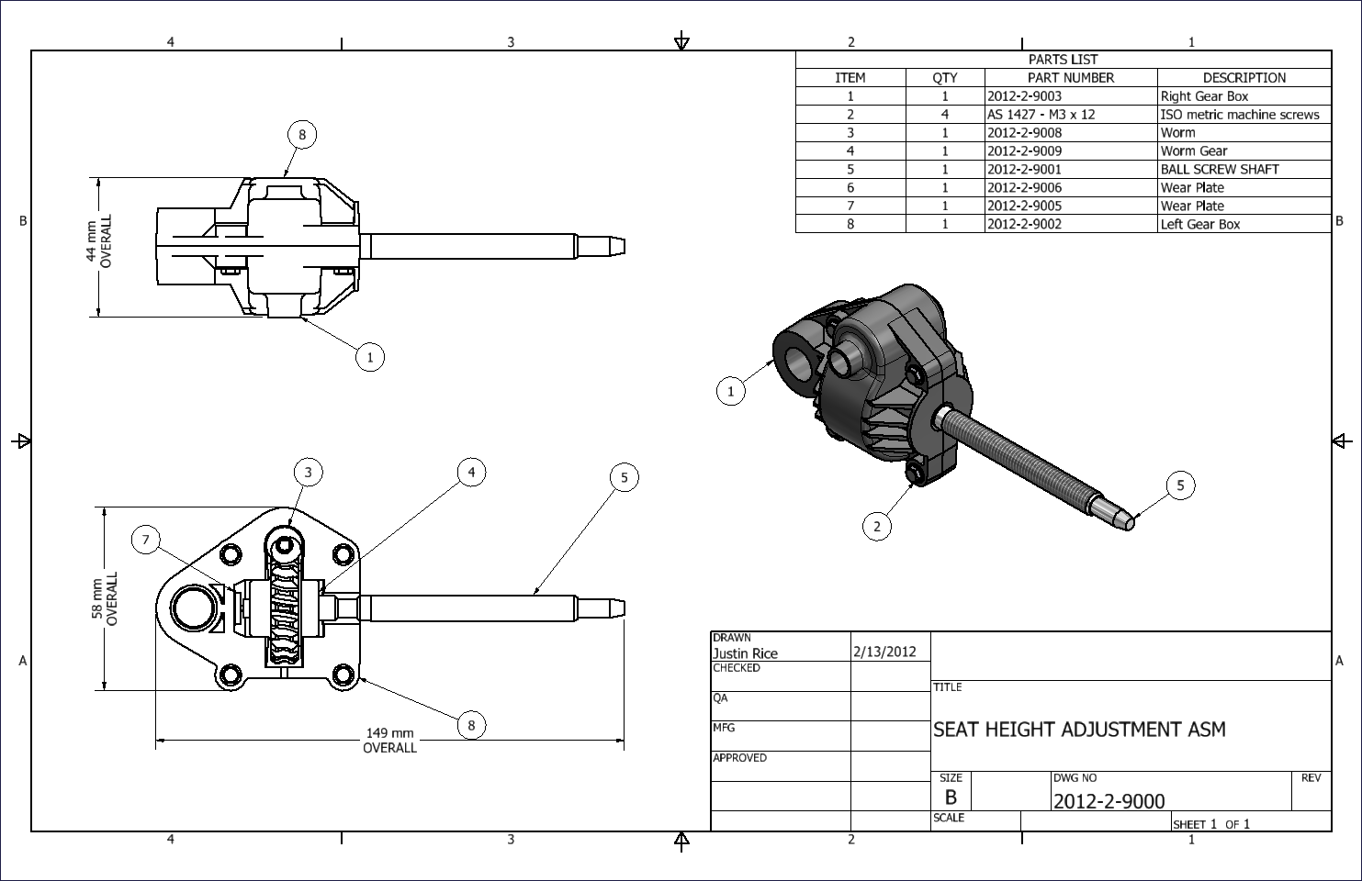
Project Set Assignment
Create and exact replica of the Assembly drawing.

Slide 32
Demo Topics

Slide 33
Bevel Gear Design Accelerator
Drawing Tab
Annotate Tab

Slide 34
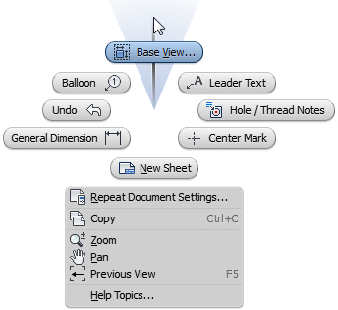
Creating Base Views
Access
Ribbon: Place Views tab > Create panel > Base
Marking Menu: Base View

Slide 35
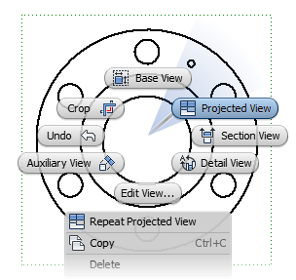
Creating Projected Views
Access
Ribbon: Place Views tab > Create panel > Projected
Marking Menu: Projected View

Slide 36
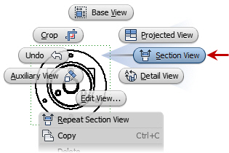
Creating Section Views
Access
Ribbon: Place Views tab > Create panel > Section
Marking Menu: Section View

Slide 37
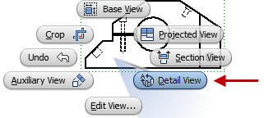
Creating Detail Views
Access
Ribbon: Place Views tab > Create panel > Detail
Marking Menu: Section View

Slide 38
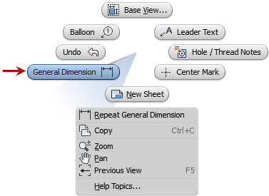
Creating General Dimensions
Access
Ribbon: Annotate tab > Dimension panel > Dimension
Keyboard: D Marking Menu: General Dimension

Slide 39
Creating Ordinate Dimensions
Access
Ribbon: Annotate tab > Dimension panel > Ordinate

Slide 40
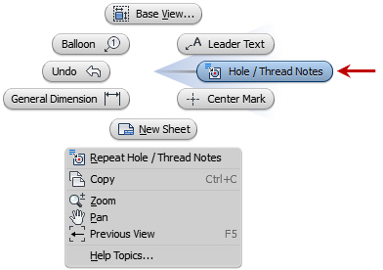
Creating Hole and Thread Notes
Access
Ribbon: Annotate tab > Features panel > Hole and Thread
Marking Menu: Hole / Thread Notes

Slide 41
Creating Centerlines
Access
Ribbon: Annotate tab > Symbols panel > Centerline
Ribbon: Annotate tab > Symbols panel > Center Mark
Ribbon: Annotate tab > Symbols panel > Centerline Bisector

Slide 42
Documenting Views with Symbols
Access
Ribbon: Annotate tab > Symbols panel

Slide 43
Adding Leaders and Text
Access
Ribbon: Annotate tab > Text panel > Text
Ribbon: Annotate tab > Text panel > Leader Text

Slide 44
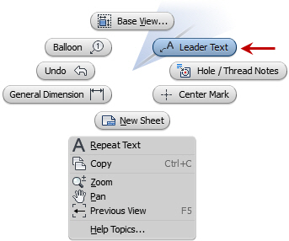
Adding Leaders and Text
Access
Ribbon: Annotate tab > Text panel > Text
Ribbon: Annotate tab > Text panel > Leader Text

Slide 45
Bill of Materials
Access
Ribbon: Assemble tab > Manage panel > Bill of Materials

Slide 46
Parts List
Access
Ribbon: Annotate tab > Table panel > Parts List

Slide 47
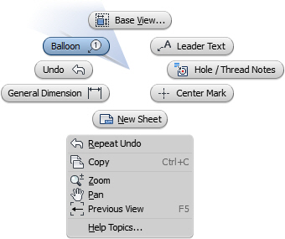
Balloons
Access
Ribbon: Annotate tab > Table panel > Balloon
Marking Menu: Balloon
Keyboard: B

Slide 48
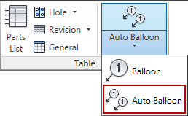
Auto Balloons
Access
Ribbon: Annotate tab > Table panel > Auto Balloon

