Slide 1


Slow and Stale Gradients can win the Race:
Error-Runtime Trade-offs in Distributed SGD
Sanghamitra Dutta
Joint Work with: Jianyu Wang, Gauri Joshi,
Soumyadip Ghosh, Parijat Dube, Priya Nagpurkar
Presented in part at AISTATS 2018
Notes:
Error-runtime trade-offs in distributed SGD

Slide 2
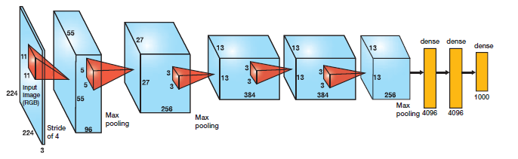
Stochastic Gradient Descent is the backbone of ML
Speeding Up SGD convergence is of critical importance!
Notes:
SGD

Slide 3
This Work:
Speeding Up Distributed SGD via
Scheduling + Algorithmic Techniques
Notes:
This work is about speeding up ‘distributed SGD’. A typical model is the parameter server model. Depending upon how gradients are aggregated, the time per iteration can be different, and error convergence may also be affected. Thus unlike most works that consider convergence wrt to number of iterations, we need to consider convergence wrt the wall-clock time. We need scheduling techniques to reduce the time per iteration, and algorithmic techniques to make the error converge faster

Slide 4
Batch Gradient Descent
F(w) is the empirical risk function
is the n-th labeled sample
Too expensive for large datasets
Notes:
Before going to the main results, let me give some background and describe the problem more concretely

Slide 5
Mini-batch SGD
F(w) is the empirical risk function
is the n-th labeled sample
Noisier, but computationally tractable
For large training datasets single-node SGD can be prohibitively slow…

Slide 6


Synchronous Distributed SGD
Parameter Server
w_{j}
w_{j}
w_{j}
Learner 1
Learner 2
Learner P
is the mini-batch of m samples for l ^{th} learner
Can process a P-times larger mini-batch in each iteration
Bottlenecked by one or more slow/straggling learners
Notes:
Assume data is well-shuffled such that the gradients at a point w_n are i.i.d. across mini-batches and learners

Slide 7
Asynchronous Distributed SGD
Parameter Server
[Recht 2011, Dean 2012, Cipar 2013 …]
w₁
w₁
w₁
Learner 1
Learner 2
Learner P
w₁
w₁
w₁

Slide 8
Asynchronous Distributed SGD
Parameter Server
[Recht 2011, Dean 2012, Cipar 2013 …]
w₂
Learner 1
Learner 2
Learner P
w₂
w₁
w₁

Slide 9
Asynchronous Distributed SGD
Parameter Server
[Recht 2011, Dean 2012, Cipar 2013 …]
Gradient Staleness
w₃
Learner 1
Learner 2
Learner P
w₂
w₃
w₁
Don’t have to wait for straggling learners
Gradient Staleness can increase error

Slide 10
Performance Comparison

Slide 11
Performance Comparison
Synchronous
Log Loss
Log Loss
Asynchronous
Iterations
Wall-clock Time

Slide 12
Performance Comparison
Synchronous
Log Loss
Log Loss
Asynchronous
Iterations
Wall-clock Time
Need to understand convergence with wall-clock time and not only with number of iterations!
Notes:
The main takeaway is: we need to

Slide 13
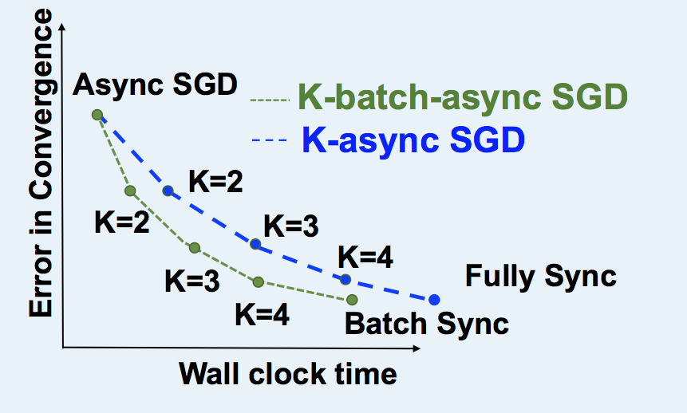
Question: How do the Error-Runtime trade-offs compare?
Notes:
The main question that we ask:

Slide 14
Assumptions for Runtime Analysis
Runtime is a random variable

Slide 15
Assumptions for Runtime Analysis
Runtime is a random variable
Independent and identically distributed across different learners and mini-batches

Slide 16
Assumptions for Runtime Analysis
Runtime is a random variable
Independent and identically distributed across different learners and mini-batches

Slide 17
Expected Runtimes of SGD Variants
Sync variants
Fully Sync-SGD
K-sync SGD
K-batch-sync SGD
w₀
w₀
w₁
w₂
w₀
w₁
w₂
PS
PS
PS
L₁
L₁
L₁
L₂
L₂
L₂
L₃
L₃
L₃

Slide 18
Expected Runtimes of SGD Variants
Sync variants
Fully Sync-SGD
K-sync SGD
K-batch-sync SGD
w₀
w₀
w₁
w₂
w₀
w₁
w₂
PS
PS
PS
L₁
L₁
L₁
L₂
L₂
L₂
L₃
L₃
L₃

Slide 19
Expected Runtimes of SGD Variants
Sync variants
Fully Sync-SGD
K-sync SGD
K-batch-sync SGD
w₀
w₁
w₀
w₁
w₂
w₀
w₁
w₂
PS
PS
PS
L₁
L₁
L₁
L₂
L₂
L₂
L₃
L₃
L₃

Slide 20
Expected Runtimes of SGD Variants
Sync variants
Fully Sync-SGD
K-sync SGD
K-batch-sync SGD
w₀
w₁
w₀
w₁
w₂
w₀
w₁
w₂
PS
PS
PS
L₁
L₁
L₁
L₂
L₂
L₂
L₃
L₃
L₃

Slide 21
Expected Runtimes of SGD Variants
Sync variants
Fully Sync-SGD
K-sync SGD
K-batch-sync SGD
w₀
w₁
w₂
w₀
w₁
w₂
w₀
w₁
w₂
PS
PS
PS
L₁
L₁
L₁
L₂
L₂
L₂
L₃
L₃
L₃

Slide 22
Expected Runtimes of SGD Variants
Sync variants
Fully Sync-SGD
K-sync SGD
K-batch-sync SGD
w₀
w₁
w₂
w₀
w₀
w₁
w₂
PS
PS
PS
L₁
L₁
L₁
L₂
L₂
L₂
L₃
L₃
L₃

Slide 23
Expected Runtimes of SGD Variants
Sync variants
Fully Sync-SGD
K-sync SGD
K-batch-sync SGD
w₀
w₁
w₂
w₀
w₁
w₀
w₁
w₂
PS
PS
PS
L₁
L₁
L₁
L₂
L₂
L₂
L₃
L₃
L₃

Slide 24
Expected Runtimes of SGD Variants
Sync variants
Fully Sync-SGD
K-sync SGD
K-batch-sync SGD
w₀
w₁
w₂
w₀
w₁
w₀
w₁
w₂
PS
PS
PS
L₁
L₁
L₁
L₂
L₂
L₂
L₃
L₃
L₃

Slide 25
Expected Runtimes of SGD Variants
Sync variants
Fully Sync-SGD
K-sync SGD
K-batch-sync SGD
w₀
w₁
w₂
w₀
w₁
w₂
w₀
w₁
w₂
PS
PS
PS
L₁
L₁
L₁
L₂
L₂
L₂
L₃
L₃
L₃

Slide 26
Expected Runtimes of SGD Variants
Sync variants
Fully Sync-SGD
K-sync SGD
K-batch-sync SGD
w₀
w₁
w₂
w₀
w₁
w₂
w₀
PS
PS
PS
L₁
L₁
L₁
L₂
L₂
L₂
L₃
L₃
L₃

Slide 27
Expected Runtimes of SGD Variants
Sync variants
Fully Sync-SGD
K-sync SGD
K-batch-sync SGD
w₀
w₁
w₂
w₀
w₁
w₂
w₀
PS
PS
PS
L₁
L₁
L₁
L₂
L₂
L₂
L₃
L₃
L₃

Slide 28
Expected Runtimes of SGD Variants
Sync variants
Fully Sync-SGD
K-sync SGD
K-batch-sync SGD
w₀
w₁
w₂
w₀
w₁
w₂
w₀
w₁
PS
PS
PS
L₁
L₁
L₁
L₂
L₂
L₂
L₃
L₃
L₃

Slide 29
Expected Runtimes of SGD Variants
Sync variants
Fully Sync-SGD
K-sync SGD
K-batch-sync SGD
w₀
w₁
w₂
w₀
w₁
w₂
w₀
w₁
PS
PS
PS
L₁
L₁
L₁
L₂
L₂
L₂
L₃
L₃
L₃

Slide 30
Expected Runtimes of SGD Variants
Sync variants
Fully Sync-SGD
K-sync SGD
K-batch-sync SGD
w₀
w₁
w₂
w₀
w₁
w₂
w₀
w₁
PS
PS
PS
L₁
L₁
L₁
L₂
L₂
L₂
L₃
L₃
L₃

Slide 31
Expected Runtimes of SGD Variants
Sync variants
Fully Sync-SGD
K-sync SGD
K-batch-sync SGD
w₀
w₁
w₂
w₀
w₁
w₂
w₀
w₁
w₂
PS
PS
PS
L₁
L₁
L₁
L₂
L₂
L₂
L₃
L₃
L₃

Slide 32
Expected Runtimes of SGD Variants
Sync variants
Fully Sync-SGD
K-sync SGD
K-batch-sync SGD
w₀
w₁
w₂
w₀
w₁
w₂
w₀
w₁
w₂
PS
PS
PS
L₁
L₁
L₁
L₂
L₂
L₂
L₃
L₃
L₃

Slide 33

Expected Runtimes of SGD Variants
Sync variants
Fully Sync-SGD
K-sync SGD
K-batch-sync SGD
w₀
w₁
w₂
w₀
w₁
w₂
w₀
w₁
w₂
PS
PS
PS
L₁
L₁
L₁
L₂
L₂
L₂
L₃
L₃
L₃

Slide 34
Expected Runtimes of SGD Variants
Sync variants
Fully Sync-SGD
K-sync SGD
K-batch-sync SGD
w₀
w₁
w₂
w₀
w₁
w₂
w₀
w₁
w₂
PS
PS
PS
L₁
L₁
L₁
L₂
L₂
L₂
L₃
L₃
L₃
[Gupta et al. ICDM 2016] [Chen et al. 2016]

Slide 35
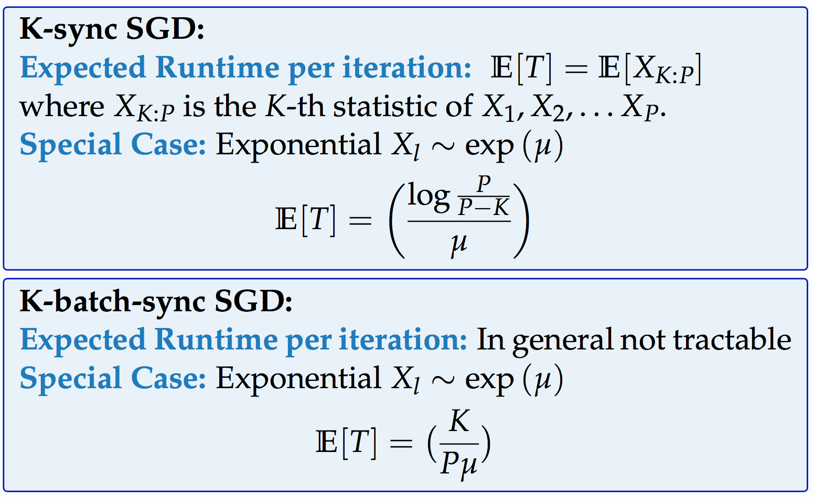
Expected Runtimes of SGD Variants
K-sync SGD
K-batch-sync SGD
w₀
w₁
w₂
w₀
w₁
w₂
PS
PS
L₁
L₁
L₂
L₂
L₃
L₃

Slide 36
Expected Runtimes of SGD Variants
K-sync SGD
K-batch-sync SGD
w₀
w₁
w₂
w₀
w₁
w₂
PS
PS
L₁
L₁
L₂
L₂
L₃
L₃

Slide 37
Expected Runtimes of SGD Variants
K-sync SGD
K-batch-sync SGD
w₀
w₁
w₂
w₀
w₁
w₂
PS
PS
L₁
L₁
L₂
L₂
L₃
L₃

Slide 38
Expected Runtimes of SGD Variants
K-sync SGD
K-batch-sync SGD
w₀
w₁
w₂
w₀
w₁
w₂
PS
PS
L₁
L₁
Key Idea of the Proof:
Every gradient push – minimum of P exponentials
L₂
L₂
L₃
L₃

Slide 39
Expected Runtimes of SGD Variants
K-sync SGD
K-batch-sync SGD
w₀
w₁
w₂
w₀
w₁
w₂
PS
PS
L₁
L₁
L₂
L₂
L₃
L₃

Slide 40
Expected Runtimes of SGD Variants
Async variants
Async SGD
K-Async SGD
K-Batch Async SGD
w₀
w₀
w₁
w₂
w₃
w₀
w₁
w₂
w₃
PS
PS
PS
L₁
L₁
L₁
L₂
L₂
L₂
L₃
L₃
L₃

Slide 41
Expected Runtimes of SGD Variants
Async variants
Async SGD
K-Async SGD
K-Batch Async SGD
w₀
w₁
w₀
w₁
w₂
w₃
w₀
w₁
w₂
w₃
PS
PS
PS
L₁
L₁
L₁
L₂
L₂
L₂
L₃
L₃
L₃

Slide 42
Expected Runtimes of SGD Variants
Async variants
Async SGD
K-Async SGD
K-Batch Async SGD
w₀
w₁
w₀
w₁
w₂
w₃
w₀
w₁
w₂
w₃
PS
PS
PS
L₁
L₁
L₁
L₂
L₂
L₂
L₃
L₃
L₃

Slide 43
Expected Runtimes of SGD Variants
Async variants
Async SGD
K-Async SGD
K-Batch Async SGD
w₀
w₁
w₂
w₀
w₁
w₂
w₃
w₀
w₁
w₂
w₃
PS
PS
PS
L₁
L₁
L₁
L₂
L₂
L₂
L₃
L₃
L₃

Slide 44
Expected Runtimes of SGD Variants
Async variants
Async SGD
K-Async SGD
K-Batch Async SGD
w₀
w₁
w₂
w₀
w₁
w₂
w₃
w₀
w₁
w₂
w₃
PS
PS
PS
L₁
L₁
L₁
L₂
L₂
L₂
L₃
L₃
L₃

Slide 45
Expected Runtimes of SGD Variants
Async variants
Async SGD
K-Async SGD
K-Batch Async SGD
w₀
w₁
w₂
w₃
w₀
w₁
w₂
w₃
w₀
w₁
w₂
w₃
PS
PS
PS
L₁
L₁
L₁
L₂
L₂
L₂
L₃
L₃
L₃

Slide 46
Expected Runtimes of SGD Variants
Async variants
Async SGD
K-Async SGD
K-Batch Async SGD
w₀
w₁
w₂
w₃
w₀
w₁
w₂
w₃
w₀
w₁
w₂
w₃
PS
PS
PS
L₁
L₁
L₁
L₂
L₂
L₂
L₃
L₃
L₃

Slide 47
Expected Runtimes of SGD Variants
Async variants
Async SGD
K-Async SGD
K-Batch Async SGD
w₀
w₁
w₂
w₃
w₀
w₀
w₁
w₂
w₃
PS
PS
PS
L₁
L₁
L₁
L₂
L₂
L₂
L₃
L₃
L₃

Slide 48
Expected Runtimes of SGD Variants
Async variants
Async SGD
K-Async SGD
K-Batch Async SGD
w₀
w₁
w₂
w₃
w₀
w₁
w₀
w₁
w₂
w₃
PS
PS
PS
L₁
L₁
L₁
L₂
L₂
L₂
L₃
L₃
L₃

Slide 49
Expected Runtimes of SGD Variants
Async variants
Async SGD
K-Async SGD
K-Batch Async SGD
w₀
w₁
w₂
w₃
w₀
w₁
w₀
w₁
w₂
w₃
PS
PS
PS
L₁
L₁
L₁
L₂
L₂
L₂
L₃
L₃
L₃

Slide 50
Expected Runtimes of SGD Variants
Async variants
Async SGD
K-Async SGD
K-Batch Async SGD
w₀
w₁
w₂
w₃
w₀
w₁
w₂
w₀
w₁
w₂
w₃
PS
PS
PS
L₁
L₁
L₁
L₂
L₂
L₂
L₃
L₃
L₃

Slide 51
Expected Runtimes of SGD Variants
Async variants
Async SGD
K-Async SGD
K-Batch Async SGD
w₀
w₁
w₂
w₃
w₀
w₁
w₂
w₀
w₁
w₂
w₃
PS
PS
PS
L₁
L₁
L₁
L₂
L₂
L₂
L₃
L₃
L₃

Slide 52
Expected Runtimes of SGD Variants
Async variants
Async SGD
K-Async SGD
K-Batch Async SGD
w₀
w₁
w₂
w₃
w₀
w₁
w₂
w₃
w₀
w₁
w₂
w₃
PS
PS
PS
L₁
L₁
L₁
L₂
L₂
L₂
L₃
L₃
L₃

Slide 53
Expected Runtimes of SGD Variants
Async variants
Async SGD
K-Async SGD
K-Batch Async SGD
w₀
w₁
w₂
w₃
w₀
w₁
w₂
w₃
w₀
PS
PS
PS
L₁
L₁
L₁
L₂
L₂
L₂
L₃
L₃
L₃

Slide 54
Expected Runtimes of SGD Variants
Async variants
Async SGD
K-Async SGD
K-Batch Async SGD
w₀
w₁
w₂
w₃
w₀
w₁
w₂
w₃
w₀
PS
PS
PS
L₁
L₁
L₁
L₂
L₂
L₂
L₃
L₃
L₃

Slide 55
Expected Runtimes of SGD Variants
Async variants
Async SGD
K-Async SGD
K-Batch Async SGD
w₀
w₁
w₂
w₃
w₀
w₁
w₂
w₃
w₀
w₁
PS
PS
PS
L₁
L₁
L₁
L₂
L₂
L₂
L₃
L₃
L₃

Slide 56
Expected Runtimes of SGD Variants
Async variants
Async SGD
K-Async SGD
K-Batch Async SGD
w₀
w₁
w₂
w₃
w₀
w₁
w₂
w₃
w₀
w₁
PS
PS
PS
L₁
L₁
L₁
L₂
L₂
L₂
L₃
L₃
L₃

Slide 57
Expected Runtimes of SGD Variants
Async variants
Async SGD
K-Async SGD
K-Batch Async SGD
w₀
w₁
w₂
w₃
w₀
w₁
w₂
w₃
w₀
w₁
w₂
PS
PS
PS
L₁
L₁
L₁
L₂
L₂
L₂
L₃
L₃
L₃

Slide 58
Expected Runtimes of SGD Variants
Async variants
Async SGD
K-Async SGD
K-Batch Async SGD
w₀
w₁
w₂
w₃
w₀
w₁
w₂
w₃
w₀
w₁
w₂
PS
PS
PS
L₁
L₁
L₁
L₂
L₂
L₂
L₃
L₃
L₃

Slide 59
Expected Runtimes of SGD Variants
Async variants
Async SGD
K-Async SGD
K-Batch Async SGD
w₀
w₁
w₂
w₃
w₀
w₁
w₂
w₃
w₀
w₁
w₂
w₃
PS
PS
PS
L₁
L₁
L₁
L₂
L₂
L₂
L₃
L₃
L₃

Slide 60
Expected Runtimes of SGD Variants
Async variants
Async SGD
K-Async SGD
K-Batch Async SGD
w₀
w₁
w₂
w₃
w₀
w₁
w₂
w₃
w₀
w₁
w₂
w₃
PS
PS
PS
L₁
L₁
L₁
L₂
L₂
L₂
L₃
L₃
L₃

Slide 61
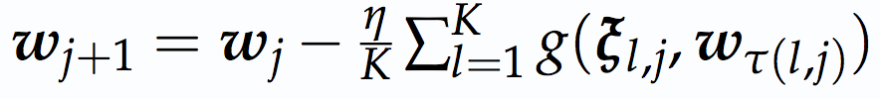
Expected Runtimes of SGD Variants
Async variants
Async SGD
K-Async SGD
K-Batch Async SGD
w₀
w₁
w₂
w₃
w₀
w₁
w₂
w₃
w₀
w₁
w₂
w₃
PS
PS
PS
L₁
L₁
L₁
L₂
L₂
L₂
L₃
L₃
L₃
[Lian et al. NIPS 2015]

Slide 62
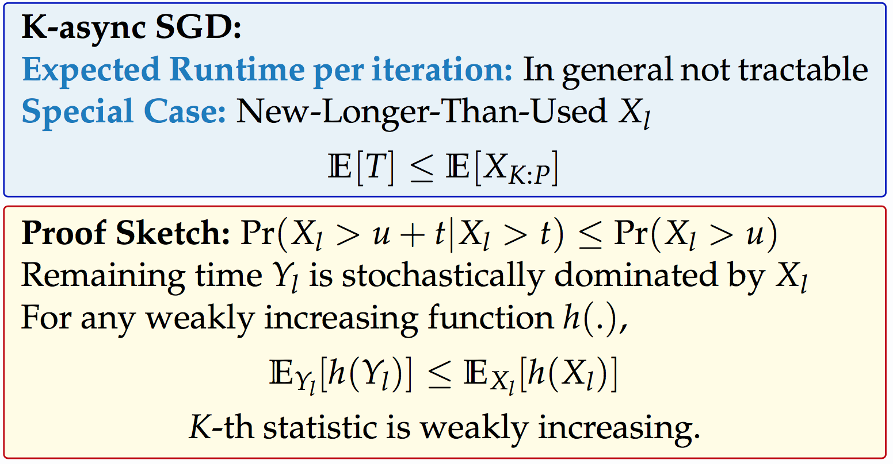
Expected Runtimes of SGD Variants
K-Async SGD
K-Batch Async SGD
w₀
w₁
w₂
w₃
w₀
w₁
w₂
w₃
PS
PS
L₁
L₁
L₂
L₂
L₃
L₃

Slide 63
Expected Runtimes of SGD Variants
K-Async SGD
K-Batch Async SGD
w₀
w₁
w₂
w₃
w₀
w₁
w₂
w₃
PS
PS
L₁
L₁
Observation:
Runtime is the K-th statistic of all learners’ remaining times.
L₂
L₂
L₃
L₃

Slide 64
Expected Runtimes of SGD Variants
K-Async SGD
K-Batch Async SGD
w₀
w₁
w₂
w₃
w₀
w₁
w₂
w₃
PS
PS
L₁
L₁
L₂
L₂
L₃
L₃

Slide 65
Expected Runtimes of SGD Variants
K-Async SGD
K-Batch Async SGD
w₀
w₁
w₂
w₃
w₀
w₁
w₂
w₃
PS
PS
L₁
L₁
L₂
L₂
L₃
L₃

Slide 66
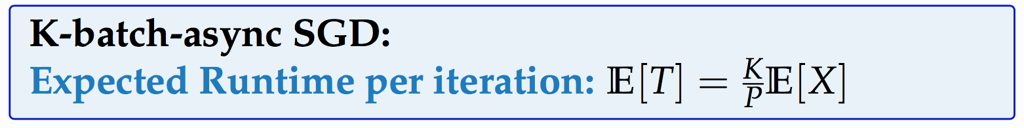
Expected Runtimes of SGD Variants
K-Async SGD
K-Batch Async SGD
w₀
w₁
w₂
w₃
w₀
w₁
w₂
w₃
PS
PS
Key Observation:
For each learner,
gradient pushes – renewal process
(inter-arrival times are iid)
L₁
L₁
L₂
L₂
L₃
L₃

Slide 67
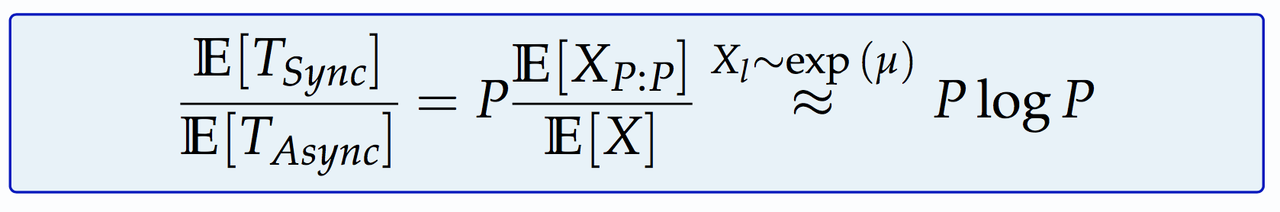
Comparison of Expected Runtime
Notes:
Add the theorem

Slide 68
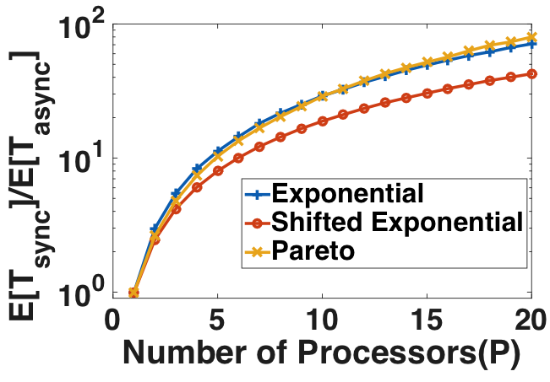
Comparison of Expected Runtime
Notes:
Add the theorem

Slide 69
How to get the error-runtime tradeoff?

Slide 70

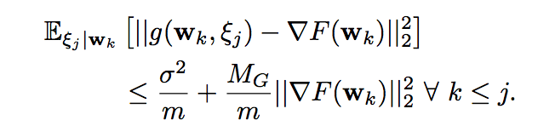
Assumptions for Error Analysis
Lipchitz smooth loss function with parameter L
Strongly Convex with parameter c
Unbiased Estimate of gradient
Upper Bound on Variance of Stochastic Gradient

Slide 71
Fully Sync SGD: Error Analysis
Update Rule: Equivalent to mini-batch SGD with batch size Pm
Notes:
More learners result in lower error floor

Slide 72
Fully Sync SGD: Error Analysis
Update Rule: Equivalent to mini-batch SGD with batch size Pm
For c-strongly convex, L-smooth functions
[Bottou, 2016]
Notes:
More learners result in lower error floor

Slide 73
Fully Sync SGD: Error Analysis
Update Rule: Equivalent to mini-batch SGD with batch size Pm
For c-strongly convex, L-smooth functions
[Bottou, 2016]
Error Floor
Decay Rate
Notes:
More learners result in lower error floor

Slide 74
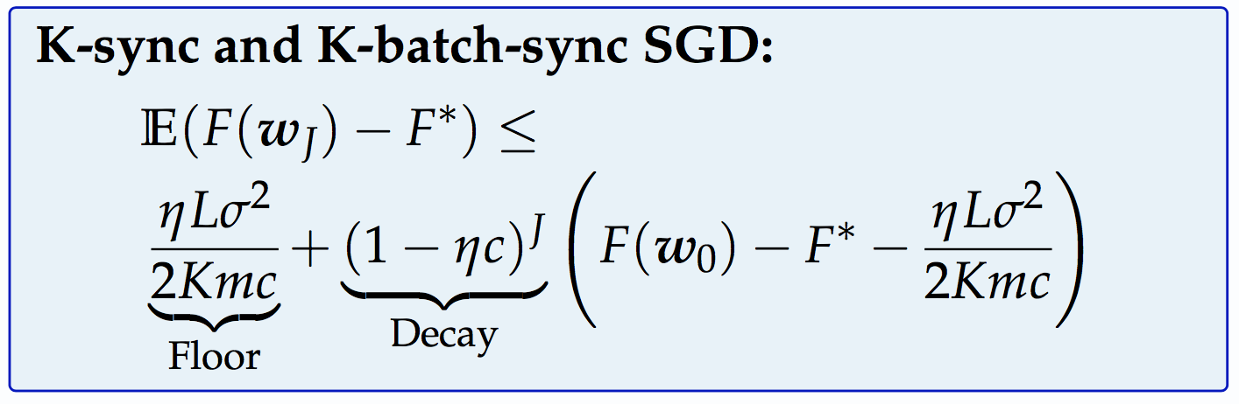
K-sync and K-batch-sync SGD: Error Analysis
Error after J iterations for sync variants

Slide 75
Async SGD: Error Analysis
Hard to analyze due to stale gradients
Update Rule
Notes:
Analysis is hard in general. There have been some recent works that make some assumptions to simplify the analysis

Slide 76
Async SGD: Error Analysis
Hard to analyze due to stale gradients
Update Rule
Assumptions in Previous works
Upper Bound on Staleness [Lian et al 2015]
Geometric staleness distribution
          [Mitiliagkas et al 2016]
          Staleness process is independent of w [Mitiliagkas et al 2016]
Notes:
Analysis is hard in general. There have been some recent works that make some assumptions to simplify the analysis

Slide 77
Async SGD: Error Analysis
Hard to analyze due to stale gradients
Update Rule
Assumptions in Previous works
Upper Bound on Staleness [Lian et al 2015]
Geometric staleness distribution
          [Mitiliagkas et al 2016]
          Staleness process is independent of w [Mitiliagkas et al 2016]
We remove these assumptions, and instead consider
Notes:
Analysis is hard in general. There have been some recent works that make some assumptions to simplify the analysis

Slide 78
Async SGD: Error Analysis
For c-strongly convex, L-smooth functions,
where
is the staleness bound,
and is the probability of getting a fresh gradient, i.e., same learner pushes the next update
Notes:
Assume data is well-shuffled such that the gradients at a point w_n are i.i.d. across mini-batches and learners

Slide 79
Async SGD: Error Analysis
For c-strongly convex, L-smooth functions,
Larger than Sync-SGD
Can be faster than Sync SGD with iterations if
p_{o}/ 2 > 𝛾
where
is the staleness bound,
and is the probability of getting a fresh gradient, i.e., same learner pushes the next update
Notes:
Assume data is well-shuffled such that the gradients at a point w_n are i.i.d. across mini-batches and learners

Slide 80
Async SGD: Error Analysis
For c-strongly convex, L-smooth functions,
Larger than Sync-SGD
Can be faster than Sync SGD with iterations if
p_{o}/ 2 > 𝛾
where
is the staleness bound,
and is the probability of getting a fresh gradient, i.e., same learner pushes the next update
Analysis can be generalized to non-convex objectives
Notes:
Assume data is well-shuffled such that the gradients at a point w_n are i.i.d. across mini-batches and learners

Slide 81
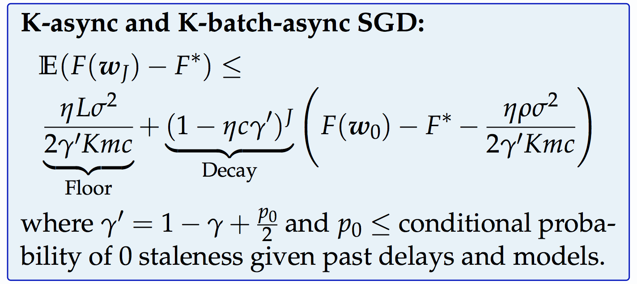
K-async and K-batch-async SGD: Error Analysis
Error after J iterations for Async variants

Slide 82
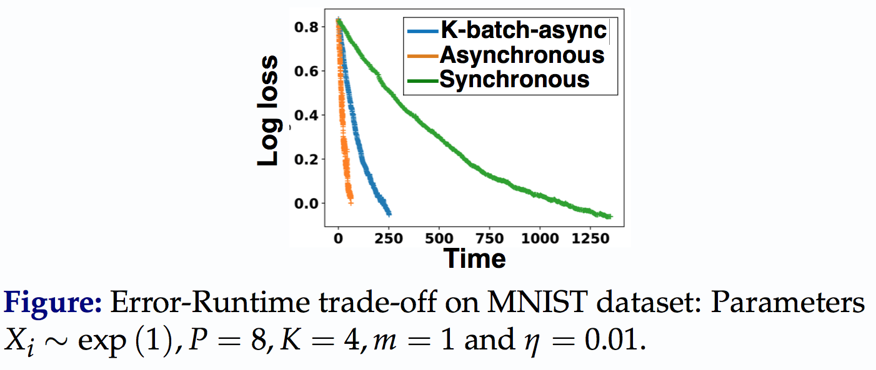
Error-Runtime Trade-offs

Slide 83
Spanning the spectrum between
Synchronous and Asynchronous SGD
Async SGD
Error at Convergence
FullySync
Runtime
Notes:
Observe that in this plot, Async SGD is clearly the best in terms of runtime.. What if we modify the algorithm to control the gradient staleness, and thus get fast convergence? That is what we do in the last research thrust.

Slide 84
Spanning the spectrum between
Synchronous and Asynchronous SGD
Async SGD
K-Batch Async
K-Async SGD
Error at Convergence
K=2
K=2
K=3
K=4
FullySync
K=3
K=4
Batch Sync
Runtime
Notes:
Observe that in this plot, Async SGD is clearly the best in terms of runtime.. What if we modify the algorithm to control the gradient staleness, and thus get fast convergence? That is what we do in the last research thrust.

Slide 85
Key Takeaways
True SGD convergence is with respect to wall-clock time!
Straggling Learners
Gradient Staleness

Slide 86
Key Takeaways
True SGD convergence is with respect to wall-clock time!
Async SGD
K-Batch Async
K-Async SGD
Straggling Learners
Gradient Staleness
Error at Convergence
K=2
K=2
K=3
FullySync
K=3
K=4
K=4
Batch Sync
Contributions:
Theoretical understanding of Error-Runtime Tradeoffs
Integrate Scheduling and Algorithmic techniques for improved performance
Runtime
S Dutta, G Joshi, S Ghosh, P Dube, and P Nagpurkar, “Slow and Stale Gradients Can Win the Race: Error-Runtime Trade-offs in Distributed SGD”, AISTATS 2018: 803-812.

Slide 87
Ongoing & Future Directions
Gradually increasing synchrony
Stochastic Staleness Analysis
(0,0)
(0,1)
(0,2)
Async-SGD
Sync-SGD
(1,0)
Async Error Floor
(2,0)
Sync Error Floor
Want this envelope
S Dutta, J Wang, G Joshi, “Slow and Stale Gradients Can Win the Race: Error-Runtime Trade-offs in Distributed SGD”, submitted to JMLR (2019).

Slide 88
Sync SGD: Choosing the best K
Error is equivalent to mini-batch SGD with batch size Km
MNIST dataset
K = 4 strikes a good balance between conv.speed and error floor

Slide 89
Thank You!

