Slide 1
Rateless Codes for Near-Perfect Load Balancing in Distributed Matrix-Vector Multiplication
Ankur Mallick
Carnegie Mellon University
joint work with Malhar Chaudhuri, Prof. Gauri Joshi

Slide 2
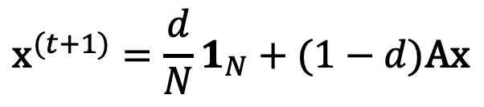
Matrices in the Big Data Era
Huge datasets are typically stored and processed in matrix form
1 2 3 ….
Link 1->2
Pg. 2
1
2
3
.
.
.
x x
x
Pg. 1
Link 2->3
= A
Link 1->3
Pg. 3
World Wide Web Graph
World Wide Web Adjacency Matrix
Matrix-Vector multiplication is one of the most common operations on such data. For eg. Page Rank
$${\text{x}}^{(t+1)}=\frac{d}{N}1_{N}+(1−d)\text{Ax}$$

Slide 3


Distributed Matrix-Vector Multiplication
Large matrices take up a lot of memory, and are stored in a distributed fashion
For eg. Web crawlers have estimated the web graph to have 3.83 billion vertices (> 10 billion GB) as of 2015^{[1]}
To compute the product b = Ax each submatrix is multiplied with x in parallel and the results are aggregated to obtain the final product
A₁
x
=
b₁
A
b₁
b
A₂
x
=
b₂
b₂
=
b₃
A₃
x
=
b₃
[1] Meusel et. al, The Graph Structure in the Web – Analyzed on Different Aggregation Levels

Slide 4
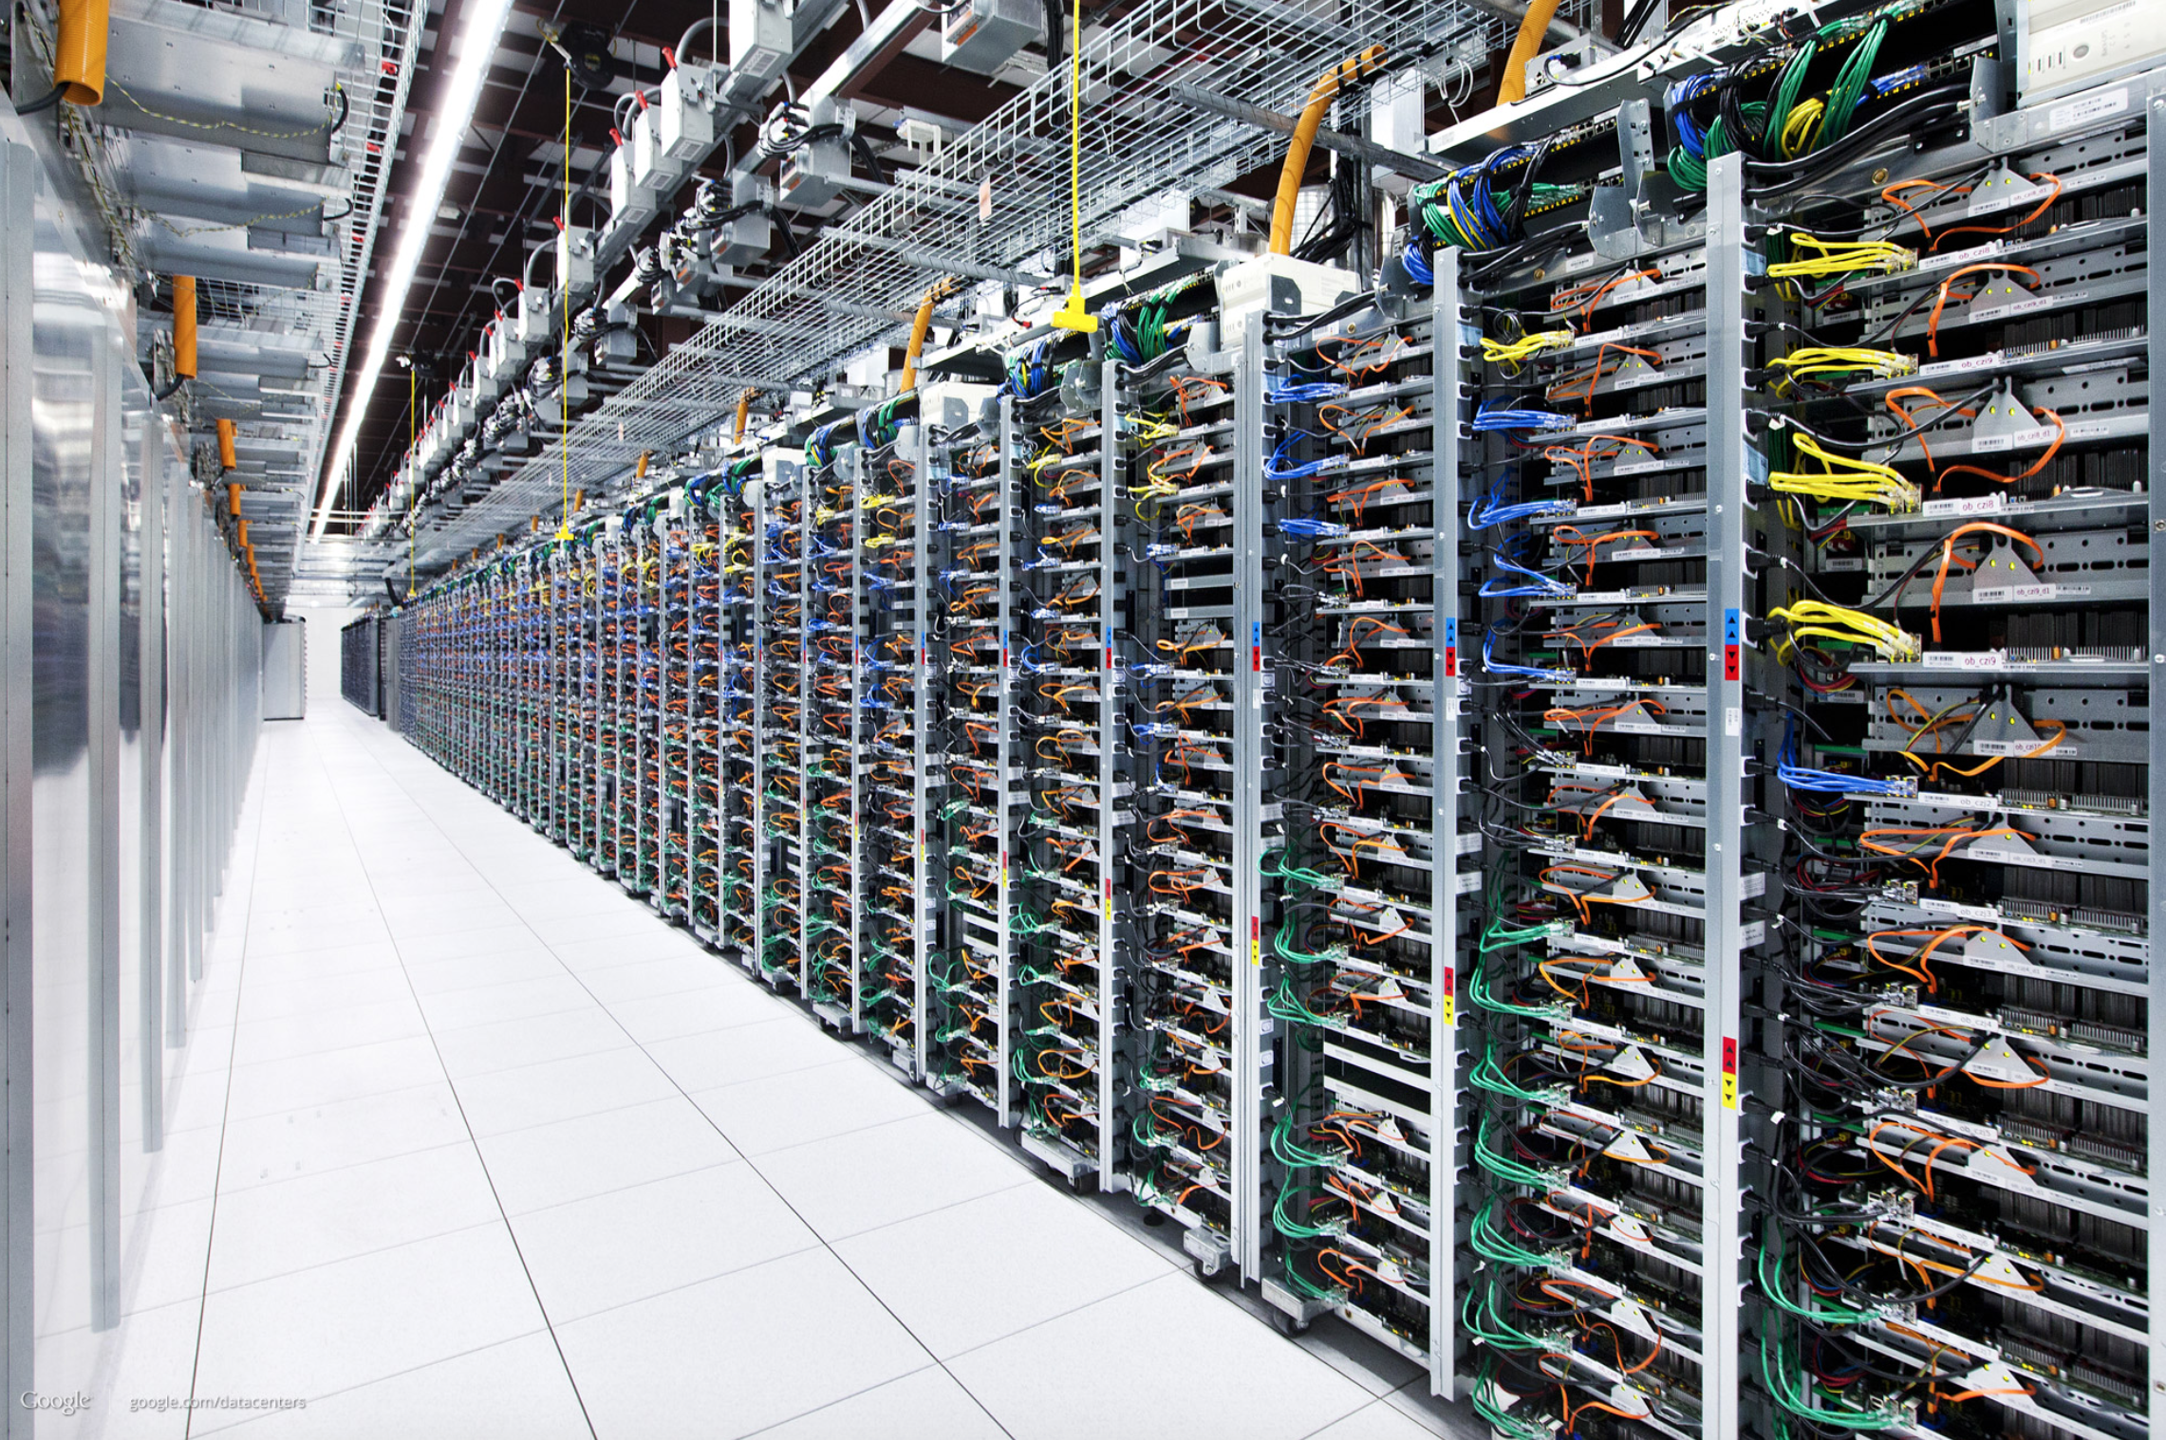
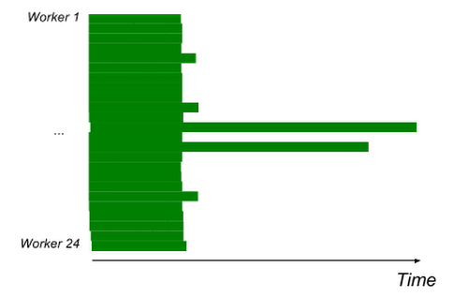
The Problem of Stragglers
Large matrix vector multiplication is distributed over several computing nodes
Distributed computations are susceptible to unpredictable slowdown or straggling of nodes
Google’s Datacenter in Oklahoma
(Source: http://fortune.com)
Straggling in a Read/Write Job
(Source: https://cloud.google.com/blog/products/gcp/)

Slide 5
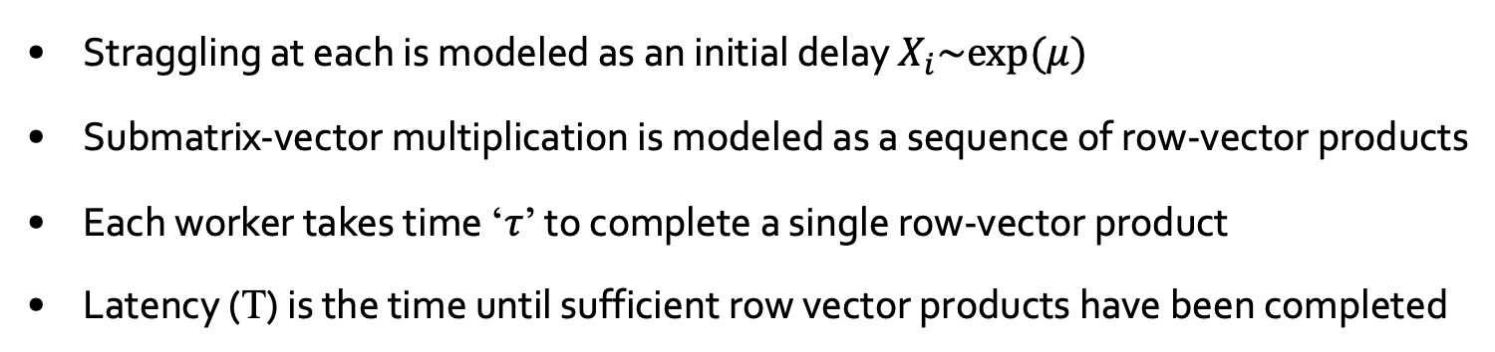
Analyzing the effect of Stragglers
B₁𝜏
A₁
x
X₁
A₂
x
X₂
B₃𝜏
A₃
x
X₃
0
T
Time
Straggling at each is modeled as an initial delay $X_{i}\sim exp⁡(μ)$
Submatrix-vector multiplication is modeled as a sequence of row-vector products
Each worker takes time ‘𝜏’ to complete a single row-vector product
Latency (T) is the time until sufficient row vector products have been completed

Slide 6
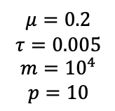
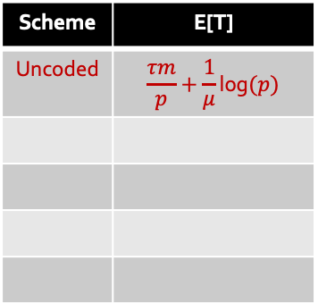
Slowdown in the naïve (uncoded) case
A₁
x
$$μ=0.2$$
$$τ=0.005$$
$$m={10}^{4}$$
$$p=10$$
T₁
A
x
A₂
x
T₂
A₃
x
T₃
Runtime
Tail estimate from 500 trials
Straggling Nodes can cause slowdown in distributed-matrix vector multiplication
Waiting for the slowest nodes increases the overall latency
Scheme | E[T]
Uncoded | $$\frac{τm}{p}+\frac{1}{μ}\text{log}(p)$$

Slide 7
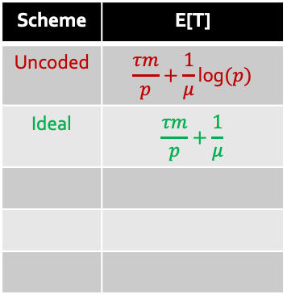
Solution 1: The Ideal Solution
A₁
x
T₁
$$μ=0.2$$
$$τ=0.005$$
$$m={10}^{4}$$
$$p=10$$
A₂
x
T₂
A₃
x
T₃
Runtime
Tail estimate from 500 trials
The ideal solution is to move data from slow to fast nodes ^{[2]}
However establishing such data movement protocols may be challenging
Scheme | E[T]
Uncoded | $$\frac{τm}{p}+\frac{1}{μ}\text{log}(p)$$
Ideal | $$\frac{τm}{p}+\frac{1}{μ}$$
[2] https://cloud.google.com/blog/products/gcp/no-shard-left-behind-dynamic-work-rebalancing-in-google-cloud-dataflow

Slide 8
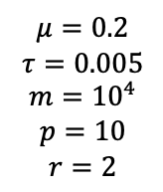
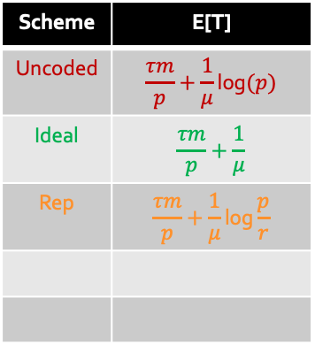
Solution 2: Task Replication
A₁
x
$$μ=0.2$$
$$τ=0.005$$
$$m={10}^{4}$$
$$p=10$$
$$r=2$$
T₁
A₁
x
T₂
A₂
x
T₃
A₂
x
T₄
Tail estimate from 500 trials
Runtime
A simpler solution is to replicate each submatrix at multiple nodes
We pick the fastest node corresponding to each submatrix
This can be generalized to ‘p’ workers and ‘r’ replicas
Any work done by the slow nodes is not used at all
Scheme | E[T]
Uncoded | $$\frac{τm}{p}+\frac{1}{μ}\text{log}(p)$$
Ideal | $$\frac{τm}{p}+\frac{1}{μ}$$
Rep | $$\frac{τm}{p}+\frac{1}{μ}\text{log}\frac{p}{r}$$

Slide 9
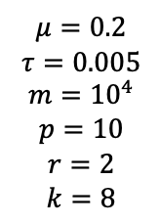
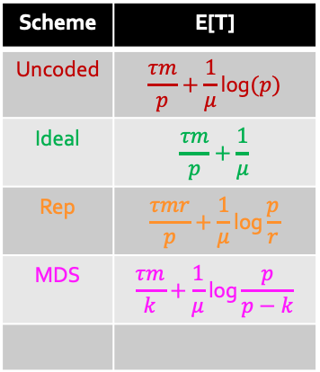
Solution 2: MDS Coding^{[3]}
A₁
x
$$μ=0.2$$
$$τ=0.005$$
$$m={10}^{4}$$
$$p=10$$
$$r=2$$
$$k=8$$
T₁
A₂
x
T₂
A₁+A₂
x
T₃
Runtime
Tail estimate from 500 trials
We can exploit the linearity of the computation (matrix-vector product)
We can recover the matrix-vector product from the fastest 2 nodes overall
This can be generalized to ‘p’ worker nodes and ‘k’ fastest nodes
Any work done by the slow nodes is not used at all
Scheme | E[T]
Uncoded | $$\frac{τm}{p}+\frac{1}{μ}\text{log}(p)$$
Ideal | $$\frac{τm}{p}+\frac{1}{μ}$$
Rep | $$\frac{τmr}{p}+\frac{1}{μ}\text{log}\frac{p}{r}$$
MDS | $$\frac{τm}{k}+\frac{1}{μ}\text{log}\frac{p}{p−k}$$
[3] Lee, Kangwook, et al. "Speeding up distributed machine learning using codes." IEEE Transactions on Information Theory

Slide 10
Adding Redundancy the ‘Right’ way
A^{(e)}₁
x
T₁
b^{(e)}₁
A
Encode
A^{(e)}
Decode
to get
b=Ax
A^{(e)} ₂
x
b^{(e)}₂
T₂
A^{(e)} ₃
x
b^{(e)}₃
T₃
Runtime
We would like to design a scheme that satisfies the following criteria:
  Amount of computations per node should be proportional to node speeds
  ‘Decoding’ should be possible as soon as any M’ > m computations are completed
  The overhead M’ – m should be as small as possible
This can be done using Fountain Codes (For eg. LT codes^{[4]})
[3] Luby, Michael. "LT codes." The 43rd Annual IEEE Symposium on Foundations of Computer Science, 2002.

Slide 11

LT Codes (Encoding)
Determine the degree d of an encoding symbol from a given degree distribution ρ(d)
Source Symbols (Matrix Rows)
d = 2 ~ ρ(d)

Slide 12
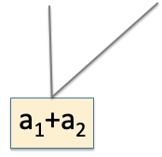
LT Codes (Encoding)
Determine the degree d of an encoding symbol from a given degree distribution ρ(d)
Choose d distinct source symbols uniformly at random
Source Symbols (Matrix Rows)
d = 2 ~ ρ(d)

Slide 13
LT Codes (Encoding)
Determine the degree d of an encoding symbol from a given degree distribution ρ(d)
Choose d distinct source symbols uniformly at random
Generate an encoded symbol which is the sum of the d source symbols
Source Symbols (Matrix Rows)
d = 2 ~ ρ(d)

Slide 14
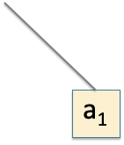
LT Codes (Encoding)
Determine the degree d of an encoding symbol from a given degree distribution ρ(d)
Choose d distinct source symbols uniformly at random
Generate an encoded symbol which is the sum of the d source symbols
Source Symbols (Matrix Rows)
d = 1 ~ ρ(d)

Slide 15
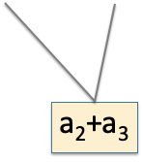
LT Codes (Encoding)
Determine the degree d of an encoding symbol from a given degree distribution ρ(d)
Choose d distinct source symbols uniformly at random
Generate an encoded symbol which is the sum of the d source symbols
Source Symbols (Matrix Rows)
d = 2 ~ ρ(d)

Slide 16
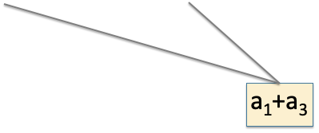
LT Codes (Encoding)
Determine the degree d of an encoding symbol from a given degree distribution ρ(d)
Choose d distinct source symbols uniformly at random
Generate an encoded symbol which is the sum of the d source symbols
Source Symbols (Matrix Rows)
d = 2 ~ ρ(d)

Slide 17
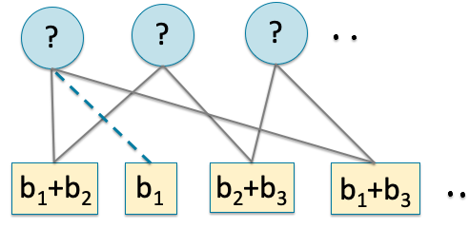
LT Codes (Decoding)
Identify a symbol with degree 1

Slide 18
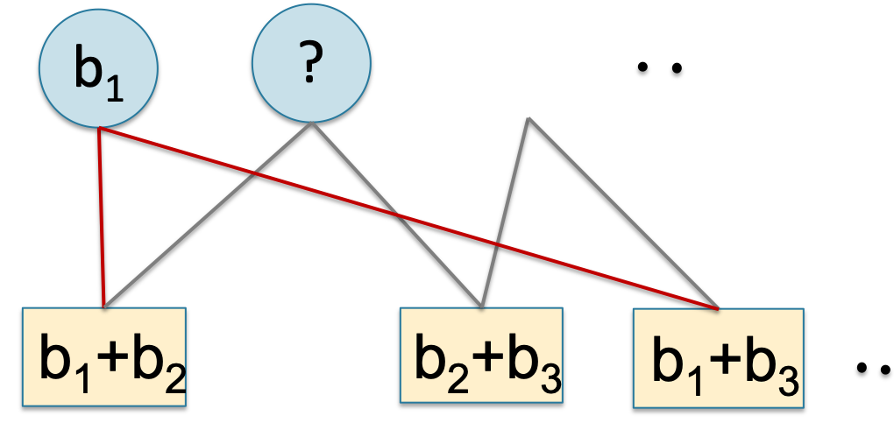


LT Codes (Decoding)
Identify a symbol with degree 1
Map that to the corresponding source symbol

Slide 19
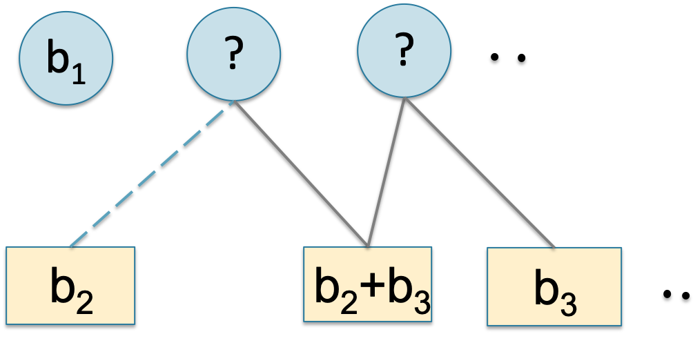
LT Codes (Decoding)
Identify a symbol with degree 1
Map that to the corresponding source symbol
Remove the recovered source symbol from all other encoded symbols containing it

Slide 20
LT Codes (Decoding)
Identify a symbol with degree 1
Map that to the corresponding source symbol
Remove the recovered source symbol from all other encoded symbols containing it
Repeat until all symbols are successfully decoded

Slide 21
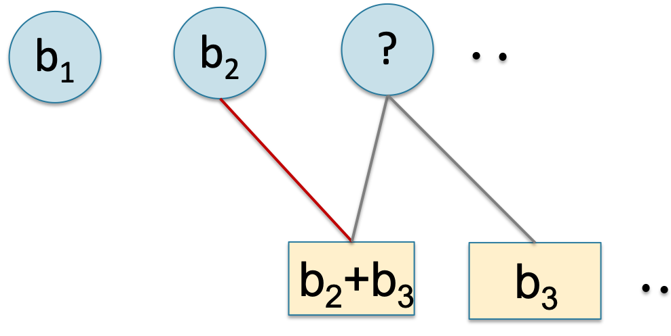
LT Codes (Decoding)
Identify a symbol with degree 1
Map that to the corresponding source symbol
Remove the recovered source symbol from all other encoded symbols containing it
Repeat until all symbols are successfully decoded

Slide 22
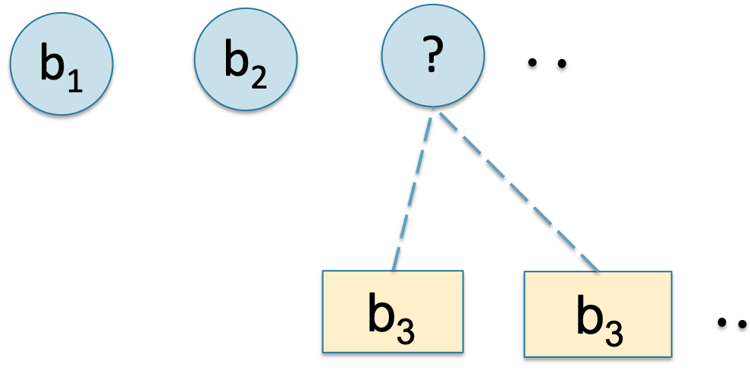
LT Codes (Decoding)
Identify a symbol with degree 1
Map that to the corresponding source symbol
Remove the recovered source symbol from all other encoded symbols containing it
Repeat until all symbols are successfully decoded

Slide 23

LT Codes (Decoding)
Identify a symbol with degree 1
Map that to the corresponding source symbol
Remove the recovered source symbol from all other encoded symbols containing it
Repeat until all symbols are successfully decoded

Slide 24
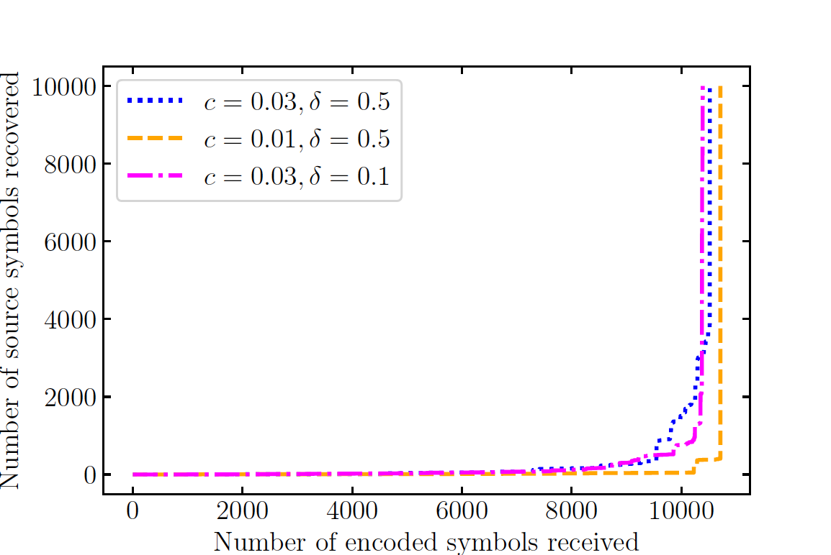
Encoding Degree Distribution
Each encoded symbol is the sum of d ~ ρ(d) source symbols
ρ(d) is the Robust Soliton Distribution
For ‘m’ source symbols the encoding/decoding complexity is O(ln m) per symbol
Successful decoding occurs with high probability from M’ = m(1+ε) symbols where ε → 0 for large m

Slide 25
Distributed Matrix Vector Multiplication using LT Codes (Approach)
A ₁^{(e)}
x
T₁
b^{(e)}₁
b
A
LT
Encoding
A^{(e)}
LT
Decoding
A ₂^{(e)}
x
b^{(e)}₂
T₂
A ₃^{(e)}
x
b^{(e)}₃
T₃
Runtime
‘Encode’ the rows of the m x n matrix A using an LT Code
Distribute the (larger) encoded matrix A^{(e)} among the nodes
Amount of computations per node is proportional to node speeds
‘Decoding’ is possible as soon as any M’ = m(1+ε) computations are completed
The overhead ε ->0 for large m
Partial work performed by all nodes (fast and slow) is efficiently utilized

Slide 26
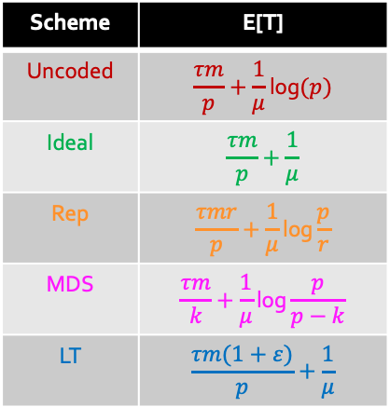
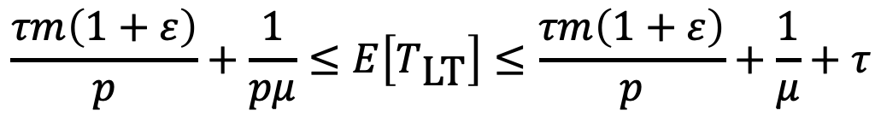
Distributed Matrix Vector Multiplication using LT Codes (Analysis)
Scheme | E[T]
Uncoded | $$\frac{τm}{p}+\frac{1}{μ}\text{log}(p)$$
Ideal | $$\frac{τm}{p}+\frac{1}{μ}$$
Rep | $$\frac{τmr}{p}+\frac{1}{μ}\text{log}\frac{p}{r}$$
MDS | $$\frac{τm}{k}+\frac{1}{μ}\text{log}\frac{p}{p−k}$$
LT | $$\frac{τm(1+ε)}{p}+\frac{1}{μ}$$
$$\frac{τm\left(1+ε\right)}{p}+\frac{1}{pμ}≤E\left[T_{\text{LT}}\right]≤\frac{τm\left(1+ε\right)}{p}+\frac{1}{μ}+τ$$

Slide 27
Distributed Matrix Vector Multiplication using LT Codes (Experiments)
Task: Distributed Matrix-Vector on the STL-10 Image Dataset (Each matrix row is an image)
Matrix Size: 11760 x 9216
Worker Nodes: 70 EC2 instances (t2.small)
Metric: Time required to complete enough row-vector products for successful decoding
Result: 3x- speedup achieved using LT Codes
LT Coded Computation achieves lowest latency!
LT Coded Computation ensures better load balancing!

Slide 28
Conclusions
Our Contribution:
  Proposed a novel scheme for distributed matrix-vector multiplication using LT Codes
  Our scheme achieves a 3x- speedup over the naive (uncoded) approach
  Partial work of all nodes (fast and slow) is efficiently utilized
Future Work:
  Extension to Sparse Matrix-Vector multiplication
  Extension to non-linear computations (For eg. Distributed DNN Inference)

Slide 29

Robust Soliton Distribution
Ideal Soliton distribution:
$ρ\left(i\right)=\left\{\begin{aligned}\frac{1}{m},i=1 \\ \frac{1}{i(i−1)},i=2,…,m\end{aligned}\right.$
Robust Soliton Distribution:
$u\left(i\right)∝ρ\left(i\right)+v\left(i\right)$
$v\left(i\right)=\left\{\begin{aligned}\frac{R}{im}, i=1,…,\frac{m}{R}−1 \\ \frac{Rln\left(\frac{R}{δ}\right)}{m},i=m/R \\ 0,\text{otherwise}\end{aligned}\right.$
For $M^{′}=m+O(\sqrt{m}{\text{ln}}^{2}⁡(m/δ))$ encoding symbols, the probability of successful decoding is at least $1−δ$

