Slide 1
OpenMP
A higher level interface for threads
programming
http://www.openmp.org
Parallelization via source code annotations
All major compilers support it, including gnu
Gcc 4.8 supports OpenMP version 3.1
https://gcc.gnu.org/wiki/openmp
Compare with explicit threads programing
#pragma omp parallel private(i)
shared(n)
{
#pragma omp for for(i=0; i < n; i++)
work(i);
}
i0 = $TID*n/$nthreads; i1 = i0 + n/$nthreads; for (i=i0; i< i1; i++)
work(i);
8

Slide 2
14-513/18-613: Computer Systems
Lecture 28, Summer 2020
Another Model for Parallelism: OpenMP
Slide Credit: Scott Baden, CSE 260, CSE, UCSD

Slide 3
OpenMP’s Fork-Join Model
A program begins life as a single thread
Enter a parallel region, spawning a team of threads
The lexically enclosed program statements execute in parallel by all team members
When we reach the end of the scope…
  The team of threads synchronize at a barrier and are disbanded; they enter a wait state
  Only the initial thread continues
Thread teams can be created and disbanded many times during program execution, but this can be costly
A clever compiler can avoid many thread creations and joins
Scott B. Baden / CSE 160 / Wi '16
9

Slide 4
Fork join model with loops
Seung-Jai Min
Serial
Parallel
cout << “Serial\n”; N = 1000;
#pragma omp parallel{
#pragma omp for for (i=0; i<N; i++)
A[i] = B[i] + C[i];
#pragma omp single M = A[N/2];
#pragma omp for for (j=0; j<M; j++)
p[j] = q[j] – r[j];
}
Cout << “Finish\n”;
Serial
Parallel
Serial

Slide 5
Loop parallelization
The translator automatically generates appropriate local loop bounds
Also inserts any needed barriers
We use private/shared clauses to distinguish thread private from global data
Handles irregular problems
Decomposition can be static or dynamic
#pragma omp parallel for shared(Keys) private(i) reduction(&:done) for i = OE; i to N-2 by 2
if (Keys[i] > Keys[i+1]) swap Keys[i] ↔ Keys[i+1]; done *= false; } end do
return done;

Slide 6
Another way of annotating loops
These are equivalent
#pragma omp parallel
{
#pragma omp for
for (int i=1; i< N-1; i++) a[i] = (b[i+1] – b[i-1])/2h
}
#pragma omp parallel for for (int i=1; i< N-1; i++)
a[i] = (b[i+1] – b[i-1])/2h

Slide 7
Variable scoping
Any variables declared outside a parallel region are shared by all threads
Variables declared inside the region are private
Shared & private declarations override defaults, also usefule as documentation
int main (int argc, char *argv[]) {
double a[N], b[N], c[N]; int i;
#pragma omp parallel for shared(a,b,c,N) private(i) for (i=0; i < N; i++)
a[i] = b[i] = (double) i;
#pragma omp parallel for shared(a,b,c,N) private(i) for (i=0; i<N; i++)
c[i] = a[i] + sqrt(b[i]);

Slide 8
Dealing with loop carried dependences
OpenMP will dutifully parallelize a loop when you tell it to, even if doing so “breaks” the correctness of the code
int* fib = new int[N]; fib[0] = fib[1] = 1;
#pragma omp parallel for num_threads(2) for (i=2; i<N; i++)
fib[i] = fib[i-1]+ fib[i-2];
Sometimes we can restructure an algorithm, as we saw in odd/even sorting
OpenMP may warn you when it is doing something unsafe, but not always

Slide 9

Why dependencies prevent parallelization
Consider the following loops
#pragma omp parallel
{
#pragma omp for nowait
for (int i=1; i< N-1; i++) a[i] = (b[i+1] – b[i-1])/2h
#pragma omp for
for (int i=N-2; i>0; i--)
b[i] = (a[i+1] – a[i-1])/2h
}
Why aren’t the results incorrect?

Slide 10


Why dependencies prevent parallelization
Consider the following loops
#pragma omp parallel
{#pragma omp for nowait
for (int i=1; i< N-1; i++) a[i] = (b[i+1] – b[i-1])/2h
#pragma omp for
for (int N-2; i>0; i--)
b[i] = (a[i+1] – a[i-1])/2h
}
Results will be incorrect because the array a[ ], in
loop #2, depends on the outcome of loop #1 (a true dependence)
 We don’t know when the threads finish
 OpenMP doesn’t define the order that the loop iterations wil be incorrect

Slide 11
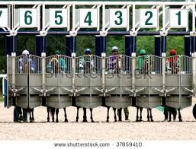


Barrier Synchronization in OpenMP
To deal with true- and anti-dependences, OpenMP inserts a barrier (by default) between loops:
for (int i=0; i< N-1; i++) a[i] = (b[i+1] – b[i-1])/2h
BARRIER
for (int i=N-1; i>=0; i--) b[i] = (a[i+1] –a[i-1])/2h
No thread may pass the barrier until all have arrived hence loop 2 may not write into b until loop 1 has finished reading the old values
Do we need the barrier in this case? Yes
for (int i=0; i< N-1; i++) a[i] = (b[i+1] – b[i-1])/2h
BARRIER?
for (int i=N-1; i>=0; i--)
c[i] = a[i]/2;

Slide 12
Which loops can OpenMP parallellize, assuming there is a barrier before the start of the loop?
A. 1 & 2
B. 1 & 3
C. 3 & 4
D. 2 & 4
All arrays have at least N elements
3. for i = 0 to N-1 step 2
All the loops
  for i = 1 to N-1
A[i] = A[i] + B[i-1];
A[i] = A[i-1] + A[i];
2. for i = 0 to N-2 A[i+1] = A[i] + 1;
4. for i = 0 to N-2{ A[i] = B[i];
C[i] = A[i] + B[i];
E[i] = C[i+1];
}

Slide 13
Which loops can OpenMP parallellize, assuming there is a barrier before the start of the loop?
A. 1 & 2
B. 1 & 3
C. 3 & 4
D. 2 & 4
All arrays have at least N elements
3. for i = 0 to N-1 step 2
All the loops
  for i = 1 to N-1
A[i] = A[i] + B[i-1];
A[i] = A[i-1] + A[i];
2. for i = 0 to N-2 A[i+1] = A[i] + 1;
4. for i = 0 to N-2{ A[i] = B[i];
C[i] = A[i] + B[i];
E[i] = C[i+1];
}

Slide 14
How would you parallelize loop 2 by hand?
for i = 1 to N-1
A[i] = A[i] + B[i-1];
for i = 0 to N-2 A[i+1] = A[i] + 1;

Slide 15
How would you parallelize loop 2 by hand?
for i = 0 to N-2 A[i+1] = A[i] + 1;
for i = 0 to N-2 A[i+1] = A[0] + i;

Slide 16
To ensure correctness, where must we remove the nowait clause?
Between loops 1 and 2
Between loops 2 and 3
D. None
#pragma omp parallel for shared(a,b,c) private(i)
for (i=0; i<N; i++) c[i] = (double) i
#pragma omp parallel for shared(c) private(i) nowait for (i=1; i<N; i+=2)
c[i] = c[i] + c[i-1]
#pragma omp parallel for shared(c) private(i) nowait for (i=2; i<N; i+=2)
c[i] = c[i] + c[i-1]
C. Between both loops

Slide 17
To ensure correctness, where must we remove the nowait clause?
Between loops 1 and 2
Between loops 2 and 3
D. None
#pragma omp parallel for shared(a,b,c) private(i)
for (i=0; i<N; i++) c[i] = (double) i
#pragma omp parallel for shared(c) private(i) nowait for (i=1; i<N; i+=2)
c[i] = c[i] + c[i-1]
#pragma omp parallel for shared(c) private(i) nowait for (i=2; i<N; i+=2)
c[i] = c[i] + c[i-1]
C. Between both loops

Slide 18
Exercise: removing data dependencies
How can we split this loop into 2 loops so that each loop parallelizes, and the result it correct?`
 B initially:
 B on 1 thread:
0 1 2 3 4 5 6 7
7 7 7 7 11 12 13 14
#pragma omp parallel for shared (N,B) for i = 0 to N-1
B[i] += B[N-1-i];
B[0] += B[7], | B[1] += B[6], | B[2] += B[5]
B[3] += B[4], | B[4] += B[3], | B[5] += B[2]
B[6] += B[1], | B[7] += B[0]

Slide 19
Splitting a loop
For iterations i=N/2+1 to N, B[N-i]
reference newly computed data
All others reference “old” data
B initially:
Correct result:
0 1 2 3 4 5 6 7
7 7 7 7 11 12 13 14
#pragma omp parallel for … nowait
for i = 0 to N/2-1
B[i] += B[N-1-i];
for i = N/2+1 to N-1 B[i] += B[N-1-i];
for i = 0 to N-1 B[i] += B[N-i];

Slide 20
Reductions in OpenMP
In some applications, we reduce a collection of values down to a single global value
 Taking the sum of a list of numbers
 Decoding when Odd/Even sort has finished
OpenMP avoids the need for an explicit serial section
int Sweep(int *Keys, int N, int OE, ){ bool done = true;
#pragma omp parallel for reduction(&:done)
for (int i = OE; i < N-1; i+=2) { if (Keys[i] > Keys[i+1]){
Keys[i] ↔ Keys[i+1];
done &= false;
}
} //All threads ‘and’ their done flag into a local variable
// and store the accumulated value into the global
return done;
}
Scott B. Baden / CSE 160 / Wi '16
26

Slide 21
Reductions in OpenMP
In some applications, we reduce a collection of values
down to a single value
 Taking the sum of a list of numbers
 Decoding when Odd/Even sort has finished
OpenMP avoids the need for an explicit serial section
int Sweep(int *Keys, int N, int OE, ){ bool done = true;
#pragma omp parallel for reduction(&:done)
for (int i = OE; i < N-1; i+=2) { if (Keys[i] > Keys[i+1]){
Keys[i] ↔ Keys[i+1];
done &= false;
}
} //All threads ‘and’ their done flag into the local variable
return done;
}

Slide 22
Which functions may we use in a reduction?
Add
Subtract
Logical And
A and B
a₀ + a₁ + …. + a_{n-1} a₀ - a₁ - …. - a_{n-1}
a₀ ⋀ a₁ ⋀ …. ⋀
ªn-1
E. A,B and C

Slide 23
Which functions may we use in a reduction?
Add
Subtract
Logical And
A and B
a₀ + a₁ + …. + a_{n-1} a₀ - a₁ - …. - a_{n-1}
a₀ ⋀ a₁ ⋀ …. ⋀
ªn-1
E. A,B and C

Slide 24
Odd-Even sort in OpenMP
for s = 1 to MaxIter do
done = Sweep(Keys, N, 0);
done &= Sweep(Keys, N, 1); if (done) break;
ªi-1
a_{i}
ªi+1
end do
int Sweep(int *Keys, int N, int OE){ bool done=true;
#pragma omp parallel for shared(Keys) private(i) reduction(&:done) for (i = OE; i < N-1; i+=2) {
if (Keys[i] > Keys[i+1]){ int tmp = Keys[i];
Keys[i] = Keys[i+1]; Keys[i+1] = tmp; done *= false;
-n 8Mi, -i 200, -f 50
P=1 | P=2 | P=4 | P=8
6.09s | 3.51s | 2.78s | 2.78s
}
}
return done;
g++ -fopenmp, on Bang
}

Slide 25
Why isn’t a barrier needed between the calls to sweep( )?
The calls to sweep occur outside parallel sections
OpenMP inserts barriers after the calls to Sweep
OpenMP places a barrier after the for i loop inside Sweep
E. B & C
D. A & C
for s = 1 to MaxIter do
done = Sweep(Keys, N, 0);
done &= Sweep(Keys, N, 1); if (done) break;
end do
int Sweep(int *Keys, int N, int OE){ bool done=true;
#pragma omp parallel for shared(Keys) private(i) reduction(&:done) for i = OE; i to N-2 by 2
if (Keys[i] > Keys[i+1]) {swap Keys[i] ↔ Keys[i+1]; done &= false; }
end do return done;

Slide 26
Why isn’t a barrier needed between the calls to sweep( )?
The calls to sweep occur outside parallel sections
OpenMP inserts barriers after the calls to Sweep
OpenMP places a barrier after the for i loop inside Sweep
E. B & C
D. A & C
for s = 1 to MaxIter do
done = Sweep(Keys, N, 0);
done &= Sweep(Keys, N, 1); if (done) break;
end do
int Sweep(int *Keys, int N, int OE){ bool done=true;
#pragma omp parallel for shared(Keys) private(i) reduction(&:done) for i = OE; i to N-2 by 2
if (Keys[i] > Keys[i+1]) {swap Keys[i] ↔ Keys[i+1]; done &= false; }
end do return done;

Slide 27
Another way of annotating loops
These are equivalent
Why don’t we need to declare private(i)?
#pragma omp parallel shared(a,b)
{
#pragma omp for schedule(static)
for (int i=1; i< N-1; i++) a[i] = (b[i+1] – b[i-1])/2h
}
#pragma omp parallel for shared(a,b) schedule(static) for (int i=1; i< N-1; i++)
a[i] = (b[i+1] – b[i-1])/2h

Slide 28
The No Wait clause
Removes the barrier after an omp for loop
Why are the results incorrect?
 We don’t know when the threads finish
 OpenMP doesn’t define the order that the loop iterations wil be incorrect
#pragma omp parallel
{
#pragma omp for nowait
for (int i=1; i< N-1; i++) a[i] = (b[i+1] – b[i-1])/2h
#pragma omp for
for (int i=N-2; i>0; i--)
b[i] = (a[i+1] – a[i-1])/2h
}

Slide 29
Why isn’t a barrier needed between the calls to sweep()?
A. The calls to sweep occur outside parallel sections
B.
C. OpenMP places a barrier after the for i loop inside Sweep
D. A & C
for s = 1 to MaxIter do
done = Sweep(Keys, N, 0);
done &= Sweep(Keys, N, 1); if (done) break;
end do
int Sweep(int *Keys, int N, int OE){ bool done=true;
#pragma omp parallel for shared(Keys) private(i) reduction(&:done) for i = OE; i to N-2 by 2
if (Keys[i] > Keys[i+1]) {swap Keys[i] ↔ Keys[i+1]; done &= false; }
end do return done;

Slide 30
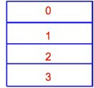
Parallelizing a nested loop with OpenMP
Not all implementations can parallelize inner loops
We parallelize the outer loop index
#pragma omp parallel private(i) shared(n)
#pragma omp for
for(i=0; i < n; i++) for(j=0; j < n; j++) {
V[i,j] = (u[i-1,j] + u[i+1,j]+ u[i,j-1]+ u[i, j+1] - h²f[i,j])/4
}
Generated code
mymin = 1 + ($TID * n/NT),
for(i=mymin; i < mymax; i++)
mymax = mymin + n/NT-1
for(j=0; j < n; j++)
V[i,j] = (u[i-1,j] + u[i+1,j]+ u[i,j-1]+ u[i, j+1] - h²f[i,j])/4 Barrier();

Slide 31
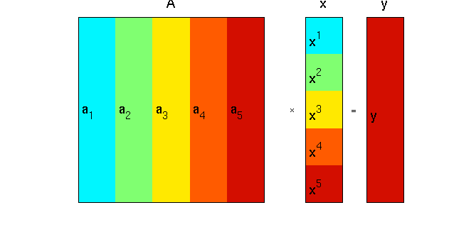
An application: Matrix Vector Multiplication
Scott B. Baden / CSE 160 / Wi '16
8

Slide 32
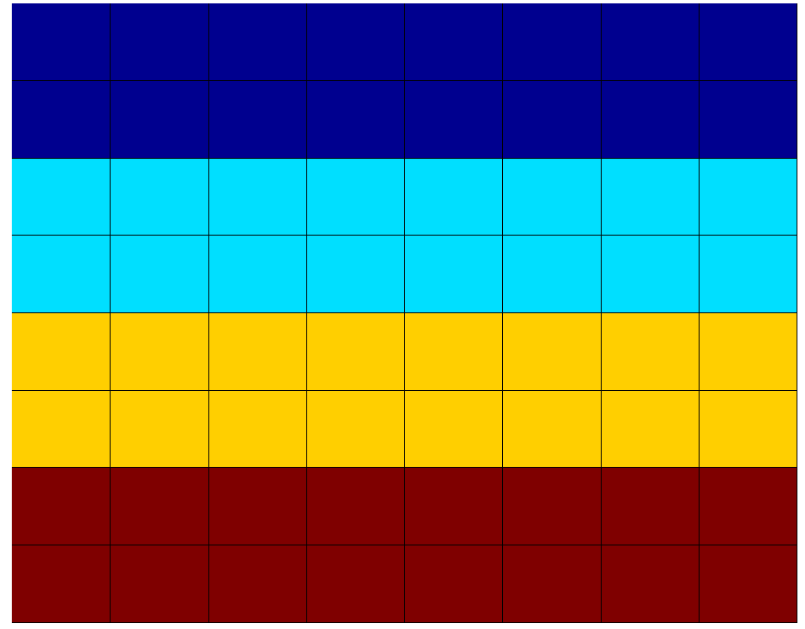
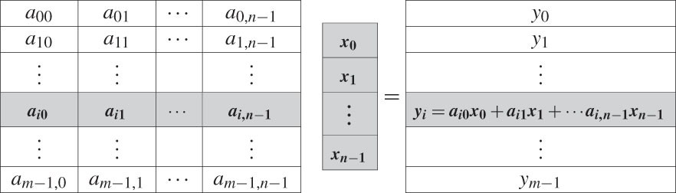
Application: Matrix Vector Multiplication
double **A, *x, *y;
#pragma omp parallel shared(A,x,N)
#pragma omp for
for (i=0; i<N; i++){ y[i] = 0.0;
for (j=0; j<N; j++) y[i] += A[i][j] * x[j];
}
// GLOBAL

Slide 33
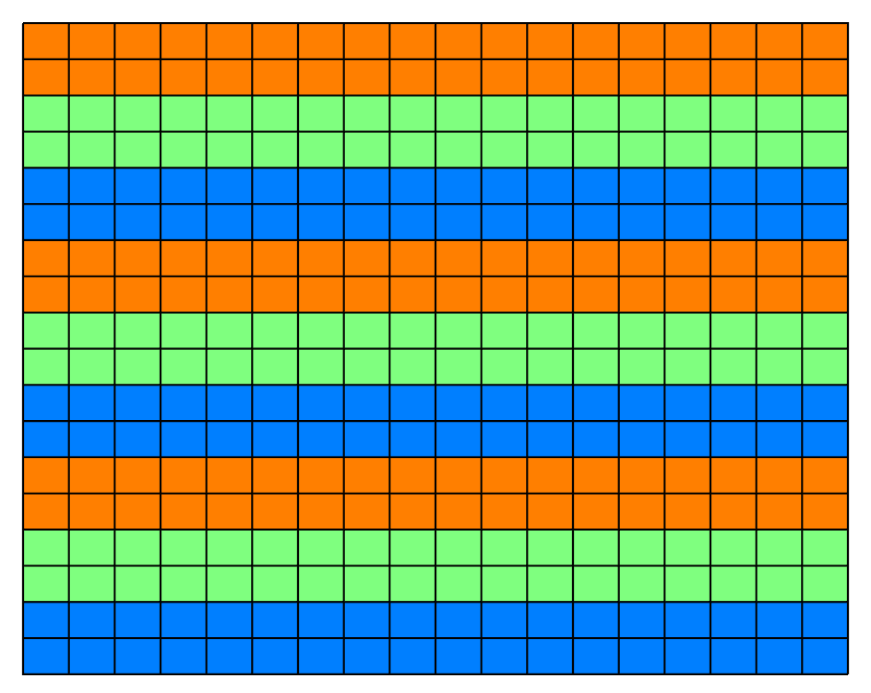

Support for load balancing in OpenMP
OpenMP supports Block Cyclic decompositions with chunk size
#pragma omp parallel for schedule(static, 2) for ( int i = 0; i < n; i++ ) {
for (int j = 0; j < n; j++ ){ do
z = z² + c
while (|z| < 2 )
}
}

Slide 34
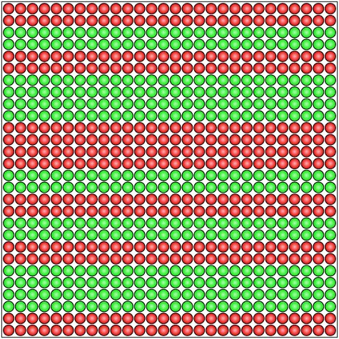
OpenMP supports self scheduling
Adjust task granularity with a chunksize
#pragma omp parallel for schedule(dynamic, 2) for( int i = 0; i < n; i++ ) {
for (int j = 0; j < n; j++ ){
do
z = z² + c
while (|z| < 2 )
}
}

Slide 35
Iteration to thread mapping in OpenMP
#pragma omp parallel shared(N,iters) private(i)
#pragma omp for for (i = 0; i < N; i++)
iters[i] = omp_get_thread_num();
N = 9, # of openMP threads = 3 (no schedule) 0 0 0 1 1 1 2 2 2
N = 16, # of openMP threads = 4, schedule(static,2) 0 0 1 1 2 2 3 3 0 0 1 1 2 2 3 3
N=9: 0 0 1 1 2 2 0 0 1

Slide 36
Initializing Data in OpenMP
We allocate heap storage outside a parallel region
But we should initialize it inside a parallel region
Important on NUMA systems, which account for most servers http://goo.gl/ao02CO
double **A;
A =(double**) malloc(sizeof(double*)*N + sizeof(double)*N*N); assert(A);
#pragma omp parallel private(j) shared(A,N)
for(j=0;j<N;j++)
A[j] = (double *)(A+N) + j*N;
#pragma omp parallel private(i,j) shared(A,N)
for ( j=0; j<N; j++ ) for ( i=0; i<N; i++ )
A[i][j] = 1.0 / (double) (i+j-1);

Slide 37
OpenMP is also an API
But we don’t use this lower level interface unless necessary
Parallel for is much easier to use
#ifdef _OPENMP
#include <omp.h>
#endif
int tid=0, nthrds,1;
#pragma omp parallel
{
#ifdef _OPENMP
tid = omp_get_thread_num();
gcc.gnu.org/onlinedocs/libgomp
nthrds = omp_get_num_threads();
#endif
int i0=(n/nthrds)*tid, i1=i0+n/nthrds;
for(i=i0; i < i1; i++) work(i);
}

Slide 38
Summary: what does OpenMP accomplish for us?
Higher level interface simplifies the programmer’s model
Spawn and join threads, “Outlining” code into a thread function
Handles synchronization and partitioning
If it does all this, why do you think we need to have a lower level threading interface?

