Slide 1

14-513
18-613

Slide 2
Cache Memories
14-513/18-613: Introduction to Computer Systems
11th Lecture, June 11, 2020

Slide 3
Today
Cache memory organization and operation
Performance impact of caches
  The memory mountain
  Rearranging loops to improve spatial locality
  Using blocking to improve temporal locality

Slide 4
Recall: Locality
Principle of Locality: Programs tend to use data and instructions with addresses near or equal to those they have used recently
Temporal locality:
  Recently referenced items are likely
  to be referenced again in the near future
Spatial locality:
  Items with nearby addresses tend
  to be referenced close together in time

Slide 5
Recall: Memory
Hierarchy
L0:
Regs
CPU registers hold words retrieved from the L1 cache.
Smaller,
faster,
and
costlier
(per byte)
storage
devices
L1:
L1 cache
(SRAM)
L1 cache holds cache lines retrieved from the L2 cache.
L2:
L2 cache
(SRAM)
L2 cache holds cache lines
retrieved from L3 cache.
L3:
L3 cache
(SRAM)
L3 cache holds cache lines
retrieved from main memory.
Larger,
slower,
and
cheaper
(per byte)
storage
devices
L4:
Main memory
(DRAM)
Main memory holds disk blocks retrieved from local disks.
L5:
Local secondary storage
(local disks)
Local disks hold files retrieved from disks
on remote servers.
L6:
Remote secondary storage
(e.g., Web servers)

Slide 6
Recall: General Cache Concepts
Smaller, faster, more expensive
memory caches a subset of
the blocks
Cache
8
4
9
14
3
Data is copied in block-sized transfer units
4
Larger, slower, cheaper memory
viewed as partitioned into “blocks”
Memory
0
1
2
3
4
4
5
6
7
8
9
10
11
12
13
14
15

Slide 7
General Cache Concepts: Hit
Request: 14
Data in block b is needed
Block b is in cache:
Hit!
Cache
8
9
14
3
14
Memory
0
1
2
3
4
5
6
7
8
9
10
11
12
13
14
15

Slide 8
General Cache Concepts: Miss
Request: 12
Data in block b is needed
Block b is not in cache:
Miss!
Cache
8
9
14
3
12
Block b is fetched from
memory
12
Request: 12
Block b is stored in cache
Placement policy:
determines where b goes
Replacement policy:
determines which block
gets evicted (victim)
Memory
0
1
2
3
4
5
6
7
8
9
10
11
12
12
13
14
15

Slide 9
Recall: General Caching Concepts:
3 Types of Cache Misses
Cold (compulsory) miss
  Cold misses occur because the cache starts empty and this is the first reference to the block.
Capacity miss
  Occurs when the set of active cache blocks (working set) is larger than the cache.
Conflict miss
  Most caches limit blocks at level k+1 to a small subset (sometimes a singleton) of the block positions at level k.
    E.g. Block i at level k+1 must be placed in block (i mod 4) at level k.
  Conflict misses occur when the level k cache is large enough, but multiple data objects all map to the same level k block.
    E.g. Referencing blocks 0, 8, 0, 8, 0, 8, ... would miss every time.

Slide 10
Cache Memories
Cache memories are small, fast SRAM-based memories managed automatically in hardware
  Hold frequently accessed blocks of main memory
CPU looks first for data in cache
Typical system structure:
CPU chip
Register file
ALU
Cache
memory
System bus
Memory bus
Main
memory
Bus interface
I/O
bridge

Slide 11
Recall: Modern CPU Design
Instruction Control
Fetch
Control
Address
Instruction
Cache
Retirement
Unit
Register
File
Instruction
Decode
Instructions
Operations
Register Updates
Prediction OK?
Execution
Functional
Units
Branch
Arith
Arith
Arith
Load
Store
Operation Results
Addr.
Addr.
Data
Data
Data
Cache

Slide 12
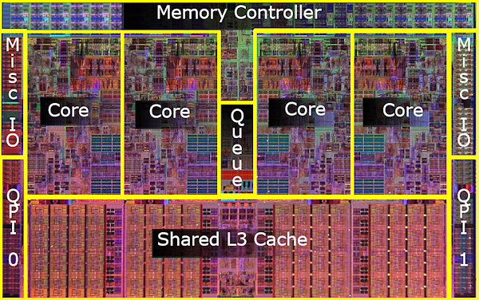
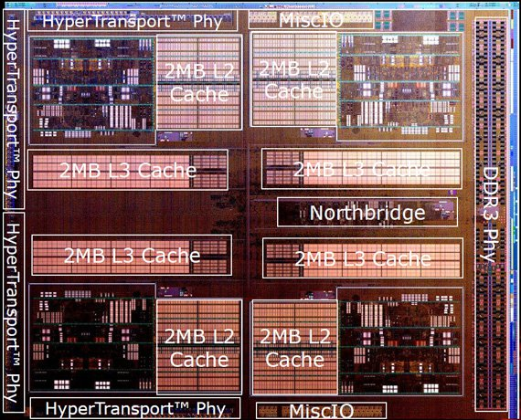
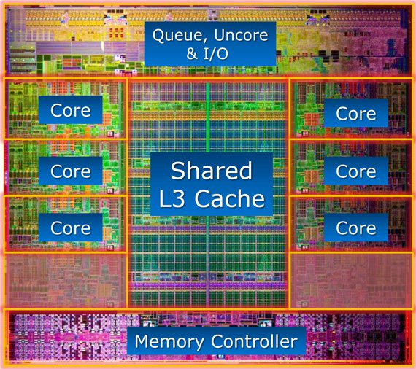
What it Really Looks Like
CPU chip
Register file
ALU
Cache
memory
Bus interface
Nehalem
AMD FX 8150
Core i7-3960X

Slide 13
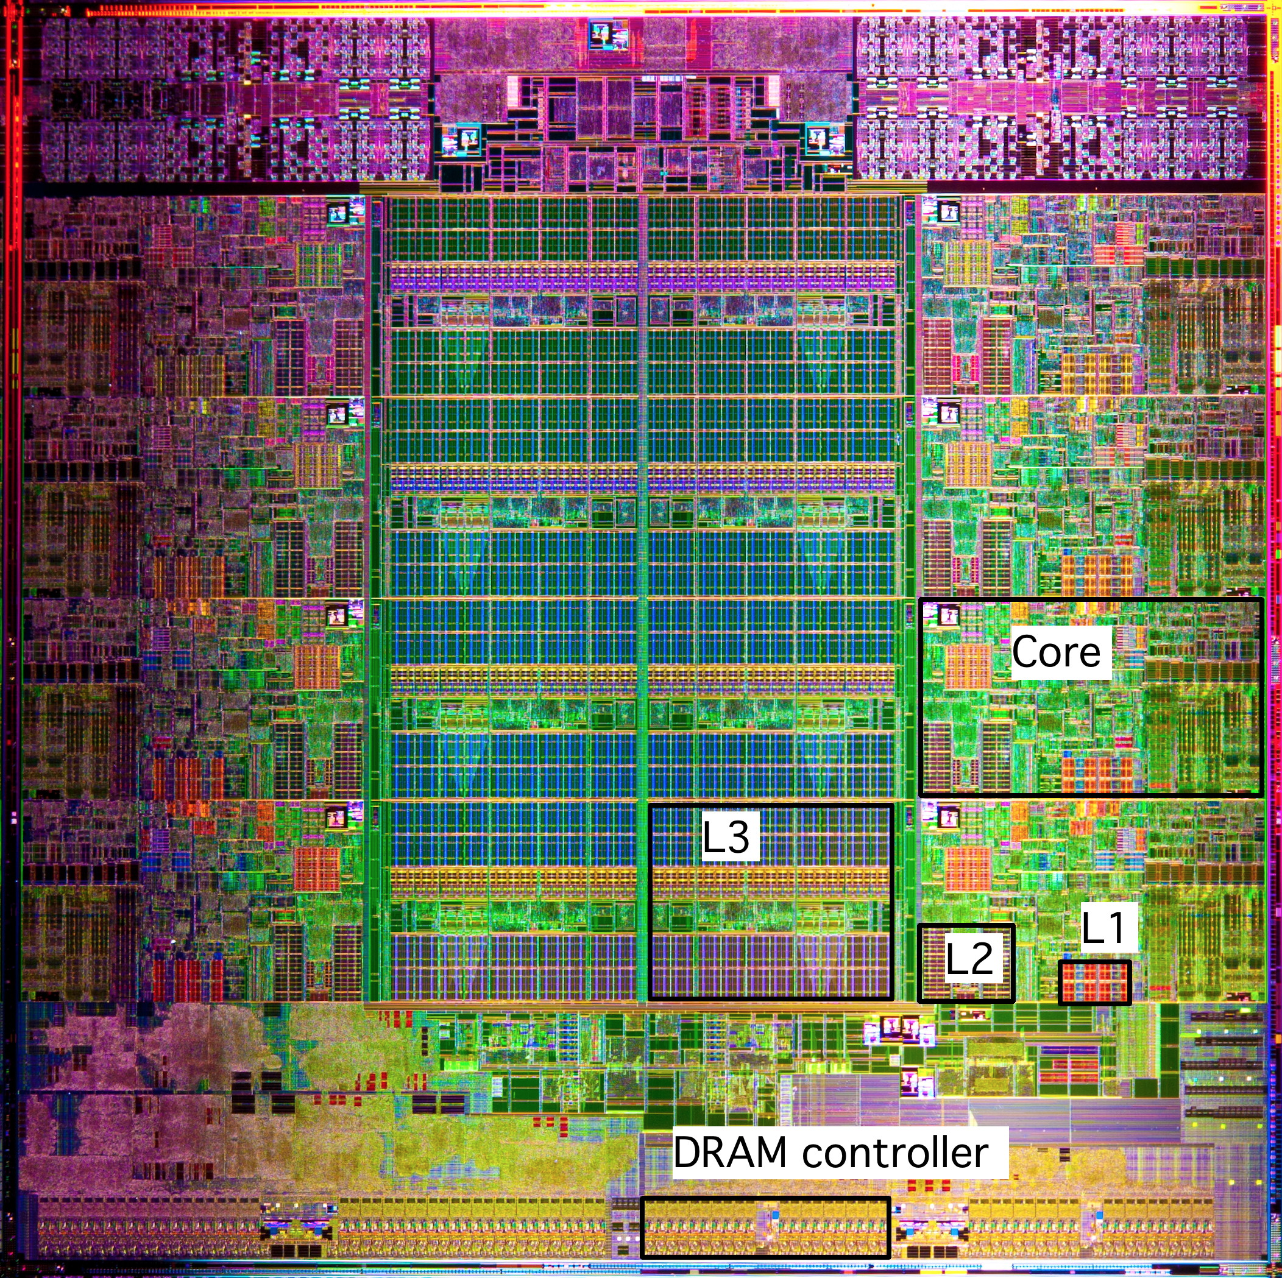
What it Really Looks Like (Cont.)
Intel Sandy Bridge
Processor Die
L1: 32KB Instruction + 32KB Data
L2: 256KB
L3: 3–20MB

Slide 14
General Cache Organization (S, E, B)
E = 2e lines per set
set
line
S = 2^{s} sets
Cache size
= S x E x B data bytes
v
tag
0
1
2
B-1
valid bit
B = 2^{b} bytes per cache block (the data)

Slide 15
Cache Read
Locate set
Check if any line in set
has matching tag
Yes + line valid: hit
Locate data starting
at offset
E = 2e lines per set
Address of word:
t bits
s bits
b bits
S = 2^{s} sets
tag
set
index
block
offset
data begins at this offset
v
tag
0
1
2
B-1
valid bit
B = 2^{b} bytes per cache block (the data)

Slide 16
Example: Direct Mapped Cache (E = 1)
Direct mapped: One line per set
Assume: cache block size B=8 bytes
Address of int:
v
tag
0
1
2
3
4
5
6
7
t bits
0…01
100
v
tag
0
1
2
3
4
5
6
7
find set
S = 2^{s} sets
v
tag
0
1
2
3
4
5
6
7
v
tag
0
1
2
3
4
5
6
7

Slide 17
Example: Direct Mapped Cache (E = 1)
Direct mapped: One line per set
Assume: cache block size B=8 bytes
Address of int:
valid? +
match: assume yes (= hit)
t bits
0…01
100
v
tag
0
1
2
3
4
5
6
7
tag
block offset

Slide 18
Example: Direct Mapped Cache (E = 1)
Direct mapped: One line per set
Assume: cache block size B=8 bytes
Address of int:
valid? +
match: assume yes (= hit)
t bits
0…01
100
v
tag
0
1
2
3
4
5
6
7
block offset
int (4 Bytes) is here
If tag doesn’t match (= miss): old line is evicted and replaced

Slide 19
Direct-Mapped Cache Simulation
t=1
s=2
b=1
4-bit addresses (address space size M=16 bytes)
S=4 sets, E=1 Blocks/set, B=2 bytes/block
Address trace (reads, one byte per read):
0 [0000₂],
1 [0001₂],
7 [0111₂],
8 [1000₂],
0 [0000₂]
x
xx
x
miss
hit
miss
miss
miss
v
Tag
Block
Set 0
1
0
M[0-1]
0
0
M[0-1]
1
1
M[8-9]
Set 1
0
Set 2
0
Set 3
1
0
M[6-7]
0
Notes:
Pause at the end of this slide to consider that M[0] and M[8] have nothing to do with one another, but that they interfere with one anothers’ existences in the cache.

Slide 20
E-way Set Associative Cache (Here: E = 2)
E = 2: Two lines per set
Assume: cache block size B=8 bytes
Address of short int:
2 lines per set
t bits
0…01
100
v
tag
0
1
2
3
4
5
6
7
v
tag
0
1
2
3
4
5
6
7
v
tag
0
1
2
3
4
5
6
7
v
tag
0
1
2
3
4
5
6
7
find set
v
tag
0
1
2
3
4
5
6
7
v
tag
0
1
2
3
4
5
6
7
v
tag
0
1
2
3
4
5
6
7
v
tag
0
1
2
3
4
5
6
7
S sets

Slide 21
E-way Set Associative Cache (Here: E = 2)
E = 2: Two lines per set
Assume: cache block size B=8 bytes
Address of short int:
compare both
t bits
0…01
100
valid? +
match: yes (= hit)
v
tag
0
1
2
3
4
5
6
7
tag
v
tag
0
1
2
3
4
5
6
7
block offset

Slide 22
E-way Set Associative Cache (Here: E = 2)
E = 2: Two lines per set
Assume: cache block size B=8 bytes
Address of short int:
compare both
t bits
0…01
100
valid? +
match: yes (= hit)
v
tag
0
1
2
3
4
4
5
tag
5
6
7
v
tag
0
1
2
3
4
5
6
7
block offset
short int (2 Bytes) is here
No match or not valid (= miss):
One line in set is selected for eviction and replacement
Replacement policies: random, least recently used (LRU), …

Slide 23
2-Way Set Associative Cache Simulation
t=2
s=1
b=1
xx
x
x
4-bit addresses (M=16 bytes)
S=2 sets, E=2 blocks/set, B=2 bytes/block
Address trace (reads, one byte per read):
0 [0000₂],
1 [0001₂],
7 [0111₂],
8 [1000₂],
0 [0000₂]
miss
hit
miss
miss
hit
v
Tag
Block
1
00
M[0-1]
Set 0
0
1
10
M[8-9]
0
1
01
M[6-7]
Set 1
0
0

Slide 24
What about writes?
Multiple copies of data exist:
  L1, L2, L3, Main Memory, Disk
What to do on a write-hit?
  Write-through (write immediately to memory)
  Write-back (defer write to memory until replacement of line)
    Each cache line needs a dirty bit (set if data differs from memory)
What to do on a write-miss?
  Write-allocate (load into cache, update line in cache)
    Good if more writes to the location will follow
  No-write-allocate (writes straight to memory, does not load into cache)
Typical
  Write-through + No-write-allocate
  Write-back + Write-allocate
v
d
tag
0
1
2
B-1
valid bit
dirty bit
B = 2^{b} bytes

Slide 25
Why Index Using Middle Bits?
Direct mapped: One line per set
Assume: cache block size 8 bytes
Standard Method:
Middle bit indexing
Address of int:
v
tag
0
1
2
3
4
5
6
7
t bits
0…01
100
v
tag
0
1
2
3
4
5
6
7
find set
S = 2^{s} sets
v
tag
0
1
2
3
4
5
6
7
Alternative Method:
High bit indexing
Address of int:
v
tag
0
1
2
3
4
5
6
7
1…11
t bits
100
find set

Slide 26
Illustration of Indexing Approaches
0000xx
0001xx
0010xx
64-byte memory
  6-bit addresses
16 byte, direct-mapped cache
Block size = 4. (Thus, 4 sets; why?)
2 bits tag, 2 bits index, 2 bits offset
0011xx
0100xx
0101xx
0110xx
0111xx
1000xx
1001xx
Set 0
1010xx
Set 1
1011xx
Set 2
1100xx
Set 3
1101xx
1110xx
1111xx
Notes:
16byte direct mapped $, 4B blocks -> must be 4 sets to account for all 16B of cache

Slide 27
Middle Bit Indexing
0000xx
0001xx
0010xx
Addresses of form TTSSBB
  TT Tag bits
  SS Set index bits
  BB Offset bits
Makes good use of spatial locality
0011xx
0100xx
0101xx
0110xx
0111xx
1000xx
1001xx
Set 0
1010xx
Set 1
1011xx
Set 2
1100xx
Set 3
1101xx
1110xx
1111xx

Slide 28
High Bit Indexing
0000xx
0001xx
0010xx
Addresses of form SSTTBB
  SS Set index bits
  TT Tag bits
  BB Offset bits
Program with high spatial locality would generate lots of conflicts
0011xx
0100xx
0101xx
0110xx
0111xx
1000xx
1001xx
Set 0
1010xx
Set 1
1011xx
Set 2
1100xx
Set 3
1101xx
1110xx
1111xx
Notes:
Go from block with set index bits 00 to 01, displace the line sitting in set 0 from the block with set index 00.

Slide 29
Intel Core i7 Cache Hierarchy
Processor package
Core 0
Core 3
L1 i-cache and d-cache:
  32 KB, 8-way,
  Access: 4 cycles
L2 unified cache:
  256 KB, 8-way,
  Access: 10 cycles
L3 unified cache:
  8 MB, 16-way,
  Access: 40-75 cycles
Block size: 64 bytes for all caches.
Regs
Regs
L1
d-cache
L1
i-cache
L1
d-cache
L1
i-cache
…
L2 unified cache
L2 unified cache
L3 unified cache
(shared by all cores)
Main memory

Slide 30
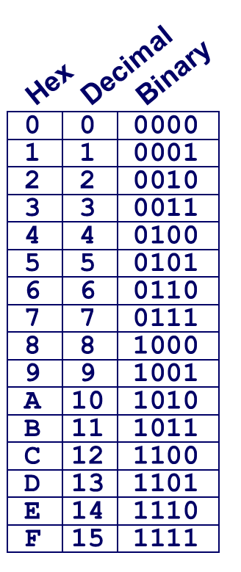
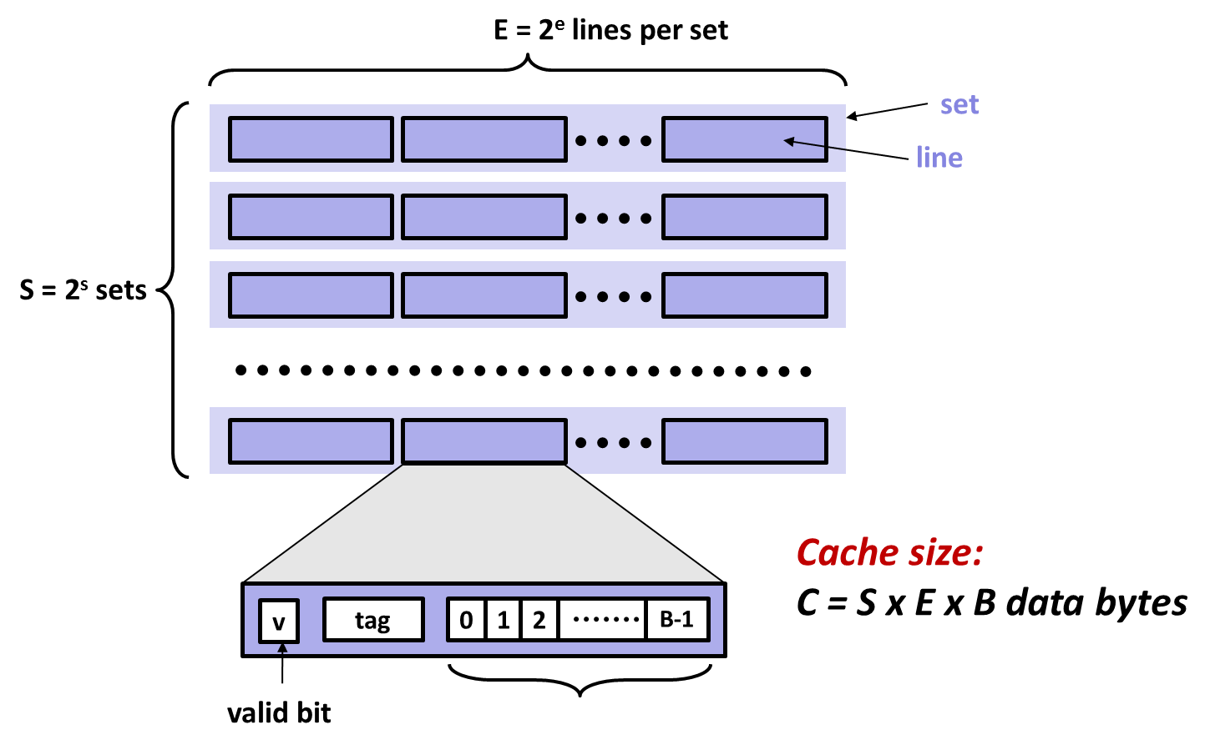
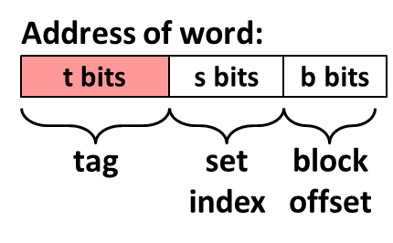
Example: Core i7 L1 Data Cache
32 kB 8-way set associative
64 bytes/block
47 bit address range
B =
S = , s =
E = , e =
C =
Stack Address:
0x00007f7262a1e010
Block offset: 0x??
Set index: 0x??
Tag: 0x??
Block offset: . bits
Set index: . bits
Tag: . bits
Notes:
B = 64 (2^6)
E = 8 (2^3)
S = 64 (2^6) [need to infer from B, E, and Cache Size]
Cache Size = 2^15 (32768)

Slide 31
Example: Core i7 L1 Data Cache
32 kB 8-way set associative
64 bytes/block
47 bit address range
B = 64
S = 64, s = 6
E = 8, e = 3
C = 64 x 64 x 8 = 32,768
Stack Address:
0x00007f7262a1e010
Block offset: 0x10
Set index: 0x0
Tag: 0x7f7262a1e
Block offset: 6 bits
Set index: 6 bits
Tag: 35 bits
0000 0001 0000
Notes:
0x010 => 0000 0001 0000, say that it awkwardly segments the bits, but that’s ok

Slide 32
Cache Performance Metrics
Miss Rate
  Fraction of memory references not found in cache (misses / accesses)
  = 1 – hit rate
  Typical numbers (in percentages):
    3-10% for L1
    can be quite small (e.g., < 1%) for L2, depending on size, etc.
Hit Time
  Time to deliver a line in the cache to the processor
    includes time to determine whether the line is in the cache
  Typical numbers:
    4 clock cycle for L1
    10 clock cycles for L2
Miss Penalty
  Additional time required because of a miss
    typically 50-200 cycles for main memory (Trend: increasing!)

Slide 33
Let’s think about those numbers
Huge difference between a hit and a miss
  Could be 100x, if just L1 and main memory
Would you believe 99% hits is twice as good as 97%?
  Consider this simplified example:
  cache hit time of 1 cycle
  miss penalty of 100 cycles
  Average access time:
  97% hits: 1 cycle + 0.03 x 100 cycles = 4 cycles
  99% hits: 1 cycle + 0.01 x 100 cycles = 2 cycles
This is why “miss rate” is used instead of “hit rate”

Slide 34
Writing Cache Friendly Code
Make the common case go fast
  Focus on the inner loops of the core functions
Minimize the misses in the inner loops
  Repeated references to variables are good (temporal locality)
  Stride-1 reference patterns are good (spatial locality)
Key idea: Our qualitative notion of locality is quantified through our understanding of cache memories

Slide 35
Today
Cache organization and operation
Performance impact of caches
  The memory mountain
  Rearranging loops to improve spatial locality
  Using blocking to improve temporal locality

Slide 36
The Memory Mountain
Read throughput (read bandwidth)
  Number of bytes read from memory per second (MB/s)
Memory mountain: Measured read throughput as a function of spatial and temporal locality.
  Compact way to characterize memory system performance.

Slide 37
Memory Mountain Test Function
long data[MAXELEMS]; /* Global array to traverse */
/* test - Iterate over first "elems" elements of
* array "data" with stride of "stride“,
* using 4x4 loop unrolling.
*/
int test(int elems, int stride) {
long i, sx2=stride*2, sx3=stride*3, sx4=stride*4;
long acc0 = 0, acc1 = 0, acc2 = 0, acc3 = 0;
long length = elems, limit = length - sx4;
/* Combine 4 elements at a time */
for (i = 0; i < limit; i += sx4) {
acc0 = acc0 + data[i];
acc1 = acc1 + data[i+stride];
acc2 = acc2 + data[i+sx2];
acc3 = acc3 + data[i+sx3];
}
/* Finish any remaining elements */
for (; i < length; i++) {
acc0 = acc0 + data[i];
}
return ((acc0 + acc1) + (acc2 + acc3));
}
Call test() with many combinations of elems
and stride.
For each elems and stride:
1. Call test() once to warm up the caches.
2. Call test() again and measure the read throughput(MB/s)
mountain/mountain.c

Slide 38
The Memory Mountain
Core i7 Haswell
2.1 GHz
32 KB L1 d-cache
256 KB L2 cache
8 MB L3 cache
64 B block size
Aggressive prefetching
L1
Ridges
of temporal locality
L2
L3
Slopes
of spatial locality
Mem
Notes:
Slopes of spatial locality – increase stride, degrade throughput because burn through blocks faster
Ridges of temporal – if after warm up, whole dataset in cache, every thing’s a hit.
Prefetching – do better than we expect.

Slide 39
Today
Cache organization and operation
Performance impact of caches
  The memory mountain
  Rearranging loops to improve spatial locality
  Using blocking to improve temporal locality

Slide 40
Matrix Multiplication Example
Description:
  Multiply N x N matrices
  Matrix elements are doubles (8 bytes)
  O(N³) total operations
  N reads per source element
  N values summed per destination
    but may be able to hold in register
Variable sum
held in register
/* ijk */
for (i=0; i<n; i++) {
for (j=0; j<n; j++) {
sum = 0.0;
for (k=0; k<n; k++)
sum += a[i][k] * b[k][j];
c[i][j] = sum;
}
}
matmult/mm.c

Slide 41
Miss Rate Analysis for Matrix Multiply
Assume:
  Block size = 32B (big enough for four doubles)
  Matrix dimension (N) is very large
    Approximate 1/N as 0.0
  Cache is not even big enough to hold multiple rows
Analysis Method:
  Look at access pattern of inner loop
j
k
j
=
x
i
i
k
C
A
B

Slide 42
Layout of C Arrays in Memory (review)
C arrays allocated in row-major order
  each row in contiguous memory locations
Stepping through columns in one row:
  for (i = 0; i < N; i++)
    sum += a[0][i];
  accesses successive elements
  if block size (B) > sizeof(a_{ij}) bytes, exploit spatial locality
    miss rate = sizeof(a_{ij}) / B
Stepping through rows in one column:
  for (i = 0; i < n; i++)
    sum += a[i][0];
  accesses distant elements
  no spatial locality!
    miss rate = 1 (i.e. 100%)

Slide 43
Matrix Multiplication (ijk)
/* ijk */
for (i=0; i<n; i++) {
for (j=0; j<n; j++) {
sum = 0.0;
for (k=0; k<n; k++)
sum += a[i][k] * b[k][j];
c[i][j] = sum;
}
}
Inner loop:
(*,j)
(i,j)
(i,*)
A
B
C
matmult/mm.c
Row-wise
Column-
wise
Fixed
Miss rate for inner loop iterations:
  A B C
  0.25 1.0 0.0
Block size = 32B (four doubles)

Slide 44
Matrix Multiplication (kij)
/* kij */
for (k=0; k<n; k++) {
for (i=0; i<n; i++) {
r = a[i][k];
for (j=0; j<n; j++)
c[i][j] += r * b[k][j];
}
}
Inner loop:
(i,k)
(k,*)
(i,*)
A
B
C
matmult/mm.c
Fixed
Row-wise
Row-wise
Miss rate for inner loop iterations:
  A B C
  0.0 0.25 0.25
Block size = 32B (four doubles)

Slide 45
Matrix Multiplication (jki)
Inner loop:
/* jki */
for (j=0; j<n; j++) {
for (k=0; k<n; k++) {
r = b[k][j];
for (i=0; i<n; i++)
c[i][j] += a[i][k] * r;
}
}
(*,k)
(*,j)
(k,j)
A
B
C
matmult/mm.c
Column-
wise
Fixed
Column-
wise
Miss rate for inner loop iterations:
  A B C
  1.0 0.0 1.0
Block size = 32B (four doubles)

Slide 46
Summary of Matrix Multiplication
for (i=0; i<n; i++) {
for (j=0; j<n; j++) {
sum = 0.0;
for (k=0; k<n; k++)
sum += a[i][k] * b[k][j];
c[i][j] = sum;
}
}
ijk (& jik):
  2 loads, 0 stores
  avg misses/iter = 1.25
for (k=0; k<n; k++) {
for (i=0; i<n; i++) {
r = a[i][k];
for (j=0; j<n; j++)
c[i][j] += r * b[k][j];
}
}
kij (& ikj):
  2 loads, 1 store
  avg misses/iter = 0.5
for (j=0; j<n; j++) {
for (k=0; k<n; k++) {
r = b[k][j];
for (i=0; i<n; i++)
c[i][j] += a[i][k] * r;
}
}
jki (& kji):
  2 loads, 1 store
  avg misses/iter = 2.0

Slide 47
Core i7 Matrix Multiply Performance
Cycles per inner loop iteration
jki / kji (2.0)
ijk / jik (1.25)
kij / ikj (0.5)

Slide 48
Today
Cache organization and operation
Performance impact of caches
  The memory mountain
  Rearranging loops to improve spatial locality
  Using blocking to improve temporal locality

Slide 49
Example: Matrix Multiplication
c = (double *) calloc(sizeof(double), n*n);
/* Multiply n x n matrices a and b */
void mmm(double *a, double *b, double *c, int n) {
int i, j, k;
for (i = 0; i < n; i++)
for (j = 0; j < n; j++)
for (k = 0; k < n; k++)
c[i*n + j] += a[i*n + k] * b[k*n + j];
}
j
c
a
b
=
x
i

Slide 50
Cache Miss Analysis
Assume:
  Matrix elements are doubles
  Cache block = 8 doubles
  Cache size C << n (much smaller than n)
First iteration:
  n/8 + n = 9n/8 misses
  Afterwards in cache:
  (schematic)
n
=
x
=
x
8 wide
Notes:
n/8 – comes from taking n and doing it in chunks of 8 tha fit in a cache line, with perfect stride 1 accesses.
N – comes from missing on everything but the 1 double needed going down a column

Slide 51
Cache Miss Analysis
Assume:
  Matrix elements are doubles
  Cache block = 8 doubles
  Cache size C << n (much smaller than n)
Second iteration:
  Again:
  n/8 + n = 9n/8 misses
Total misses:
  9n/8 n² = (9/8) n³
n
=
x
8 wide

Slide 52
Blocked Matrix Multiplication
c = (double *) calloc(sizeof(double), n*n);
/* Multiply n x n matrices a and b */
void mmm(double *a, double *b, double *c, int n) {
int i, j, k;
for (i = 0; i < n; i+=B)
for (j = 0; j < n; j+=B)
for (k = 0; k < n; k+=B)
/* B x B mini matrix multiplications */
for (i1 = i; i1 < i+B; i1++)
for (j1 = j; j1 < j+B; j1++)
for (k1 = k; k1 < k+B; k1++)
c[i1*n+j1] += a[i1*n + k1]*b[k1*n + j1];
}
matmult/bmm.c
j1
c
a
b
c
=
x
+
i1
Block size B x B

Slide 53
Cache Miss Analysis
Assume:
  Cache block = 8 doubles
  Cache size C << n (much smaller than n)
  Three blocks fit into cache: 3B² < C
First (block) iteration:
  B²/8 misses for each block
  2n/B x B²/8 = nB/4
  (omitting matrix c)
  Afterwards in cache
  (schematic)
n/B blocks
=
x
Block size B x B
=
x
Notes:
2n/B comes from doing n/B blocks of size B^2 in each source matrix
B^2 / 8 comes from taking B^2 bytes per block and perfectly caching them 8 doubles at a time.

Slide 54
Cache Miss Analysis
Assume:
  Cache block = 8 doubles
  Cache size C << n (much smaller than n)
  Three blocks fit into cache: 3B² < C
Second (block) iteration:
  Same as first iteration
  2n/B x B²/8 = nB/4
Total misses:
  nB/4 * (n/B)² = n³/(4B)
n/B blocks
=
x
Block size B x B
Notes:
n/B is the dimension of the matrix in blocks. (n/B)^2 is the number of iterations. nB/4 is the misses per iteration. N^3/4B is the total miss count.

Slide 55
Blocking Summary
No blocking: (9/8) n³ misses
Blocking: (1/(4B)) n³ misses
Use largest block size B, such that B satisfies 3B² < C
  Fit three blocks in cache! Two input, one output.
Reason for dramatic difference:
  Matrix multiplication has inherent temporal locality:
    Input data: 3n², computation 2n³
    Every array elements used O(n) times!
  But program has to be written properly
Notes:
3B^2 to accommodate M3 = M1 x M2, with M1,2,3 all supplying blocks of dim B^2

Slide 56
Cache Summary
Cache memories can have significant performance impact
You can write your programs to exploit this!
  Focus on the inner loops, where bulk of computations and memory accesses occur.
  Try to maximize spatial locality by reading data objects sequentially with stride 1.
  Try to maximize temporal locality by using a data object as often as possible once it’s read from memory.

Slide 57
Supplemental slides

Slide 58
The Memory Mountain
Core i5 Haswell
3.1 GHz
32 KB L1 d-cache
256 KB L2 cache
8 MB L3 cache
64 B block size
Aggressive prefetching
L1
Ridges
of temporal locality
L2
L3
Slopes
of spatial locality
Mem

Slide 59
Cache Capacity Effects from Memory Mountain
Core i7 Haswell
3.1 GHz
32 KB L1 d-cache
256 KB L2 cache
8 MB L3 cache
64 B block size
Main Memory
L3
L2
L1
Slice through memory mountain with stride=8

Slide 60
Cache Block Size Effects from Memory Mountain
Core i7 Haswell
2.26 GHz
32 KB L1 d-cache
256 KB L2 cache
8 MB L3 cache
64 B block size
Miss rate = s/8
Miss rate = 1.0
Stride s

Slide 61
Modeling Block Size Effects from Memory Mountain
Core i7 Haswell
2.26 GHz
32 KB L1 d-cache
256 KB L2 cache
8 MB L3 cache
64 B block size
Stride s

Slide 62
2008 Memory Mountain
Core 2 Duo
2.4 GHz
32 KB L1 d-cache
6MB L2 cache
64 B block size
No prefetching

Slide 63
Matrix Multiplication (jik)
/* jik */
for (j=0; j<n; j++) {
for (i=0; i<n; i++) {
sum = 0.0;
for (k=0; k<n; k++)
sum += a[i][k] * b[k][j];
c[i][j] = sum
}
}
Inner loop:
(*,j)
(i,j)
(i,*)
A
B
C
matmult/mm.c
Row-wise
Column-
wise
Fixed
Misses per inner loop iteration:
  A B C
  0.25 1.0 0.0
Block size = 32B (four doubles)

Slide 64
Matrix Multiplication (ikj)
/* ikj */
for (i=0; i<n; i++) {
for (k=0; k<n; k++) {
r = a[i][k];
for (j=0; j<n; j++)
c[i][j] += r * b[k][j];
}
}
Inner loop:
(i,k)
(k,*)
(i,*)
A
B
C
matmult/mm.c
Fixed
Row-wise
Row-wise
Misses per inner loop iteration:
  A B C
  0.0 0.25 0.25
Block size = 32B (four doubles)

Slide 65
Matrix Multiplication (kji)
/* kji */
for (k=0; k<n; k++) {
for (j=0; j<n; j++) {
r = b[k][j];
for (i=0; i<n; i++)
c[i][j] += a[i][k] * r;
}
}
Inner loop:
(*,k)
(*,j)
(k,j)
A
B
C
matmult/mm.c
Column-
wise
Fixed
Column-
wise
Misses per inner loop iteration:
  A B C
  1.0 0.0 1.0
Block size = 32B (four doubles)

