Slide 1
Making the Coda File System a 1st Class Citizen on Handheld Linux Devices
Unlocking the Hildon-FM &
Introducing Fine File Manager for Coda
Sang Kil Cha
Jae Yoon Chong
Anoop Jaishankar
Mentor: Jan Harkes

Slide 2
Agenda
Abstract
High-level Requirement
Achievement
Risk Analysis
Schedule
Future Work
Question

Slide 3
Abstract
Failure-resilient, scalable, and secure access to shared information by mobile user over wireless network is a challenge
Coda file system meets this challenge through disconnected operation, weak connectivity, translucent caching, and other mechanisms
Notes:
Mobile devices are becoming more and more popular in these days, and most of them are equipped with
Wireless network connection capabilities, such as WIFI.
As mobile devices and mobile computing are becoming more popular, more users rely on them to
Access information over the network.
However, it is still a challenge to provide users with
Failure-resilent, scalable, and secure access to shared information over wireless network.
Our project, the integration of Coda file system with Nokia N810 mobile device, is aimed to show that
Coda file system meets this challenge thru various mechanisms, such as disconnected operation,
Weak connectivity, and translucent caching.

Slide 4
High-level Requirement
Visibility
  Coda file system should be visible in any application that uses Hildon-FM library
  Hildon-FM should provide graphical user interface for authentication
Usability
  User should be able to access cached information in any built-in application

Slide 5
Achievement
Installed Coda client on Nokia N810 device
Analyzed and modified Hildon-FM library to show Coda file system
Designed new user friendly file manager application
Incorporated Coda authentication module in Hildon-FM library

Slide 6
Coda Client
Failed to run Coda client in Scratchbox environment
  Scratchbox tool-kit does not emulate Maemo
  Opportunity to learn more about Maemo, Scratchbox, libraries, and other environment
Installed Coda client on the device with required dependencies
  Works for current Maemo version, Diablo
  Cache saved in internal memory
  Manual load of Venus and kernel module required

Slide 7
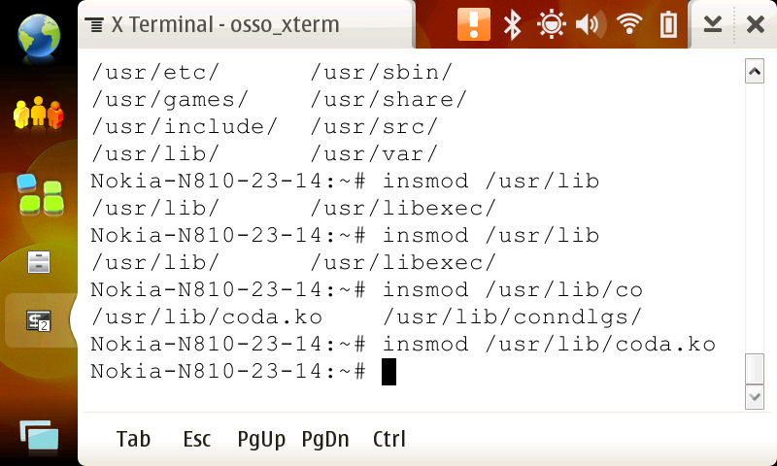
Coda Client
Manually loading Coda kernel module

Slide 8
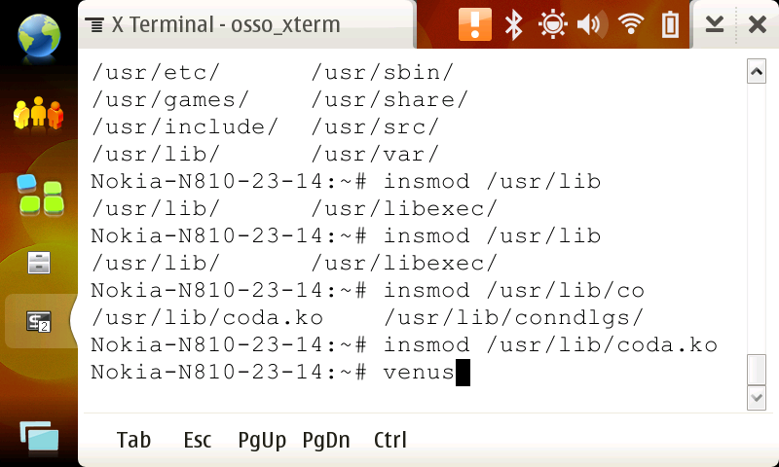
Coda Client
Manually loading Venus client cache manager

Slide 9
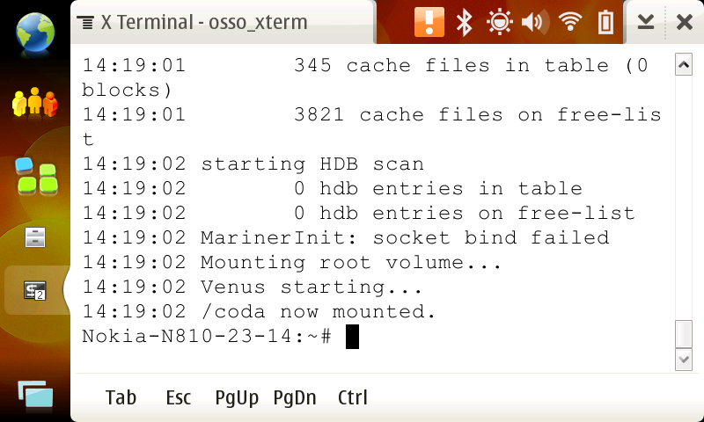
Coda Client
Manually loading Venus client cache manager

Slide 10
Coda Client
What to do next
  Automate loading Venus and kernel module
Risk Analysis
  Venus crash, kernel module failed to load, cache directory being deleted
    Out of scope of this project
  Is internal memory enough for Coda?
    2 GB space shared with other application
    Yes, it is
Notes:
Solutions
Making daemon which periodically check the venus client.
Internal memory space problem
We can store the cache in the external (removable) memory such as SD card.
→ still, have problem: if user remove the memory, the cache will be gone.
We can compress the cache.
→ speed will be decreased

Slide 11
Hildon-FM Library
Application transparent vs. application aware
Part of Hildon application framework, default library for Maemo platform
  Default application (music player, web browser) use the library for file system related operation
  Provides encapsulated view for protection of system
  Right click equivalent mechanism support
Analyzed Hildon-FM source code to figure out its structure and modified it to show Coda file system

Slide 12
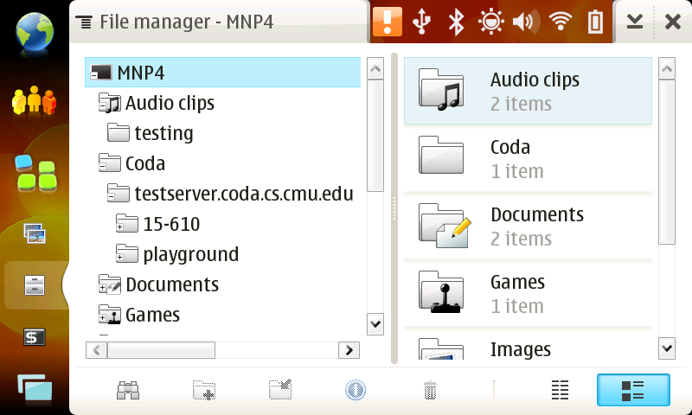
Hildon-FM Library
Coda file system is shown in file manager

Slide 13
Hildon-FM Library
What to do next
  Refresh Coda directory after Venus is executed and the directory is mounted

Slide 14
File Manager Application
From application-transparent to application-aware
Some features cannot be made application transparent
Source code for Maemo file manager application is not available to developer
There’s no open source file manager that uses Hildon-FM library

Slide 15
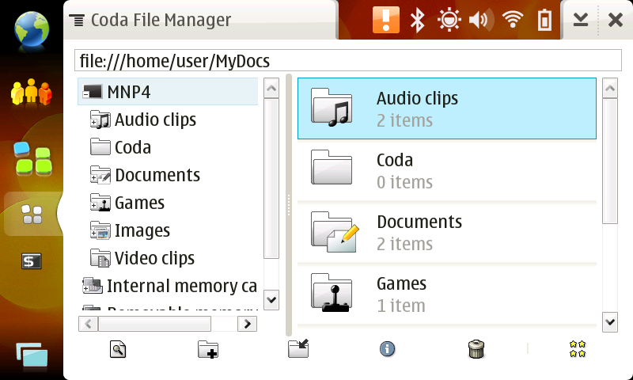
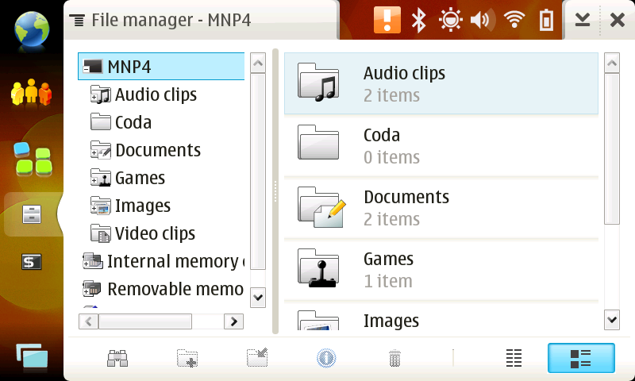
File Manager Application
New Fine File Manager (left) and original Maemo File Manager(right)

Slide 16
File Manager Application
What to do next
  Copy and paste, and move
  More options in main menu
  Full file system display

Slide 17
Authentication Module
User has to authenticate with Coda server
Parameters required: username, password, realm
Two ways
  Modify and include clog as a function
  Fork/exec a clog program to authenticate
Problems:
  Context menu is application-dependent
Notes:
Reason why we chose clog fork.
1. We have to include every dependent libraries of clog, such as lwp and rpc2.
Problems:
1. Context menu is application-dependent
2. Hence we pop up the Auth dialog everytime. → can be cumbersom
3. Using ctoken?
→We cannot determine whether users are already authenticated or not.

Slide 18
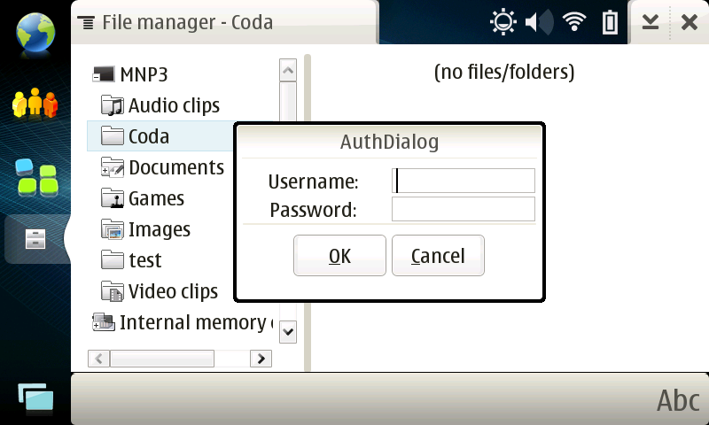
Authentication Module (cont’d)

Slide 19
Risk Analysis
Internal memory for caching
Software/hardware update
Theft of the device after authentication

Slide 20
Schedule
Original schedule after checkpoint 1
Sang Kil: file manager application
Jae Yoon: analyze and modified Hildon-FM
Anoop: authentication and file manager application

Slide 21
Schedule
Revised Schedule, actual work done after checkpoint 1

Slide 22
Future Work
Script for Coda client startup
Fix Hildon-FM related problem
  USB disconnection, mount refresh
Distinguish realms in authentication
More features in file manager application
Testing with multiple Coda server
Embellishment / packaging

Slide 23
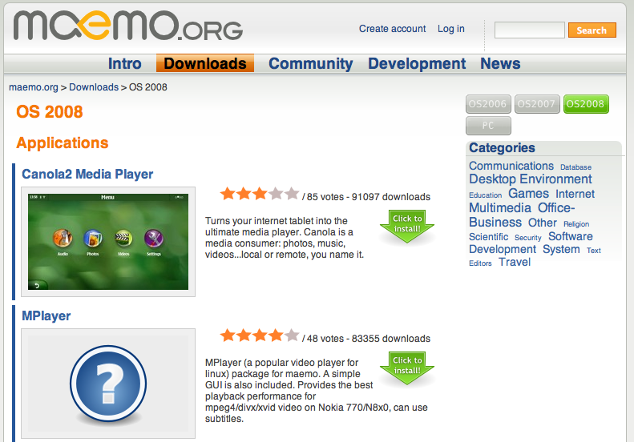
Future Work (cont’d)
Register with the official Maemo website, as an open source application

Slide 24
Questions

Slide 25
Hildon-FM Library
Libraries used in our application

Slide 26
Work Division
 | New Coda File Manager Application | Hildon-FM Analysis and Modification | Coda Client Installation and Automation | Authentication Module
Sang Kil Cha | 80% | 10% | 33% | 10%
Jae Yoon Chong | 10% | 80% | 33% | 10%
Anoop Jaishankar | 10% | 10% | 33% | 80%

