Slide 1
15-640/440: Distributed Systems
Lecture 23: Key Distribution and Management
Thanks to the many, many people who have contributed various slides to this deck over the years.

Slide 2
Key Distribution
Have network with n entities
Add one more
  Must generate n new keys
  Each other entity must securely get its new key
  Big headache managing n² keys!
One solution: use a central keyserver
  Needs n secret keys between entities and keyserver
  Generates session keys as needed
  Downsides
    Only scales to single organization level
    Single point of failure
Notes:
Note that a network with n entities has O(n^2) keys. Question: what ways could you handle distributing new keys?

Slide 3
Symmetric Key Distribution
How does Andrew do this?
Andrew Uses Kerberos, which relies on a Key Distribution Center (KDC) to establish shared symmetric keys.

Slide 4



Key Distribution Center (KDC)
Alice, Bob need shared symmetric key.
KDC: server shares different secret key with each registered user (many users)
Alice, Bob know own symmetric keys, K_{A-KDC} K_{B-KDC} , for communicating with KDC.
KDC
K_{A-KDC}
K_{P-KDC}
K_{X-KDC}
K_{P-KDC}
K_{B-KDC}
K_{Y-KDC}
K_{Z-KDC}
K_{A-KDC}
K_{B-KDC}

Slide 5
Key Distribution Center (KDC)
Q: How does KDC allow Bob, Alice to determine shared symmetric secret key to communicate with each other?
KDC generates R1
K_{A-KDC}(A,B)
Alice
knows R1
K_{A-KDC}(R1, K_{B-KDC}(A,R1) )
Bob knows to use R1 to communicate with Alice
K_{B-KDC}(A,R1)
Alice and Bob communicate: using R1 as
session key for shared symmetric encryption
Notes:
Downside:
KDC must always be online to communicate securely
KDC can give our session keys away (escrow)

Slide 6
How Useful is a KDC?
Must always be online to support secure communication
KDC can expose our session keys to others!
Centralized trust and point of failure.
In practice, the KDC model is mostly used within single organizations (e.g. Kerberos) but not more widely.

Slide 7
Kerberos
Trivia
  Developed in 80’s by MIT’s Project Athena
  Used on all Andrew machines
  Mythic three-headed dog guarding the entrance to Hades
Uses DES, 3DES
Key Distribution Center (KDC)
  Central keyserver for a Kerberos domain
  Authentication Service (AS)
    Database of all master keys for the domain
    Users’ master keys are derived from their passwords
    Generates ticket-granting tickets (TGTs)
  Ticket Granting Service (TGS)
    Generates tickets for communication between principals
  “slaves” (read only mirrors) add reliability
  “cross-realm” keys obtain tickets in others Kerberos domains
Notes:
Kerberos was built on the idea that almost nobody trusted anybody else. You can authenticate to the AS with a hash of your password, and in turn, it gives you a few encrypted tokens which can be presented to others, but only after being verified.
AS and TGS are designed to be modular, but almost all implementations group them together in a KDC (Key Distribution Center)
AS takes care of recalling master keys and creating TGTs, TGS takes care of comm. Between principals.
Every user and service in Kerberos has a principal. (ebardsle@ANDREW..., imap/cyrus, afs)
Talk about cross-realm: initial trust is the issue – how do you get initial trust with another realm, that is on a potentially hostile, dynamic network? (Answer: get it from your own TGS)

Slide 8
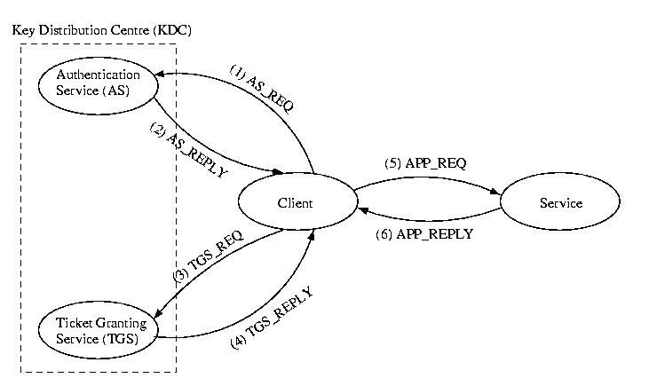
Kerberos Authentication Steps
Kerberos
TGS
TGT
Service TKT
Client
Server
Service REQ
Notes:
High level overview: client gets TGT from AS.

Slide 9
(1) AS_REQUEST
The first step in accessing a service that requires Kerberos authentication is to obtain a ticket-granting ticket.
To do this, the client sends a plain-text message to the AS:
  <client id, KDC id, requested ticket expiration, nonce1>

Slide 10
Kerberos Authentication Steps
Kerberos
TGS
TGT
Service TKT
Client
Server
Service REQ
Notes:
High level overview: client gets TGT from AS.

Slide 11
(2) AS_REPLY
<{K_{c,TGS}, none1}K_{c}, {ticket_{c,tgs}}K_{TGS}>
Notice the reply contains the following:
  The nonce, to prevent replays
  The new session key
  A ticket that the client can’t read or alter
A ticket:
  ticket_{x,y} = {x, y, beginning valid time, expiration time, K_{x,y}}

Slide 12
Kerberos Authentication Steps
Kerberos
TGS
TGT
Service TKT
Client
Server
Service REQ
Notes:
High level overview: client gets TGT from AS.

Slide 13
(3) TGS_REQUEST
The TGS request asks the TGS for a ticket to communicate with a a particular service.
<{auth_{c}} _{Kc, TGS}, {ticket_{c}, TGS}K_{TGS}, service, nonce2>
<{auth_{c}} is known as an authenticator it contains the name of the client and a timestamp for freshness.

Slide 14
Kerberos Authentication Steps
Kerberos
TGS
TGT
Service TKT
Client
Server
Service REQ
Notes:
High level overview: client gets TGT from AS.

Slide 15
(4) TGS_REPLY
<{K_{c,service}, nonce2}K _{c, TGS}, {ticket_{c, service} }K_{service} >
Notice again that the client can’t read or alter the ticket
Notice again the use of the session key and nonce between the client and the TGS

Slide 16
(5) APP_REPLY
<{auth_{c}}K_{c,service}, {ticket_{c,service}}K_{service}, request, nonce3>
Notice again the use of the session key as well as the protected ticket.

Slide 17
Kerberos Authentication Steps
Kerberos
TGS
TGT
Service TKT
Client
Server
Service REQ
Notes:
High level overview: client gets TGT from AS.

Slide 18
(6) APP_REPLY
<{nonce3}K_{c,service}, response>
Because of the use of the encrypted nonce, the client is assured the reply came form the application, not an imposter.

Slide 19
Using Kerberos
kinit
  Get your TGT
  Creates file, usually stored in /tmp
klist
  View your current Kerberos tickets
kdestory
  End session, destroy all tickets
kpasswd
  Changes your master key stored by the AS
“Kerberized” applications
  kftp, ktelnet, ssh, zephyr, etc
  afslog uses Kerberos tickets to get AFS token
unix41:~ebardsle> klist
Credentials cache: FILE:/ticket/krb5cc_61189_9FTlN6
Principal: ebardsle@ANDREW.CMU.EDU
Issued Expires Principal
Apr 18 19:40:50 Apr 19 20:40:49 krbtgt/ANDREW.CMU.EDU@ANDREW.CMU.EDU
Apr 18 19:40:50 Apr 19 20:40:49 afs@ANDREW.CMU.EDU
Apr 18 19:40:51 Apr 19 20:40:49 imap/cyrus.andrew.cmu.edu@ANDREW.CMU.EDU

Slide 20
Asymmetric Key Crypto:
Instead of shared keys, each person has a “key pair”
K_{B}
Bob’s public key
Bob’s private key
K_{B}⁻¹
The keys are inverses, so:
K_{B}⁻¹ (K_{B} (m)) = m
Notes:
Note: We are not going to go into the details of that K_{B}(m) means as far as computation. We will treat it as a black box function with these properties.

Slide 21
Asymmetric Key Crypto:
It is believed to be computationally unfeasible to derive K_{B}⁻¹ from K_{B} or to find any way to get M from K_{B}(M) other than using K_{B}⁻¹ .
=> K_{B} can safely be made public.
Note: We will not detail the computation that K_{B}(m) entails, but rather treat these functions as black boxes with the desired properties.
Notes:
Note: We are not going to go into the details of that K_{B}(m) means as far as computation. We will treat it as a black box function with these properties.

Slide 22
Asymmetric Key: Confidentiality
Bob’s public
key
K_{B}
Bob’s private
key
K_{B}⁻¹
encryption
algorithm
ciphertext
decryption
algorithm
plaintext
message
K_{B} (m)
m = K_{B}⁻¹ (K_{B} (m))

Slide 23
Asymmetric Key: Sign & Verify
If we are given a message M, and a value S such that K_{B}(S) = M, what can we conclude?
The message must be from Bob, because it must be the case that S = K_{B}⁻¹(M), and only Bob has K_{B}⁻¹ !
This gives us two primitives:
    Sign (M) = K_{B}⁻¹(M) = Signature S
    Verify (S, M) = test( K_{B}(S) == M )

Slide 24
Asymmetric Key: Integrity & Authentication
We can use Sign() and Verify() in a similar manner as our HMAC in symmetric schemes.
Integrity:
S = Sign(M)
Message M
Receiver must only check Verify(M, S)
Nonce
Authentication:
S = Sign(Nonce)
Verify(Nonce, S)
Notes:
Note: there is another way to do authentication, which we will see when we look at SSL.

Slide 25
Asymmetric Key Review:
Confidentiality: Encrypt with Public Key of Receiver
Integrity: Sign message with private key of the sender
Authentication: Entity being authenticated signs a nonce with private key, signature is then verified with the public key
But, these operations are computationally expensive*

Slide 26
Cryptographic Hash Functions
Given arbitrary length message m, compute constant length digest h(m)
Desirable properties
  h(m) easy to compute given m
  Preimage resistant
  2nd preimage resistant
  Collision resistant
Crucial point : These are not inverted, they are recomputed
Example use: file distribution (ur well aware of that!)
Common algorithms: MD5, SHA
Notes:
Now, you’ve all used hash tables. What is one of the primary concerns in developing a hash function? Collisions!!
Occur here as well due to pigeonhole principle
Advantage : Very fast.. Faster than DES
You all are using SHA hashes in project 2, so you know that they take an arbitrary amount of data and reduce it to a fixed length string.
It should also be noted that collisions have been found in MD5, and that SHA-1 in no longer considered to be secure. SHA-2, however, has a much larger output range (224 to 512 bits)

Slide 27
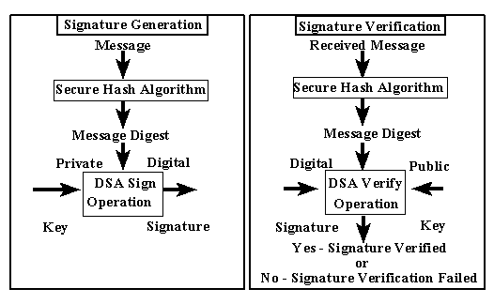
Digital Signatures
Alice wants to convince others that she wrote message m
  Computes digest d = h(m) with secure hash
  Send <m,d>
Digital Signature Standard (DSS)
Notes:
Why is this commonly done? Public key cryptography is really slow for large files, so if you only need to authenticate them, it is easier to create a unique digest, and sign that digest. Since it is hard to find two files that hash to the same digest, it is unlikely that an attacker could insert a false file.

Slide 28
The Dreaded PKI
Definition:
Public Key Infrastructure (PKI)
A system in which “roots of trust” authoritatively bind public keys to real-world identities
A significant stumbling block in deploying many “next generation” secure Internet protocol or applications.
Notes:
PKI’s are notoriously complex

Slide 29
Certification Authorities
Certification authority (CA): binds public key to particular entity, E.
An entity E registers its public key with CA.
  E provides “proof of identity” to CA.
  CA creates certificate binding E to its public key.
  Certificate contains E’s public key AND the CA’s signature of E’s public key.
Bob’s
public
key
CA generates
S = Sign(K_{B})
K_{B}
K_{B}
CA
private
key
certificate = Bob’s public key and signature by CA
Bob’s
identifying information
K⁻¹ _{CA}
Notes:
Note: CA’s do NOT generate keys. They simply are handed a public key along with proof of identify, and generate a signature which can accompany the key when it is given to a user that must validate that they key is in fact Bob’s public key.

Slide 30
Certification Authorities
When Alice wants Bob’s public key:
  Gets Bob’s certificate (Bob or elsewhere).
  Use CA’s public key to verify the signature within Bob’s certificate, then accepts public key
K_{B}
Verify(S, K_{B})
If signature is valid, use K_{B}
CA
public
key
K_{CA}

Slide 31
Certificate Contents
info algorithm and key value itself (not shown)
Cert owner
Cert issuer
Valid dates
Fingerprint of signature
Notes:
Wait… didn’t we just say that we needed to have the key’s from the CA’s? What does our browser use?

Slide 32
Pretty Good Privacy (PGP)
History
  Written in early 1990s by Phil Zimmermann
  Primary motivation is email security
  Controversial for a while because it was too strong
    Distributed from Europe
  Now the OpenPGP protocol is an IETF standard (RFC 2440)
  Many implementations, including the GNU Privacy Guard (GPG)
Uses
  Message integrity and source authentication
    Makes message digest, signs with public key cryptosystem
    Webs of trust
  Message body encryption
    Private key encryption for speed
    Public key to encrypt the message’s private key

Slide 33
Secure Shell (SSH)
Negotiates use of many different algorithms
Encryption
Server-to-client authentication
  Protects against man-in-the-middle
  Uses public key cryptosystems
  Keys distributed informally
    kept in ~/.ssh/known_hosts
  Signatures not used for trust relations
Client-to-server authentication
  Can use many different methods
  Password hash
  Public key
  Kerberos tickets
Notes:
Developed for use over hostile networks. Utilizes encryption (usually blowfish or twofish, for speed), and bidirectional authentication. Interesting in that both encryption and client-to-server authentication are very modular.

Slide 34
SSL/TLS
History
  Standard libraries and protocols for encryption and authentication
  SSL originally developed by Netscape
    SSL v3 draft released in 1996
  TLS formalized in RFC2246 (1999)
Uses public key encryption
Uses
  HTTPS, IMAP, SMTP, etc
Notes:
TLS is SSL v3
Things like stunnel will allow you to wrap any plaintext connection in SSL. The thing to note here is that SSL does not change the underlying protocol, but rather, it adds negotiation at the beginning of the connection, before passing it back to the application, which almost doesn’t know that it’s there.

Slide 35
Transport Layer Security (TLS) aka Secure Socket Layer (SSL)
Used for protocols like HTTPS
Special TLS socket layer between application and TCP (small changes to application).
Handles confidentiality, integrity, and authentication.
Uses “hybrid” cryptography.
Notes:
Originally created by a little known and know largely defunct net start-up called “netscape” in the mid-90’s

Slide 36
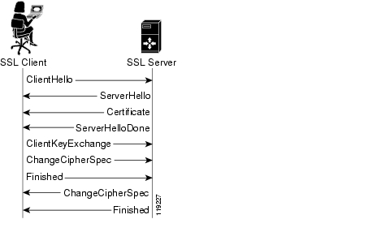
Setup Channel with TLS “Handshake”
Handshake Steps:
Clients and servers negotiate exact cryptographic protocols
Client’s validate public key certificate with CA public key.
Client encrypt secret random value with servers key, and send it as a challenge.
Server decrypts, proving it has the corresponding private key.
This value is used to derive symmetric session keys for encryption & MACs.

Slide 37
How TLS Handles Data
1) Data arrives as a stream from the application via the TLS Socket
2) The data is segmented by TLS into chunks
3) A session key is used to encrypt and MAC each chunk to form a TLS “record”, which includes a short header and data that is encrypted, as well as a MAC.
4) Records form a byte stream that is fed to a TCP socket for transmission.

Slide 38
Works Cited/Resources
http://www.psc.edu/~jheffner/talks/sec_lecture.pdf
http://en.wikipedia.org/wiki/One-time_pad
http://www.iusmentis.com/technology/encryption/des/
http://en.wikipedia.org/wiki/3DES
http://en.wikipedia.org/wiki/AES
http://en.wikipedia.org/wiki/MD5Textbook: 8.1 – 8.3
Wikipedia for overview of Symmetric/Asymmetric primitives and Hash functions.
OpenSSL (www.openssl.org): top-rate open source code for SSL and primitive functions.
“Handbook of Applied Cryptography” available free online: www.cacr.math.uwaterloo.ca/hac/

