Slide 1



Today’s presentation is largely stolen from Ricky Ho’s Blog posting
(But, any mistakes are assuredly mine!):
Sunday, August 29, 2010
Designing algorithms for Map Reduce
15-440/640 October 29, 2013 (Gregory Kesden, Presenting)
http://horicky.blogspot.com/2010/08/designing-algorithmis-for-map-reduce.html

Slide 2
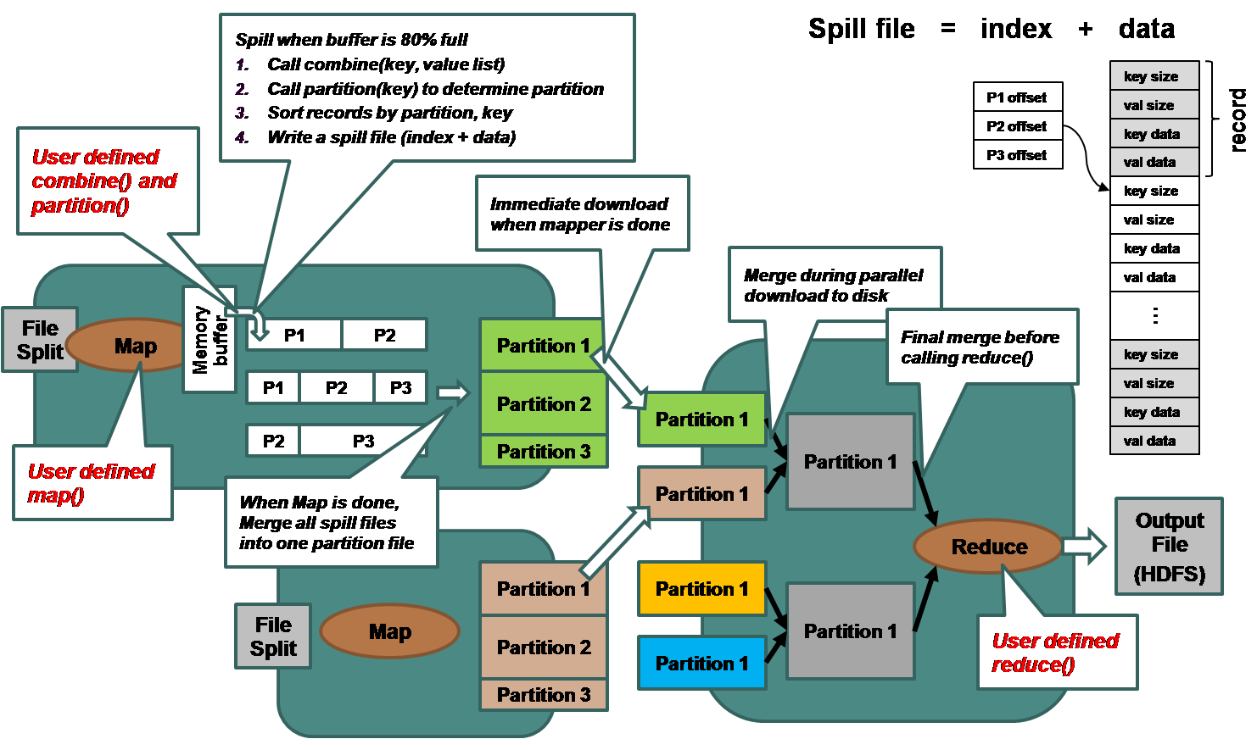
Map-Reduce Overview

Slide 3
Where’s The Hype?
Parallelism is (mostly) in the maps, which are independent (unsynchronized).
  O(n) becomes O(1) with parallelism
Merge sorts are Merge Sorts
  O(n log n)
Reduces are linear
  O(n)

Slide 4
“Embarrassingly Parallel”
Some things are essentially only Maps
  Identity reduce
  Massively parallel
  No bottleneck
Examples:
  Filter to retain or exclude only certain patterns
  Reduce data size by random sampling
  Convert format, e.g. bold to italics
  Flag bad data, e.g. negative, out of range, etc.

Slide 5
“Embarrassingly Parallel”
Split
Map
Part
Part
IdRed
File1
Split
Map
Part
Part
IdRed
File2
Split
Map
Part
Part
IdRed
File…
Split
Map
Part
Part
IdRed
Filen
FS @Map
FS@Reduce
DFS
DFS
RPC/Download

Slide 6
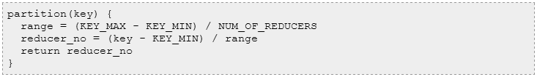
Sorting
Map-Reduce is, in many ways, a distributed sorting engine that can some useful work along the way
  The merge sort and reduce perform the sort
We can leverage this if we actually want to sort
  Identity map
  Identity reduce
One possibly trick: Partition by range
  Simplifies merge.

Slide 7
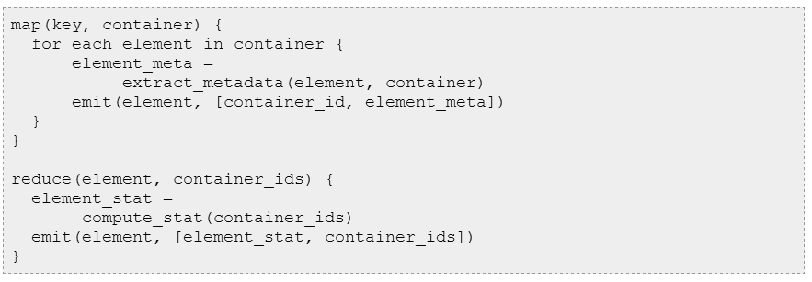
Inverted Indexes
Common index from key to location, e.g. word to <fileName:line#>
Map emits key, e.g. <word, fileName:line#>
Reduce produces <key, list<metadata>>, e.g. <word, list<fileName:line#>>

Slide 8
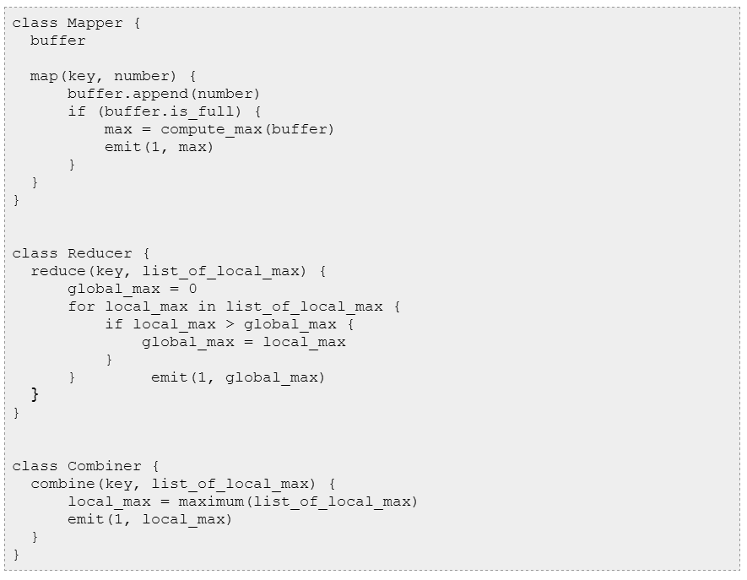
Simple Statistics
Where operation is both commutative and associative
Map does local computation
Reduce forms global computation
Examples: Min, max, count, sum (What about average?)

Slide 9
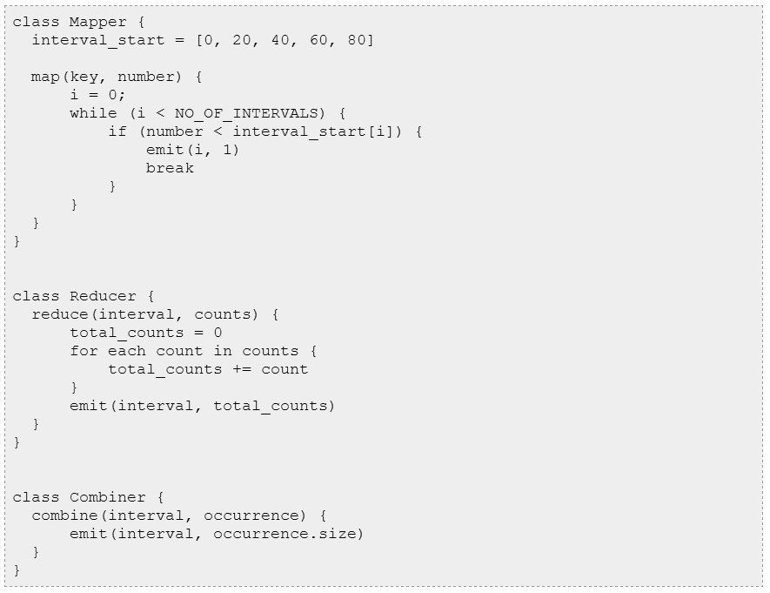
Histograms
Divide into different intervals.
Maps compute the count per interval.
Reduce will compute the per interval.
Note power is in map: Ability to classify in parallel

Slide 10
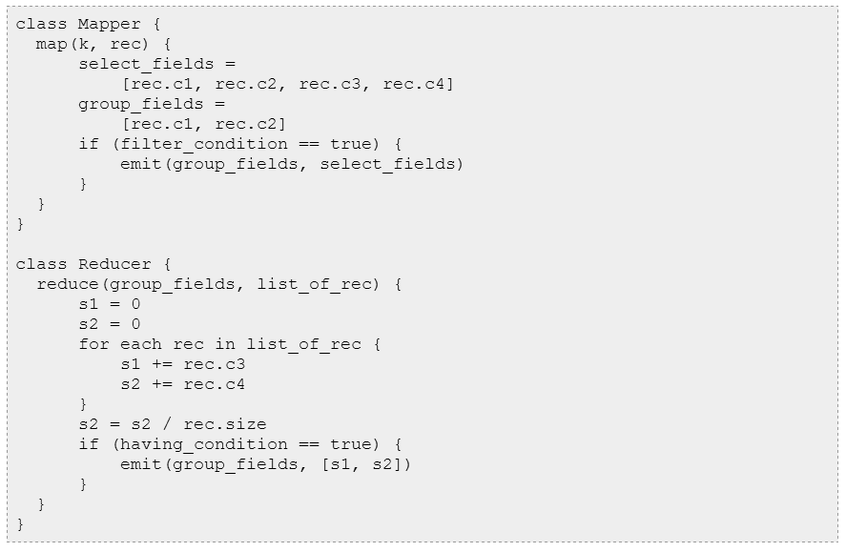
SELECT
Filter: result = SELECT c1, c2, c3, c4 FROM source WHERE conditions
  Implement in Map
Aggregation: SELECT sum(c3) as s1, avg(c4) as s2 ... FROM result GROUP BY c1, c2 HAVING conditions
  Implement in Reduce

Slide 11
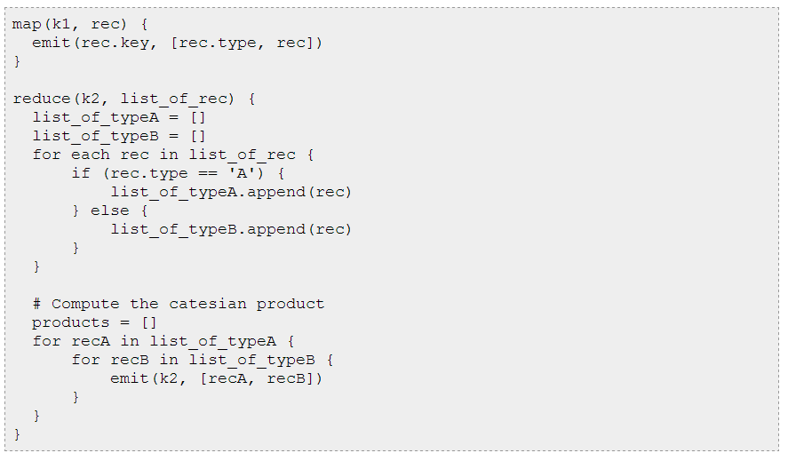
Simple Join

Slide 12
Kesden’s Additional Slides
The next few slides are from me, rather than the cited source for the rest of the presentation.

Slide 13
Normalize Format For Join
Map records to common Format
Identity reduce
Identity Map
Reduce to form cross-product
Filter to get results

Slide 14
Shortest Path
Form Graph as Adjacency List
  Map: <Node, <Node, Distance>> for each adjacency
  Reduce:<Node, Shortest<Node, Distance>>
Work from each node in parallel
Map
  Node n as a key and (D, points-to) as its value
    D is the distance form the start
    Points-to is a list of Nodes reachable from n, initially direct adjacencies
    Emits all points reachable from n via each node in points-to
Reduce
  Emits one Node n for each key, the one with the shortest D
Repeat Map and Reduce phases until no shorter distances found (nothing learned, nothing can be learned, convergance)

