Slide 1
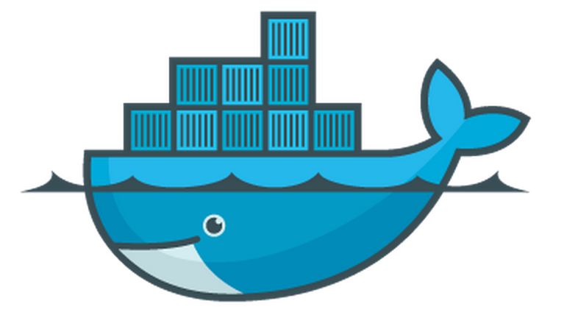
Docker Overview
Rohit Jnagal, Docker Meetup, Bangalore

Slide 2
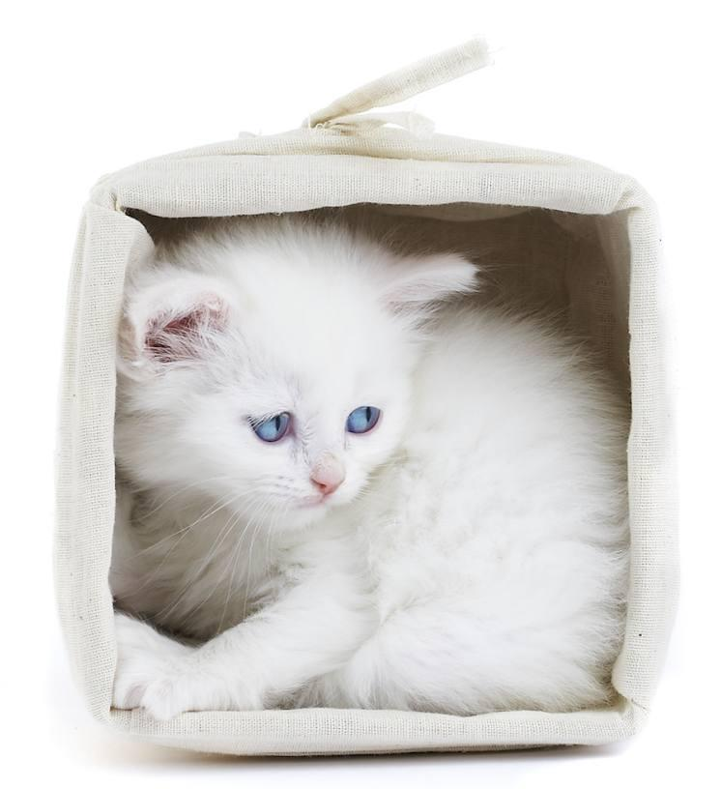
jnagal@
Containerizing everything @ Google
Containers at scale.
Resource Isolation.
lmctfy
libcontainer

Slide 3
Docker : What & Why
Machine or Application containers
Build Once, Configure Once.
Deploy Everything*
Everywhere*
Reliably & Consistently
Efficiently
Cheaply

Slide 4
Docker Features
Image Management
Resource Isolation
File system Isolation
Network Isolation
Change Management
Sharing
Process
Management

Slide 5
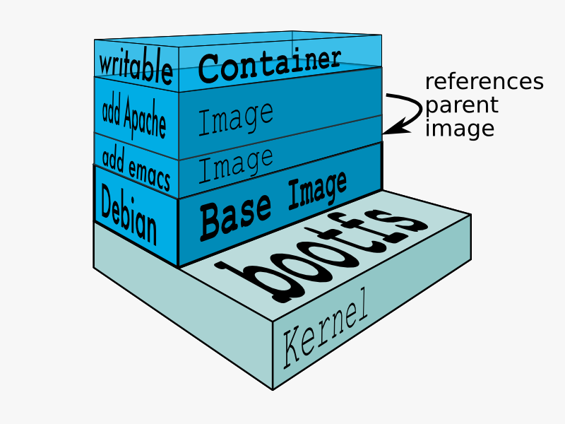
Docker Components

Slide 6
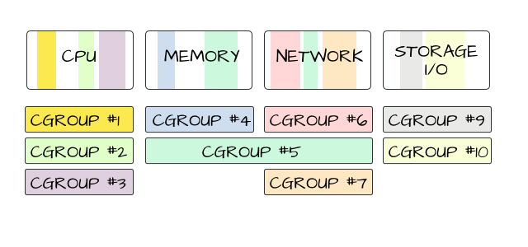
Docker Grounds up: Resource Isolation
Cgroups : Isolation and accounting
cpu
memory
block i/o
devices
network
numa
freezer
image credit: mairin

Slide 7
Docker Grounds up: Namespaces
Process trees.
Mounts.
Network.
User accounts.
Hostnames.
Inter-process communication.
pid_t pid = clone(..., flags, ...)
CLONE_NEWUTS hostname, domainname
CLONE_NEWIPC IPC objects
CLONE_NEWPID Process IDs
CLONE_NEWNET Network configuration
CLONE_NEWNS File system mounts
CLONE_NEWUSER User and Group IDs
setns(int fd, int nstype)
CLONE_NEWIPC
CLONE_NEWNET
CLONE_NEWUTS
Also: unshare(flags)

Slide 8
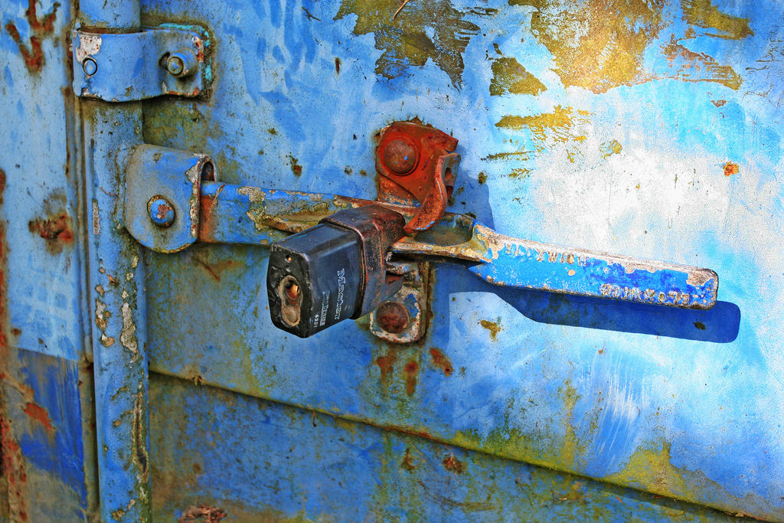
Docker Grounds up: Add Security
Linux Capabilities
Drops most capabilities.
Enable what a task needs.
GRSEC and PAX
SELinux
AppArmor
image credit: Leo Reynolds

Slide 9
Docker Grounds up: Filesystem
File-system Isolation:
Building a rootfs dir and chroot into it.
With mount namespace, use pivot-root.
Features:
Layering, CoW, Caching, Diffing
Solutions:
UnionFS, Snapshotting FS, CoW block devices

Slide 10
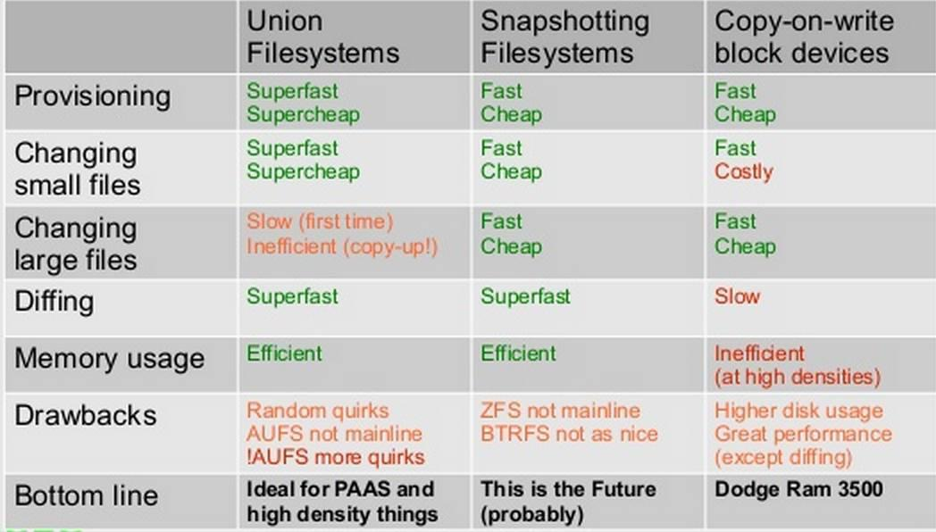
Docker Grounds up: Filesystem
From: Jérôme Petazzoni

Slide 11
Docker Grounds up: Processes & Networking
We have resources, isolation, and file system management.
Docker daemon handles starting/stopping processes with:
Attach logic
Logs
TTY management
Docker run options
Events and container state
Network Management
NAT, Bridge, Veth
Expose
Links

Slide 12
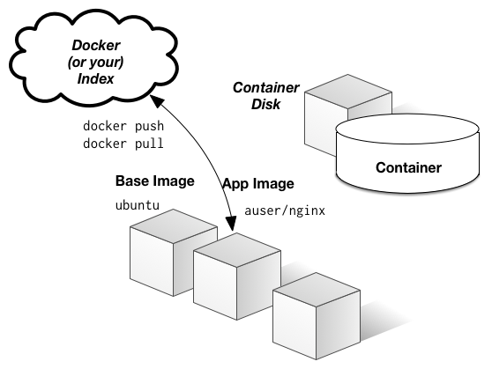
Docker Grounds up: Images
Create and share images
Push, pull, commit images.
Registry (public, private) and index.
Dockerfiles
Orchestration:
Linking Containers
Multi-host linking
Dynamic discovery
image: jbarratt

Slide 13
Docker Codewalk
github.com/dotcloud/docker/
api : docker client and server api
daemon : Managing containers and images
engine: commands/jobs processing
graph: store for versioned filesystem images and their relationship.
registry: handling registry and repository.
links: Linking containers.
integration-cli: Integration tests.
docs: documentation.
pkg: collection of standalone utility packages that are not docker specific.
sdd -> Great place to start contributing.
Time for actual walkthrough...

Slide 14
Docker Codewalk : docker/daemon
Docker Daemon
Exec Driver
Network Driver
Graph Driver
LXC
Native
AUFS
BTRFS
DevMapper

Slide 15
Docker Codewalk : pkg
github.com/dotcloud/docker/pkg
libcontainer: cgroup and namespaces. Uses lot of other utility packages.
nsinit binary.
apparmor, selinux, label : applying security profiles.
mount, signals : system utilities.
iptables, networkfs, netlink : network utilities.
term: terminal handling
systemd
Let’s look through some of these.

Slide 16
Thanks!
Rohit Jnagal
jnagal@google
@jnagal

