Slide 1
Paxos
14-736 (Distributed Systems)
This lecture based heavily upon :
https://www.quora.com/In-distributed-systems-what-is-a-simple-explanation-of-the-Paxos-algorithm
Lamport, Leslie, “Paxos Made Simple”, 01 Nov 2001.

Slide 2
Consensus
A collection of process can propose values. A consensus algorithm ensures
That a single proposal is chosen
The processes can learn the proposed value
No value is chosen if there are no proposals.

Slide 3
Consensus Safety Requirements
Only a value that has been proposed may be chosen
Only a single value is chosen, and
A process never learns that a value has been chosen unless it has been

Slide 4
Goal, Simply Put
The goal of the Paxos algorithm is for some number of peers to reach agreement on a value.
Paxos guarantees that if one peer believes some value has been agreed upon by a majority, the majority will never agree on a different value.

Slide 5
Liveness, By Intuition
A proposed value is eventually chosen
Once a value is chosen, the processes eventually learn it

Slide 6
Communication
Agents operate at arbitrary speed
Agents may fail by stopping and then be restarted
Unless some information can be remembered across restart, consensus isn’t possible

Slide 7
Mechanism
The protocol is designed so that any agreement must go through a majority of nodes.
Any future attempts at agreement, if successful must also go through at least one of those nodes.
Thus: Any node that proposes after a decision has been reached must communicate with a node in the majority. The protocol guarantees that it will learn the previously agreed upon value from that majority.

Slide 8
Three Phases
Prepare
Accept
Decided

Slide 9
Prepare Phase: Prepare and Promise
First, we have the prepare phase. A sends a prepare request to A, B and C.
Paxos relies on sequence numbers to achieve its guarantees.
The prepare request asks a node to promise: "I will never accept any proposal with a sequence number less than that in the prepare request."
The nodes reply with any value they have previously agreed to (if any).
Node A must propose the value it receives with the highest sequence number. This action provides the guarantee the previously agreed upon values will be preserved.

Slide 10
Accept Phase
A sends an accept request to A, B and C.
The accept request states: "Do you accept foo?"
If the accompanying sequence number is not below the what the node had previously promised or request the node has previously accepted, it will accept the new value and sequence number.
If node A receives accepts from a majority of nodes, the value is decided. This round of Paxos will never agree to another value

Slide 11
Decided/Accepted Phase
The third phase is not strictly necessary, but is a crucial optimization in any productionized Paxos implementation.
After A receives a majority of accepts, it sends decided messages to A, B and C.
These messages let all the peers know that a value has been chosen, and accelerate the end of the decision process.
Without this message, the other peers would have to attempt to propose a value to learn of the agreement.
In the prepare phase, they'd learn of the previously agreed upon value. Once that agreement was driven to conclusion, the node would recognize the agreement.

Slide 12
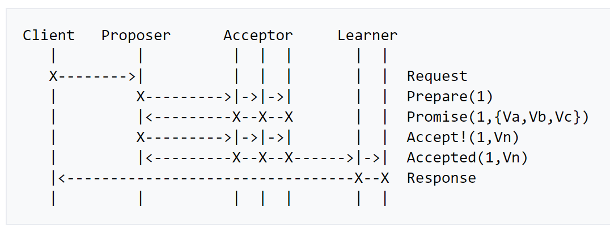
Paxos Message Flow
https://en.wikipedia.org/wiki/Paxos_(computer_science)

Slide 13
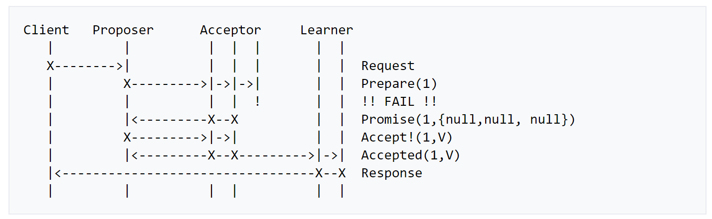
Message Flow: Failure of Acceptor
https://en.wikipedia.org/wiki/Paxos_(computer_science)

Slide 14
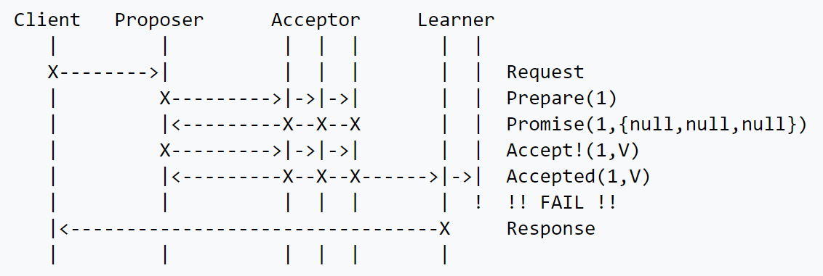
Message Flow: Failure of Redundant Learner
https://en.wikipedia.org/wiki/Paxos_(computer_science)

Slide 15
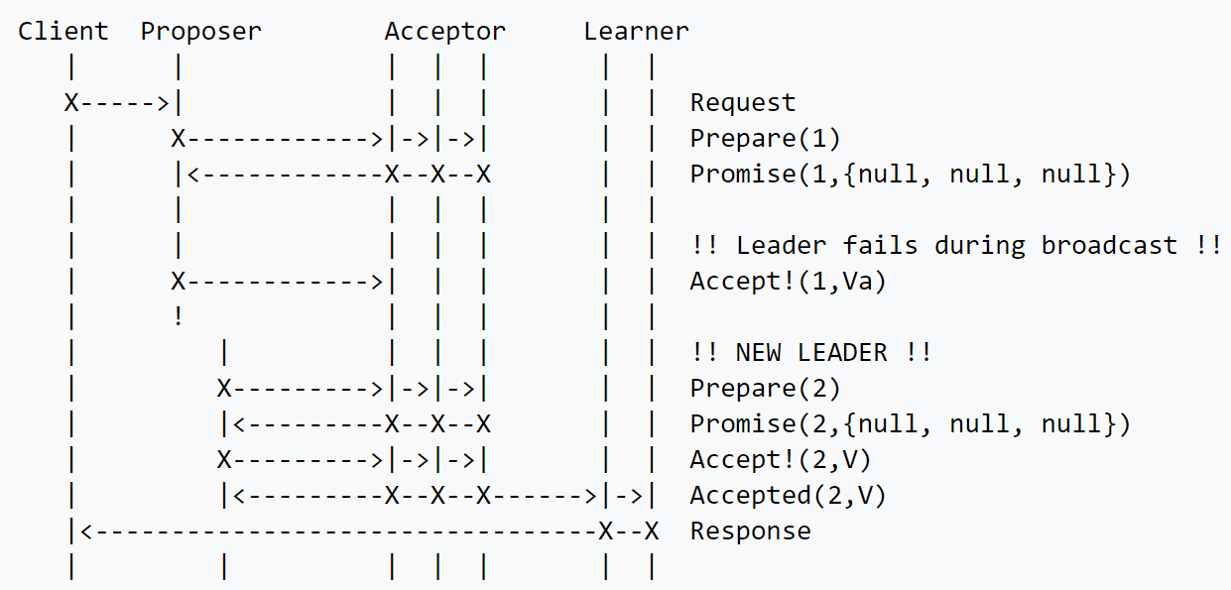
Message Flow: Failure of Proposer
https://en.wikipedia.org/wiki/Paxos_(computer_science)

Slide 16
Multi-Paxos
If leader is stable, no need for Prepare phase
Include round number included in proposal.
Incremented with each proposal from same leader.
https://en.wikipedia.org/wiki/Paxos_(computer_science)

