Slide 1
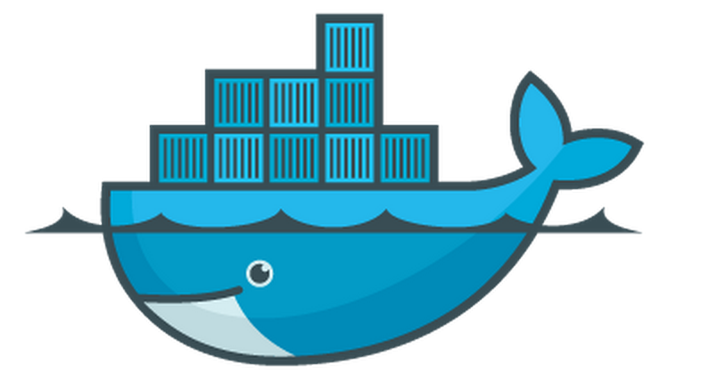

Docker Overview
Rohit Jnagal, Docker Meetup, Bangalore

Slide 2
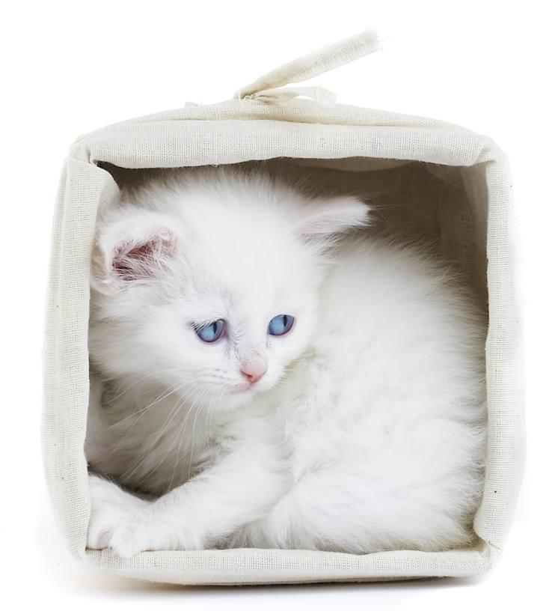
jnagal@
Containerizing everything @ Google
Containers at scale.
Resource Isolation.
lmctfy
libcontainer

Slide 3
Docker : What & Why
Machine or Application containers
Build Once, Configure Once.
Deploy Everything*
Everywhere*
Reliably & Consistently
Efficiently
Cheaply

Slide 4
Docker Features
Image Management
Resource Isolation
File system Isolation
Network Isolation
Change Management
Sharing
Process
Management

Slide 5
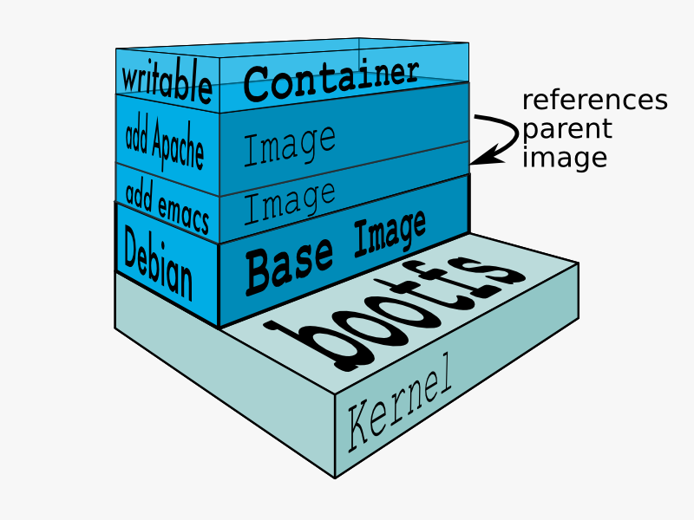
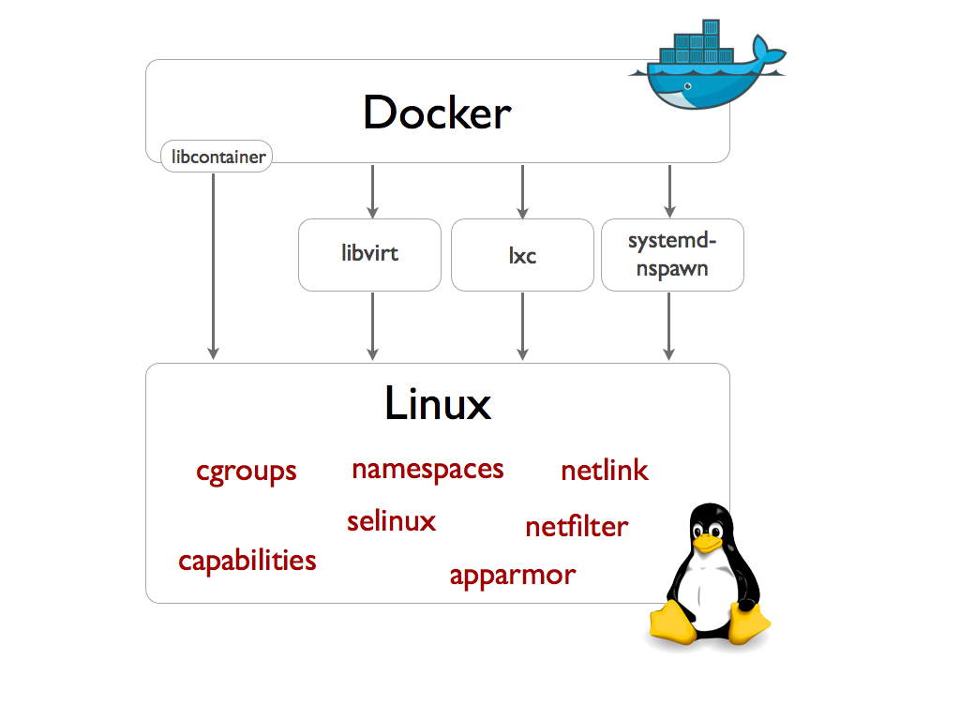
Docker Components

Slide 6
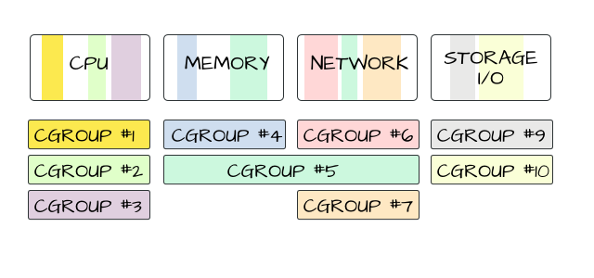
Docker Grounds up: Resource Isolation
Cgroups : Isolation and accounting
cpu
memory
block i/o
devices
network
numa
freezer
image credit: mairin

Slide 7
Docker Grounds up: Namespaces
Process trees.
Mounts.
Network.
User accounts.
Hostnames.
Inter-process communication.
pid_t pid = clone(..., flags, ...)
CLONE_NEWUTS hostname, domainname
CLONE_NEWIPC IPC objects
CLONE_NEWPID Process IDs
CLONE_NEWNET Network configuration
CLONE_NEWNS File system mounts
CLONE_NEWUSER User and Group IDs
setns(int fd, int nstype)
CLONE_NEWIPC
CLONE_NEWNET
CLONE_NEWUTS
Also: unshare(flags)

Slide 8
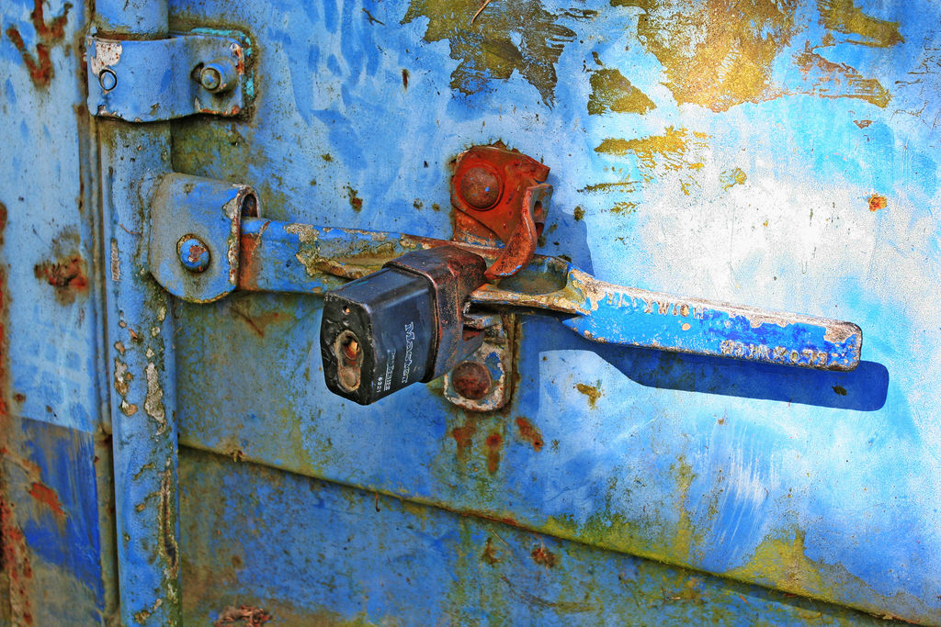
Docker Grounds up: Add Security
Linux Capabilities
  Drops most capabilities.
  Enable what a task needs.
GRSEC and PAX
SELinux
AppArmor
image credit: Leo Reynolds

Slide 9
Docker Grounds up: Filesystem
File-system Isolation:
Building a rootfs dir and chroot into it.
With mount namespace, use pivot-root.
Features:
Layering, CoW, Caching, Diffing
Solutions:
UnionFS, Snapshotting FS, CoW block devices

Slide 10
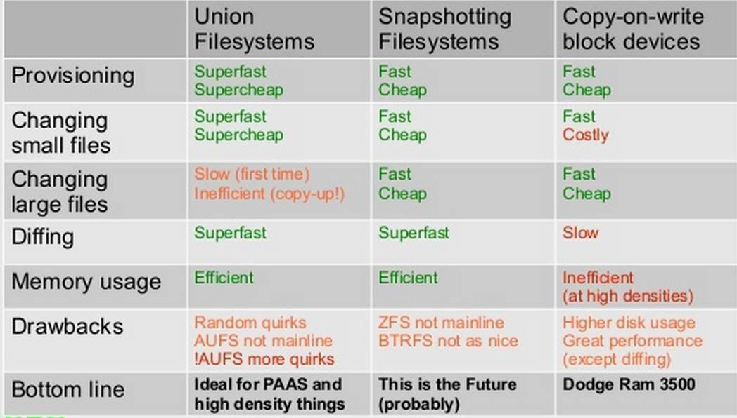
Docker Grounds up: Filesystem
From: Jérôme Petazzoni

Slide 11
Docker Grounds up: Processes & Networking
We have resources, isolation, and file system management.
Docker daemon handles starting/stopping processes with:
Attach logic
Logs
TTY management
Docker run options
Events and container state
Network Management
NAT, Bridge, Veth
Expose
Links

Slide 12
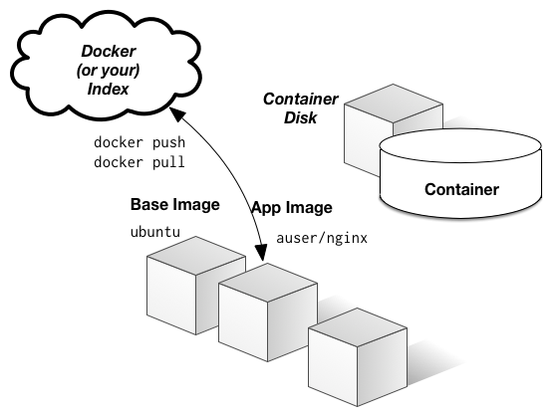
Docker Grounds up: Images
Create and share images
Push, pull, commit images.
Registry (public, private) and index.
Dockerfiles
Orchestration:
Linking Containers
Multi-host linking
Dynamic discovery
image: jbarratt

Slide 13
Docker Codewalk
github.com/dotcloud/docker/
api : docker client and server api
daemon : Managing containers and images
engine: commands/jobs processing
graph: store for versioned filesystem images and their relationship.
registry: handling registry and repository.
links: Linking containers.
integration-cli: Integration tests.
docs: documentation.
pkg: collection of standalone utility packages that are not docker specific.
sdd -> Great place to start contributing.
Time for actual walkthrough...

Slide 14
Docker Codewalk : docker/daemon
Docker Daemon
Exec Driver
Network Driver
Graph Driver
LXC
Native
AUFS
BTRFS
DevMapper

Slide 15
Docker Codewalk : pkg
github.com/dotcloud/docker/pkg
libcontainer: cgroup and namespaces. Uses lot of other utility packages.
nsinit binary.
apparmor, selinux, label : applying security profiles.
mount, signals : system utilities.
iptables, networkfs, netlink : network utilities.
term: terminal handling
systemd
Let’s look through some of these.

Slide 16
Thanks!
Rohit Jnagal
jnagal@google
@jnagal

Slide 17
Kesden Additional Slide:
VMs vs Containers
      • VMs virtualize Hardware, OS, etc
      • Containers virtualize application environment
      Containers may not provide as strong a security model
        • What is virtualized? What is real?
        • What about the super users?
        • Things that are sideways, e.g. virtual file system, devices, etc
      Generally use containers to virtualize for one application in shared host or VM
      Use VMs to virtualize for many applications
      VMs probably 2-3x as resource intensive as containers
          • Corollary: Can get 2-3x as much from containerized solution vs VMs

