Slide 1
14-736: Distributed Systems
Lecture 4 * Spring 2018 * Kesden

Slide 2
Frequently Overheard
…among “Kesden and his students”
Student: I looked everywhere: The slides, notes, textbook, readings, Wikipedia, Google, and the whiteboard near your office…I didn’t find the answer to the homework question anywhere.
Kesden: Yeah. I know.
Hint: Think about it. Chat with your peers. Chat with the TAs. Chat with Kesden. Homework is like trivia/boardgame night. : A great way to meet people and chat!

Slide 3
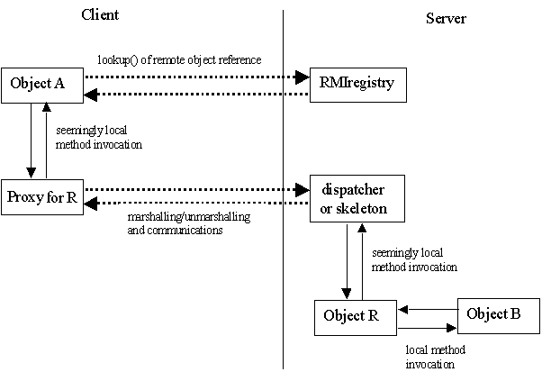
Quick Review from last class
Proxies and Skeletons can be created before runtime
Ex, rmic, for Java’s original RMI
They can also be dynamic
Modern Java RMI
Skeletons unified into a dispatcher within JVM. It unmarshalls the communication, inspects it, and dispatches the local method and marshalls return
Proxies can be created dynamically upon need based upon interface.

Slide 4
Quick Quiz! N-powerful machine? Or M*N/M-Powerful machines?
Which is “better”?
More likely to be fully available?
More likely to have some availability?
Cheaper?
Which would be expected to finish one or more tasks faster?
Let’s rephrase as…Which would be expected to finish one or more tasks faster?

Slide 5
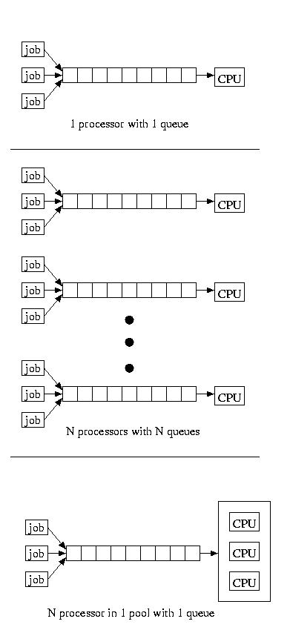
Consider the way one or more jobs queue: One Big Jobs? Many Small Jobs?

Slide 6
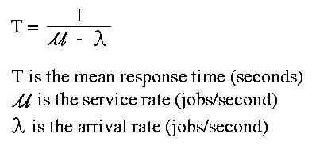
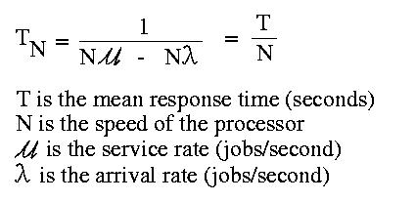
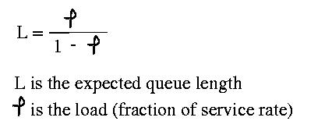
Modeling the queues
Nx service rate, Nx response rate
Same response time
Arrival rate < service rate:
Or jobs will never get done

Slide 7
Let’s remember why we have distributed systems
Distributed Users
Distributed peers/providers/other resources
Cost per resource (processor, memory, storage, network) at scale
Hard ceiling on capacity (processor, memory, storage, network)
Failure model (high chance of 1 of N failure, lower chance of N of N failure)
Localized risks
Etc.

Slide 8
Threads vs tasks vs Processes
Classically
Process: Unit of user work when concurrency wasn’t a consideration
Thread of Control: Unit of work, considered independently of its resources, e.g. open files, open communication sessions, memory state, etc.
Task: Unit or Units of work, including their resources.
In Distributed Systems:
Process or Thread: Synonyms. A unit of work, considered independently of its resources
Task: An overarching goal of a user and the resources allocated to accomplishing it, including the tasks/processes. The related threads/processes and their environment.

Slide 9
allocation vs migration
Allocation: Choosing the initial resource to use for a task, e.g. which of many host machines for cycles or which of many replicas of a file
Migration: The processes and effort of moving a process/thread from one resource to another, e.g. one host machine to another host machine for cycles
Allocation is important because migration is expensive!

Slide 10
Consider Process migration
Requires capturing and restoring process state, classically:
Freeze process (processing, network sessions, file sessions, clients/peers, etc)
Serialize process state (memory, registers, file state, network state)
Transmit serialized state
Instantiate simple state
Reopen files, reseek to offsets. Requires DFS, higher-level recoverable session file API
Restablish network state. Requires higher-level recoverable session network API.
Inform clients, peers, etc. (proxies, forwarded communication, etc)
Etc
Unfreeze process

Slide 11
Key Challenge: What Are WE Dispatching?
How much CPU required?
How much bulk storage?
How much network?
Dependency on other processes?
When in lifetime? Characteristic burst cycles?
Scheduling the unknown is hard?
Don’t even have “Control cards” these days!
But, different types of jobs may have different characteristics
The past may be a good indicator.

Slide 12
Key Challenge: Communication
Latency and Overhead vs Freshness
More up-to-date information is more costly

Slide 13
Communication: Common Pitfalls
Polling everyone when needed
Many to ask
Long tail
Long latency
Much Overhead
Broadcasting upon change
Typically still many messages
Many updates never used
“Thundering Herds”
Caching with expiry
What happens during bursts?

Slide 14
Scheduling Dependencies
Tightly communicating processes?
Concurrently co-Schedule on different hosts
Competing Processes?
Schedule on same resource at different times
Sharing Memory artifacts? Files?
Gang schedule on same host?

Slide 15
Communication strategies
Avoid “All or nothing”
Poll N at random
Update N per time period
High- and Low- water levels
Ask for help or ask for work only at relative extremes
Centralized dispatch: N-to-one updates.
Partitioning and Hierarchies
Keep communication local
Use representative above high- or below low- water marks

Slide 16
“Resource HoGs”
Balancing different types of hogs makes sense in monolithic systems with diverse resources, e.g. old school multiprogramming of tasks to overlap CPU-IO burst cycles
Makes much less sense in distributed systems where hosts are generally more specialized, e.g. cycle servers, file servers, database servers, etc.
Potential Answer: Prioritize dispatch
Potential Answer: Reward infrequent or short requests, penalize expensive requests
Potential Answer: All depends upon situation and goals

Slide 17
Time Budgets
Users or other components of a system impose deadlines
Deadlines are often divided vertically into phases, each with its own constituent time budget
Phases are often parallel
The tail, e.g. the slowest response within a phase, can delay the entire phase
Potential Answer: Re-request slow work as insurance
Potential Answer: Cut off after time budget and use less comprehensive result
Potential Answer: “Timed Snooze” consistently slow machines
Burst load will pass
Transient distractions, e.g. maintenance processes, will complete
Etc.

Slide 18
Microeconomic approaches
Bid on resources, resource goes to high bid
Bid based upon priority
Priority may raise with time (or lower)
Interesting when different resource qualities available
How important is the fastest processor if others are available?
How important is the fastest IO? Or Network?
Setting budgets (and adjusting them) is, of course, interesting.
So are the details of auctions.

