Slide 1
14-736 Distributed Systems
Lecture 26:
Internet Routing as a DS Problem

Slide 2
Outline
Intro
Distance Vector
Link State

Slide 3
Graph Model
Represent each router as node
Direct link between routers represented by edge
Symmetric links ⇒ undirected graph
Edge “cost” c(x,y) denotes measure of difficulty of using link
delay, $ cost, or congestion level
Task
Determine least cost path from every node to every other node
Path cost d(x,y) = sum of link costs
E
C
3
1
F
1
2
6
1
3
D
A
4
B

Slide 4
Routes from Node A
Forwarding Table for A
Dest | Cost | Next Hop
A | 0 | A
B | 4 | B
C | 6 | E
D | 7 | B
E | 2 | E
F | 5 | E
E
C
3
1
F
1
2
6
1
3
D
A
4
B
Properties
Some set of shortest paths forms tree
Shortest path spanning tree
Solution not unique
E.g., A-E-F-C-D also has cost 7

Slide 5
Key Challenges
This would be easy if the graph didn’t change
But, what happens as links are removed and are added?
Links fail
Links heal
Internet routing is basically a big distributed agreement problem
If routers agree on the graph, they can make consistent decisions
If routers disagree on the graph, badness can happen
Cycles are a notable problem
Lost packets are another (time out)

Slide 6
Ways to Compute Shortest Paths
Centralized
Collect graph structure in one place
Use standard graph algorithm
Disseminate routing tables
Link-state
Every node collects complete graph structure
Each computes shortest paths from it
Each generates own routing table
Distance-vector
No one has copy of graph
Nodes construct their own tables iteratively
Each sends information about its table to neighbors

Slide 7
Outline
Intro
Distance Vector
Link State

Slide 8
Distance-Vector Method
Initial Table for A
Dest | Cost | Next Hop
A | 0 | A
B | 4 | B
C | ∞ | –
D | ∞ | –
E | 2 | E
F | 6 | F
E
C
3
1
F
1
2
6
1
3
D
A
4
B
Idea
At any time, have cost/next hop of best known path to destination
Use cost ∞ when no path known
Initially
Only have entries for directly connected nodes

Slide 9
Distance-Vector Update
z
d(z,y)
c(x,z)
y
x
d(x,y)
Update(x,y,z)
d ← c(x,z) + d(z,y) # Cost of path from x to y with first hop z
if d < d(x,y)
# Found better path
return d,z # Updated cost / next hop
else
return d(x,y), nexthop(x,y) # Existing cost / next hop

Slide 10
Algorithm
Bellman-Ford algorithm
Repeat
For every node x
For every neighbor z
For every destination y
d(x,y) ← Update(x,y,z)
Until converge

Slide 11
Start
Optimum 1-hop paths
Table for A
Dst | Cst | Hop
A | 0 | A
B | 4 | B
C | ∞ | –
D | ∞ | –
E | 2 | E
F | 6 | F
Table for B
Dst | Cst | Hop
A | 4 | A
B | 0 | B
C | ∞ | –
D | 3 | D
E | ∞ | –
F | 1 | F
E
C
3
1
F
1
2
6
1
3
D
A
4
B
Table for C
Dst | Cst | Hop
A | ∞ | –
B | ∞ | –
C | 0 | C
D | 1 | D
E | ∞ | –
F | 1 | F
Table for D
Dst | Cst | Hop
A | ∞ | –
B | 3 | B
C | 1 | C
D | 0 | D
E | ∞ | –
F | ∞ | –
Table for E
Dst | Cst | Hop
A | 2 | A
B | ∞ | –
C | ∞ | –
D | ∞ | –
E | 0 | E
F | 3 | F
Table for F
Dst | Cst | Hop
A | 6 | A
B | 1 | B
C | 1 | C
D | ∞ | –
E | 3 | E
F | 0 | F

Slide 12
Iteration #1
Optimum 2-hop paths
Table for A
Dst | Cst | Hop
A | 0 | A
B | 4 | B
C | 7 | F
D | 7 | B
E | 2 | E
F | 5 | E
Table for B
Dst | Cst | Hop
A | 4 | A
B | 0 | B
C | 2 | F
D | 3 | D
E | 4 | F
F | 1 | F
E
C
3
1
F
1
2
6
1
3
D
A
4
B
Table for C
Dst | Cst | Hop
A | 7 | F
B | 2 | F
C | 0 | C
D | 1 | D
E | 4 | F
F | 1 | F
Table for D
Dst | Cst | Hop
A | 7 | B
B | 3 | B
C | 1 | C
D | 0 | D
E | ∞ | –
F | 2 | C
Table for E
Dst | Cst | Hop
A | 2 | A
B | 4 | F
C | 4 | F
D | ∞ | –
E | 0 | E
F | 3 | F
Table for F
Dst | Cst | Hop
A | 5 | B
B | 1 | B
C | 1 | C
D | 2 | C
E | 3 | E
F | 0 | F

Slide 13
Iteration #2
Optimum 3-hop paths
Table for A
Dst | Cst | Hop
A | 0 | A
B | 4 | B
C | 6 | E
D | 7 | B
E | 2 | E
F | 5 | E
Table for B
Dst | Cst | Hop
A | 4 | A
B | 0 | B
C | 2 | F
D | 3 | D
E | 4 | F
F | 1 | F
E
C
3
1
F
1
2
6
1
3
D
A
4
B
Table for C
Dst | Cst | Hop
A | 6 | F
B | 2 | F
C | 0 | C
D | 1 | D
E | 4 | F
F | 1 | F
Table for D
Dst | Cst | Hop
A | 7 | B
B | 3 | B
C | 1 | C
D | 0 | D
E | 5 | C
F | 2 | C
Table for E
Dst | Cst | Hop
A | 2 | A
B | 4 | F
C | 4 | F
D | 5 | F
E | 0 | E
F | 3 | F
Table for F
Dst | Cst | Hop
A | 5 | B
B | 1 | B
C | 1 | C
D | 2 | C
E | 3 | E
F | 0 | F

Slide 14
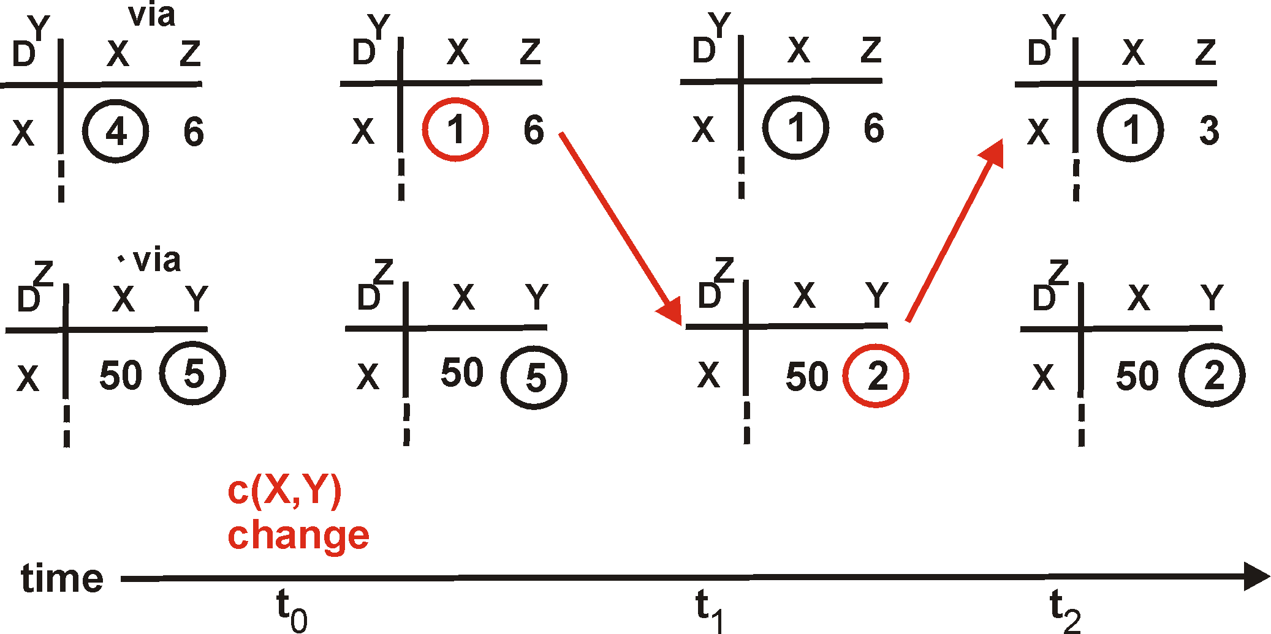
Distance Vector: Link Cost Changes
Link cost changes:
Node detects local link cost change
Updates distance table
If cost change in least cost path, notify neighbors
1
Y
4
1
X
Z
50
algorithm
terminates
“good
news
travels
fast”

Slide 15
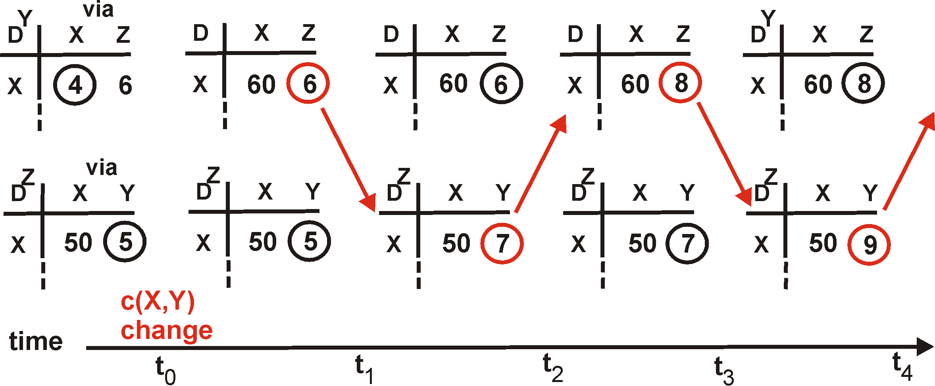
Distance Vector: Link Cost Changes
Link cost changes:
Good news travels fast
Bad news travels slow - “count to infinity” problem!
60
Y
4
1
X
Z
50
algorithm
continues
on!

Slide 16
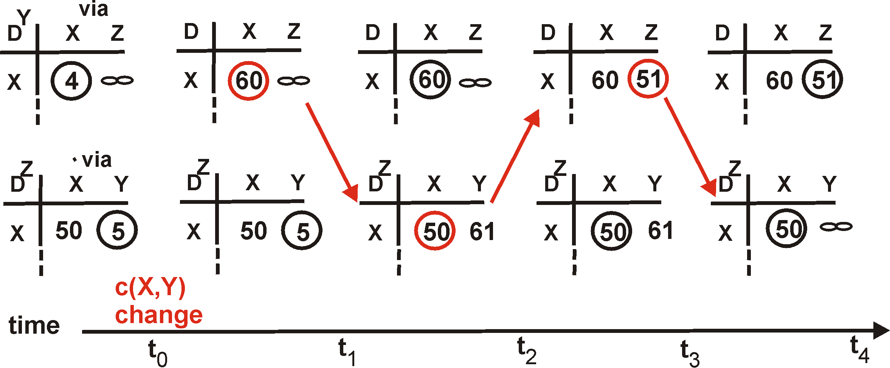
Distance Vector: Split Horizon
If Z routes through Y to get to X :
Z does not advertise its route to X back to Y
60
Y
4
1
X
Z
50
algorithm
terminates
?
?
?

Slide 17
Distance Vector: Poison Reverse
If Z routes through Y to get to X :
Z tells Y its (Z’s) distance to X is infinite (so Y won’t route to X via Z)
Immediate notification of unreachability, rather than split horizon timeout waiting for advertisement
Will this completely solve count to infinity problem?
60
Y
4
1
X
Z
50
algorithm
terminates

Slide 18
Poison Reverse Failures
Table for A
Dst | Cst | Hop
C | 7 | F
Table for B
Dst | Cst | Hop
C | 8 | A
Table for D
Dst | Cst | Hop
C | 9 | B
Table for F
Dst | Cst | Hop
C | 1 | C
∞
1
Table for A
Dst | Cst | Hop
C | ∞ | –
Table for F
Dst | Cst | Hop
C | ∞ | –
F
C
Forced
Update
Forced
Update
6
A
1
Table for A
Dst | Cst | Hop
C | 13 | D
Better
Route
4
1
B
D
Forced
Update
Table for B
Dst | Cst | Hop
C | 14 | A
Iterations don’t converge
“Count to infinity”
Solution
Make “infinity” smaller
What is upper bound on maximum path length?
Forced
Update
Table for D
Dst | Cst | Hop
C | 15 | B
Table for A
Dst | Cst | Hop
C | 19 | D
•
•
•
Forced
Update

Slide 19
Routing Information Protocol (RIP)
Earliest IP routing protocol (1982 BSD)
Current standard is version 2 (RFC 1723)
Features
Every link has cost 1
“Infinity” = 16
Limits to networks where everything reachable within 15 hops
Sending Updates
Every router listens for updates on UDP port 520
RIP message can contain entries for up to 25 table entries

Slide 20
RIP Updates
Initial
When router first starts, asks for copy of table for every neighbor
Uses it to iteratively generate own table
Periodic
Every 30 seconds, router sends copy of its table to each neighbor
Neighbors use it to iteratively update their tables
Triggered
When every entry changes, send copy of entry to neighbors
Except for one causing update (split horizon rule)
Neighbors use it to update their tables

Slide 21
RIP Staleness / Oscillation Control
Small Infinity
Count to infinity doesnt take very long
Route Timer
Every route has timeout limit of 180 seconds
Reached when haven’t received update from next hop for 6 periods
If not updated, set to infinity
Soft-state refresh → important concept!
Behavior
When router or link fails, can take minutes to stabilize
Notes:
Lots of subtlety to get good implementation (RFC 1058).

Slide 22
Outline
Intro
Distance Vector
Link State

Slide 23
Link State Protocol Concept
Every node gets complete copy of graph
Every node “floods” network with data about its outgoing links
Every node computes routes to every other node
Using single-source, shortest-path algorithm
Process performed whenever needed
When connections die / reappear

Slide 24
Sending Link States by Flooding
X Wants to Send Information
Sends on all outgoing links
When Node Y Receives Information from Z
Send on all links other than Z
X
A
X
A
C
B
D
C
B
D
(a)
(b)
X
A
X
A
C
B
D
C
B
D
(c)
(d)

Slide 25
Dijkstra’s Algorithm
Given
Graph with source node s and edge costs c(u,v)
Determine least cost path from s to every node v
Shortest Path First Algorithm
Traverse graph in order of least cost from source

Slide 26
Dijkstra’s Algorithm: Concept
E
C
∞
2
3
5
1
Current Path Costs
F
2
2
6
Source
Node
0
1
∞
3
3
D
A
3
B
Done
Unseen
Horizon
Node Sets
Done
Already have least cost path to it
Horizon:
Reachable in 1 hop from node in Done
Unseen:
Cannot reach directly from node in Done
Label
d(v) = path cost from s to v
Path
Keep track of last link in path

Slide 27
Dijkstra’s Algorithm: Initially
E
C
∞
∞
3
∞
1
Current Path Costs
F
2
2
6
Source
Node
0
1
∞
∞
3
D
A
3
Horizon
B
Done
Unseen
No nodes done
Source in horizon

Slide 28
Dijkstra’s Algorithm: Initially
E
C
∞
2
3
6
1
Current Path Costs
F
2
2
6
Source
Node
0
1
∞
3
3
D
A
3
B
Done
Horizon
Unseen
d(v) to node A shown in red
Only consider links from done nodes

Slide 29
Dijkstra’s Algorithm
E
C
∞
2
3
5
6
1
Current Path Costs
F
2
2
6
Source
Node
0
1
∞
3
3
D
A
3
B
Done
Unseen
Horizon
Select node v in horizon with minimum d(v)
Add link used to add node to shortest path tree
Update d(v) information

Slide 30
Dijkstra’s Algorithm
E
Horizon
C
∞
2
3
5
1
Current Path Costs
F
2
2
6
Source
Node
0
1
∞
3
3
D
A
3
B
Done
Unseen
Repeat…

Slide 31
Dijkstra’s Algorithm
∞
Unseen
2
E
C
3
4
1
Current Path Costs
F
2
2
6
Source
Node
0
1
6
3
3
D
A
3
B
Horizon
Done
Update d(v) values
Can cause addition of new nodes to horizon

Slide 32
Dijkstra’s Algorithm
E
C
5
2
3
4
1
F
2
2
6
Source
Node
0
1
6
3
3
D
A
3
B
Final tree shown in green

Slide 33
Link State Characteristics
With consistent LSDBs*, all nodes compute consistent loop-free paths
Can still have transient loops
B
1
X
1
A
3
C
5
2
D
Packet from C→A
may loop around BDC
if B knows about failure
and C & D do not
Link State Data Base

Slide 34
OSPF Routing Protocol
Open
Open standard created by IETF
Shortest-path first
Another name for Dijkstra’s algorithm
More prevalent than RIP

Slide 35
OSPF Reliable Flooding
Transmit link state advertisements
Originating router
Typically, minimum IP address for router
Link ID
ID of router at other end of link
Metric
Cost of link
Link-state age
Incremented each second
Packet expires when reaches 3600
Sequence number
Incremented each time sending new link information

Slide 36
OSPF Flooding Operation
Node X Receives LSA from Node Y
With Sequence Number q
Looks for entry with same origin/link ID
Cases
No entry present
Add entry, propagate to all neighbors other than Y
Entry present with sequence number p < q
Update entry, propagate to all neighbors other than Y
Entry present with sequence number p > q
Send entry back to Y
To tell Y that it has out-of-date information
Entry present with sequence number p = q
Ignore it

Slide 37
Flooding Issues
When should it be performed
Periodically
When status of link changes
Detected by connected node
What happens when router goes down & back up
Sequence number reset to 0
Other routers may have entries with higher sequence numbers
Router will send out LSAs with number 0
Will get back LSAs with last valid sequence number p
Router sets sequence number to p+1 & resends

Slide 38
Adoption of OSPF
RIP viewed as outmoded
Good when networks small and routers had limited memory & computational power
OSPF Advantages
Fast convergence when configuration changes

Slide 39
Comparison of LS and DV Algorithms
Message complexity
LS: with n nodes, E links, O(nE) messages
DV: exchange between neighbors only
Speed of Convergence
LS: Relatively fast
Complex computation, but can forward before computation
may have transient loops
DV: convergence time varies
may have routing loops
count-to-infinity problem
faster with triggered updates
Space requirements:
LS maintains entire topology
DV maintains only neighbor state
Robustness: router malfunctions
LS: Node can advertise incorrect link cost
Each node computes its own table
DV: Node can advertise incorrect path cost
Each node’s table used by others (error propagates)

Slide 40
Outline
Distance Vector
Link State
Routing Hierarchy

Slide 41
EXTRA SLIDES
The rest of the slides are FYI

Slide 42
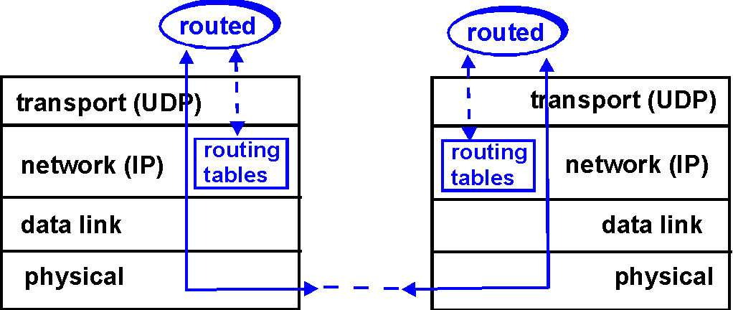
RIP Table Processing
RIP routing tables managed by application-level process called route-d (daemon)
advertisements sent in UDP packets, periodically repeated

Slide 43
Dijsktra’s Algorithm
1 Initialization:
2 N = {A}
3 for all nodes v
4 if v adjacent to A
5 then D(v) = c(A,v)
6 else D(v) = infinity
7
8 Loop
9 find w not in N such that D(w) is a minimum
10 add w to N
11 update D(v) for all v adjacent to w and not in N:
12 D(v) = min( D(v), D(w) + c(w,v) )
13 /* new cost to v is either old cost to v or known
14 shortest path cost to w plus cost from w to v */
15 until all nodes in N

Slide 44
Dijkstra’s algorithm: example
Step
0
1
2
3
4
5
start N
A
AD
ADE
ADEB
ADEBC
ADEBCF
D(B),p(B)
2,A
2,A
2,A
D(C),p(C)
5,A
4,D
3,E
3,E
D(D),p(D)
1,A
D(E),p(E)
infinity
2,D
D(F),p(F)
infinity
infinity
4,E
4,E
4,E
5
B
3
C
2
5
A
2
1
F
3
1
2
D
E
1

