Slide 1

ZooKeeper Tutorial
Flavio Junqueira Benjamin Reed
Yahoo! Research
hCps://cwiki.apache.org/conﬂuence/display/ZOOKEEPER/EurosysTutorial
Eurosys 2011 ‐ Tutorial
1
Used for 14-848 Discussion, 11/6/2017 by Gregory Kesden

Slide 2

Plan for today
First half
  Part 1
    Motivation and background
  Part 2
    How ZooKeeper works on paper
Second half
  Part 3
    Share some practical experience
    Programming exercises
  Part 4
    Some caveats
    Wrap up
Eurosys 2011 ‐ Tutorial
2

Slide 3
ZooKeeper Tutorial
Part 1 Fundamentals

Slide 4
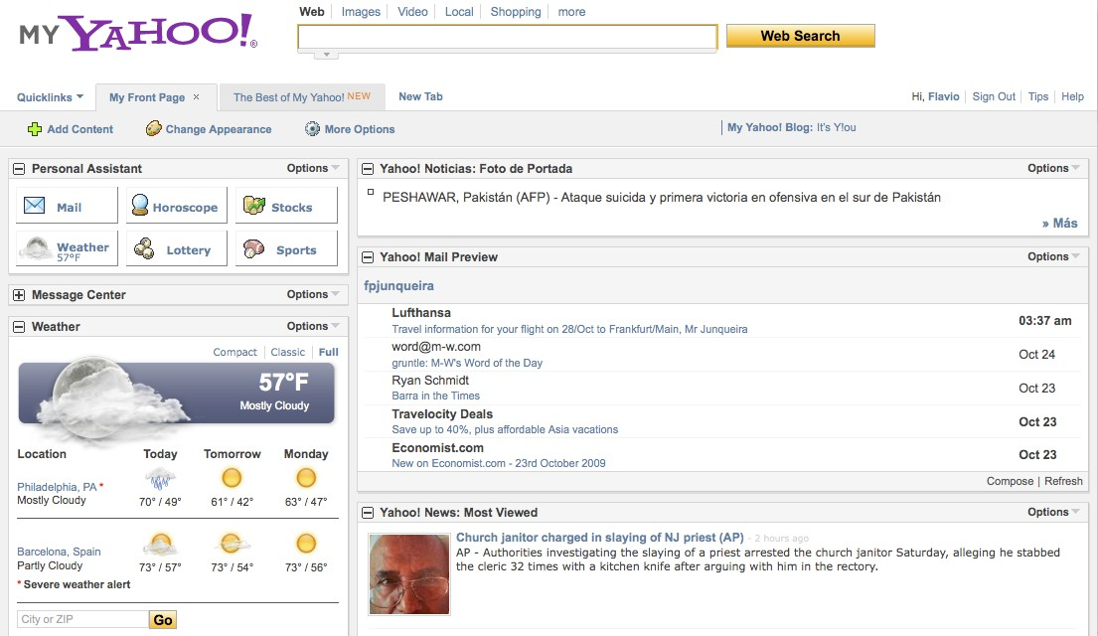



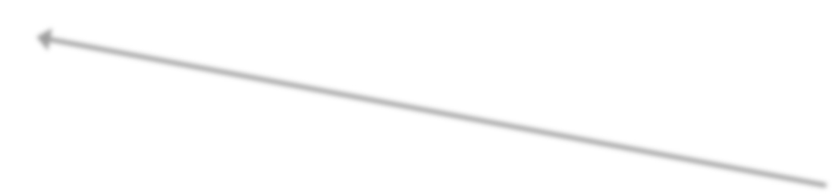

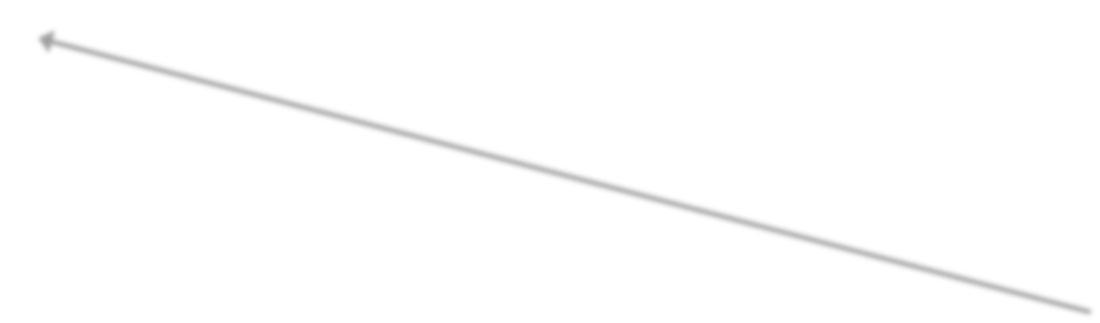


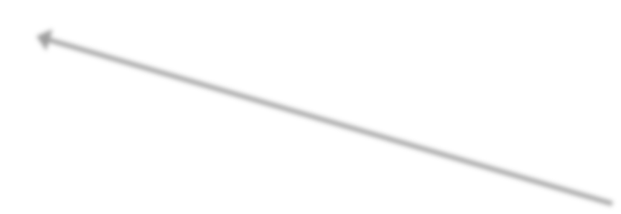


Yahoo! Portal
Search
E‐mail Finance Weather News
4

Slide 5
Yahoo!: Workload generated
Home page
  38 million users a day (USA)
  2.5 billion users a month (USA)
Web search
  3 billion queries a month
E‐mail
  90 million actual users
  10 min/visit
5

Slide 6
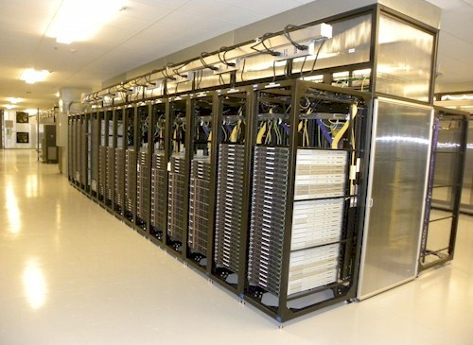
Yahoo! Infrastructure
Lots of servers
Lots of processes
High volumes of data
Highly complex soaware systems
… and developers are mere mortals
Yahoo! Lockport Data Center
6

Slide 7
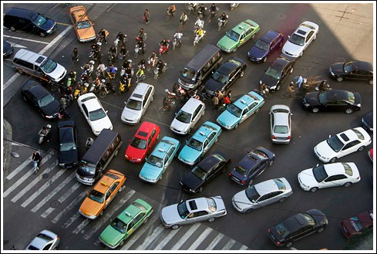
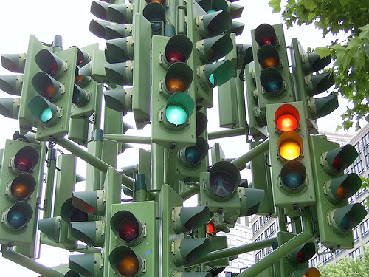
Coordination is important
7

Slide 8
Coordination primitives
Semaphores
Queues
Leader election
Group membership
Barriers
Conﬁguration
8

Slide 9

Even small is hard…
9

Slide 10
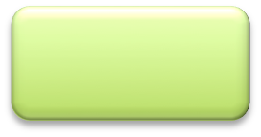
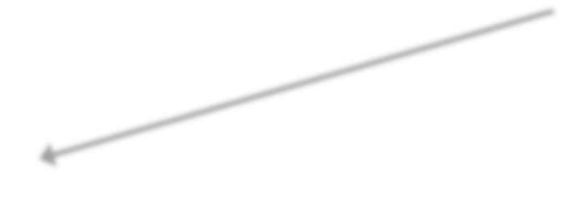

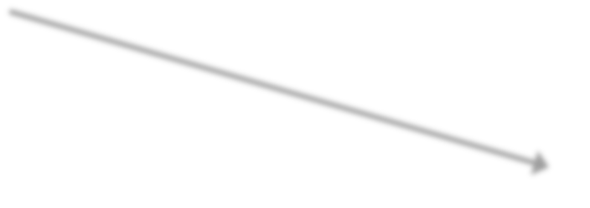





A simple model
Work assignment
  Master assigns work
  Workers execute tasks assigned by master
Master
Worker
Worker
Worker
Worker
10

Slide 11

Master crashes
Single point of failure
No work is assigned
Need to select a new master
Master
Worker
Worker
Worker
Worker

Slide 12

Worker crashes
Not as bad… Overall system still works
– Does not work if there are dependencies
Some tasks will never be executed
Need to detect crashed workers
Master
Worker
Worker
Worker
Worker

Slide 13

Worker does not receive assignment
Same problem as before
Some tasks may not be executed
Need to guarantee that worker receives assignment
Master
Worker
Worker
Worker
Worker

Slide 14












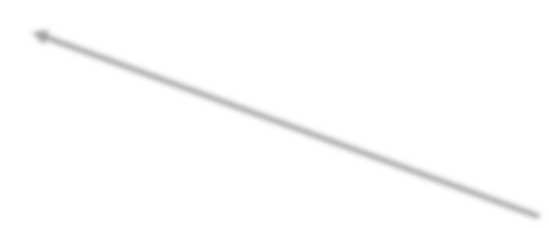
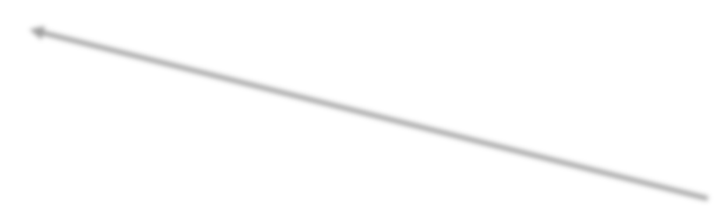
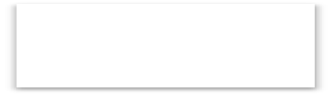
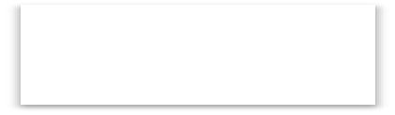



Fault‐tolerant distributed system
Master
Coordination Service
Master
Worker
Worker
Worker
Worker
Worker
Worker

Slide 15





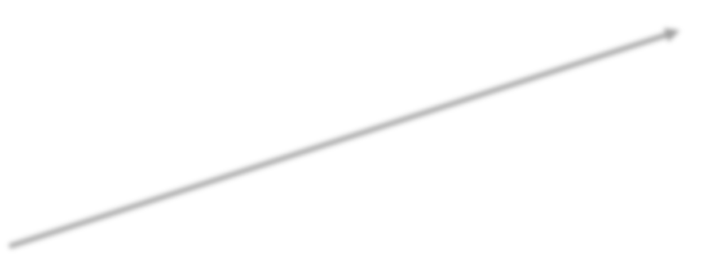









Fault‐tolerant distributed system
Master
Coordination Service
Master
Worker
Worker
Worker
Worker
Worker
Worker

Slide 16


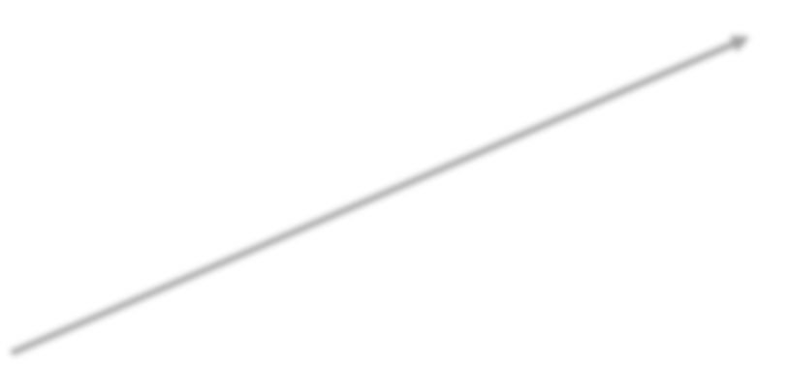








Fully distributed
Coordination Service
Worker
Worker
Worker
Worker
Worker
Worker

Slide 17
Fallacies of distributed computing
The network is reliable.
Latency is zero.
Bandwidth is inﬁnite.
The network is secure.
Topology doesn't change.
There is one administrator.
Transport cost is zero.
The network is homogeneous.
Peter Deutsch, http://blogs.sun.com/jag/resource/Fallacies.html

Slide 18

One more fallacy
You know who is alive

Slide 19
Why is it diﬃcult?
FLP impossibility result
  Asynchronous systems
  Consensus is impossible if a single process can crash
Fischer, Lynch, Paterson, ACM PODS, 1983
According to Herlihy, we do need consensus
  Wait‐free synchronization
  Wait‐free: completion in a ﬁnite number of steps
  Universal object: equivalent to solving consensus for n
processes
Herlihy, ACM TOPLAS, 1991

Slide 20
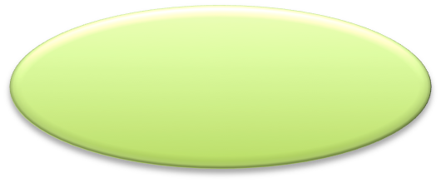






Why is it diﬃcult?
CAP principle
– Can’t obtain availability, consistency, and parOtion tolerance simultaneously
Availability
Consistency
ParOtion tolerance
Gilbert, Lynch, ACM SIGACT NEWS, 2002
20

Slide 21
The case for a coordination service
Many impossibility results
Many fallacies to stumble upon
Several common requirements across applications
  Duplicating is bad
  Duplicating poorly is even worse
Coordination service
  Implement it once and well
  Share by a number of applications

Slide 22
Current systems
Chubby, Google
  Lock service
Burrows, USENIX OSDI, 2006
Centrifuge, Microsoft
  Lease service
Adya et al., USENIX NSDI, 2010
ZooKeeper, Yahoo!
  Coordination kernel
  On Apache since 2008
Hunt et al., USENIX ATC, 2010

Slide 23
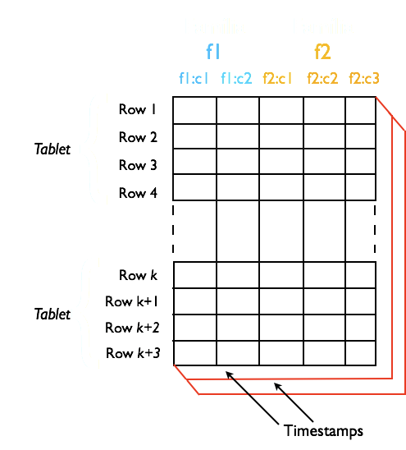
Example – Bigtable, HBase
Sparse column‐oriented data storage
  Tablet: range of rows
  Unit of distribution
Architecture
  Master
  Tablet servers

Slide 24
Example – Bigtable, HBase
Master election
  Tolerate master crashes
Metadata management
  ACLs, Tablet metadata
Rendezvous
  Find tablet server
Crash detection
  Live tablet servers

Slide 25











Example – Web crawling
Fetching service
– Fetch Web pages for search engine
Master election
  Assign work
Metadata management
  Politeness constraints
  Shards
Crash detection
  Live workers
Master
Fetcher
Fetcher
Fetcher

Slide 26
And more examples…
GFS – Google File System
  Master election
  File system metadata
KaCa ‐ Document indexing system
  Shard information
  Index version coordination
Hedwig – Pub‐Sub system
  Topic metadata
  Topic assignment

Slide 27
Summary of Part 1
Large infrastructures require coordination
Fallacies of distributed compuOng
Theory results: FLP, CAP
Coordination services
Examples
  Web search
  Storage systems

Slide 28
ZooKeeper Tutorial
Part 2 The service

Slide 29
ZooKeeper Introduction
Coordination kernel
  Does not export concrete primitives
  Recipes to implement primitives
File system based API
  Manipulate small data nodes: znodes
29

Slide 30





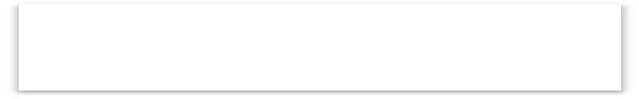


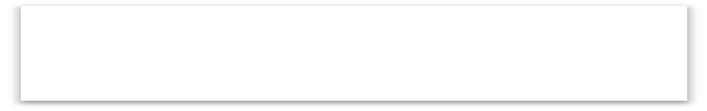





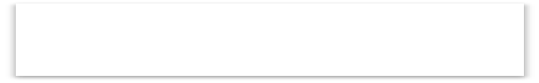

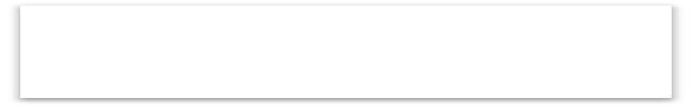




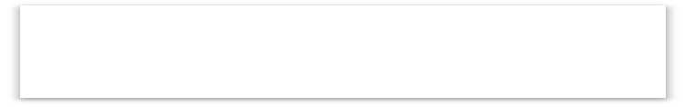

ZooKeeper: Overview
Ensemble
Client App
ZooKeeper Client Lib
Follower
Session
Leader atomically broadcast updates
Leader
Client App
ZooKeeper Client Lib
Follower
Session
Follower
Replicated system
Client App
ZooKeeper Client Lib
Follower
Session
30

Slide 31




ZooKeeper: Read operations
Ensemble
Client App
Read operations processed locally
ZooKeeper Client Lib
Read “x”
X = 10
Follower
Leader
Client App
ZooKeeper Client Lib
Follower
Follower
Client App
ZooKeeper Client Lib
Follower
31

Slide 32

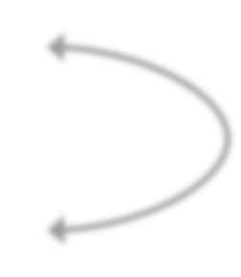
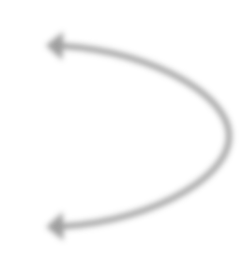
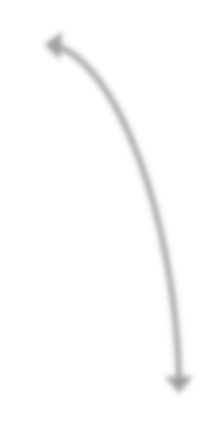
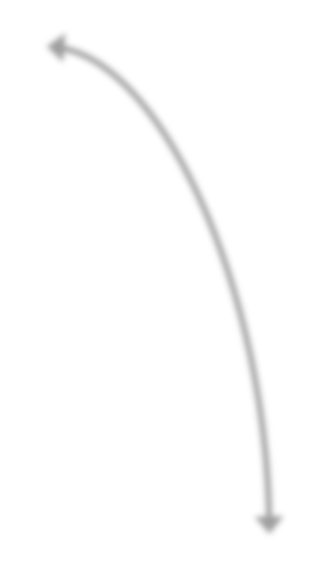


ZooKeeper: Write operations
Ensemble
Client App
ZooKeeper Client Lib
Write “x”,11
X = 11
Follower
X = 11
Leader
Client App
ZooKeeper Client Lib
X = 11
Follower
Follower
Client App
ZooKeeper Client Lib
Follower
Replicates across a quorum
32

Slide 33
ZooKeeper: Semantics of Sessions
A preﬁx of operations submitted through a session are executed
Upon disconnection
  Client lib tries to contact another server
  Before session expires: connect to new server
  Server must have seen a transaction id at least as large as the session
33

Slide 34
ZooKeeper: API
Create znodes: create
– Persistent, sequential, ephemeral
Read and modify data: setData, getData
Read the children of znode: getChildren
Check if znode exists: exists
Delete a znode: delete
34

Slide 35
ZooKeeper: API
Order
  Updates: Totally ordered, linearizable
  FIFO order for client operations
  Read: sequentially ordered
write(x, 10)
Client 1:
write(x, 11)
Client 2:
write(x, 10) write(x, 11)
Sequen7al:
35

Slide 36
ZooKeeper: API
Order
  Updates: Totally ordered, linearizable
  FIFO order for client operations
  Read: sequentially ordered
write(x, 10)
read(x)
Client 1:
read(x)
Client 2:
read(x)
write(x, 10)
read(x)
Sequen7al:
9

Slide 37



















ZooKeeper: Example
1‐ create “/C‐”, “Ci”, sequential, ephemeral 2‐ getChildren “/”
3‐ If not leader, getData “ﬁrst node”
Client 1 (C1)
/
C1 /C‐1
Client 2 (C2)
C3
/C‐2
Client 3 (C3)
C2 /C‐3
10

Slide 38
ZooKeeper: Znode changes
Znode changes
  Data is set
  Node is created or deleted
  Etc…
To learn of znode changes
  Set a watch
  Upon change, client receives a notiﬁcation
  Notiﬁcation ordered before new updates

Slide 39

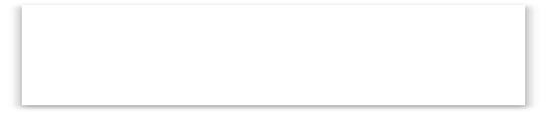








ZooKeeper: Watches
Client
getData “/foo”, true
return 10
/
10
/foo

Slide 40
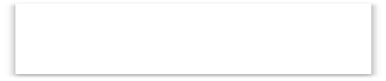


ZooKeeper: Watches
Client
/
11
/foo
Client
setData “/foo”, 11
return ok

Slide 41


ZooKeeper: Watches
Client
/
notification
11
/foo
Client

Slide 42
Watches, Locks, and the herd eﬀect
Herd eﬀect
  Large number of clients wake up simultaneously
Load spikes
  Undesirable

Slide 43















Watches, Locks, and the herd eﬀect
Client 1 (C1)
Client 2 (C2)
/
C1
/C‐1
C2
/C‐2
Client 3 (Cn)
Cn
/C‐m

Slide 44




Watches, Locks, and the herd eﬀect
Client 1 (C1)
Client 2 (C2)
/
C2
/C‐2
Client 3 (Cn)
Cn
/C‐m

Slide 45



Watches, Locks, and the herd eﬀect
Client 1 (C1)
/
Client 2 (C2)
notification
C2
/C‐2
Client 3 (Cn)
Cn
/C‐m
notification

Slide 46
Watches, Locks, and the herd eﬀect
A solution
  Use order of clients
  Each client
    Determines the znode z preceding its own znode in the sequential order
    Watch z
  A single notiﬁcation is generated upon a crash
Disadvantage for leader election
  One client is notiﬁed of a leader change

Slide 47
Linearizability
Correctness condition
Informal deﬁnition
  Order of operations is equivalent to a sequential execution
  Equivalent order satisﬁes real time precedence order
write(x, 10)
read(x)
Client 1:
read(x)
Client 2:
read(x)
write(x, 10)
read(x)
Sequential:

Slide 48



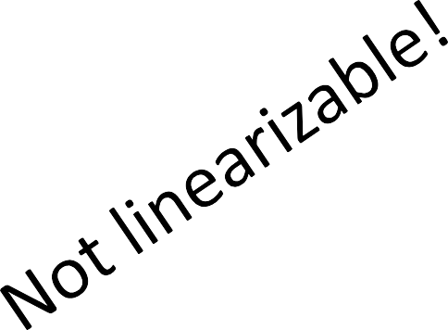
Linearizability
Correctness condition
Informal deﬁnition
  Order of operations is equivalent to a sequential execution
  Equivalent order satisﬁes real time precedence order
write(x, 10)
read(x)
Client 1:
read(x)
Client 2:
read(x)
write(x, 10)
read(x)
Sequen7al:

Slide 49
Linearizability
Correctness condition
Informal deﬁnition
  Order of operations is equivalent to a sequential execution
  Equivalent order satisﬁes real time precedence order
write(x, 10)
read(x)
Client 1:
read(x)
Client 2:
write(x, 10)
read(x)
read(x)
Sequen7al:

Slide 50
Linearizability
Is it important? It depends…
Implements universal object
  Herlihy’s result
  Implement consensus for n processes

Slide 51
Implementing consensus
Each process p proposes then decides
Propose(v)
  setData “/c/proposal-”, “v”, sequential
Decide()
  getChildren “/c”
  Select znode z with smallest sequence number
  v’ = getData “/c/z”
  Decide upon v’

Slide 52
Linearizability
Is it important? It depends…
Implements universal object
  Herlihy’s result
  Implement consensus for n processes
  … but it is aﬀected by hidden channels

Slide 53



















Hidden channels
/
Client 1
ZK1
C1
/conﬁg
/
ZK2
C1
/conﬁg
Client 2
/
ZK3
C1
/conﬁg

Slide 54



Hidden channels
/
Client 1
ZK1
C1
/conﬁg
/
ZK2
C2
/conﬁg
setData “/config”, C2
Client 2
/
ZK3
return OK
C2
/conﬁg

Slide 55





Hidden channels
/
Client 1
ZK1
C1
/conﬁg
/
I have changed the conﬁg, please read it!
ZK2
C2
/conﬁg
Client 2
/
ZK3
C2
/conﬁg

Slide 56



Hidden channels
getData “/config”
Client 1
/
ZK1
return C1
C1
/conﬁg
/
ZK2
C2
/conﬁg
Client 2
/
ZK3
C2
/conﬁg

Slide 57







A hat trick…
sync
  Asynchronous operation
  Before read operations
  Flushes the channel between follower and leader
  Makes operations linearizable
Client 1 (C1)
getData “/foo” sync
Follower
/foo = C1
Leader
setData
30

Slide 58


A hat trick…
sync
  Asynchronous operation
  Before read operations
  Flushes the channel between follower and leader
  Makes operations linearizable
Client 1 (C1)
Follower
getData
/foo = C1
sync
Leader
setData

Slide 59




A hat trick…
sync
  Asynchronous operation
  Before read operations
  Flushes the channel between follower and leader
  Makes operations linearizable
Client 1 (C1)
Follower
getData
/foo = C1
sync
sync
Leader
setData
sync

Slide 60



A hat trick…
sync
  Asynchronous operation
  Before read operations
  Flushes the channel between follower and leader
  Makes operations linearizable
Client 1 (C1)
Follower
getData
/foo = C2
sync
setData “/foo”, C2
Leader
sync

Slide 61

A hat trick…
sync
  Asynchronous operation
  Before read operations
  Flushes the channel between follower and leader
  Makes operations linearizable
Client 1 (C1)
Follower
getData
/foo = C2
sync
sync
Leader

Slide 62


A hat trick…
sync
  Asynchronous operation
  Before read operations
  Flushes the channel between follower and leader
  Makes operations linearizable
Client 1 (C1)
return sync
Follower
/foo = C2
getData
Leader

Slide 63


A hat trick…
sync
  Asynchronous operation
  Before read operations
  Flushes the channel between follower and leader
  Makes operations linearizable
Client 1 (C1)
return “/foo”, C2
Follower
/foo = C2
Leader

Slide 64
Summary of Part 2
ZooKeeper
  Replicated service
  Propagate updates with a broadcast protocol
Updates use consensus
Reads served locally
Workload not linearizable because of reads
sync() makes it linearizable

Slide 65
ZooKeeper Tutorial
Part 3
How it really works

Slide 66
























Master/Worker System
Clients
  Monitor the tasks
  Queue tasks to be executed
Masters
  Assign tasks to workers
Workers
  Get tasks from the master
  Execute tasks
Master
Coordination Service
Master
Worker
Worker
Worker
Worker
Eurosys 2011 ‐ Tutorial

Slide 67






Task Queue
client1
tasks
client1‐1 client3‐4 client1‐6
create(“/tasks/client1-”, cmds,
SEQUENTIAL)
cmds is an array of String
Eurosys 2011 ‐ Tutorial

Slide 68








Group Membership
worker1
assign
worker1
worker2 worker3
create(“/assign/worker-”, “”,
EPHEMERAL SEQUENTIAL)
listChildren(“/assign”,
true)
Master
Eurosys 2011 ‐ Tutorial

Slide 69





Leader ElecKon
master
create(“/master”,
hostinfo, EPHEMERAL)
getdata(“/master”,
true);
Master
Backup
Eurosys 2011 ‐ Tutorial

Slide 70







Conﬁguration
worker2
assign
worker1
worker2
getdata(“/assign/worker2”, true)
setdata(“/assign/worker2”, znode_of_task)
Master
Eurosys 2011 ‐ Tutorial

Slide 71
Connecting to ZooKeeper
Everyone has their own ZooKeeper address and auth info.
Try connecting to ZooKeeper with the CLI. java ‐jar zookeeper‐3.3.2‐fatjar.jar client zkaddr
Use addAuth command to authenKcate
Try out some commands
  Create znodes for /servers, /tasks, /assign
Eurosys 2011 ‐ Tutorial

Slide 72
Worker Processing
Create a session
Create the “worker” ephemeral znode
Watch for the assign znode
Deal with the watches
  Processing the assignment
    Update status in the task
    Delete assignment znode when ﬁnished
  What do to with SessionExpired
Eurosys 2011 ‐ Tutorial

Slide 73
Code on your own or follow together
Eurosys 2011 ‐ Tutorial
9

Slide 74
Client Processing
Create a session
Create a task as a child of the /tasks znode
Watch the status child of the /tasks znode
Eurosys 2011 ‐ Tutorial
10

Slide 75
Code on your own or follow together
Eurosys 2011 ‐ Tutorial
11

Slide 76
Master Processing
Create a session
Do leader election using master znode
Watch the worker list
Watch the task queue
Watch the assignment queue
Deal with the watches
  Deal with workers coming and going
  Assign new tasks
  Watch for compleKons
Eurosys 2011 ‐ Tutorial
12

Slide 77
Code on your own or follow together
Eurosys 2011 ‐ Tutorial
13

Slide 78
Give it a try…
Start up the master
Start up a worker
Try submitting a command
Queue up a bunch of sleep 100
Add more workers
Try killing a worker
Try killing the master. Did take over work?
Eurosys 2011 ‐ Tutorial
14

Slide 79
ZooKeeper Tutorial
Part 4
Caveat Emptor

Slide 80
Revisit FLP and CAP
What should a master do when disconnected?
  What is the consequence of acAng as a master while disconnected?
P1 elected P1 disconnected P1 expires
P1 reconnects
gets expired event
Ame
P2 elected

Slide 81
Revisit FLP and CAP
What happens if master elecAon gets a “ConnectionLossException” aLer the create?
  How do you ﬁx it?
  How do you test it?

Slide 82
Guidelines to ConnectionLoss
A process will not see state changes while disconnected
Masters should act very conservaAvely, they should not assume that they sAll have mastership
Don't treat as if it's the end of the world. The client library will try to recover the session

Slide 83
Other issues
Watch out for SEQUENTIAL | EPHEMERAL!
Problems resetting the ZooKeeper state
  What happens when you clear server state while clients are running?
  What happens when you clear some servers but not others?

Slide 84
WriAng a test
Use JUnit
Use QuorumBase
  In setup call QuorumBase.setup()
  In tearDown call QuorumBase.tearDown()
Write a simple test
  Use QuorumBase.hostPort to iniAalize the ZooKeeper object in the tests
  Startup a master and a backup.
  Kill the master and make sure backup takes over

Slide 85
Guidelines for SessionExpiration
It is the end of the world!
Should be rare.
The session handle is dead, so you need a new one.
It is dangerous to try to transparently recover by creating a new session. Usually there is some cleanup and setup that needs to be done

Slide 86
Code on your own or follow together
Eurosys 2011 ‐ Tutorial
8

Slide 87
Summary
When used properly ZooKeeper can make it easy to build distributed applicaAons.
ZooKeeper is a tool to help you deal with the chaos of distributed systems. It isn't magic.
  Don't try to shortcut the API
  Think about the consequences of ConnectionLoss
and SessionExpiration
  Make sure you test
Checkout the developer resources
http://zookeeper.apache.org
Eurosys 2011 ‐ Tutorial
9

