Slide 1
Memcached and Redis
14-736 Distributed Systems, Spring 2018
Kesden

Slide 2
Classic Problems
Web servers query from disk
  Main memory is wasted
Underlying databases queries can be redundant and slow
Distributing load among Web servers partitions main memory
  Redundant memory cache, not larger memory cache
Dedicated caching can often maintain whole, or large portions of, the working set, limiting the need to go to disk

Slide 3

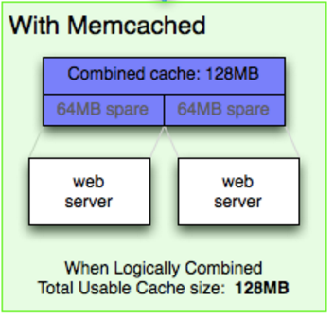
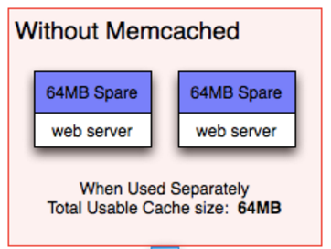
Common Use of Memcached
(But, dedicated servers are also common)
https://memcached.org/about

Slide 4
Memcached Overview
Distributed hashtable (Key-Value Store)
Except that “Forgetting is a feature”
  When full – LRU gets dumped
Excellent for high-throughput servers
  Memory is much lower latency than disk
Excellent for high-latency queries
  Caching results can prevent the need to repeat these big units of work

Slide 5
Memcached Architecture
Servers maintain a “key-value” store
Clients know about all servers
Clients query server by key to get value
Two hash functions
  Key--->Server
  Key-->Associative Array, within server
All clients know everything.

Slide 6
Code, From Wikipedia
function get_foo(int userid) {
data = db_select("SELECT * FROM users WHERE userid = ?", userid);
return data;
}
function get_foo(int userid) {
/* first try the cache */
data = memcached_fetch("userrow:" + userid);
if (!data) {
/* not found : request database */
data = db_select("SELECT * FROM users WHERE userid = ?", userid);
/* then store in cache until next get */
memcached_add("userrow:" + userid, data);
}
return data;
}

Slide 7
Memcached: No replication
Designed for volatile data
  Failure: Just go to disk
  Recovery: Just turn back on and wait
Need redundancy?
  Build above memcached
  Just build multiple instances

Slide 8
REDIS
REmote DIctionary SErver
Like Memcached in that it provides a key value store
But, much richer
  Lists of strings
  Sets of strings (collections of non-repeating unsorted elements)
  Sorted sets of strings (collections of non-repeating elements ordered by a floating-point number called score)
  Hash tables where keys and values are strings
  HyperLogLogs used for approximated set cardinality size estimation.
  (List from Wikipedia)

Slide 9
REDIS
REmote DIctionary SErver
Each data type has associated operations, e.g. get the one in particular position in a list, intersect sets, etc.
Transaction support
Configurable cache policy
  LRU-ish, Random, keep everything, etc.

Slide 10
REDIS: Persistence
Periodic snapshotting to disk
Append-only log to disk as data is updated
  Compressed in background
Updates to disk every 2 seconds to balance performance and risk
Single process, single thread

Slide 11
REDIS Clustering: Old School
Old School
  Divide up yourself
    Clients hash
    Clients divide range
    Clients Interact with Proxy which does the same
    Hard to handle queries involving multiple keys

Slide 12
REDIS Clustering: New School
REDIS Cluster
  Distribute REDIS across nodes
  Multiple key queries okay, so long as all keys in query in same slot
  Hash tags used to force keys into the same slot.
  this{foo}key and that{foo}key in the same slot
    Only {foo} is hashed

