Slide 1
Cassandra - A Decentralized Structured Storage System
Avinash Lakshman and Prashant Malik
Facebook
Presented by Gregory Kesden

Slide 2
Agenda
Outline
Data Model
System Architecture
Implementation
Experiments

Slide 3
Outline
Extension of Bigtable with aspects of Dynamo
Motivations:
High Availability
High Write Throughput
Fail Tolerance

Slide 4
Data Model
Table is a multi dimensional map indexed by key (row key).
Columns are grouped into Column Families.
2 Types of Column Families
Simple
Super (nested Column Families)
Each Column has
Name
Value
Timestamp

Slide 5
Data Model
keyspace
settings
column family
settings
column
name
value
timestamp
* Figure taken from Eben Hewitt’s (author of Oreilly’s Cassandra book) slides.

Slide 6
System Architecture
Partitioning
How data is partitioned across nodes
Replication
How data is duplicated across nodes
Cluster Membership
How nodes are added, deleted to the cluster

Slide 7
Partitioning
Nodes are logically structured in Ring Topology.
Hashed value of key associated with data partition is used to assign it to a node in the ring.
Hashing rounds off after certain value to support ring structure.
Lightly loaded nodes moves position to alleviate highly loaded nodes.

Slide 8
Replication
Each data item is replicated at N (replication factor) nodes.
Different Replication Policies
Rack Unaware – replicate data at N-1 successive nodes after its coordinator
Rack Aware – uses ‘Zookeeper’ to choose a leader which tells nodes the range they are replicas for
Datacenter Aware – similar to Rack Aware but leader is chosen at Datacenter level instead of Rack level.

Slide 9
Partitioning and Replication
h(key1)
1
0
E
A
N=3
C
h(key2)
F
B
D
1/2
* Figure taken from Avinash Lakshman and Prashant Malik (authors of the paper) slides.
9
Notes:
9

Slide 10
Gossip Protocols
Network Communication protocols inspired for real life rumour spreading.
Periodic, Pairwise, inter-node communication.
Low frequency communication ensures low cost.
Random selection of peers.
Example – Node A wish to search for pattern in data
Round 1 – Node A searches locally and then gossips with node B.
Round 2 – Node A,B gossips with C and D.
Round 3 – Nodes A,B,C and D gossips with 4 other nodes ……
Round by round doubling makes protocol very robust.

Slide 11
Gossip Protocols
Variety of Gossip Protocols exists
Dissemination protocol
Event Dissemination: multicasts events via gossip. high latency might cause network strain.
Background data dissemination: continuous gossip about information regarding participating nodes
Anti Entropy protocol
Used to repair replicated data by comparing and reconciling differences. This type of protocol is used in Cassandra to repair data in replications.

Slide 12
Cluster Management
Uses Scuttleback (a Gossip protocol) to manage nodes.
Uses gossip for node membership and to transmit system control state.
Node Fail state is given by variable ‘phi’ which tells how likely a node might fail (suspicion level) instead of simple binary value (up/down).
This type of system is known as Accrual Failure Detector.

Slide 13
Accrual Failure Detector
If a node is faulty, the suspicion level monotonically increases with time.
Φ(t) → k as t → k
Where k is a threshold variable (depends on system load) which tells a node is dead.
If node is correct, phi will be constant set by application. Generally
Φ(t) = 0

Slide 14
Bootstrapping and Scaling
Two ways to add new node
New node gets assigned a random token which gives its position in the ring. It gossips its location to rest of the ring
New node reads its config file to contact it initial contact points.
New nodes are added manually by administrator via CLI or Web interface provided by Cassandra.
Scaling in Cassandra is designed to be easy.
Lightly loaded nodes can move in the ring to alleviate heavily loaded nodes.

Slide 15
Local Persistence
Relies on local file system for data persistency.
Write operations happens in 2 steps
Write to commit log in local disk of the node
Update in-memory data structure.
Why 2 steps or any preference to order or execution?
Read operation
Looks up in-memory ds first before looking up files on disk.
Uses Bloom Filter (summarization of keys in file store in memory) to avoid looking up files that do not contain the key.

Slide 16
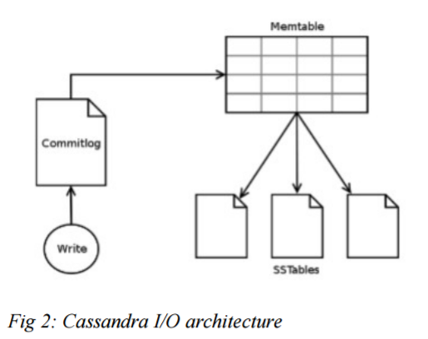
I/O Architecture

Slide 17
Read Operation
Client
Query
Result
Cassandra Cluster
Read repair if digests differ
Closest replica
Result
Replica A
Digest Query
Digest Response
Digest Response
Replica B
Replica C
* Figure taken from Avinash Lakshman and Prashant Malik (authors of the paper) slides.

Slide 18
Facebook Inbox Search
Cassandra developed to address this problem.
50+TB of user messages data in 150 node cluster on which Cassandra is tested.
Search user index of all messages in 2 ways.
Term search : search by a key word
Interactions search : search by a user id
Latency Stat | Search Interactions | Term Search
Min | 7.69 ms | 7.78 ms
Median | 15.69 ms | 18.27 ms
Max | 26.13 ms | 44.41 ms

Slide 19
Comparison with MySQL
MySQL > 50 GB Data Writes Average : ~300 ms Reads Average : ~350 ms
Cassandra > 50 GB Data Writes Average : 0.12 ms Reads Average : 15 ms
Stats provided by Authors using facebook data.

Slide 20
Comparison using YCSB
Following results taken from ‘Benchmarking Cloud Serving Systems with YCSB’ by Brain F Cooper et all.
YCSB is Yahoo Cloud Server Benchmarking framework.
Comparison between Cassandra, HBase, PNUTS, and MySQL.
Cassandra and Hbase have higher read latencies on a read heavy workload than PNUTS and MySQL, and lower update latencies on a write heavy workload.
PNUTS and Cassandra scaled well as the number of servers and workload increased proportionally.

Slide 21
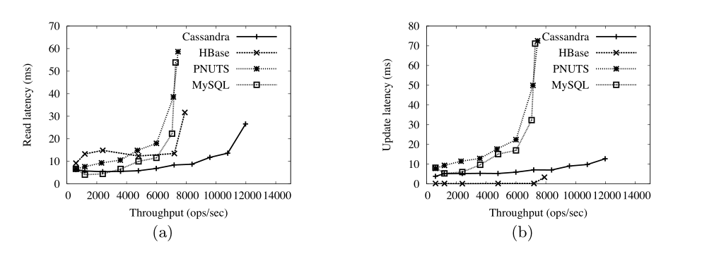
Comparison using YCSB
Cassandra, HBase and PNUTS were able to grow elastically while the workload was executing.
PNUTS and Cassandra scaled well as the number of
servers and workload increased proportionally. HBase’s
performance was more erratic as the system scaled.

Slide 22
Thank You

