Slide 1
14-736:
Distribted Systems
Lecture 8 * Spring 2019 * Kesden

Slide 2
Coordinator Selection:
Selecting a “Special HosT”
Given N available hosts, where N isn’t 1, how do we pick one for a different role, e.g. coordinator, front-end server, etc?
  Appoint one: A human simply picks
  Elect one: Participating hosts pick

Slide 3
Appointing A Coordinator
A human, e.g. system administrator, picks from available hosts
Advantages:
  Simple
  Minimal development time
  Agile
Disadvantages
  Slow, i.e. human speed
  Requires human to detect failure, understand cause, determine participants, and react.

Slide 4
Electing A Coordinator
The participants determine the need to pick a (new?) coordinator
Participants “discuss” it among themselves
Participants agree on coordinator
New coordinator takes charge
Advantages:
  Automatic
Disadvantages
  Complexity (partitionings, etc)
  Network traffic (storms)
  Failure mode can be complex, e.g. many coordinators or none

Slide 5
Bully Approach
(Garcia-Molina '82)
Probably the most common
Simplest
Can lead to storms (We’ll see why)

Slide 6
Bully Algorithm
Assumptions:
  All messages are delivered within some T_{m} units of time, called the message propagation time.
  Once a message is received, the reply will be dispatched within some T_{p} units of time, called the message handling time.
  T_{p} and T_{m} are known.
These are nice, because together they imply that if a response is is not received within (2*T_{m} + T_{p}) units of time the process or connection has failed.
  But, of course, in the real world congestion, load, and the indeterminate nature of most networks mean that a good amount of “slop” needs to be included.

Slide 7
Bully Algorithm
The idea behind the Bully Algorithm is to elect the highest-numbered processor as the coordinator.
  If any host thinks that the coordinator has failed, it tries to elect itself by sending a message to the higher-numbered processors.
  If any of them answer it loses the election.
    At this point each of these processors will call an election and try to win themselves.
  If none of the higher-ups answer, the processor is the highest numbered processor, so it should be the coordinator.
    So it sends the lower level processors a message declaring itself the coordinator
    After they answer (or the ACK of a reliable protocol), it starts doing its job as coordinator
      E.g. It starts to query participants to find out what they know, then begins providing coordination, etc.
  If a new processor arrives, or recovers from a failure, it gets the state from the current coordinator and then calls an election
    Or, for efficiency, just remains a participant and lets the new coordinator lead, until it fails, etc.

Slide 8
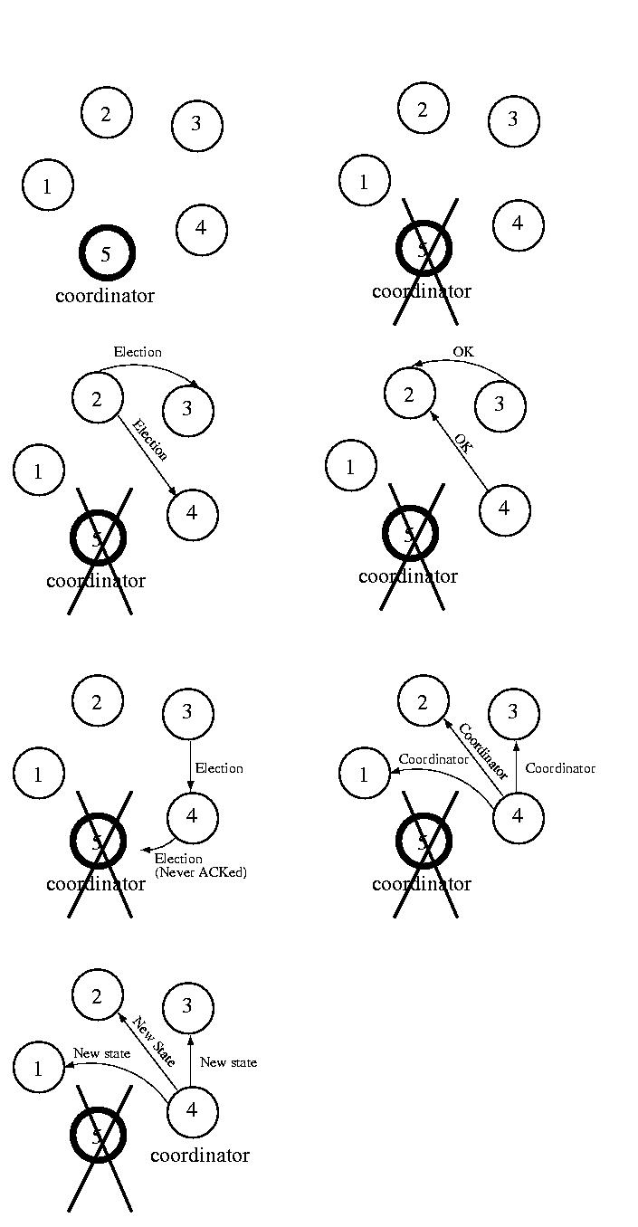
Bully Algorithm

Slide 9
Bully Algorithm

Slide 10
Invitation Algorithm:
Assumptions and goal
Goal: The Invitation Algorithm provides a protocol for forming groups of available participants within partitions, and then merging them into larger groups as partitions heal or failed coordinators are returned to service.
  In many ways, it is like a self-healing, partitionable Bully Algorithm
Assumption: In practice communication failure, high latency, and/or congestion can partition a network.
Assumption: A collection of participants under the direction of a coordinator, can perform useful work, even if other such groups exists.
  In other words, partitioned participants can still organize and make progress

Slide 11
Invitation Algorithm:
Assumptions and Goal
Groups are named using a group number.
  The group number is unique among all groups, is changed every time a new group is formed, and is never reused.
  To accomplish this, the group number might be a simple sequence number attached to the processor ID.
  The sequence number component can be incremented each time the processor becomes the coordinator of a new group.
Basic idea:
  Partitioned participants (or whole group) elect their own coordinator
  Coordinators "yell out" periodically to participants outside their group asking each if it is a coordinator.
  When a coordinator answers, the coordinators pick one to coordinate, and merge their groups, electing a new coordinator
    Choosing the coordinator is Bully-like, with higher nodes winning.

Slide 12
Invitation Algorithm:
Merging Groups
One might think that it is acceptable for the coordinator that initiated the merge to be the coordinator of the new group.
But it might be the case that two or more coordinators were concurrently looking for other coordinators and that their messages may arrive in different orders.
To handle this situation, there should be some priority among the coordinators -- some method to determine which of the perhaps many coordinators should take over.
  One way of doing this might be to use the processor ID to act as a priority.
  Perhaps higher-numbered processors ignore queries from lower-level processors.
  This would allow lower-level processors to merge the groups with lower priority coordinators during this operation.
  At some later time the higher-level coordinators will each act to discover other coordinators and merge these lower-priority groups.
  Perhaps receiving the query will prompt the higher-level coordinator to try to merge its group with others sooner than it otherwise might.
  An alternative would be for a coordinator only to try to merge lower-level coordinators.

Slide 13
Invitation Algorithm:
Options
Perhaps higher-numbered processors ignore queries from lower-level processors.
  This would allow lower-level processors to merge the groups with lower priority coordinators during this operation. At some later time the higher-level coordinators will each act to discover other coordinators and merge these lower-priority groups.
  Perhaps receiving the query will prompt the higher-level coordinator to try to merge its group with others sooner than it otherwise might.
An alternative would be for a coordinator only to try to merge lower-level coordinators.
Or perhaps processors delay some amount of time between the time that they look for other coordinators and the time that they start to merge these groups.
  This would allow time for a higher-priority coordinator to search for other coordinators (it knows that there is at least one) and ask them to merge into its group.
  If after such a delay, the old coordinator finds itself in a new group, it stops and accepts its new role as a participant.
  In this case, it might be useful to make the delay inversely proportional to one's priority. For example, there is no reason for the highest-priority processor to delay. But the lowest priority processor might want to delay for a long time.

Slide 14
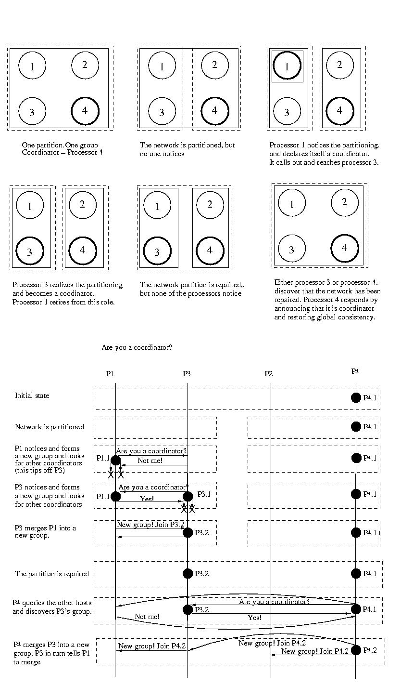
Invitation Algorithm

Slide 15
Invitation Algorithm

Slide 16
Ring EleCtion
Another approach, Ring election, is very similar to token ring synchronization, except no token is used.
Assumptions:
  We assume that each processor is logically ordered, perhaps by IP address, so that each processor knows its successor, and its successor's successor, and so on.
  Each processor must know the entire logical structure.

Slide 17
Ring Election
When a processor discovers that the coordinator has died, it starts circulating an ELECTION message around the ring.
Each node advances it in logical order, skipping failed nodes as necessary.
Each node adds their node number to the list.
Once this message has made its way all the way around the ring, the message which started it will see its own number in the list.
It then considers the node with the highest number to be the coordinator, and this messages is circulated.
Each receiving node does the same thing. Once this message has made its way around the ring, it is removed.
If multiple nodes concurrently discover a failed coordinator, each will start an ELECTION.
This isn't a problem, because each election will select the same coordinator. The extra messages are wasted overhead, while this isn't optimal, it isn't deadly, either.

Slide 18
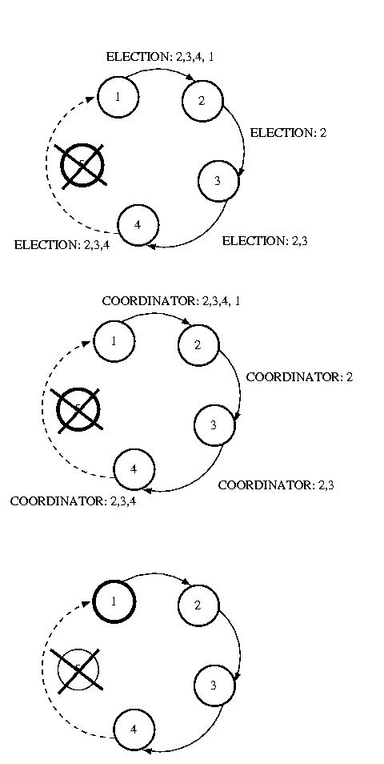
Ring Election

