Slide 1
14-736: Distributed Systems
Lecture 6 * Concurrency Control * Spring 2019 (Kesden)

Slide 2
Classical Concurrency Control
Semaphores, Mutexes, ConditionVariables, Monitors, etc.
Requirement: Efficient, shared, consistent, memory
Do we have that in distributed systems?
Why or why not?

Slide 3
Distributed Mutual Exclusion: Requirements
Correct: At most one user
Progress: If the resource is available and a participant wants it, it can be put to use.
Some level of fairness
FCFS vs. tightly bounded wait vs eventual
Must assume processes hold lock for bounded or non-infinite time.
Fairness guarantees implies deadlock free

Slide 4
Distributed Mutual Exclusion: Additional goals
Lets participants join and leave
Tolerates failure
Low message overhead
Tolerates communications anomalies
Loss, Delay, Reordering
Obviously can’t work with total failure

Slide 5
Central approach
Single coordination server maintains a local queue
Participant: REQUEST message
Coordinator: GRANT message
Participant: RELEASE message
6 Messages per access, regardless of number of hosts.
Note: All messages are ACKed, so 2x the 3 messages
Simple, effective

Slide 6
Central Approach
Single point of failure
Can use primary-backup arrangement, but it isn’t necessarily easy.
Example: backup gets all requests, but only primary replies. backup takes over if primary fails heartbeat.
But, what happens if there is a partitioning?
What happens if server reboots?

Slide 7
Lamport Mutual Exclusion
Big Idea
Maintain a distributed queue, with a copy at each participant
When done with critical section send RELEASE messages to each and every participant
Each participant pops queue and new head gets to go
New head sees for itself that it is at the head of the queue
Trick:
How to keep the queues in sync given that the messages can cross and arrive at different hosts in different orders?

Slide 8
Lamport mutual exclusion
Assumption: Messages between pairs of hosts are delivered in order
Such as via TCP
Messages bear Lamport time stamps
Queue is ordered by Lamport time stamps
Total ordering, such as by hostID
Requestor can’t enter critical section until:
It’s own request is at the head of its own queue
It’s request is acknowledged by each and every host.
Key point: The ACK will have a timestamp from the sender greater than the time at which the request was sent.
Since requests are in-order between pairs of hosts, this means that the requestor has seen any prior request from the ACKing host, so its queue is correctly ordered in this respect.

Slide 9
Lamport Performance
3(N-1) messages (Request, ACK, Release)
No need to send to self, hence “minus 1”
Robustness?
What happens if any 1 of N hosts fail? Ouch!
Communication problems?
Missing? Usual: No release? Ouch. No Request? Ouch. No reply? Ouch
Reordered? Okay, except if within sender-receiver pair
Upshot: Better rely upon TCP, etc.

Slide 10
Ricarti and Agrawala
In may ways inspired by Lamport
Key observation: Reply and Grant can be combined by delaying reply until it is okay to use the critical section
Reply effectively means “Okay with me”

Slide 11
Ricarti and Agrawala
Requestor (Request)
Send REQUEST to each and every participant
Participant
If in CS, enqueue request
If not in CS
and don't want in, reply OK
and want into the CS, and the requestor's time is lower, reply OK (messages crossed, requestor was first)
and want into the CS, and the requestor's time is greater, enqueue request (messages crossed, participant was first)
Requestor (Release)
On exit from CS, reply OK to everyone on queue (and dequeue each)
Requestor (When to enter critical section?
Once received OK from everyone, enter CS

Slide 12
Ricarti and Agrawala Performance
2(N-1) messages ) = (N-1)(REQUEST + RELEASE) + OK
No need to send to self, hence “minus 1”
Robustness?
What happens if any 1 of N hosts fail? Ouch!
Communication problems?
Missing? Usual: No release? Ouch. No Request? Ouch. No reply? Ouch
Reordered? OK
Upshot: Better rely upon TCP, etc.

Slide 13
Majority voting
When entry into the critical section is desired:
Ask permission from all other participants via a multicast, broadcast, or collection of individual messages
Wait until more than 50% respond "OK"
Enter the critical section
When a request from another participant to enter the critical section is received:
If you haven't already voted, vote "OK."
Otherwise enqueue the request.
When a participant exits the critical section:
It sends RELEASE to those participants that voted for it.
When a participant receives RELEASE from the elected host:
It dequeues the next request (if any) and votes for it with an "OK."

Slide 14
Majority Voting: Ties (Ut-Oh!)
Imagine M concurrent requests, each getting exactly N/M votes.
We’re stuck!
To get unstuck, we use Lamport ordering w/hostID tie-breaking and favor earlier requests
If a host gets an earlier request after voting for a later one, it asks for its vote back (INQUIRE)
If the host to which it gave its vote is in the critical section
No fault, no foul. Things happen out of order, but no deadlock is possible as progress was made: DENY
If the host to which it gave its vote is not in the critical section
Deadlock is possible: RELINQUISH
The tie will now be broken in favor of lower ID host (and, even if not tied, no problem)

Slide 15
MAJORITY Voting Performance
3(N-1) messages (Request, OK, RELEASE)
No need to send to self, hence “minus 1”
PLUS: Up to 2(N-1) INQUIRE-RELINQUISH
Robustness?
What happens if any hosts fail? <50% okay.
Communication problems?
Missing? Usual: No release? Ouch. No Request? Ouch. No reply? Ouch
Upshot: Better rely upon TCP, etc.

Slide 16
Voting Districts
What we need is a way to reduce the number of hosts involved in making decisions.
This way, fewer hosts need to vote, and fewer hosts need to reorganize their votes in the event of a misvote.
In order to address to reduce the number of messages required to win an election we are going to organize the participating systems into voting districts called coteries (pronounced, "koh-tarz" or "koh-tErz"), such that winning an election within a single district implies winning the election across all districts.

Slide 17
Gerrymandering: A US History Moment!
Gerrymandering is a term that was coined by Federalists in the Massachusetts election of 1812. Governor Elbridge Gerry, a Republican, won a very narrow victory over his Federalist rival in the election of 1810. In order to improve their party's chances in the election of 1812, he and his Republican conspirators in the legislator redrew the electoral districts in an attempt to concentrate much of the Federalist vote into very few districts, while creating narrow, but majority, Republican suport in the others.The resulting districts were very irregular in shape. One Federalist commented that one among the new districts looked like a salamander. Another among his cohorts corrected him and declared that it was, in fact, a "Gerrymander." The term Gerrymandering, used to describe the process of contriving political districts to affect the outcome of an election, was born.
Incidentally, it didn't work and the Republicans lost the election. He was subsequently appointed as Vice-President of the U.S. He served in that role for two years. Since that time both federal law and judge-made law have made Gerrymandering illegal.

Slide 18
Back To… Voting Districts
The method of Gerrymandering disticts that we'll study was developed by Maekawa and published in 1985.
Using this method, processor's are organized into a grid.
Each processor's voting district contains all processors on the same row as the processor and all processors on the same column.
That is to say that the voting district of a particular processor are all of those systems that form a perpendicular cross through the processor within the grid.
Given N nodes, (2*SQRT(n) – 1) nodes will compose each voting district.

Slide 19
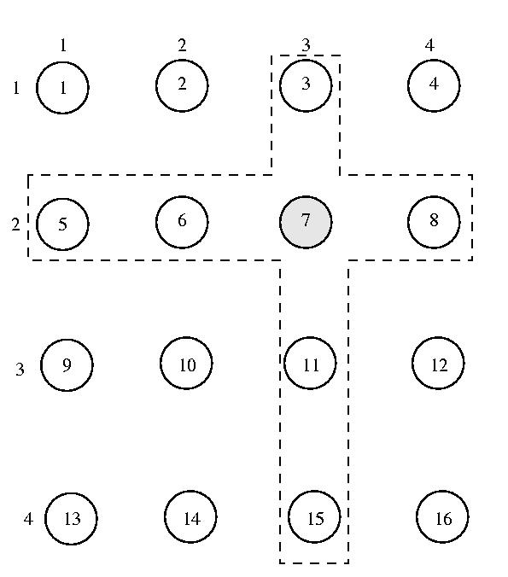
Voting District Example
Request:
Send a REQUEST to each and every member of host’s district
Wait until each and every member of district votes YES (Unanimous YES)
Enter the critical section
Release
Upon exit from the CS, send RELEASE to each and every member of host’s district
Received a REQUEST?
If already voted in an outstanding election, enqueue the request.
Otherwise send YES
Receive a RELEASE?
Dequeue oldest request from its queue, if any. Send a YES vote to this node, if any.

Slide 20
Voting Districts: Ties
Just as before…
Imagine M concurrent requests, each getting exactly N/M votes.
We’re stuck!
To get unstuck, we use Lamport ordering w/hostID tie-breaking and favor earlier requests
If a host gets an earlier request after voting for a later one, it asks for its vote back (INQUIRE)
If the host to which it gave its vote is in the critical section
No fault, no foul. Things happen out of order, but no deadlock is possible as progress was made: DENY
If the host to which it gave its vote is not in the critical section
Deadlock is possible: RELINQUISH
The tie will now be broken in favor of lower ID host (and, even if not tied, no problem)

Slide 21
Voting District Performance
3*(2*SQRT(N)-1) messages (Request, YES, RELEASE)
No need to send to self, hence “minus 1”
PLUS: Up to (2*SQRT(N)-1) INQUIRE-RELINQUISH
Robustness?
What happens if any host fail? Intersecting districts can’t get critical section. Ouch!
Communication problems?
Missing? Usual: No release? Ouch. No Request? Ouch. No reply? Ouch
Upshot: Better rely upon TCP, etc.

Slide 22
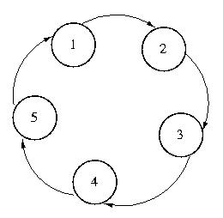
Token Ring Approach
Pass token around ring. Host with it has access to CS.
High contention? 1 message/request
Low contention? (N-1) messages/request

Slide 23
Token Ring: Failure
Failed host or link to host
Pass token to next logical node
Failure within CS
Minimally, no worse than any other situation
With max CS time, can use timer to regenerate
At time out, start ROSTER message around ring
If sent ROSTER and receive ROSTER only propagate if from higher hostID.
Highest host gets ROSTER will all hosts and generates new token
Many regeneration messages can be sent.
Can result in multiple tokens if partitioning
Okay if can make parallel progress slower, or if only one partition can reach resources needed for progress
Can require majority to generate token, preventing multiple (also possibly preventing regeneration)

Slide 24
Raymond’s Algorithm
Another way of approaching token-based mutual exclusion is to organize the hosts into a tree instead of a ring.
This organization allows the token to travel from host-to-host, traversing far fewer unnecessary hosts.
Raymond's algorithm is one such approach.
It organizes all of the nodes into an unrooted n-ary tree.
When the system is initialized, one node is given the token
The other nodes are organized so that they form a tree.
The edges of this tree are directional -- they must always point in the direction of the token.

Slide 25
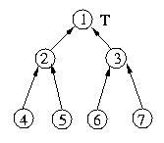
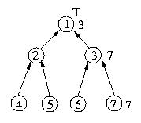
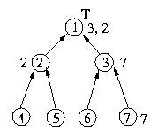
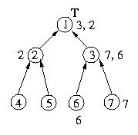
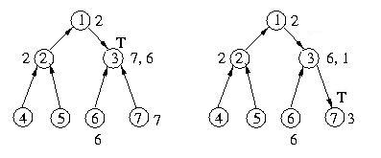
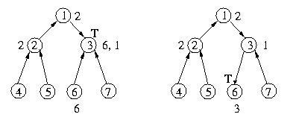
Raymond’s algorithm example
Initial
7 Makes Request
2 Makes Request
6 Makes Request
1 Exits
7 Exits
6 Exits

Slide 26
Raymond’s Algorithm Performance
Obviously not robust to failure – breaks path
Worst case number of messages?
Up and down, 2*log(N)
Not FIFO/FCFS
But, bounded wait
May handle local request first, but then goes up before coming back down

Slide 27
Path compression (Li and Hudak)
Originally developed to pass memory objects
But, memory object can be a simple token
Based on a queue of pending requests. The queue is maintained implicitly by two different types of edges among the nodes:
Each node's current_dir edge leads to its best guess of the node that is at "the end of the line" of hosts waiting for access to the critical section.
The node "at the end of the line" has this pointer set to itself.
Current edges may be out of date. This is because a node may not be aware of the fact that additional nodes have been enqueued. But this is okay. A request can follow the current edge to the "old" end of the queue. This node will in turn lead to a node farther back in the list. Eventually, the request will come to the end of the list.
Once a request reaches the end of the current edge chain, it will also be at the back of the queue maintained by the next pointers, so it can "get in line" and take its place at the end of the queue.
The next edge is only valid for those nodes that either have the token or have requested the token.
If there is a next edge from node A to node B, this indicates that node A will pass the token to node B, once it has exited the critical section.
Nodes which have not requested the critical section, or have no requests enqueued after them, have a null next pointer.
In this way, the next pointer forms the queue of requests. The next pointer from the token holder to the next node forms the head of the list. The next pointer from that point forward indicates the order in which the nodes that have made requests for the critical section will get the token.
How do the current edges get updated?
As a request is percolating through the nodes via the current edges, each node's current edge is adjusted to point to the requesting node. Why? Well the requesting node is the most recent request and is (or will soon be) at the end of the request queue.

Slide 28
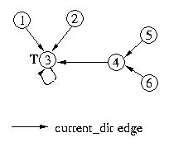
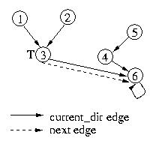
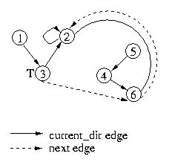
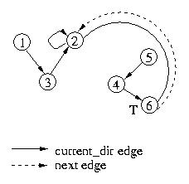
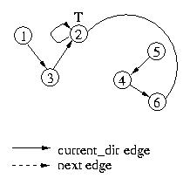
Path compression (Li and Hudak)
6 requests token
2 requests token
3 releases token
6 releases token
Start
Fewer messages/request than Raymond’s
Still not robust to failure.

Slide 29
Leases (General Note)
Each approach has a problem:
What happens if a client dies/walks-away/hogs a resource?
Everything stops
When possible it is most often preferable to “Lease” resources than to give them away
Permission to use resource limited in time
Not honored after that
If needed longer, can request renewal
Decision to renew may be nearly automatic (DHCP prefers to renew IP addresses to keep them stable)
Or, it may be nearly automatic (Deny – get back in line)
Or, it may be based upon demand, etc.

