Slide 1
14-736 Distributed Systems
RPC (Kesden, Spring 2019)
Many thanks to Profs. Srini and Agarwal
…most of the PC slides are from their fall 2016 15-440/640 lecture 6 slide deck

Slide 2
A quick story: Two armies (And One Messenger)

Slide 3
Common communication pattern
Client
Hey, do something
Server
working {
Done/Result

Slide 4
Writing it by hand...
E.g., if you had to write a, say, password cracker
struct foomsg {
u_int32_t len;
}
send_foo(char *contents) {
int msglen = sizeof(struct foomsg) + strlen(contents);
char buf = malloc(msglen);
struct foomsg *fm = (struct foomsg *)buf;
fm->len = htonl(strlen(contents));
memcpy(buf + sizeof(struct foomsg),
contents,
strlen(contents));
write(outsock, buf, msglen);
}
Then wait for response, etc.
Notes:
htonl

Slide 5
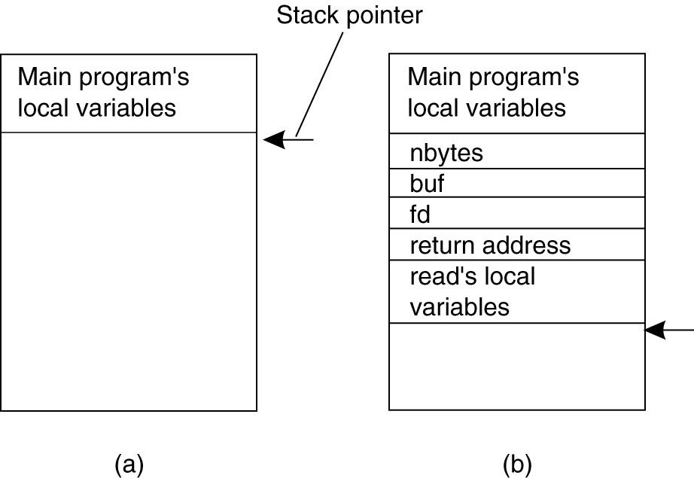
Conventional Procedure Call: Communication via the local stack
(a) Parameter passing in a local procedure call: the stack before the call to read
(b) The stack while the called procedure – read(fd, buf, nbytes) - is active.

Slide 6
Today's Lecture
RPC overview
RPC challenges
RPC other stuff

Slide 7
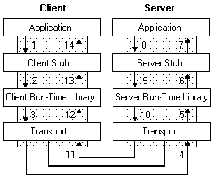
RPC – Remote Procedure Call: Replace Communication via the stack with the network
A type of client/server communication
Attempts to make remote procedure calls look like local ones
{ ...
foo()
}
void foo() {
invoke_remote_foo()
}
figure from Microsoft MSDN

Slide 8
RPC Goals
Ease of programming
Hide complexity
Automates task of implementing distributed computation
Familiar model for programmers (just make a function call)
Historical note: Seems obvious in retrospect, but RPC was only invented in the ‘80s. See
Birrell & Nelson, “Implementing Remote Procedure Call” ... or
Bruce Nelson, Ph.D. Thesis, Carnegie Mellon University: Remote Procedure Call., 1981 :)

Slide 9
Remote procedure call
A remote procedure call makes a call to a remote service look like a local call
RPC makes transparent whether server is local or remote
RPC allows applications to become distributed transparently
RPC makes architecture of remote machine transparent

Slide 10
But it’s not always simple
Calling and called procedures run on different machines, with different address spaces
And perhaps different environments .. or operating systems ..
Must convert to local representation of data
Machines and network can fail

Slide 11
Stubs: obtaining transparency
Compiler generates from API stubs for a procedure on the client and server
Client stub
Marshals arguments into machine-independent format
Sends request to server
Waits for response
Unmarshals result and returns to caller
Server stub
Unmarshals arguments and builds stack frame
Calls procedure
Server stub marshals results and sends reply

Slide 12
Writing it by hand - (again…)
E.g., if you had to write a, say, password cracker
struct foomsg {
u_int32_t len;
}
send_foo(char *contents) {
int msglen = sizeof(struct foomsg) + strlen(contents);
char buf = malloc(msglen);
struct foomsg *fm = (struct foomsg *)buf;
fm->len = htonl(strlen(contents));
memcpy(buf + sizeof(struct foomsg),
contents,
strlen(contents));
write(outsock, buf, msglen);
}
Then wait for response, etc.
Notes:
htonl

Slide 13
Marshaling and Unmarshaling
(From example) htonl() -- “host to network-byte-order, long”.
network-byte-order (big-endian) standardized to deal with cross-platform variance
Note how we arbitrarily decided to send the string by sending its length followed by L bytes of the string? That’s marshalling, too.
Floating point...
Nested structures? (Design question for the RPC system - do you support them?)
Complex datastructures? (Some RPC systems let you send lists and maps as first-order objects)

Slide 14
Endian
Original message on x86 (Little Endian)
The message after receipt on the SPARC (Big Endian)
The message after being inverted. The little numbers in boxes indicate the address of each byte
Notes:
Network byte order is big endian

Slide 15
“stubs” and IDLs
RPC stubs do the work of marshaling and unmarshaling data
But how do they know how to do it?
Typically: Write a description of the function signature using an IDL -- interface definition language.
Lots of these. Some look like C, some look like XML, ... details don’t matter much.

Slide 16
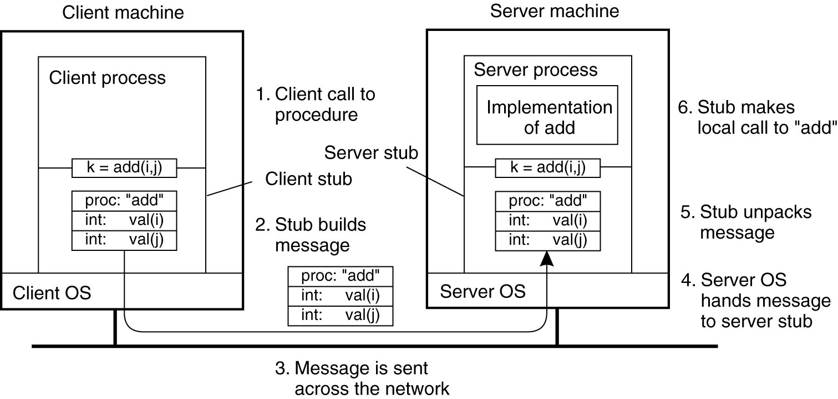
Passing Value Parameters (1)
The steps involved in a doing a remote computation through RPC.

Slide 17
Remote Procedure Calls (1)
A remote procedure call occurs in the following steps:
The client procedure calls the client stub in the normal way.
The client stub builds a message and calls the local operating system.
The client’s OS sends the message to the remote OS.
The remote OS gives the message to the server stub.
The server stub unpacks the parameters and calls the server.
Continued …

Slide 18
Remote Procedure Calls (2)
A remote procedure call occurs in the following steps (continued):
The server does the work and returns the result to the stub.
The server stub packs it in a message and calls its local OS.
The server’s OS sends the message to the client’s OS.
The client’s OS gives the message to the client stub.
The stub unpacks the result and returns to the client.

Slide 19
Passing Reference Parameters
Replace with pass by copy/restore
Need to know size of data to copy
Difficult in some programming languages
Solves the problem only partially
What about data structures containing pointers?
Access to memory in general?

Slide 20
Two styles of RPC implementation
Shallow integration. Must use lots of library calls to set things up:
How to format data
Registering which functions are available and how they are invoked.
Often seen in heterogeneous uses, i.e.. cross-environment, Java to C
Deep integration.
Data formatting done based on type declarations
(Almost) all public methods of object are registered.
Often seen in homogeneous uses, e.g. Go or Java.

Slide 21
Today's Lecture
RPC overview
RPC challenges
RPC other stuff

Slide 22
RPC vs. LPC
3 properties of distributed computing that make achieving transparency difficult:
Partial failures
Latency
Memory access

Slide 23
RPC failures
Request from cli → srv lost
Reply from srv → cli lost
Server crashes after receiving request
Client crashes after sending request

Slide 24
Partial failures
In local computing:
if machine fails, application fails
In distributed computing:
if a machine fails, part of application fails
one cannot tell the difference between a machine failure and network failure
How to make partial failures transparent to client?

Slide 25
Strawman solution
Make remote behavior identical to local behavior:
Every partial failure results in complete failure
You abort and reboot the whole system
You wait patiently until system is repaired
Problems with this solution:
Many catastrophic failures
Clients block for long periods
System might not be able to recover

Slide 26
Real solution: break transparency
Possible semantics for RPC:
Exactly-once
Impossible in practice
At least once:
Only for idempotent operations
At most once
Zero, don’t know, or once
Zero or once
Transactional semantics

Slide 27
Exactly-Once?
Sorry - no can do in general.
Imagine that message triggers an external physical thing (say, a robot fires a nerf dart at the professor)
The robot could crash immediately before or after firing and lose its state. Don’t know which one happened. Can, however, make this window very small.

Slide 28
Real solution: break transparency
At-least-once: Just keep retrying on client side until you get a response.
Server just processes requests as normal, doesn‘t remember anything. Simple!
At-most-once: Server might get same request twice...
Must re-send previous reply and not process request (implies: keep cache of handled requests/responses)
Must be able to identify requests
Strawman: remember all RPC IDs handled.
→ Ugh! Requires infinite memory.
Real: Keep sliding window of valid RPC IDs, have client number them sequentially.

Slide 29
Implementation Concerns
As a general library, performance is often a big concern for RPC systems
Major source of overhead: copies and marshaling/unmarshaling overhead
Zero-copy tricks:
Representation: Send on the wire in native format and indicate that format with a bit/byte beforehand. What does this do? Think about sending uint32 between two little-endian machines
Scatter-gather writes (writev() and friends)

Slide 30
Dealing with Environmental Differences
If my function does: read(foo, ...)
Can I make it look like it was really a local procedure call??
Maybe!
Distributed filesystem...
But what about address space?
This is called distributed shared memory
People have kind of given up on it - it turns out often better to admit that you’re doing things remotely

Slide 31
Today's Lecture
RPC overview
RPC challenges
RPC other stuff

Slide 32
Asynchronous RPC (1)
The interaction between client and server in a traditional RPC.

Slide 33
Asynchronous RPC (2)
The interaction using asynchronous RPC.

Slide 34
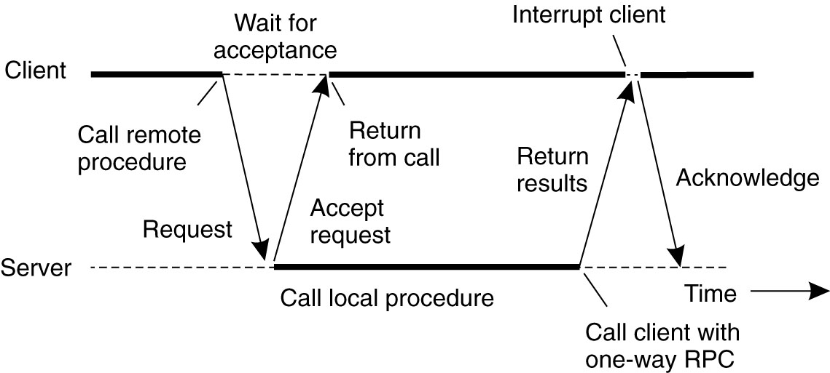
Asynchronous RPC (3)
A client and server interacting through two asynchronous RPCs.

Slide 35
Using RPC
How about a distributed bitcoin miner.
Three classes of agents:
Request client. Submits cracking request to server. Waits until server responds.
Worker. Initially a client. Sends join request to server. Now it should reverse role & become a server. Then it can receive requests from main server to attempt cracking over limited range.
Server. Orchestrates whole thing. Maintains collection of workers. When receive request from client, split into smaller jobs over limited ranges. Farm these out to workers. When finds bitcoin, or exhausts complete range, respond to request client.

Slide 36
Using RPC
Request→Server→Response:
Classic synchronous RPC
Worker→Server.
Synch RPC, but no return value.
"I'm a worker and I'm listening for you on host XXX, port YYY."
Server→Worker.
Synch RPC?
No that would be a bad idea. Better be Asynch.
Otherwise, it would have to block while worker does its work, which misses the whole point of having many workers.

Slide 37
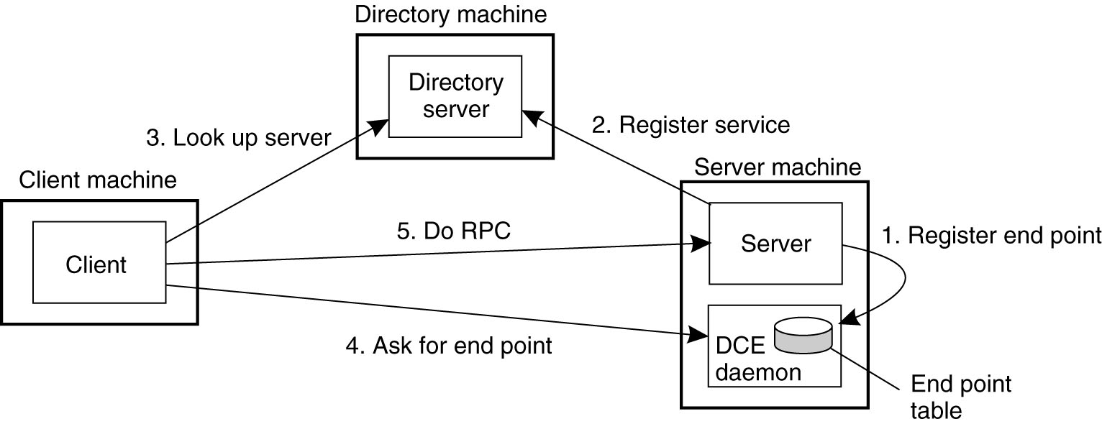
Binding a Client to a Server
Registration of a server makes it possible for a client to locate the server and bind to it
Server location is done in two steps:
Locate the server’s machine.
Locate the server on that machine.

Slide 38
Summary: expose remoteness to client
Expose RPC properties to client, since you cannot hide them
Application writers have to decide how to deal with partial failures
Consider: E-commerce application vs. game

Slide 39
Important Lessons
Procedure calls
Simple way to pass control and data
Elegant transparent way to distribute application
Not only way…
Hard to provide true transparency
Failures
Performance
Memory access
Etc.
How to deal with hard problem → give up and let programmer deal with it
“Worse is better”

