Slide 1
14-736
Distributed Systems
Lecture 25 * Spring 2019 * Kesden

Slide 2
Why Talk About DNS?
…this isn’t a networks class, right?
I argue that DNS is the most successful distributed system ever deployed:
  Global scale
  Nearly transparent, taken for granted
  Highly available and reliable
  Distributed Management
  Etc, etc, etc.

Slide 3
Naming
How do we efficiently locate resources?
  DNS: name → IP address
Challenge
  How do we scale these to the wide area?

Slide 4
Obvious Solutions (1)
Why not centralize DNS?
Single point of failure
Traffic volume
Distant centralized database
Single point of update
Doesn’t scale!

Slide 5
Obvious Solutions (2)
Why not use /etc/hosts?
Original Name to Address Mapping
  Flat namespace
  /etc/hosts
  SRI kept main copy
  Downloaded regularly
Count of hosts was increasing: machine per domain → machine per user
  Many more downloads
  Many more updates

Slide 6
Domain Name System Goals
Basically a wide-area distributed directory service
Scalability
Decentralized maintenance
Robustness
Global scope
  Names mean the same thing everywhere
Don’t need
  Atomicity
  Strong consistency
Notes:
ACID
Atomic
Consistent
Isolated
Durable

Slide 7
Programmer’s View of DNS
Conceptually, programmers can view the DNS database as a collection of millions of host entry structures:
Functions for retrieving host entries from DNS:
  getaddrinfo: query key is a DNS host name.
  getnameinfo: query key is an IP address.
/* DNS host entry structure */
struct addrinfo {
int ai_family; /* host address type (AF_INET) */
size_t ai_addrlen; /* length of an address, in bytes */
struct sockaddr *ai_addr; /* address! */
char *ai_canonname; /* official domain name of host */
struct addrinfo *ai_next; /* other entries for host */
};

Slide 8
DNS Message Format
Identification
Flags
12 bytes
No. of Questions
No. of Answer RRs
No. of Authority RRs
No. of Additional RRs
Name, type fields for a query
Questions (variable number of answers)
RRs in response to query
Answers (variable number of resource records)
Records for authoritative servers
Authority (variable number of resource records)
Additional “helpful info that may be used
Additional Info (variable number of resource records)

Slide 9
DNS Header Fields
Identification
  Used to match up request/response
Flags
  1-bit to mark query or response
  1-bit to mark authoritative or not
  1-bit to request recursive resolution
  1-bit to indicate support for recursive resolution

Slide 10
DNS Records
RR format: (class, name, value, type, ttl)
DB contains tuples called resource records (RRs)
  Classes = Internet (IN), Chaosnet (CH), etc.
  Each class defines value associated with type
FOR IN class:
Type=A
  name is hostname
  value is IP address
Type=NS
  name is domain (e.g. foo.com)
  value is name of authoritative name server for this domain
Type=CNAME
  name is an alias name for some “canonical” (the real) name
  value is canonical name
Type=MX
  value is hostname of mailserver associated with name

Slide 11
Properties of DNS Host Entries
Different kinds of mappings are possible:
  Simple case: 1-1 mapping between domain name and IP addr:
    kittyhawk.cmcl.cs.cmu.edu maps to 128.2.194.242
  Multiple domain names maps to the same IP address:
    eecs.mit.edu and cs.mit.edu both map to 18.62.1.6
  Single domain name maps to multiple IP addresses:
    aol.com and www.aol.com map to multiple IP addrs.
  Some valid domain names don’t map to any IP address:
    for example: cmcl.cs.cmu.edu

Slide 12
DNS Design: Hierarchy Definitions
root
Each node in hierarchy stores a list of names that end with same suffix
  Suffix = path up tree
E.g., given this tree, where would following be stored:
  Fred.com
  Fred.edu
  Fred.cmu.edu
  Fred.cmcl.cs.cmu.edu
  Fred.cs.mit.edu
org
net
edu
com
uk
gwu
ucb
cmu
bu
mit
cs
ece
cmcl

Slide 13
DNS Design: Zone Definitions
root
Zone = contiguous section of name
space
  E.g., Complete tree, single
  node or subtree
A zone has an associated set of
name servers
  Must store list of names and tree links
org
ca
net
edu
com
uk
gwu
ucb
cmu
bu
mit
cs
ece
Subtree
cmcl
Single node
Complete Tree

Slide 14
DNS Design: Cont.
Zones are created by convincing owner node to create/delegate a subzone
  Records within zone stored multiple redundant name servers
  Primary/master name server updated manually
  Secondary/redundant servers updated by zone transfer of name space
    Zone transfer is a bulk transfer of the “configuration” of a DNS server – uses TCP to ensure reliability
Example:
  CS.CMU.EDU created by CMU.EDU administrators
  Who creates CMU.EDU or .EDU?

Slide 15
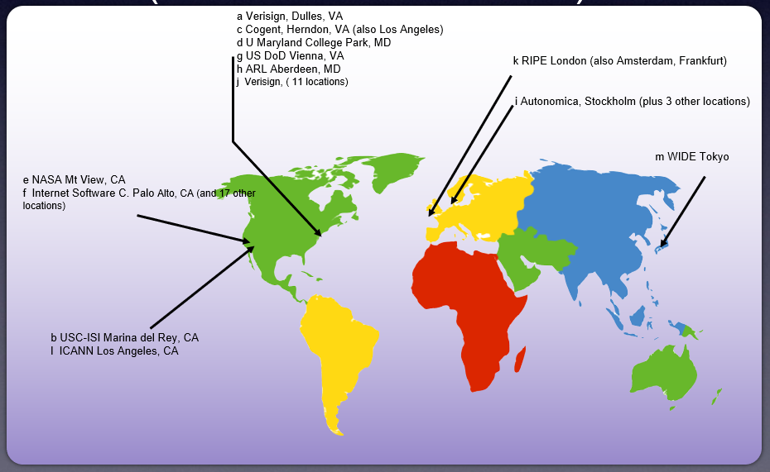
DNS: Root Name Servers
Responsible for “root” zone
Approx. 13 root name servers worldwide (well, clusters, thereof)
  Currently {a-m}.root-servers.net
Local name servers contact root
servers when they cannot
resolve a name
  Configured with well-known
  root servers
  www.root-servers.org
Credit: Bill Nace, 14-740

Slide 16
Servers/Resolvers
Each host has a resolver
  Typically a library that applications can link to
  Local name servers hand-configured (e.g. /etc/resolv.conf)
Name servers
  Either responsible for some zone or…
  Local servers
    Do lookup of distant host names for local hosts
    Typically answer queries about local zone

Slide 17
Typical Resolution
root & edu
DNS server
www.cs.cmu.edu
www.cs.cmu.edu
NS ns1.cmu.edu
ns1.cmu.edu
DNS server
Local
DNS server
NS ns1.cs.cmu.edu
Client
ns1.cs.cmu.edu
DNS
server
A www=IPaddr

Slide 18
Typical Resolution
Steps for resolving www.cmu.edu
  Application calls gethostbyname() (RESOLVER)
  Resolver contacts local name server (S₁)
  S₁ queries root server (S₂) for (www.cmu.edu)
  S₂ returns NS record for cmu.edu (S₃)
  What about A record for S₃?
    This is what the additional information section is for (PREFETCHING)
  S₁ queries S₃ for www.cmu.edu
  S₃ returns A record for www.cmu.edu
Can return multiple A records → what does this mean?

Slide 19
Lookup Methods
Recursive query:
Server goes out and searches for more info (recursive)
Only returns final answer or “not found”
Iterative query:
Server responds with as much as it knows (iterative)
“I don’t know this name, but ask this server”
Workload impact on choice?
Local server typically does recursive
Root/distant server does iterative
root name server
2
iterated query
3
4
7
local name server
dns.eurecom.fr
intermediate name server
dns.umass.edu
5
6
1
8
authoritative name server
dns.cs.umass.edu
requesting host
surf.eurecom.fr
gaia.cs.umass.edu

Slide 20
Workload and Caching
Are all servers/names likely to be equally popular?
  Why might this be a problem? How can we solve this problem?
DNS responses are cached
  Quick response for repeated translations
  Other queries may reuse some parts of lookup
    NS records for domains
DNS negative queries are cached
  Don’t have to repeat past mistakes
  E.g. misspellings, search strings in resolv.conf
Cached data periodically times out
  Lifetime (TTL) of data controlled by owner of data
  TTL passed with every record

Slide 21
Typical Resolution
root & edu
DNS server
www.cs.cmu.edu
www.cs.cmu.edu
NS ns1.cmu.edu
ns1.cmu.edu
DNS server
Local
DNS server
NS ns1.cs.cmu.edu
Client
ns1.cs.cmu.edu
DNS
server
A www=IPaddr

Slide 22
Subsequent Lookup Example
root & edu
DNS server
ftp.cs.cmu.edu
cmu.edu
DNS server
Local
DNS server
Client
ftp.cs.cmu.edu
cs.cmu.edu
DNS
server
ftp=IPaddr

Slide 23
Reliability
DNS servers are replicated
  Name service available if ≥ one replica is up
  Queries can be load balanced between replicas
UDP used for queries
  Need reliability → must implement this on top of UDP!
  Why not just use TCP?
Try alternate servers on timeout
  Exponential backoff when retrying same server
Same identifier for all queries
  Don’t care which server responds

Slide 24
Reverse DNS
unnamed root
Task
  Given IP address, find its name
Method
  Maintain separate hierarchy based on IP names
  Write 128.2.194.242 as 242.194.128.2.in-addr.arpa
    Why is the address reversed?
Managing
  Authority manages IP addresses assigned to it
  E.g., CMU manages name space 128.2.in-addr.arpa
arpa
edu
in-addr
cmu
128
cs
2
cmcl
194
kittyhawk
128.2.194.242
242

Slide 25
.arpa Name Server Hierarchy
in-addr.arpa
a.root-servers.net • • • m.root-servers.net
chia.arin.net
(dill, henna, indigo, epazote, figwort, ginseng)
128
cucumber.srv.cs.cmu.edu,
t-ns1.net.cmu.edu
t-ns2.net.cmu.edu
2
194
mango.srv.cs.cmu.edu
(peach, banana, blueberry)
At each level of hierarchy, have group of servers that are authorized to handle that region of hierarchy
kittyhawk
128.2.194.242

Slide 26
Prefetching
Name servers can add additional data to response
Typically used for prefetching
  CNAME/MX/NS typically point to another host name
  Responses include address of host referred to in “additional section”

Slide 27
Mail Addresses
MX records point to mail exchanger for a name
  E.g. mail.acm.org is MX for acm.org
Addition of MX record type proved to be a challenge
  How to get mail programs to lookup MX record for mail delivery?
  Needed critical mass of such mailers

Slide 28
Root Zone
Generic Top Level Domains (gTLD) = .com, .net, .org, etc…
Country Code Top Level Domain (ccTLD) = .us, .ca, .fi, .uk, etc…
Root server ({a-m}.root-servers.net) also used to cover gTLD domains
  Wow, how times have changed!

Slide 29
gTLDs
Unsponsored
  .com, .edu, .gov, .mil, .net, .org
  .biz → businesses
  .info → general info
  .name → individuals
Sponsored (controlled by a particular association)
  .aero → air-transport industry
  .cat → catalan related
  .coop → business cooperatives
  .jobs → job announcements
  .museum → museums
  .pro → accountants, lawyers, and physicians
  .travel → travel industry
Starting up
  .mobi → mobile phone targeted domains
  .post → postal
  .tel → telephone related
Etc.

Slide 30
Measurements of DNS
No centralized caching per site
  Each machine runs own caching local server
  Why is this a problem?
  How many hosts do we need to share cache? → recent studies suggest 10-20 hosts
“Hit rate for DNS = 60-80% → 1 - (#DNS/#connections)
  Depends upon number of users of cache.
  Larger community means greater hit rate, to a point.
Lower TTLs for A records does not affect performance
DNS performance really relies more on NS-record caching

Slide 31
DNS (Summary)
Motivations → large distributed database
  Scalability
  Independent update
  Robustness
Hierarchical database structure
  Zones
  How is a lookup done
Caching/prefetching and TTLs
Reverse name lookup
What are the steps to creating your own domain?

