Slide 1
Virtual Machines
Lecture 24 * 14-736 (Distributed Systems) * Spring 2019

Slide 2
What Is Virtualization?
“In computing, virtualization refers to the act of creating a virtual (rather than actual) version of something, including virtual computer hardware platforms, storage devices, and computer network resources.”
-- https://en.wikipedia.org/wiki/Virtualization

Slide 3
What, Then, Is a Virtual Machine?
A virtual , rather than actual machine
Okay, so what does that mean?
Something with the “virtues” or good parts of a machines
Without the realities of being that machine!
A software program, known as a guest, that runs on one computer, known as a host, that can run software as if it (the program) were an actual computer, often of a different type.

Slide 4
Why Use Virtual Machines?
Share resources among many uses
One physical machine can host many guests
Decouple the physical environment from the presented environment
Run Atari 2600 games on Macs or Windows PCs
Run Android and phone software on an Mac or Windows PC
Deliver several different Linux environments (different OS versions, libraries, etc) from one Linux host.
Provide for protection
Different VMs for different domains, applications, users, etc.
Provide for elasticity
Launch and Recall VMs as needed to meet demand.
Provide a unit of accounting, e.g. AWS.
Provide a mechanism for migration, checkpointing, etc
Recovery, maintenance

Slide 5
Why Not Use Virtual Machines?
Complexity
There is overhead in maintaining multiple environments
Most of us just run native on our phones, laptops, etc.
Efficiency
VMs introduce overhead, which can reduce increase costs and latency
Of course, sharing efficiently can lower costs and provide better efficiency for the same cost, too.
Performance Isolation
Hard to manage well with sharing, but there are some tools.
Protection
VMs mostly provide a better model for this and improve it
But, any sharing presents risks that real-world physical separation does not.

Slide 6
Why Critical In Cloud Environments?
Sharing of resources
Improve utilization
Fungibility
Decouple guest hardware and software configuration from configuration
Isolation
Pretty well defined protection model
Elasticity
Easy to create and destroy
Robustness
Model for checkpointing, recovering, migrating
Metering
Can define to provide various qualities of service, e.g. processor speeds, memory models, networking capacities, etc.
All, for example, by time-sharing or space-sharing capabilities of host.

Slide 7
Virtualized Applications
In may ways, the ideal model
Each app runs in its own VM
It has its own environment, which can be unique from the rest.
May include a few related apps
Has everything it needs packaged
But, can mean a lot of overhead if many apps sharing the same host
We’ll talk about containers soon

Slide 8
Types of Virtual Machines
Full virtualization
Virtual machines runs entirely as a program in guest OS without any special support from guest OS
Nice in that it requires no specialized support
Not nice in that it has to grind through virtualizing expensive operations that can be done faster in host.
Paravirtualization
Host OS modified to provide an API to enable VM to request the host to perform operations on behalf of the guest.
Makes operations that are inefficient to virtualize efficient
Requires a modified guest
May complicate protection and/or isolation models, etc.

Slide 9
Hardware Support
Can eliminate many of the pain points
Traps
Hardware access, e.g. for I/O (Interrupts, DMA, etc)
Supervisor vs user mode
Consider what happens if a guest can run in supervisor mode
Consider what happen if a guest OS cannot run in supervisor mode
Etc
Very powerful when combined with paravirtualization
Ties implementation to specific, evolving hardware support.

Slide 10
Related Technologies
Simulators
Simulates internal mechanisms as well as emulating behaviors, even when dramatically inefficient and unnecessary.
Mostly used for research, debugging with full transparency, etc
Far too slow for production use
Containers (“OS-level virtualization”)
Share not only hardware, but also OS components (Limits presented OS)
Improves efficiency
Complicates protection and isolation model
Examples: Docker, BSD Jails, etc.
More soon

Slide 11
Virtual Machine Monitor (VMM) a.k.a. Hypervisor
Manages virtual machines
Creates
Destroys
Suspends
Resumes
Migrates
Etc.
Typically manages all VMs on one host
Name derived from supervisor, an old-school synonym for a running OS (kernel) in its role managing processes and resources
The hypervisor is, in some ways, a supervisor for the guest supervisors. Hyper sounding bigger than super, and all

Slide 12
Types of Hypervisors
Native Hypervisor, a.k.a. Bare-metal Hypervisor
Runs on guest hardware instead of conventional operating system
Old school IBM stuff and Microsoft Hyper-V (Based on trimmed down Windows) are classic examples
Hosted Hypervisor
Runs as user software within a conventional operating system environment
VMware is classic example
Reality isn’t always so clear
What do you call a hosted hypervisor running on an OS that is hosting nothing but that hypervisor and the VMs it manages?
Does it matter if paravirtualization blends the line between OS, hypervisor, and VM?
KVM is classic example
Obviously, the tighter the integration, the more efficient things likely will be.

Slide 13
Containers a.k.a. OS Virtualization
Maintain one host OS
Guest OS is the same type
Share it for efficiency
Isolate guests within host OS
For protection purposes
For environment purpose (Libraries, file system, users, etc)
Maybe for resource management purposes
More efficient model
More sharing = Less overhead

Slide 14
Containers a.k.a. OS Virtualization, cont
Built using existing OS mechanism
In many ways co-developed with those mechanisms
But, weaker in some ways
Need to present same guest OS
Performance/Security model harder to understand
Limits to ability to control performance impact
Model is “share first, isolate second”
Careful! Careful!

Slide 15
Container Building blocks: Chroot
chroot = change root
Uses any directory within the file system’s tree as the root for a process and its descendants.
It can’t get out of this box in the file system
Old school use: chroot a Web server.
Breaking the Web server doesn’t expose host file system
But, only isolates the file system

Slide 16
Container Building blocks: Linux Namespaces
Creates a partitioned view of certain linux kernel resources such that only certain processes can see certain resources
Types of namespaces:
Mount (mnt)
Process ID (pid)
Network
Interprocess Communication (ipc)
Unix Time Share, a.k.a. uname (uts)
User ID (user)
Control group (cgroup)
Basic model is that once resources are isolated into a namespace, only the original processes and their descendants can’t get out of that view.
Now we can partition the view of the file system – and kernel resources

Slide 17
Container Building blocks: Mount (mnt) NameSpAce
Mount points are the points where one file system is grafted onto another file system.
For example
/afs is the mount point where the AFS distributed file system is graphed into the visible file system.
/proc is the mount point where the kernel’s virtual file system is mounted into the local file system
The mnt namespace allows mounts to be viewed within certain namespaces, but not others
Subtrees can also be shared among namespaces.
This allows changes to mounts within them to be seen across the namespace.
So, now we can not only limit what portion of a file system a process can see, but we can build it up by layering mounts on top of it – and deleting them.
And define them hierarchically (take X, add Y to form Z; take Z and add A and subtract B, etc)

Slide 18
Container Building blocks: Process ID (pid) NameSpAce
Basically like a “chroot” for the pid tree
A new namespace is created and a process is forked into it using a more parameterizable version of fork() called clone()
This process now has pid=1 in this namespace.
Only its descendants are visible within the name space
Careful! Careful!
Containers are a broken first, fixed from there model
Most tools get their process information from /proc, which is in the file system
So, unless this, too is “fixed”, top, ps, etc, will all still show global processes (oops)

Slide 19
Container Building blocks: Network (net) NameSpAce
Network namespaces virtualize the network stack. On creation a network namespace contains only a loopback interface.
Each network interface (physical or virtual) is present in exactly 1 namespace and can be moved between namespaces.
Virtual network interfaces can share physical ones, thereby allowing a physical network interface to be shared. (Kesden note)
Each namespace will have a private set of IP addresses, its own routing table, socket listing, connection tracking table, firewall, and other network-related resources.
Destroying a network namespace destroys any virtual interfaces within it and moves any physical interfaces within it back to the initial network namespace.
-- https://en.wikipedia.org/wiki/Linux_namespaces#Mount_(mnt)

Slide 20
Container Building blocks: Inter-Process Communication (IPC) NameSpAce
Inter-process communication makes use of shared memory to allow processes to communicate with each other
Pages of shared memory get mapped into multiple processes’ virtual memory
Libraries make uses of this shared memory to provide structured communication
Shared memory, mailboxes, etc.
Synchronization primitives may also make use of it
Semaphores, mutexes, etc.
This has an obvious impact upon isolation.
IPC Namespaces partition IPC so it can’t be used across name spaces

Slide 21
Container Building blocks: Unix Time Share, a.k.a. uname (uts) NameSpAce
UTS is an old school name for what is returned by “uname -a”
Basically, this namespace allows processes to have different hostnames and domain names.

Slide 22
Container Building blocks: Userid (uid) NameSpAce
You’ve guessed this one
It lets different name spaces have different userids, including their mappings
Including uid(#) → userid(string) mappings
So, both uids and userids can e reused across name spaces.
root and uid=0 can both be reused within each user space
The root user within a user space has the ability to do root things with any protected resources owned by that namespace or any of its descendants.
Recall, for example, that network interfaces are owned by some namespace and can be moved among them – but not shared among them.

Slide 23
Container Building blocks: Control Group (cgroup) NameSpAce
Control groups (cgroups) are basically a mechanism for the hierarchical grouping of processes for resource management
Resource management is applied to a group – including its descendants
Many different resources can be managed:
CPU, Memory, disk I/O. Network I/O, etc
Monitoring and accounting can be done on a per-group basis.
Some process management can be done on a per cgroup basis
Freezing, Resuming, Killing, etc.

Slide 24
Union FilE System (UnionFS)
Ability to mount one file system layered over another
See lower level file systems through upper level file systems to the extent non-conflicting.
But, upper level file systems hide conflicting things in lower layers
Makes it easy to define one file system by specializing another
In some sense it enables inheritance for a file system .

Slide 25
Container Building Blocks: Container Libraries
Libraries may package functionality into an interface to support containerizing environments:
Examples include libcontainer, LXC, libvirt, &c e
These are currently not generally portable
But, one can imagine a standardized interface working across operating systems with rich enough features
Wouldn’t that be nice ☺

Slide 26
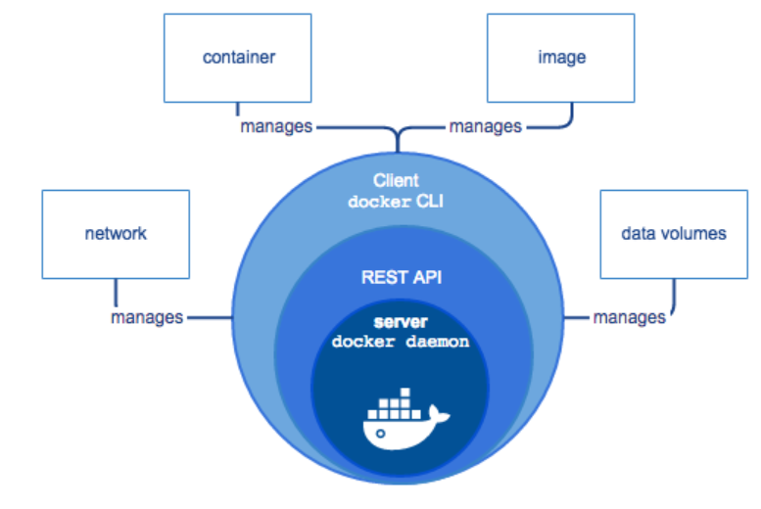
Docker
Probably the best known Linux container solution including:
Network, data volumes, images, and containers
Onion:
Daemon manages the containers
API provides for programmatic control of the daemon
Command-line interface (CLI) is built upon the API and provides command line tools
https://docs.docker.com/engine/docker-overview/#docker-engine

Slide 27
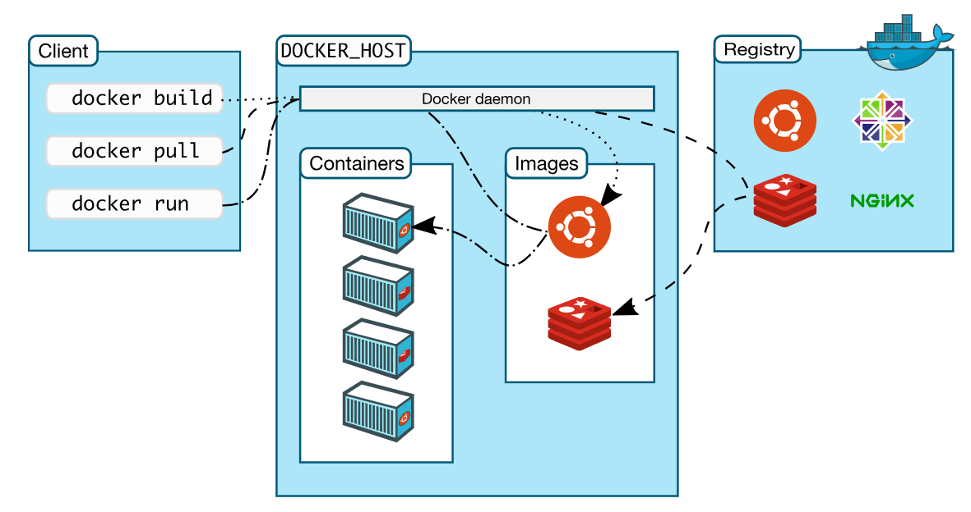
Docker Architecture/Ecosystem
https://docs.docker.com/engine/docker-overview/#docker-architecture

Slide 28
Containers + VMs
In some ways these are competing technologies
Clear protection model and independence from host favors VMs
Efficiency, tuning a similar base environment, and reasonable isolation favors Containers
But, they are also cooperative technologies
VMs can contain containers
Common model:
VM provides hardware independence (for sharing, fungibility, efficiency, isolation, robustness, etc)
Containers provide application environment (for deployability and further management)

