Slide 1
14-736: Distributed Systems
Lecture 17 * Spring 2019 * Kesden

Slide 2
Reminder
Brittle: Failure is likely to result in a disproportionately large disability, e.g. one system of many fails or becomes disconnected, and thereby prevents a write-all quorum, disabling all writes.
Robust: Failure generates a less-than-proportional disability, e.g. one server of many fails, but the others are able to maintain the full availability of the service, so the only disability is reduced robustness. Robust systems are often “fail soft”.

Slide 3
Techniques for Building Robust Systems
Hardening: Make individual components less likely to fail.
Redundancy: Make additional resources, and the capability to use them, available, thereby hiding failure.
Resilience: Enable systems to recover quickly from failure
Self-healing: Automatic retirement of failed resources and reintroduction of fresh resource
Visibility and Control: Enable humans to see and respond to failure.
Gracefulness degradation: Enable systems to continue to make use of available resources, even aftger some resources have failed or become disconnected.

Slide 4
Our Toolbox So Far
Redundancy, replication and quorums
Failing soft, e.g. Coda allowing temporary inconsistency
Self-healing, e.g. coordinator elections, removing and introducing anew failed participants, etc.
Human intervention, e.g. appointment of new coodinators, etc.

Slide 5
Today: Logging and Recovery
Enables self-healing, etc.
Already discussed in some contexts, as needed, e.g. Write-Ahead Logging (WAL) for transactions
Today’s discussion will provide a comprehensive look, including at those uses.

Slide 6
Checkpointing
Making a consistent copy of all relevant state to stable storage.
Can be used to restore this state
“Consistent copy” is major challenge
Often involves freezing things and letting tings in-flight settle
Disrupts availability
Distributed systems present special challenge
Consistency must be global, not just per host.

Slide 7
Logging
Recording of events as they occur
Enables playback of events to restore state later
Recording is a key challenge, because it needs to be to stable storage if it is to be guaranteed available later
Playback has many challenges:
Length of time it takes for long logs
Impact upon other systems which receive redundant requests, e.g. peers, databases, etc.
Insert prior discussion about Write-Ahead Logging (WAL) here.

Slide 8
Checkpointing + Logging
Common idiom
Periodically checkpoint to save complete state
Incrementally log to maintain updates from that state
Upon checkpointing prune the log to include only those events subsequent to the checkpoint
Reduces replay time
Reduces need to store large log

Slide 9
Still Unanswered
How to maintain a stable log without introducing unmanageable delay?
What about resends from recovering server playing back logs?
What about system availability during checkpointing?
How to maintain global consistency
What about “in flight” communication?

Slide 10
Buffering Logs
Fast, stable storage is one option for maintaining logs
Flash ram, etc.
But, it may not be fast enough
Buffer logs into block-sized chunks, then commit to stable storage
Amortizes any seek cost or read-merge-write cost
Delays commit point
Logs can only restore the timeline to the most recent point in time to which they contiguously exist

Slide 11
Fast Stable Logging?
No less latent than available stable storage

Slide 12
Side-Effects of Playbacks
Naïve playbacks of logs can repeat messages already sent, having undesirable effects on other systems
Other participants may act
Databases may repeat updates that aren’t idempotent
Etc
Options:
Squelch sending such communication
Use incarnation numbers to enable recipients to do the same.
Increment number with each “reboot”, record in sender and receiver logs. Used to detect duplicates by receiver.

Slide 13
Checkpointing
Generally involves freezing the system to maintain consistency
Checkpointing takes time and can’t change values mid-way
Maybe make “fixups”, but dependencies cascade, so not really
Freezing means not only local system, but others that might need it
Inbound messages need to be frozen
Maybe buffered for later
What about ACKs and Resends? Can be a complexity
What about other systems? (See next slide)

Slide 14
Distributed Checkpointing
Need global consistency
Easiest solution – free all systems and checkpoint simultaneously
Called Synchronous Checkpointing
But, what about availability?
More complex and higher risk solution
Checkpoint independently, called Asynchronous Checkpointing
Checkpoints are not at same point in time and unlikely to restore to globally consistent state
Patch up with logs? Are they synchronous, i.e. not buffered?

Slide 15
Recovery Line
Restoration might involve:
Checkpointing
Log playback
Updates from peers or a coordinator
If one of many participants can’t be brought up-to-date, it may be necessary for others to fall back to a prior point in time for global consistency. This is called a Rollback.
If other systems checkpoints are granular, rollback may Cascade until a Consistent Recovery Line can be found.

Slide 16
Quick Definition
Interval, def:
The time between two sequential checkpoints of the same state
The time between the commitment of buffered log messages to stable storage

Slide 17
Uncoordinated Checkpointing
Each related system checkpoints independently of the others.
Note the checkpoints and intervals.

Slide 18
Uncoordinated Checkpointing, cont.
If we have multiple participants we can use subscripts such as C_{i,c} and I_{i,c}, where i is the participant number and c is the checkpoint sequence number.

Slide 19
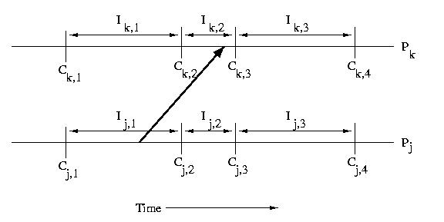
Uncoordinated Checkpointing, cont.
If we have multiple participants we can use subscripts such as C_{i,c} and I_{i,c}, where i is the participant number and c is the checkpoint sequence number.

Slide 20
Uncoordinated Checkpointing, cont.
Note that I_{k,2} depends on I_{j,1}
Without I_{j,1} we couldn’t have I_{k,2}

Slide 21
Interval Dependency Graph (IDG)

Slide 22
Interval Dependency Graph (IDG), cont.
Two types of dependencies
Dependency of a system’s present state upon its prior state (downward vertical edges)
Dependency of a system’s present state upon communication it received (messages from others)
But, wait! Don’t sent messages generate a dependency? They won’t get resent!
Well, if one cares, they need ACKs or something, which is a message in the other direction, which generates the dependency.
In a model where one doesn’t need ACKs, well, that is a different model.

Slide 23
Interval Dependency Graph (IDG), cont.
How do we find a recovery line?
Remove the failed state
Remove every state that depends upon it
Wash. Rinse. Repeat.
Can’t this keep falling back?
Yep! That’s a cascading rollback.
Can’t this cascade back forever?
Nope! The beginning of time is a checkpoint ☹

Slide 24
Asynchronous Logging

Slide 25
Direct Dependency Vectors (DDVs)
Each sending participant includes its interval number with each message.
Each receiving processor forms a DDV contains the processor's understanding of the interval on all processors.
One processor is only informed about another processor's interval, if it directly receives a message from that processor. No gossip. Not inherited.
A message from processor X to processor Y only contains X's interval, not the DDV present on X.

Slide 26
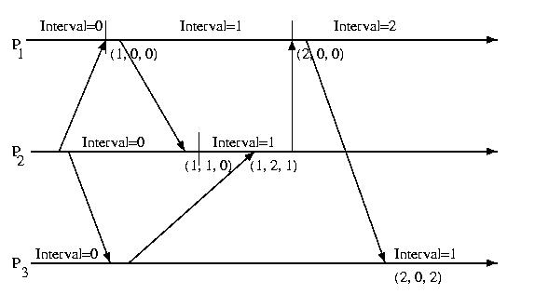
Direct Dependency Vectors, cont.

Slide 27
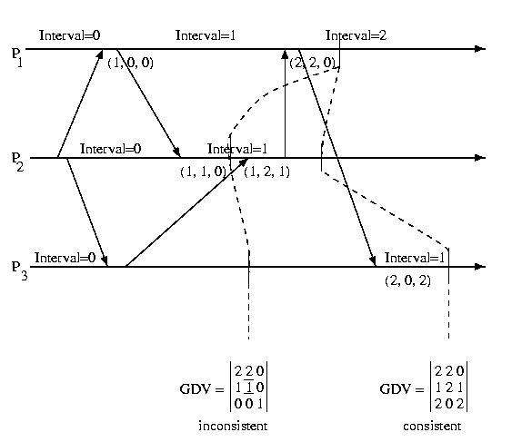
Global Dependency Vector (GDV)
We can check to see if a GDV represents a consistent state, by comparing the DDVs pair-wise.
For each entry in a consistent GDV, the interval shown for another processor must be less than or equal to the interval that that processor's DDV within the GDV contains for itself.
GDV(p)[q] <= GDV(q)[q], 1<=p, q<=M
In other words, no processor can have received a message from another processor originating in an interval in advance of that processor's current interval.

Slide 28
Where Is the GDV Stored?
It can be stored in a distributed fashion with each host keep its own edges
DDVs can be sent periodically or upon update to a coordinator
The coordinator can keep track of the recovery line
The coordinator can advise participants which checkpoints may be deleted, e.g. are behind the recovery line. (Or maybe the current and immediate prior recovery line, etc).
This can also be done in a distributed way – but requires communication to all hosts, not just one coordinator.
Having said that, there is then no need to separately communicate the recovery line or unneeded checkpoints, as they are locally computed.

Slide 29
Adaptive Logging
One might observe that it isn't necessary for a processor to log every message.
It only needs to log those messages that have originated from processors that have taken checkpoints more recently than it has.
If processors with less recent checkpoints were to fail, they would be forced to roll back prior to the message's sending, anyway.
One optimization is then for each processor to give a sequence number to its checkpoints (as we have done before), and to keep a vector containing its best understanding of the most recent checkpoints on all other processors.
If each time a message is sent, the current recovery line (CRL) is sent with it, a processor can determine if it is ahead of, or behind, the sender with respect to making checkpoints by comparing its checkpoint sequence number, to the sequence number of the sender in CRL received with the message.
If, and only if, the sender is ahead, the receiver will log the message. If not, it won't worry about it.

Slide 30
Sender-Based Logging
Logging normally occurs on the recipient, because only the recipient knows the order in which it has received the messages.
Sender only know the order in which they sent the messages, not how their receipt might have been interleaved with those from other senders on the recipient
Unreliable or light-weight clients might not be able to maintain stable storage for checkpointing, so may need to rely upon sender logging
To achieve this, they can communicate the serial number back to the sender indicating the order in which they received the message. The sender can then annotate this in its log.
Upon playback, the recipient just buffers the messages as necessary to applies them in order, and if the buffer becomes fully, relies upon resends.

Slide 31
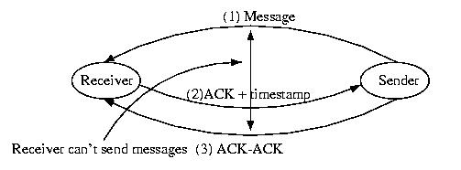
Sender-Based Logging, cont

