Slide 1
14-736: Distributed Systems
Lecture 13 * Spring 2019 * Kesden

Slide 2
What Are Distributed File Systems?
Maybe we’d better start with what are file systems?
Maybe we’d better start with what are files?
A file is a unit of data organized by the user. The data within a file isn't necessarily meaningful to the operating system. Instead, a file is created by the user and meaningful to the user. It is the job of the file system to maintain this unit, without understanding or caring why.
Contrast this with a record in a database, which is described by a schema and upon which the database enforces constraints

Slide 3
What Are Distributed File Systems?
Okay. We got files.
So, what are file systems?
A file system is a service responsible for managing files. File systems typically implement persistent storage, although volatile file systems are also possible (/proc is such an example).

Slide 4
What does it mean to “Manage Files”?
Name files in meaningful ways. The file system should allow a user to locate a file using a human-friendly name. In many cases, this is done using a hierarchical naming scheme like those we know and love in Windows, UNIX, Linux, &c.
Access files. Create, destroy, read, write, append, truncate, keep track of position within, &c
Physical allocation. Decide where to store things. Reduce fragmentation. Keep related things close together, &c.
Security and protection. Ensure privacy, prevent accidental (or malicious) damage, &c.
Resource administration. Enforce quotas, implement priorities, &c.

Slide 5
What Are Distributed File Systems?
Got files.
Got file systems.
Well, it is a type of file system, which means that it is a file system.
The distinction isn't what it is or what it does but the environment in which it does it.
A traditional file system typically has all of the users and all of the storage resident on the same machine. A distributed file system typically operates in an environment where the data may be spread out across many, many hosts on a network -- and the users of the system may be equally distributed.

Slide 6
Goal of a General Purpose Distributed File System (DFS)
A general purpose distributed file system should appear to the user as if a local file system
Users shouldn’t have to worry about details such as
Where files are located
How to identify the locations
How many replicas there are
If the replicas are up to date
What happens if part of the system fails, e.g. partitioning, host failure, etc.

Slide 7
Why Might We Want A General Purpose Distributed File System?
More storage
More throughput
More robustness from host and storage failure
More robust from environmental hazards
Faster access, e.g. closer to users
Etc.

Slide 8
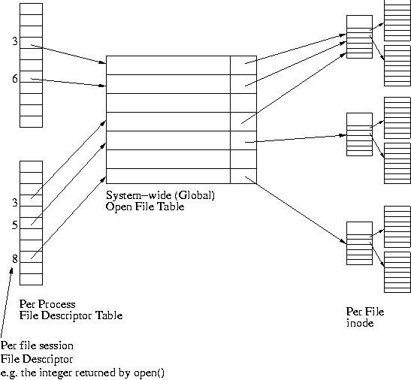
Recall, For Example, UNIX-Style FilE sYSTEMS

Slide 9
UNIX-Like File Systems, COntinued
“Virtual File System (VFS)”
File system, inode are base classes
Known as “Virtual file system (VFS)” and vnode
Specific implementation is derived type
Implementation may be legit OO, e.g. C++
Or, implementation may, for example, ugly C with unions, etc.
Implementation abstracted from interface
Distributed File Systems can be just an alternative implementation for storage

Slide 10
General Purpose Distributed File System
Maintain same naming system
“Mount” in UNIX
“Map” in Windows, etc
Just change storage layer to use network and manage errors

Slide 11
NEtwork File System (NFS) “Early Versions”
Not a DFS
Simply central storage accessed via network
Client made requests on per-block basis
“Stateless server”
No client caching
Turned out to be too painful
Clients cached anyway
Just accepted staleness for a while since no way to validate
Evolved over time into DFS with support for caching

Slide 12
AndreW File System (AFS) “Our Friend”
Stateful server
Callback mechanism
Invalidates client caches upon change, but in use copies unaffected
Whole-file semantics
Modified to move blocks in version 2.x (when it left CMU and went to IBM)

Slide 13
Coda
Extension of AFS Project
Added replication
Added weakly connected mode: One server replicates on behalf of client
Added disconnected mode: Uploaded and resolved by client later
Hoard demon: Pull whole files needed for later
Spy: Figure out which files to hoard.
Client-side resolution
“Insert CVV discussion again here”

