Slide 1
14-736:
Distributed Systems
Lecture 12 * Spring 2019 * Kesden

Slide 2
Why Replicate Data/Objects/Etc?
Increased Throughput/Bandwidth/Parallelism
Increased Fault Tolerance (Independent Failure)
Increased Fault Tolerance (Local Risk)
Improve latency by storing content closer to distributed consumers, e.g. toward edges
Etc.

Slide 3
1st Class RePlicas Vs 2nd ClaSs Replicas
1st Class Replicas
Copies of the original, equal to the original
Common for file servers, databases, etc.
2nd Class Replicas
Derivable from the original
Lower fidelity in some way
  Caches (possibly stale)
  Thumbnails (lower resolution, faster to transmit, smaller to store)
  Compressed copies (slower to access, harder to update)

Slide 4
Assumptions for today
1st Class Replicas
One-Copy Semantics
  Reads and writes operate as if they are acting upon a single, non-distributed data store
  Perspective is one of reading and writing objects vs edits
  But, edits can be viewed as reads and writes of whole blocks/units within store.
Concurrency control remains important.
  Insert prior discussion here
  We are just going to “assume” it to exist, since we’ve already studied it.

Slide 5
Quorums: How many copies to read/Write?
Replica #1
Replica #2
Replica #3
Replica #4
Replica #5
Read quorum: Number of server from which a reader should read
Write quorum: Number of servers to which a writer should write.
Is there a relationship between these two?
Can we tune them to achieve different goals?

Slide 6
Thinking About QUorums
Replica #1
Replica #2
Replica #3
Replica #4
Replica #5
Do multiple versions exist? If so, how can we recognize the most up-to-date version?
How many replicas do we need to read to get the most up-to-date version?
How many replicas should we write? Read?
Are the answers to these questions related to each other?
Are the answers to these questions related to other goals?

Slide 7
Conflicts
Goal of quorums is to avoid conflicts
Writes cause conflicts
  Write-Write
  Write-Read
Reads don’t cause conflicts
  Read-Read is safe

Slide 8
R + W > N
The read quorum and the write quorum must overlap
  Why? Without overlap, reads could miss write and get old value
  R + W > N
Can rewrite R+ W > N
  R > N –W
  W > N – R
Requires the ability to identify the most recent version from among those read, e.g. by version number or timestamp.

Slide 9
Tuning Quorums
Greater write quorum
  More redundancy for robustness
  Greater throughput
  More local to consumers
  Higher write cost (Network and device throughout, contention, long tail, etc)
Lower read quorum
  Lower cost to read (Network and device throughout, contention, long tail, etc)
  More choices about where to read (closer to user)
  More expensive writes (But reads are usually more common)
Greater overlap
  More tolerance to failure

Slide 10
Examples OF Valid QUORUMS
Replica #1
Replica #2
Replica #3
Replica #4
Replica #5
Read any 1
Write all
Read all
Write one
Read 3
Write 3

Slide 11
Examples OF Valid QUORUMS
Read-1/Write-All
Replica #1
Replica #2
Replica #3
Replica #4
Replica #5
Write-All/Read-1
Replica #1
Replica #2
Replica #3
Replica #4
Replica #5
Read-3/Write-3
Replica #1
Replica #2
Replica #3
Replica #4
Replica #5
Key
Read
Write
Read+Write

Slide 12
Examples OF INValid QUORUMS
Replica #1
Replica #2
Replica #3
Replica #4
Replica #5
Read 1
Write 1
Read 3
Write 2
Read 2
Write 2

Slide 13
Examples OF INValid QUORUMS
Read-1/Write-1
Replica #1
Replica #2
Replica #3
Replica #4
Replica #5
Read-3/Write-2
Replica #1
Replica #2
Replica #3
Replica #4
Replica #5
Read-2/Write-2
Replica #1
Replica #2
Replica #3
Replica #4
Replica #5
Key
Read
Write
Read+Write
Unused

Slide 14
Most Common: Read-1/Write All
Read-1/Write All is most common
Reads are more common than writes
  Read gets most current data (requirement)
  Reads can choose any replica (nearby, failure, etc)
  Reads require low bandwidth
  Reads protected from long tail, etc
  Makes common case safe and fast.

Slide 15
Version Numbers
It isn’t good enough for a read to simply get the most recent version among multiple versions it might see.
  It must be able to tell newest version is sees from older versions
Solutions:
  Version numbers, use highest (Easiest answer)
  Update all versions, so they are the same, e.g. Read-All/Write-One
  Overlap more: Guarantee majority of read quorum will have newest version (Surprisingly painful)

Slide 16
Overlaping More Is Painful (Vs Version Numbers)
Overlap must be a majority of read quorum
  Must write to majority of read quorum, plus
  Must write to all members not a part of read quorum
  W > (R/2) + (N-R), which simplifies to
  W > (N - R/2)
  Hope for no failures, or overlap even more
Replica #1
Replica #2
Replica #3
Replica #4
Replica #5
Key
Read
Write
Read+Write
Unused

Slide 17
Quick Note About Locking
Repeat for emphasis: Prior discussion about concurrency control applies here
Uncontrolled concurrent writes can break quorum discipline (and maybe even corrupt data)
  Also could break version number increment
What to lock?
  Object at servers, not whole servers
How many to lock?
  L >= R: Lock quorums must cover the most recent version, or it could get an updating version
  L > =W: Lock quorums must cover everything being written to protect version number and data
  L > MAX (R,W): More specifically, L must be large enough so it blocks reads and writes of the updating object. Can be relaxed to cover just writes if reading outdating version is okay.

Slide 18
What about failure?
If covered by overlap, no problem, e.g.
  R + W – F > N (Assuming version numbers)
  W + R/2 –F > N (Assuming no version numbers)
  Still guaranteed to see up-to-date version
If not covered by overlap, the failure model becomes important

Slide 19
Voting with ghosts
(van Renesse, Tannenbaum)
If (by magic) we can assume that a dead host is distinguishable from a partitioned host…
  Or that non-participating partitioned hosts know they are assumed to be “dead” (even more magical)
If….we can count “ghost” of “dead” hosts toward write quorum
This is basically like using a smaller N for the quorum
  Writes are forced into a smaller set of hosts
  Writes must only overlap within that set of hosts
Doesn’t work if can’t meet read quorum since only copy could be on “dead” host
  Consider write-one/Read-all
Requires that reincarnating hosts get updates before coming online, since effective quorum will expand.

Slide 20
Voting with ghosts
Tannenbaum, Van Renesse
Replica #1
Replica #2
Replica #3
Replica #4
Replica #5
Read-3/Write-3
Replica #1
Replica #2
Replica #3
Replica #4
Replica #5
Read 3
Write 3
Note that reads still necessarily see most recent version.
Key
Read
Write
Read+Write
Unused

Slide 21
Static Quorums, Generally
Static quorums are consistent, pre-defined quorums, such as those we are discussing
  As compared to those that may be adaptive, e.g. view-based, that we are not discussing
So far, we have counted each replica equally
  one replica = one vote
  This is not a requirement
We can assign different weights to different hosts
  Quorum rules still apply, just account for weights not replica counts (as replicas may have different weights)
Examples:
  More weight to more reliable hosts
    It takes more replicas to less reliable hosts to result in the same robustness
  Don’t count caches
    They can go away.

Slide 22
Coda Version Vectors (CVVs)
(Quick Refresher, In Context)
Each CVV contains one entry for each host server. Each entry is the version number of the file on the corresponding server. In the perfect case, the entry for each replica will be identical. But, should an update reach only a portion of the servers, some servers will have newer versions than others.

Slide 23
Coda CVVs and Client reads
In Coda, the client request a file via a three-step process.
It asks all replicas for their version number
It then asks the replica with the greatest version number for the file
If the servers don't agree about the files version, the client can direct the servers to update a client that is behind, or inform them of a conflict. CVVs are compared just like vector timestamps. A conflict exists if two CVVs are concurrent, because concurrent vectors indicate that each server involved has seen some changes to the file, but not all changes.

Slide 24
Coda cvvs and client writes
In the perfect case, when the client writes a file, it does it in a multi-step process:
The client sends the file to all servers, along with the original CVV.
Each server increments its entry in the file's CVV and ACKS the client.
The client merges the entries form all of the servers and sends the new CVV back to each server.
If a conflict is detected, the client can inform the servers, so that it can be resolved automatically, or flagged for mitigation by the user.

Slide 25
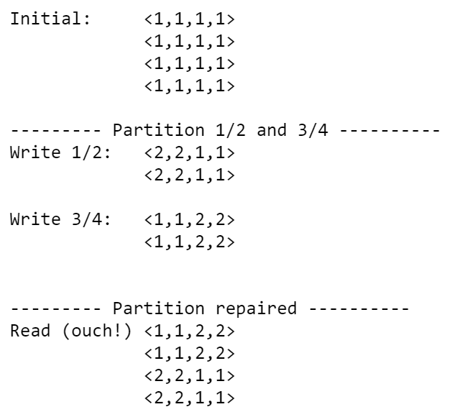
Coda CVV Example

