Slide 1
14-736: Distributed Systems
Spring 2019 (Kesden)

Slide 2
Socrative
https://api.socrative.com/rc/9754eN

Slide 3
Course Description
This course explores both foundational and contemporary topics in distributed systems, such as communication, coordinating time, synchronization, consensus, impossibility of agreement, replica management, file systems, distributed SQL and noSQL databases, CAP, ACID, BASE, distributed hashing, anonymous communication, models of computation, and higher-level tools. The course project work focuses on the implementation of scalable, fault-tolerant distributed systems.
In other words: We learn how to cooperate in an environment where communication is constrained and resources are partitioned.

Slide 4
Meeting Times
Lecture: 5:00pm -6:20pm ET Mondays and Wednesdays(CMU-PGH CIC-DEC)
Lecture: 2:00pm -3:20pm PT Mondays and Wednesdays (CMU-SV B23-118)

Slide 5
Textbook
There are a ton of good resources to support learning. One of my favorites is Wikipedia.
Some people like textbooks. There are plenty of good ones out there. My present favorite is:
Tanenbaum and Van Steen, Distributed Systems: Principles and Paradigms, Creative Space Publishing, 2006.

Slide 6
Gregory Kesden
http://www.andrew.cmu.edu/~gkesden
gkesden@andrew.cmu.edu
412-268-5943 (Forwards to cell, 24x7)
412-818-7813 (Cell, direct)
gkesden@skype, gkesden@Hangouts/GChat, gkesden@Messenger, etc
Office: INI 124 (Henry Street)
Office hours: http://www.andrew.cmu.edu/~gkesden/schedule.html
I’m here to help! Contact me any time!

Slide 7
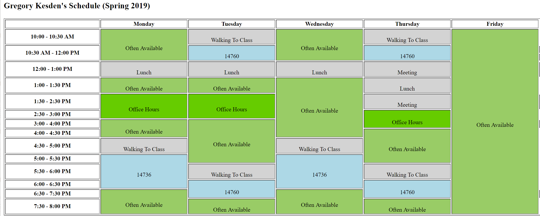
http://www.andrew.cmu.edu/~gkesden/schedule.html

Slide 8
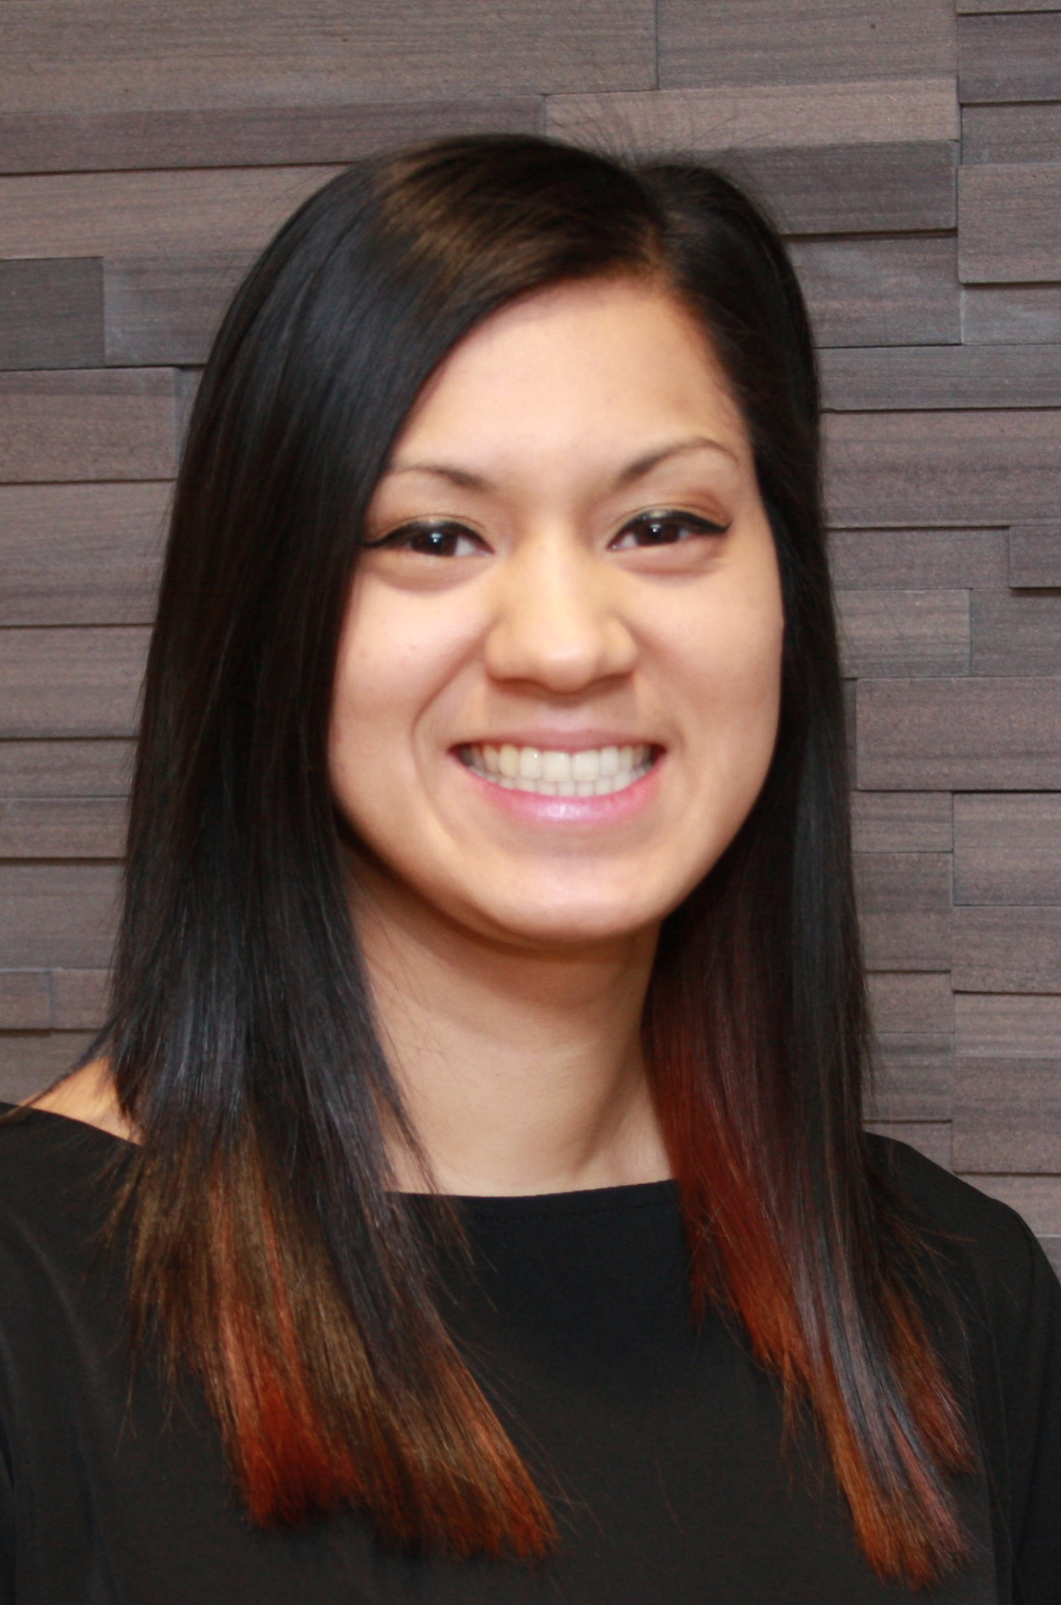
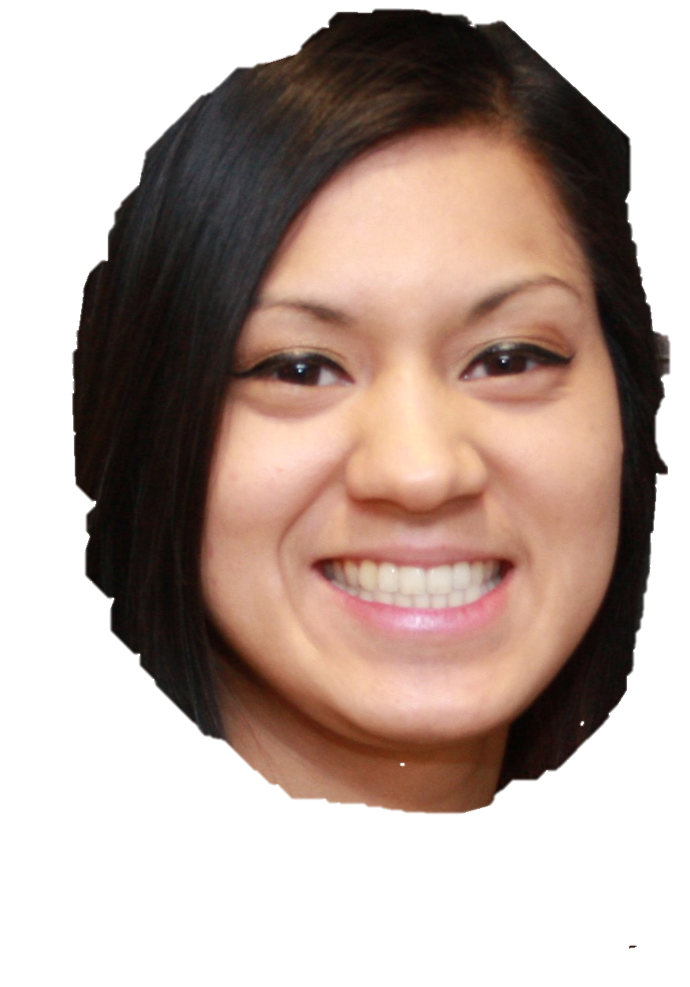
Lion Guarding My Office
(Hint: She’s actually really
Helpful and friendly and
will gladly buzz you in and
Help you find my office)
Emory Sen
INI Receptionist

Slide 9
Teaching Assistants
Saksham
Mingjie “Jack” Zhao
Office hours: TBA
Email: staff-736@lists.andrew.cmu.edu

Slide 10
Online Resources
Website: Course schedule, materials, announcements, etc
http://www.andrew.cmu.edu/course/14-736-s19/
Canvas: Used for turning in work
https://www.cmu.edu/canvas/
Piazza: Used for discussion among fellow students
https://piazza.com/class/jqwv0skcspj72e
Email list: Used to get rapid answers from course staff
staff-736@lists.andrew.cmu.edu

Slide 11
Assignments and Grading
Exams: 45% (midterm and final count equally, 22.5% each)
Homework: 10% (All homeworks count equally, 2.5% each)
Project: 45% (All projects count equally)

Slide 12
Important note ABOUT GRADING
Because of the importance of understanding both the theoretical and hands-on elements of systems, students must pass all three components of the course (homeworks, exams, and the projects) in order to receive a passing grade for the course. This does not affect the actual letter grade assignment unless one of the components is not completed to a passing standard.

Slide 13
Homework
Homework questions will be released alongside lecture materials, such as slides and notes.
You should do them as part of your continuous review of lecture materials and other studying.
The questions will be collected and graded four times during the semester.
The goal is to help you to consistently engage with the material, your peers, and the course staff, rather than giving you the work all at once periodically, which is less valuable for learning and more challenging for time management.

Slide 14
Exams
Midterm: About 1 hour (80 minute period)
Final exam: About 1 hour (80 minute period)
Last class period
Not intentionally cumulative, but some material naturally builds.
The exams are designed to be completed in about an hour during a 1.5 hour exam period.
Sample exams will be released.
But, they will be released very shortly before the exam to provide a mechanism to put you at ease with the question format and tune-up your studying.
They are not intended as study guides or resources

Slide 15
Projects (Tentative Plan, May Change)
RMI Facility
Raft Consensus and Key-Value Store
Distribute File System
Block Chain Ledger

Slide 16
Grade Corrections
Please bring any grading concerns to the staff’s attention ASAP
Help learn material and expectations
Get points back
No harm in asking!
Staff reserves the right to decline to award points if request isn’t timely (see syllabus)
See syllabus for details.
Policy isn’t invoked very often. We like correcting our mistakes and helping you learn!
But, can be used to redirect “learning-free threshold pushing” when folks are tired and grade-focused at the end of the semester.

Slide 17
Collaboration/Academic integrity
If you turn it in, we expect you did it by yourself unless you attribute the work to others
Credit all persons and resources consulted or involved. Always.
Use of resources other than those permitted for the project may result in grade penalties
Use of uncredited resources, permitted or not, may result in an Academic Integrity Violation
AI violations come with potential grade penalties, as well as program and institutional sanctions
AI violations result in automatic loss of scholarship for INI students
Any questions? Just ask!

Slide 18
Late Work?
5 “Late Days”
Spend as you choose, whole days only
Can’t share with partner (but can fork and turn in separately, appropriately documented)
Not “Procrastination days”. Covers trips, illnesses, etc.
Major life event?
Speak with your academic advisor, faculty advisor, student life representative, or other student official ombudsman-type. We’ll work it out from there.

Slide 19
Electronically mediated communication
No electronically mediated communication in class (email, Web surfing, etc)
Includes course web site, Piazza, Canvas, related resources on Web, etc.
Bring paper and pen/pencil.
If there are violations, electronics won’t be permitted
We may experiment with Socrative or other interaction tool.
When explicitly permitted, and only as explicitly permitted, such things are okay.

Slide 20
Recording Prohibited
No audio or video or other high-fidelity recording of class is permitted
This is to protect student privacy
Audio and video may be recorded incidental to the telecast across campuses from CMU-PGH to CMU-SV and vice-versa.
These recordings will not necessarily be available to you
They might, or might not, be made available a few days before exams
This depends upon attendance. If attendance is low, they likely won’t be made available.
They may be made available only to those who regularly attend class, etc
If, how, and when to release such recordings is up to the instructor
These recordings may not be used other than via the official players
They may not be separately archived, transmitted, etc.

Slide 21
Most Important thing: Your well-being and happiness
Everyone gets crunched sometimes! Everyone!
Take care of yourself, Watch out for friends
Take breaks to get perspective. Get sleep. Eat well. Exercise. Socialize. Etc. Use available resources
Counseling and Psychological Services (CaPS)
412-268-2922, https://www.cmu.edu/counseling/
RE:SOLVE Crisis Network
888-796-8226, http://www.upmc.com/Services/behavioral-health/Pages/resolve-crisis-network.aspx
University police:
412-268-2323
Faculty member (me or another), faculty advisors, academic advisors, student life staff, academic deans, student life deans, etc. It is a supportive community!
If you, or somebody you know, needs advice or support, it’s easy to ask: "Greg [or whomever], I think I’d like some advice".

