Slide 1
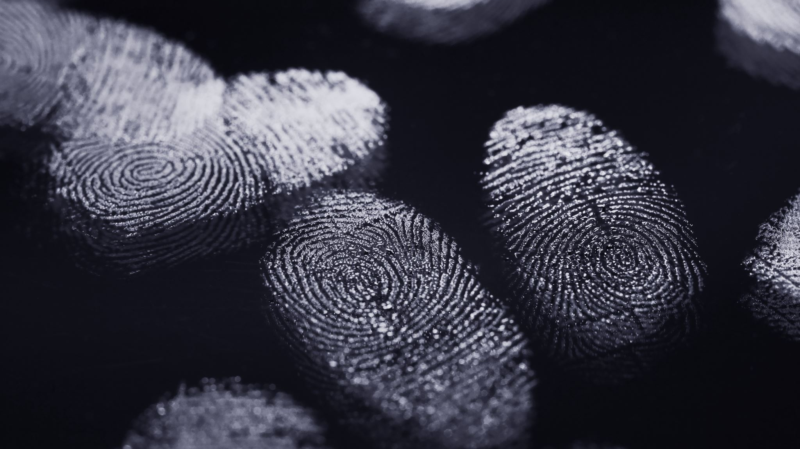
Self-Sovereign Identity
A Blockchain application

Slide 2
Major ProblemS with cloud computing
Each organization we interact with must store our personal information in massive databases. These ‘silos’ become gold mines to hackers and toxic liabilities for anyone obligated to store the data.
People have hundreds of online personas at hundreds of organizations.
If you need to change your address or update a credit card, you need to deal with each of these hundreds of systems in turn.
People maintain many passwords to interact with many systems.
Password managers to the rescue.

Slide 3
Federated Identity
Concerns:
Controlled by others
Surveillance
Censorship
Only low impact use case
e.g. Not healthcare
Alice
1
3
4
Facebook
Dating Site
2
5

Slide 4
Self-sovereign Identity
DMV
1
Alice
Tavern
3
2
Credential
Credential

Slide 5
Siloed identity also leaves serious problems for organizations
Expensive in terms of fraud related expenses
Organizations are forced to become identity providers and security experts
Data breaches cause embarrassment and loss of trust
Greater security may reduce the quality of user experience
Compliance is an issue (KYC/AML, HIPAA, GDPR)
Billions of dollars in fines levied annually

Slide 6
we already use Self-sovereign identity Offline
An offline example that illustrates the flexibility that we desire. Online identity is much more complex.
You carry a wallet or a purse containing credentials from various third parties.
These credentials are typically hard to forge and easy to authenticate.
A driver’s license may be presented to a police officer during a traffic stop or to a bartender to show you are old enough to drink.
A CMU ID (based on MIFARE from NXP uses NFC within 10 cm) may be presented to an instructor to show you are eligible to take an exam or placed on a reader in a bus to show your organization has paid for the ride.
See: https://www.nxp.com/video/tap-into-mifare:TAP-INTO-MIFARE
It is up to the verifier to decide whether the credentials are acceptable. The instructor or bus reader decides.
People trust that CMU and the Department of Motor Vehicles are careful in how and to whom credentials are provided.

Slide 7
Self-sovereign identity offline
Consider the bar example.
The bar has no legal contract, business relationship, or technical integration with the department of motor vehicles. The bar does not get anyone’s permission – they just ask you for your license. The person they are trying to authenticate and authorize gives them the credential.
The offline world makes use of decentralized credentials that are granted to and then conveyed by the person they’re about.
Get once and use many times.

Slide 8
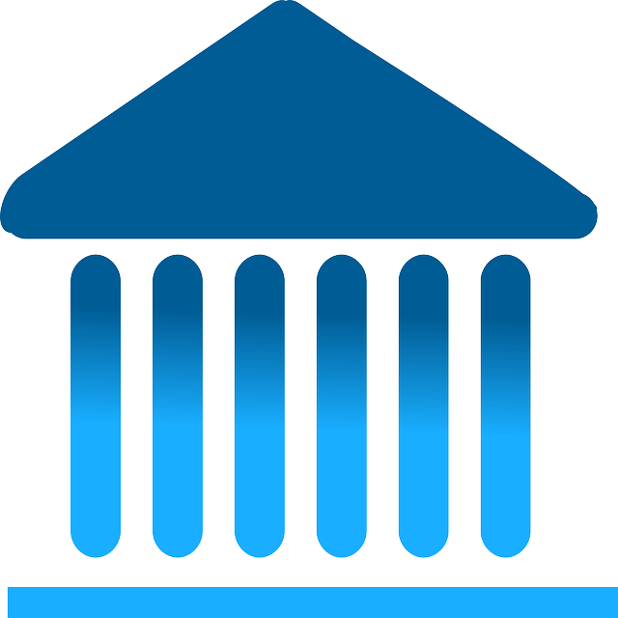
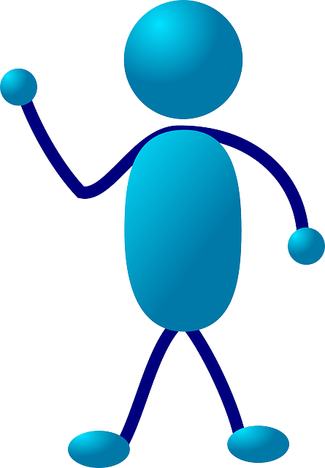
Self-sovereign identity online
We want people to prove things about themselves using decentralized, verifiable credentials - just as they do offline.
To “countersign” is to add a signature to a document already signed by another person.
DMV holds
private key(s)
You hold your
private key(s)
Claim Issuer
Signs claims – public key available on a blockchain
Claim Holder
uses wallet to
countersign claims – public key available on blockchain
Claim Verifier
Uses signatures available on the blockchain to
Verifies claims
Bar
Issue claims
Present claims
Public Blockchain (verifiable data registry)

Slide 9
Self-sovereign identity
Suppose that every time that you receive a paper credential, you receive a digital one as well.
This digital credential is given to you and not provided to some third party. It is you who shows it to others.
Any person or organization can issue claims. For example, a utility company can issue a bill to you.
The bill may be used to “prove” you live at a location – the PA DMV requires this to get a driver’s license.
You now have a driver’s license – the claims are accumulated and held by you.
You can store any claims that you want in your wallet.
Claim verifiers are able to choose what claims they trust and request those from you.
Since you hold your private key, you can prove to the verifier that you are in possession of the private key
that goes with the claim.

Slide 10
Self-sovereign identity key features
Persistent: An identity that can be taken away is not self sovereign. Identifiers are long lived, non-reusable and owned by the person who creates them. Organizations and connected things also need them, and can use the same infrastructure as individuals.
Peer-to-peer and not client-server.
Privacy protecting.
Portable and interoperable.
Do things have credentials?
Inspection sticker
License plate
Water heater inspection
URL beacons (signed)

Slide 11
New digital credentials May be combined with Zero Knowledge proofs
These assertions are verifiable without revealing details:
I am a citizen of France.
I am over 21.
I am allowed to enter this country.
I am allowed to board this plane.
I am allowed to sit in business class.

Slide 12
The verifier or relying party has the following concerns
Suppose Y provides to V a credential making statements S , from issuer X.
Did the credential really come from issuer X?
Was the credential provided to Y and not Z and, perhaps, stolen from Z?
Have any of the statements S in the credential been altered?
Has the time limit expired on this credential?
Has the credential been revoked by X?
You may not want V to have to talk to X. That gives X information about you that you may not want to share with X.
For example, you may not want the passport authority to know who you show your passport to. Avoid correlation.

Slide 13
The verifier needs to verify without contacting the issuer
How is this done?
The issuer puts public key information into a store.
The verifier reads that information and uses it to verify the credential.
Best if the store is not run by a single organization.
The store should be tamper resistant and tamper evident.
The store needs to be chronologically ordered – you have the most recent additions.
We need a blockchain to hold the store. That is all the store is used for.

Slide 14
No more user names and passwords
Every relationship you have is separate and unique. Compare this with the way you pass out your single phone number. A single phone allows for correlation.
All the credential sharing occurs off ledger – on the edge. This scales well.
Once you have a credential from the bank, you no longer need a user name and password. To log in , just provide the credential and you can prove you have the associated private key.

Slide 15
What will improve with dids and verifiable credentials
Onboarding new customers becomes fast
Each of your customers has a secure, direct, connection to you.
You can check that each customer is genuine.
No more ID’s and passwords.
No more fraudulent card payments.
You can send each customer verifiable digital receipts.

Slide 16
Existing ONLINE systems and STANDARDS
Each of these supports decentralized, self-sovereign identity but differ in how claims are issued and presented.
Sovrin
uPort
Veres One
Microsoft Identity Overlay Network
Standards for decentralized identifiers and verifiable claims are being developed to provide interoperability.

Slide 17
INTRODUCING sovrin
The Sovrin Network is the first public-permissioned blockchain designed as a global public utility exclusively to
support self-sovereign identity and verifiable claims. Recent advancements in blockchain technology now allow
every public key to have its own address, which is called a decentralized identifier (DID)
Drummond Reed and Manu Sporny are both associated with SOVRIN
The SOVRIN Foundation is a non-profit.
Currently, we lack an easy, secure, standardized system for a person to collect, hold, and ultimately present trustworthy,
verifiable credentials online.
Currently, the internet lacks a universally available digital identity system that lets individuals collect, hold and present
any credentials they want, to whomever they want, whenever they want– without the reliance on a third-party managing
access.
Hyperledger Indy(Linux Foundation) is the blockchain built by Sovrin.

Slide 18
INTRODUCING sovrin
Sovrin is a hybrid - public and permissioned and open source. Aries and Ursa are spin offs from Sovrin.
Aries is all about agents – phones, wallets.
Ursa is the crypto library.
Permissioned means that the network nodes that ensure consensus of transactions on the ledger are governed,
in this case by the non-profit ​Sovrin Foundation​.
The Sovrin Identity Network (SIDN) consists of multiple, distributed nodes located around the world. Each​ has a
copy of the ledger. Nodes are hosted and administered by stewards.
One of the major concerns with identity is c​orrelation. If Jane were to use one identifier in multiple places, those
places might collude to correlate that identifier and amass significant data about her without her permission. Sovrin
avoids this by allowing Jane to use a different identifier with everyone she relates to.
Jane has a relationship with her bank. She shares a verification key, A, with the bank that she created specifically for
this relationship. This key represents Jane's identity to the bank and can be used to verify any interactions that they have.
The bank also has its own key, K. This is a well-known key that represents the bank to the world. Jane would also have a
copy of that so that she can validate communications she has with her bank. The verification keys of both Jane and the bank
are found on Sovrin

Slide 19
SOVRIN
The local government would create a claim definition that describes a driver's license claim. A claim includes a reference to the definition so
that anyone to whom you present your driver's license to can look up its definition and make sense of it.
Claims can be reused and tailored to the applied purpose at hand using disclosure proofs. Disclosure proofs allow claims to be used without disclosing unnecessary information about the subject.
You can combine the verifiable claims from your school and government along with information you have self-asserted into a disclosure. You
can pick the attributes you want to share from each of these without disclosing the entire claim.
You would use a master secret, a special key, to create the disclosure using a zero-knowledge proof algorithm. The disclosure proof links the attributes so that a potential employer, for example, knows that they were made about the same person.
An employer can verify each of these attributes were asserted by the party who makes the claim. The employer has a verification key from you that allows them to validate claims that you make about yourself. You can disclose additional details as the relationship with the employer progresses. While the algorithms behind this are complex, the user experience is simple and natural.
An important point about disclosure proofs is that they are non-correlatable. Suppose someone at the employer had a friend who worked in the local government. These two people couldn't collude to use the proof that you sent to the employer to discover additional information about you that the government holds. Neither
the proof nor the identifier the employer holds for you correlate to any identifier that the government holds and thus can't be used as a key to look you up in the
government's systems.

Slide 20
SOVRIN
Sovrin builds “Verity” for the enterprise
Sovrin builds connect.me - an app for Android and IOS.
Allows for you to store and verify credentials.
Allows for you to set up DID-based connections.
Expose bits of different credentials as a response to a proof request.
Visit try.connect.me to experience this with three organizations.
Experiment withevernym.com/early-access

Slide 21
INTRODUCING uport
Ethereum based
uPort's open identity system allows users to register their own identity on Ethereum, send and request credentials, sign transactions,
and securely manage keys & data.
See ERC 780 EIP (Ethereum Claims Registry) and ERC 1056 EIP (Lightweight Identity).
To verify the source of signed information, it’s essential anyone can lookup the corresponding public key i.e. via the Ethereum Claims Registry using a decentralized identity resolver.
The uPort SimpleSigner library allows trust anchors to privately sign attestations using the JSON Web Token (JWT) specification. By
using JWTs, instead of saving information on a public blockchain (ERC725) user’s private information can be kept confidential… and private.
The first instance of blockchains disrupting an existing vertical is currency. Currency is valuable for a number of reasons, and one core reason is scarcity. When you have an finite amount of something, it can be of value.
Anyone can easily generate a key-pair. In fact, that’s the feature that makes it self-sovereign — no third-party is required.

Slide 22
Introducing Veres one
When you sign up with a website, you typically create a username and a password. The website asks you for this information so that it can start to associate data with you.
The identifiers and data, however, are locked away on the site; they are not portable.
You must rebuild your identity information -- your identifiers and data -- from scratch on many different websites.
The result is a strong economic incentive for large data warehousing companies to store and sell your information, often without your consent.

Slide 23
Veres one
The Veres One Blockchain is a fit-for-purpose blockchain built specifically for Decentralized Identifiers.
Public - Anyone in the world may read and audit the entire contents of the ledger.
Permissionless - Any person or organization in the world may create and control their identifiers.
Leaderless - Blockchain consensus relies on leaderless elector collaboration, not proof of work, to determine when consensus has been finalized. Electors are selected dynamically to allow participants to join and leave the network and to ensure that there is no centralization or single point of failure for the ledger.
Based entirely on open standards and open specifications - Broad implementation and interoperability can only be achieved if all aspects of the system are documented and standardized in a non-discriminatory, patent-free and royalty-free manner while ensuring that the creators and maintainers of the system are properly funded.
Entities (people, organizations, and devices) use the Network to create and update decentralized identifiers and their associated metadata.
Entities may use the Veres One Network to create decentralized identifiers via software applications such as digital wallets. There are two mechanisms for creating Decentralized Identifiers on the Network. Both mechanisms require roughly $1 USD to perform, which is derived from the estimated cost of running the Network.

Slide 24
Introducing Identity Overlay Network (ION)
Microsoft: Today, we’re announcing an early preview of a Sidetree-based DID network, called ION (Identity Overlay Network), which runs atop the Bitcoin blockchain. May 2019
ION is based on an emerging set of open standards that we’ve developed working with many of our partners in the Decentralized Identity Foundation. This approach greatly improves the throughput of DID systems to achieve tens-of-thousands of operations per second.

