Slide 1
Lecture 4:
Immunology and Immunotherapies
Review of Antibody Response
Antibody based therapies for cancer (Final presentations)
Cell-based Response
Cell-based cancer therapy (Final presentations)
Vaccines & Vaccine development
Enzymes & Enzyme Inhibitors
Review of steady-state enzyme kinetics
Suicide inhibitors
Competitive inhibitors
Allosteric inhibitors
HIV drug therapy

Slide 2
B-Cell Biology - From Stem Cells to Pathogen Killing.
1. Generation of high diversity of chains during development of stem cells to B-cells in bone marrow.
DNA rearrangements to generate functional exons for variable segments of both light and heavy chain.
2. Molecular & cellular biology of membrane bound antibodies on cell surface = B-cell receptor (BCR)
Transcriptional enhancers, mRNA splicing
Light chain and heavy chain exported to surface of B-cells.
3. Self tolerance test to prevent autoimmune diseases, autoreactive B-cells eliminated.
4. Encounter and capture of antigen in lymph nodes
5. Activation of B-cells by T_{H} cells
Peptides from pathogen presented on major histocompatibility proteins (MHC II).
T-cell activation by tyrosine kinase receptors (T-cell Receptor, TCR), secretion of signaling molecules.
6. Development of
Plasma cells - Production of soluble antibodies of the same specificity as the parent B-cell.
B-memory cells (basis of immunity)
T-memory cells (basis of immunity)
7. Destruction of Pathogens
Fc region of antibody binds to Fc Receptor on NK cells, neutrophiles, macrophages
Pathogen internalized and destroyed.
BCR – B-cell receptor = antibody + signaling chains.
TCR – T cell receptor = MHC-peptide recognition + signaling.

Slide 3
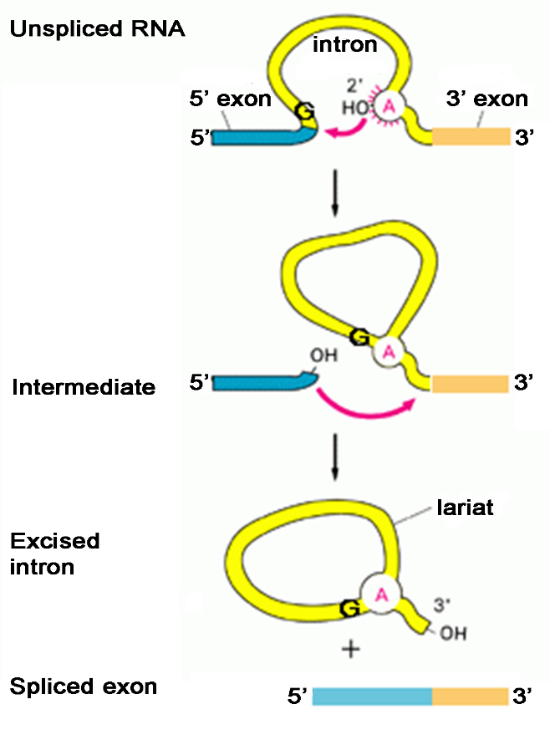
Antibody Genes are Modular – mRNA Splicing Required to Produce mRNA
Splice sites are recognized due to specific sequences at the exon-intron boundaries. Sequences in both the exon and intron are recognized.
When DNA sequences were aligned to RNA sequences, it was found that segments were deleted in the final RNA.
This suggested that the gene encoding a protein was coded by segments of the DNA:
Those to be in the final mRNA were called exons.
Those sections not in the mRNA were called introns (intervening sequences).
5’ splice site
3’ splice site
Branch Point
There is a 5’ splice site with a conserved sequence:
(A/C)AG|GU(A/G)AGU
There is a 3’ splice site with a conserved sequence:
CAG|G
There is an A in the intron (branch point) required for splicing.
Steps:
The branch A breaks at the 5’ splice site, forming a lariat.
The 5’-OH is joined to the 5’ end of the downstream 3’ exon.

Slide 4
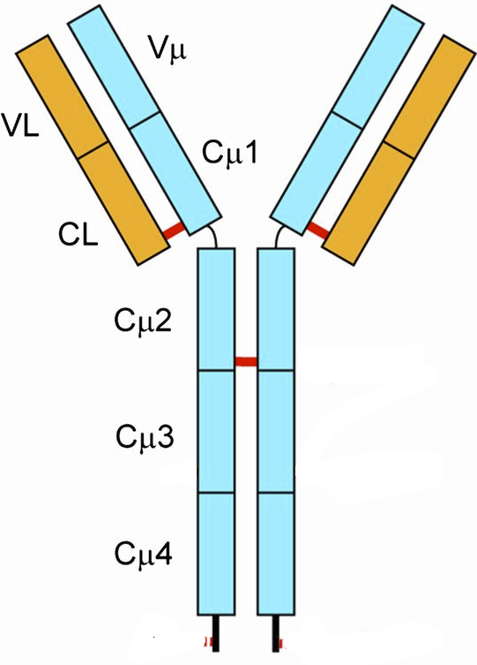
Antibody genes are assembled from DNA segments, giving many different sequences.
Production of Heavy Chain Gene:
V_{H} exon = V+D+J segment (selected at random)
The mRNA coding for antibodies contains 5 exons.
Germline/Stem cell DNA
←300→
D-J joining
Random selection of D & J segments
L = leader (signal)
V = variable segment
D = diversity segment
J = joining segment
V joining to (DJ)
Random selection of V-segment
Heavy chains have different V-sequences.
B-cell DNA
V_{H} exon differs from one cell to the next.
Heavy chains have the same constant sequences in all B-cells.
Stem cells -> B-cells
The exon that codes for the variable region of the heavy chain is generated by the random joining of a V, D, and J DNA segments.
Each B-cell will generate a unique sequence for its heavy and light chain DNA.
This is a permanent change to the DNA (genome) of the B-cell.
1. If there are 300 possible V-heavy segments, 10 possible D segments, and 6 possible J segments, how many different heavy chains can be made?

Slide 5
Light-chain genes are assembled from DNA segments, giving many different sequences.
Production of Light Chain Gene
Germline/Stem cell DNA
←100→
B-cell DNA
Light chains have different V-sequences in different B-cells.
Light chains have the same constant sequences in all B-cells.
Antibody Diversity
1. If there are 100 possible V-heavy segments and 5 possible J segments, how many different light chains can be made?
Stem cells -> B-cells
In the case of the light chain, the variable region is generated by VJ joining.
Each B-cell will generate a unique sequence for its heavy and light chain DNA.
This is a permanent change to the DNA (genome) of the B-cell.
2. If any possible heavy chain can pair with any possible light chain, how many different antibodies can be generated, assuming there are 10,000 possible heavy chains and 500 different light chains?

Slide 6
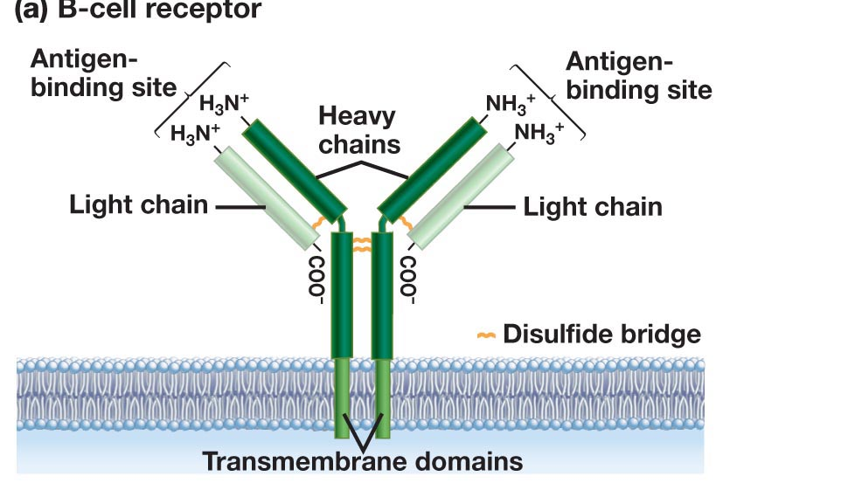
Antibody Production – From Stem Cells to B-Cells
Stem Cell
B-Cell
Rearranged light chain gene
Rearranged heavy chain gene
Transcription
mRNA Splicing
Translation
Export to cell surface (ER -> golgi -> Membrane)

Slide 7
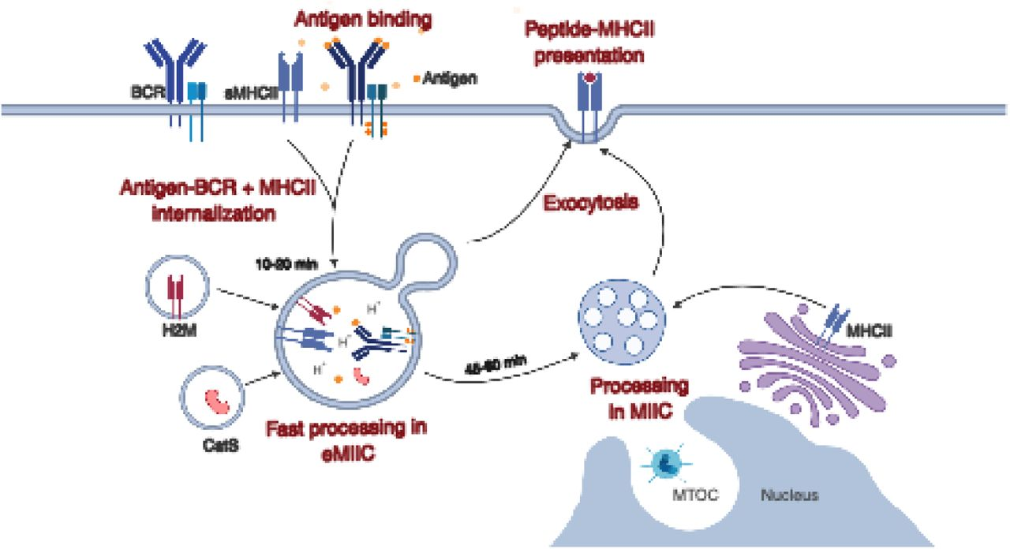
Antigen Capture by B-Cells - Endocytic Pathways
Antigen binds to variable domains of antibody on the BCR (B-cell receptor)
Antigen is internalized and digested into peptides
Peptides are loaded on to class II MHC for presentation to T-cells
Endocytosis of bacteria by a B-cell
Bacteria labeled with Green fluorescent protein.
Capture of the bacteria
Internalization (endocytosis)
Degradation of the bacterial proteins, producing peptides.
Journal of Cell Science doi: 10.1242/jcs.235192

Slide 8
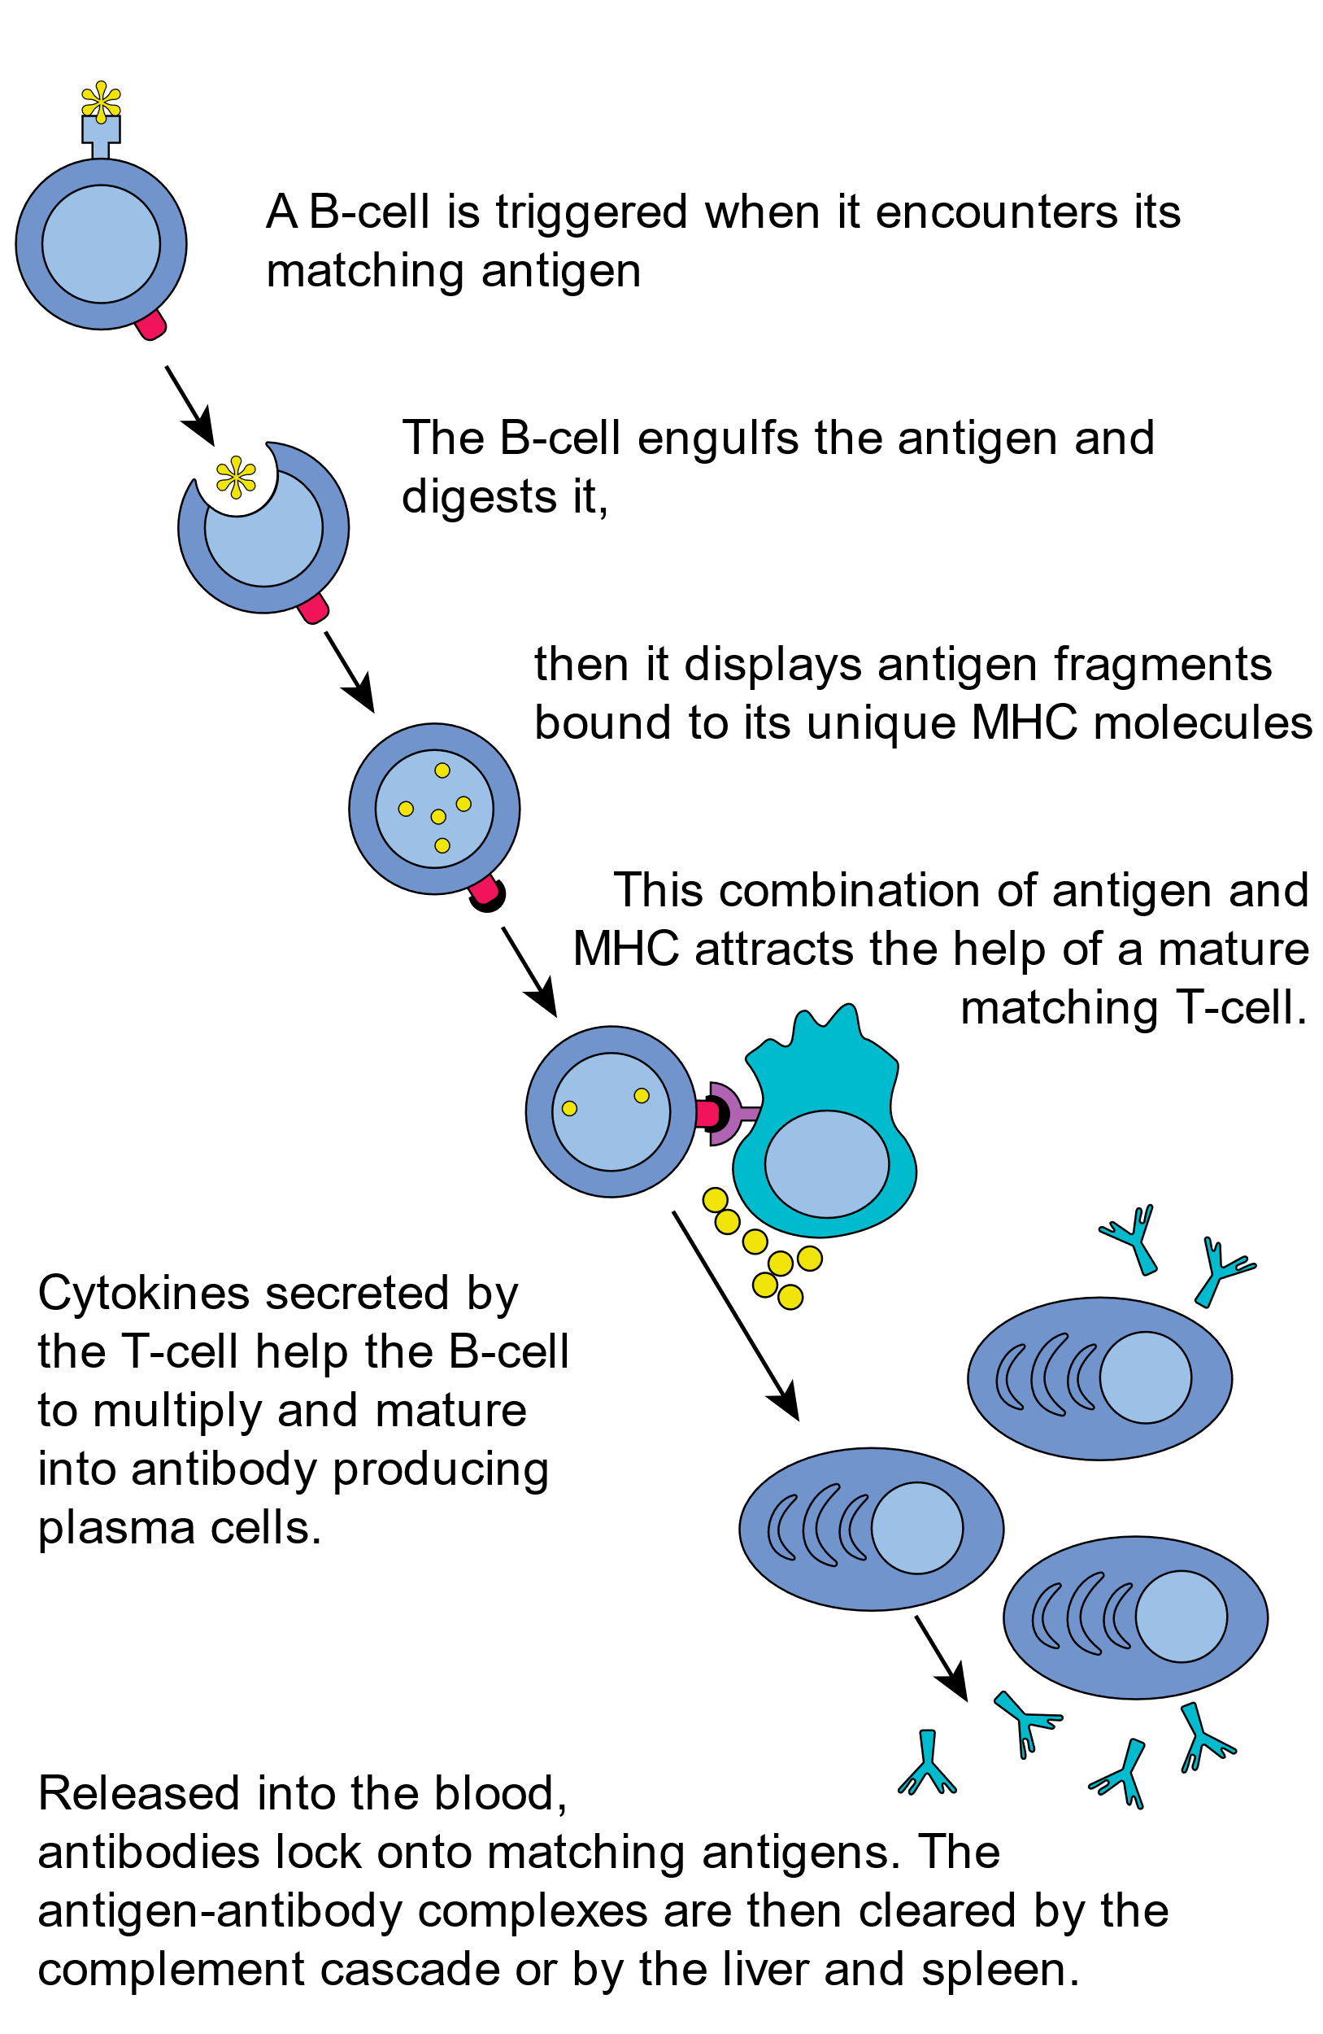
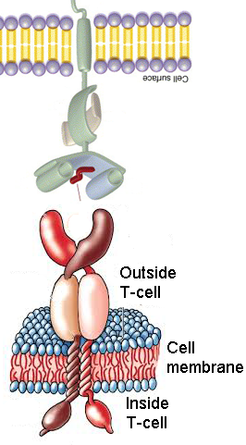
Activation of B cells by Antigen - Lymph Node
B-cells develop into antibody secreting plasma cells.
B and T-helper cells develop into memory cells, that are long-lived and are quickly activated by the same pathogen. This is the basis of vaccination.
(e.g. carbohydrate on bact. cell wall)
B-cell
MHC II - Major histocompatibility complex
Peptide from pathogen
(foreign peptide)
T-cell Receptor (TCR)
T_{H} cell
Events:
Recognition of MHC II-peptide by TCR
Tyrosine kinase signaling in T_{H} cell
Cytokines (protein messengers) produced.
Cytokines activate B-cells.
Soluble antibody from plasma cells has the same light and heavy chains as the original B-cell.
Membrane anchors are missing, so antibody is secreted outside the cell.

Slide 9
Can you:
Describe how the genes for the heavy and light chain are generated, and how this give rise to many different antibodies?
Do you understand the process of B-cell activation, including presentation of foreign peptides on MHC II and the role of the T-helper cell.
Describe how antibodies inactivate pathogens?

Slide 10
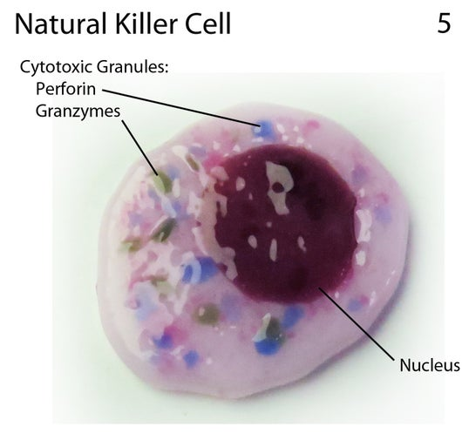
Cell Based Immunology
Key Questions:
1. How does your immune system fight viruses?
2. How does your immune system detect and destroy cancer cells?
3. How can the immune response be engineered to fight cancer?
T_{C}
T_{CTL}
Activation of Tc cells requires:
Recognition of foreign peptide on MHC I.
Assistance from T-helper cells.
T_{C} Memory
Cell Types:
Innate
Natural Killer (NK) cell
Acquired
T_{H}
T_{C}, T_{CTL}
Activated Tc cell becomes a cytotoxic T-lymphocyte T_{CTL}
T_{CTL}
Kill virally infected cells
Kill cancer cells
NK: Innate
Kill virally infected cells
Kill cancer cells

Slide 11
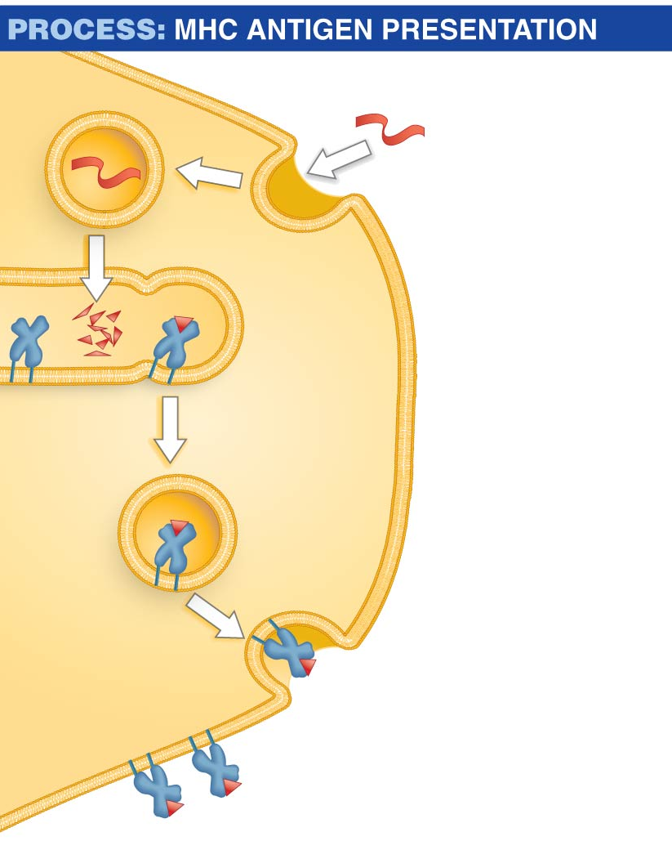
Dendritic cells acquire antigen from viruses and cancerous cells, activating T-cells
Antigen
1. Dendritic cell ingests antigen via phagocytosis (intact virus, cell debris from cancer cell).
Peptide
fragment
2. Enzymes break antigen proteins into peptide fragments.
Major
histocompatibility
(MHC) protein
Endosome
3. Peptide fragments are loaded onto both class I and class II MHC proteins in endosomes.
4. MHC I & II –peptide complex is transported to cell surface.
Dendritic cell
MHC protein
5. MHC protein presents peptide fragment on cell
surface.
Peptide
fragment
Notes:
At first, cells known as dendritic cells attack the antigen
The dendritic cells contain proteins called MHC (major histocompatibility) proteins, antigen-presenting proteins that have a groove where small peptide fragments, typically 8 to 20 amino acids in length, bind
There are two MHC classes:
​Class I MHC proteins bind antigens inside the ER
​Class II MHC proteins bind antigens inside endosomes
Dendritic cells process protein antigens and load the peptide fragments onto class II MHC proteins:
Dendritic cells ingest antigens present at the wound
The antigen is moved from the phagosome to an endosome, where enzymes breakdown antigens
Some of the peptides are bound to the grooves of class II MHC proteins
The MHC–peptide complexes are exported from the endosomes and transported to the cell surface
The MHC–antigen complex is displayed on the cell surface

Slide 12
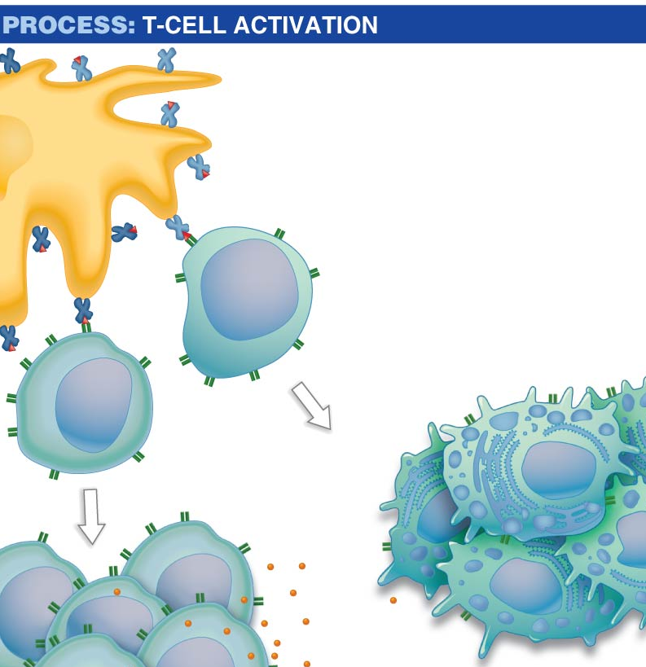
Dendritic cells acquire antigen from viruses and cancerous cells, activating T-cells
Activation of Tc cells requires:
Recognition of foreign peptide on MHC I by TCR on Tc cell
Assistance from T-helper cells via secreted messengers (small proteins called cytokines)
Only foreign proteins on self-MHC are recognized by T-cells
Dendritic cell
Class I MHC
+ peptide
Class II MHC + peptide
T_{H} interaction
1
T_{C} cell
Cytotoxic T cells
=T_{CTL}
T_{H} cell
2
Notes:
At first, cells known as dendritic cells attack the antigen
The dendritic cells contain proteins called MHC (major histocompatibility) proteins, antigen-presenting proteins that have a groove where small peptide fragments, typically 8 to 20 amino acids in length, bind
There are two MHC classes:
​Class I MHC proteins bind antigens inside the ER
​Class II MHC proteins bind antigens inside endosomes
Dendritic cells process protein antigens and load the peptide fragments onto class II MHC proteins:
Dendritic cells ingest antigens present at the wound
The antigen is moved from the phagosome to an endosome, where enzymes breakdown antigens
Some of the peptides are bound to the grooves of class II MHC proteins
The MHC–peptide complexes are exported from the endosomes and transported to the cell surface
The MHC–antigen complex is displayed on the cell surface

Slide 13
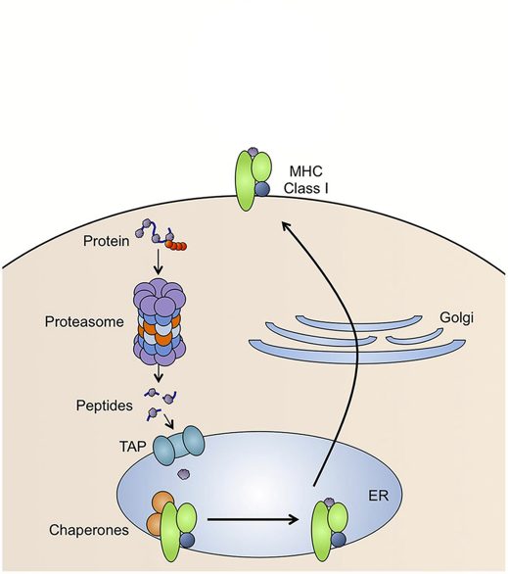
Acquired Cellular Immunity - Role of MHC I in Presentation of Peptides
Foreign Peptide Source:
1. From replication of viruses in the cell
2. From replication of intracellular bacteria (e.g. TB)
3. New coding sequences in cancer cells due to genetic changes (e.g. mutations in p53 may lead to novel sequences).
Only foreign peptides activate T-cells
MHC I present peptides
Peptides are generated from of all of the proteins that are made in the cell.
Steps:
protein targeted for degradation by ubiquitin
Protein digested by proteasome
Peptides transported into ER
Peptides loaded on to MHC I
Peptide/MHC complex transported to cell membrane.
p53 Protein Sequence
Zn Fingers (DNA binding)
10 20 30 40 50 MEEPQSDPSV EPPLSQETFS DLWKLLPENN VLSPLPSQAM DDLMLSPDDI 60 70 80 90 100 EQWFTEDPGP DEAPRMPEAA PPVAPAPAAP TPAAPAPAPS WPLSSSVPSQ 110 120 130 140 150 KTYQGSYGFR LGFLHSGTAK SVTCTYSPAL NKMFCQLAKT CPVQLWVDST 160 170 180 190 200 PPPGTRVRAM AIYKQSQHMT EVVRRCPHHE RCSDSDGLAP PQHLIRVEGN 210 220 230 240 250 LRVEYLDDRN TFRHSVVVPY EPPEVGSDCT TIHYNYMCNS SCMGGMNRRP 260 270 280 290 300 ILTIITLEDS SGNLLGRNSF EVRVCACPGR DRRTEEENLR KKGEPHHELP 310 320 330 340 350 PGSTKRALPN NTSSSPQPKK KPLDGEYFTL QIRGRERFEM FRELNEALEL 360 370 380 390 KDAQAGKEPG GSRAHSSHLK SKKGQSTSRH KKLMFKTEGP DSD
1
5
2
3
4
EVVRRCPHHE Normal seq., ignored by TCR
EVVGGCPHHE Mutant seq. in cancer,
detected by TCR

Slide 14
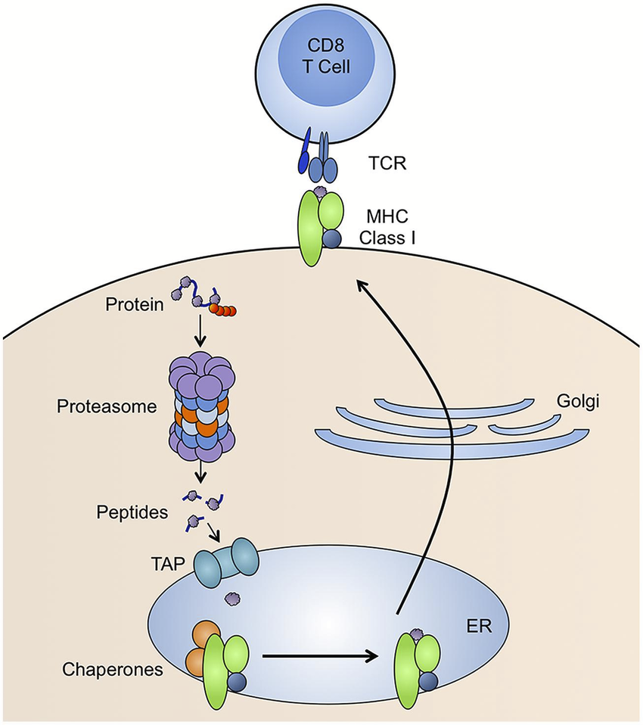
Acquired Cellular Immunity – Recognition of MHC I + Peptide by Tc Cells
Foreign Peptide Source:
1. From replication of viruses in the cell
2. From replication of intracellular bacteria (e.g. TB)
3. New coding sequences in cancer cells due to genetic changes (e.g. mutations in p53 may lead to novel sequences).
T_{CTL}
Tc cells will be activated only by foreign peptides on MHC class I.
Tc cells develop into:
Tc memory cells
cytotoxic T-lymphocytes (T_{CTL})
T_{CTL} cells kill the infected/cancer cell presenting the same peptide that activated it.
p53 Protein Sequence
Zn Fingers (DNA binding)
10 20 30 40 50 MEEPQSDPSV EPPLSQETFS DLWKLLPENN VLSPLPSQAM DDLMLSPDDI 60 70 80 90 100 EQWFTEDPGP DEAPRMPEAA PPVAPAPAAP TPAAPAPAPS WPLSSSVPSQ 110 120 130 140 150 KTYQGSYGFR LGFLHSGTAK SVTCTYSPAL NKMFCQLAKT CPVQLWVDST 160 170 180 190 200 PPPGTRVRAM AIYKQSQHMT EVVRRCPHHE RCSDSDGLAP PQHLIRVEGN 210 220 230 240 250 LRVEYLDDRN TFRHSVVVPY EPPEVGSDCT TIHYNYMCNS SCMGGMNRRP 260 270 280 290 300 ILTIITLEDS SGNLLGRNSF EVRVCACPGR DRRTEEENLR KKGEPHHELP 310 320 330 340 350 PGSTKRALPN NTSSSPQPKK KPLDGEYFTL QIRGRERFEM FRELNEALEL 360 370 380 390 KDAQAGKEPG GSRAHSSHLK SKKGQSTSRH KKLMFKTEGP DSD
EVVRRCPHHE Normal seq., ignored by TCR
EVVGGCPHHE Mutant seq. in cancer,
detected by TCR

Slide 15
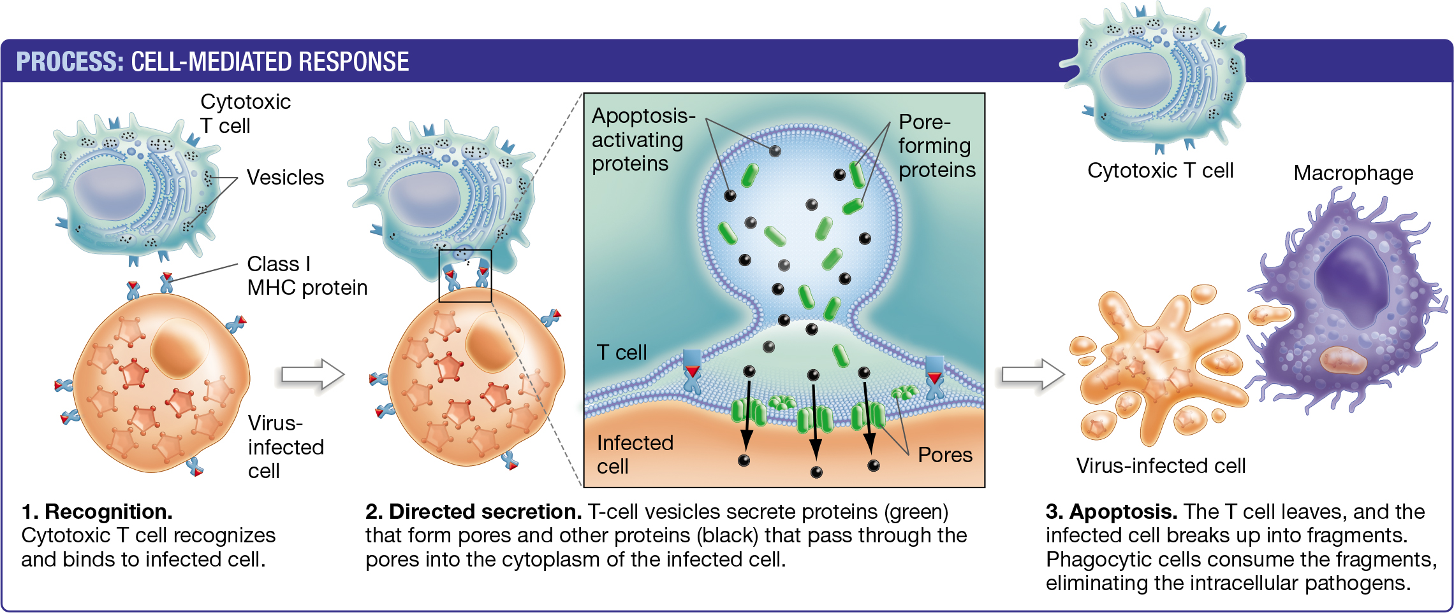
Detection and Killing of Virally Infected or Cancer Cells:
(T_{CTL})
Cancer cell or
Infected cell
Granzymes enter through perforin pore and cause cell undergo programmed cell death (apoptosis)

Slide 16
Cancer Evasion Mechanism I - Loss of MHC I on Tumor Cell
Loss of MHC I expression means that T_{CTL} cells can no longer recognize and kill cancer cells because T-cell activation requires recognition of the MHC-peptide complex.
How to re-establish T_{C} contact with tumor cell and activation of the T-cell so that the cancer cell is killed?
Cancer
Cell

Slide 17
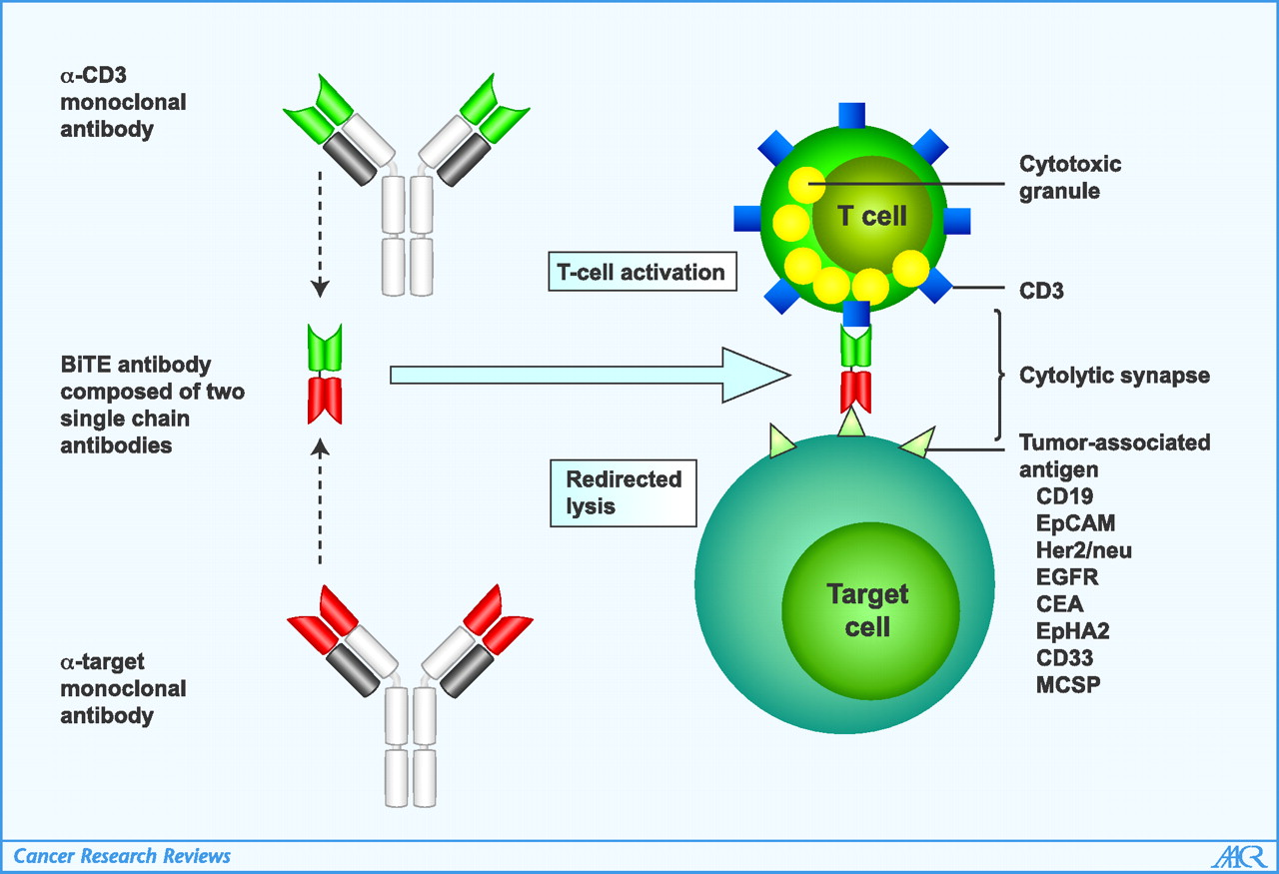
Cancer Treatment with Antibodies - 1. Cancer Evasion - Loss of MHC I on Tumor Cell
Loss of MHC I expression means that T_{CTL} cells can no longer recognize and kill cancer cells because T-cell activation requires recognition of the MHC-peptide complex.
Cancer cell
Cancer
Cell
How to re-establish T_{C} contact with tumor cell and activation of the T-cell so that the cancer cell is killed?
Bispecific antibodies are generated from two separate antibodies:
One recognizes CD3, which is part of the T-cell receptor (TCR)
Other recognizes a tumor antigen.
The two variable regions from each antibody are linked into a single polypeptide chain.
The dual binding event mimics the original MHC-I TCR interaction.,

Slide 18
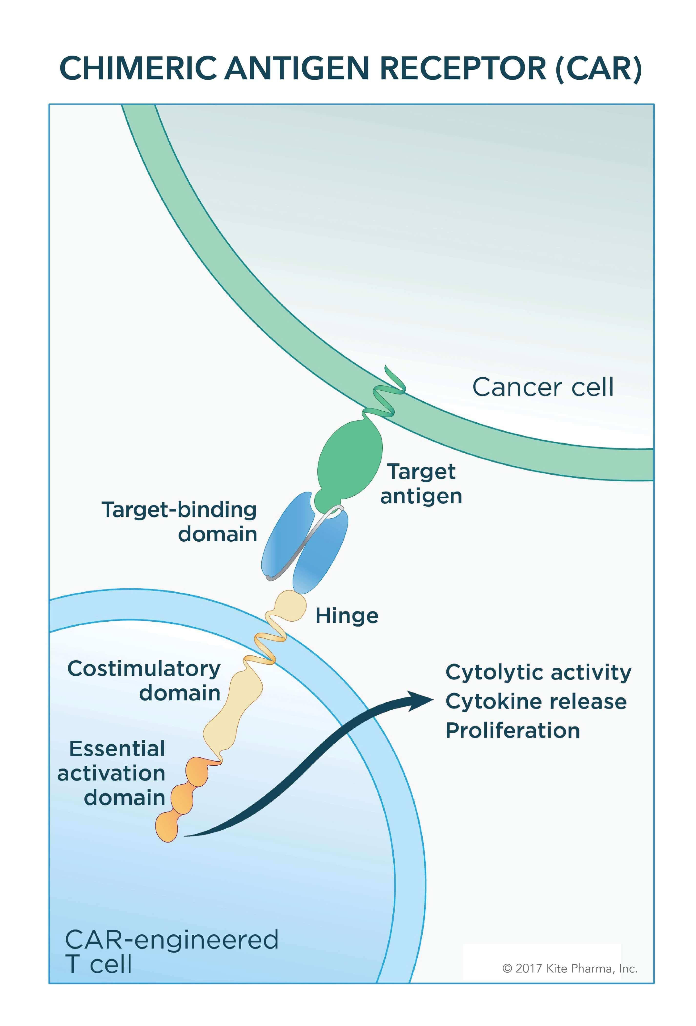
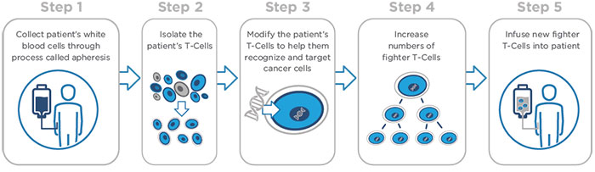
Chimeric Antigen Receptor T-cells = CAR T-Cells
Obtain antibodies against cancer antigen, isolate genes that code for light and heavy chains for those antibodies.
Fuse coding region for variable light and heavy domains to coding region for RTK on T-cells = single CAR-T gene.
Heavy chain gene
Light chain gene
RTK gene
ATG……………….…………..TAA
ATG…………..TAA
ATG…………………..TAA
RTK – receptor tyrosine kinase
Signaling domain on T-cells
V_{H}
V_{L}
RTK
ATG……………….…………………………..TAA
Introduce gene for CAR-T cell into Patient
D. What happens when cancer cell is encountered by CarT cell?
Obtain white blood cells from patient
Isolate T-cells
Introduce DNA into T-cells
Obtain large amounts of T-cells by cell culture
Inject CAR-T cells into cancer patient.
Tumor cell

Slide 19
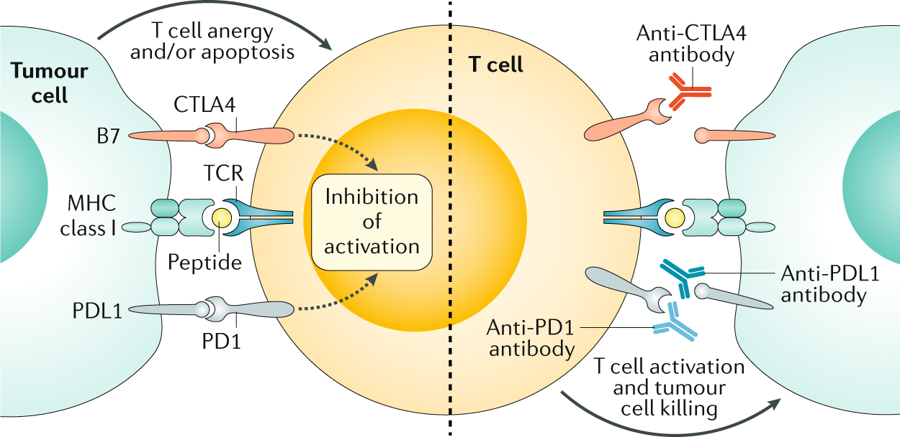
Cancer Evasion Mechanism II – Downregulation/killing of Tc cells.
Cancer cells overproduce b7. Binding of b7 to CTLA4 receptor on the surface of the Tc cell deactivates the Tc cell - immunosuppressive reaction called anergy.
Cancer cells overproduce PDL1. PDL1 binds to PD1 on T-cells. Activation of signaling causes Tc cell to enter apoptosis (programmed cell death).
How to block this signaling?

Slide 20
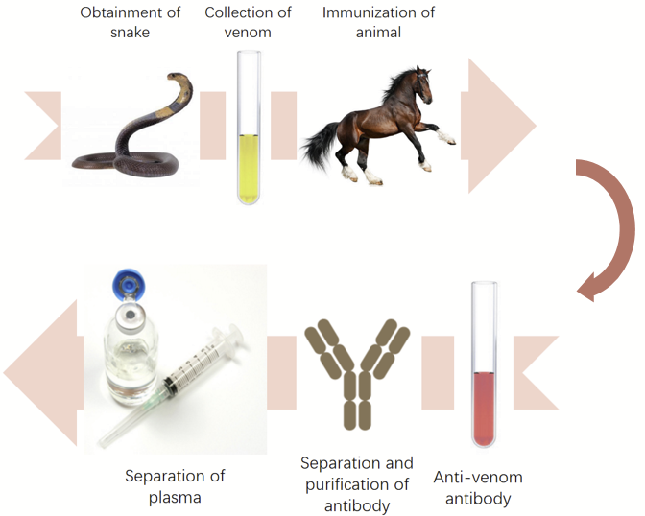
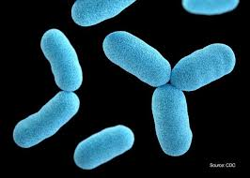
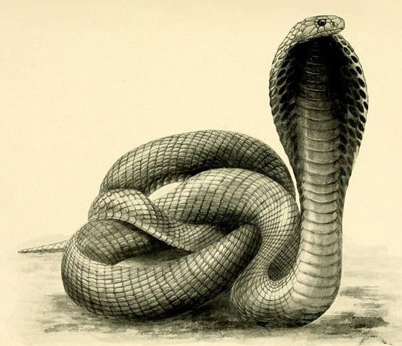
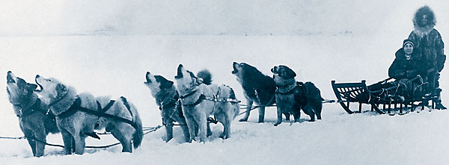
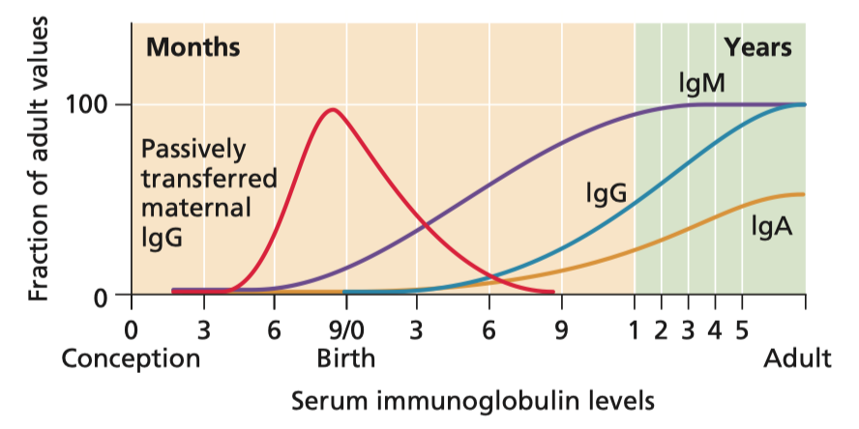
Vaccination
Diphtheria
Types of vaccines:
1. Passive (Ab injected)
2. Active (Antigen Provided)
Breast feeding provides IgA to the newborn.

Slide 21
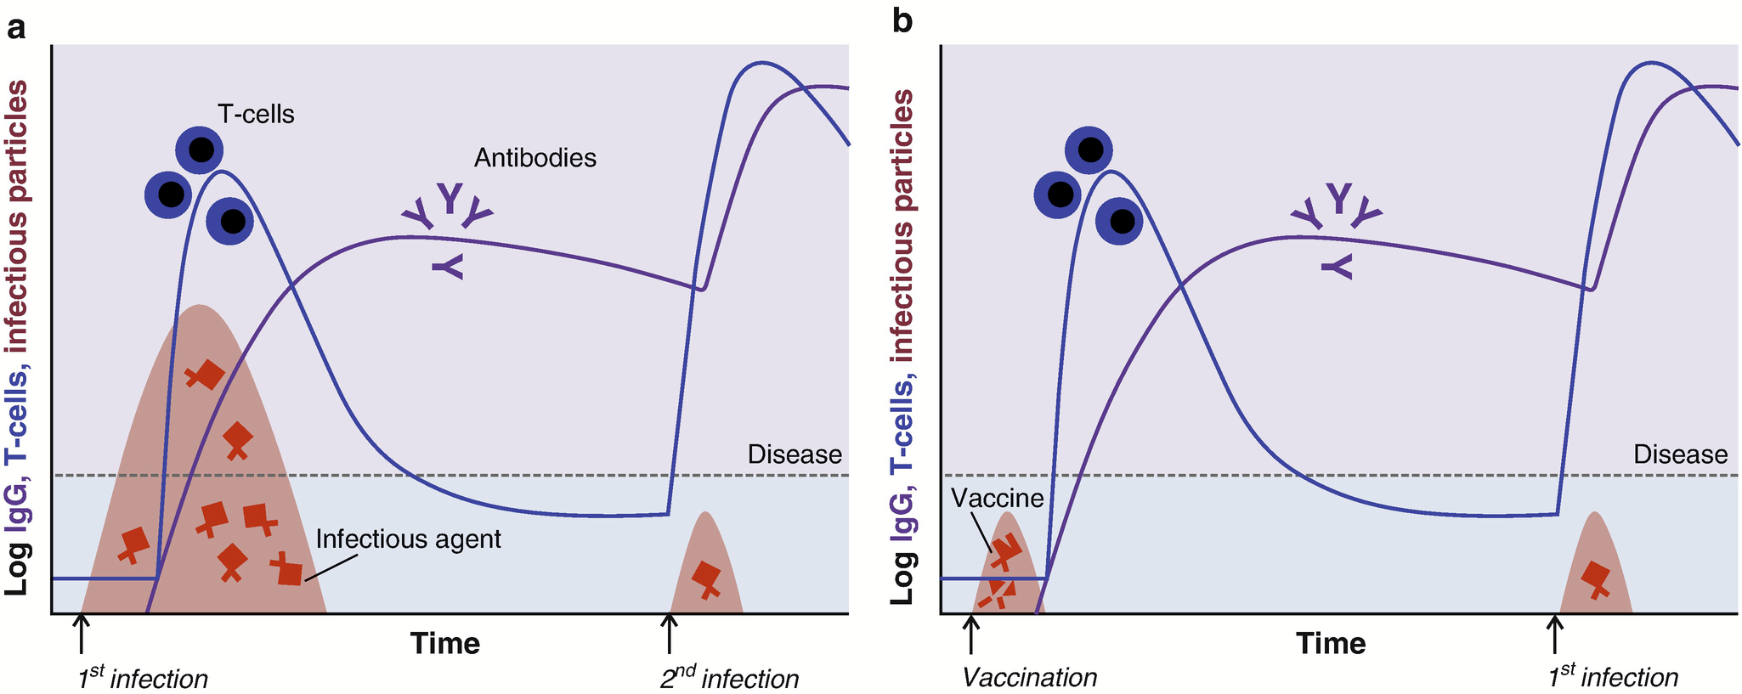
Vaccine: a vehicle containing a form of an antigen that is administered to induce memory B and T cells specific for that antigen.
Not Vaccinated
Vaccinated
DC
Large number of pathogens during first (primary) infection causes disease symptoms
More rapid secondary response prevents extensive pathogen growth – no symptoms.
Jiskoot W., Kersten G.F.A., Mastrobattista E., Slütter B. (2019) Vaccines. In: Crommelin D., Sindelar R., Meibohm B. (eds) Pharmaceutical Biotechnology. Springer, Cham. https://doi.org/10.1007/978-3-030-00710-2_14
T_{H}-Memory
T_{C}-Memory

Slide 22
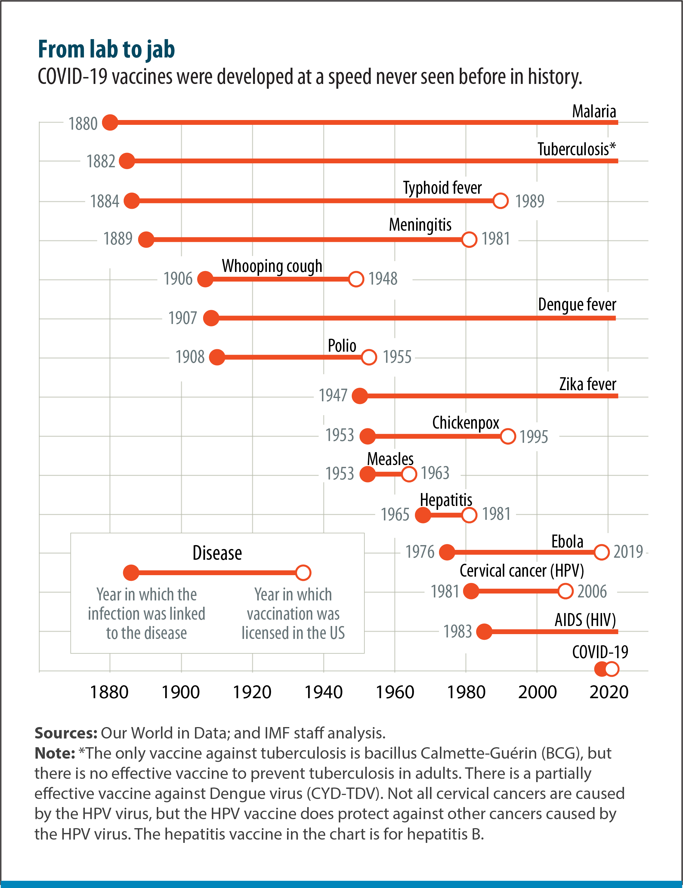
Vaccine History
Some diseases still do not have vaccines
Other diseases have been eliminated by vaccination
https://www.imf.org/en/Publications/fandd/issues/2021/12/Journey-covid-19-vaccine-Stanley

Slide 23
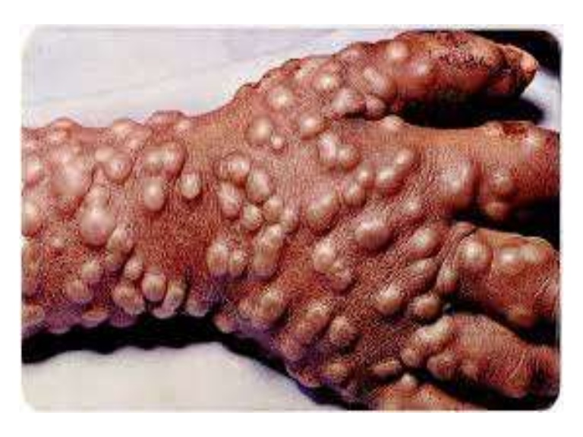
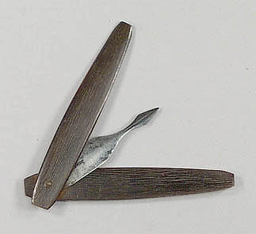
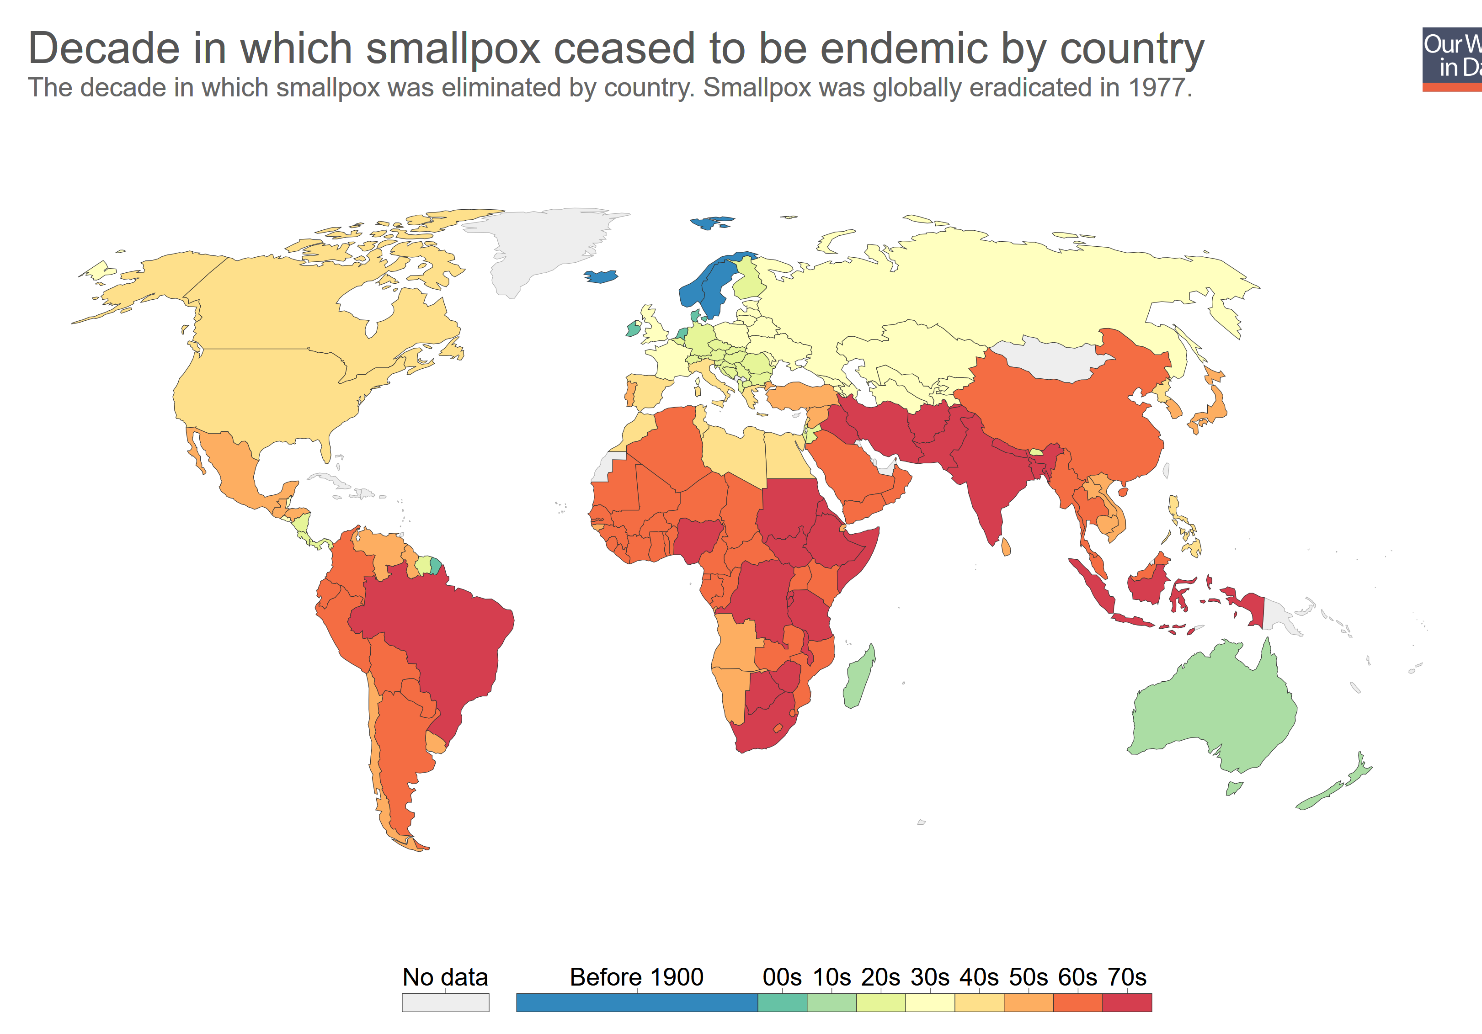
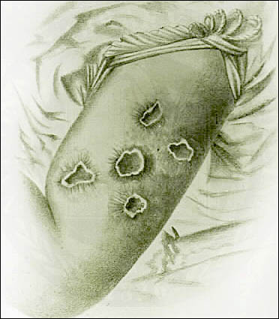
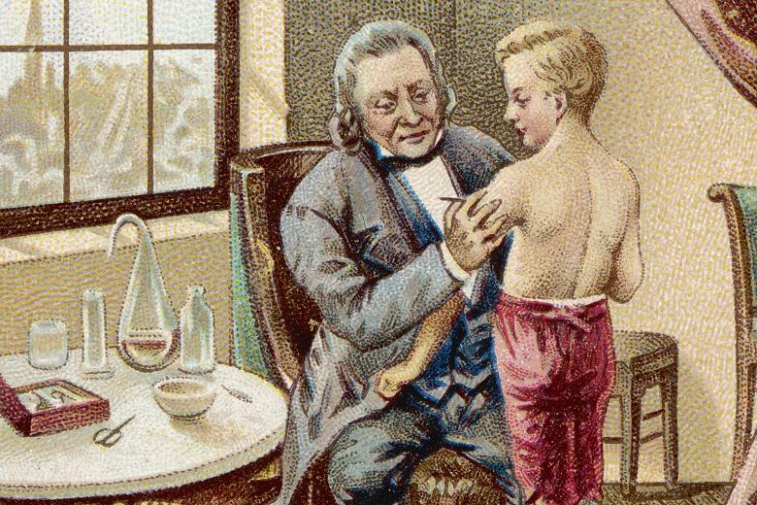
Smallpox - A Success Story for Vaccination
Vaccination – to introduce immunity prior to infection by pathogen
Variolation (1800) provided protection by exposing people to small amounts of smallpox virus (obtained from blisters on infected people).
Risky because smallpox was used to vaccinate
Smallpox - 30% lethality
Vaccinia virus (similar to smallpox) is one form of the current vaccine.
Cowpox virus causes production of antibodies against smallpox
Jenner was the first to use cowpox to vaccinate against smallpox

Slide 24
Types of Vaccines
A. Subunit Vaccine:
A protein from the pathogen is used to induce memory cells, e.g. spike protein from the virus.
A
B. Inactivated Virus
The virus is chemicall inactivated before administration.
B
C. Live Attenuated
The virus is grown under conditions that select for mutant viruses that:
Induce memory cells in humans
Do not cause disease symptoms
C

Slide 25
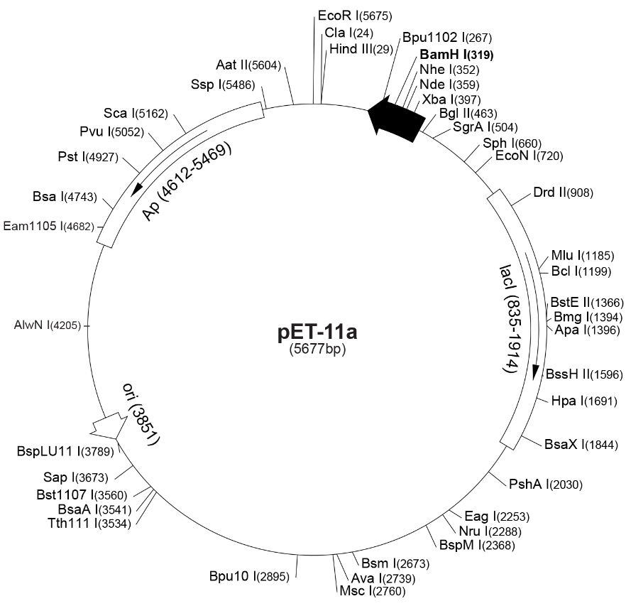
A. Subunit Vaccine - Producing Covid-19 Spike Protein in Bacteria
Terminator
We will incorporate the gene for the spike protein into a plasmid.
Plasmid is a circular DNA molecule that is replicated by the bacteria.
The plasmid will also provide a promotor and mRNA termination sites so that the bacteria will make mRNA and then the mRNA will be translated into the spike protein.
Promoter
A synthetic gene the encodes the entire spike protein will be inserted downstream from the promoter using restriction enzymes.
Notes:
Early trials showed that people with pituitary dwarfism could be treated successfully but only if protein came from humans, other animals were ineffective. But the only source was glands from human cadavers. Was extremely scarce and expensive. Some were also containminated with prions infectious proteins. Banned in 1984.

Slide 26
How to insert a DNA fragment into a Plasmid – Restriction enzymes
EcoR1
GAATTC G AATTC
CTTAAG CTTAA G
NdeI
CATATG CA TATG
GTATAC GTAT AC
BamHI
GGATCC G GATCC
CCTAGG CCTAG G
Cuts both strands, generating single-stranded DNA (sticky ends).
Complementary sticky ends can bind to each other.
DNA can be joined by DNA ligase.
Notes:
Plasmids are physically separate from the bacterial chromosome. Most of the 400 known restriction sites are only at sites that form palindromes reads the same way frontwards to backwards or same identical sequence 5’ to 3’ on the antiparallel strand. Called EcoRI because it was the first restriction enzyme discovered in E.Coli. Like most it makes a staggered cut forming sticky ends. As a result the two ends can pair up and H-bond with one another. Use DNA ligase to seal the pieces together. Sticky ends allows us to create novel combinations by cutting and pasting them into new locations.

Slide 27
How to insert a DNA fragment into a Plasmid
Synthetic spike protein gene
NdeI
BamH1
CATATGGCTACAG...TGGCTTCTAGGGATCC
GTATACCGATGTC...ACCGAAGATCCCTAGG
CA TATGGCTACAG...TGGCTTCTAGG GATCC
GTAT ACCGATGTC...ACCGAAGATCCCTAG G
After digestion with NdeI and BamHI
---CATATGGCTACAG...TGGCTTCTAGGGATCC---
---GTATACCGATGTC...ACCGAAGATCCCTAGG---
Anneal and ligate to pET11a
---CA GATCC---
---GTAT G---
After digestion with NdeI and BamHI
Cut plasmid and synthetic gene with both NdeI and BamHI enzymes to make sticky ends.
Cool to allow sticky ends to anneal TA from NdeI will anneal, GATC from BamH1 will anneal.
DNA ligase to join fragments.
---CATATGGCTAGCA....GGGTCGCGGATCC---
---GTATACCGATCGT....CCCAGCGCCTAGG---
NdeI
pET11a
BamH1
Notes:
Plasmids are physically separate from the bacterial chromosome. Most of the 400 known restriction sites are only at sites that form palindromes reads the same way frontwards to backwards or same identical sequence 5’ to 3’ on the antiparallel strand. Called EcoRI because it was the first restriction enzyme discovered in E.Coli. Like most it makes a staggered cut forming sticky ends. As a result the two ends can pair up and H-bond with one another. Use DNA ligase to seal the pieces together. Sticky ends allows us to create novel combinations by cutting and pasting them into new locations.

Slide 28
Final Product – Covid-19 Spike protein codons in plasmid
Covid spike protein
Gene that codes for a protein that makes the bacteria containing the plasmid resistant to penicillin.
Origin of replication so that the plasmid is copied when the bacteria divide.

Slide 29
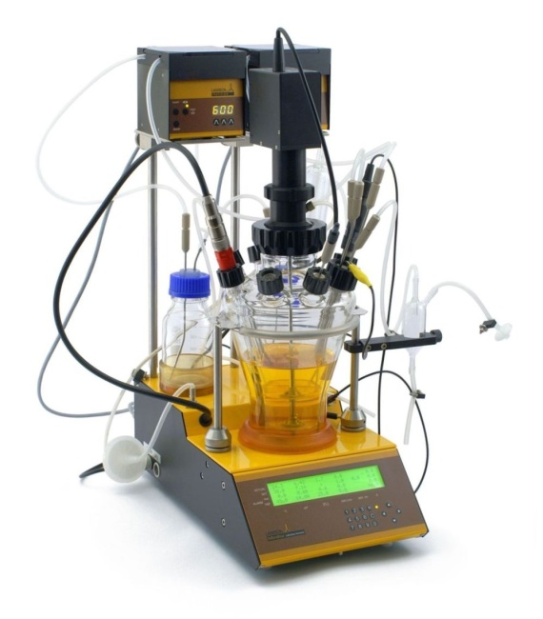
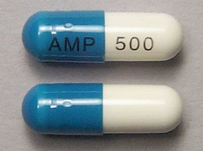
Inserting the Plasmid into Bacterial Cells
Cells can take up DNA from the environment and incorporate it into their genomes in a process called transformation.
To transform bacterial cells with a plasmid, researchers increase the permeability of the cell’s membrane using a chemical treatment (calcium chloride).
Cell that contain the plasmid are selected by growth on ampicillin.
Only those cells with plasmid can grow.
The plasmid with the cDNA produces the spike protein in bacteria.
Large amounts of E.coli that produce the vaccine can be grown in a fermenter.
The spike protein can be used as a vaccine
Notes:
In many cases, researchers add a primer and use DNA polymerase to synthesize a second strand. So essentially what they did way isolate the mRNAs from pituitary glands and use reverse transcriptase to make cDNAs for all the genes actively expressed in pituitary cells.

Slide 30
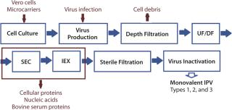
B. Inactivated Viruses

Slide 31
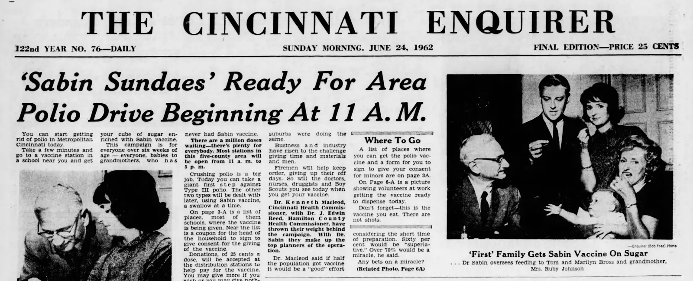
C. Attenuated Viruses

Slide 32
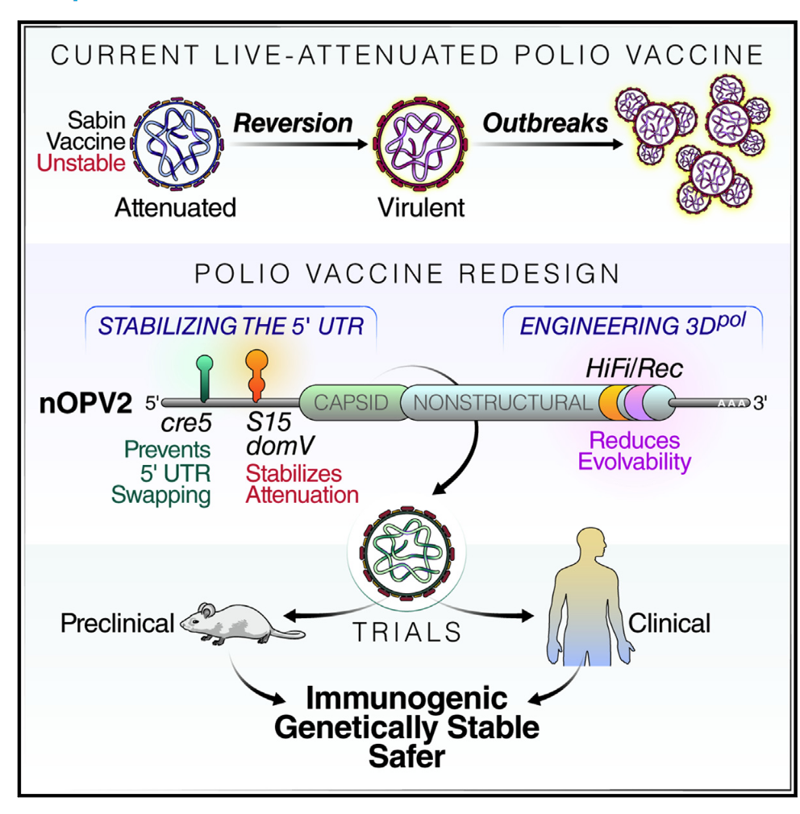
C. Attenuated Viruses

Slide 33
D – Virus Like Particles:
Proteins isolated from the virus form virus-like-particles, without the genetic material of the virus
D
E. Recombinant Virus:
A “safe virus” is used (e.g. cold virus)
Gene for a protein from a pathogen is inserted into the DNA of the virus.
When virus grows it produces the protein from the pathogen generating immunity.
Also includes vaccines that are a mixture of genetic material from human and animal viruses (reassortment viruses)
E
F. RNA Vaccines (Pfizer Covid Vaccines)
RNA coding for a viral protein is introduced into cells. The RNA is used by the cell to make viral proteins, inducing an immune response.
F

Slide 34
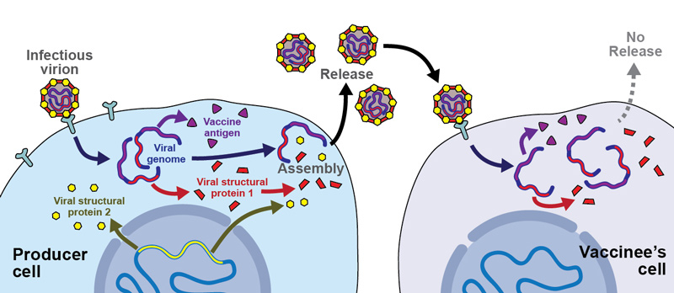
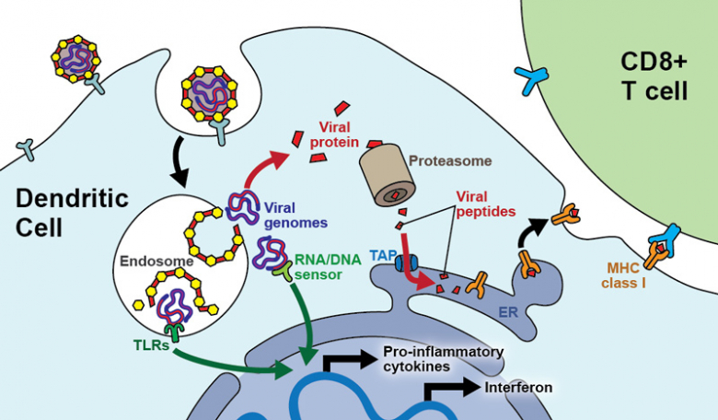
E. Viral Vectors for Antigen Delivery
AstraZeneca Covid
2. Action of vaccine
Virus infects host cell in vaccinated person.
Viral genome is used to make viral proteins, including proteins from the pathogen.
Activate T_{C} cells to become T_{C} – memory cells (can be re-activated by MHC I + Peptide).
B-cell response can occur due to antigens that are sent to the surface of the cell, generating B- and T_{H}-memory cells.
1. Production of vaccine
Genes from the pathogenic virus are added to an adenovirus (common cold)
Adenovirus is defective and cannot replicate without key structural proteins that are provided in the producer cell.
No viral particles are released in the vaccinee’s cells because they lack the key structural proteins.
DOI: https://doi.org/10.4414/smw.2017.14465 Publication Date: 08.08.2017 Swiss Med Wkly. 2017;147:w14465

Slide 35
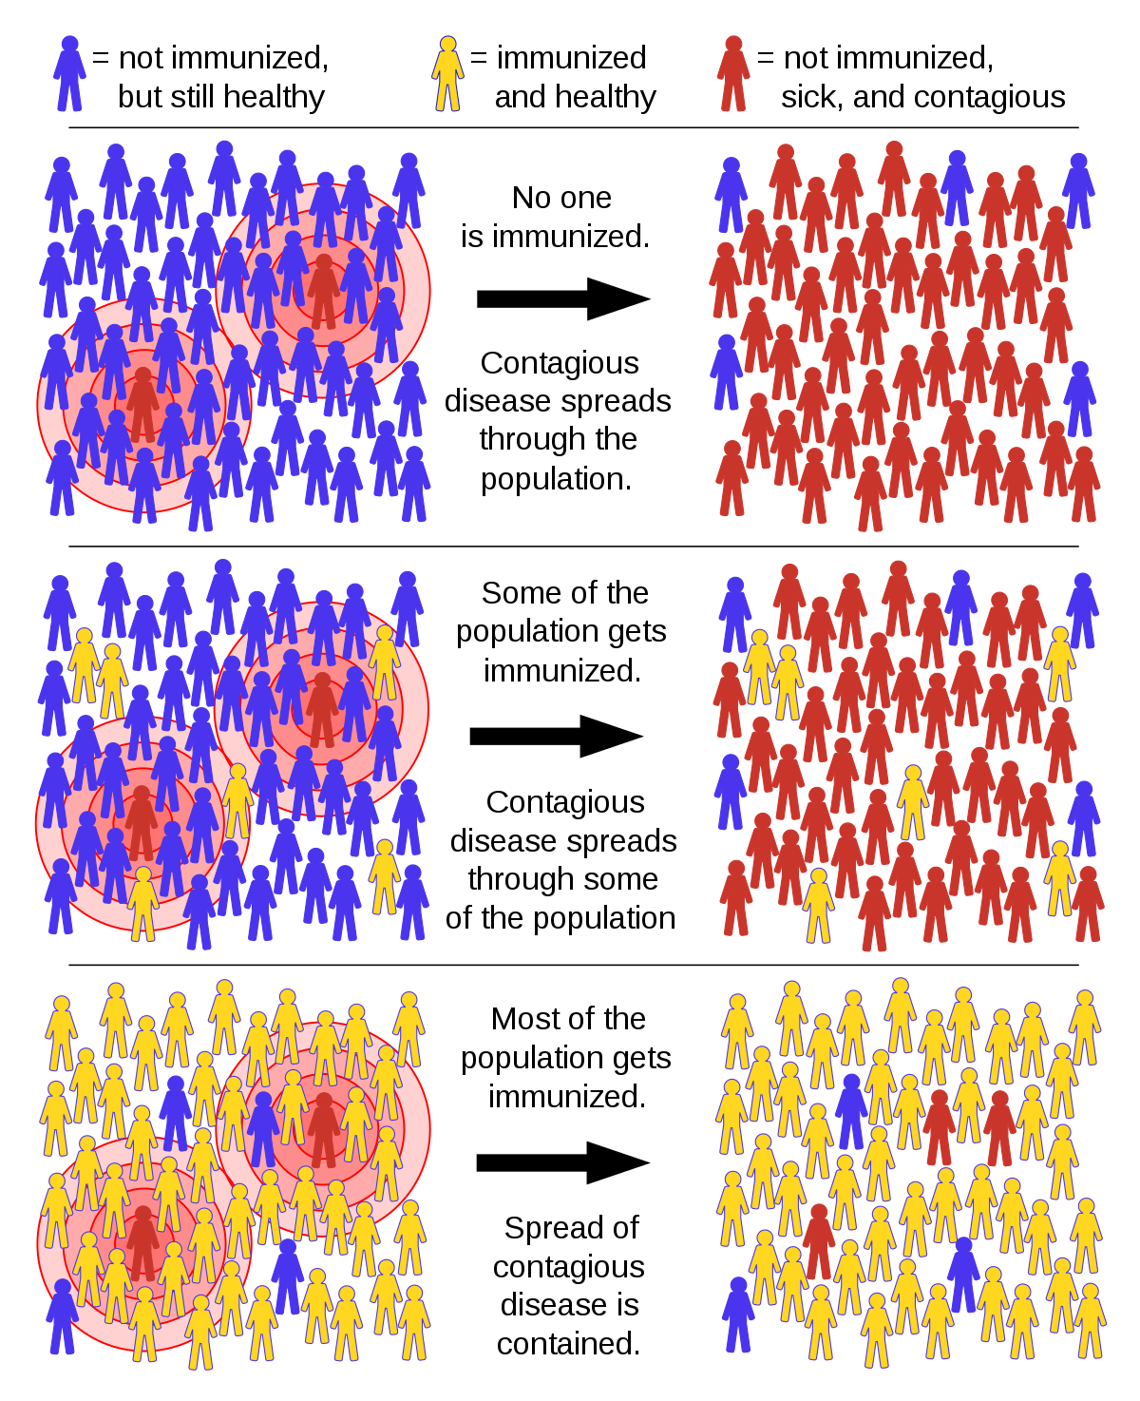
Herd Immunity:
High risk
Can’t be vaccinated
(too young, immune -compromised
Vaccinated individuals prevent disease from spreading from sick to unvaccinated.
At sufficient levels, the “herd” is immune because the virus cannot spread.
Gets infected
Below herd
immunity
At herd
immunity
Protected

Slide 36
Herd Immunity
How Many People need to be vaccinated to achieve herd immunity?
10% ?
20% ?
50% ?
90% ?
100% ?
It depends on the how infectious the virus is
Our Experimental Viruses:
Ebola: Low infectivity
Polio: Moderate infectivity
Measles: High infectivity

Slide 37
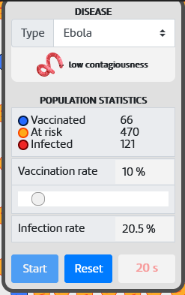
Simulation to Determine Infectivity Versus Vaccination Level (Pset)
Go to the following web site and open both links: http://www.andrew.cmu.edu/~rule/stayin-alive
Copy the googlesheet.
Group Number | Virus | % Vaccination
1 | Ebola | 10, 20, 40, 50
2 | Ebola | 70, 80, 90
2 | Polio | 10, 20, 40, 50
3 | Polio | 70, 80, 90
4 | Measles | 10, 20, 40, 50
5 | Measles | 70, 80, 90
3. On the Infection Simulator link, scroll down (2/3 page) to the image of the plane, and click on it.
A. Select the virus.
B. Use the slider to select the different vaccination levels. For each of the vaccination levels do three simulations.
C. Enter the value for the % Infection rate at 20s into the appropriate cell of the google sheet. Your data will be automatically averaged and plotted.
3 Simulation Runs at 10%

Slide 38
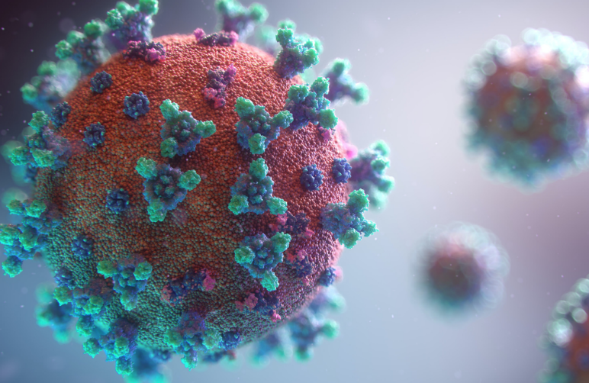
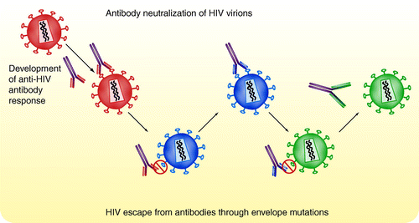
Why Are There No Vaccines for HIV?

Slide 39
Summary Questions for Immunology:
What are the two major branches of the immune system? Why are both important?
What are the roles of different cell types in each system, e.g. what would happen if T_{H}-cells disappeared?
What is the quaternary structure of an antibody? Can you sketch an antibody and indicate where the antigen binds?
What defines the specificity of antibodies?
What are the steps in the production of antibody genes, at the molecular level:
How do DNA rearrangements produce functional heavy and light chain genes
How are is the mature mRNA generated in B-cells and Plasma cells.
What is the difference between the heavy chain export process for B-cells and plasma cells.
Can you describe how antibodies kill/inactivate pathogens
How are virally infected cells and tumor cells recognized by Tc cells?
How does the Tc cell kill those cells?
What evasion mechanisms are used by cancer cells and how have these been addressed by antibody therapy?
What was the origin of the idea for vaccination?
What was one of the first “safe” vaccines? What disease has now been eradicated due to this vaccine?
Why is it important to be vaccinated (Herd immunity)
Can you describe one way to generate a vaccine for a pathogen? Do you know the pros and cons for that method?

Slide 40
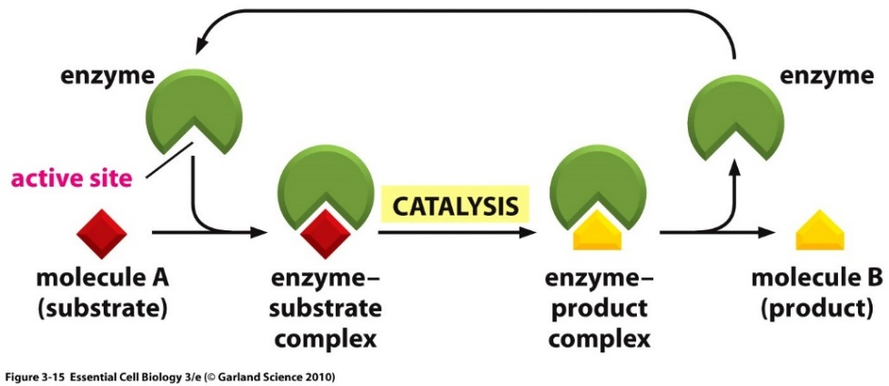
Enzymes
Enzymes are protein or RNA catalysts. They increase the rate of the reaction.
They bind “substrates” and convert them to “products”. Usually, the substrate undergoes a chemical reaction and is changed in its structure.
Substrates bind specifically to the enzyme’s active site, interacting with amino acid side chains.
The chemical change caused by the enzyme is catalyzed by additional functional groups in the active site.
Many enzymes undergo a conformational change when the substrates are bound to the active site; this change is called an induced fit.
The rate (or velocity) is the number of products produce/unit time.
E + S (ES) (EP) E + P
substrates
products

Slide 41
Summary of Kinetic Parameters
E + S (ES) (EP) E + P
i) The K_{M} or Michaelis constant: This is almost the same as the K_{D} (= k_{off}/k_{on}), the dissociation constant, except for the presence of the k_{CAT} term. Therefore, it is related to the affinity of a substrate to an enzyme. It is a constant for any particular enzyme-substrate pair. Substrates with slow off-rates (k_{off}) bind more tightly, and possess a smaller K_{M}.
When [S]=K_{M} the enzyme is ½ saturated with substrate: v = ½ V_{Max}
ii) V_{MAX} = k_{CAT}[E_{T}]: This is the highest rate of product production possible. It is obtained at high substrate levels ([S]>>K_{M}). Under these conditions all of the enzyme is in the [ES] form (i.e. [ES]=[E_{T}]), the enzyme is saturated with substrate. k_{CAT} is obtained from V_{MAX} since the total amount of enzyme is known: k_{CAT}=V_{MAX}/[E_{T}].
iii) k_{CAT} is also called the turn-over number – how many products are produced/sec by a single enzyme molecule.
$$v=V_{MAX}\frac{[S]}{\left[S\right]+K_{M}}=E_{TOT}k_{CAT}\frac{[S]}{\left[S\right]+K_{M}}$$

Slide 42
Enzyme Inhibitors
Studies on Inhibitors are useful for:
1. Mechanistic studies to learn about how enzymes interact with their substrates.
2. Understanding the role of inhibitors in enzyme regulation.
3. Drugs if they inhibit aberrant biochemical reactions:
penicillin, ampicillin, etc. interfere with the synthesis of bacterial cell walls, acting as suicide inhibitors.
4. Understanding the role of biological toxins.
Amino acid analogs - useful herbicides (i.e. roundup)
Insecticides - chemicals targeted for insect nervous system.
Covalent
Competitive
Types of Inhibitors:
Covalent – inhibitor covalently modifies enzyme, usually in active site, these are generally irreversible – the enzyme is dead! Example – Sarin gas (Tokyo subway 1995)
Competitive – inhibitor blocks substrate, binds reversibly to active site with a K_{D} = K_{I}. Enzyme activity returns when drug is removed.
Allosteric (mixed type) – inhibitor causes allosteric change. Binds reversibly to a different location, with two different K_{D}s: K_{I} and K_{I}’. Enzyme activity returns when drug is removed.
Allosteric (Mixed type)

Slide 43
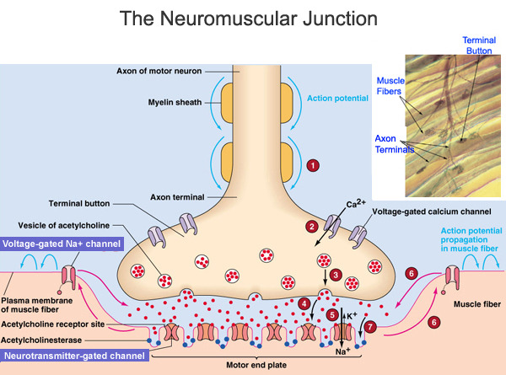
1. Suicide Inhibitors:
Inhibitor binds in the active site. This type of inhibitor binds irreversibly.
Inhibitor becomes a reactive transition state that forms a covalent bond with the enzyme, irreversibly inactivating it.
Example: Sarin nerve gas
Acetylcholine esterase is required to breakdown the neural transmitter acetylcholine in neuro-muscular junctions so that the muscle will relax.
The esterase has an active site Serine that is activated in a similar manner as serine proteases.
Sarin modifies the active site serine in the esterase by forming a stable covalent bond with the serine that cannot be easily hydrolyzed.
Inhibition of acetylcholine esterase results in suffocation since the diaphragm muscles no longer function properly.
The enzyme has committed suicide by trying to perform the chemical step on sarin.

Slide 44
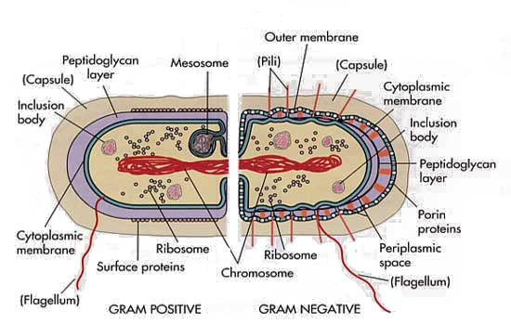
Bacterial Cell Wall
Mechanism of Penicillin – A suicide Inhibitor
Serine breaks peptide bond between terminal D-Ala residues
Covalent intermediate formed
Amino group of glycine forms peptide linkage with D-Ala = crosslink
Bacterial cell wall:
Linear polymers of alternating NAM (N-acetylmuramic acid) and NAG (N-acetylglucosamine), beta(1-4) linkage
NAM units on adjacent strands are linked via a peptide linker.
Crosslinking catalyzed by serine-containing transpeptidase.

Slide 45
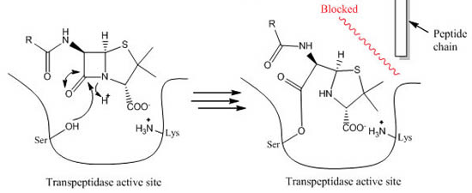
Mechanism of Penicillin
Mechanism of Action of Penicillin:
Penicillin inhibits enzymes that are responsible for crosslinking the Gly₅ chain to alanine (circled on diagram).
The crosslinking of the cell wall is broken, making the bacteria fragile to breakage.
Inhibition is by formation of a chemical bond between penicillin and the enzyme (covalent inhibitor). This type of inhibition is not the same as competitive inhibition because: i) the penicillin forms a covalent bond with the enzyme, ii) penicillin is modified by the reaction, iii) the reaction is essentially irreversible.
Penicillin
Penicillin Resistance: Bacteria produce a protein that degrades penicillin (β-lactamase). This is a common antibiotic resistance gene that is used on plasmids. The transformed bacterial are resistant to penicillin.
Lactamase can regenerate the serine, regenerating the enzyme.

Slide 46
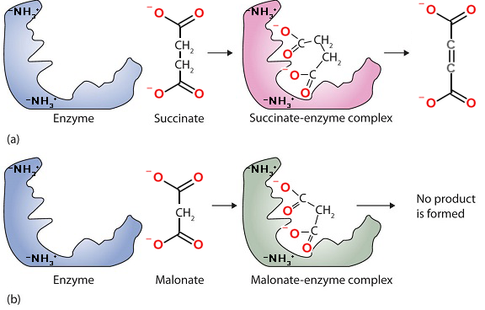
Competitive Inhibitors
Succinate dehydrogenase converts succinate to fumarate by removal of two hydrogens.
Malonate is a competitive inhibitor, because:
It is similar to the substrate – binds in active site – substrate cannot bind at the same time.
Cannot undergo the chemical reaction – it is not possible to remove two hydrogens without leaving carbon with too few bonds.
Fumarate
(product)
Substrate
Inhibitor

Slide 47
Example: A competitive inhibitor of elastase is shown below.
Quantification of Inhibitor Binding
$$K_{I}=K_{D}=\frac{\left[E][I\right]}{\left[EI\right]}$$
Why is this compound a competitive inhibitor? Recall the two key properties of competitive inhibitors.
(A substrate for elastase is shown below)

Slide 48
Effect of Competitive Inhibitor on Steady-State Kinetics:
A competitive inhibitor reduces the amount of [E] by the formation of [EI] complex.
The inhibitor cannot affect the [ES] complex since the inhibitor can no longer bind.
There are two consequences of a competitive inhibitor binding on the kinetics of the enzyme:
V_{MAX} is unchanged: At high levels of substrate all of the inhibitor is displaced by substrate, so [ES]=E_{TOTAL}, and v_{MAX} = k_{CAT}[E_{TOT}].
The observed K_{M} is increased: It requires more substrate to reach 1/2 maximal velocity because some of the enzyme is complexed with inhibitor.
K_{M}^{OBS} = αK_{M}
The change in K_{M} can be used to determine how well the inhibitor binds to the free enzyme, if we know how α is related to K_{I}.
v = k_{cat} [ES], k_{cat} =1
No inhibitor
Comp inhibitor

Slide 49
$${=E_{Tot}k}_{CAT}\frac{[S]}{K_{M}+[S]}$$
= $E_{Tot}k_{CAT}×Y_{(ES)}$
=$E_{Tot}k_{CAT}\frac{[ES]}{\left[E\right]+\left[ES\right]+[EI]}$
= $E_{Tot}k_{CAT}\frac{\frac{\left[S\right][E]}{K_{M}}}{\left[E\right]+\frac{\left[S\right][E]}{K_{M}}+\frac{\left[I\right][E]}{K_{I}}}$
= $E_{Tot}k_{CAT}\frac{\frac{[S]}{K_{M}}}{1+\frac{[S]}{K_{M}}+\frac{[I]}{K_{I}}}$
= $E_{Tot}k_{CAT}\frac{\frac{[S]}{K_{M}}}{1+\frac{[S]}{K_{M}}+\frac{[I]}{K_{I}}}×\frac{\frac{K_{M}}{1}}{\frac{K_{M}}{1}}$
=$E_{Tot}k_{CAT}\frac{[S]}{K_{M}+[S]+\frac{[I]}{K_{I}}K_{M}}$
=$E_{Tot}k_{CAT}\frac{[S]}{ (1+\frac{\left[I\right]}{K_{I}})K_{M}+[S] }$
=$E_{Tot}k_{CAT}\frac{[S]}{ αK_{M}+[S] }$
Steady-State Analysis of Competitive Inhibitors
$$K_{I}=\frac{\left[I\right][E]}{[EI]}$$
$$\left[EI\right]=\frac{\left[I\right][E]}{K_{I}}$$
$$K_{M}≈\frac{\left[S\right][E]}{[ES]}$$
$$\left[ES\right]=\frac{\left[S\right][E]}{K_{M}}$$
$$α=1+\frac{[I]}{K_{I}}$$
α = degree of inhibition
A double reciprocal plot can be used to obtain α:
No-you don’t need to know this derivation
No Inhibitor Present → Double Reciprocal Equation
1/v
Inhibitor Present → Double Reciprocal Equation
1/[S]
A competitive inhibitor changes the slope of a double recip. plot!
The change in slope can be used to obtain α and then K_{I.}

Slide 50
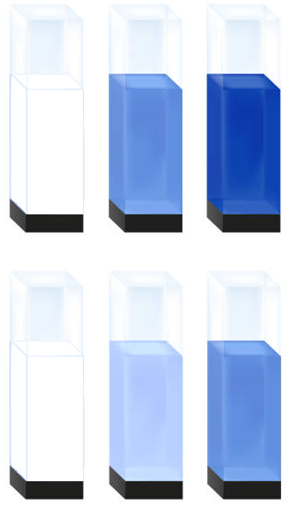
Experimental Determination of Inhibitor-Enzyme Affinity (K_{I})
A. Data Collection
i) Measure initial velocity for different [S], in the absence of inhibitor.
ii) Measure initial velocity for different [S], in the presence of a fixed concentration of inhibitor (i.e. only [S] is varied, not [I]).
B: Obtaining K_{I}
Linearization of Data using Double-Reciprocal Plot:
i) Both data sets are plotted on a double reciprocal plot.
ii) Ratio of the slopes gives α (degree of inhibition).
iii) K_{I} = [I]/(α-1).
[S] mM | v_{i} [I]=0 | v_{i} I=10μM | 1/[S] | 1/v [I]=0 | 1/v I=10μM
1 | 16.7 | 9.1 | 1.0 | 0.060 | 0.110
5 | 50.0 | 33.3 | 0.2 | 0.020 | 0.030
10 | 66.7 | 50.0 | 0.1 | 0.015 | 0.020
α=
K_{I} =

Slide 51
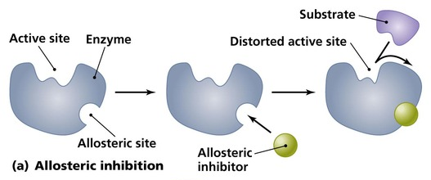
Allosteric Inhibition of an Enzyme
E₁
E₂
E₃
E₄
A B C D CTP
Inhibitor does not bind in the active site.
Inhibitor can bind to both the free enzyme (E) and the (ES) complex
Feedback Regulation:
Product of pathway prevents production by inhibition of enzyme earlier in the pathway.
Example - Allosteric regulation of CTP production
Cytosine triphosphate
CTP (a component of RNA) is generated by a series of enzymatic steps – a metabolic pathway.
The first enzyme in the pathway is inhibited by the final product of the pathway, CTP (cytosine triphosphate)
The CTP binds at an allosteric site, cause a conformational change in the active site, decreasing V_{MAX}, shutting off its own production.
Notes:
One of the final products, cytosine triphosphate turns off the enyzyme by binding to it.

Slide 52
Allosteric (Mixed Type) Inhibitors
The binding site of the inhibitor is not at the active site. The inhibitor does not look like the substrate.
The binding is reversible.
The inhibitor can bind to both [E] and [ES].
The inhibitor binding causes a change in the conformation of the protein that can affect substrate binding (K_{M}) or the chemical step (k_{CAT}) or both!
Active Site
W/O Inh
Active Site
with Inh
Nomenclature: Uncompetitive & noncompetitive are unrealistic simplifications of mixed type inhibitors.
 | Binds to (E) | Binds to (ES)
Mixed type | yes | yes
Uncompetitive | no | yes
Noncompetitive | Same affinity | Same affinity
Both V_{MAX} and K_{M} can be altered by mixed inhibitors since the precise geometry of the active site is altered when the inhibitor is bound, potentially affecting binding and catalysis.
The change in V_{MAX} can be used to find K_{I}’: V_{MAX}^{OBS} = V_{MAX}/α’
The change in K_{m} can be used to find K_{I}. K_{M}^{OBS} = (α/ α’) K_{M}

Slide 53
2. Allosteric (Mixed Type) Inhibitors
There are two K_{D} values that describe the binding.
$$K_{I}=K_{D}=\frac{\left[E][I\right]}{\left[EI\right]}$$
$$K_{I}^{′}=K_{D}^{′}=\frac{\left[ES][I\right]}{\left[ESI\right]}$$
$$K_{I}=\frac{\left[E][I\right]}{\left[EI\right]}$$
$$K_{I}^{′}=\frac{\left[ES][I\right]}{\left[ESI\right]}$$

Slide 54
Determining Binding of Allosteric Inhibitors:
The change in V_{MAX} can be used to find K_{I}’: V_{MAX}^{OBS} = V_{MAX}/α’
The change in K_{m} can be used to find K_{I}. K_{M}^{OBS} = (α/ α’) K_{M}
Obtaining K_{i}s from Double Reciprocal plots:
α = ratio of slopes
(+Inh/no inh)
K_{I} = [I]/(α -1)
α’ = ratio of y-intercept
(+Inh/no inh)
K_{I}’ = [I]/(α’-1)
No Inhibitor
Allosteric Inhibitor
1/v
1/[S]

Slide 55
Example:
Allosteric (mixed type) Inhibitor
[S] mM | v ([I]=0) | v I=10μM | 1/S | 1/V ([I]=0) | 1/V I=10μM
1 | 16.7 | 2.9 | 1.0 | 0.060 | 0.340
5 | 50.0 | 10.0 | 0.2 | 0.020 | 0.100
10 | 66.7 | 14.3 | 0.1 | 0.015 | 0.070
20 | 80.0 | 18.2 | 0.05 | 0.0125 | 0.055
K_{I} - Obtain α - ratio of slopes.
Slope ([I]=0): Slope ([I]>0):
α =slope([I]>0)/slope([I]=0): K_{I}:
K_{I}’ Obtain α' – ratio of y-intercepts:
y-int([I]=0): y-int([I]>0):
α' = y-int([I]>0)/y-int([I]=0): K’_{I}:
Which form of the enzyme, (E) or (ES), binds the inhibitor with higher affinity?

Slide 56
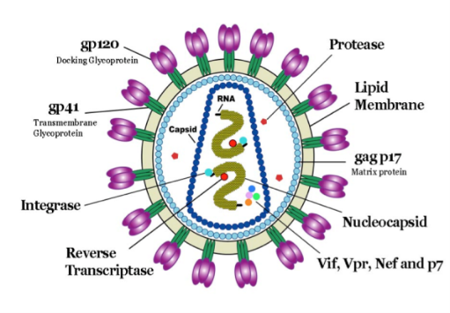
HIV Drug Therapy
Retroviruses & Inhibitors - HIV Protease.
Goals
Identify potential drug targets, based on viral life cycle.
Mechanism of aspartyl proteases
Measure inhibitor binding to characterize drug efficiency.
Human Immunodeficiency Virus (HIV)
Retrovirus, genetic material is RNA that is converted to DNA first, and then the copy in the DNA is used to make new copies of the viral RNA (as well as viral proteins)
Infects specialized cells in the immune system – T-helper cells (T_{H}) cells, killing them.
T_{H} cells are required for activation of the immune response to all pathogens (bacteria, virus)
Killing of T_{H} cells by the HIV virus causes AIDS (Acquired Immunodeficiencies), making the individual susceptible to serious infection by many otherwise harmless bacteria, as well as developing rare cancers.
Viral particle contains enzymes required for the replication of the virus:
Reverse Transcriptase: Copies viral RNA to DNA
Integrase: Integrates viral DNA into host chromosome.
HIV Protease: Cleaves immature viral protein to produce smaller mature proteins.

Slide 57
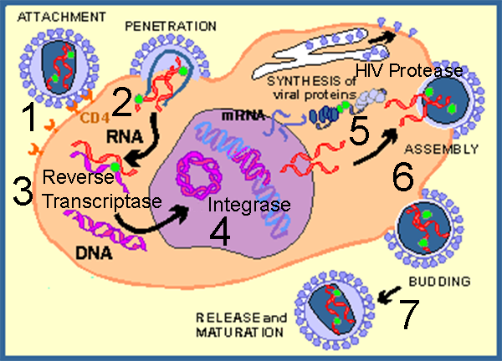
HIV Viral Infection of T-Helper Cells:
1. Viruses bind to molecules displayed on the T_{H} cell surface.
2. The virus then fuses with the cell membrane and releases its RNA genome from its lipid envelope.
3. The HIV enzyme reverse transcriptase first makes a double-stranded DNA copy of the viral RNA molecule. This process is error prone, leading to mutations in the virus. These mutations cause drug resistant strains of the virus to arise.
4. The DNA is integrated into the host cell’s DNA by an enzyme called integrase, also from the HIV virus.
5. Integrated DNA produces vRNA, the genetic material for new virus particles. mRNA is also made from this DNA, to produce proteins for new particles.
6. HIV protease, coded for by the virus, is required for maturation of viral proteins, by cleaving them into smaller proteins that form the mature virus.
7. Mature virus buds out of cell.
Drug Targets to Combat the HIV Virus –
Viral fusion
Reverse transcriptase
Integrase
HIV Protease
Why are these good targets for inhibitors that are anti-viral drugs?

Slide 58
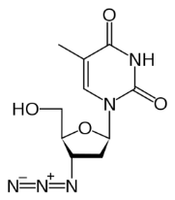
HIV Anti-viral Drugs
1980-84 HIV virus characterized | Fusion Inhibitors | RevTrans Inhibitors – NRTI (competitive) | RevTrans Inhibitors – NNRTI (allosteric) | Integrase Inhibitors | Protease Inhibitors (competitive)
1985-89 |  | AZT
1990-94 |  | Didanoisine, Zalcitabine, Stavudine
1995-99 |  | Lavidudine | Nevirapine, Delavirdine, Efavirenz |  | Saquinavir, Ritonovair, Indinavir, Nelfinavir
2000-04 | Enfuvirtide | Didanosine Emtricitabine |  |  | Atazanavir
2005-09 | Maraviroc |  | Etravirine | Raltegravir | Darunavir, Tipranavir
2010-14 |  |  | Nevirapine XR, Rilpivirine | Dolutegravir, Evitegravir

Slide 59
HIV Protease (Aspartyl protease)
https://www.andrew.cmu.edu/user/rule/jsmol/hiv_prot.html
1. An essential enzyme in the maturation of HIV viral proteins. If inhibited, the virus cannot replicate.
2. A homo-dimeric protein, containing two catalytic Asp residues, Asp25 and Asp25', the same residue on each chain. The pK_{a} values of these two differ widely, one is about 4.0 and the other about 6.0. One of the Asp residues must be protonated the other must be deprotonated for full activity.
4. Prefers hydrophobic substrates due to Leu23, Pro81, and Val82, in its specificity pocket.

Slide 60
Mechanism – Single Transition State – No Acyl Intermediate.
1. Activation of H₂O by Asp25’
2. Nucleophilic attack on C=O of substrate.
3. Tetrahedral transition state, no oxyanion hole.
4. Peptide bond cleavage
5. Protonation of new NH2 terminal by Asp25
pH Dependence of Activity

Slide 61
Inhibition of HIV Protease (HIV Drugs):
Most drugs are small peptide-like analogs with non-cleavable bonds (highlighted).
Where will they bind on the enzyme?
What will happen to them after they bind?
Drug Design and Analysis:
Question: Compounds A (Isobutyl) and B (cyclohexane) are candidates for HIV protease inhibitors. Which of the two drugs will be more effective at inhibiting the wild-type protease?
Answer: We will assume that these are competitive inhibitors. Therefore, we need to compare the K_{I} values for each inhibitor binding to the protease, using the following steps:

Slide 62
Measuring K_{I} for both Drugs:
a) Acquire v versus (S), no inhibitor. Use substrate that generates colored product (nitrophenylate ion).
b) Acquire v versus (S), fixed inhibitor.
c) Analysis – Graphical (Double Recp Plot)
i) Plot double reciprocal plots.
ii) Obtain α from ratio of slopes
iii) Once the α values are found, we can calculate the K_{I} for each inhibitor using the formula: K_{I}=[I]/(α-1).
With Inhibitor
[S] μM | v (I=0) | v ([A]=10 nM) | v ([B]=10 nM)
10 | 7.3 | 3.8 | 0.7
25 | 16 | 8.9 | 1.6
50 | 26.7 | 16.0 | 3.2
1/[S] | 1/V (I=0) | 1/V ([A]=10nM) | 1/V ([B]=10nM)
0.10 | 0.138 | 0.263 | 1.513
0.04 | 0.063 | 0.113 | 0.613
0.02 | 0.038 | 0.063 | 0.313
No Inhibitor
The units of velocity are μmoles product/sec.

Slide 63
Data | Slope | α | K_{I} = [I]/(α-1)
No Inhibitor | 1.25
Inhibitor A [I] = 10 nM | 2.5 | (2.5/1.25)=2 | 10 nM/(2-1) = 10 nM
Inhibitor B [I] = 10 nM | 15 | (15/1.25) =12 | 10 nM/(12-1) = 0.9 nM
2. Why does B have a lower K_{I}?
1. Which is the more effective inhibitor? A or B?
Y
1
0.5
0
1
10
20
[I]
A: K_{I} = K_{D} = 10 nM
B: K_{I} = K_{D} = 0.9 nM

Slide 64
Drug resistance & Rational Drug Design:
Error prone copying of vRNA to DNA introduces changes in the sequence of the viral RNA (mutations), leading to altered amino acids in the viral proteins.
Changes in the residues that are involved in drug binding may reduce binding.
The mutant virus is no longer inhibited and will quickly overgrow the wild-type virus.
A common mutation that arises in many HIV patients is changing Val82→Asn82 in HIV protease.
The altered HIV protease can be inhibited with modified protease inhibitors (personalized medicine).
1. How might you alter the existing inhibitor to be effective at binding to HIV protease with the Asn82 mutation?
2. How would you test your new drug? What parameter would you measure?
K_{M} or k_{CAT} or K_{I}

