Slide 1
Lecture 3: Nucleic Acid Technologies
Review of DNA Polymerase activity
Nucleic Acid Technologies – PCR & Sequencing
Immunology and Immunotherapies
Overview of immune system
Antibody Response
Antibody based therapies for cancer (Final presentations)
Cell-based Response
Cell-based cancer therapy (Final presentations)
Vaccines & Vaccine development

Slide 2
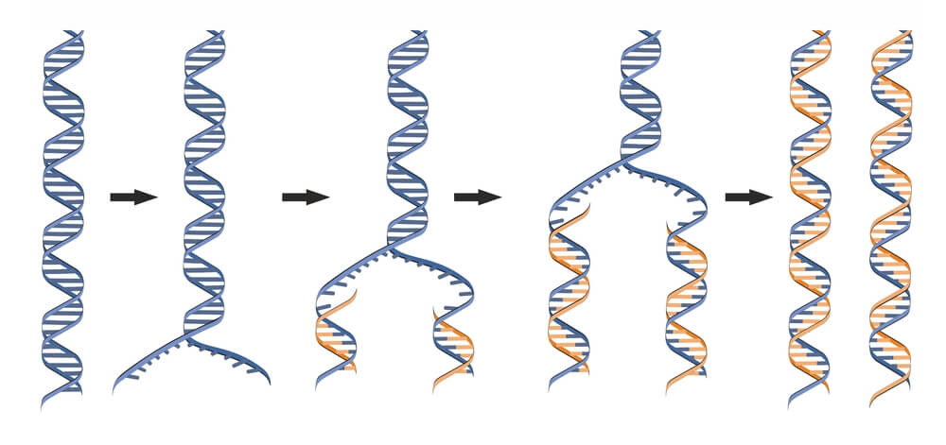
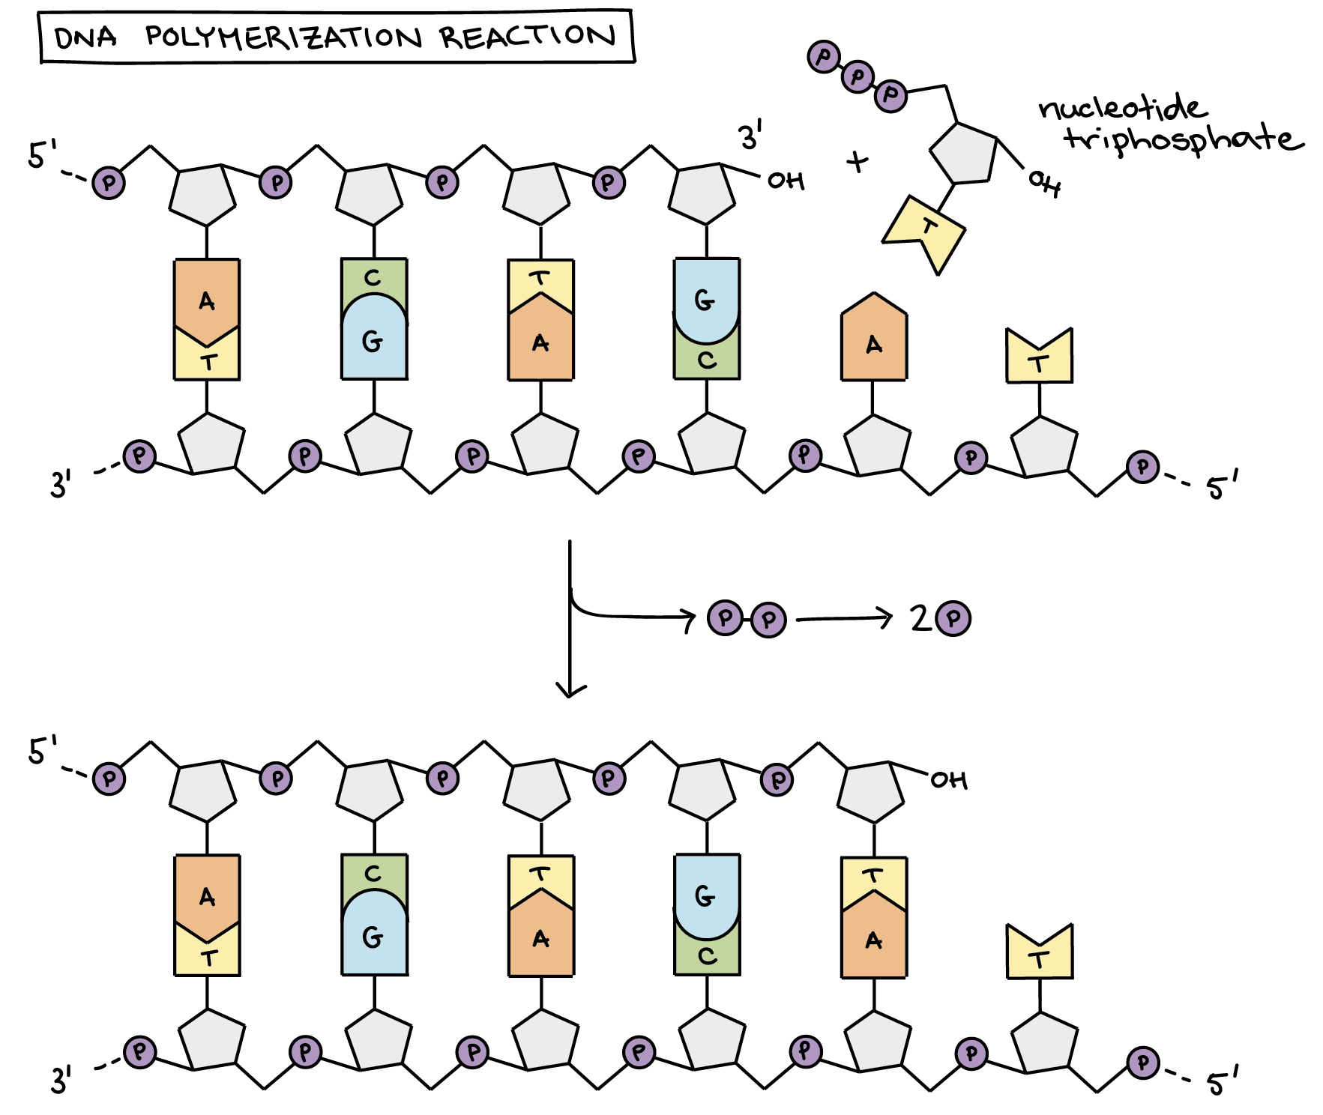
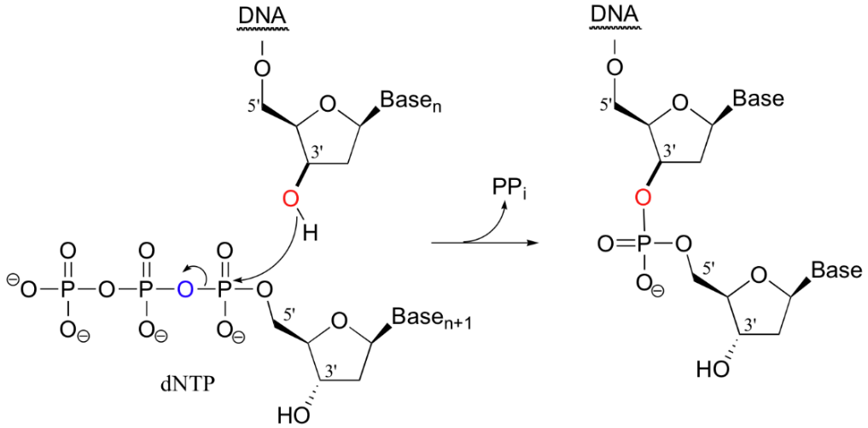
DNA Polymerase – Fundamental Activity.
5’ to 3’
polymerization
Where on the deoxyribose is the new base added?
2. What determines which base is to be added?
Phosphodiester linkage
ester linkage
pyrophosphate
Notes:
dNTP deoxyribonuceleoside triphosphate.

Slide 3
DNA Polymerase – Fundamental Activity.
5’ A-T-C-A
3’A-T-G-C-C-G-T-A-G-T-C-G-T-A-C-A-G-T-A-C-G-T-G-C-A
1 2 3 4 5 6 7 8 9 0 1 2 3 4 5 6 7 8 9 0 1 2 3 4 5
1 2
Where (what position) will this primer (ATCA) anneal?
What base will be added first?
What is the last base added?

Slide 4
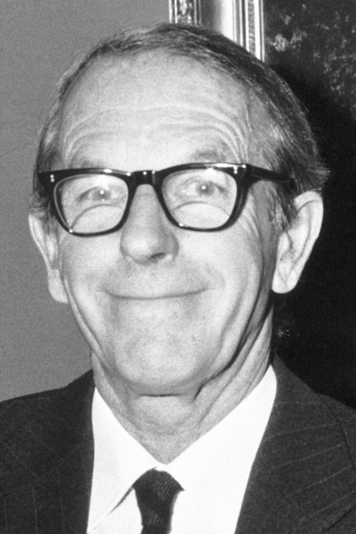
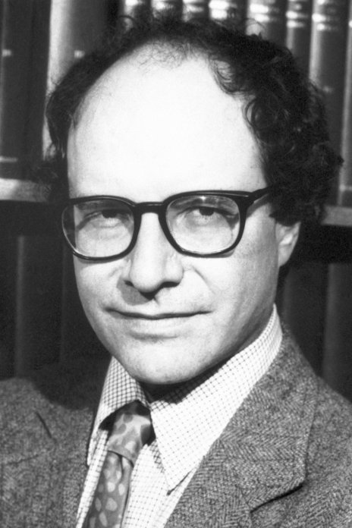
DNA Sequencing – Sanger (dideoxy) Sequencing
DNA Sequencing - Determining the Order of Bases in the DNA.
Sanger Sequencing:
Second method to generate long (~1000 base) sequence information (an earlier chemical method developed by Gilbert proved to be impractical for most laboratories (hydrazine = rocket fuel was required)
Sanger was awarded his 2nd Nobel prize for this work in 1980, shared with Gilbert.
Determine the position of all four bases in a DNA strand = Sequence (video)
Sanger Sequencing:
Sequenced region (~1000 bases)
5’----C-T-T-C-A-G-C-T-T-A-G-T-A-A-T-C-C-G-G-T-A-C-G-T-G-C-A----
Template
3’----G-A-A-G-T-C-G-A-A-T-C-A-T-T-A-G-G-C-C-A-T-G-C-A-C-G-T----
Primer
^{5’}C-T-T-A^{OH}
Template
3’----G-A-A-G-T-C-G-A-A-T-C-A-T-T-A-G-G-C-C-A-T-G-C-A-C-G-T----

Slide 5
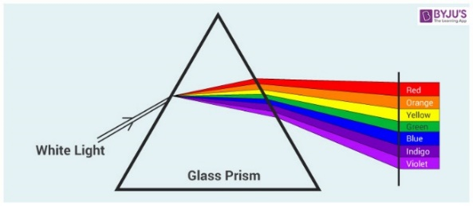
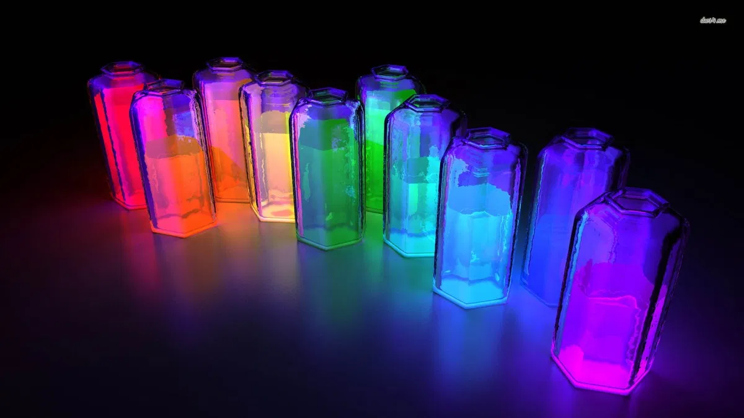
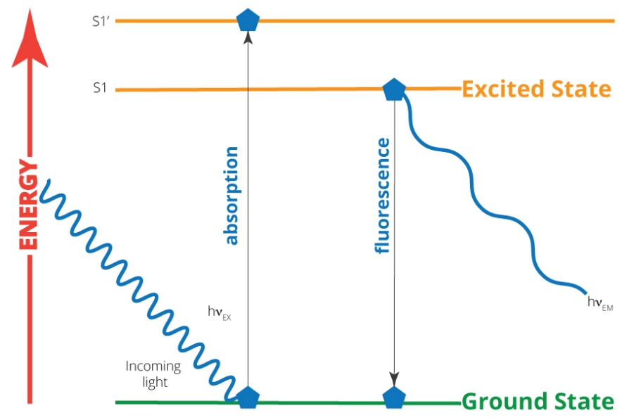
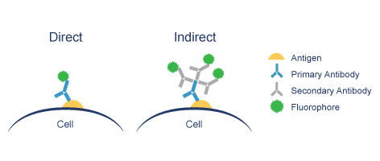
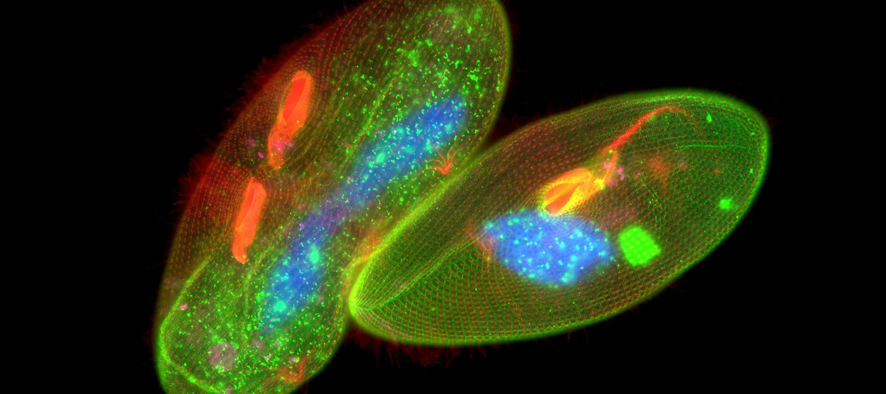
What is fluorescence?
When molecules absorb light an electron goes from a lower shell to a higher shell. This is where the energy from the light goes.
In most molecules the electron goes back down to its original shell with the release of heat.
Fluorescent molecules emit the energy as light of a longer wavelength (different color).
The color that is emitted depends on the molecule.
Fluorescently tagged antibodies can be used to stain components of cell with fluorophores.

Slide 6
DNA Sequencing - Determining the Order of Bases Added by DNA Polymerase
1. Start sequencing at known location with primer that anneals at a unique location on the plasmid, “upstream” from the region to be sequenced.
First base is added here.
All DNA molecules begin here.
5’C-T-T-A
3’-A-G-T-C-G-A-A-T-C-A-T-T-A-G-G-C
Known Seq (plasmid)
Unknown sequence
(insert)

Slide 7
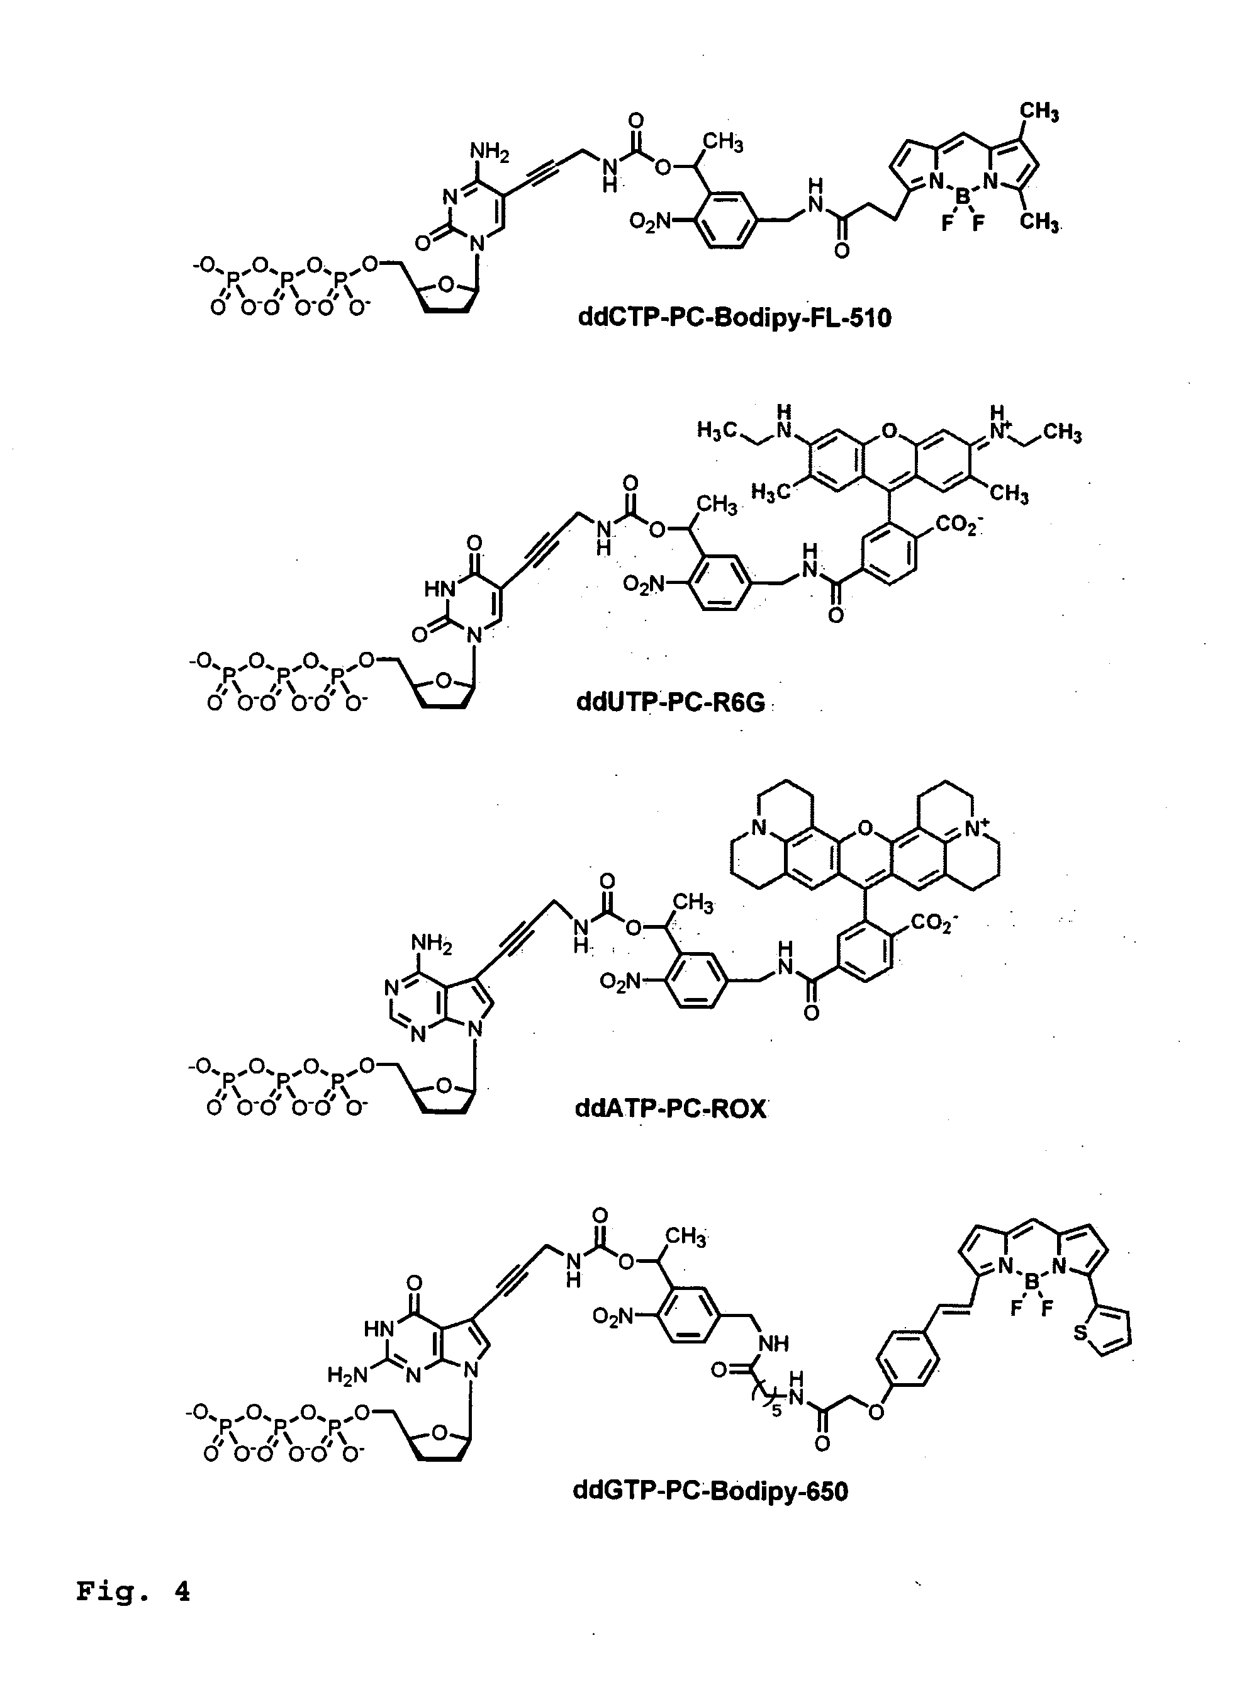
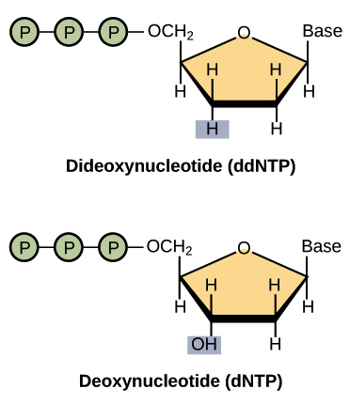
DNA Sequencing - Determining the Order of Bases Added by DNA Polymerase
2. Use a mixture of normal bases (dNTPs) and dideoxy bases (ddNTP) for polymerization. Ratio of dNTP to ddNTP is (100:1), most of the time elongation occurs.
ddNTPs can be added to the DNA since they have a 5’-triphosphate but terminate the chain due to the lack of a 3’-OH. ~ 1 in 100 chains terminate at each base addition
3. The ddNTPs are color coded by different fluorescent emission wavelengths.
The ddNTP that terminated the chain is known from its fluorescent color.
ddCTP^{H}
After
ddTTP incorporated
ddTTP^{H}
ddATP^{H}
After
dTTP incorporated
ddGTP^{H}

Slide 8
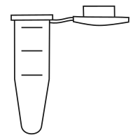
Template
Primer
DNA Pol
dTNP, ddNTP
DNA Sequencing – Generation of Fragments
Length=5, Black color
All Possible Fragments are Made:
Each begins with the primer
Each ends with a known ddNTP, based on the color of the fluorescence.
Each is one longer than the previous.
5’-C-T-T-A-G^{H}
3’-A-G-T-C-G-A-A-T-C-A-T-T-A-G-G-C
(10)
5’-C-T-T-A
3’-A-G-T-C-G-A-A-T-C-A-T-T-A-G-G-C
(990)
5’-C-T-T-A-G^{OH}
3’-A-G-T-C-G-A-A-T-C-A-T-T-A-G-G-C
(1000 molecules)
Length=6, Red color
5’-C-T-T-A-G-T^{H}
3’-A-G-T-C-G-A-A-T-C-A-T-T-A-G-G-C
(10)
5’-C-T-T-A-G^{OH}
3’-A-G-T-C-G-A-A-T-C-A-T-T-A-G-G-C
5’-C-T-T-A-G-T^{OH}
3’-A-G-T-C-G-A-A-T-C-A-T-T-A-G-G-C
(990 molecules)
(980)
Length=7, Green color
C-T-T-A-G
C-T-T-A-G-T
C-T-T-A-G-T-A
C-T-T-A-G-T-A-A
C-T-T-A-G-T-A-A-T
C-T-T-A-G-T-A-A-T-C
C-T-T-A-G-T-A-A-T-C-C
C-T-T-A-G-T-A-A-T-C-C-G
5’-C-T-T-A-G-T-A^{H}
3’-A-G-T-C-G-A-A-T-C-A-T-T-A-G-G-C
(10)
5’-C-T-T-A-G-T^{OH}
3’-A-G-T-C-G-A-A-T-C-A-T-T-A-G-G-C
5’-C-T-T-A-G-T-A^{OH}
3’-A-G-T-C-G-A-A-T-C-A-T-T-A-G-G-C
(980 molecules)
(970)
Primer
Added by Pol.

Slide 9
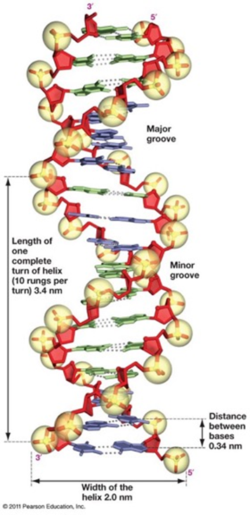
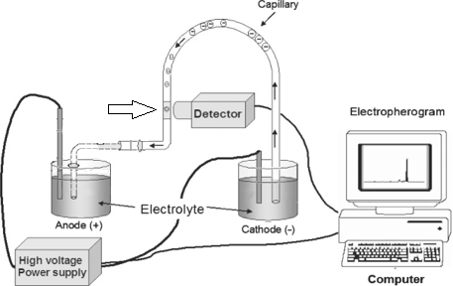
Size Determination of Fragments from DNA Sequencing Capillary Electrophoresis
Capillary
Sample loaded
Fluorescence excitation
DNA has a negative charge.
It will migrate towards the anode.
Capillary is filled with a gel that causes separation by size.
DNA molecules that are smaller migrate _____________.

Slide 10
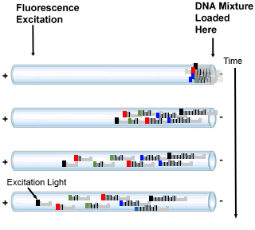
DNA Sequencing – Analysis of Fragments to Determine Order of Addition
4. Capillary Gel Electrophoresis
Migration due to the voltage because of the neg. charge on DNA phosphates
Separation of DNA molecules by size, smaller travel through gel faster.
Fragments reach the detector in the order of their length: primer+1 first, primer+2 second, etc.
At the detector, a laser excites the fluorescence.
Only fluorescent DNA molecules (terminated with ddNTP) give a signal.
The color of the emitted fluorescence gives the dideoxy base at the 3’ end of the DNA fragment.
The order of peaks gives the sequence that is complementary to the template (= strand with primer).
Fluor.
Detector
C-T-T-A-G-T-A-A-T-C-C
C-T-T-A-G-T-A-A-T-C
C-T-T-A-G-T-A-A
C-T-T-A-G-T-A-A-T-C-G
C-T-T-A-G-T
C-T-T-A-G-T-A-A-T
C-T-T-A-G
C-T-T-A-G-T-A
Fluorescent output over time.
G-T-A-A-T-C-C-G
3’-A-G-T-C-G-A-A-T-C-A-T-T-A-G-G-C---
5’C-T-T-A
Time

Slide 11
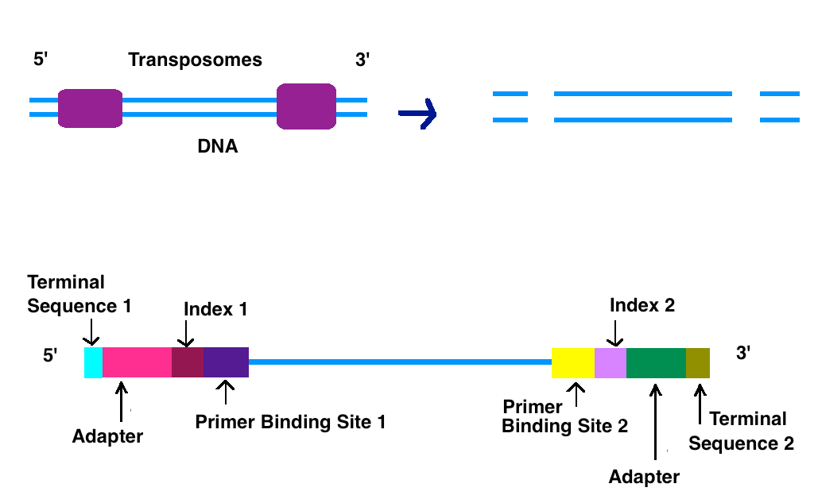
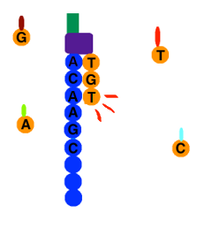
Newer Sequencing Methods-Illumina Dye Sequencing – Next Generation High Throughput
A. Obtaining the DNA
B. Sequencing by synthesis – Fluorescent labeling & reversible 3’-OH blocking
Addition of T
The entire genome can be sequenced.
The DNA is fragmented into small 100 base pieces.
Synthetic DNA is added to the ends (sites for primers for sequencing)
Different fragments are bound to different location on a chip.
All fragments are sequenced at the same time on a chip.
Only one base is added at a time (3’-OH is blocked)
The base that is added is determined by the color of the fluorescent base.
3’-OH blocking group and the fluorescent group are removed prior to the next addition. ~100 cycles can be performed.
By DMLapato - Own work, CC BY-SA 4.0, https://commons.wikimedia.org/w/index.php?curid=43777596
Method | Read Length | Samples Processed
Sanger | ~1000 | 1
Illumina | ~100 | ~1000s

Slide 12
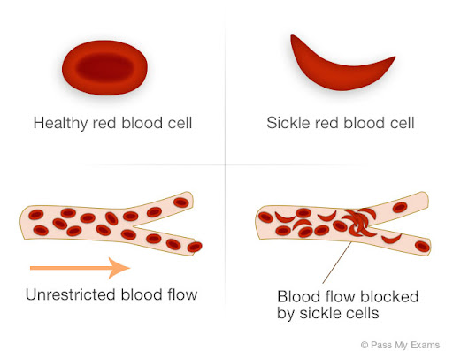
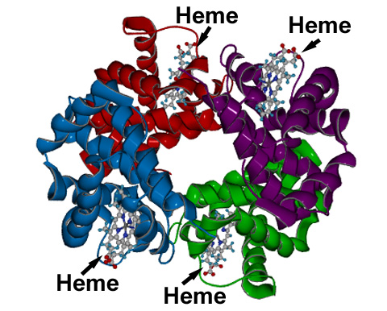
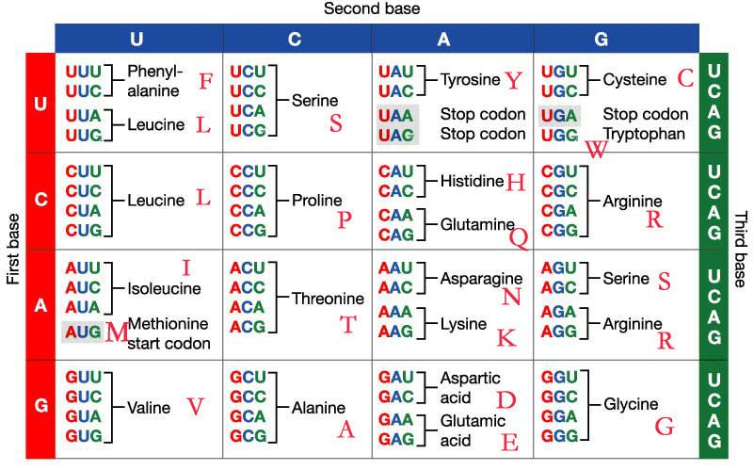
Genotyping at the Molecular Level with DNA Sequencing.
Sickle cell anemia is caused by a single mutation in the beta chain of hemoglobin
This mutation causes the hemoglobin to form long polymers that distort the shape of the red blood cell.
Determining whether someone has the mutation can be useful for treatment.
The 5’ end of the Hb gene is shown on the right (ATG=start). Using GGTGCCAG as a sequencing primer gives the following sequences for the normal and mutant genes:
First dd-base added by polymerase
GGTGCCAGaggatggtgcacctgactcctgaggagaagtc..
CCACGGTCtcctaccacgtggactgaggactcctcttcag..
The sequencing data for the normal beta chain is:
aggatggtgcacctgactcctgaggagaagtctgccgttact...
MetValHisLeuThrProGluGluLysSerAlaValThr...
The sequencing data for the mutation with sickle cell is:
Aggatggtgcacctgactcctgtggagaagtctgccgttact...
MetValHisLeuThrProValGluLysSerAlaValThr...
False color code:
A=Green
G=Black
T=Red
C=Blue

Slide 13
Sequencing Summary & Expectations
Sanger Sequencing:
Gives the sequence that is complementary to the template strand = “top” strand, same strand at the primer.
The start of the sequencing information is defined by a primer that anneals to the template (therefore some of the sequence has to be known, how this is done will be described later)
Dideoxy sequencing is carried out by adding both dideoxynucleotide triphosphates (ddNTPs) and deoxyribonucleotide triphosphates (dNTPs) to the synthesis reactions, at a ratio of 1:100. Most growing chains do not terminate.
ddNTPs are identical to dNTPs except that they lack the 3' hydroxyl group. Because of the missing 3’-OH, DNA polymerization stops once one ddNTP is added to a growing strand.
The type of the added base is determined by “color coding” each base.
The location of added bases is determined by measuring the size of the DNA fragment that was terminated by the ddNTP.
It is possible to sequence approximately 1000 bases by this method.
Next Gen-Sequencing:
Simultaneous sequencing of a large number of fragments
Shorter “reads” 100 versus 1000 bases/template
Expectations:
Can you explain how the colored peaks are generated by random termination using dideoxybases in Sanger Sequencing?
Can you compare and contrast major features of Sanger and Next-Gen Sequencing?
gcagatgatacagtattagaagaaatgaGtttgccaggaaGatggaaaccaaaaatgata....

Slide 14
Polymerase Chain Reaction -PCR
In 1983, Kary Mullis developed the molecular biology technique that has since revolutionized genetic research, earning him the Nobel Prize in 1993.
PCR had an impact on four main areas of biotechnology: gene mapping, cloning, DNA sequencing, and gene detection (e.g. coronavirus).
PCR is now used as a medical diagnostic tool to detect specific mutations that may cause genetic disease, in criminal investigations and courts of law to identify suspects on a molecular level, and in the sequencing of the human genome.
Expectations:
Be able to explain how PCR works to amplify a segment of DNA.
Be able to give the left and right primers.
Apply PCR approaches to determine genotype and detection of viruses.

Slide 15
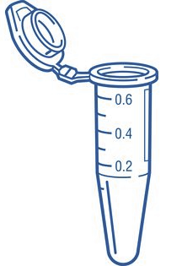
Polymerase Chain Reaction
PCR is an in vitro DNA synthesis reaction in which a specific section of DNA is replicated over and over generating exponentially large amounts of a specific piece of DNA from trace amounts of starting material (template).
Template can be trace amounts of DNA from a drop of blood, a single hair follicle, or a cheek cell.
The region of DNA that is copied is specified by the sequence of two primers, which are short ssDNA that initiate polymerase activity. The primers are in vast excess over the DNA.
The location of the amplified segment is defined by two primers (left = upstream, right = downstream):
they anneal to their templates according to Watson-Crick pairing rules (A-T, G-C),
initiate polymerization from those sites,
they are incorporated into the final PCR product.
Left primer = sequence of top strand at left boundary
Right primer = sequence of bottom strand at right boundary
The primers are DNA and are synthesized chemically, they can be any desired sequence.
If there is no homology between the primers and the input DNA, then no PCR product will be formed.
Each PCR cycle consists of three steps:
Denaturation of the DNA to make it single stranded (2 min at 98 C)
Lowering of temperature to let the primers form double-stranded DNA (1 min at 55 C)
Elongation by DNA polymerase (1 min/kb at 78 C)

Slide 16
PCR – Primer Design
Before a region of DNA can be amplified, one must identify and determine the sequence of a piece of DNA upstream and downstream of the region of interest.
These areas are then used to determine the sequence of oligonucleotide primers that will be synthesized and used as starting points for DNA replication.
Primers are complimentary to the up- and down-stream regions of the sequence to be amplified, so they stick, or anneal, to those regions.
Left primer = sequence of top strand on the left. This primer will anneal to the bottom strand.
Right primer = sequence of bottom strand on the right. This primer will anneal to the top strand.
Primers are in large excess over the template DNA, they are never used up and they are incorporated into the final PCR product.
Amplified region
Amplified region
5’--AAGCTGACTAGTCGATGCGAATGTGCGGTGC—3’
3’--TTCGACTGATCAGCTACGCTTACACGCCACG—5’
Know these rules!
^{5’}CTGAC
ACACG5’ = 5’GCACA
CTGACTAGTCGATGCGAATGTGC
GACTGATCAGCTACGCTTACACG
Note: Actual primer lengths are 20-30 bases, in the illustrations here and on problem sets, much shorter primers are used.

Slide 17
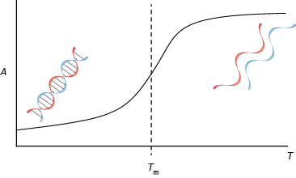
PCR Step 1 - Thermal Stability of Double Stranded DNA (dsDNA)
5’ A-T-C-A
3’A-T-G-C-C-G-T-A-G-T-C-G-T-A-C-A-G-T-A-C-G-T-G-C-A
5’ A-T-C-A
3’A-T-G-C-C-G-T-A-G-T-C-G-T-A-C-A-G-T-A-C-G-T-G-C-A

Slide 18
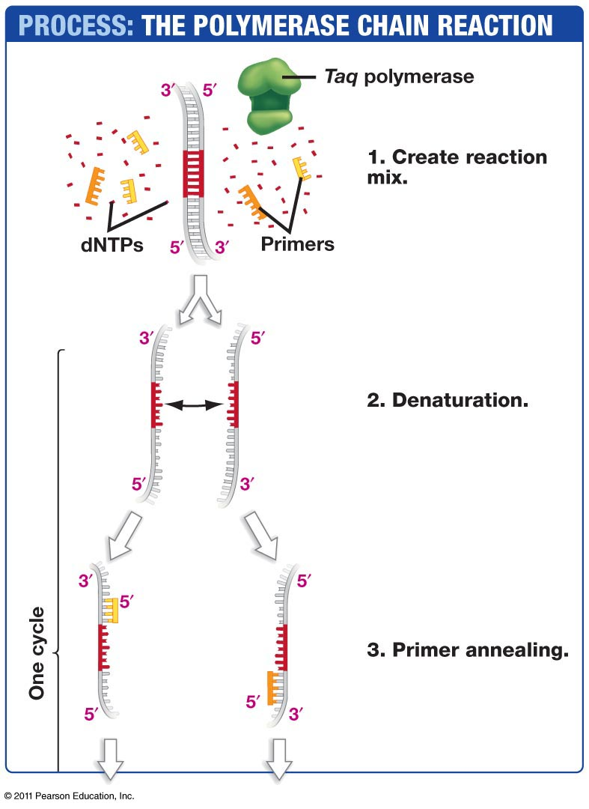
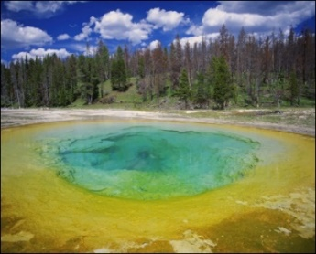
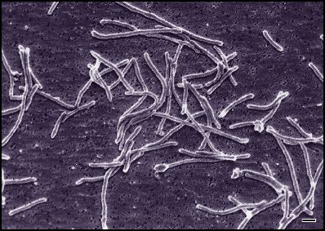
PCR Step 1 - Thermostable Polymerases
If we heat up the DNA to temperatures high enough that it denatures into single stranded form, (temperatures of between 60°C and 94°C) what will happen to our DNA polymerases?
Most DNA polymerases are destroyed at this high temperature.
How can we synthesize DNA is all of our DNA polymerases are destroyed?
Utilize a thermostable polymerase
DNA Polymerase
Thermus Aquaticus
http://www.mun.ca/biology/scarr/Thermus_aquaticus.html

Slide 19
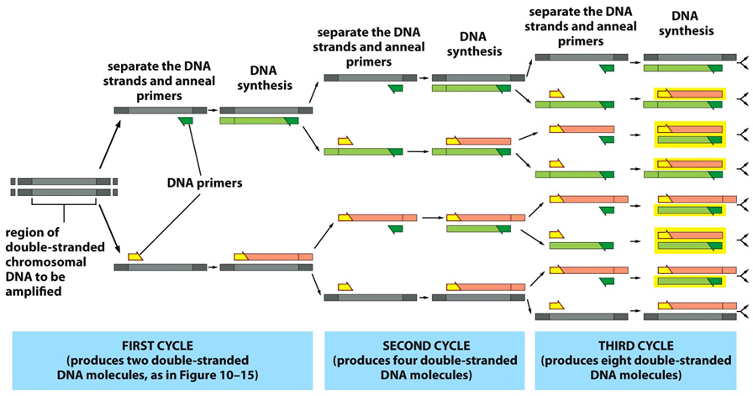
Three PCR Cycles
Other end of PCR product is defined by starting at the primer, using the new DNA as the template.
One end of PCR product is defined by starting at the primer.
After 30 cycles there will be 2³⁰, or over 1 billion times more copies than at the beginning!!!

Slide 20
PCR Animation
Watch Me!
Notes:
2 ½ min

Slide 21
Detailed Events during first Three PCR Cycles
Cycle I
Cycle II
--AAGCTGACTAGTCGATGCGAATGTGCGGTGC--
--TTCGACTGATCAGCTACGCTTACACGCCACG--
--AAGCTGACTAGTCGATGCGAATGTGCGGTGC--
--TTCGACTGATCAGCTACGCTTACACG5’
5’CTGACTAGTCGATGCGAATGTGCGGTGC--
--TTCGACTGATCAGCTACGCTTACACGCCACG--
Denature & Anneal
--AAGCTGACTAGTCGATGCGAATGTGCGGTGC--
ACACG5’
5’CTGAC
--TTCGACTGATCAGCTACGCTTACACGCCACG--
Denature & Anneal
--AAGCTGACTAGTCGATGCGAATGTGCGGTGC--
5’CTGAC
--TTCGACTGATCAGCTACGCTTACACG5’
5’CTGACTAGTCGATGCGAATGTGCGGTGC--
ACACG5’
--TTCGACTGATCAGCTACGCTTACACGCCACG--
Polymerase
--AAGCTGACTAGTCGATGCGAATGTGCGGTGC--
<-TTCGACTGATCAGCTACGCTTACACG5’
5’CTGACTAGTCGATGCGAATGTGCGGTGC->
--TTCGACTGATCAGCTACGCTTACACGCCACG--
Polymerase
--AAGCTGACTAGTCGATGCGAATGTGCGGTGC--
5’CTGACTAGTCGATGCGAATGTGC
--TTCGACTGATCAGCTACGCTTACACG5’
5’CTGACTAGTCGATGCGAATGTGCGGTGC--
GACTGATCAGCTACGCTTACACG5’
--TTCGACTGATCAGCTACGCTTACACGCCACG--
Now have one strand of the product
So far - defined one end of the product
Final Product
CTGACTAGTCGATGCGAATGTGC
GACTGATCAGCTACGCTTACACG

Slide 22
Detailed Events during first Three PCR Cycles
Example – follow the PCR cycles for the following template with primers 5’ AATT (left) and 5’ GGCC (right)
Cycle 3
5’CTGACTAGTCGATGCGAATGTGC
--TTCGACTGATCAGCTACGCTTACACG5’
5’CTGACAGTCGATGCGAATGTGCGGTGC--
GACTGTCAGCTACGCTTACACG5’
----AATT-------------------------GGCC----
----TTAA-------------------------CCGG----
Denature & Anneal
5’CTGACTAGTCGATGCGAATGTGC
ACACG5’
--TTCGACTGATCAGCTACGCTTACACG5’
5’CTGACAGTCGATGCGAATGTGCGGTGC--
5’CTGAC
GACTGTCAGCTACGCTTACACG5’
Now have complete PCR product. This is doubled in each of the following cycles.
Note that the primers are the first bases at the beginning of each strand.
Polymerase
5’CTGACTAGTCGATGCGAATGTGC
GACTGATCAGCTACGCTTACACG5’
--TTCGACTGATCAGCTACGCTTACACG5’
5’CTGACAGTCGATGCGAATGTGCGGTGC--
5’CTGACAGTCGATGCGAATGTGC
GACTGTCAGCTACGCTTACACG5’

Slide 23
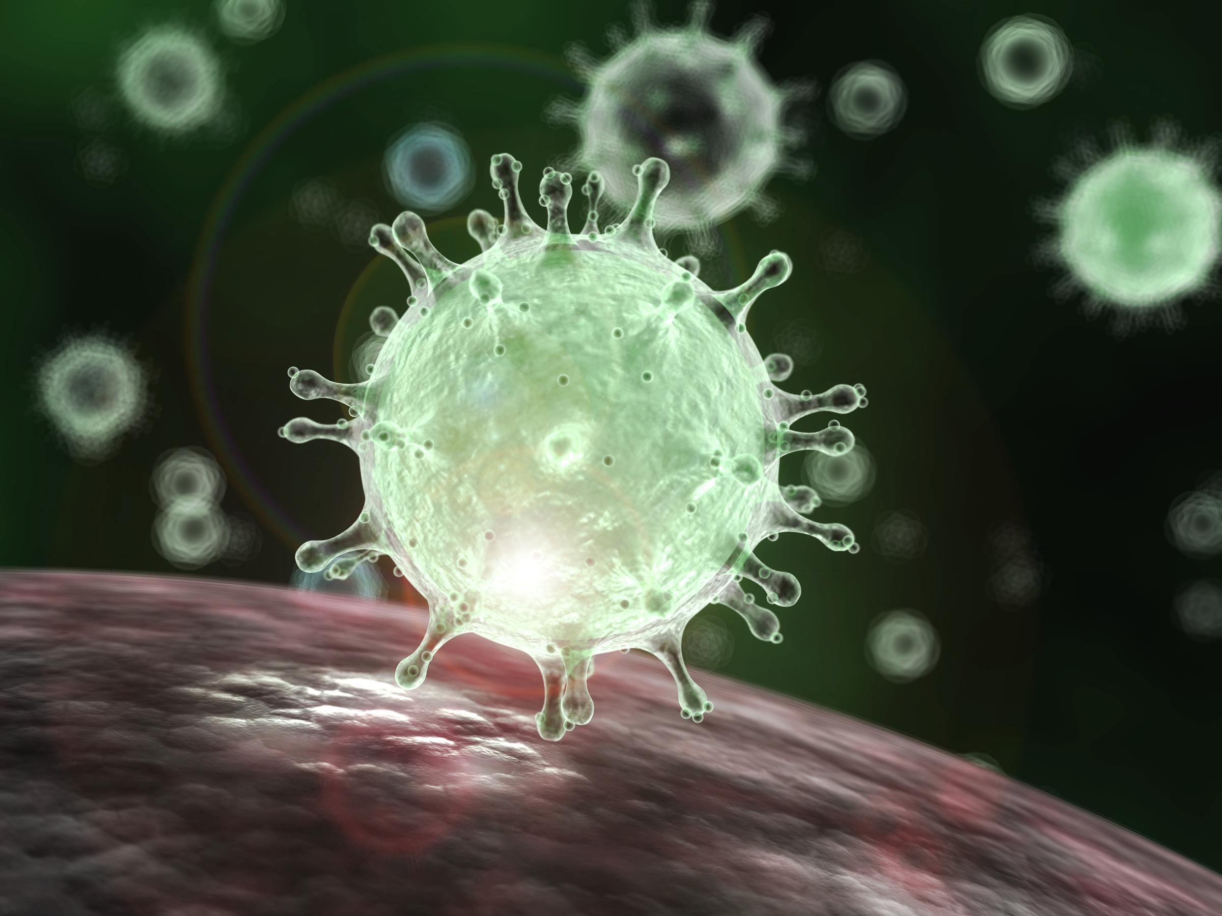
PCR & Detection of Viruses
Sequence of Covid-19 (top strand only)
Coronavirus
1 attaaaggtt tataccttcc caggtaacaa accaaccaac tttcgatctc ttgtagatct
61 gttctctaaa cgaactttaa aatctgtgtg gctgtcactc ggctgcatgc ttagtgcact
121 cacgcagtat aattaataac taattactgt cgttgacagg acacgagtaa ctcgtctatc
181 ttctgcaggc tgcttacggt ttcgtccgtg ttgcagccga tcatcagcac atctaggttt
28261 cgaacaaact aaaatgtctg ataatggacc ccaaaatcag cgaaatgcac cccgcattac
28321 gtttggtgga ccctcagatt caactggcag taaccagaat ggagaacgca gtggggcgcg
28381 atcaaaacaa cgtcggcccc aaggtttacc caataatact gcgtcttggt tcaccgctct
28441 cactcaacat ggcaaggaag accttaaatt ccctcgagga caaggcgttc caattaacac
29701 gggaggactt gaaagagcca ccacattttc accgaggcca cgcggagtac gatcgagtgt
29761 acagtgaaca atgctaggga gagctgccta tatggaagag ccctaatgtg taaaattaat
29821 tttagtagtg ctatccccat gtgattttaa tagcttctta ggagaatgac aaaaaaaaaa
29881 aaaaaaaaaa aaaaaaaaaa aaa
CDC Recommended PCR Primers
dsSeq of above bold & circled region
28271 aaaatgtctgataatggaccccaaaatcagcgaaatgcaccccgcattacgtttggtggaccctcagattcaactggcagtaaccagaatggagaacgca
ttttacagactattacctggggttttagtcgctttacgtggggcgtaatgcaaaccacctgggagtctaagttgaccgtcattggtcttacctcttgcgt
PCR Product
GACCCCAAAATCAGCGAAATGCACCCCGCATTACGTTTGGTGGACCCTCAGATTCAACTGGCAGTAACCAGA CTGGGGTTTTAGTCGCTTTACGTGGGGCGTAATGCAAACCACCTGGGAGTCTAAGTTGACCGTCATTGGTCT
Will PCR generate products if the viral DNA is not present?

Slide 24
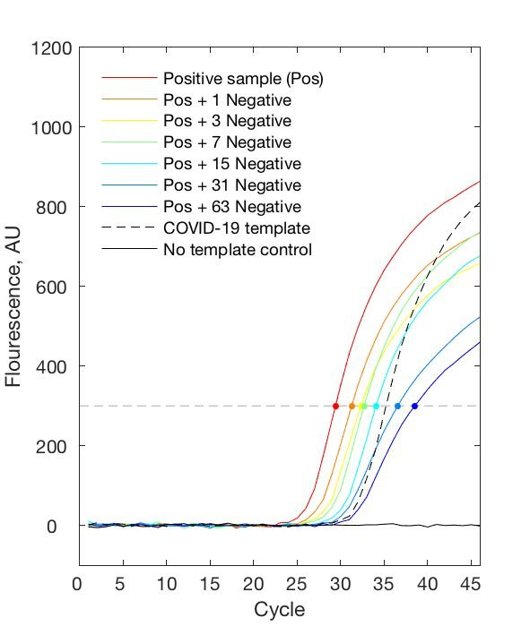
Covid 19 PCR Test: Detection of the PCR Product.
https://www.medrxiv.org/content/10.1101/2020.03.26.20039438v1
Production of PCR products (double stranded DNA) causes an increase in signal (fluorescence)
Dots represent the cross point of the fluorescence threshold (threshold = 300, gray dashed line).
Red curve (Positive sample) shows a threshold level of PCR product after 27 cycles.
Next 6 samples are the positive sample mixed with up to 63 negative samples, showing that it is possible to test pooled samples.
- - - is a positive control amount of Covid template. It shows that you can detect a PCR product if the covid genome is present.
Solid black line is a negative control, no Covid DNA. It shows that addition of covid template will lead to a signal.
Amount of PCR Product
Number of PCR Cycles

Slide 25
Application of PCR – Identification of Individuals
Regions of DNA have variable numbers of repeated DNA sequences (Short tandem repeats, STR) that differ from one person to the next.
STR
--TGCCGACTCGTAGGCCAGGCCAGGCCAGGCCACTGGTGAGGTACG--
--ACGGCTGAGCATCCGGTCCGGTCCGGTCCGGTGACCACTCCATGC--
Individuals will inherit one copy of the repeat from each parent. The length of the inherited DNA can be the same or different.
PCR Primers are designed to be outside the repeated region, so that they will anneal to a single location on the chromosome and then amplify the region containing the STR
PCR Product length = primer lengths + number of tandem repeats (+ any DNA between the primers and the repeats). Individuals can be differentiated by the length of the PCR product if they have different numbers of STR
5’-CCGACTC
CTCCATG-5’
CCGACTCGTAGGCCAGGCCAGGCCAGGCCACTGGTGAGGTAC
GGCTGAGCATCCGGTCCGGTCCGGTCCGGTGACCACTCCATG
Which individual has the shortest PCR product?
Which has the longest?

Slide 26
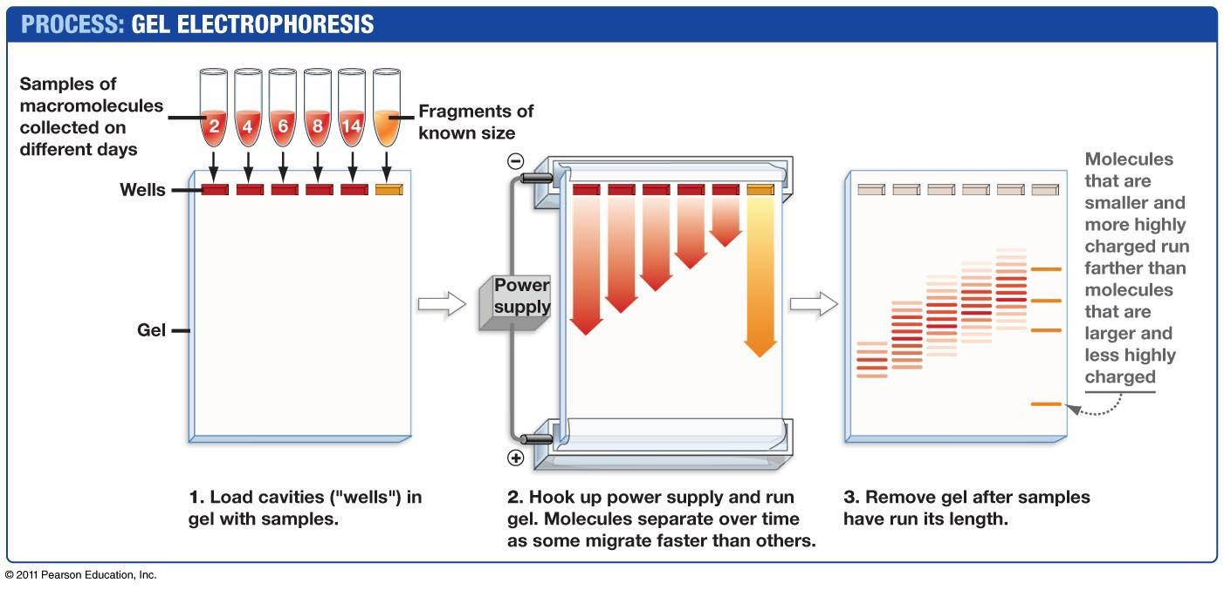
Size Determination of PCR products - Agarose Gel Electrophoresis.
https://dnalc.cshl.edu/resources/animations/gelelectrophoresis.html
Which are the smallest PCR fragments?

Slide 27
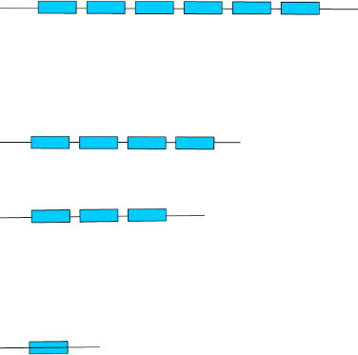
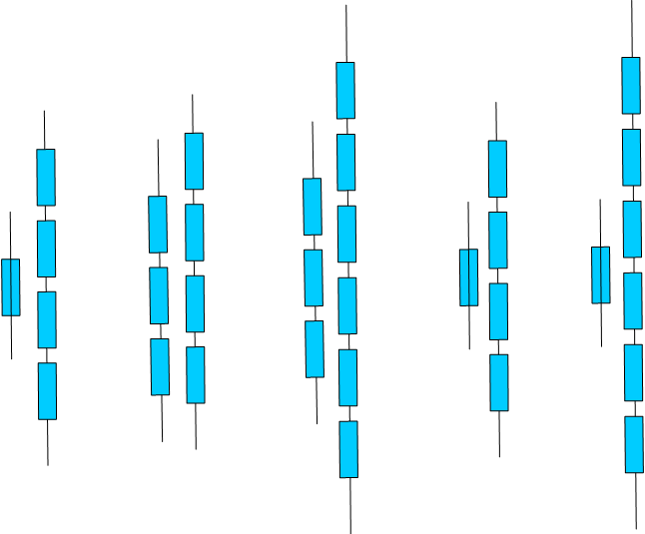
Short Tandem Repeats to Test Paternity
1. DNA samples (blood, cheek cells) would be obtained from:
Mother
Child
Candidate fathers.
2. PCR would be preformed using primers that amplify a segment of the chromosome containing repeats.
3. Each individual would show 2 bands on the gel, corresponding to the PCR product from each chromosome (we have two copies of each chromosome).
4. The child would inherit one copy from the mother and the other from the father:
One of the child’s PCR product would match one of the mothers.
The other PCR product from the child would match one of the PCR products from the father.
Top
Gel
PCR primers:
Repeat:
Lane 1: Child
Lane 2: Mother
Lanes 3-5: Possible Fathers
2. Who is not the father?
3. Who may be the father?
Child

Slide 28
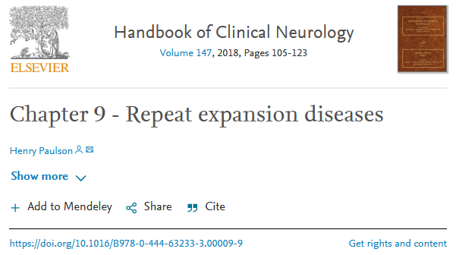
Repeat Expansions Related to Diseases
The number of repeats can be detected by:
DNA sequencing
PCR
• CAG – at least 10 diseases (Huntington disease, spinal and bulbar muscular atrophy, dentatorubral-pallidoluysian atrophy and seven SCAs)
• CGG – fragile X, fragile X tremor ataxia syndrome, other fragile sites (GCC, CCG)
• CTG – myotonic dystrophy type 1, Huntington disease-like 2, spinocerebellar ataxia type 8, Fuchs corneal dystrophy
• GAA – Friedreich ataxia
• GCC – FRAXE mental retardation
• GCG – oculopharyngeal muscular dystrophy
• CCTG – myotonic dystrophy type 1
• ATTCT – spinocerebellar ataxia type 10
• TGGAA – spinocerebellar ataxia type 31
• GGCCTG – spinocerebellar ataxia type 36
• GGGGCC – C9ORF72 frontotemporal dementia/amyotrophic lateral sclerosis
• CCCCGCCCCGCG – EPM1 (myoclonic epilepsy)

Slide 29
Introduction to Immunology
Branches of the immune system (Innate and acquired)
Properties of antibodies (Quaternary structure, antigen recognition)
How antibodies are produced:
Genome DNA changes
mRNA splicing
Cellular export
4. How antibodies eliminate pathogens
Key Questions:
1. Why is the innate system important?
2. What is the origin of diversity in acquired immunity?
3. How are antibodies made.

Slide 30
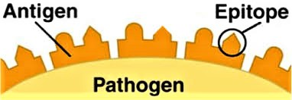
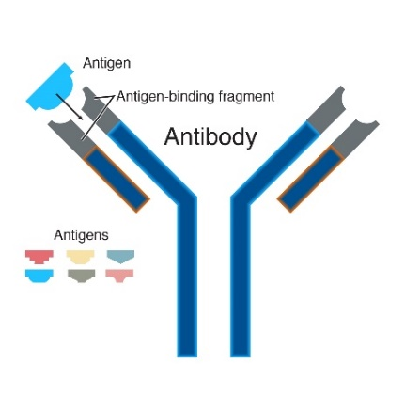
Some Important Definitions:
Antigen = something that is recognized by the immune system, e.g. bacteria, virus, pollen.
Epitope = the part of the antigen that is contacted by the antibody.
Antibody (Ab) = Y-shaped protein that recognizes antigens, found on the surface of B-cells or secreted by plasma cells. When bound to antigen, it can initiate a process that results in the destruction of the antigen. Specificity is high due to AA sequence in the variable segments.
Immunoglobulin (Ig) = antibody.
B-cell = involved in antibody production and recognition of pathogen. Has antibody molecule on its surface (as part of the B-cell receptor). Develops into plasma cells after activation by T_{H} cells. Called B-cells because they are generated in the organ called the Bursa in birds.
Plasma cell = derived from B-cell after activation of the B-cell, produces secreted antibodies with the same specificity as the original B-cell.
T_{H} cell = T-helper: Required to activate both B and T_{C} cells, as well as other cells in the immune system.
Called T-cells because they mature in the thymus.
T_{c} cell = T-cellular: Involved in defense against viruses and cancer.
TCR = T-cell receptor – found on the surface of T-cells, recognizes MHC proteins + bound peptide, RTK.
T_{c} cell = recognizes MHC I + peptide
T_{H} cell = recognizes MHC II + peptide
MHC = major histocompatibility complex – required for acquired immunity (basis of transplant rejection)
MHC I = protein found on the surface of all cells, “presents” peptides derived from the proteins that were made by the cell. The MHC-peptide complex is recognized by T_{c} cells. Only foreign peptides produce a response.
MHC II = on the surface of B-cells, macrophages, and dendritic cells. Presents external peptides to T_{H} cells, leading to activation of the cell by T_{H} cells. Only foreign peptides produce a response.

Slide 31
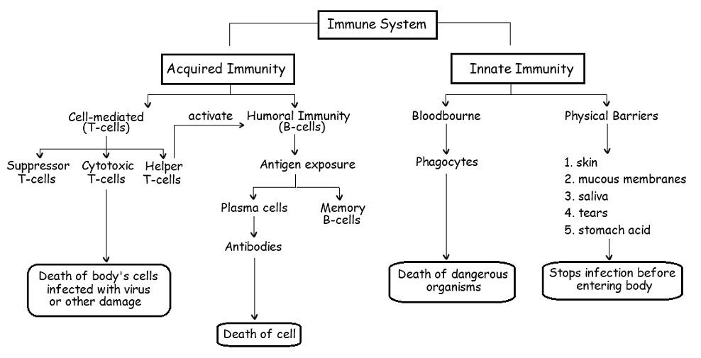
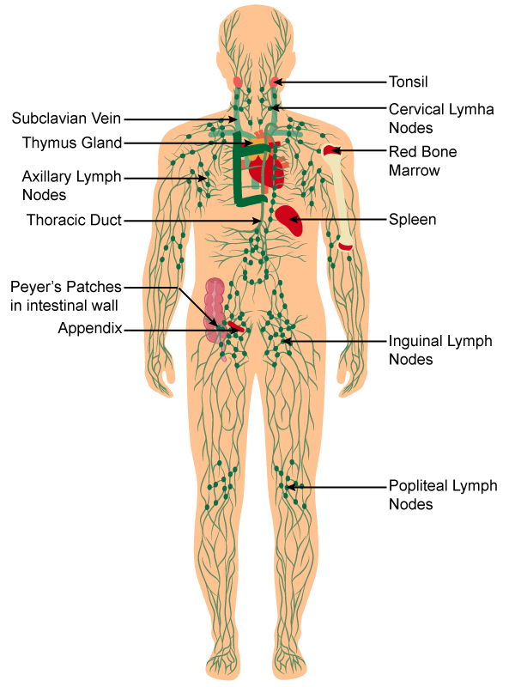
Branches of the Immune System:
http://ibbiologyhelp.com/AnimalPhysiology/antibodyproduction.html
Neutrophil
Macrophage
Dendritic cell
Important primary lymphatic organs: bone marrow (B), thymus (T)-Generate all immune cell.
Important secondary lymphatic organs: lymph nodes, spleen, Peyer’s patches – Activation of immune cells.
Why is the innate system essential?
A pathogen doubles every hour.
It takes 7 days to produce antibody (1st exposure)
How many bacteria would be present if they grew uncontrolled for 7 days (=2 ^{24 x 7})
(there are approximately 10¹³ cells in the human body)
https://www.topperlearning.com/
Notes:
3.7 e 50 cells

Slide 32
B-Cell Biology - From Stem Cells to Pathogen Killing.
1. Generation of high diversity of chains during development of stem cells to B-cells in bone marrow.
DNA rearrangements to generate functional exons for variable segments of both light and heavy chain.
2. Molecular & cellular biology of membrane bound antibodies on cell surface = B-cell receptor (BCR)
Transcriptional enhancers, mRNA splicing
Light chain and heavy chain exported to surface of B-cells.
3. Self tolerance test to prevent autoimmune diseases, autoreactive B-cells eliminated.
4. Encounter and capture of antigen in lymph nodes
5. Activation of B-cells by T_{H} cells
Peptides from pathogen presented on major histocompatibility proteins (MHC II).
T-cell activation by tyrosine kinase receptors (T-cell Receptor, TCR), secretion of signaling molecules.
6. Development of
Plasma cells - Production of soluble antibodies of the same specificity as the parent B-cell.
B-memory cells (basis of immunity)
T-memory cells (basis of immunity)
7. Destruction of Pathogens
Fc region of antibody binds to Fc Receptor on NK cells, neutrophiles, macrophages
Pathogen internalized and destroyed.
BCR – B-cell receptor = antibody + signaling chains.
TCR – T cell receptor = MHC-peptide recognition + signaling.

Slide 33
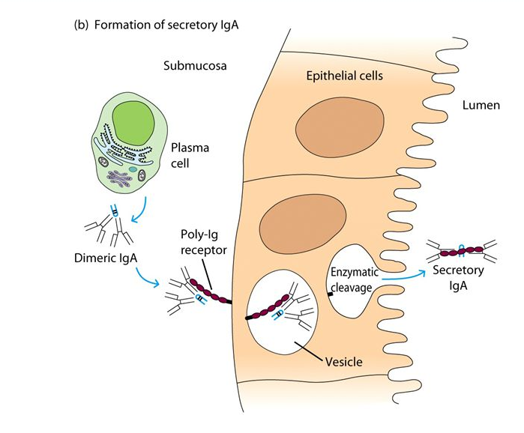
Antibodies Inactive Pathogens by Many Mechanisms
Antibodies can be Secreted Outside the Body (10 g/day).
Antibodies can target tumor cells.
Lancet, 373, 966B, P1033

Slide 34
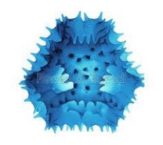
Production of Antibodies by B-cells
Primary Structure of Antibodies:
Light chain sequences:
M..TSERTQYESTTY...
M..AAFQRTYESTTY...
1.....110......210
(one letter AA code)
Each Antibody:
Two identical light chains
Two identical heavy chains
First ~100 Amino acids on each chain are called the variable region and differ from antibody to antibody.
Unique sequence for variable region of both heavy and light chains – defines specificity
Constant regions - same protein sequence for all.
Heavy chain sequences:
M...AGLLITWHIKLPA...
M...FPREYAWHIKLPA...
1......120.......440

Slide 35
Production of Antibodies by B-cells & Plasma Cells
B- Cells & B-cell Receptor (BCR)
Each B-cell has only one type of antibody as part of its BCR (B-cell receptor), i.e. the 10⁵ BCRs are homogeneous on the same cell.
Approximately 10⁸ different specificities at any one time. i.e. 10⁸ different B-cells!
Plasma Cells:
After activation, a B-cell develops into a plasma cell.
The antibody is secreted.
The same light chains are produced.
The heavy chains differ only in the absence of the transmembrane domains.
Antigen-
binding site
Heavy
chains
Antigen-
binding site
Antigen-
binding site
Heavy
chains
Antigen-
binding site
Light chain
Light chain
Light chain
Light chain
Disulfide bond
Disulfide bond
Transmembrane domains
RTK
(domains)

Slide 36
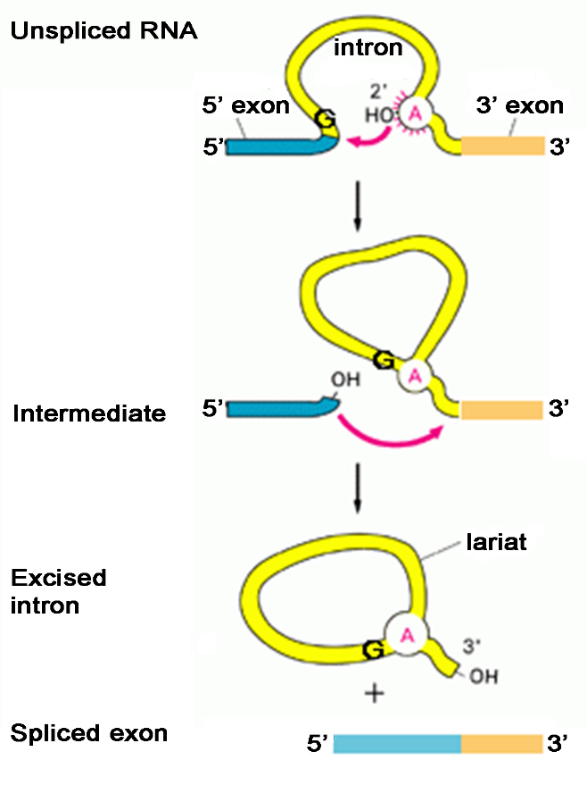
Antibody Genes are Modular – mRNA Splicing Required to Produce Final mRNA
Splice sites are recognized due to specific sequences at the exon-intron boundaries. Sequences in both the exon and intron are recognized.
When DNA sequences were aligned to RNA sequences, it was found that segments were deleted in the final RNA.
This suggested that the gene encoding a protein was coded by segments of the DNA:
Those to be in the final mRNA were called exons.
Those sections not in the mRNA were called introns (intervening sequences).
5’ splice site
3’ splice site
Branch Point
There is a 5’ splice site with a conserved sequence:
(A/C)AG|GU(A/G)AGU
There is a 3’ splice site with a conserved sequence:
CAG|G
There is an A in the intron (branch point) required for splicing.
Steps:
The branch A breaks at the 5’ splice site, forming a lariat.
The 5’-OH is joined to the 5’ end of the downstream 3’ exon.

Slide 37
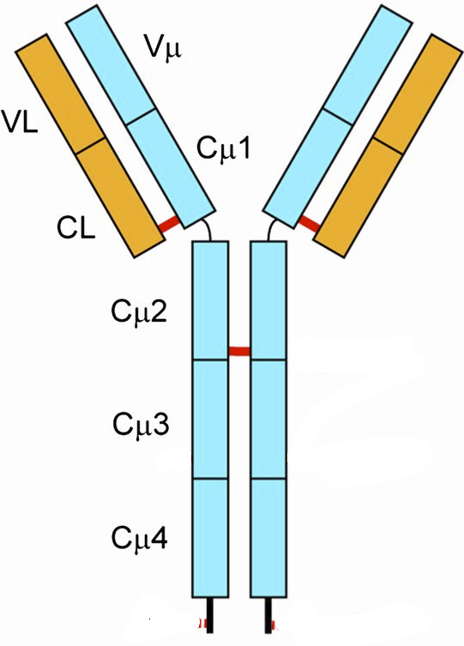
Antibody genes are assembled from DNA segments, giving many different sequences.
Production of Heavy Chain Gene:
V_{H} exon = V+D+J segment (selected at random)
The mRNA coding for antibodies contains 5 exons.
Germline/Stem cell DNA
L = leader (signal)
V = variable segment
D = diversity segment
J = joining segment
←300→
D-J joining
Random selection of D & J segments
V joining to (DJ)
Random selection of V-segment
Heavy chains have different V-sequences.
B-cell DNA
V_{H} exon differs from one cell to the next.
Heavy chains have the same constant sequences in all B-cells.
Stem cells -> B-cells
The exon that codes for the variable region of the heavy chain is generated by the random joining of a V, D, and J DNA segments.
Each B-cell will generate a unique sequence for its heavy and light chain DNA.
This is a permanent change to the DNA (genome) of the B-cell.
1. If there are 300 possible V-heavy segments, 10 possible D segments, and 6 possible J segments, how many different heavy chains can be made?

Slide 38
Light-chain genes are assembled from DNA segments, giving many different sequences.
Production of Light Chain Gene
Germline/Stem cell DNA
←100→
B-cell DNA
Light chains have different V-sequences in different B-cells.
Light chains have the same constant sequences in all B-cells.
Antibody Diversity
1. If there are 100 possible V-heavy segments and 5 possible J segments, how many different light chains can be made?
Stem cells -> B-cells
In the case of the light chain, the variable region is generated by VJ joining.
Each B-cell will generate a unique sequence for its heavy and light chain DNA.
This is a permanent change to the DNA (genome) of the B-cell.
2. If any possible heavy chain can pair with any possible light chain, how many different antibodies can be generated, assuming there are 10,000 possible heavy chains and 500 different light chains?

Slide 39
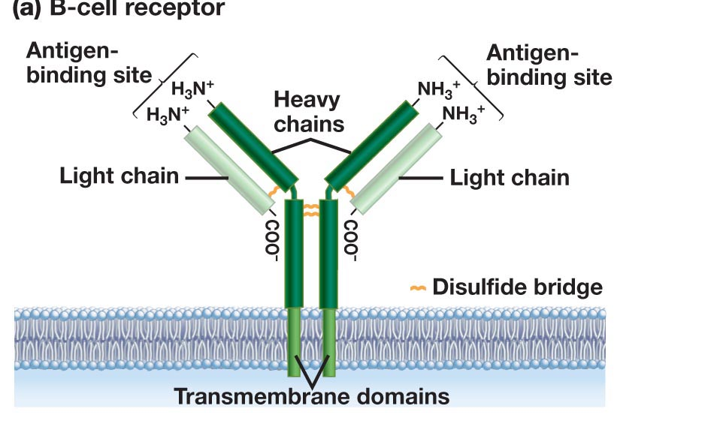
Antibody Production – From Stem Cells to B-Cells
Stem Cell
B-Cell
Rearranged light chain gene
Rearranged heavy chain gene
Transcription
mRNA Splicing
Translation
Export to cell surface (ER -> golgi -> Membrane)

Slide 40
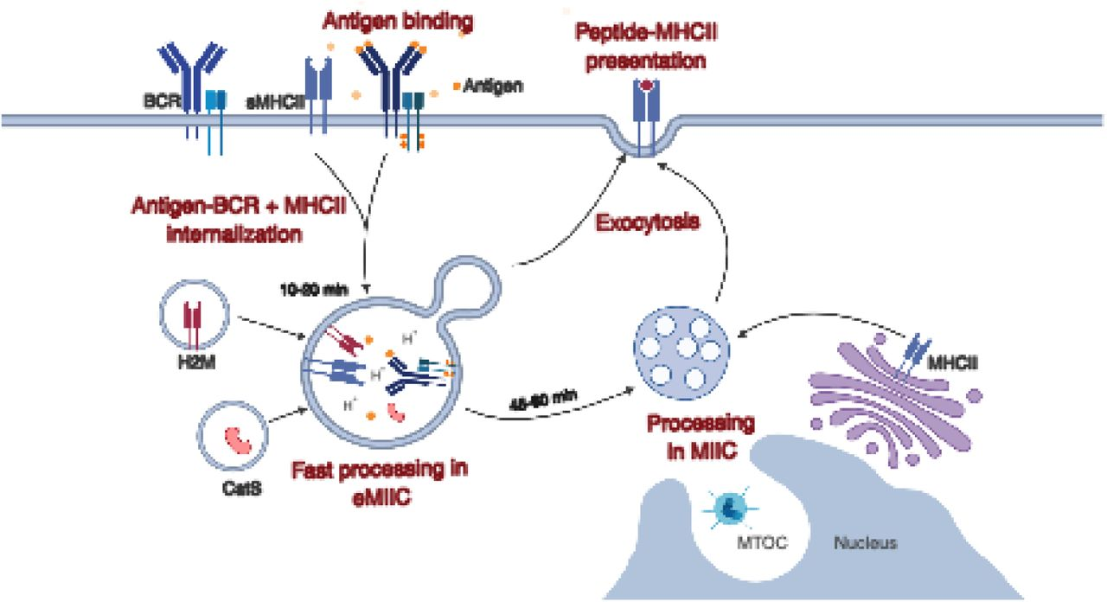
Antigen Capture by B-Cells - Endocytic Pathways
Antigen binds to variable domains of antibody on the BCR (B-cell receptor)
Antigen is internalized and digested into peptides
Peptides are loaded on to class II MHC for presentation to T-cells
Endocytosis of bacteria by a B-cell
Journal of Cell Science doi: 10.1242/jcs.235192

Slide 41
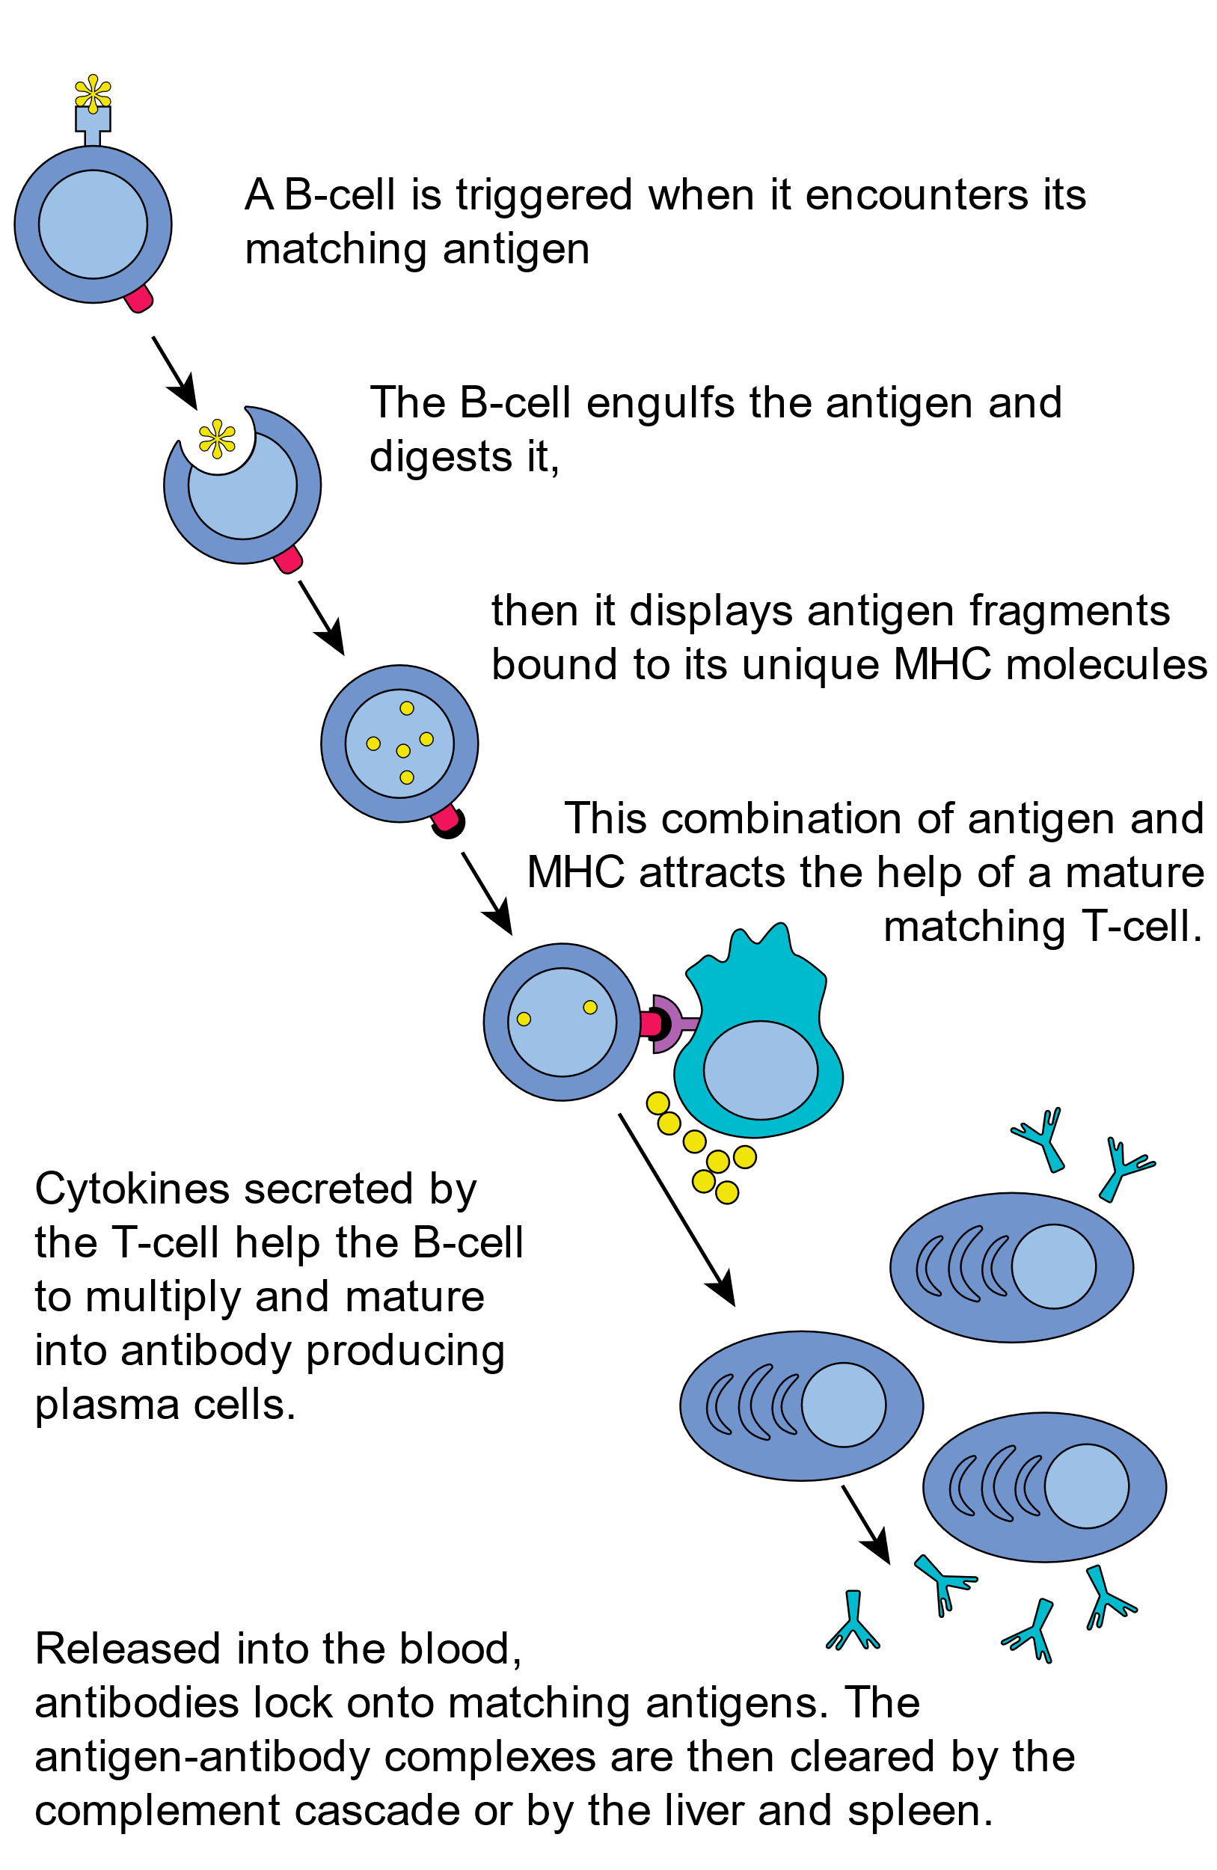
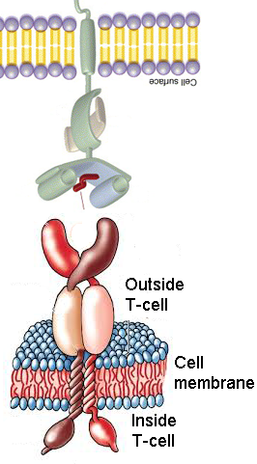
Activation of B cells by Antigen - Lymph Node
B-cells develop into antibody secreting plasma cells.
B and T-helper cells develop into memory cells, that are long-lived and are quickly activated by the same pathogen. This is the basis of vaccination.
(e.g. carbohydrate on bact. cell wall)
B-cell
MHC II - Major histocompatibility complex
Peptide from pathogen
(foreign peptide)
T-cell Receptor (TCR)
T_{H} cell
Events:
Recognition of MHC II-peptide by TCR
Tyrosine kinase signaling in T_{H} cell
Cytokines (protein messengers) produced.
Cytokines activate B-cells (paracrine)
Soluble antibody from plasma cells has the same light and heavy chains as the original B-cell.
Membrane anchors are missing, so antibody is secreted outside the cell.

Slide 42
Can you:
Describe how the genes for the heavy and light chain are generated, and how this give rise to many different antibodies?
Do you understand the process of B-cell activation, including presentation of foreign peptides on MHC II and the role of the T-helper cell.
Describe how antibodies inactivate pathogens?

Slide 43
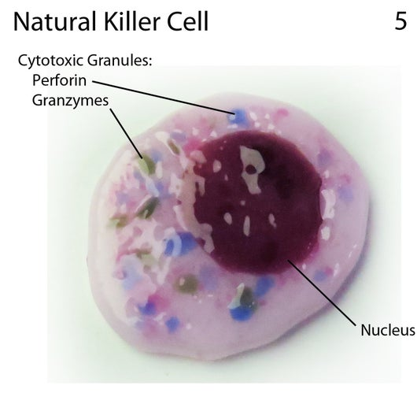
Immunology – Part B
Cell Based Immunology
Key Questions:
1. How does your immune system fight viruses?
2. How does your immune system detect and destroy cancer cells?
3. How can the immune response be engineered to fight cancer?
T_{C}
T_{CTL}
Activation of Tc cells requires:
Recognition of foreign peptide on MHC I.
Assistance from T-helper cells.
T_{C} Memory
Cell Types:
Innate
Natural Killer (NK) cell
Acquired
T_{H}
T_{C}, T_{CTL}
Activated Tc cell becomes a cytotoxic T-lymphocyte T_{CTL}
T_{CTL}
Kill virally infected cells
Kill cancer cells
NK: Innate
Kill virally infected cells
Kill cancer cells

Slide 44
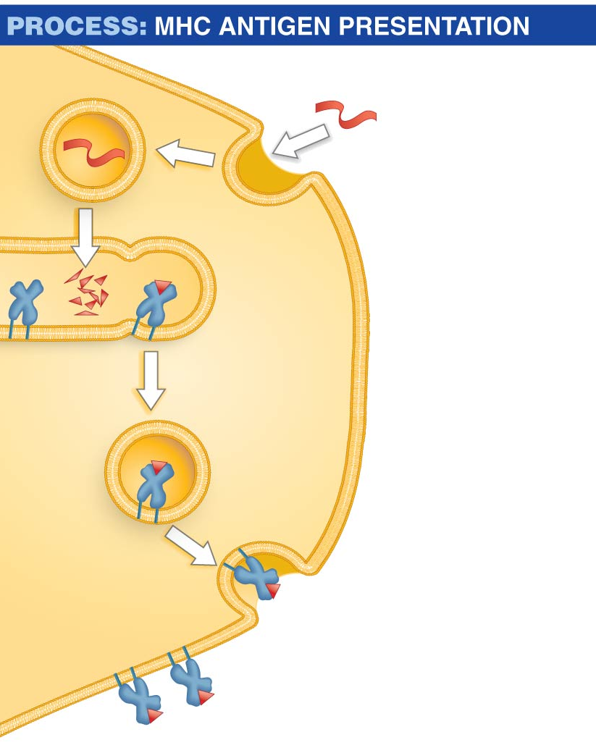
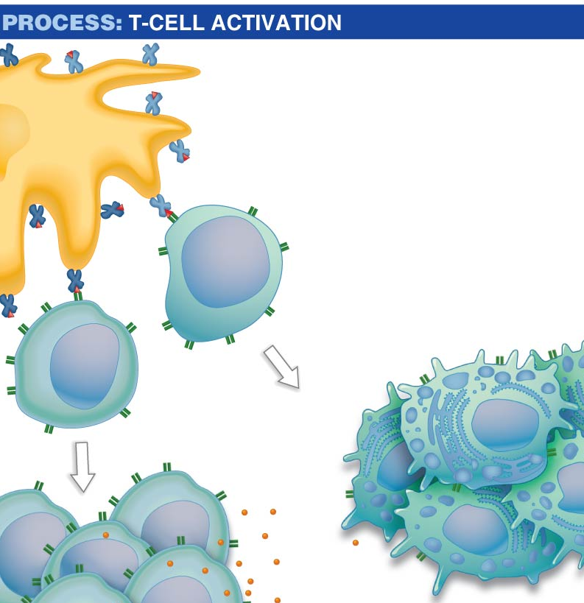
Dendritic cells acquire antigen from viruses and cancerous cells, activating T-cells
Antigen
1. Dendritic cell ingests antigen via phagocytosis (intact virus, cell debris from cancer cell).
Only foreign proteins on self-MHC are recognized by T-cells
Dendritic cell
Class I MHC
+ peptide
Class II MHC + peptide
T_{H} interaction
Peptide
fragment
2. Enzymes break antigen proteins into peptide fragments.
1
T_{C} cell
Major
histocompatibility
(MHC) protein
Cytotoxic T cells
=T_{CTL}
Endosome
3. Peptide fragments are loaded onto both class I and class II MHC proteins in endosomes.
T_{H} cell
2
Dendritic cell
4. MHC I & II –peptide complex is transported to cell surface.
Activation of Tc cells requires:
Recognition of foreign peptide on MHC I.
Assistance from T-helper cells via secreted messengers (small proteins called cytokines)
MHC protein
5. MHC protein presents peptide fragment on cell
surface.
Peptide
fragment
Notes:
At first, cells known as dendritic cells attack the antigen
The dendritic cells contain proteins called MHC (major histocompatibility) proteins, antigen-presenting proteins that have a groove where small peptide fragments, typically 8 to 20 amino acids in length, bind
There are two MHC classes:
​Class I MHC proteins bind antigens inside the ER
​Class II MHC proteins bind antigens inside endosomes
Dendritic cells process protein antigens and load the peptide fragments onto class II MHC proteins:
Dendritic cells ingest antigens present at the wound
The antigen is moved from the phagosome to an endosome, where enzymes breakdown antigens
Some of the peptides are bound to the grooves of class II MHC proteins
The MHC–peptide complexes are exported from the endosomes and transported to the cell surface
The MHC–antigen complex is displayed on the cell surface

Slide 45
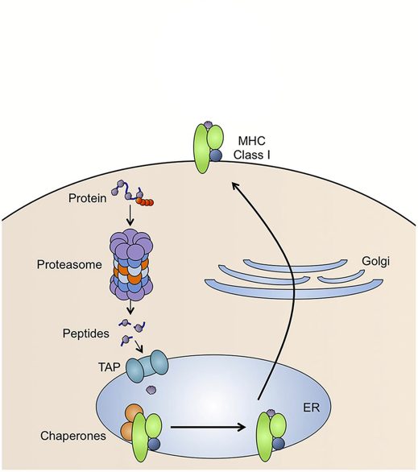
Acquired Cellular Immunity - Role of MHC I in Presentation of Peptides
Foreign Peptide Source:
1. From replication of viruses in the cell
2. From replication of intracellular bacteria (e.g. TB)
3. New coding sequences in cancer cells due to genetic changes (e.g. mutations in p53 may lead to novel sequences).
MHC I present peptides
Peptides are generated from of all of the proteins that are made in the cell:
protein targeted by ubiquitin
Protein digested by proteasome
Peptides transported into ER
Peptides loaded on to MHC I
Peptide/MHC complex transported to cell membrane.
p53 Protein Sequence
Zn Fingers (DNA binding)
10 20 30 40 50 MEEPQSDPSV EPPLSQETFS DLWKLLPENN VLSPLPSQAM DDLMLSPDDI 60 70 80 90 100 EQWFTEDPGP DEAPRMPEAA PPVAPAPAAP TPAAPAPAPS WPLSSSVPSQ 110 120 130 140 150 KTYQGSYGFR LGFLHSGTAK SVTCTYSPAL NKMFCQLAKT CPVQLWVDST 160 170 180 190 200 PPPGTRVRAM AIYKQSQHMT EVVRRCPHHE RCSDSDGLAP PQHLIRVEGN 210 220 230 240 250 LRVEYLDDRN TFRHSVVVPY EPPEVGSDCT TIHYNYMCNS SCMGGMNRRP 260 270 280 290 300 ILTIITLEDS SGNLLGRNSF EVRVCACPGR DRRTEEENLR KKGEPHHELP 310 320 330 340 350 PGSTKRALPN NTSSSPQPKK KPLDGEYFTL QIRGRERFEM FRELNEALEL 360 370 380 390 KDAQAGKEPG GSRAHSSHLK SKKGQSTSRH KKLMFKTEGP DSD
1
5
2
3
4
EVVRRCPHHE Normal seq., ignored by TCR
EVVGGCPHHE Mutant seq. in cancer,
detected by TCR

Slide 46
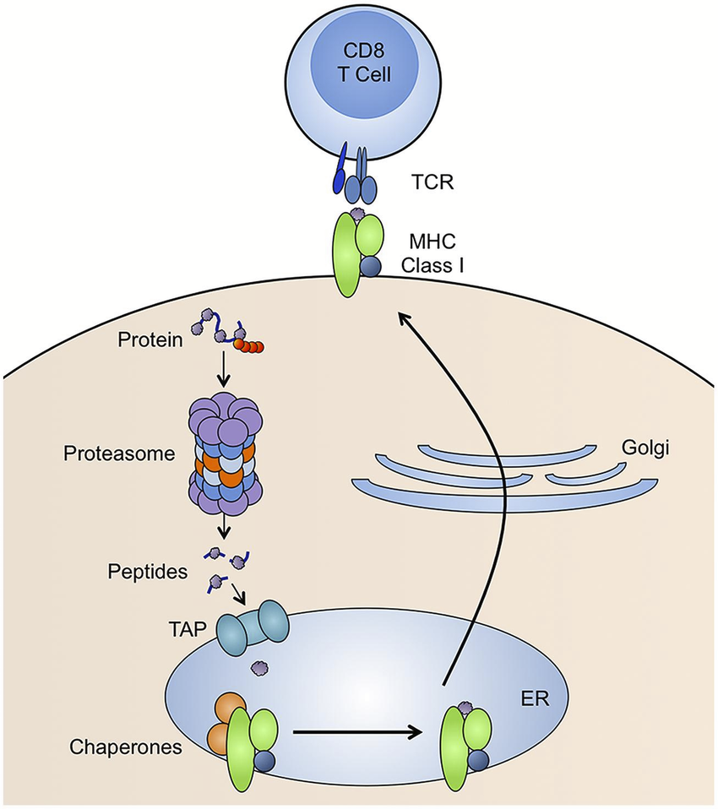
Acquired Cellular Immunity – Recognition of MHC I + Peptide by Tc Cells
Foreign Peptide Source:
1. From replication of viruses in the cell
2. From replication of intracellular bacteria (e.g. TB)
3. New coding sequences in cancer cells due to genetic changes (e.g. mutations in p53 may lead to novel sequences).
T_{CTL}
Tc cells will be activated only by foreign peptides on MHC class I.
Tc cells develop into:
Tc memory cells
cytotoxic T-lymphocytes (T_{CTL})
T_{CTL} cells kill the infected/cancer cell presenting the same peptide that activated it.
p53 Protein Sequence
Zn Fingers (DNA binding)
10 20 30 40 50 MEEPQSDPSV EPPLSQETFS DLWKLLPENN VLSPLPSQAM DDLMLSPDDI 60 70 80 90 100 EQWFTEDPGP DEAPRMPEAA PPVAPAPAAP TPAAPAPAPS WPLSSSVPSQ 110 120 130 140 150 KTYQGSYGFR LGFLHSGTAK SVTCTYSPAL NKMFCQLAKT CPVQLWVDST 160 170 180 190 200 PPPGTRVRAM AIYKQSQHMT EVVRRCPHHE RCSDSDGLAP PQHLIRVEGN 210 220 230 240 250 LRVEYLDDRN TFRHSVVVPY EPPEVGSDCT TIHYNYMCNS SCMGGMNRRP 260 270 280 290 300 ILTIITLEDS SGNLLGRNSF EVRVCACPGR DRRTEEENLR KKGEPHHELP 310 320 330 340 350 PGSTKRALPN NTSSSPQPKK KPLDGEYFTL QIRGRERFEM FRELNEALEL 360 370 380 390 KDAQAGKEPG GSRAHSSHLK SKKGQSTSRH KKLMFKTEGP DSD
EVVRRCPHHE Normal seq., ignored by TCR
EVVGGCPHHE Mutant seq. in cancer,
detected by TCR

Slide 47
Detection and Killing of Virally Infected or Cancer Cells:
(T_{CTL})
Cancer cell or
Infected cell
Granzymes enter through perforin pore and cause cell undergo programmed cell death (apoptosis)

Slide 48
Cancer Evasion Mechanism I - Loss of MHC I on Tumor Cell
Loss of MHC I expression means that T_{CTL} cells can no longer recognize and kill cancer cells because T-cell activation requires recognition of the MHC-peptide complex.
How to re-establish T_{C} contact with tumor cell and activation of the T-cell so that the cancer cell is killed?

Slide 49
Cancer Treatment with Antibodies - 1. Cancer Evasion - Loss of MHC I on Tumor Cell
Loss of MHC I expression means that T_{CTL} cells can no longer recognize and kill cancer cells because T-cell activation requires recognition of the MHC-peptide complex.
Cancer cell
Cancer cell
How to re-establish T_{C} contact with tumor cell and activation of the T-cell so that the cancer cell is killed?
Bispecific antibodies are generated from two separate antibodies:
One recognizes CD3, which is part of the T-cell receptor (TCR)
Other recognizes a tumor antigen.
The two variable regions from each antibody are linked into a single polypeptide chain.
The dual binding event mimics the original MHC-I TCR interaction.,

Slide 50
Chimeric Antigen Receptor T-cells = CAR T-Cells
Obtain antibodies against cancer antigen, isolate genes that code for light and heavy chains for those antibodies.
Fuse coding region for variable light and heavy domains to coding region for RTK on T-cells = single CAR-T gene.
Heavy chain gene
Light chain gene
RTK gene
ATG……………….…………..TAA
ATG…………..TAA
ATG…………………..TAA
RTK – receptor tyrosine kinase
Signaling domain on T-cells
V_{H}
V_{L}
RTK
ATG……………….…………………………..TAA
Introduce gene for CAR-T cell into Patient
D. What happens when Antigen is encountered?
Obtain white blood cells from patient
Isolate T-cells
Introduce DNA into T-cells
Obtain large amounts of T-cells by cell culture
Inject CAR-T cells into cancer patient.
Tumor cell

Slide 51
Cancer Evasion Mechanism II – Downregulation/killing of Tc cells.
Cancer cells overproduce b7. Binding of b7 to CTLA4 receptor on the surface of the Tc cell deactivates the Tc cell - immunosuppressive reaction called anergy.
Cancer cells overproduce PDL1. PDL1 binds to PD1 on T-cells. Activation of signaling causes Tc cell to enter apoptosis (programmed cell death).
How to block this signaling?

Slide 52
Vaccination
Diphtheria
Types of vaccines:
1. Passive (Ab injected)
2. Active (Antigen Provided)

Slide 53
Vaccine: a vehicle containing a form of an antigen that is administered to induce memory B and T cells specific for that antigen.
Not Vaccinated
Vaccinated
DC
Jiskoot W., Kersten G.F.A., Mastrobattista E., Slütter B. (2019) Vaccines. In: Crommelin D., Sindelar R., Meibohm B. (eds) Pharmaceutical Biotechnology. Springer, Cham. https://doi.org/10.1007/978-3-030-00710-2_14
T_{H}-Memory
T_{C}-Memory

Slide 54
Vaccine History
Some diseases still do not have vaccines
Other diseases have been eliminated by vaccination
https://www.imf.org/en/Publications/fandd/issues/2021/12/Journey-covid-19-vaccine-Stanley

Slide 55
Smallpox - A Success Story for Vaccination
Vaccination – to introduce immunity prior to infection by pathogen
Variolation (1800) provided protection by exposing people to small amounts of smallpox virus (obtained from blisters on infected people).
Risky because smallpox was used to vaccinate
Smallpox - 30% lethality
Vaccinia virus (similar to smallpox) is one form of the current vaccine.
Cowpox virus causes production of antibodies against smallpox
Jenner was the first to use cowpox to vaccinate against smallpox

Slide 56
Types of Vaccines
A. Subunit Vaccine:
A protein from the pathogen is used to induce memory cells, e.g. spike protein from the virus.
A
B. Inactivated Virus
The virus is chemicall inactivated before administration.
B
C. Live Attenuated
The virus is grown under conditions that select for mutant viruses that:
Induce memory cells in humans
Do not cause disease symptoms
C

Slide 57
A. Subunit Vaccine - Producing Covid-19 Spike Protein in Bacteria
Terminator
We will incorporate the gene for the spike protein into a plasmid, which is replicated by the bacteria.
The plasmid will also provide a promotor and mRNA termination sites so that the bacteria will make mRNA and then the mRNA will be translated into the spike protein.
Promoter
A synthetic gene the encodes the entire spike protein will be inserted downstream from the promoter using restriction enzymes.
Notes:
Early trials showed that people with pituitary dwarfism could be treated successfully but only if protein came from humans, other animals were ineffective. But the only source was glands from human cadavers. Was extremely scarce and expensive. Some were also containminated with prions infectious proteins. Banned in 1984.

Slide 58
How to insert a DNA fragment into a Plasmid – Restriction enzymes
EcoR1
GAATTC G AATTC
CTTAAG CTTAA G
NdeI
CATATG CA TATG
GTATAC GTAT AC
BamHI
GGATCC G GATCC
CCTAGG CCTAG G
Cuts both strands, generating single-stranded DNA (sticky ends).
Complementary sticky ends can bind to each other.
DNA can be joined by DNA ligase.
Notes:
Plasmids are physically separate from the bacterial chromosome. Most of the 400 known restriction sites are only at sites that form palindromes reads the same way frontwards to backwards or same identical sequence 5’ to 3’ on the antiparallel strand. Called EcoRI because it was the first restriction enzyme discovered in E.Coli. Like most it makes a staggered cut forming sticky ends. As a result the two ends can pair up and H-bond with one another. Use DNA ligase to seal the pieces together. Sticky ends allows us to create novel combinations by cutting and pasting them into new locations.

Slide 59
How to insert a DNA fragment into a Plasmid
Synthetic spike protein gene
NdeI
BamH1
CATATGGCTACAG...TGGCTTCTAGGGATCC
GTATACCGATGTC...ACCGAAGATCCCTAGG
CA TATGGCTACAG...TGGCTTCTAGG GATCC
GTAT ACCGATGTC...ACCGAAGATCCCTAG G
After digestion with NdeI and BamHI
---CATATGGCTACAG...TGGCTTCTAGGGATCC---
---GTATACCGATGTC...ACCGAAGATCCCTAGG---
Anneal and ligate to pET11a
---CA GATCC---
---GTAT G---
After digestion with NdeI and BamHI
Cut plasmid and synthetic gene with both NdeI and BamHI enzymes to make sticky ends.
Cool to allow sticky ends to anneal TA from NdeI will anneal, GATC from BamH1 will anneal.
DNA ligase to join fragments.
---CATATGGCTAGCA....GGGTCGCGGATCC---
---GTATACCGATCGT....CCCAGCGCCTAGG---
NdeI
pET11a
BamH1
Notes:
Plasmids are physically separate from the bacterial chromosome. Most of the 400 known restriction sites are only at sites that form palindromes reads the same way frontwards to backwards or same identical sequence 5’ to 3’ on the antiparallel strand. Called EcoRI because it was the first restriction enzyme discovered in E.Coli. Like most it makes a staggered cut forming sticky ends. As a result the two ends can pair up and H-bond with one another. Use DNA ligase to seal the pieces together. Sticky ends allows us to create novel combinations by cutting and pasting them into new locations.

Slide 60
Final Product – Covid-19 Spike protein codons in plasmid
Covid spike protein
Gene that codes for a protein that makes the bacteria containing the plasmid resistant to penicillin.
Origin of replication so that the plasmid is copied when the bacteria divide.

Slide 61
Inserting the Plasmid into Bacterial Cells
Cells can take up DNA from the environment and incorporate it into their genomes in a process called transformation.
To transform bacterial cells with a plasmid, researchers increase the permeability of the cell’s membrane using a chemical treatment (calcium chloride).
Cell that contain the plasmid are selected by growth on ampicillin.
Only those cells with plasmid can grow.
The plasmid with the cDNA produces the spike protein in bacteria.
Large amounts of E.coli that produce the vaccine can be grown in a fermenter.
The spike protein can be used as a vaccine
Notes:
In many cases, researchers add a primer and use DNA polymerase to synthesize a second strand. So essentially what they did way isolate the mRNAs from pituitary glands and use reverse transcriptase to make cDNAs for all the genes actively expressed in pituitary cells.

Slide 62
B. Inactivated Viruses

Slide 63
C. Attenuated Viruses

Slide 64
C. Attenuated Viruses

Slide 65
D – Virus Like Particles:
Proteins isolated from the virus form virus like particles, without the genetic material of the virus
D
E. Recombinant Virus:
A “safe virus” is used (e.g. cold virus)
Gene for a protein from a pathogen is inserted into the DNA of the virus.
When virus grows it produces the protein from the pathogen generating immunity.
Also includes vaccines that are a mixture of genetic material from human and animal viruses (reassortment viruses)
E
F. RNA Vaccines (Pfizer Covid Vaccines)
RNA coding for a viral protein is introduced into cells. The RNA is used by the cell to make viral proteins, inducing an immune response.
F

Slide 66
E. Viral Vectors for Antigen Delivery
AstraZeneca Covid
2. Action of vaccine
Virus infects host cell in vaccinated person.
Viral genome is used to make viral proteins, including proteins from the pathogen.
Activate T_{C} cells to become T_{C} – memory cells (can be re-activated by MHC I + Peptide).
B-cell response can occur due to antigens that are sent to the surface of the cell, generating B- and T_{H}-memory cells.
1. Production of vaccine
Genes from the pathogenic virus are added to an adenovirus (common cold)
Adenovirus is defective and cannot replicate without key structural proteins that are provided in the producer cell.
No viral particles are released in the vaccinee’s cells.
DOI: https://doi.org/10.4414/smw.2017.14465 Publication Date: 08.08.2017 Swiss Med Wkly. 2017;147:w14465

Slide 67
Herd Immunity:
High risk
Can’t be vaccinated
(too young, immune -compromised
Vaccinated individuals prevent disease from spreading from sick to unvaccinated.
At sufficient levels, the “herd” is immune because the virus cannot spread.
Gets infected
Below herd
immunity
At herd
immunity
Protected

Slide 68
Herd Immunity
How Many People need to be vaccinated to achieve herd immunity?
10% ?
20% ?
50% ?
90% ?
100% ?
It depends on the how infectious the virus is
Our Experimental Viruses:
Ebola: Low infectivity
Polio: Moderate infectivity
Measles: High infectivity

Slide 69
Simulation to Determine Infectivity Versus Vaccination Level
Go to the following web site and open both links: http://www.andrew.cmu.edu/~rule/stayin-alive
2. On the Infection Simulator link, scroll down (2/3 page) to the image of the plane, and click on it.
Group Number | Virus | % Vaccination
1 | Ebola | 10, 20, 40, 50
2 | Ebola | 70, 80, 90
2 | Polio | 10, 20, 40, 50
3 | Polio | 70, 80, 90
4 | Measles | 10, 20, 40, 50
5 | Measles | 70, 80, 90
3. Select the virus for your group
4. Use the slider to select the different vaccination levels. For each of the vaccination levels do three simulations. Enter the value for the % Infection rate at 20s into the appropriate cell of the google sheet. Your data will be automatically averaged and plotted.
3 Simulation Runs at 10%

Slide 70
Why Are There No Vaccines for HIV?

Slide 71
Summary Questions for Immunology:
What are the two major branches of the immune system? Why are both important?
What are the roles of different cell types in each system, e.g. what would happen if T_{H}-cells disappeared?
What is the quaternary structure of an antibody? Can you sketch an antibody and indicate where the antigen binds?
What defines the specificity of antibodies?
What are the steps in the production of antibody genes, at the molecular level:
How do DNA rearrangements produce functional heavy and light chain genes
How are is the mature mRNA generated in B-cells and Plasma cells.
What is the difference between the heavy chain export process for B-cells and plasma cells.
Can you describe how antibodies kill/inactivate pathogens
How are virally infected cells and tumor cells recognized by Tc cells?
How does the Tc cell kill those cells?
What evasion mechanisms are used by cancer cells and how have these been addressed by antibody therapy?
What was the origin of the idea for vaccination?
What was one of the first “safe” vaccines? What disease has now been eradicated due to this vaccine?
Why is it important to be vaccinated (Herd immunity)
Can you describe one way to generate a vaccine for a pathogen? Do you know the pros and cons for that method?

