Slide 1
Lecture 1: Chemistry and Biology Fundamentals
Chemical Bonding
Functional Groups
Protein Structure and Stability
Ligand Binding
Proteins as enzymes
Carbohydrates
Notes:
.

Slide 2
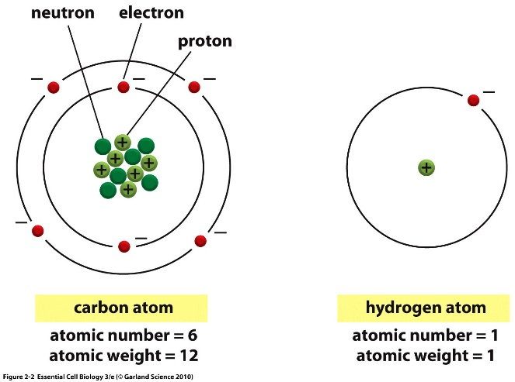
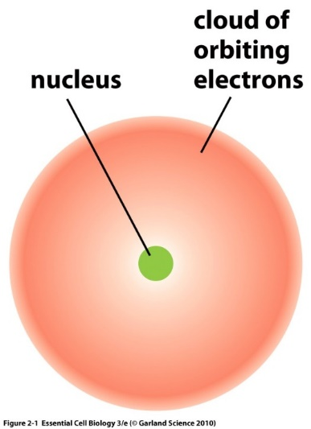
Atoms are composed of:
Protons – positively charged particles
Neutrons – neutral particles
Electrons – negatively charged particles
Protons and neutrons are located in the nucleus.
Electrons are found in orbitals surrounding the nucleus.
Atomic number = # of protons = # electrons in element

Slide 3
Electron Orbitals
Electrons arranged around the nucleus in specific regions called orbitals.
Each orbital can only hold two electrons
Orbitals are grouped into electron shells
Numbered 1,2,3…
Lower numbers = shells closer to the nucleus
First shell can hold a maximum of 2 electrons
Second shell can hold up to 8
Third shell can also hold 8
Orbitals are usually filled from lowest energy (inner shell) to highest energy (outer shell)
Outer shell is the valence shell and is used for forming bonds with other elements.
The most stable configuration is a complete (full) outer shell.
Electron Configuration of Ne – an inert gas (10e)
Shells: 1st = 1s, 2nd = 2s + 2p, 3rd = 3s + 3p
Shell is a collection of orbitals with similar energy

Slide 4
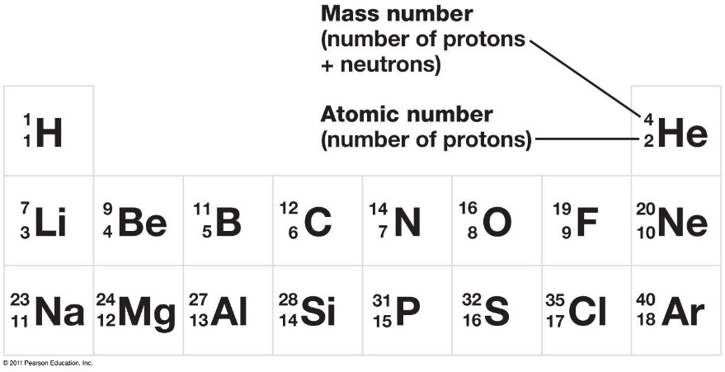
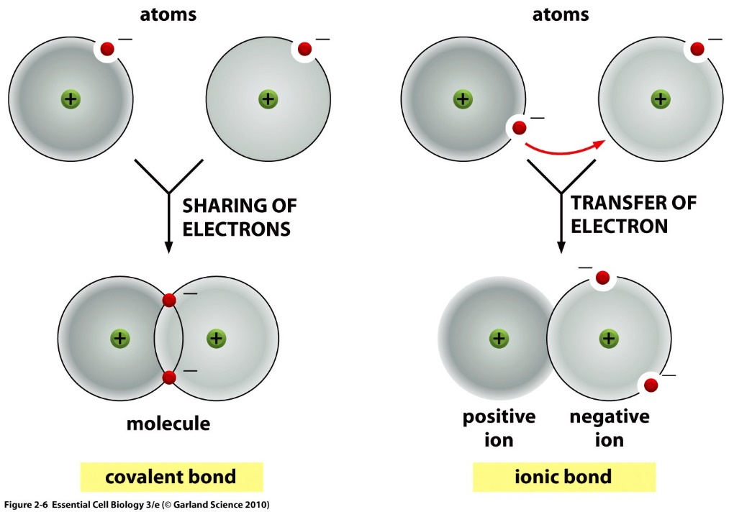
Covalent Chemical Bonds
Elements like Li, Na, F, Cl, Mg, readily form ions to generate a complete outer shell.
Some elements cannot form stable ions because it would involve the loss or gain of too many electrons. This includes C, N, and O – which are common in biological systems.
Unfilled electron orbitals on elements like C, N, and O allow for the formation of covalent bonds, and atoms are most stable when each electron orbital is filled.
Each atom’s unpaired valence electrons are shared by both nuclei to fill their orbitals.
Substances held together by covalent bonds are called molecules

Slide 5
The number of unpaired electrons (in the outer shell) determines the number of bonds an atom can make.
Multiple bonds form when atoms share multiple electrons.
The number of covalent bonds (valence) formed by common elements.
Oxygen = 2 bonds
Nitrogen = 3 bonds
Carbon = _________
Sulfur = 2 bonds (in biological systems)
Hydrogen = 1 bond
Phosphorous = 5 bonds in biological molecules
You must know these numbers.
In chemical drawings:
“C” for carbon is not drawn, but carbons are found at the ends of lines and when lines join or “kink”
Hydrogens attached to carbon are not shown, you need to add them to complete to complete the valence of the carbon atoms.
You must know how to do this.
How many bonds will carbon form?
“C” for carbons
Complete valence with H

Slide 6
Representation of Molecules

Slide 7
Electron Sharing and Bond Polarity
The polarity of a bond depends on the electronegativity of the atoms.
Electronegativity - ability of atoms to pull electrons from other atoms.
Atoms with higher electronegativity will develop a partial negative charge, the atom they are bonded will have a partial positive charge.
The order of electronegativity is:
H ~ C < N < O
Increased pos. charge of nucleus.
Electron Sharing Continuum

Slide 8
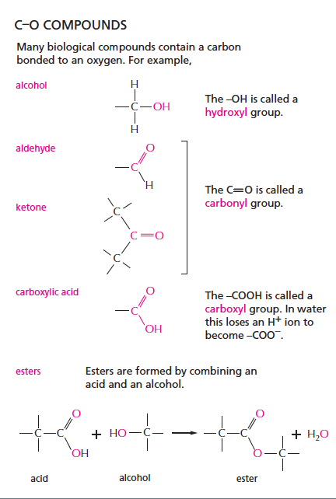
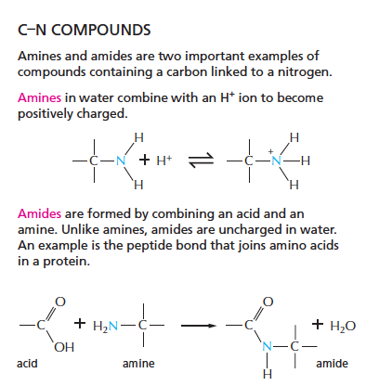
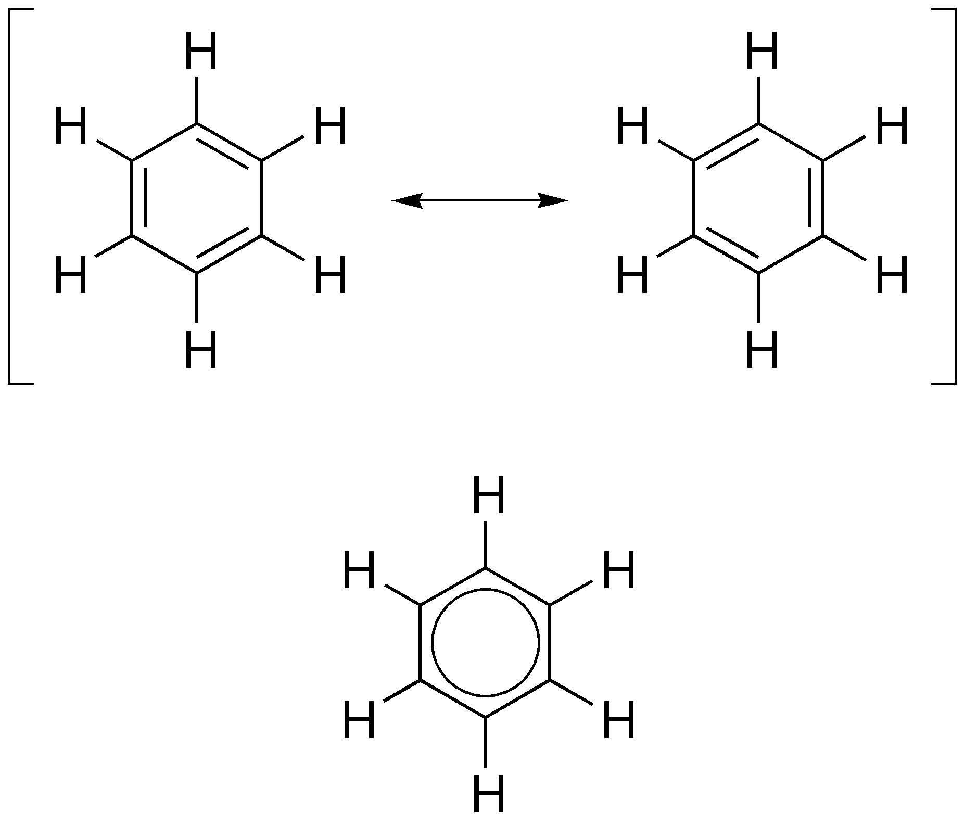
Functional Groups – You should Become Familiar with These
C–H Groups
(hydrophobic)
Isoleucine (amino acid)
Aromatic – planer rings
C–S Compounds
thiol
Cysteine (amino acid)

Slide 9
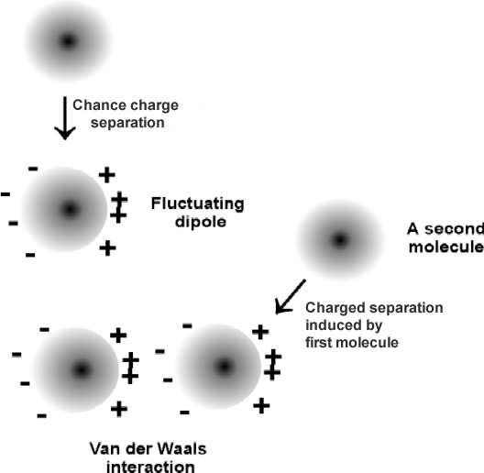
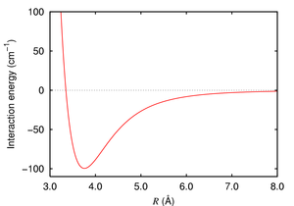
Inter-molecular Interactions in Biology
Electrostatic interactions between fully charged molecules (ionic interactions)
Like charges repel
Opposite charges attract
van der Waals interactions between:
Molecules with partial charges (polar)
Molecules with no charge (non-polar)
Hydrogen bond:
Hydrogen bond between NH and O=C
X & Y are electronegative (N and O usually)
X-H = Donor of the hydrogen bond, it provides the hydrogen
(the hydrogen remains in a covalent bond to X)
Y = Acceptor of the hydrogen bond
X-H Y
δ⁻
δ⁺
δ⁻

Slide 10
The Geometry of Simple Molecules
The shape of a molecule is determined by the geometry of its bonds.
Carbon, oxygen, and nitrogen often form bonds with a tetrahedral geometry

Slide 11
Unique Feature of Tetrahedral Carbon - Chirality
A single tetrahedral carbon atom can have four groups attached (group = collection of atoms)
If the four groups are different, then two forms of the molecule are possible, they are mirror images of each other.
The carbon that has four different groups is called a chiral carbon.
The two different mirror-image molecules are called enantiomers
These two cannot be superimposed on each other (superimposed = rotated so that the same atoms overlap)
A mixture of both enantiomers is called a racemic mixture.
One naming system to distinguish enantiomers is D & L
Two Different enantiomers (L and D alanine) binding to the same receptor
The biological properties of each enantiomer may be quite different, because they may interact with different receptors in the cell.
Naproxen (Aleve)
Chiral carbon
L-Alanine binds better because of more favorable _______________ interactions.
Liver toxin
Anti-inflammatory

Slide 12
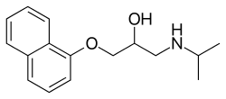
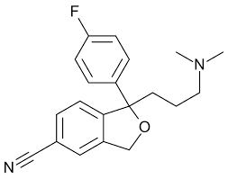
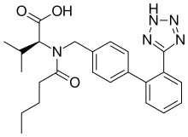
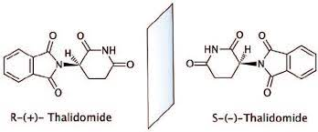
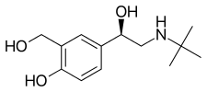
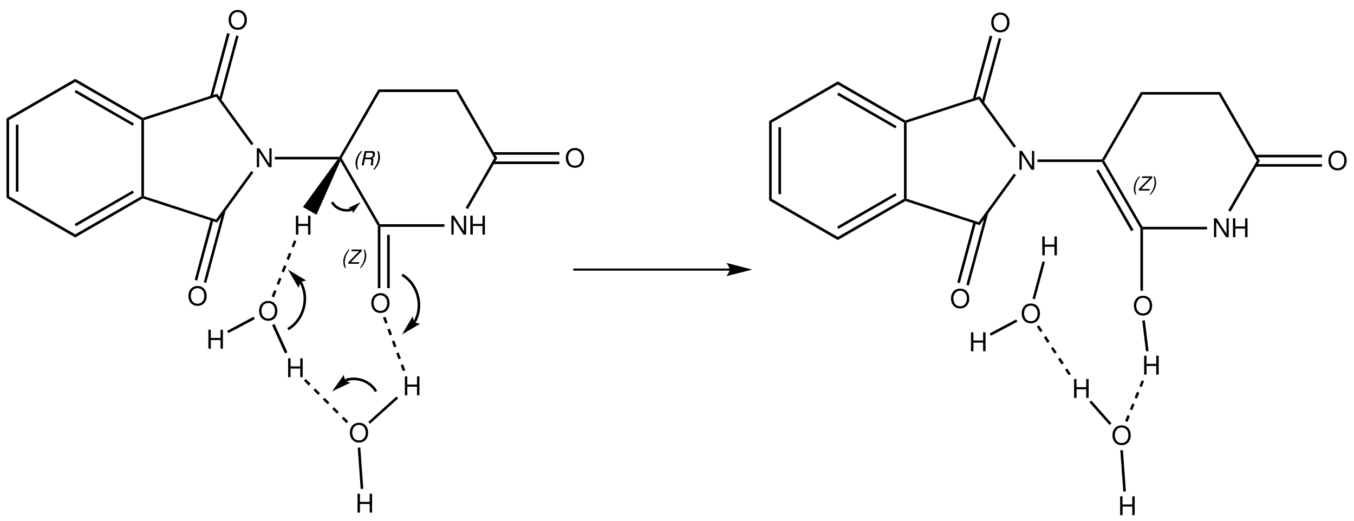
Instructions: Go to the google slide with the same number as your breakout room
Propranolol
levamisole
1.
4.
citalopram
5.
Valsartan
2.
Thalidomide
6.
levalbuterol
3.
https://docs.google.com/presentation/d/1PJ33ZCi55w4Bdjg4KVQ0qf2HrCfwVHKLcdkvIbUbdfw/edit?usp=sharing
Notes:
Propranolol – beta blocker – high blood pressure (racemic)
Valsrtan – aniotensin II receptor blocker – high blood pressure
Levalbuterol – b2-adrenergic receptor agonist – asthma – R-enantiomer
Levamisole – parasitic worm infections – L-form
Citalopram – antidepressant – racemic (Escitalopram is L)
Thalidomide – current use is cancer treatment, was originally prescribed as anxiety & morning sickness – causes birth defects.

Slide 13
pH, Strong Acids & Bases
pH = –log [H⁺]
The pH of a solution tells us how acidic the solution is.
The pH scale is used to transform the large range of possible [H+] values to more manageable numbers.
Note a low pH is a high [H+].
The pH is a property of the solvent (water) and can be changed by the addition of a strong acid or base, such as HCl or NaOH.
Acids release protons and will lower the pH of the solution, e.g.
HCl + H₂O H₃O⁺ + Cl⁻
Bases (e.g. ammonia, sodium hydroxide) will absorb protons and lower the hydrogen ion concentration. These increase the pH.
NaOH Na⁺ + OH⁻
OH⁻ + H₃O⁺ 2 H₂O
1. Which solution has a higher H⁺ concentration, pH=3 or pH 4.
2. How large is the difference?

Slide 14
Acids and Bases.
Strong acid – complete ionization in solution. e.g.
HCl H⁺ + Cl ⁻
Why this is important: protonation/deprotonation changes the charge on species, either creating or destroying strong electrostatic interactions!
Weak Acid – incomplete ionization in solution.
“HA”=protonated form
“A”=deprotonated form (conjugate base)

Slide 15
What Affects the Degree of Protonation?
1. The extent of protonation/deprotonation depends on the pH of the solution:
Low pH values will favor protonation of acids since there are many protons that will collide with (A) to make (HA).
High pH values will favor deprotonation of acids since there are fewer protons to protonate the acid.
What would you expect to happen to the fraction of the acid that is protonated (f_{HA}) as the pH of the solution is decreased?
$$f_{HA}=\frac{[HA]}{\left[HA\right]+[A]}$$
Fraction
protonated
2. The amount of protonated/deprotonated species also depends on the chemical properties of the acid.
Comparing acetic acid to a protonated amine. At neutral pH (7) most of the acetic acid will be deprotonated while most of the amine will be protonated.
Favored at pH=7
(stronger acid)
pH
99.5%
The pKa of an acid is the pH where equal amounts of protonated and deprotonated species are found.
Favored at pH=7
(weaker acid)
99%

Slide 16
Key Points & Expectations
Chemistry
Number of bonds formed by common elements:
(N=3, C=4, O=2, S=2, H=1).
You should be able to complete chemical structures by adding hydrogens to carbons.
Chiral carbon and enantiomers - different enantiomers can have different properties. You need to identify chiral carbons.
Polar (unequal charge distribution, e.g. N-H) versus non-polar bonds (e.g. C-H). You need to be able to identify polar and non-polar bonds.
H-bond - Partial charges due to X-H interacting with Y (X & Y electronegative)
H-bond - Identify donors and acceptors, partial charges
pH – be able to predict the charge on a group, given the pH of the solution and the pKa of the acid.
Notes:
Simplest cell
- no nucleus, but has genetic material (information storage and replication
-bounded by cell membrane.
- extracts energy from environment to fuel growth, machinery must be in the cytoplasm

Slide 17
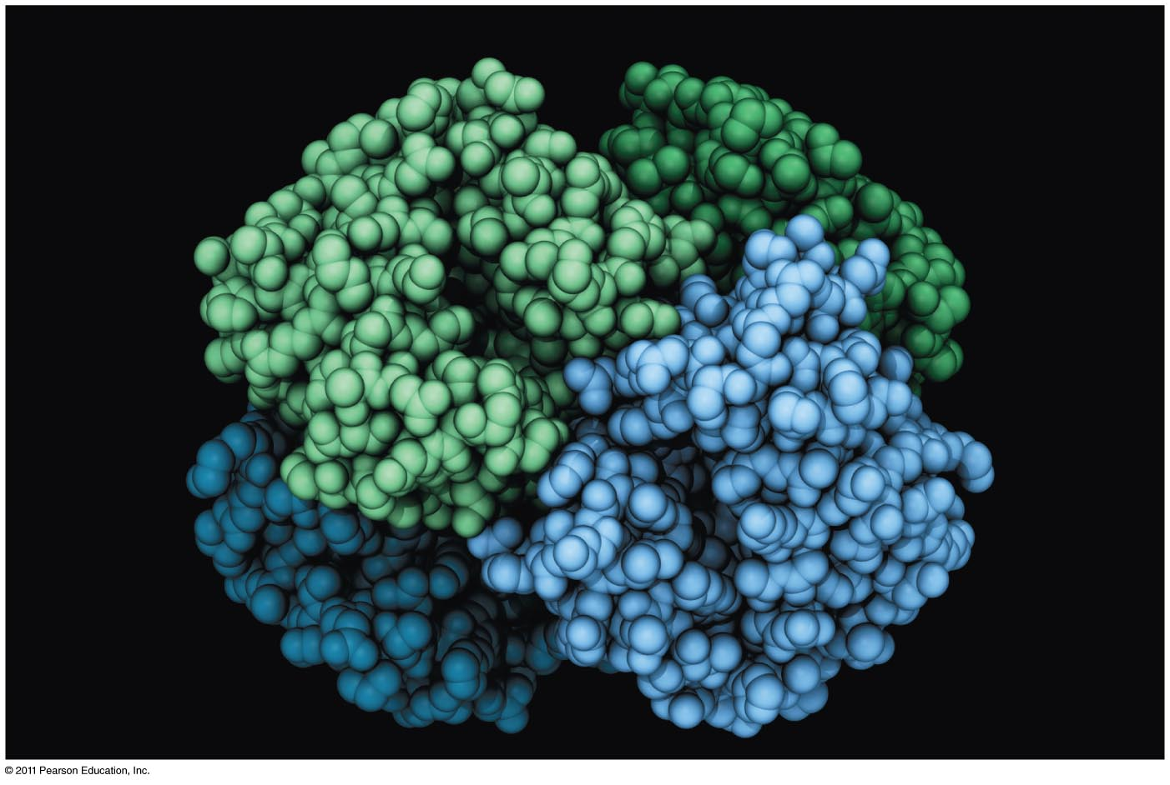
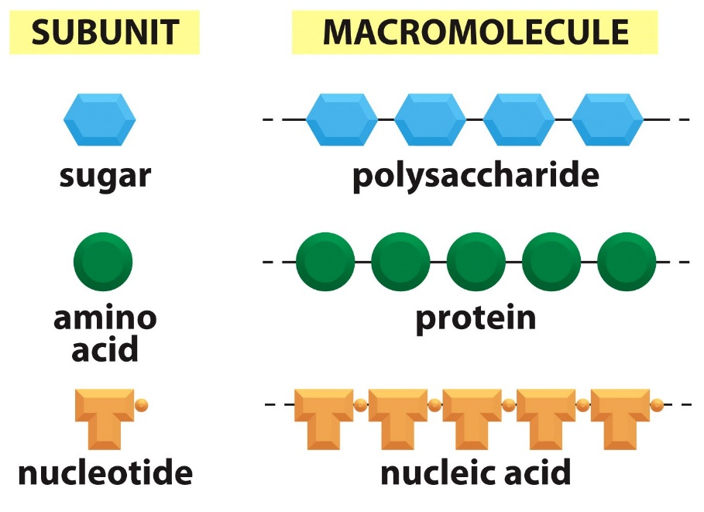
Proteins and Amino Acids

Slide 19
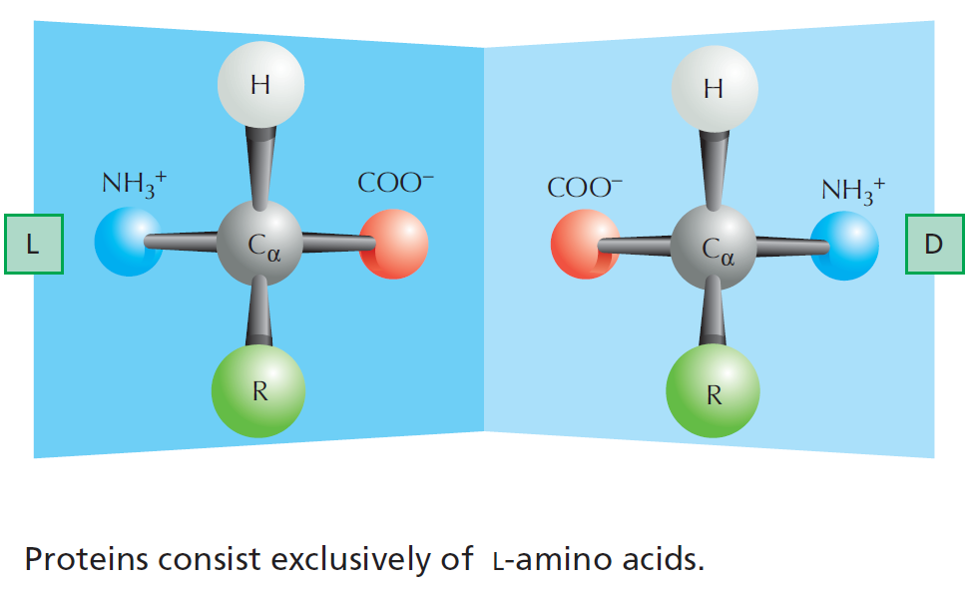
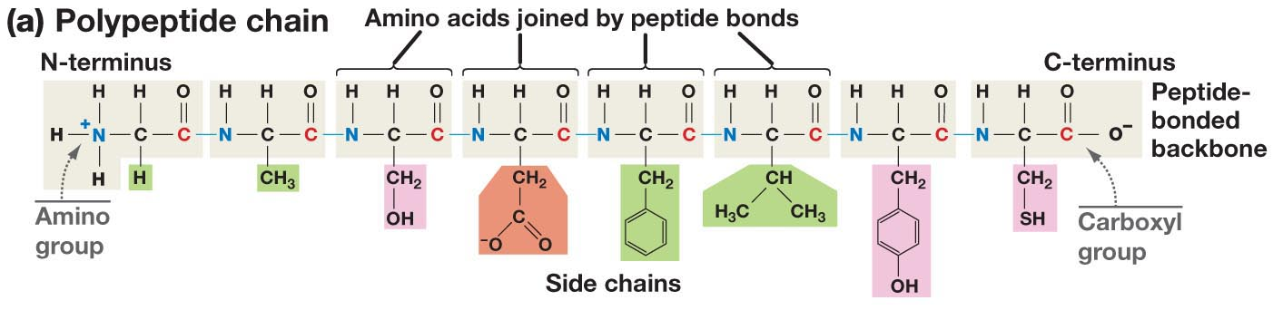
The Structure of Amino Acids and Proteins
Is there a chiral carbon on amino acids?
The amino group, Cα (and one hydrogen), and the carbonyl group are common to all amino acids
The N-Cα-C=O are the mainchain of the protein polymer.
The R groups are different –there are 20 common R groups they are the sidechain of the protein polymer – their sequence defines the properties of the protein.
(as does the ribosome that make them)

Slide 20
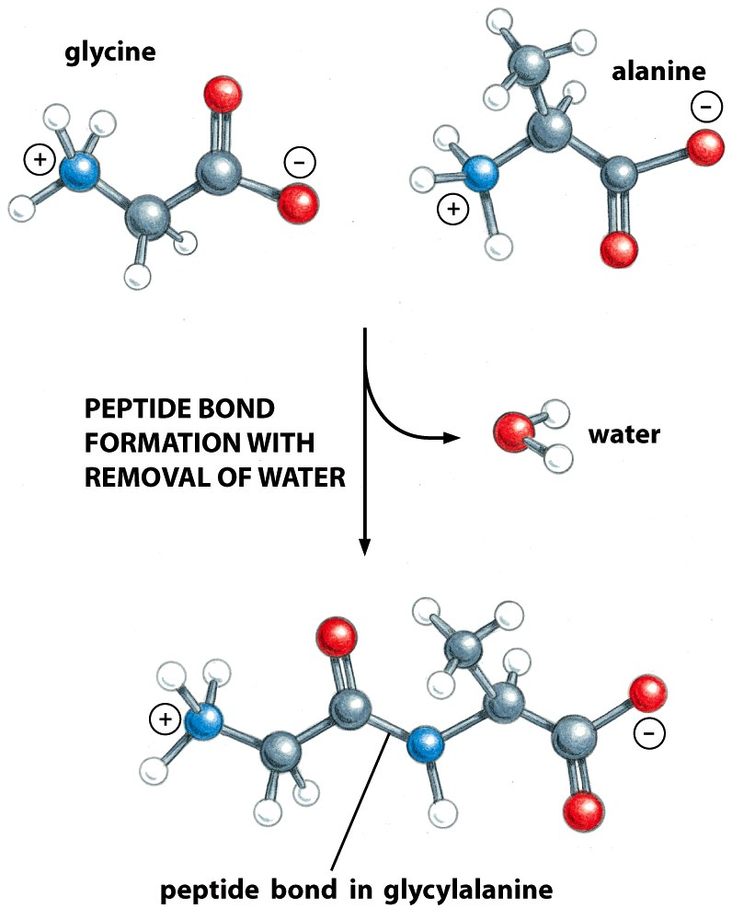
Proteins are generated by formation of Peptide Bonds
Amino acids are linked to form linear polymers:
Dehydration reactions bond the carboxyl group of one amino acid to the amino group of another to form a peptide bond.
A chain of amino acids linked by peptide bonds is called a polypeptide.
Polypeptides containing fewer than 50 amino acids are called oligopeptides (peptides).
Polypeptides containing more than 50 amino acids are called proteins.
The four atoms involved in the peptide bond all lie on the same plane.
The C=O is usually across from the N-H (trans conformation)

Slide 21
Sidechain Functional Groups Affect Behavior (and the order is important)
Sidechains (R-groups) differ in their size, shape, reactivity, and interactions with water.
Nonpolar Sidechains: hydrophobic; do not form hydrogen bonds; coalesce in water - typically form the core of folded proteins.
Polar Sidechains: hydrophilic; form hydrogen bonds; readily dissolve in water
Ionizable Sidechains: Can be charged at certain pH values. Interact strongly with water.

Slide 22
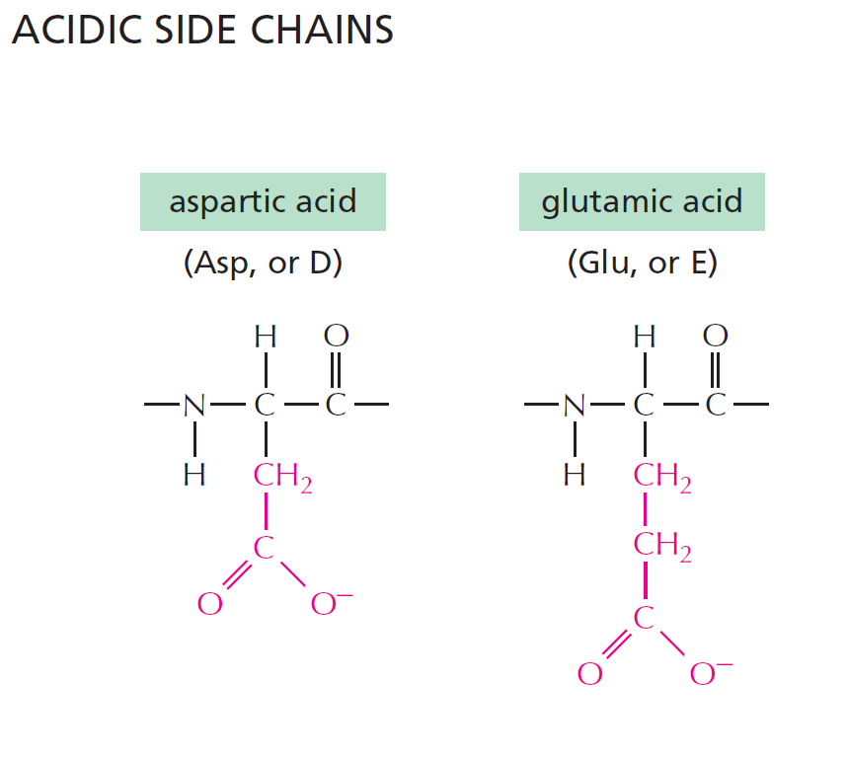
pK_{a} of sidechain ~ 4
pK_{a} of sidechain ~ 4
Have a net negative charge at pH 7.0
Notes:
Weak acids but still strong enough to give up its proton at pH = 7.0. Negative charges play an important role in proteins. Binding metal ions or acting in enzymatic reactions.

Slide 23
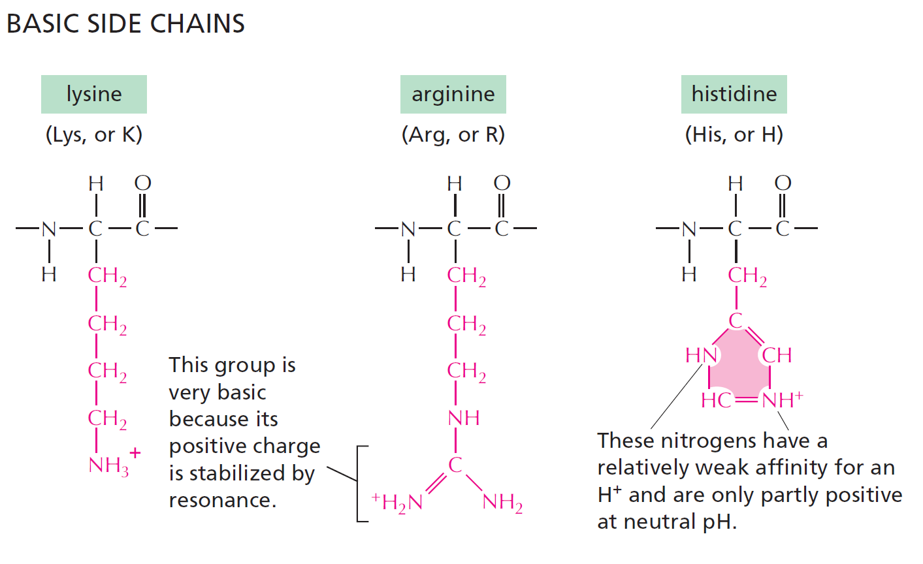
pK_{a} ~ 10
pK_{a} ~ 12
pK_{a} ~ 6
Have a net positive charge at pH 7.0
Positive charge when protonated
10% Protonated at pH 7.0
Notes:
Histidine is only 10% protonated at pH 7.0. With a pKa near neutral, plays an important role as a proton donor and acceptor in enzymatic reactions.

Slide 24
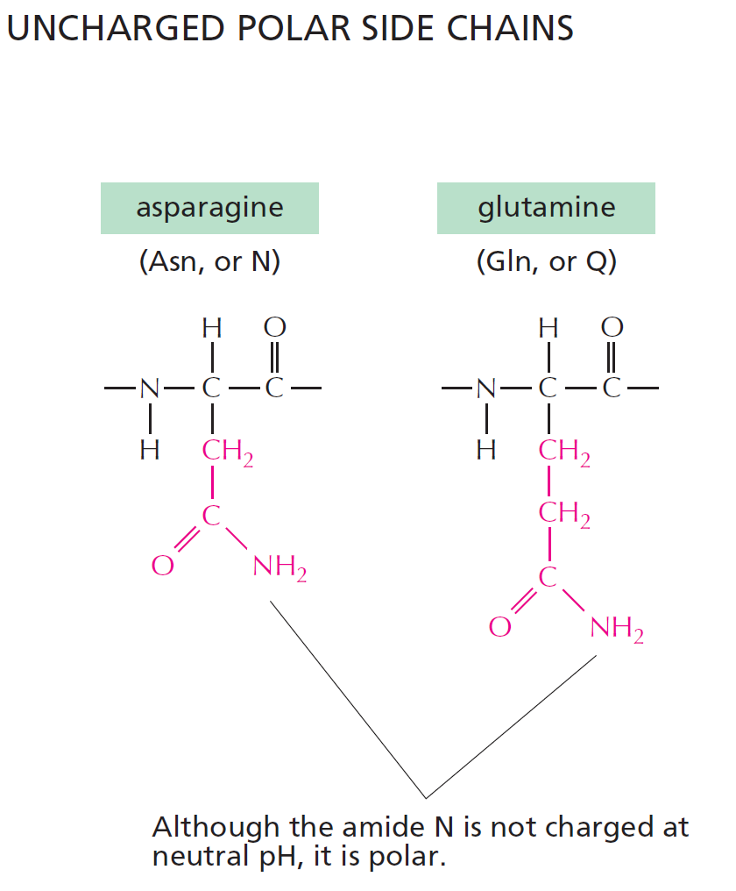
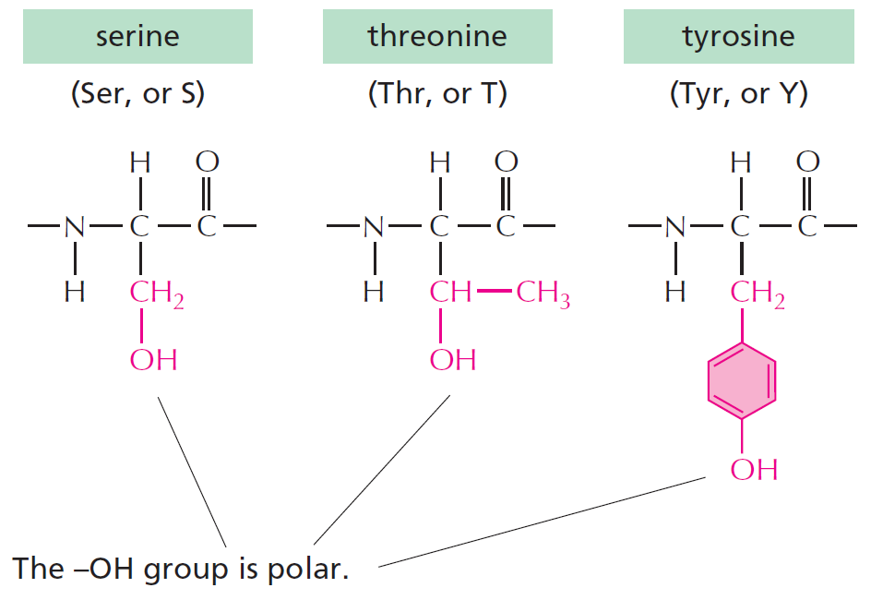
This is a significant
non-polar functionality
Forms weak H-bonds
Can ionize with a pK=8, forming thiolate ion (-S⁻)
Can form S-S disulfide bonds with other Cys residues
These can form what type of bond with water?

Slide 25
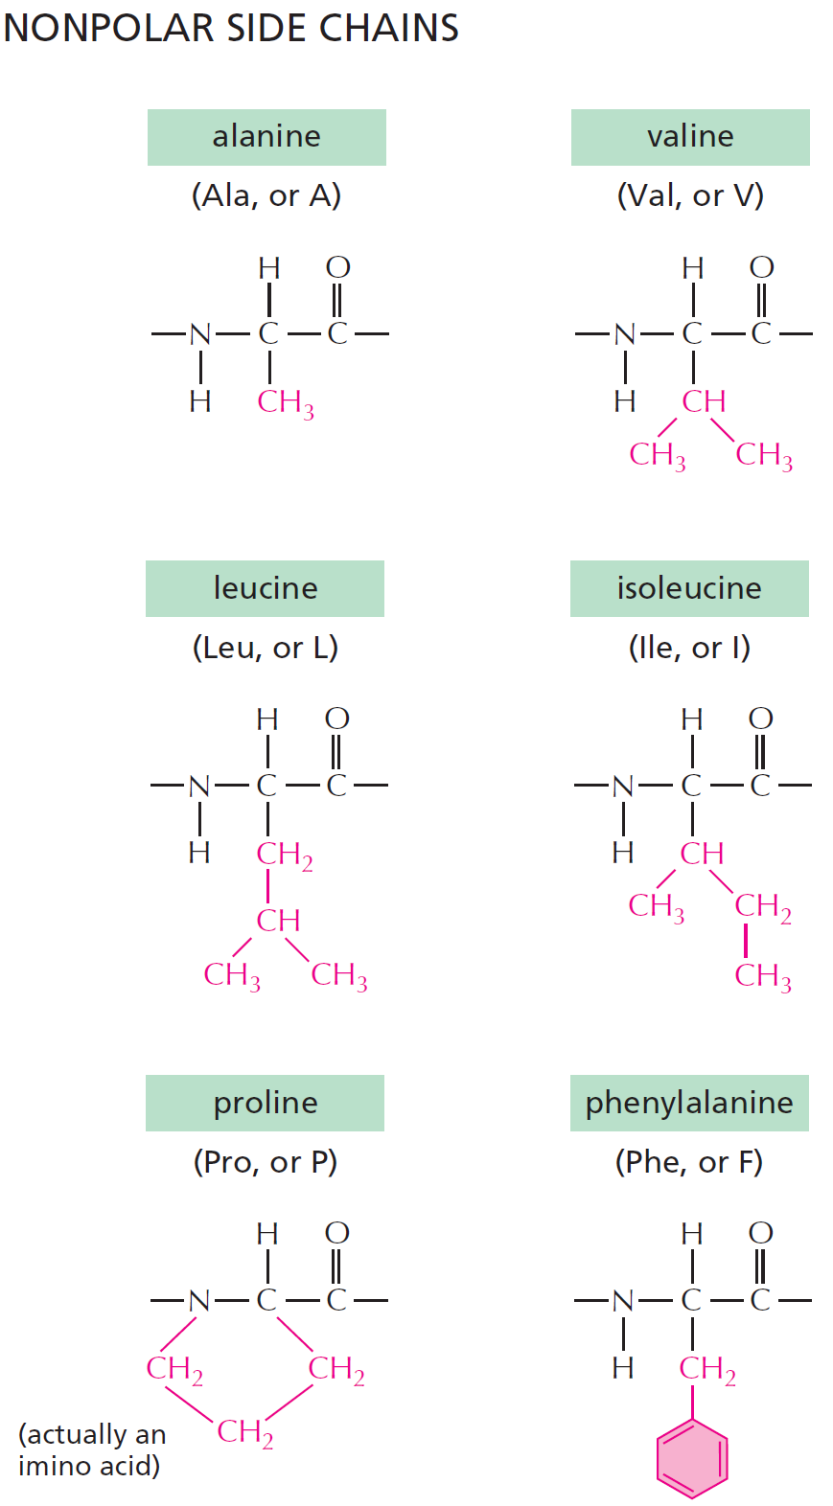
NONPOLAR SIDE CHAINS
H-bond donor
(polar functionality)
And at last there is glycine:
Ring results in no NH group for H-bonding
No real functionality for its R group (H)
Only AA that is achiral

Slide 26
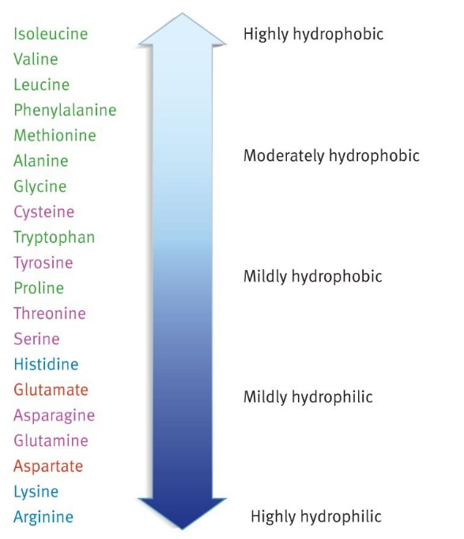
Summary of what you should know about amino acids:
Relative Hydrophobicity of Sidechains (one of many)
All amino acids have a carbon atom bonded to an amino group, a hydrogen atom and a carboxyl group. What makes each amino acid unique is its sidechain.
The common atoms will form the mainchain of the protein.
Most amino acids have at least one chiral center - the alpha carbon, exception is glycine, which is achiral.
You should be able to look at the functional groups on the side-chain and determine how they will interact with water:
Polar
Charged
Non-polar (hydrophobic). You should be able to justify large differences in hydrophobicity, e.g. Val versus Ala

Slide 27
Protein Structure and Stability

Slide 28
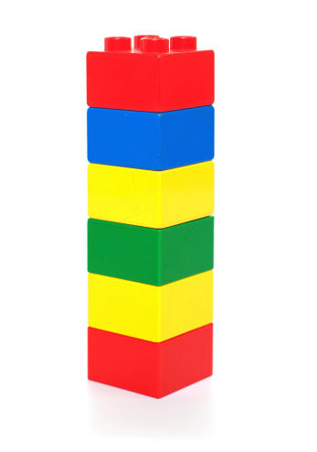
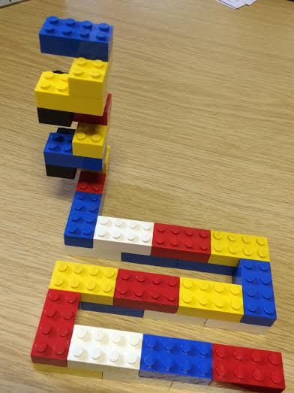
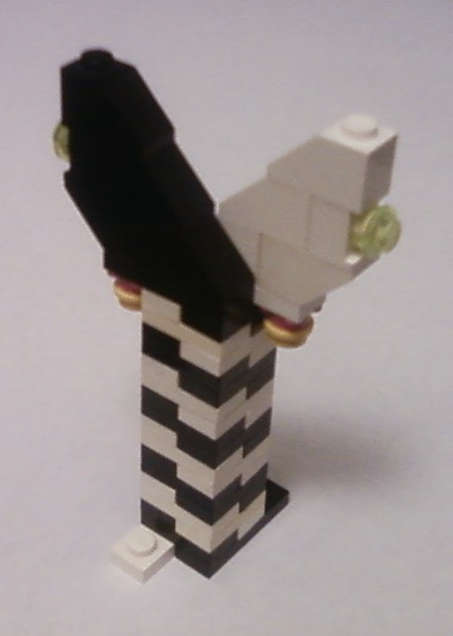
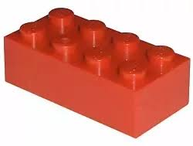
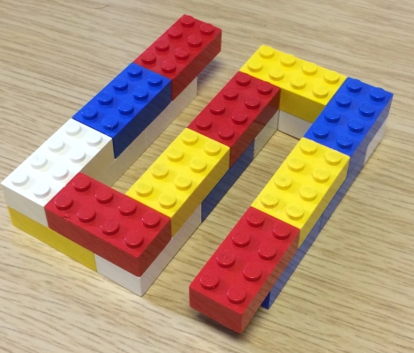
Structural Hierarchy of Proteins
Primary - sequence of amino acids, no 3D structural information
Secondary - local structural elements, only mainchain atoms involved
Tertiary - 3D position of all atoms, functional form of many proteins.
Quaternary - multiple chains – multiple chains often required for function.
Biological Function
(White and black represent two different chains)

Slide 29
Secondary Structure
“Building blocks of proteins”
Hydrogen bonds between the mainchain carbonyl group of one amino acid and the mainchain amino group of another form a protein’s secondary structure.
A polypeptide must bend to allow this hydrogen bonding, forming:
α-helices
β-pleated sheets
The large number of hydrogen bonds in a protein’s secondary structure increases its stability - each hydrogen bond that is formed releases some energy.
All amino acids can be incorporated into either secondary structure
(However, some are found more frequently in one structure)
General Rule for Hydrogen Bonds:
X-H Y
X & Y are electronegative (N and O usually)
X-H = Donor of the hydrogen bond
Y = Acceptor of the hydrogen bond
Mainchain hydrogen bonds
N-H O=C
The NH is the hydrogen bond_donor.
The C=O is the hydrogen bond acceptor.

Slide 30
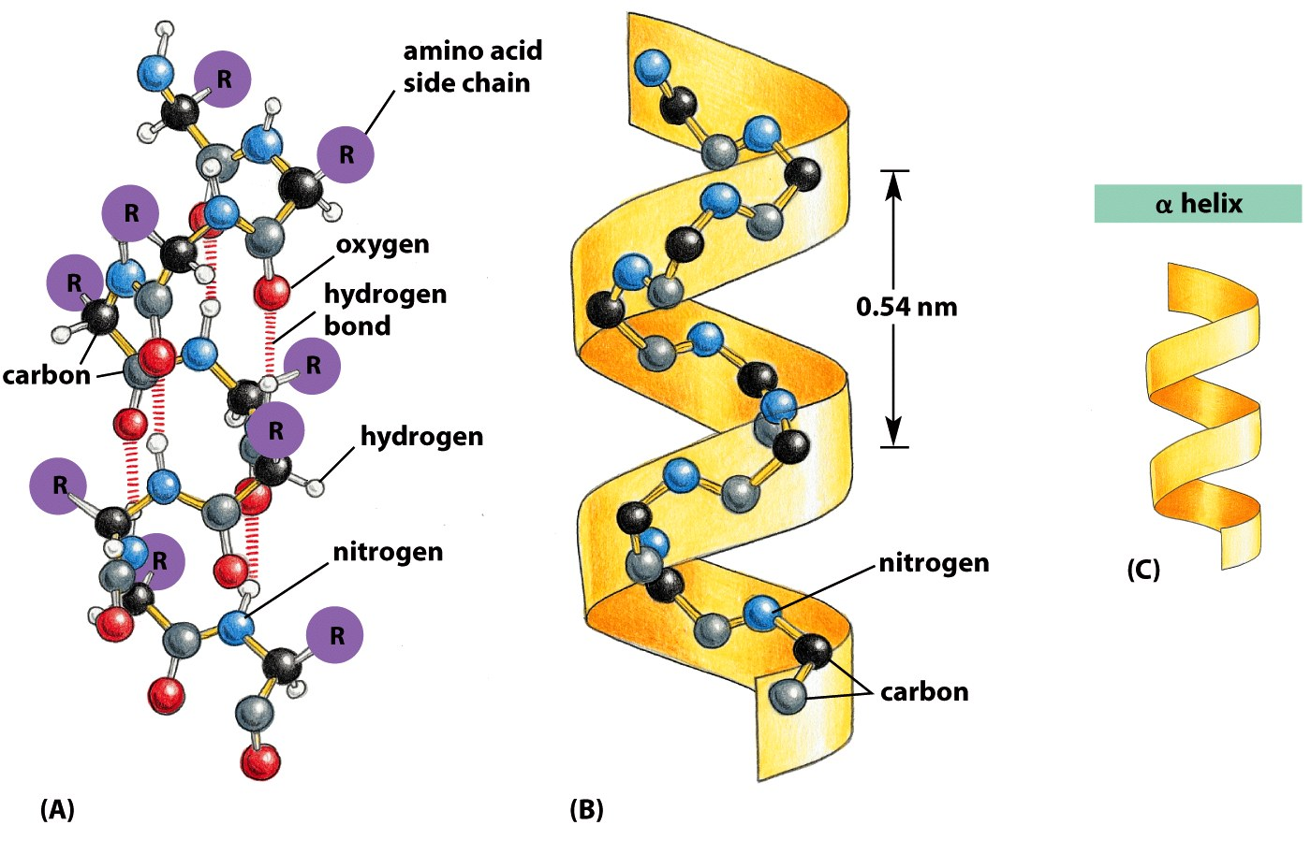
Alpha Helix
Spiral conformation (helix) in which every backbone N-H group donates a hydrogen bond to the backbone C=O group of the amino acid four residues earlier:
Intra-strand H-bonds, parallel to helix axis.
Side-chains project outwards.
Notes:
is a righthand-coiled or spiral conformation (helix) in which every backbone N-H group donates a hydrogen bond to the backbone C=O group of the amino acid four residues earlier (

Slide 31
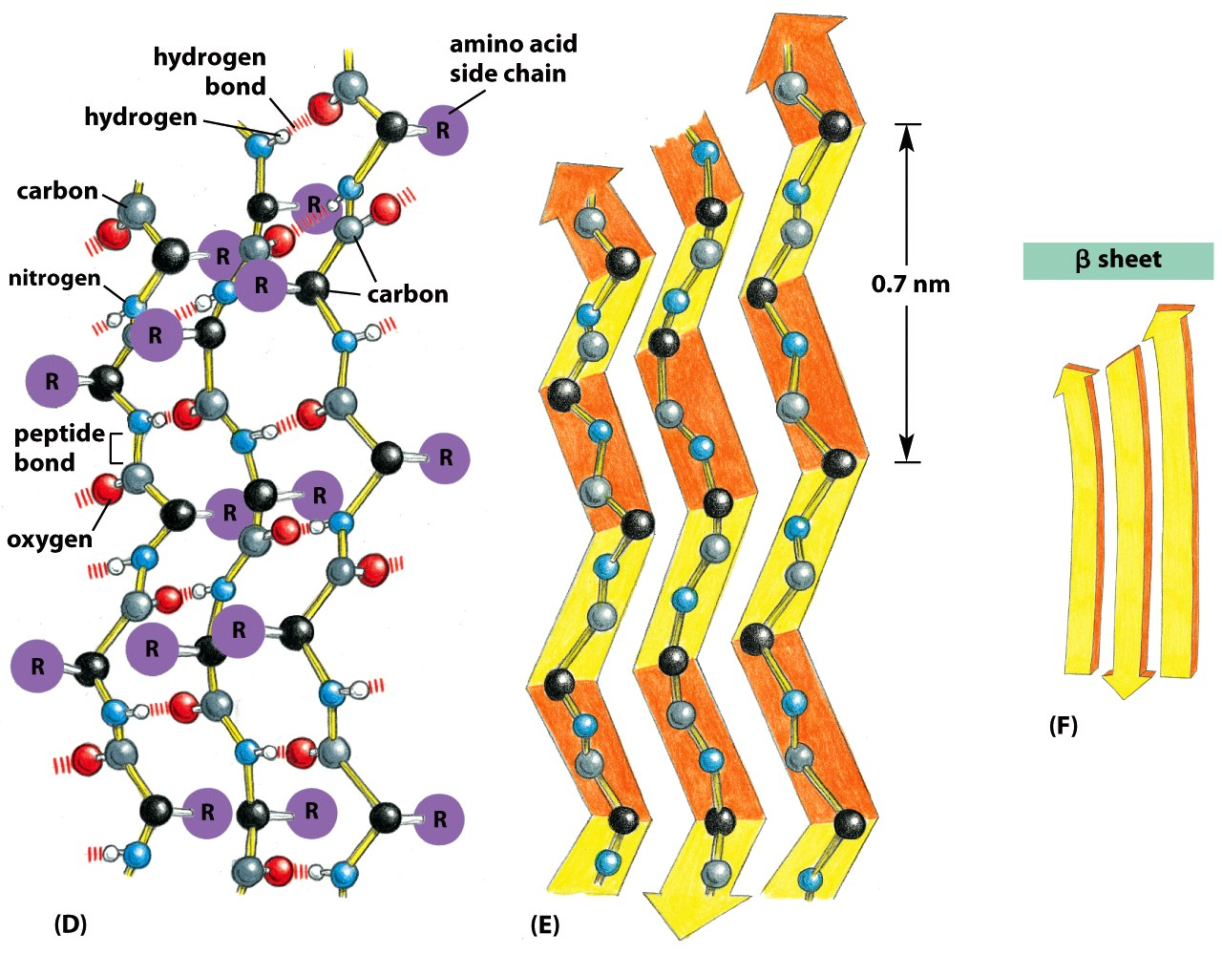
Beta Sheet
Beta-Strands connected laterally by backbone hydrogen bonds that are perpendicular to the strand, forming a generally twisted, pleated sheet.
Sheets can have two or more strands
Side-chains:
project up and down along a strand.
project in the same direction going from strand to strand across the sheet.
Notes:
strands connected laterally by at least two or three backbone hydrogen bonds, forming a generally twisted, pleated sheet.

Slide 32
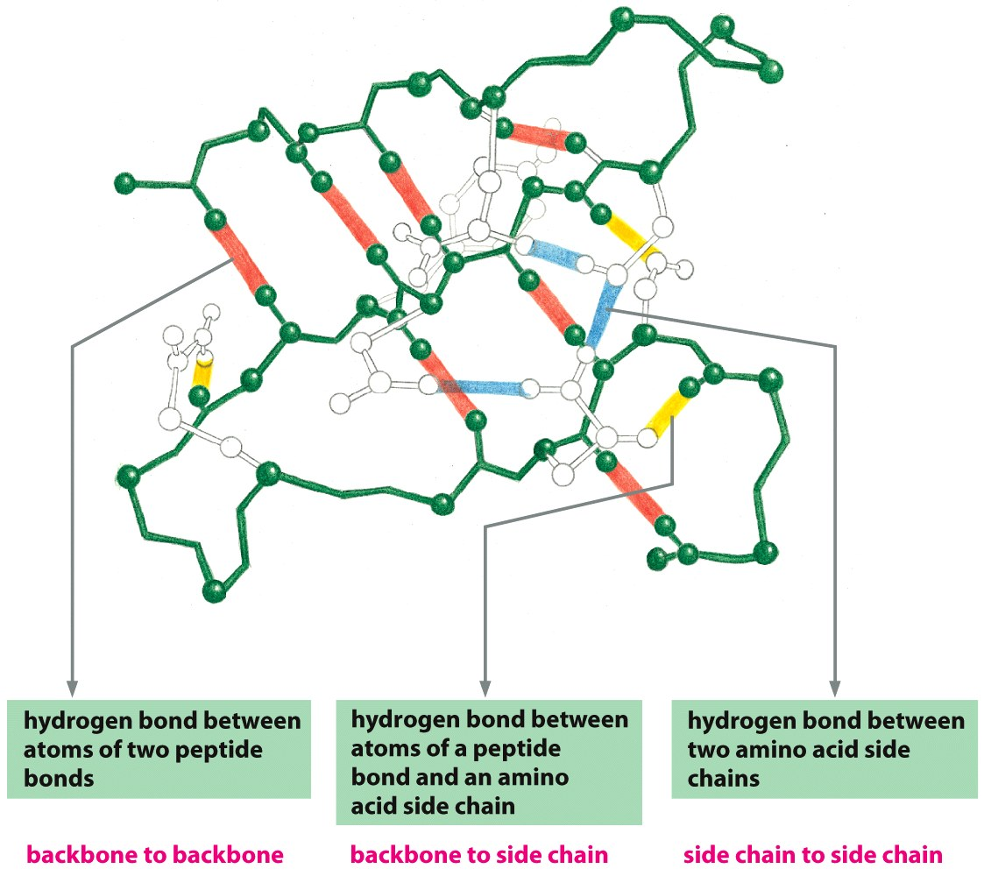
Hydrogen Bonding Stabilizes the Tertiary Structure
Hydrogen bonds form between hydrogen atoms and the carbonyl group in the peptide-bonded backbone – secondary structure
Hydrogen bonds are also found between hydrogen and electronegative atoms in side chains (sidechain-sidechain)
Sidechains can form hydrogen bonds to the mainchain too.
2^{ndy} Structure
3^{ry} Structure

Slide 33
Van der Waals (VdW) interactions Stabilize the Folded State
VdW are weak electrostatic interactions between side chains due to temporary (fluctuating) charges.
Attractive from long distance
Distance at lowest energy is at the van der Waals radii of the atoms.
Optimized in the core of folded proteins by “knobs fitting into holes”
Strength proportional to contact area.
Notes:
van der Waals force (or van der Waals interaction), named after Dutch scientist Johannes Diderik van der Waals, is the sum of the attractive or repulsive forces between molecules (or between parts of the same molecule) other than those due to covalent bonds, the hydrogen bonds, or the electrostatic interaction of ionswith one another or with neutral molecules or charged molecules.^{[1]} The term includes:
force between two permanent dipoles (Keesom force)
force between a permanent dipole and a corresponding induced dipole (Debye force)
force between two instantaneously induced dipoles (London dispersion force).
London forces are exhibited by nonpolar molecules because of the correlated movements of the electrons in interacting molecules. Because the electrons in adjacent molecules "flee" as they repel each other, electron density in a molecule becomes redistributed in proximity to another molecule (see quantum mechanical theory of dispersion forces). This is frequently described as the formation of instantaneous dipoles that attract each other. London forces are present between all chemical groups, and usually represent the main part of the total interaction force in condensed matter, even though they are generally weaker than ionic bonds and hydrogen bonds.

Slide 34
Strength of Van der Waals Depends on the Surface Area

Slide 35
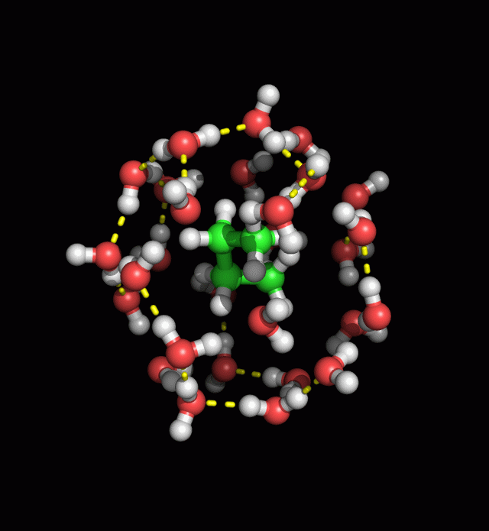
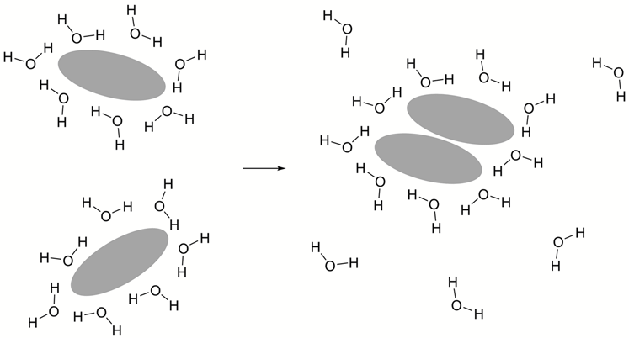
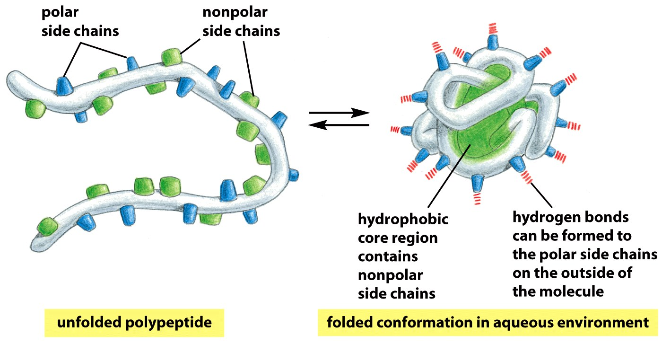
Hydrophobic Interactions are Critical for Stabilizing Folded Proteins
Hydrophobic interactions within a folded protein increase stability of surrounding water molecules by releasing the ordered water that surrounded exposed non-polar groups when the protein is unfolded, increasing the entropy of the water – disorder is favorable.
Which amino acid is most likely to be found in the core of a folded protein:
Valine Serine

