Slide 1
MSIT Summer Leadership Symposium Internet of Things 101
Michael J. McCarthy
Associate Teaching Professor
Carnegie Mellon University

Slide 2
“As with the internet itself, smart, connected products reflect a whole new set of technological possibilities that have emerged.”
Smart and Connected Products
From: “How Smart Connected Products are Transforming Competition” Harvard Business Review

Slide 3
A few products: not smart or connected
https://en.wikipedia.org/wiki/Jeep_Cherokee#/media/File:1974_Jeep_Cherokee_S_-_Beach_(cropped).jpg
Let’s add some “smarts” to the products…

Slide 4
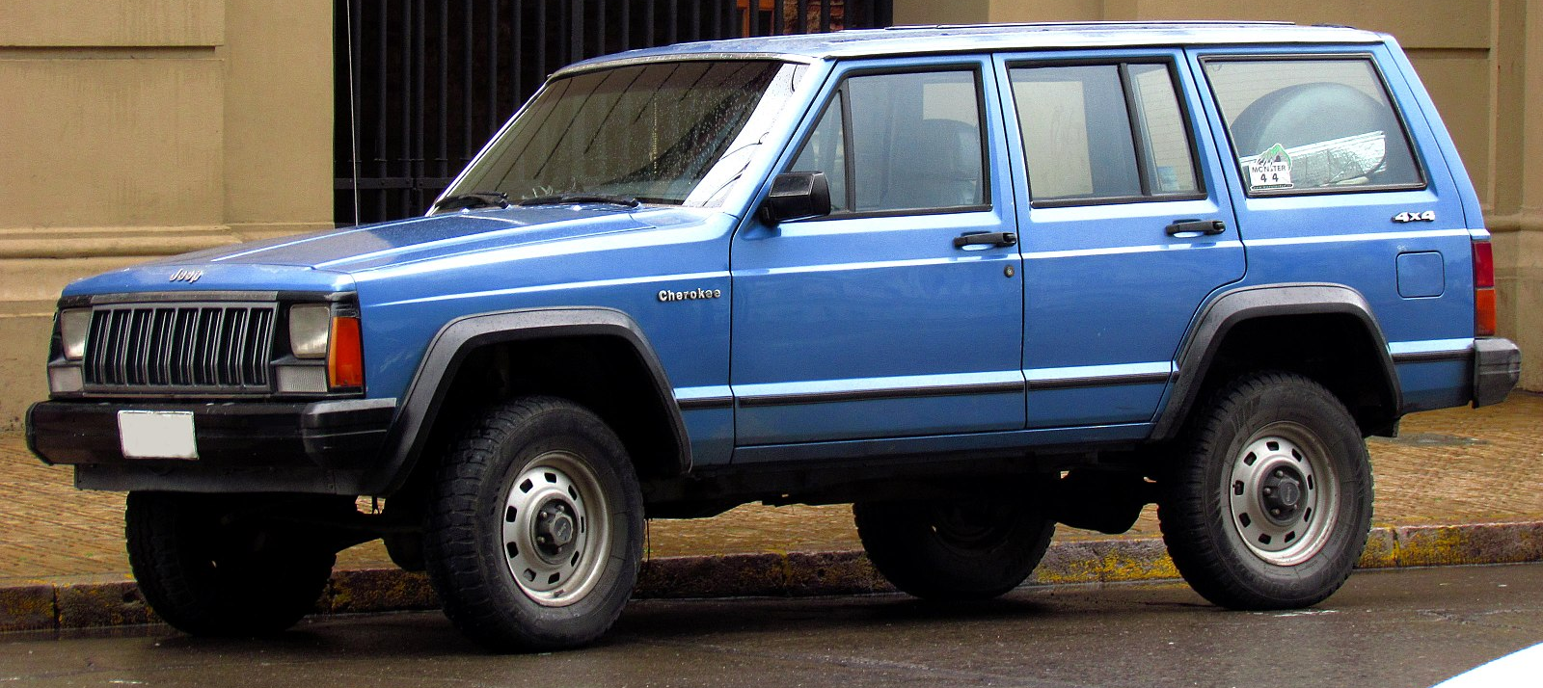
Smarts added to the products
https://en.wikipedia.org/wiki/Jeep_Cherokee#/media/File:1974_Jeep_Cherokee_S_-_Beach_(cropped).jpg
https://en.wikipedia.org/wiki/File:Jeep_Cherokee_2.5_1988_(15289674633)_(cropped).jpg
https://www.amazon.com/Keurig-B60-Special-Brewing-System/dp/B000AQSMPO
Talking doll
Power brakes on the jeep
Microcontrollers
in the coffee pot
No elevator operator needed
Let’s connect these things to the internet…

Slide 5
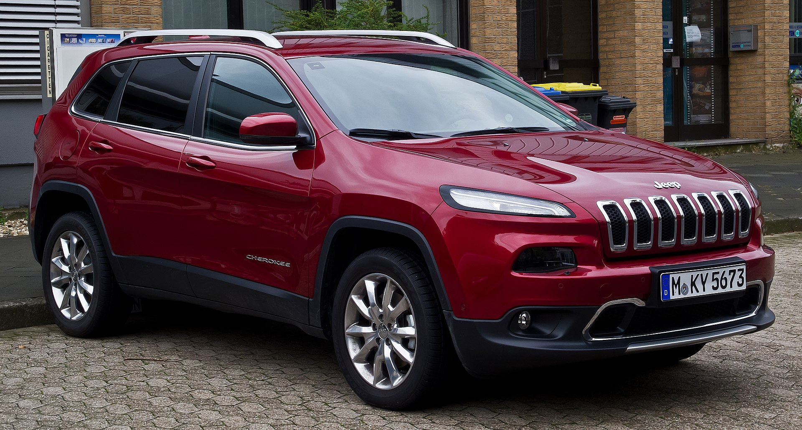
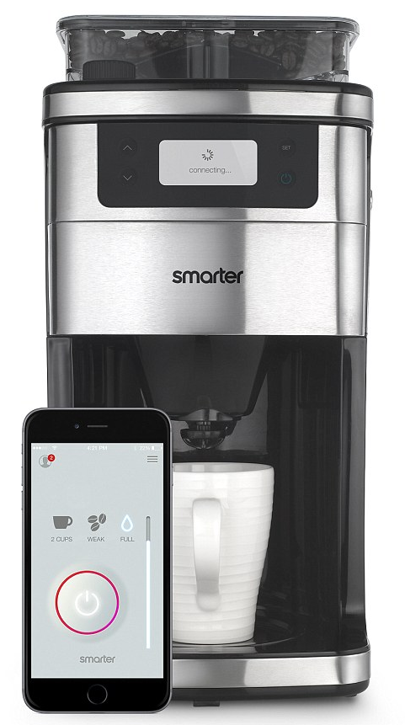
Connectivity added to smart products
https://en.wikipedia.org/wiki/Jeep_Cherokee#/media/File:1974_Jeep_Cherokee_S_-_Beach_(cropped).jpg
https://en.wikipedia.org/wiki/File:Jeep_Cherokee_2.5_1988_(15289674633)_(cropped).jpg
https://www.amazon.com/Keurig-B60-Special-Brewing-System/dp/B000AQSMPO
https://en.wikipedia.org/wiki/Jeep_Cherokee#/media/File:1974_Jeep_Cherokee_S_-_Beach_(cropped).jpg
https://www.engadget.com/2015/01/02/smarter-wifi-coffee-machine/
Notes:
https://www.cbsnews.com/news/your-kids-toys-could-be-spying-on-your-family/
Last doll – parents are worried this kid toy could be spying on your family, it listens and connects to wifi
Cathedral of Learning – all the elevators are connected to a network so they are integrated together

Slide 6
Smart and Connected
My Friend Cayla, which costs $59.93 at Walmart.com, is billed as “a wonderful choice for
a young child who needs a companion.”
The Electronic Privacy Information Center (EPIC) claims the toys allegedly send
recordings to speech-to-text software company Nuance Communications, which
the complaint notes has contracts with military and law enforcement agencies.
Notes:
https://www.cbsnews.com/news/your-kids-toys-could-be-spying-on-your-family/
Last doll – parents are worried this kid toy could be spying on your family, it listens and connects to wifi
Cathedral of Learning – all the elevators are connected to a network so they are integrated together

Slide 7
Smart and Connected
“Connect your vehicle to Alexa via an Amazon Echo that syncs
with any Uconnect®- equipped Jeep®Cherokee. Use your voice
to start your vehicle, check fuel levels, send an address directly
to your Navigation system and more, all from your home.” From
An advertisement describing connected Jeeps at
https://www.jeep.com/uconnect.html/
Modern cars collect as much as 25 gigabytes of data per hour, the consulting firm
McKinsey estimates, and it’s about much more than performance and maintenance.
NYT May 20, 2019. Data is collected about a driver’s performance. That data can be sold.
“Though I hadn't touched the dashboard, the vents in the Jeep
Cherokee started blasting cold air at the maximum setting,
chilling the sweat on my back through the in-seat climate
control system. Next the radio switched to the local hip hop
station and began blaring Skee-lo at full volume. I spun the
control knob left and hit the power button, to no avail. Then
the windshield wipers turned on, and wiper fluid blurred the
glass.” From Wired https://www.wired.com/2015/07/hackers-remotely-kill-jeep-highway/
Notes:
https://www.cbsnews.com/news/your-kids-toys-could-be-spying-on-your-family/
Last doll – parents are worried this kid toy could be spying on your family, it listens and connects to wifi
Cathedral of Learning – all the elevators are connected to a network so they are integrated together

Slide 8
Smart and Connected
“It’s great for the person who is looking to buy smarter; it monitors your supply
of coffee, and sends push notifications to your phone when it is time to pick up
fresh beans or ground coffee.”
From https://ideaing.com/ideas/best-smart-coffee-makers
“A coffee-machine hack may seem harmless, but the Dyn attack proved how easily
IoT devices can cause damage at a grand scale.”
From https://qz.com/901823/the-easy-way-your-smart-coffee-machine-could-get-hacked-and-ruin-your-life/
The attack caused major Internet platforms and services to be unavailable to
large swathes of users in Europe and North America.^{Wikipedia}
David Fidler, adjunct senior fellow for cybersecurity at the Council on Foreign Relations,
said he couldn’t recall a DDoS attack even half as big as the one that hit Dyn.
From https://www.theguardian.com/technology/2016/oct/26/ddos-attack-dyn-mirai-botnet
Notes:
https://www.cbsnews.com/news/your-kids-toys-could-be-spying-on-your-family/
Last doll – parents are worried this kid toy could be spying on your family, it listens and connects to wifi
Cathedral of Learning – all the elevators are connected to a network so they are integrated together

Slide 9
Smart and Connected
Proactive maintenance is available. Dashboards showing location and status
of elevator fleet. A rules engine is used to detect and respond to emergency
conditions. API’s and SDK’s are provided for developers. Users are able to
find an appropriate elevator within a bank of elevators using a smart phone.
Improve operating capabilities and efficiency to obtain real-time accurate
information remotely.
“The idea of a hackable elevator, where someone can trap and move around
its occupants on a whim, maybe while watching the whole thing via the
security camera, is just horrifying.”
From https://www.infosecurity-magazine.com/slackspace/connected-elevators-iot-doomsday/
Notes:
https://www.cbsnews.com/news/your-kids-toys-could-be-spying-on-your-family/
Last doll – parents are worried this kid toy could be spying on your family, it listens and connects to wifi
Cathedral of Learning – all the elevators are connected to a network so they are integrated together

Slide 10
A Key Architectural Idea: The Digital Twin
It seems like a good idea for the IoT architecture to register every device with a cloud service and communicate with that service alone. From the article on “Enabling the Internet of Things“
Users or other computers would then interact with this service to determine the device’s status or control its behavior.
This approach provides economics of scale, automatic backup of data, and security provided by providers on the cloud.
General Electric promotes its PREDIX platform. Digital Twins are described as :
- providing a software representation of a physical asset.
- providing a single source of truth about the asset
- holding data about past and present state, condition, and performance of
the asset and providing analytics

Slide 11
Types of Connectivity
One-to-one: An individual product connects to the user, manufacturer or another product. For
example, a car connected to a diagnostic machine.
One-to-many: A central system collects data from many products simultaneously. For example,
a Tesla car makes reports to a single manufacturer system – monitoring performance, provide
remote services and upgrades.
Many-to-many: Multiple products connected to many other types of products and to the cloud
as well. For example, automated tillers inject nitrogen fertilizer at precise depths and intervals,
and seeders follow, placing corn seeds directly in the fertilized soil.

Slide 12
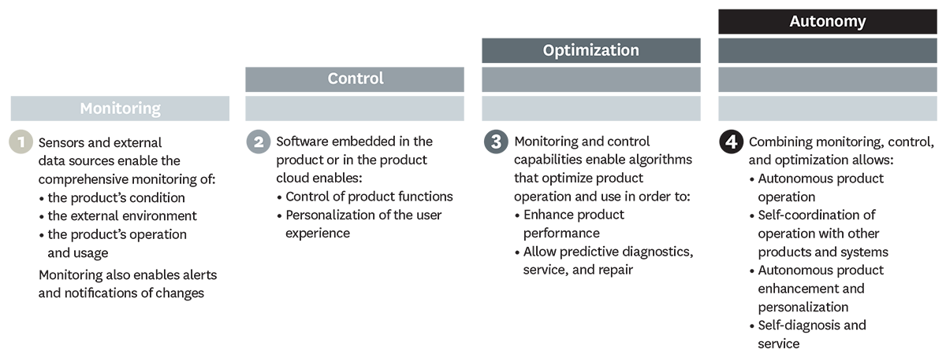
What Can Smart, Connected Products Do?
From HBR article by Porter and Heppelmann

Slide 13
Monitoring
In some cases, such as medical devices, monitoring is the core element of value creation. Medtronic’s digital blood-glucose meter uses a sensor inserted under the patient’s skin to measure glucose levels in tissue fluid and connects wirelessly to a device that alerts patients and clinicians up to 30 minutes before a patient reaches a threshold blood-glucose level, enabling appropriate therapy adjustments.
From HBR article by Porter and Heppelmann

Slide 14
Control
Users can adjust their Philips Lighting hue lightbulbs via smartphone, turning them on and off, programming them to blink red if an intruder is detected, or dimming them slowly at night. Doorbot, a smart, connected doorbell and lock, allows customers to give visitors access to the home remotely after screening them on their smartphones.
From HBR article by Porter and Heppelmann

Slide 15
Optimization
The rich flow of monitoring data from smart, connected products, coupled with the capacity to control product operation, allows companies to optimize product performance in numerous ways, many of which have not been previously possible.
Diebold, for example, monitors many of its automated teller machines for early signs of trouble. After assessing a malfunctioning ATM’s status, the machine is repaired remotely if possible, or the company deploys a technician who has been given a detailed diagnosis of the problem, a recommended repair process, and, often, the needed parts.
From HBR article by Porter and Heppelmann

Slide 16
Autonomy
More-sophisticated products are able to learn about their environment, self-diagnose their own service needs, and adapt to users’ preferences. Autonomy not only can reduce the need for operators but can improve safety in dangerous environments and facilitate operation in remote locations.
Joy Global’s Longwall Mining System, for example, is able to operate autonomously far underground, overseen by a mine control center on the surface. Equipment is monitored continuously for performance and faults, and technicians are dispatched underground to deal with issues requiring human intervention.
From HBR article by Porter and Heppelmann

Slide 17
We Used to Make Tractors!
From HBR article by Porter and Heppelmann
To build such system of systems, systems need to interoperate well with others.
Principles from the World Wide Web, provide us with guidance on the construction of interoperable systems.

Slide 18
Summary: Smart and Connected Products
IT is revolutionizing products.
Once, solely mechanical and electrical parts.
Now, complex systems with connectivity.
Smart, connected products are unleashing a new era of competition.
Some companies will ask “What business am I in ?”
The product contains a computer and has a representation in the
cloud.
This changes product design, marketing, manufacturing, and after sales service.
This creates opportunities for rich data analytics and machine learning.
Security and privacy concerns are significant but will probably not be a show stopper.
Lessons learned from the WWW may help us achieve a more interoperable IOT.
We can build a Web of Things.

Slide 19
Building a web of things
It’s about more than smart, connected products.

Slide 20
Let’s revisit our traditional objects
BLE Tag
BLE Tag
NFC Tag
BLE Tag
URL
URL
URL
URL
What good are the URL’s?
Each URL can be dereferenced and used to request additional information.
A web service will exist at the URL, allowing us to, say, purchase a ticket for a concert.
Of course, these objects may be smart and connected as well.
Quiz: in the video that follows, identify the objects that use tags.
https://www.youtube.com/watch?v=1yaLPRgtlR0&feature=youtu.be

Slide 21
Tagging Passive Things
Passive things are not suitable for direct wired or wireless connections to the internet.
For these things, we need perhaps a tag, a smartphone and a proxy web service.
See the NFC tag on the movie poster in the video.
Three popular approaches to passive tagging
(1) UHF RFID < 10 ft not successful in practice
NFC is a form of RFID (the user must be very close to engage)
(2) Optical tags (Quick Response Codes)
Requires a camera and an application. That is a drawback.
Yields text, number or URI
(3) Bluetooth Low Energy (BLE)
All modern smart phones support
Advertise a packet, perhaps a URL, every second
One year on one small battery
BLE is used by iBeacon (Apple) and Eddystone (Google)

Slide 22
Networks
Any device, in practice, that connects directly to the internet requires a physical Ethernet, Wi-Fi radio, or cellular modem. All of these increase cost and power consumption.
The wireless coverage of a cell tower is measured in miles.
The wireless coverage of Wi-Fi is measured in yards.
We can use constrained networks for low or no power devices.
We can use one bridging device that supports Wi-Fi and enables simple peripheral IoT devices to talk to the bridge.
BLE wireless coverage is measured in feet.
NFC wireless coverage is measured in centimeters.
NFC requires user attention and engagement. BLE does not.
BLE Beacons continually transmit a discovery signal to be received by a
BLE enabled device - Smartphone
NFC Tags communicate only when close to an NFC enabled device - Smartphone
BLE beacons have been around since 2006
NFC is based on RFID and RFID has been around since the 1940’s.
From: Mobile Payements Today

Slide 23
Building the Web of Things
Things need to be identified.
At a low level, IPV6 supports 128-bit addresses.
That’s a lot of addresses.
At a higher level, identify things with Web URI’s (URL’s and URN’s).
URL’s in conjunction with DNS route and connect to services.

Slide 24
Building the Web of Things
Design the IoT as an extension of the World Wide Web.
Build a physical web = web technologies + IoT.
Web technologies include URL’s, XML, JSON, HTTP, Websockets,
REST, CoAp, and TLS .
To overcome scale and complexity, preferentially discover things
nearby.
Useful processing may be performed on the edge.
Consider peer to peer connections and cloudlets.
Consider the integration of devices that have little or no processing
capabilities.

Slide 25
The Physical Web
The Physical Web associates People, Places, and Things with web pages or services.
Take seriously the use of proximity beacons.

Slide 26
The Physical Web
An Eddystone Beacon
RadBeacon Dot for The Physical Web
From the advertisement:
“Simply include the PhysicalWebURL you will
like your beacon configured for, and we will
get the beacon configured prior to shipping.
To place an order for beacons with
different URLs, please follow the steps below:”

Slide 27
The Web of Things
Smart phone or browser client interaction
with services
Fitbit.com
Proxy web service for poster
Phone or
gateway
Low level peer to
Peer – Bluetooth
or wi-fi
Identification data
Status and Control
URI
NFC Tag on Poster
Smart and
connected
FitBit
Figure 1
Bluetooth LE Tag

Slide 28
Edge Computing
An innovative solution to latency problems (using the cloud) is edge computing.
Cloudlets (from CMU) are an important example:
A cloudlet is dynamically provisioned with software and services.
Is nearby and holds only soft state.
Is more powerful than local devices.
An important edge API is is IBM’s Apache Edgent. Apache Edgent is a lightweight
and embedded streaming analytics runtime that analyze events locally, on the edge
of your system, sending only relevant events downstream. (From Apache Edgent)

Slide 29
Client Server or Peer to Peer
Simple device and powerful cloud service. (a centralized model)
Complex device on its own (perhaps involved in a peer to peer network)
Tradeoffs Complex Device Simple Device Cloudlet
Latency Low High Low
Security Low Higher Higher
Privacy High Lower Lower
Cost High Lower Lower
Management High Low Low
Autonomy High Low Low

Slide 30
Proximity Sharing
One nearby device has a capability needed by another (need a big screen?)
Companies may not adopt standards so they can lock you in and dominate.
European banking PSD2 regulates API’s in order to increase competition.
Not easy. For proximity sharing we need:
Discovery,
Trust,
Connection through standard data formats and protocols.

Slide 31
The Physical Web
What if a Thing is not smart, connected, or tagged?
San Francisco bans facial recognition technology. May 14, 2019

Slide 32
Final Thoughts
The World Wide Web is an excellent guide to building an interoperable IoT.
Interoperability, context awareness and machine learning will lead to very smart devices
and many things being web present.
Security and privacy problems will continue but will not stop the show.
Thank you.

