Slide 1
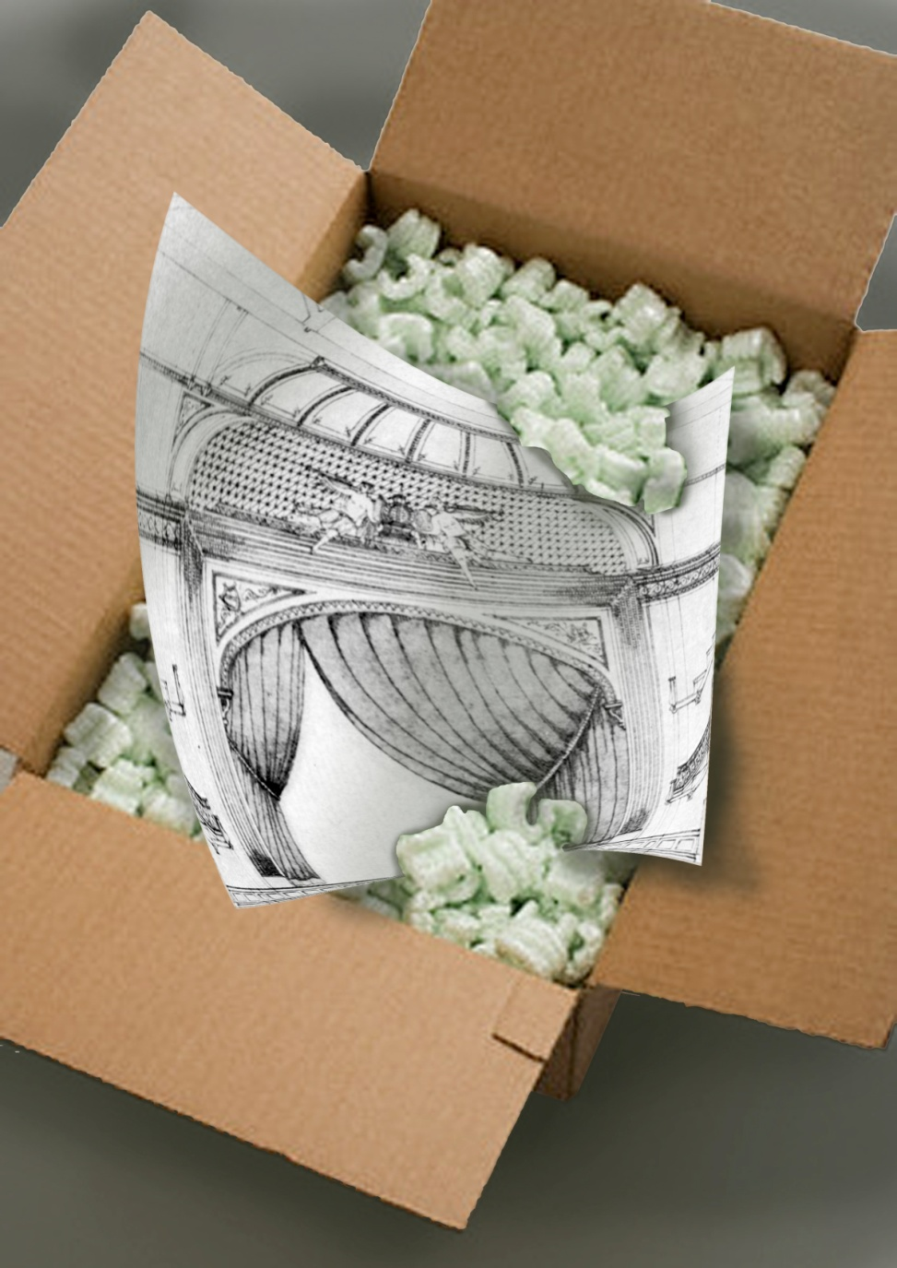
Designing Outside of the Proscenium
Anne Mundell
Presented by
Casey Kearns

Slide 2
Similarities to Theater Design
Story
Institutional Meta-goals
Resourcing
Collaboration

Slide 3
Similarities to Theater Design
Story: There’s always a story to tell.
Finding a story on which all parties agree will lead to an overall approach against which ideas can be tested.
How do you ask the right questions to discover what the “story” of the world you are creating will be?

Slide 4
Similarities to Theater Design
Institutional Meta-goals: The institution within which you work will be working toward incorporating your project into an institutional mission.
Like projects fitting into a theatrical season, an organization will always have goals and target audiences for each project.
Ferreting out what those overall objectives are can help determine what the story of the project will be.

Slide 5
Similarities to Theater Design
Resourcing: No matter how much money/time/labor you have, it’s never enough.
Budgets and resourcing that may seem huge (or tiny) depending on what you are used to working with are illusory.
I like to determine what a dollar and an hour means for each project and organization, calling them “project hours” and “project dollars”, so that I can calibrate my resourcing expectations correctly.

Slide 6
Similarities to Theater Design
Collaboration: Most projects in which designers may be involved will have a major component of collaboration.
Figure out who the major collaborators are early on, and what their roles are.
Create an organizational chart for yourself to avoid falling into the trap of assuming that the structure of the organization is the same as, or even similar to, theater.
In most other applications, there will be more “suits” and engineers and fewer artists.
While you are probably expert at collaboration, almost always you will have to adjust to an organization’s collaborative and hierarchical structure.

Slide 7
Differences from Theater Design
Lexicon: You will often have to learn a different dictionary of terms for different industries.
Audience: Your audience will often be different than in theater, for example, sometimes your audience may be a camera and sometimes your audience will be much more interactive than traditional theater demands and sometimes the audience will have different kinds of expectations than those of a theater audience.
Priorities: Discovering the major priorities of each type of project is a priority. For example, while we always want to keep actors and patrons safe in theater, in museum design, keeping the objects on display safe is paramount, as well.
Longevity: Sometimes projects will have a life of months or years, during which they may be exposed to weather, and other kinds of corrosion, such as human interaction.
Problem Solving: Projects will often have major challenges not found in the theater. Those must be discovered early in the process by figuring out the right questions to ask.
Expectations: Work practices and expectations of you as a designer will be different from organization to organization.

Slide 8
Differences from Theater Design
Lexicon: You will often have to learn a different dictionary of terms for different industries.
Ask, if you don’t know what a term means …
Or, write down a list of confusing ideas and terms and research them as you go, depending on how immediate your knowledge needs are.

Slide 9
Differences from Theater Design
Priorities: Discovering the major priorities of each type of project is a priority.
For example, while we always want to keep actors and patrons safe in theater, in museum design, keeping the objects on display safe is paramount, as well.

Slide 10
Differences from Theater Design
Longevity: Sometimes projects will have a life of months or years.
During which they may be exposed to weather, and other kinds of corrosion, such as human interaction.
If you are working in Museum design, there are corrosives that we would not consider in theater: everything from off-gassing from paint and new carpet to excess light or temperature change.

Slide 11
Differences from Theater Design
Problem Solving: Projects will often have major challenges not found in the theater.
Those must be discovered early in the process by figuring out the right questions to ask.
What are the problems unique to this organization or project?
Who is the audience?
How does this project fit into a greater scheme? Are there story or style considerations that must be considered?

Slide 12
Differences from Theater Design
Expectations: Work practices and expectations of you as a designer will be different from organization to organization.
What does the organization expect from you in terms of:
Communication
Meeting presence
Deliverables
Engineering
Do you need to sub-contract people to do work outside of your expertise, for example if there are engineering questions or if there is a large number of materials with which you are not familiar?

Slide 13
Kidsize: The Material World of Childhood Carnegie Museum of Art Problem and Story
The problems were:
that we wanted to tell a story more specific to how these objects were used.
That we wanted to create something that was more interactive and child friendly than the original show.
We wanted to brand each item with an identifiable category.

Slide 14
The Exhibition as is Existed

Slide 15
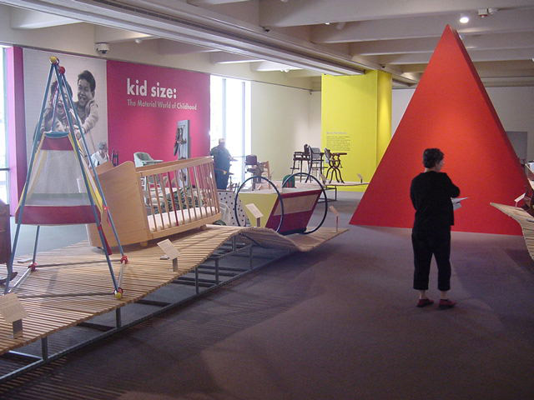

Slide 16
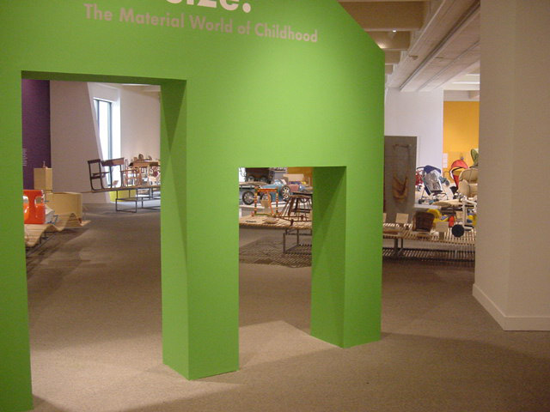

Slide 17
Solutions
Sleep

Slide 18
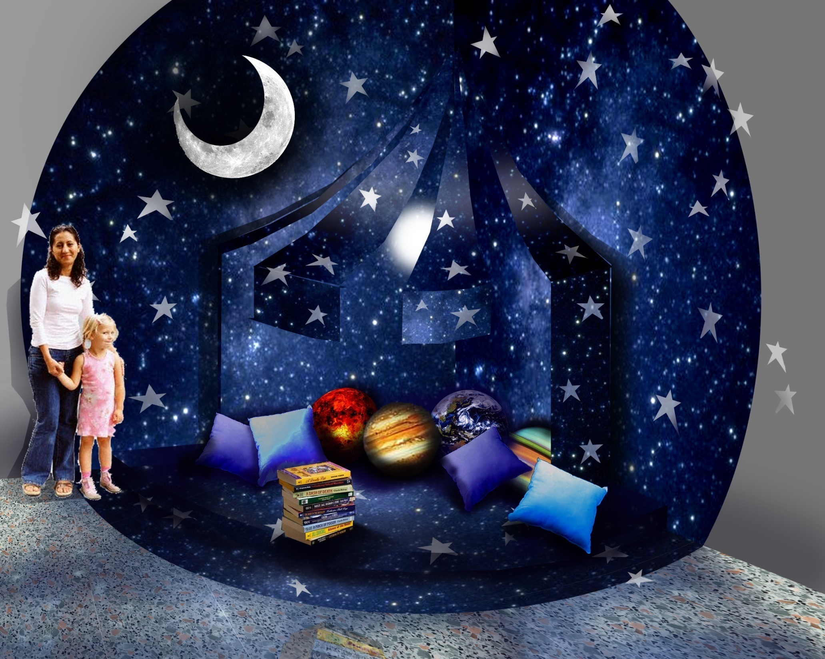

Slide 19
Solutions
Basic Functions

Slide 20
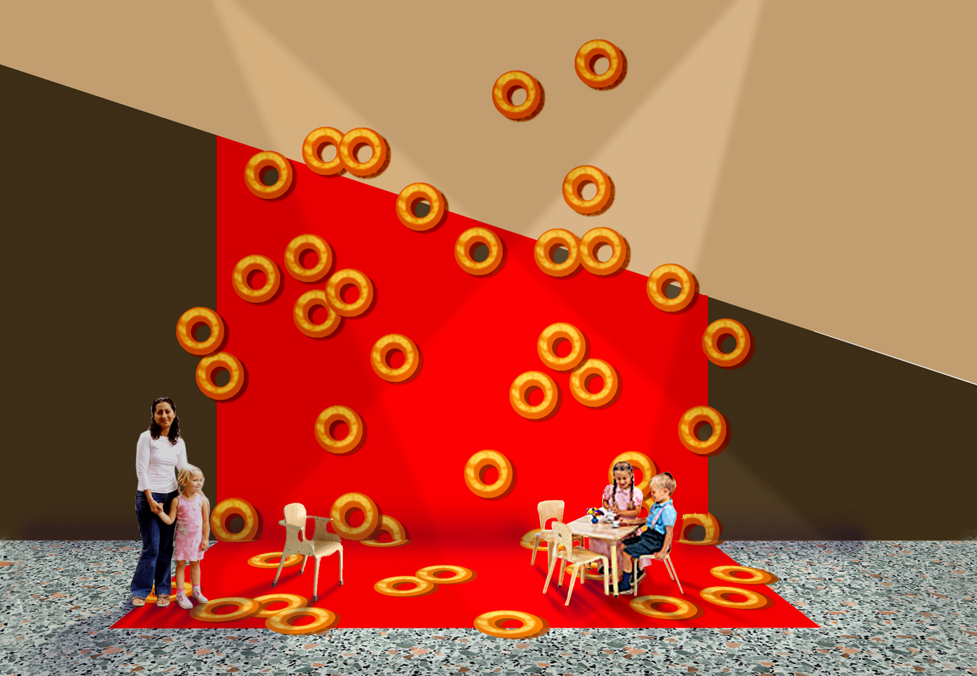

Slide 21
Solutions
Play

Slide 22
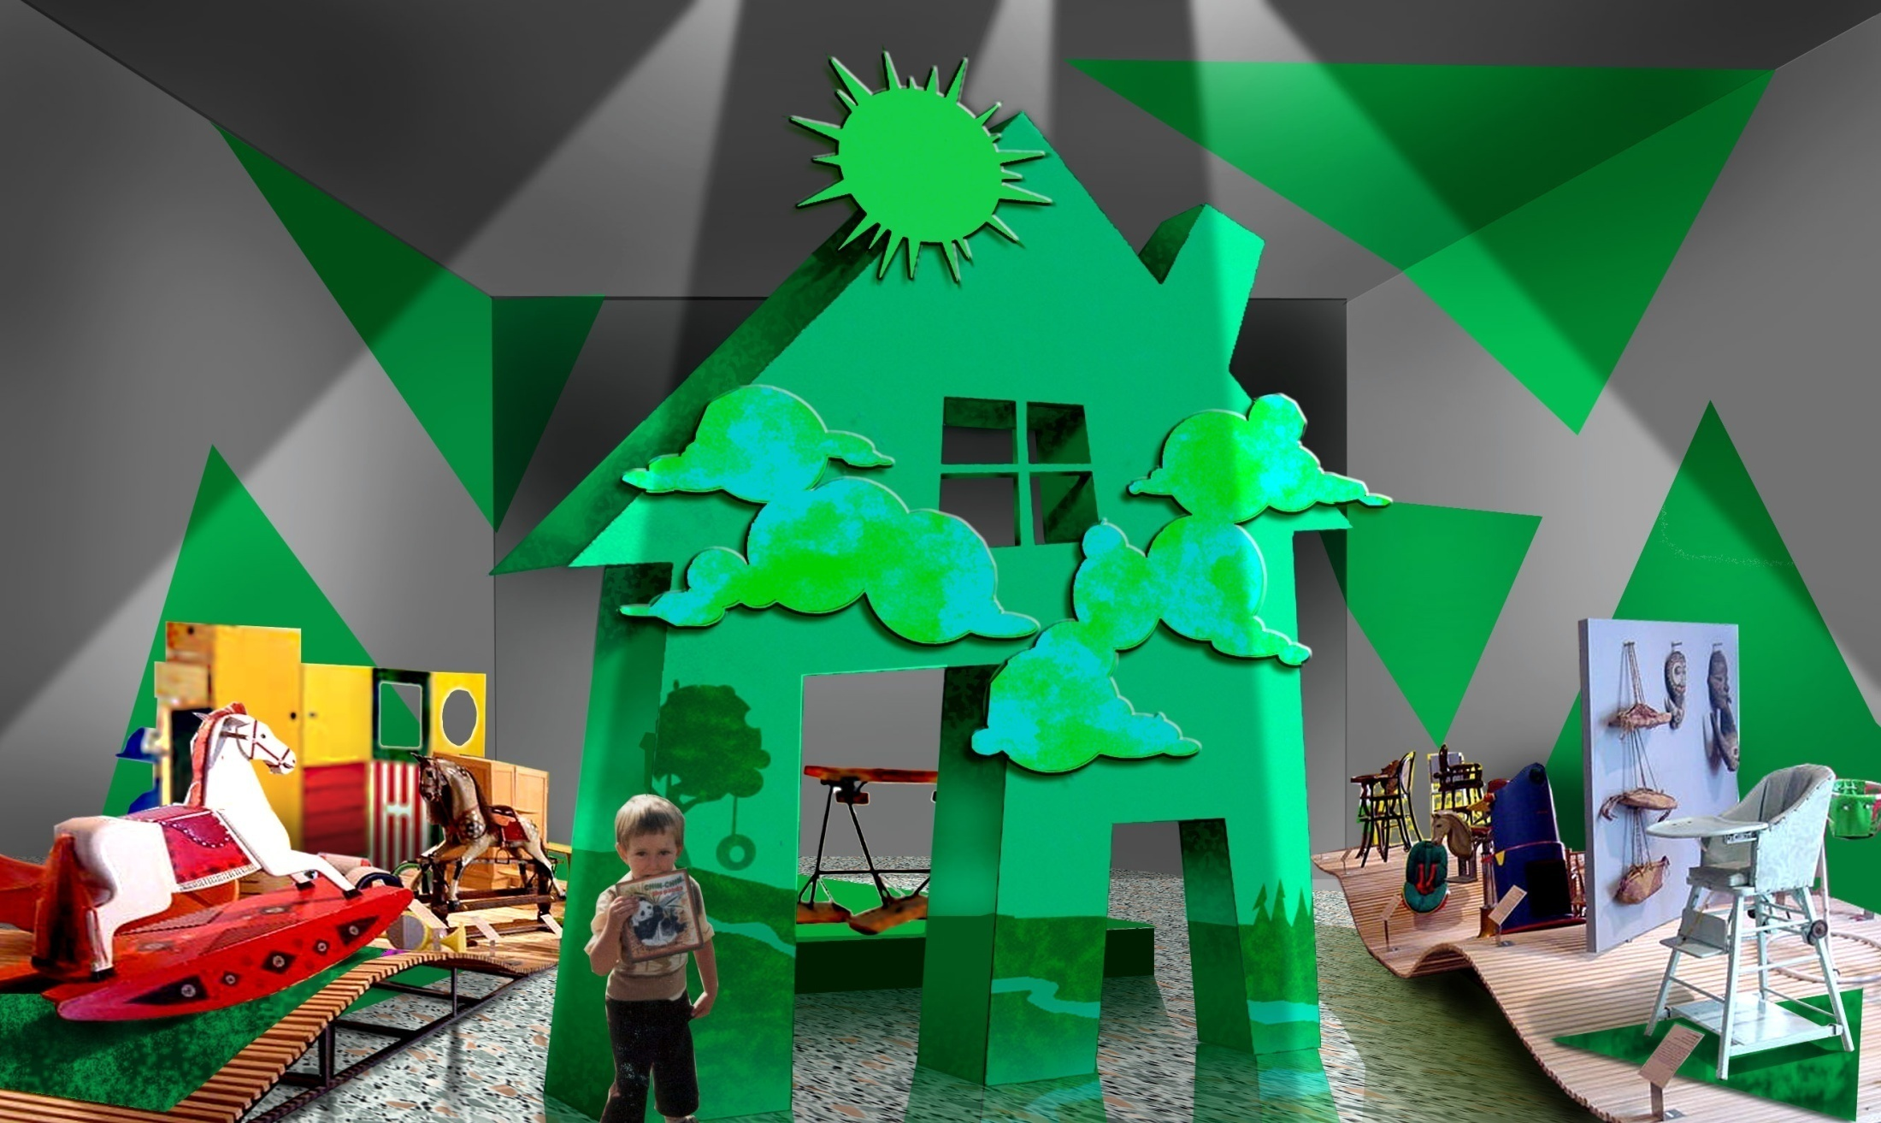

Slide 23
Solutions
Formal Learning

Slide 24
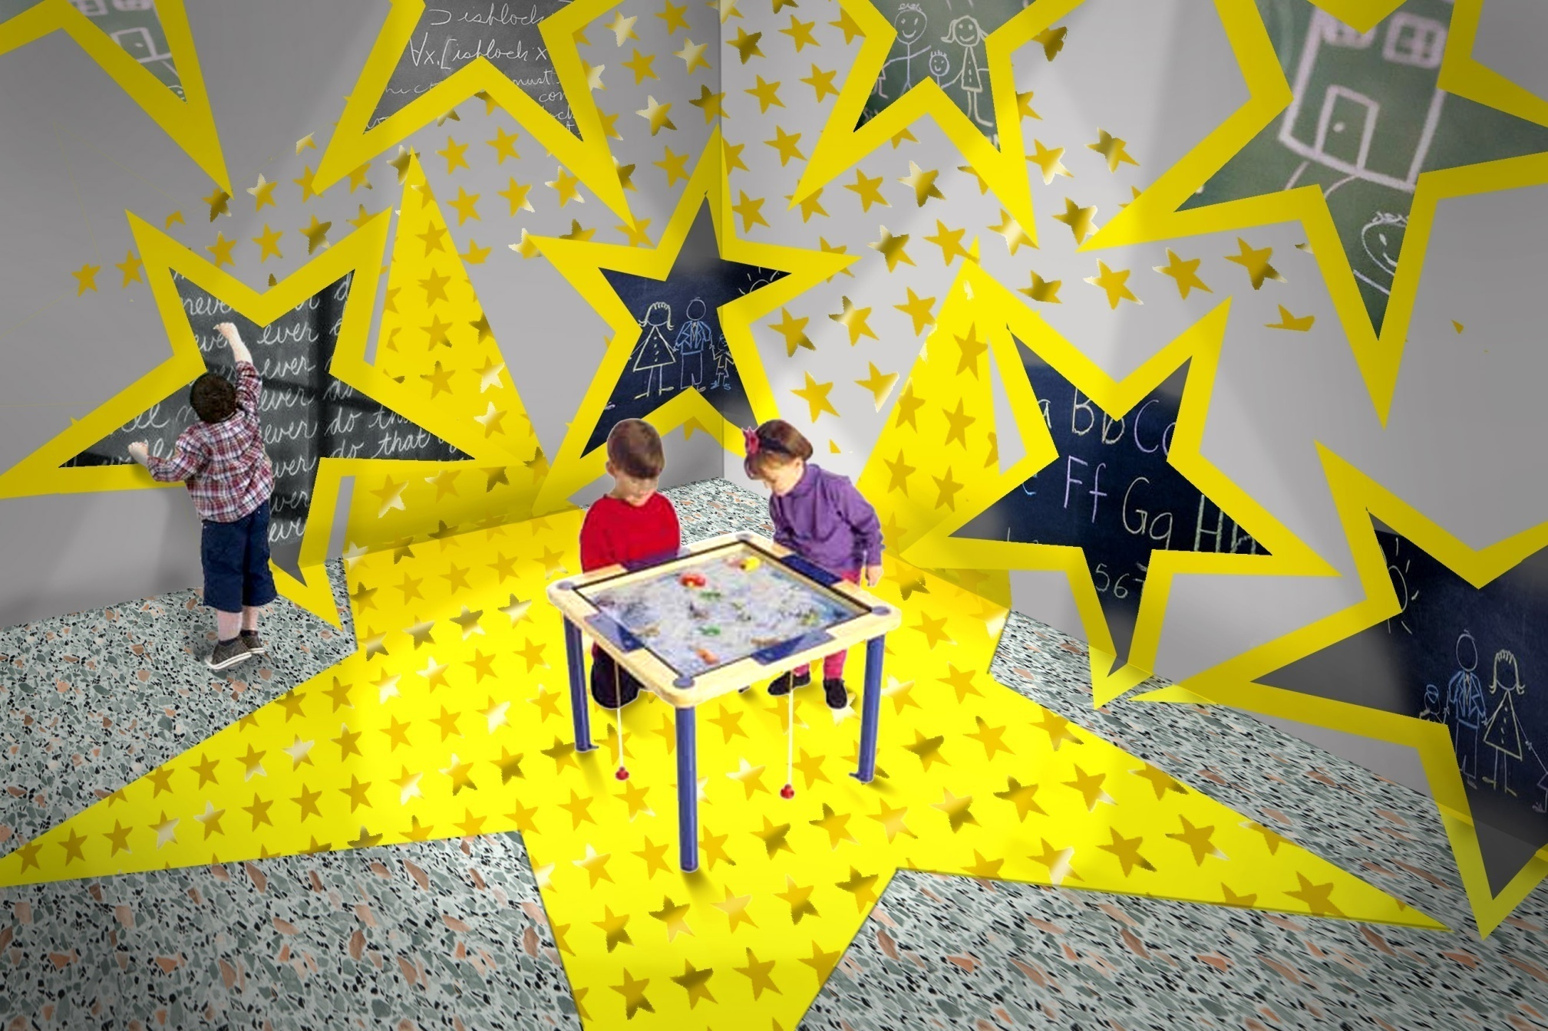

Slide 25
Panopticon Carnegie Museum of Art Problem and Story
The problems were:
The museum was closing its permanent collection galleries for a year and wanted to house their collection in a series of smaller galleries.
We decided to create a lush Victorian salon hang, one where many pieces are crowded into a smaller space than is now popular in American Exhibitions.

Slide 26
Drawings and Idea Development

Slide 27
Approach to Exhibition

Slide 28
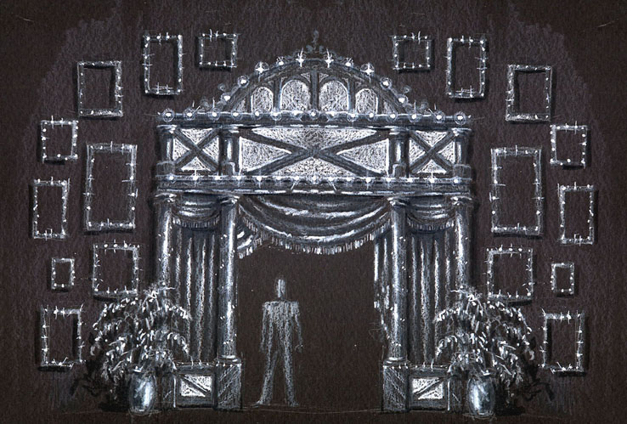

Slide 29
Galleries

Slide 30
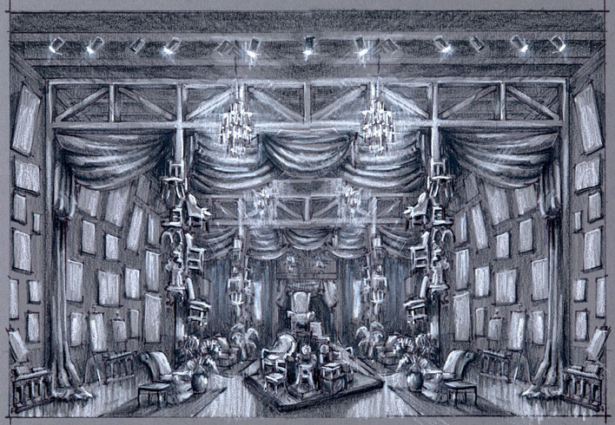

Slide 31
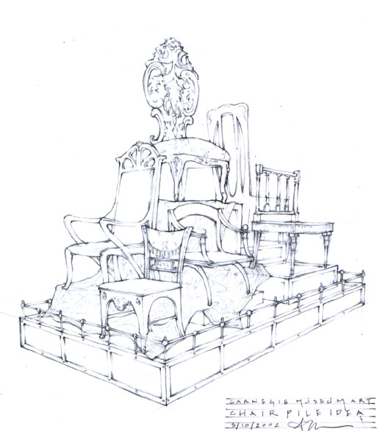

Slide 32
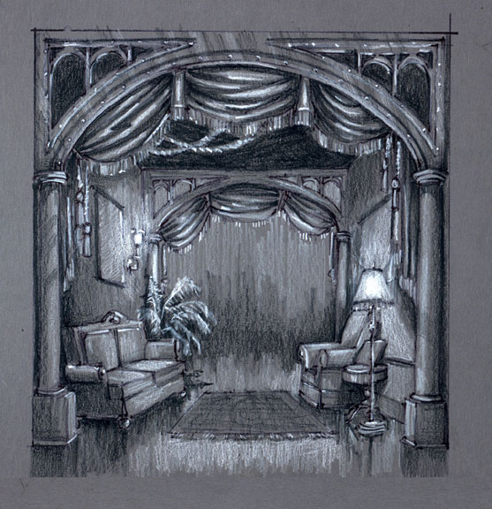

Slide 33
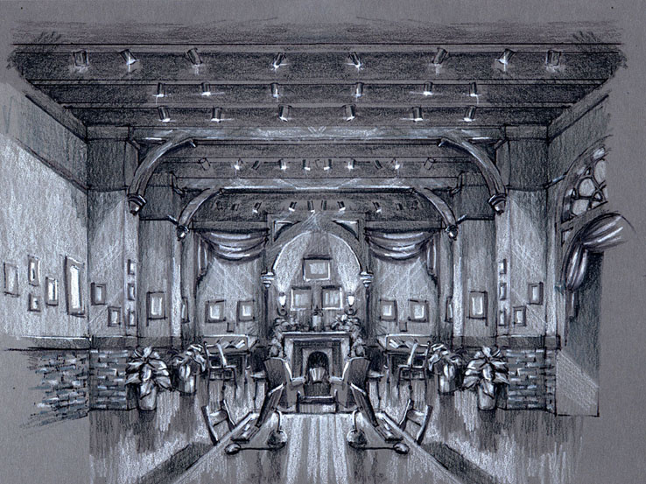

Slide 34
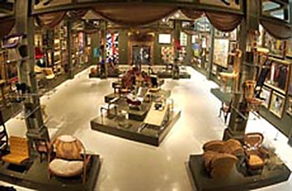

Slide 35
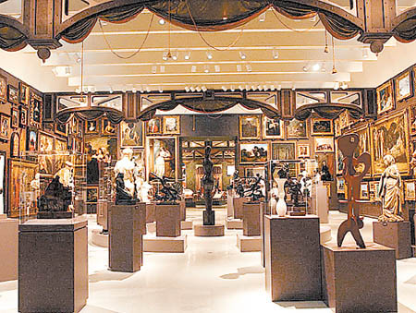

Slide 36
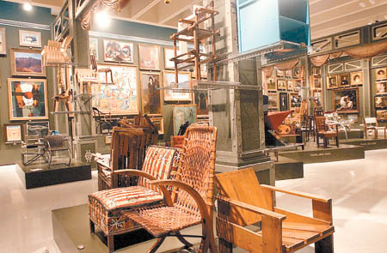

Slide 37
Pressure Chamber UPMC Medical Center Problem and Story
The problems were:
Researchers were investigating the effect o atmospheric pressure on kids with recurrent ear infections and they had to place the kids in a hyperbaric chamber, which was scary.
We decided to create turn the chamber into a “submarine” and the dark basement lab into an undersea adventure.

Slide 38
The Design

Slide 39
Chamber Room "Unfolded"

Slide 40
Hallway

Slide 41
Entrance

Slide 42
The Lab in Process

Slide 43
Chamber Room

Slide 44
Hallway

Slide 45
Entrance

Slide 46
Roboceptionist Problem and Story Collaboration between the Carnegie Mellon Robotics Institute and the CMU School of Drama
The problems were:
To create a “sentient” robot with a personality and back story which would interact with humans and which would have a story that unfolded over a period of months.
My responsibility was as “a producer” to oversee writing of the story, to model the head for the robot and to create a home for it, as well as building a website.

Slide 47
The Robot

Slide 48
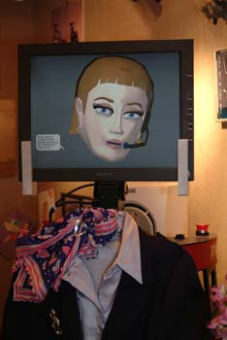

Slide 49
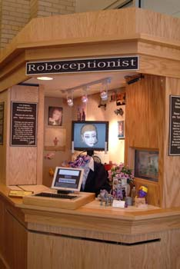

Slide 50
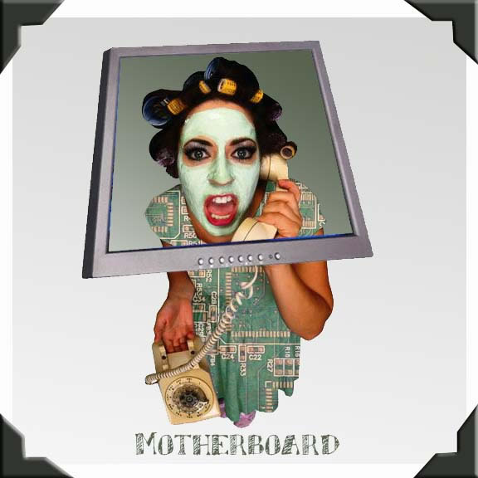
The Robot interacted with various characters on the phone (such as her "motherboard" her shrink, friends, coworkers, etc.. who were depicted on the website.

Slide 51
Thank you!

