Slide 1
Queueing Theory
14-740: Fundamentals of Computer Networks
Credit: Bill Nace

Slide 2
traceroute
QT Overview
Performance Evaluation
Little’s Law
Rate Transition Diagrams
M/M/1 Systems
M/M/c Systems
Examples

Slide 3
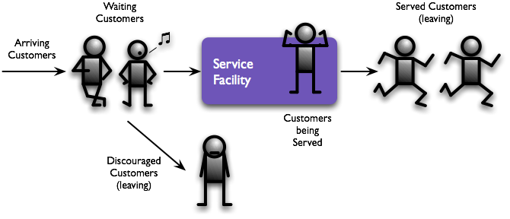
Queueing Theory
An analytic tool to make performance statements about queueing processes
Very applicable: retail, manufacturing, ...
Network uses: routers, transport, ...

Slide 4
Queueing System
Describe via six characteristics
Arrival pattern
Service pattern
Queue discipline
System capacity
# of service channels
# of service stages

Slide 5
#1: Arrival Pattern
Often, arrivals are stochastic
Need to know the PDF of interarrival times
Sometimes, arrive in batches or in bulk
Need the PDF of batch size
A stationary arrival pattern doesn’t change with time

Slide 6
Impatient Customers
Customer reaction is sometimes impatient
Balk is when a customer refuses to enter
Renege is when customer leaves
Customer may jockey for position by switching input queues
Network packets rarely do any of these
Notes:
Image from snagglefrack.blogspot.com

Slide 7
#2: Service Pattern
Similar to arrival patterns, service patterns are often stochastic
Described by a PDF of customer service times
A state-dependent server changes based on the number of customers waiting
Server may get flustered or work faster
Service can be stationary or nonstationary

Slide 8
#3: Queue Discipline
The manner in which customers are chosen from the queue for service
First Come First Served (FCFS)
Last Come First Served
Useful for stack based or inventory systems
Random Service Selection (RSS)
Priority Schemes

Slide 9
#4: System Capacity
Is there a physical limitation to the number of customers in the queue?
Common in real life
Buffer memory in a router
# of chairs for waiting at barber shop
Often ignored to simplify the analysis

Slide 10
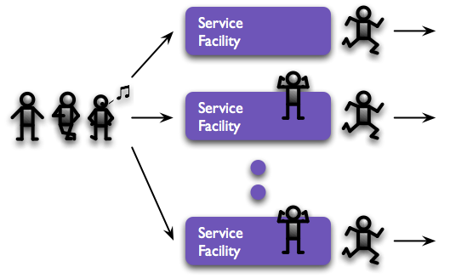
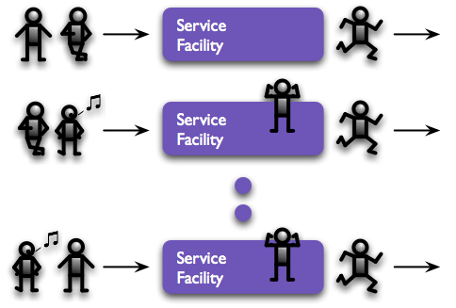
#5: Multiple Service Channels
Adding servers increases capacity
How do customers wait?
Single queue can feed many servers
Each server may have its own queue

Slide 11
#6: Stages of Service
In a multistage queueing system, customers exit one service only to start waiting for another service
Doctor’s Office: check-in, history, exam, tests, re-exam, payment
Some systems allow feedback (recycling parts is common in manufacturing)

Slide 12
Greek
λ “Lambda”
Arrival rate
$μ$ “Mu”
Service rate
Rarer: Scale (1/rate)
ρ “Rho”
Utilization (probability of being busy)

Slide 13
Kendall53’s A/B/X/Y/Z Notation
Characteristic | Symbol | Explanation
Interarrival-time distribution (A) | M | Exponential
 | D | Deterministic
 | Ek | Erlang type k
Service-time distribution (B) | Hk | k exponentials
 | PH | Phase Type
 | G | General
# parallel servers (X) | 1, 2, 3... , ∞
Max capacity (Y) | 1, 2, 3... , ∞
Queue Discipline (Z) | FCFS | First come, first served
 | LCFS | Last come, first served
 | RSS | Random Selection for Service
 | PR | Priority
 | GD | General Discipline

Slide 14
Kendall53’s A/B/X/Y/Z Notation
Characteristic | Symbol | Explanation
Interarrival-time distribution (A) | M | Exponential
 | D | Deterministic
 | Ek | Erlang type k
Service-time distribution (B) | Hk | k exponentials
 | PH | Phase Type
 | G | General
# parallel servers (X) | 1, 2, 3... , ∞
Max capacity (Y) | 1, 2, 3... , ∞
Queue Discipline (Z) | FCFS | First come, first served
 | LCFS | Last come, first served
 | RSS | Random Selection for Service
 | PR | Priority
 | GD | General Discipline

Slide 15
Exponential
“the exponential distribution…is the probability distribution that describes the time between events in a Poisson point process, i.e., a process in which events occur continuously and independently at a constant average rate.” (Wikipedia)

Slide 16
Deterministic
“In mathematics, a degenerate [Deterministic] distribution is a probability distribution in a space (discrete or continuous) with support only on a space of lower dimension. If the degenerate distribution is univariate (involving only a single random variable) it is a deterministic distribution and takes only a single value. Examples include a two-headed coin and rolling a dice whose sides all show the same number. ”(Wikipedia)

Slide 17
Erlang
The Erlang distribution is a two parameter family of continuous probability distributions…The two parameters are:
a positive integer k, the "shape", and
a positive real number λ, the "rate". The "scale“, $μ$, the reciprocal of the rate, is sometimes used instead.
The Erlang distribution was developed by A. K. Erlang to examine the number of telephone calls which might be made at the same time to the operators of the switching stations. This work on telephone traffic engineering has been expanded to consider waiting times in queueing systems in general. The distribution is now used in the fields of stochastic processes and of biomathematics.
Events that occur independently with some average rate are modeled with a Poisson process. The waiting times between k occurrences of the event are Erlang distributed.
(Wikipedia)

Slide 18
General
Known mean and variance, but nothing else.

Slide 19
Markovian
A Markov chain is "a stochastic model describing a sequence of possible events in which the probability of each event depends only on the state attained in the previous event."
In probability theory and related fields, a Markov process, named after the Russian mathematician Andrey Markov, is a stochastic process that satisfies the Markov property
(Wikipedia)

Slide 20
Common Queueing Systems
G/G/1 ➙ General, single server system
G/G/c ➙ General, multi-server system
G/G/∞ ➙ General, self-serve system
M/M/1 ➙ Markovian, single server
M/M/c ➙ Markovian, multi-server
M/M/c/k ➙ Multi-server, with limited size
Infinite system size and FCFS discipline are always assumed as the defaults

Slide 21
traceroute
QT Overview
Performance Evaluation
Little’s Law
Rate Transition Diagrams
M/M/1 Systems
M/M/c Systems
Examples

Slide 22
Parameters
λ is the average arrival rate
# customers or packets per second
μ is the average service rate
# packets served per second
c is number of servers

Slide 23
Traffic intensity
ρ ≡ λ / cμ
A measure of traffic congestion in the servers
When ρ > 1, average # of arrivals exceeds service capability ➙ bad
When ρ = 1, randomness prevents queues from emptying (unless perfectly scheduled deterministic arrivals) ➙ bad
Steady state only when ρ < 1

Slide 24
# of customers
N(t) is number of customers in the system
Sum of Nq(t) and Ns(t), for queues and service
Expected number in system
Expected number in queue
Where pn is Pr{N=n}, probability of a particular number n customers in the system
Notes:
L = E[N] = \sum_{n=0}^\infty np_n
L_q = E[N_q] = \sum_{n=c+1}^\infty (n-c)p_n

Slide 25
# of customers
N(t) is number of customers in the system
Sum of Nq(t) and Ns(t), for queues and service
Expected number in system
Expected number in queue
Where pn is Pr{N=n}, probability of a particular number n customers in the system
Notes:
L = E[N] = \sum_{n=0}^\infty np_n
L_q = E[N_q] = \sum_{n=c+1}^\infty (n-c)p_n

Slide 26
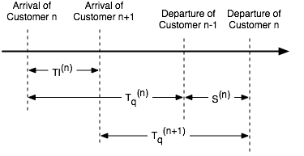
Time
TI is interarrival time (time between successive arrivals)
Tq is time spent in queue
S is service time
T is total time
T = Tq + S

Slide 27
Little’s Law
“the long-term average number L of customers in a stationary system is equal to the long-term average effective arrival rate λ multiplied by the average time W that a customer spends in the system.”
(Wikipedia)

Slide 28
Little’s Law
Relationship between # customers and the waiting time
W is the mean waiting time in the system
W = E[ T ] and Wq = E[ Tq ]
Little’s Law: L = λW ( and Lq = λWq )
Especially powerful when combined with
E[ T ] = E[ Tq ] + E[ S ] to get
W = Wq + 1/μ
Given λ, μ and any 1 of {W, Wq, L, Lq} can get rest

Slide 29
Further Results
What is E[ Ns ]?
L - Lq = λ(W - Wq) = λ(1/μ) = λ / μ
r ≡ λ / μ
For c=1, r = ρ and
Notes:
.Expected value of number of customers in service
.Which is the number of customers in the system, minus those in the queue. Apply Little's law to each. W-Wq is Ws or time waiting.
r is expected number of customers in service
L - L_q = \sum_{n=1}^\infty np_n - \sum_{n=1}^\infty (n-1)p_n = \sum_{n=1}^\infty p_n = 1 - p_0

Slide 30
Further Results
What is E[ Ns ]?
L - Lq = λ(W - Wq) = λ(1/μ) = λ / μ
r ≡ λ / μ
For c=1, r = ρ and
Notes:
.Expected value of number of customers in service
.Which is the number of customers in the system, minus those in the queue. Apply Little's law to each. W-Wq is Ws or time waiting.
r is expected number of customers in service
L - L_q = \sum_{n=1}^\infty np_n - \sum_{n=1}^\infty (n-1)p_n = \sum_{n=1}^\infty p_n = 1 - p_0

Slide 31
Busy Probability
For a G/G/c system, Pb is the probability of a given server being busy
At steady state, E[ Ns ] = r
Servers are identical, so
E[Na server] = r/c = Pb
Recall that ρ = λ / cμ and r = λ / μ
Therefore, Pb = ρ

Slide 32
G/G/c Summary
ρ = λ/cμ | Traffic intensity
L = λW | Little’s Law
Lq = λWq | Little’s Law
W = Wq+1/μ
Pb= λ/cμ = ρ | Busy probability for an arbitrary server
r = λ/μ | Expected number of customers in service
L = Lq + r
p0 = 1 - ρ | G/G/1 empty-system probability
L = Lq + (1-p0) | G/G/1 combined result

Slide 33
traceroute
QT Overview
Performance Evaluation
Little’s Law
Rate Transition Diagrams
M/M/1 Systems
M/M/c Systems
Examples

Slide 34
Birth-death process
A type of continuous-time Markov chain
System modeled as a set of states
Transitions occur between adjacent states
When in state n, an arrival moves the system to state n+1
When in state n > 0, a departure moves the system to state n-1

Slide 35
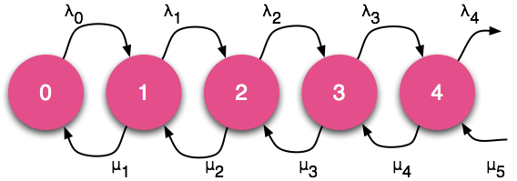
Rate Transition Diagram
Describes the number of customers in the system
Customers arrival time is an exponential random variable with rate λn
Likewise, departure is random with rate μn

Slide 36
Flow-balance Equations
pn is the probability of being in state n
The system is in steady-state, therefore:
(λn+μn)pn = λn-1pn-1 + μn+1pn+1 for n ≥ 1
λ0p0 = μ1p1

Slide 37
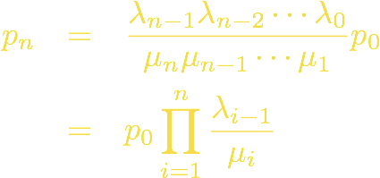
My apologies for the derivation!
Rewriting the flow-balance equations:
Do some inductive reasoning:
Similarly:
Which leads to:
Notes:
\begin{eqnarray*}
p_{n+1} & = & \frac{\lambda_n + \mu_n}{\mu_{n+1}}p_n - \frac{\lambda_{n-1}}{\mu_{n+1}}p_{n-1} \\
p_1 & = & \frac{\lambda_0}{\mu_1}p_0
\end{eqnarray*}
\begin{eqnarray*}
p_2 & = & \frac{\lambda_1 + \mu_1}{\mu_2}p_1 - \frac{\lambda_0}{\mu_2}p_0 \\
& = & \frac{\lambda_1 + \mu_1}{\mu_2}\frac{\lambda_0}{\mu_1}p_0 - \frac{\lambda_0}{\mu_2}p_0 \\
& = & \frac{\lambda_1\lambda_0}{\mu_2\mu_1}p_0
\end{eqnarray*}
p_3 = \frac{\lambda_2\lambda_1\lambda_0}{\mu_3\mu_2\mu_1}p_0
\begin{eqnarray*}
p_n & = & \frac{\lambda_{n-1}\lambda_{n-2}\cdots\lambda_0}{\mu_n\mu_{n-1}\cdots\mu_1}p_0 \\
& = & p_0 \prod^n_{i=1}\frac{\lambda_{i-1}}{\mu_i}
\end{eqnarray*}

Slide 38
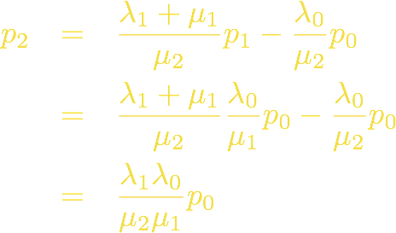
My apologies for the derivation!
Rewriting the flow-balance equations:
Do some inductive reasoning:
Similarly:
Which leads to:
Notes:
\begin{eqnarray*}
p_{n+1} & = & \frac{\lambda_n + \mu_n}{\mu_{n+1}}p_n - \frac{\lambda_{n-1}}{\mu_{n+1}}p_{n-1} \\
p_1 & = & \frac{\lambda_0}{\mu_1}p_0
\end{eqnarray*}
\begin{eqnarray*}
p_2 & = & \frac{\lambda_1 + \mu_1}{\mu_2}p_1 - \frac{\lambda_0}{\mu_2}p_0 \\
& = & \frac{\lambda_1 + \mu_1}{\mu_2}\frac{\lambda_0}{\mu_1}p_0 - \frac{\lambda_0}{\mu_2}p_0 \\
& = & \frac{\lambda_1\lambda_0}{\mu_2\mu_1}p_0
\end{eqnarray*}
p_3 = \frac{\lambda_2\lambda_1\lambda_0}{\mu_3\mu_2\mu_1}p_0
\begin{eqnarray*}
p_n & = & \frac{\lambda_{n-1}\lambda_{n-2}\cdots\lambda_0}{\mu_n\mu_{n-1}\cdots\mu_1}p_0 \\
& = & p_0 \prod^n_{i=1}\frac{\lambda_{i-1}}{\mu_i}
\end{eqnarray*}

Slide 39
traceroute
QT Overview
Performance Evaluation
Little’s Law
Rate Transition Diagrams
M/M/1 Systems
M/M/c Systems
Examples

Slide 40
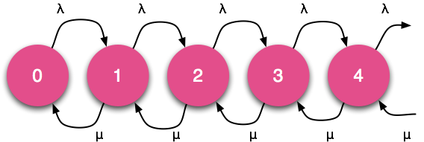
M/M/1 Systems
Exponentially distributed because
Independent of state of the system
Notes:
\begin{eqnarray*}
\mbox{Interarrival time}\quad TI(t) = \lambda e^{-\lambda t} \\
\mbox{Service time}\qquad S(t) = \mu e^{-\mu t}
\end{eqnarray*}

Slide 41
M/M/1 Flow Balance Eqns
Rewrite the G/G/c eqns with λ and μ
λn = λ and μn = μ for all n
Now what?
We need to know what p0 is!
Notes:
p_n = p_0 \prod^n_{i=1}\left( \frac{\lambda}{\mu} \right) = p_0 \left( \frac{\lambda}{\mu} \right)^n

Slide 42
M/M/1 Flow Balance Eqns
Rewrite the G/G/c eqns with λ and μ
λn = λ and μn = μ for all n
Now what?
We need to know what p0 is!
Notes:
p_n = p_0 \prod^n_{i=1}\left( \frac{\lambda}{\mu} \right) = p_0 \left( \frac{\lambda}{\mu} \right)^n

Slide 43
Probabilities must add to 1
(Remember ρ = λ/cμ and c=1 server)
Notes:
This result should make sense to you: The probability of no customers in the system is 1-traffic intensity. As traffic intensity increases, less likely to have an empty system.
1 = \sum^\infty_{n=0}p_n = \sum^\infty_{n=0}p_0\left( \frac{\lambda}{\mu} \right)^n = p_0 \sum^\infty_{n=0}\rho^n
\sum^\infty_{n=0}\rho^n\quad\mbox{converges if}\quad\rho<1
\begin{eqnarray*}
\sum^\infty_{n=0}\rho^n & = & \frac{1}{1 - \rho} \\
1 & = & \frac{p_0}{1-\rho} \\
p_0 & = & 1-\rho
\end{eqnarray*}

Slide 44
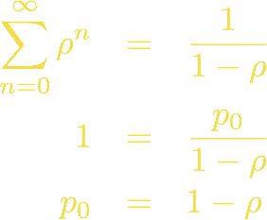
Probabilities must add to 1
(Remember ρ = λ/cμ and c=1 server)
Notes:
This result should make sense to you: The probability of no customers in the system is 1-traffic intensity. As traffic intensity increases, less likely to have an empty system.
1 = \sum^\infty_{n=0}p_n = \sum^\infty_{n=0}p_0\left( \frac{\lambda}{\mu} \right)^n = p_0 \sum^\infty_{n=0}\rho^n
\sum^\infty_{n=0}\rho^n\quad\mbox{converges if}\quad\rho<1
\begin{eqnarray*}
\sum^\infty_{n=0}\rho^n & = & \frac{1}{1 - \rho} \\
1 & = & \frac{p_0}{1-\rho} \\
p_0 & = & 1-\rho
\end{eqnarray*}

Slide 45
Plug p0 into Flow-Balance
This final equation is incredibly useful, as it allows us to determine probabilities of system state, given only λ and μ
Also allows us to generate measures of effectiveness
Notes:
\begin{eqnarray*}
p_0 & = & 1-\rho \quad\mbox{gets plugged into} \\
p_n & = & p_0 \left( \frac{\lambda}{\mu} \right)^n \quad\mbox{to produce} \\
p_n & = & (1-\rho)\rho^n
\end{eqnarray*}

Slide 46
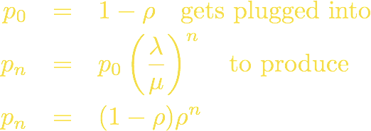
Plug p0 into Flow-Balance
This final equation is incredibly useful, as it allows us to determine probabilities of system state, given only λ and μ
Also allows us to generate measures of effectiveness
Notes:
\begin{eqnarray*}
p_0 & = & 1-\rho \quad\mbox{gets plugged into} \\
p_n & = & p_0 \left( \frac{\lambda}{\mu} \right)^n \quad\mbox{to produce} \\
p_n & = & (1-\rho)\rho^n
\end{eqnarray*}

Slide 47
Measures of Effectiveness
Manipulating the summation (via the derivative of the version without n inside)
Notes:
L = E[N] = \sum^\infty_{n=0}np_n \\
= (1 - \rho)\sum^\infty_{n=0}n\rho^n
\begin{eqnarray*}
\sum_{n=1}^\infty n\rho^{n-1} & = & \frac{1}{(1-\rho)^2}\quad\mbox{leads to} \\
L & = & \frac{\rho}{1-\rho} = \frac{\lambda}{\mu - \lambda}
\end{eqnarray*}

Slide 48
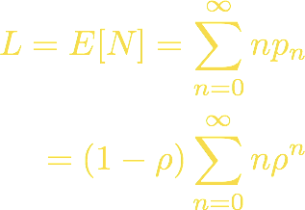
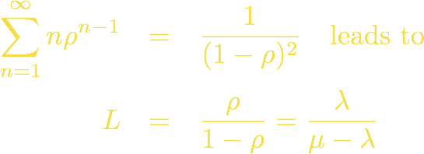
Measures of Effectiveness
Manipulating the summation (via the derivative of the version without n inside)
Notes:
L = E[N] = \sum^\infty_{n=0}np_n \\
= (1 - \rho)\sum^\infty_{n=0}n\rho^n
\begin{eqnarray*}
\sum_{n=1}^\infty n\rho^{n-1} & = & \frac{1}{(1-\rho)^2}\quad\mbox{leads to} \\
L & = & \frac{\rho}{1-\rho} = \frac{\lambda}{\mu - \lambda}
\end{eqnarray*}

Slide 49
More Measures of Effectiveness
Avg size of nonempty queue
Notes:
\begin{eqnarray*}
L_q & = & \frac{\rho^2}{1-\rho} = \frac{\lambda^2}{\mu(\mu-\lambda)} \\
L^\prime_q & = & \frac{1}{1-\rho} = \frac{\mu}{\mu - \lambda} \\
W & = & \frac{L}{\lambda} = \frac{\rho}{\lambda ( 1- \rho)} = \frac{1}{\mu - \lambda} \\
W_q & = & \frac{L_q}{\lambda} = \frac{\rho}{\mu ( 1- \rho)} = \frac{\rho}{\mu - \lambda}
\end{eqnarray*}

Slide 50
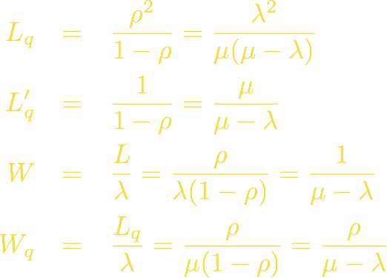
More Measures of Effectiveness
Avg size of nonempty queue
Notes:
\begin{eqnarray*}
L_q & = & \frac{\rho^2}{1-\rho} = \frac{\lambda^2}{\mu(\mu-\lambda)} \\
L^\prime_q & = & \frac{1}{1-\rho} = \frac{\mu}{\mu - \lambda} \\
W & = & \frac{L}{\lambda} = \frac{\rho}{\lambda ( 1- \rho)} = \frac{1}{\mu - \lambda} \\
W_q & = & \frac{L_q}{\lambda} = \frac{\rho}{\mu ( 1- \rho)} = \frac{\rho}{\mu - \lambda}
\end{eqnarray*}

Slide 51
traceroute
QT Overview
Performance Evaluation
Little’s Law
Rate Transition Diagrams
M/M/1 Systems
M/M/c Systems
Examples

Slide 52
M/M/c Systems
How are things different with multiple servers?
Arrival rate is still constant ➙ λ
Service rate is not
System has service capability of cμ
Assuming c customers to service

Slide 53
Rate Transition Diagram
Discontinuity caused by limited # servers
Service rate determined by number of servers in use...
... capped by number of available servers

Slide 54
Similar derivation to M/M/1
Notes:
p_n = \left\{\begin{array}{ll}\frac{\lambda^n}{n!\mu^n}p_0 & (0 \le n < c), \\ \frac{\lambda^n}{c^{n-c}c!\mu^n}p_0 & (n \ge c)\end{array}\right.
p_0 = \left(\frac{r^c}{c!(1-\rho)} + \sum^{c-1}_{n=0}\frac{r^n}{n!}\right)^{-1}\quad(r/c=\rho<1)

Slide 55
Similar derivation to M/M/1
Notes:
p_n = \left\{\begin{array}{ll}\frac{\lambda^n}{n!\mu^n}p_0 & (0 \le n < c), \\ \frac{\lambda^n}{c^{n-c}c!\mu^n}p_0 & (n \ge c)\end{array}\right.
p_0 = \left(\frac{r^c}{c!(1-\rho)} + \sum^{c-1}_{n=0}\frac{r^n}{n!}\right)^{-1}\quad(r/c=\rho<1)

Slide 56
M/M/c Measures of Effectiveness
Notes:
\begin{eqnarray*}
L_q & = & \left(\frac{r^c\rho}{c!(1-\rho)^2}\right)p_0 \\
W_q & = & \frac{L_q}{\lambda} = \left(\frac{r^c}{c!(c\mu)(1-\rho)^2}\right)p_0\\
W & = & \frac{1}{\mu} + \left(\frac{r^c}{c!(c\mu)(1-\rho)^2}\right)p_0 \\
L & = & r + \left(\frac{r^c\rho}{c!(1-\rho)^2}\right)p_0
\end{eqnarray*}

Slide 57
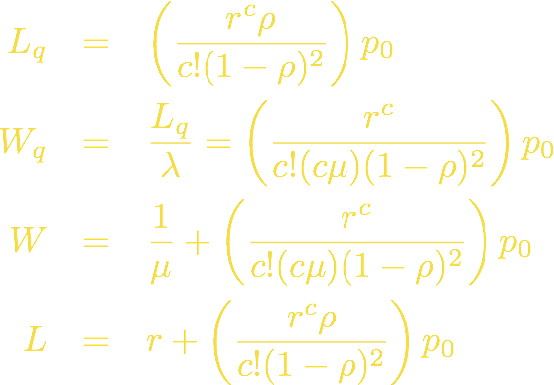
M/M/c Measures of Effectiveness
Notes:
\begin{eqnarray*}
L_q & = & \left(\frac{r^c\rho}{c!(1-\rho)^2}\right)p_0 \\
W_q & = & \frac{L_q}{\lambda} = \left(\frac{r^c}{c!(c\mu)(1-\rho)^2}\right)p_0\\
W & = & \frac{1}{\mu} + \left(\frac{r^c}{c!(c\mu)(1-\rho)^2}\right)p_0 \\
L & = & r + \left(\frac{r^c\rho}{c!(1-\rho)^2}\right)p_0
\end{eqnarray*}

Slide 58
traceroute
QT Overview
Performance Evaluation
Little’s Law
Rate Transition Diagrams
M/M/1 Systems
M/M/c Systems
Examples

Slide 59
Example 1
7 customers use a system with 1 server
TIi is the interarrival time between customers i and i+1
Si is the service time of customer i
i | 1 | 2 | 3 | 4 | 5 | 6 | 7
TIi | 2 | 1 | 3 | 1 | 1 | 4
Si | 1 | 3 | 6 | 2 | 1 | 1 | 4

Slide 60
Another look
Same data, graphical layout
i | 1 | 2 | 3 | 4 | 5 | 6 | 7
TIi | 2 | 1 | 3 | 1 | 1 | 4
Si | 1 | 3 | 6 | 2 | 1 | 1 | 4

Slide 61
Find λ, μ, L, W
... and ρ and Wq and Lq and whatever else we can figure out

Slide 62
Example 2
Joe’s website (www.joe.com) is run by two servers that are busy 99% of the time. Ideally, the server should be idle about 10% of the time for admin/mgmt reasons
If Joe adds another server, what will the busy time be?

Slide 63
Example 2 (cont’d)
Suppose that by adding a third server, added overhead to maintain consistency of files will reduce the service output rate by 20%. What is the percent time each is busy?
Would it be better to purchase additional CPU power for the 2 servers, which would increase their service output rate by 25%?

Slide 64
Example 3
Prof Nace notices that his office hours are well attended, with 5 students arriving per hour. He likes to ensure students understand the material, so he spends 10 minutes per student. Modeled as an M/M/1 system, find:
λ, μ, ρ, L, Lq

Slide 65
Example 3 (cont'd)
How often can a student walk right in without waiting?
If there are only 4 seats, how often will a waiting student have to stand?
What is the average wait time in the queue? Avg total time?

Slide 66
Example 4
A router that serves a particular LAN is an M/M/1 system (i.e. poisson arrivals, service)
It appears that money can be saved by replacing the router with n smaller routers, each of which has 1/n the processing power of the original router
The sales guy claims that the response time will not change
Your thoughts?

Slide 67
Lesson Objectives
Now, you should be able to:
describe the application of queuing theory to common networking problems
calculate simple queueing theory problems, including use of Little's law, M/M/1 and M/M/c measures of effectiveness. In such cases, all equations will be given
not memorize queueing theory equations
classify problems in terms of queueing system characteristics and know Kendall53 notation for those systems

